Slide 1


CUSTOMER TRANSACTION ANALYSIS
Data Analysis Project
Tools Used:
Python
SQL
Google Sheets
VS Code
Presented by Donasri

Slide 2


01
Understand customer transaction behavior
Objective
02
The objective of this project is to analyze customer transaction data and derive meaningful business insights using Python, SQL, and Google Sheets.
Analyze revenue trends over time
03
Identify top-performing customers, Create visualizations and dashboards
04
Support data-driven business decisions

Slide 3
Dataset Features
Customer ID
Transaction Date
Transaction Amount
01.
Dataset Overview
Dataset Statistics
Total Transactions: 125,000
Total Customers: 6,889
Total Revenue: 8,123,673
Average Transaction Amount: 64.99
02.
Dataset Information
Technologies Used
Pandas
Matplotlib
SQL
Google Sheets
03.

Slide 4
01
Loaded transaction dataset using Pandas. Checked dataset structure and data types
Data Cleaning & Preparation
02
Identified and removed duplicate records. Converted transaction date into datetime format
Data Cleaning Process
03
Result
Removed 6 duplicate records
Prepared dataset for time-based analysis
Created additional columns:
Year
Month
Day
Verified data quality for analysis

Slide 5
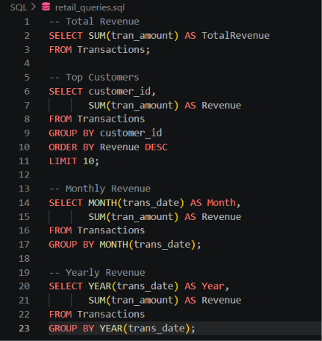
SQL
Analysis
Total Revenue Analysis
Top Customers Analysis
Monthly Revenue Analysis
Yearly Revenue Analysis
SELECT SUM(tran_amount)
FROM Transactions;
SELECT customer_id,
SUM(tran_amount)
FROM Transactions
GROUP BY customer_id;
SELECT MONTH(trans_date),
SUM(tran_amount)
FROM Transactions
GROUP BY MONTH(trans_date);
SELECT YEAR(trans_date),
SUM(tran_amount)
FROM Transactions
GROUP BY YEAR(trans_date);

Slide 6
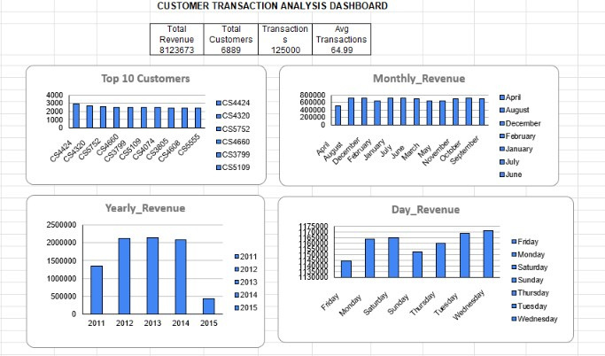
Data Visualisation & Dashboard
Dashboard KPIs
Total Revenue: 8,123,673
Total Customers: 6,889
Total Transactions: 125,000
Average Transaction Amount: 64.99
Visualizations Included
Top Customers Analysis
Monthly Revenue Analysis
Year-wise Revenue Analysis
Day-wise Revenue Analysis

Slide 7

01.
04.
Yearly Analysis
2013 generated the highest revenue of 2,137,352.
Revenue remained consistently strong between 2012 and 2014.
Revenue Insights
Total revenue generated was 8,123,673.
02.
Customer Insights
Customer CS4424 generated the highest revenue of 2,933.
Top customers contribute significantly to overall revenue.
Insights Generated
03.
05.
Day-wise Analysis
Wednesday generated the highest revenue (1,170,771).
Tuesday and Saturday also recorded strong transaction activity.
Monthly Analysis
August recorded the highest monthly revenue of 726,921.
January and October also showed strong performance

Slide 8
Conclusion
This project successfully analyzed customer transaction data using Python, SQL, and Google Sheets
Achievements
Future Scope
Cleaned and prepared transaction data
Performed SQL-based business analysis
Created revenue and customer insights
Developed an interactive dashboard
Identified key customer and revenue trends
Customer segmentation analysis
Customer lifetime value prediction
Sales forecasting
Interactive Power BI dashboard development

Slide 9

Thank you

