Slide 1
Incremental dependency analysis over large software models
Donát Csikós (CERN Controls Systems)
Ákos Horváth, István Ráth (BUTE FTSRG)

Slide 2
Software models and dependencies in Java
Project A
A:
DJar
B:
DJar
public class Service {
public void serve(){}
}
public class Service {
public void serve(){}
}
Service:
DClass
Client:
DClass
serve:
DMethod
doWork:
DMethod
Project B
public class Client {
public void doWork(){
Service s = getService();
s.serve();
}
}
Structure
Explicit and implicit dependencies
Computable from both source and binaries
Typically: dense dependency graph
Strukúra
Explicit és implicit függőségek
Strukúra
Explicit és implicit függőségek
Co-operating Java software components
Model (graph) representation of Java software
Notes:
Kód/bináris → modell absztrakció
Sokféle statikus függőség
Szoftverkomponensek ÖSSZEFÜGGENEK

Slide 3
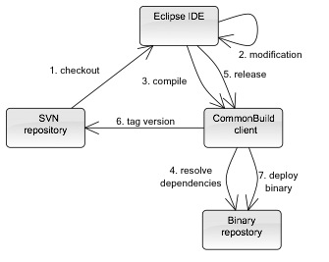
Dependency management in practice
Software lifecycle: frequent bug fixes and new features
Requirement: modifications should not introduce errors down the dependency chain (smooth upgrade)
Goal: continuously ensure consistency
Cél: konzisztencia mindenkori biztosítása
Necessary:
Knowing and managing (static) dependencies over the entire software infrastructure (components x versions), so that
The (potential) net effect of modifications can be computed
Developers know what can (should) be changed and how

Slide 4
Why develop a dedicated tool for this?
„Big model”
Lots of software components
Loading all of them into an IDE workspace is not feasible
Heterogenous environment
Organization (many small dev groups, no strong hierarchy and centralization)
Technology (many languages, frameworks, platforms, IDEs, ...)
Specific requirements of CERN Controls Systems
Teams largely independent
Continuous delivery a must for a very large system of custom software
No downtime allowed
No off-the-shelf solution was found to be adequate
Notes:
Verziókezeléssel
Szervezeti heterogenitás: egységes követelménymenedzsment
Technológiai heterogenitás:

Slide 5
Incremental hybrid Dependency analysis

Slide 6

Tool system architecture
Dependency queries directly from the source code editor
Dependency information display (developer workstations):
Fast queries over the dependency model
Integrated into the Eclipse framework
Eclipse IDE
Queries
Display query results
Client plug-in
Developer
Contains all managed software modules
Client (IDE)
Bytecode analysis
Efficient execution, independently of bytecode size
Dependency analysis (build server):
Fast dependency model derivation from bytecode analysis
Incremental dependency model updates on changes
(Build) server
Binary repository
Server
Dependency database
Structural and dependency model of code

Slide 7
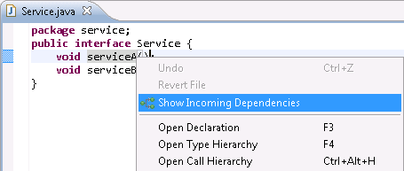
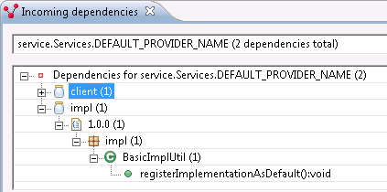
IDE integration

Slide 8
Hybrid dependency analysis
Core idea: also use local information
Contained in source projects in the workspace
To answer questions (before committing changes) like
What projects (dependencies) have changed locally?
What is the effect of the change down the dependency chain? (impact analysis)
Additional goal: instantaneous and automatic dependency visualization
To increase productivity
Our approach
Derive a graph model representation of local source code on-the-fly
Connect it with the model graph on the server (hybrid analysis)
Execute fast incremental graph queries over the entire dependency model → provide instantaneous feedback and visualization during source code editing

Slide 9
Extended tool system architecture
Source code model derived from local projects
On-the-fly synchroniztion between model and code thanks to Eclipse AST parser
Source code editing
Eclipse IDE
Depencency graph queries
Queries
Client plug-in
Developer
Server model synchronizer
Source code model synchronizer
Instantaneous visualization
Over the entire (local and global) model
Query all dependeocy relationships with incremental graph pattern matching
Efficient query result updates as the models change thanks to EMF-IncQuery
Client IDE
Build Server
Binary repository
Server
Dependency database
Notes:
Ami boldface, azt hangsúlyozni is!!!

Slide 10
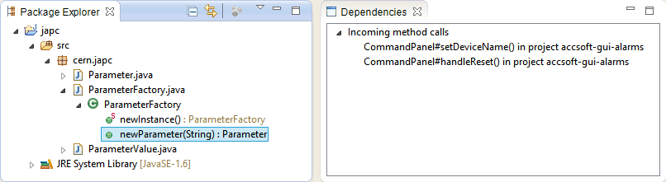
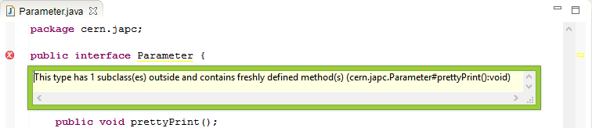
Instantaneous visualization in the IDE
Dependency query results in a dedicated view
Instantaneous validation feedback when a dependency management policy is violated
Select an element in the source
Instantaneously get a list of local and remote artefacts that depend on it
Error message indicates that a local change will have uncontrolled effects on remote artefacts

Slide 11
Scalability of the system

Slide 12
Measuring scalability
Evaluation was carried out over a large real life software infrastructure at CERN Controls Systems
Scalability goals
Build server:
Binary dependency analysis should be fast even with a large (1300+) number of software modules
Server-side dependency database queries should be fast
Developer IDE:
Instantaneous dependency query feedback over the entire (local and global) dependency graph
(Typical local environment:
5-10 workspace projects
Dependencies to 100+ remote projects
Developer IDEs run in a resource constrained, virtualized environment)

Slide 13
Scalability of dependency analysis
Entire dependency analysis
Around 10 minutes (compare with: around 1 day for a complete build from source)
Dependency extraction and update: ~0,5sec/project (compare with: several minutes / project when building from source)
Execution time for a dependency database query (single dependency relationship): ~200ms
Notes:
Sokszor (itt is) csak a dián szereplő adatok töredékét mondtam el.

Slide 14
Scalability of client-side dependency graph queries
Warm-up time: needs to be executed only once per developer working session
Memory: the entire CERN software infrastructure fits into workstation RAM
Query (re-)execution after a change: ~1ms for all dependency relationships → instantaneous feedback is a reality
http://eclipse.org/incquery http://incquery.net/performance

Slide 15
Conclusion

Slide 16
Results
A new approach for incremental hybrid dependency analysis of large software models
Based on a uniform graph representation from binary and source analysis
Dependency queries supported by incremental graph pattern matching
Supports impact analysis
Tool system fully implemented and tested
Efficient dependency discovery based on bytecode analysis
Incremental source-model sychronization
Scalability verified by systematic benchmarking
Currently used at CERN Controls Systems
~1300 Java projects,
on average 15 active versions per project,
overall 10 new releases rolled out per day

Slide 17
Future plans and possibilities
Make it open source
Extend range of dependency analysis
More complex static dependencies
Simple runtime dependencies (reflection, DI)
Complex runtime dependencies (temporal, dynamic, …)
Use impact analysis along the build processes to
Reduce (re-)testing execution times
Reduce static conformance analysis execution times
Extend to C++

