Slide 1

Eclipse IDE
dependency
information
UI components
result
explicit queries
Model query
developer
repository
model
workspace
model
source
code
editing
Dependency database synchronizer
Source code model synchronizer
source code
Client plugin
query & retrieve model
Source
Repository
Server
build
Byte
code
analyzer
structure
Dependency processor
Storage
engine
Binary
component repository
binaries
external
references
Dependency
database
Notes:
2 nyíl kivételével piros nyilak.

Slide 2
Other classes
.java
.class
javac
java
Java language
Java Virtual Machine

Slide 3
Header
Constant pool
Access rights
Implemented interfaces
Fields
Methods
Class attributes
“println”
“(Ljava/lang/String;)V”
”java/io/PrintStream”
ConstantMethodRef
getstatic java.lang.System.out
ldc “Hello, world”
invokevirtual java.io.PrintStream.println
“varName”
“[Ljava/lang/Object;”
”HelloWorld”
ConstantFieldRef
“Hello, world”
ConstantString
“java/io/PrintStream”
ConstantClass

Slide 4
Gather structure
Gather references
Convert to source format
Filter information
Header
Constant pool
Access rights
Implemented interfaces
Fields
Methods
Class attributes
Header
Constant pool
Access rights
Implemented interfaces
Fields
Methods
Class attributes

Slide 5

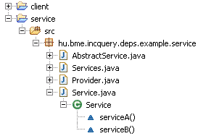
Eclipse Startup
Java code changes
Incremental model update
Load Java Model Structure
Search dependencies
Eclipse shuts down
Save model to disk
Subscribe for Java Model change
Original model
Element after modifications
Change event
Merged model

Slide 6
IncQuery
patterns
Code generation
Query
source
code
Compile and load
IncQuery
runtime

Slide 7
Jface treeviewer
Query
Result
Content provider
Data adapter

Slide 8
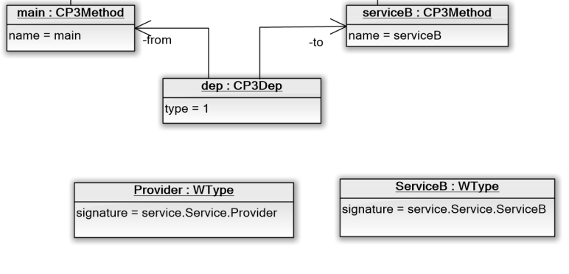
Repository
Workspace

Slide 9
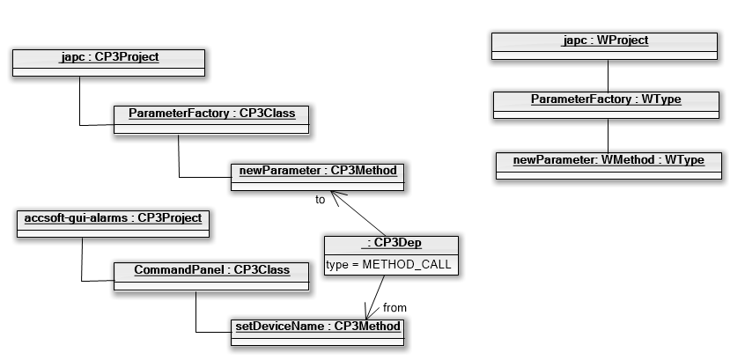
Repository
Workspace

