Slide 1


Blood Donation Management System
Presented by:
Lana Al-Juhani
SID #4450984
Reham lbrahim
SID #4451964
Atheer Al- Harbi.
SID #4451855
Abeer Al-Anazi.
SID #4453204
Tuqaal-Nakhli
SID #4553366
Supervisor: Dr.Hala Hameed

Slide 2


Blood Donation Management System
The success of this project relies on the guidance and support of many individuals. First and foremost, we are grateful to Allah Almighty for granting us the ability to complete this endeavor. We would also like to express our sincere gratitude to our supervisor, Dr. Hala Hameed, who has provided invaluable direction and mentorship throughout the project's development. Additionally, we extend our appreciation to our professors and colleagues who have been instrumental in offering their encouragement and assistance during this journey. The collaborative efforts of the entire team have been crucial in shaping the project and ensuring its successful implementation.

Slide 3
Problem Definition
Millions of people require blood transfusions annually, whether due to serious injuries, major surgeries, or medical conditions like anemia, hemophilia, and sickle cell disease. However, hospitals often face difficulties in finding enough blood donors to meet this growing demand. Lack of awareness, challenges in connecting donors to recipients, and shortages of rare blood types contribute to this problem.
Blood donation is a simple yet crucial medical procedure that can directly save lives. Each whole blood donation has the potential to help up to three people in need. By donating blood, individuals can not only support critical medical treatments but also reduce their own risk of heart disease and other conditions.

Slide 4
Project Objectives
1
Enhance Visibility
2
Increase Donor Engagement
Improve tracking and management of available blood supplies across hospitals and blood banks in real-time.
Simplify the donation process and provide notifications for urgent blood needs to encourage regular donations.
3
Facilitate Efficient Matching
4
Raise Awareness
Ensure timely and accurate matching of donors to recipients in need of blood transfusions.
Educate the community on the importance of blood donation and foster a culture of regular giving.

Slide 5





Existing Blood Donation Platforms
Wateen
Ihsan
Blood Bank Systems
The official blood donation app in Saudi Arabia, aiming to reduce the communication gap between donors and blood banks, and increase awareness about the importance of voluntary blood donation.
A Saudi national platform for charitable work, including facilitating the donation process and informing users about various donation opportunities within the Kingdom.
Specialized software solutions used by hospitals and blood banks to manage the entire blood donation lifecycle, from donor registration to inventory tracking and distribution.

Slide 6

Functional Requirements
1
User Registration
Allow users to register as donors, recipients, or administrators with secure accounts and profiles.
2
Donor Search
Enable recipients to search for compatible blood donors based on criteria like blood type, location, and availability.
3
Appointment Scheduling
Facilitate the process of scheduling blood donation appointments between donors and recipients.

Slide 7
Non-Functional Requirements
1
1. Usability: Ensure the website is user-friendly and accessible to all users, including those with disabilities.
2. Performance: Ensure the system can handle multiple concurrent users and maintain responsiveness during peak usage times.
3. Security: Implement measures to protect user data, including encryption of sensitive information and secure login mechanisms.
4. Reliability: Ensure the system is reliable and available 24/7, with minimal downtime for maintenance or upgrades.
2
3

Slide 8
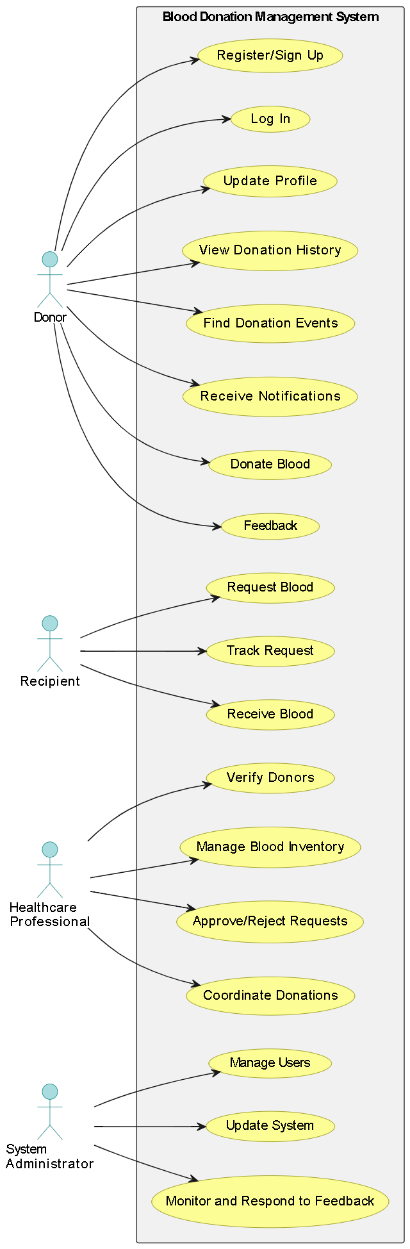



Use Case Diagram
User Interface
The web-based user interface provides a seamless and intuitive experience for donors, recipients, and administrators to interact with the system.
Application Logic
The application layer handles the core functionalities, such as user management, appointment scheduling, and inventory tracking, ensuring the system's overall functionality.
Database
The database component securely stores and manages all the relevant data, including donor profiles, blood inventory, and donation records.

Slide 9
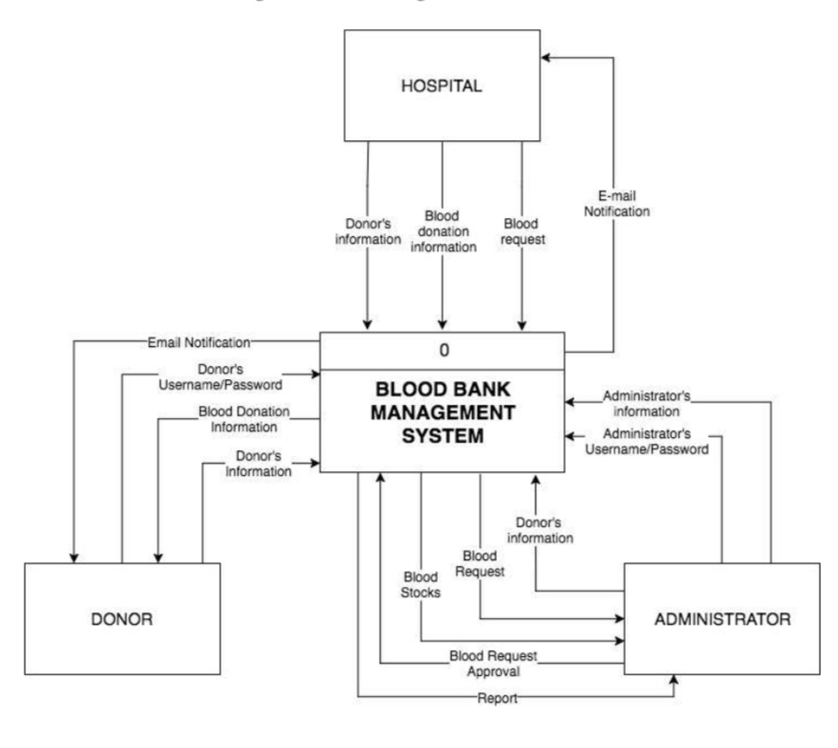
System Design
Data Flow Diagrams
The system's data flow diagrams illustrate the movement of information and processes within the application, from the high-level context to detailed sub-systems.

Slide 10
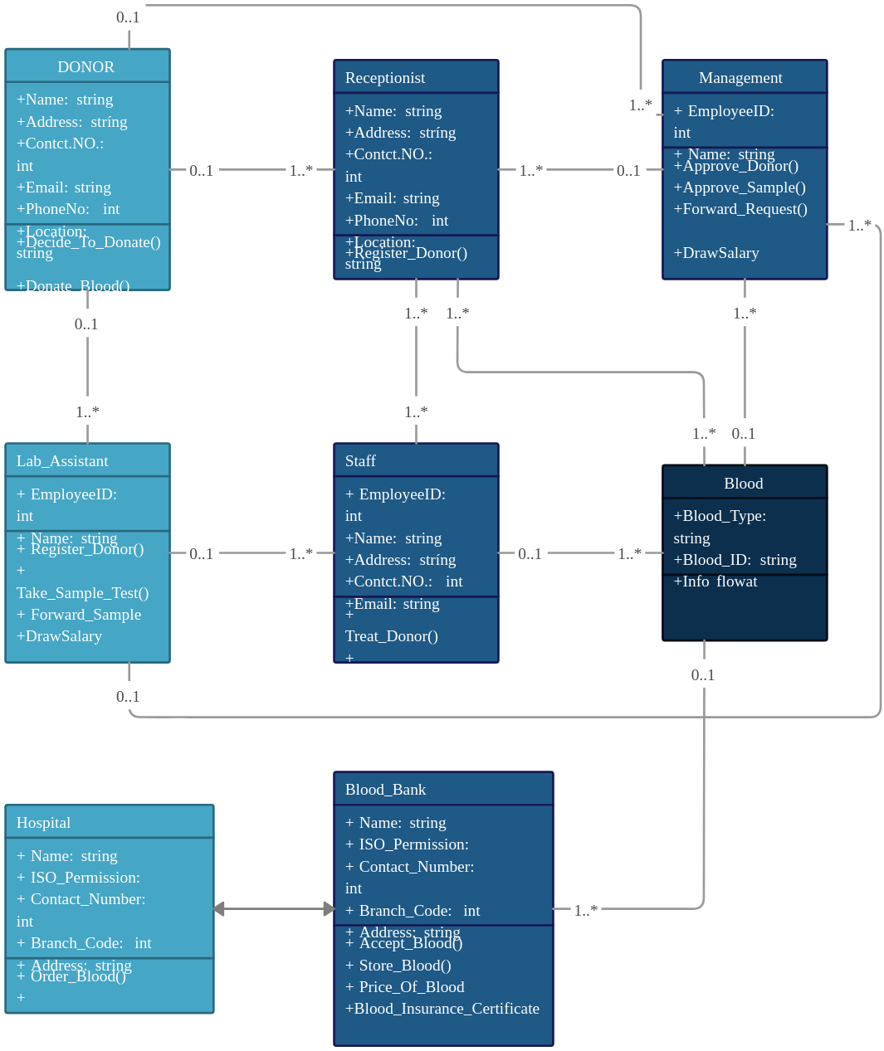
System Design
Entity Relationship Diagram ERD

Slide 11

Conclusion
The Blood Donation Management System project represents a comprehensive and strategic approach to addressing the critical issue of blood shortages in our community. By leveraging technology, streamlining processes, and fostering a culture of donation, this platform aims to save lives and have a lasting positive impact on public health.
Through the implementation of this system, we envision a future where blood donation is a seamless, accessible, and widely-embraced practice, ensuring that those in need of life-saving transfusions can receive the support they require. The project's success will be measured not only by its technical capabilities but also by its ability to inspire and empower individuals to become active contributors to this vital cause.

