Slide 1

DONATE CLUB
Donation Listing Platform For NGOs

Slide 2
TEAM MEMBERS
Abhinav Marwaha
Sukaran Kant
Akshit Garg
Avneesh Goyal

Slide 3
Problem Statement
Many people want to donate things and their time for a better cause and NGO’s and other organizations need donations. But they often find difficulty finding each other. This is due to an absence of a centralized system connecting the two.

Slide 4

Donate Almost everything!
DonateClub will provide a listing platform for donations and services, a marketing channel and an encouraging environment for more donations and help.

Slide 5
How we support NGOs?
NGO’s will be able to ADD PRODUCTS they need and people will be able to contact the NGO when they want to DONATE the same. And NGO’s will be able to manage the inventory efficiently.
1. Register on our website
2. Enter information for validation
3. List the required products and services on the admin panel along with the quantity required.
4. Effectively add, update or delete the products/services listed.

Slide 6
Other Ways To Donate
People will be able to LIST PRODUCTS that they want to donate and organizations and individuals can REQUEST to accept that donation.
Register
Register on the website
List
List products/services willing to provide but are not yet requested by any NGO
Contact
Direct contact with NGO when request is received.

Slide 7
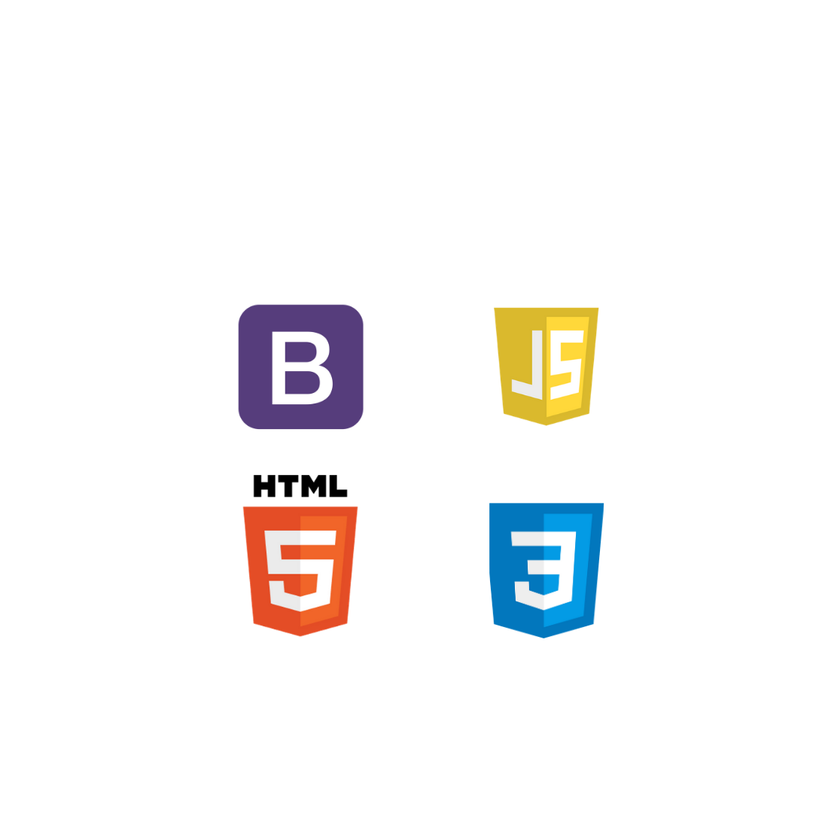
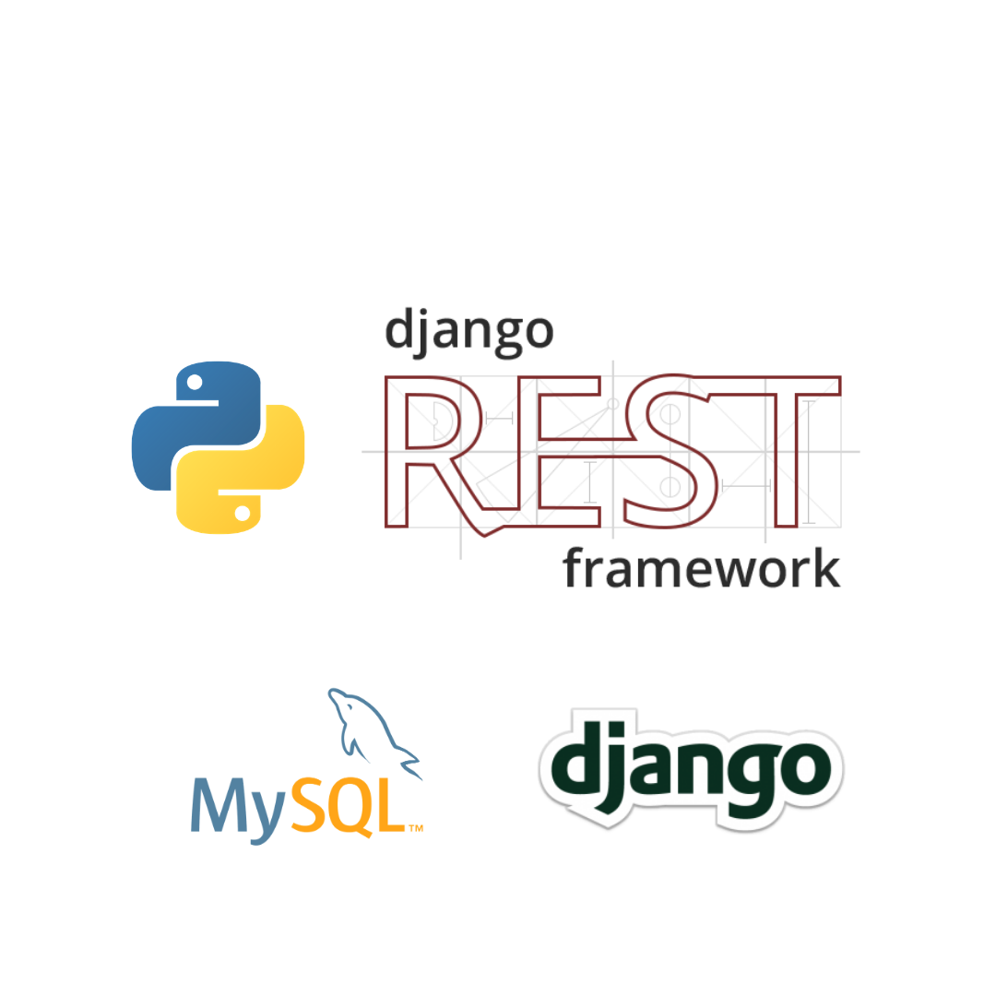
Technologies used

Slide 8
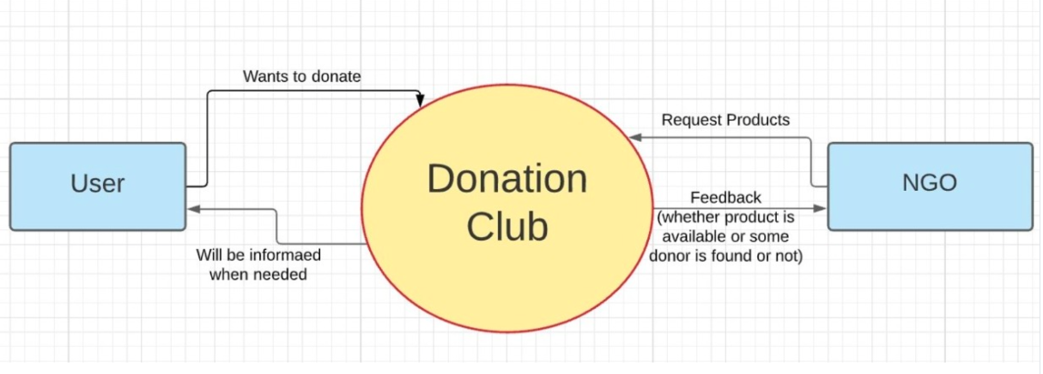
Proposed Solution
Our team has come up with an ONLINE PLATFORM that will help to connect the people who want to donate and NGO’s who want their donations.
Notes:
DFD level 0 definition

Slide 9
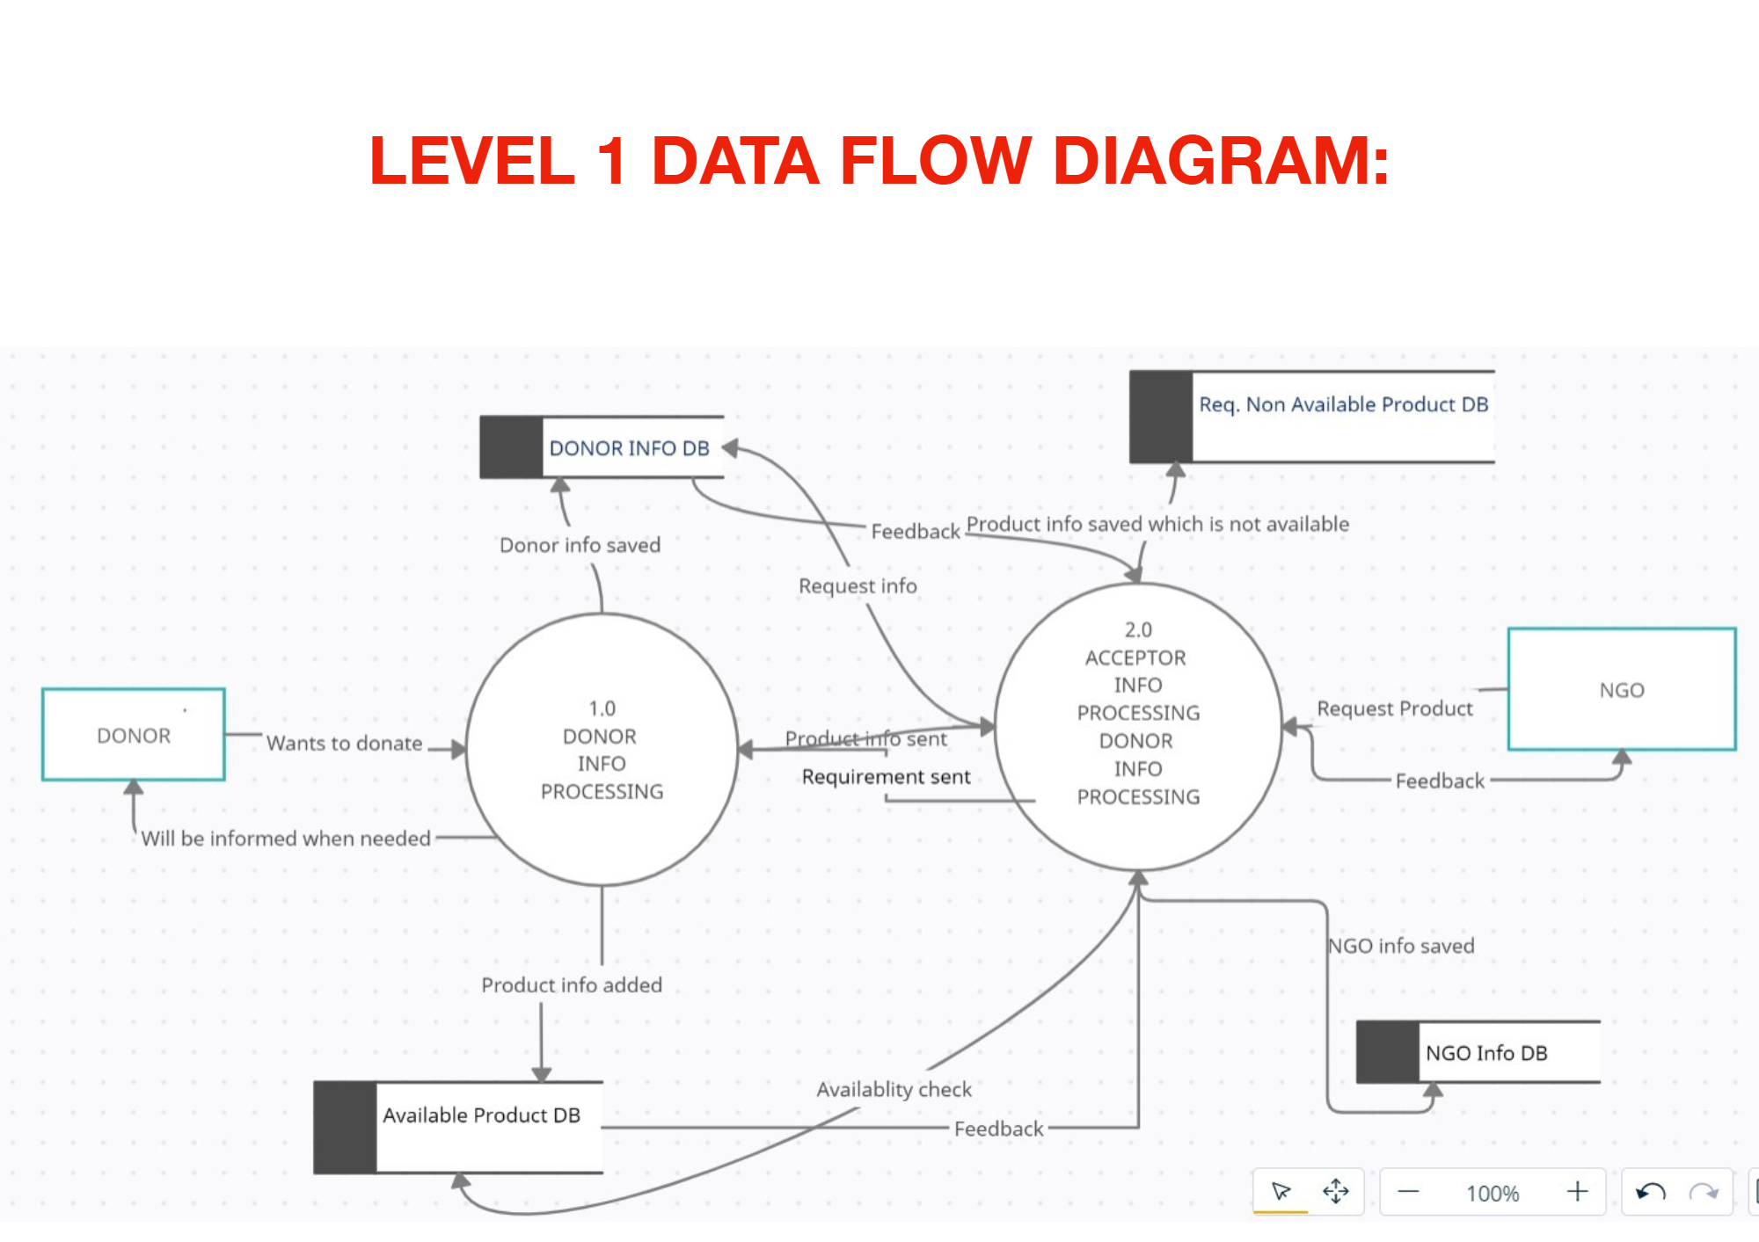
DFD Level 1
Users, NGOs both will have their own accounts on our platform and will be assigned respective permissions to request or donate products.

Slide 10
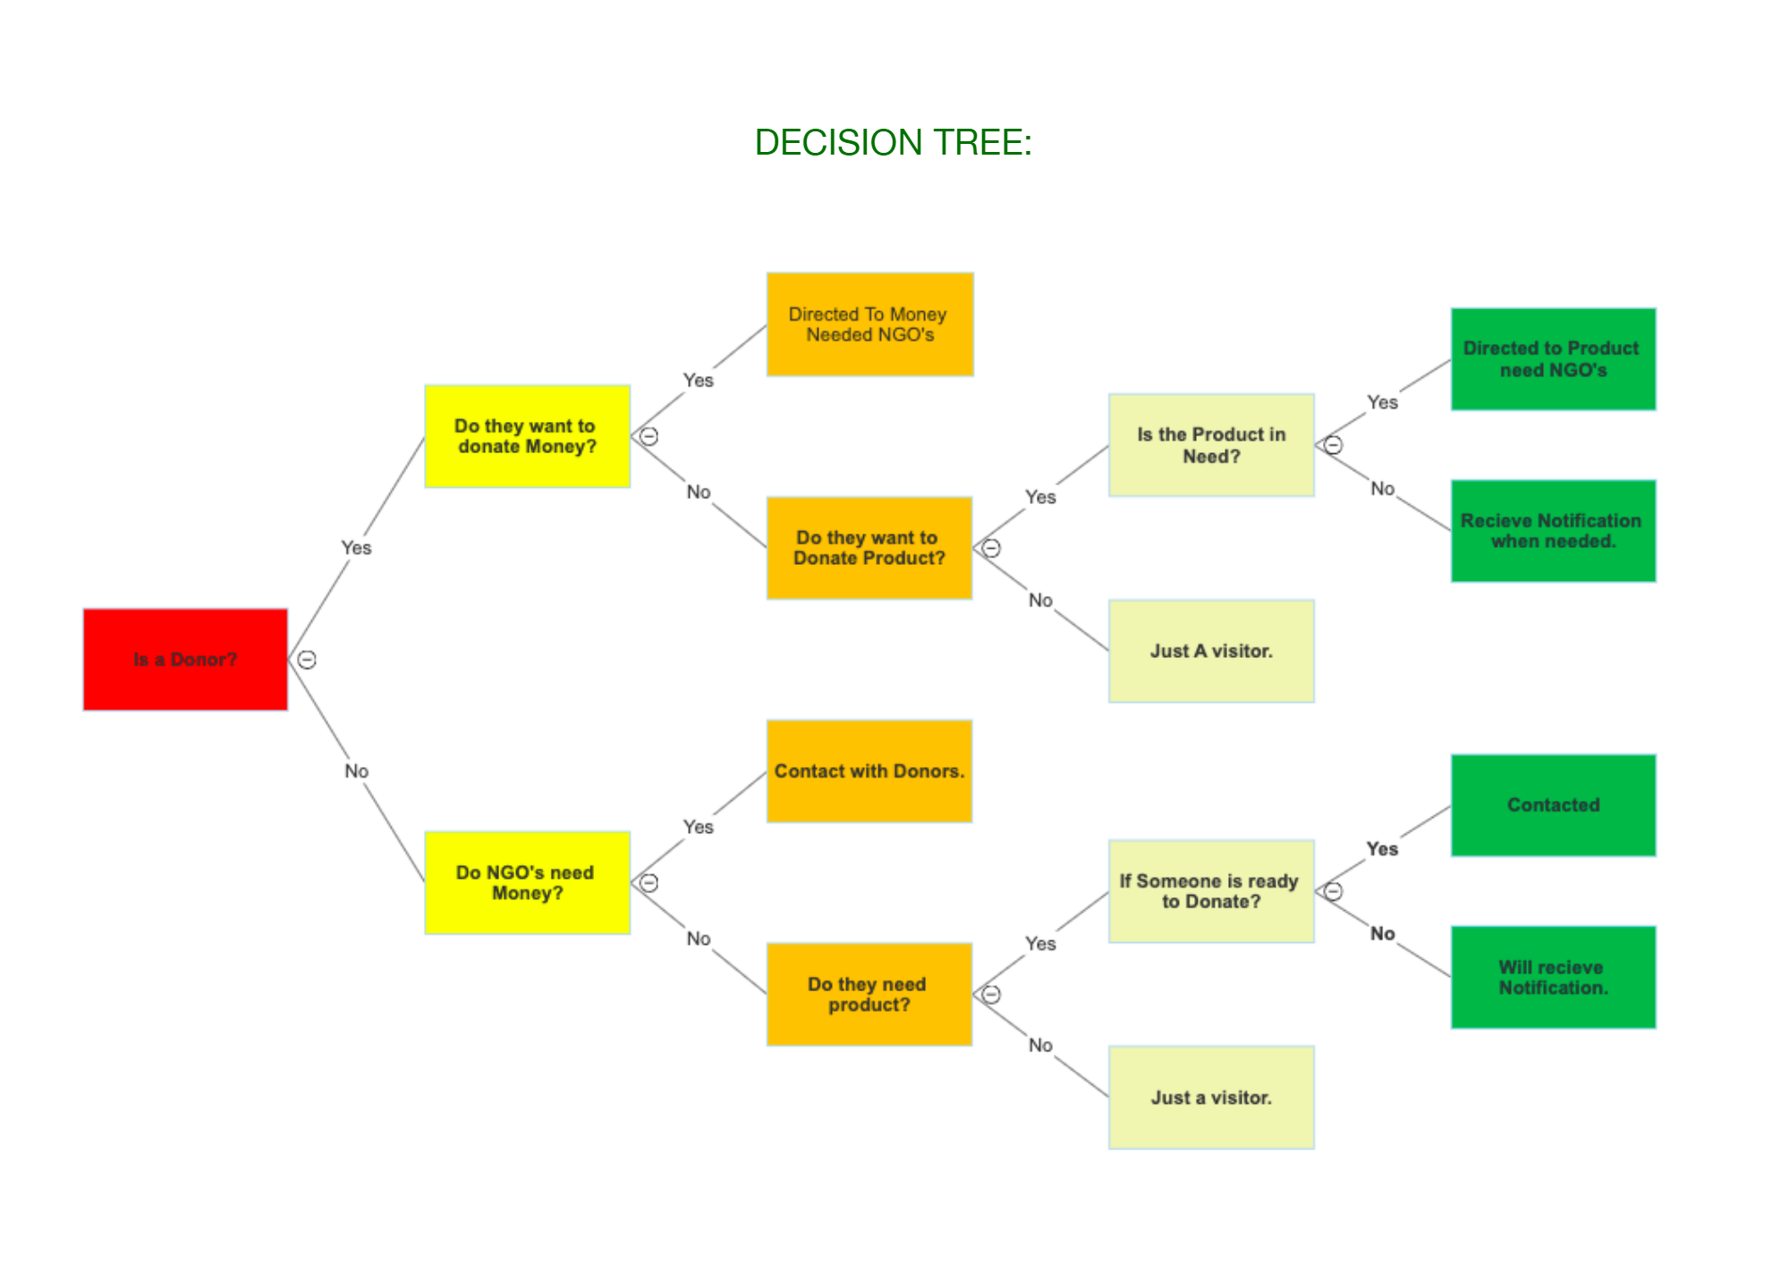
Decision Tree
A single platform for all the needs of NGOs. Users can donate money, products or services

Slide 11

Share Your Achievements and Experiences
NGO’s will be able to have a BLOG that can showcase what they have been doing and what are their plans for the future and this may act as their marketing channel.
Users will be able to see all that is being said about us in the media, and how people are joining us in bringing about the change. They will stay in touch with the recent developments on project sites, events and success stories.

Slide 12
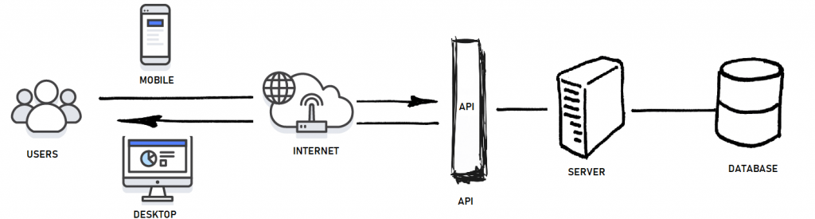
Django Rest Framework

Slide 13
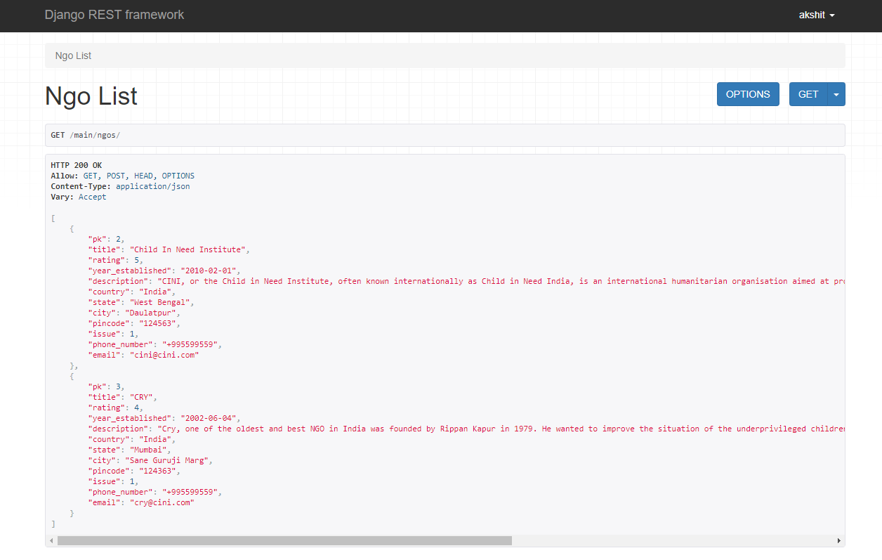
All data structures with examples in JSON format
NGO

Slide 14
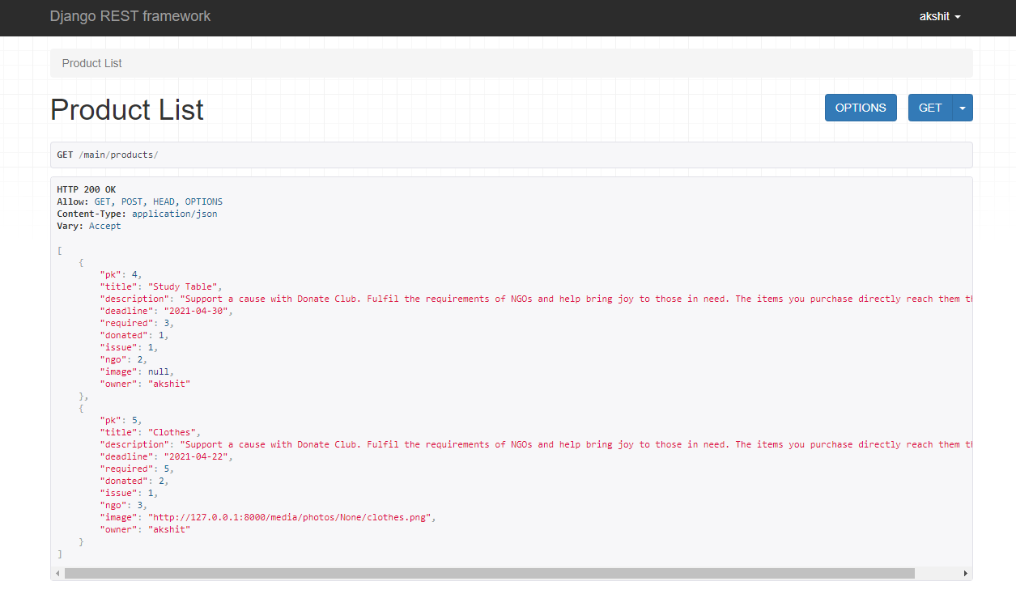
Product

Slide 15
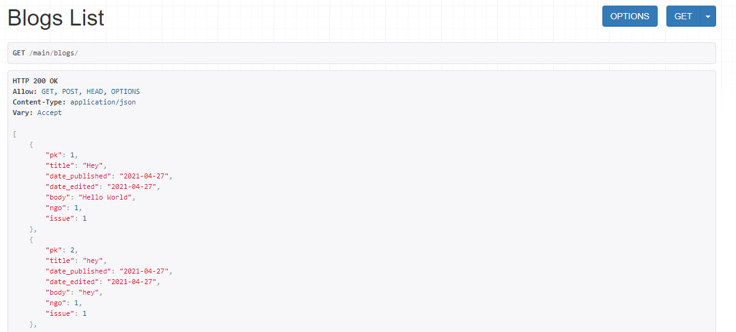
Blog Page

Slide 16

Badges and Donations
Users will have BADGES for their donations and each of them will have a profile page SHOWCASING their donations.

Slide 17
Django Admin Panel

Slide 18
Data Dictionary

Slide 19
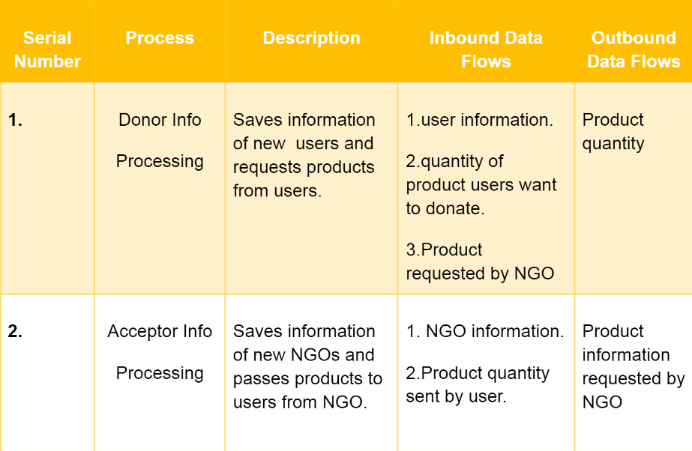
Processes

Slide 20
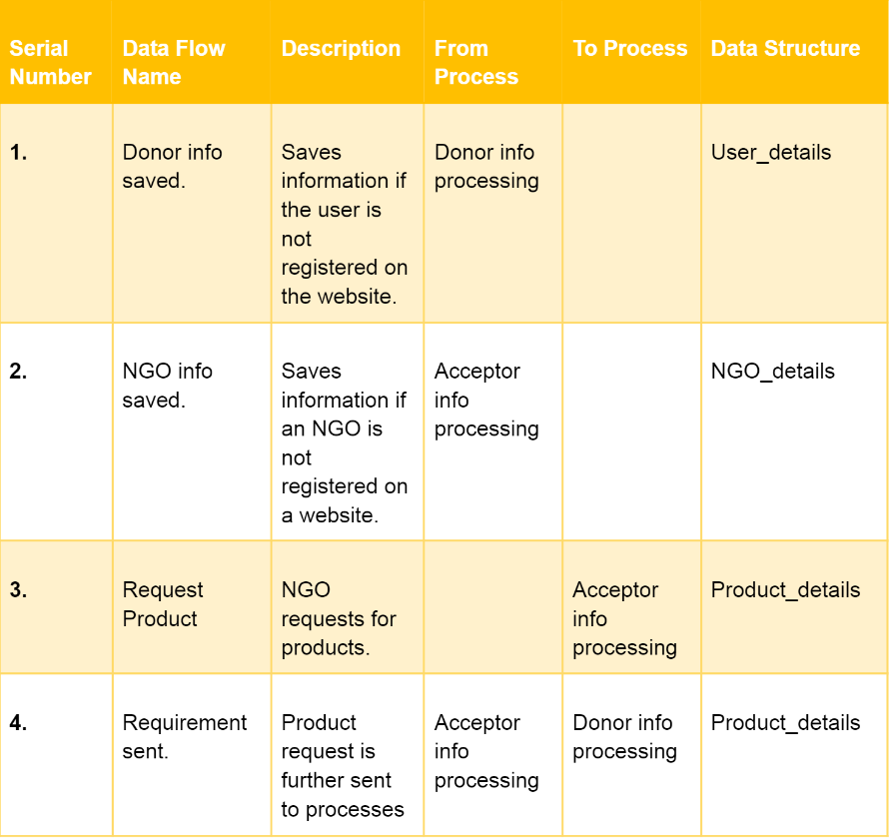
Data Flow

Slide 21
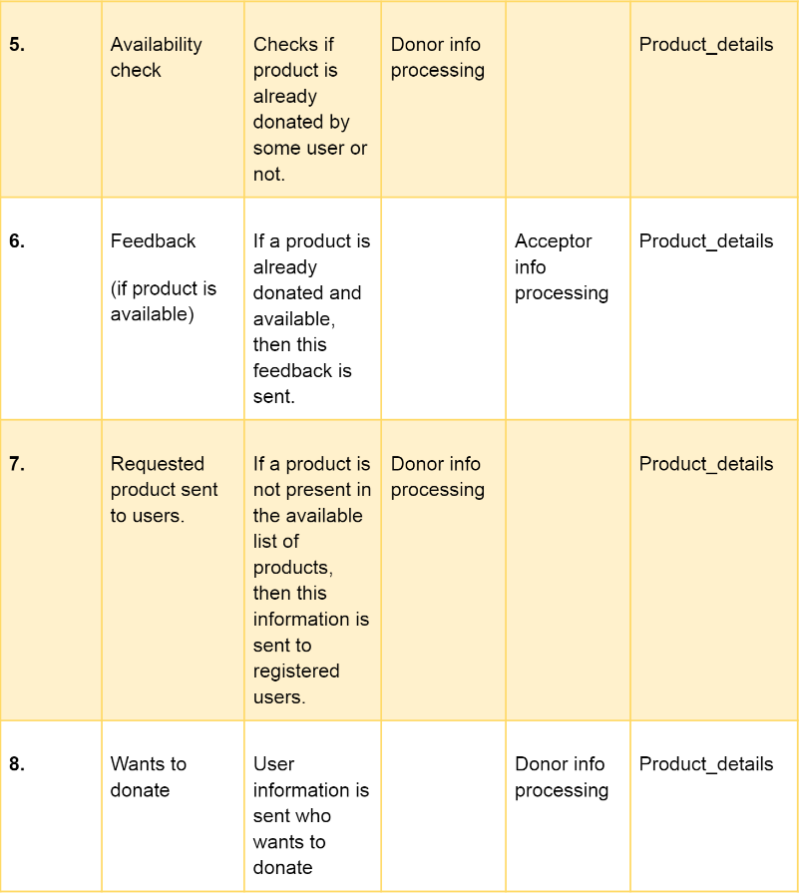
Data Flow Cont.

Slide 22
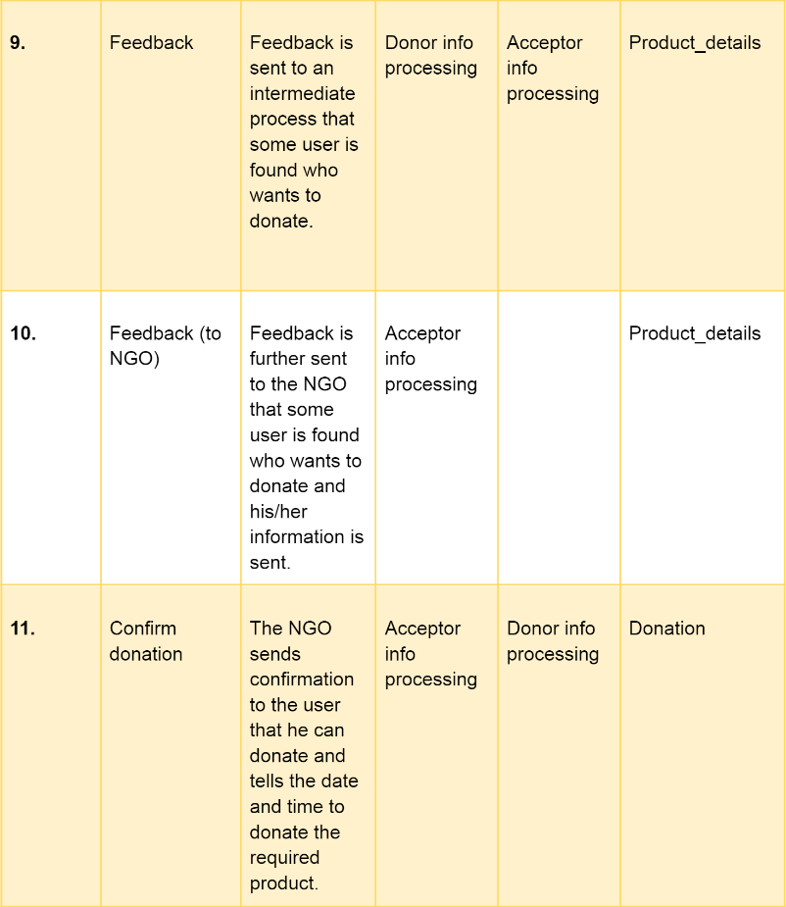
Data Flow Cont.

Slide 23
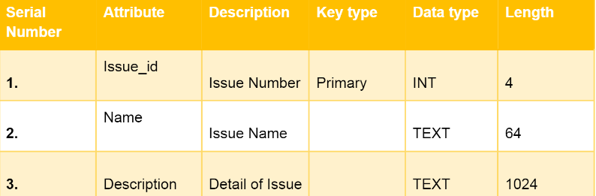
Data Stores
Issue

Slide 24
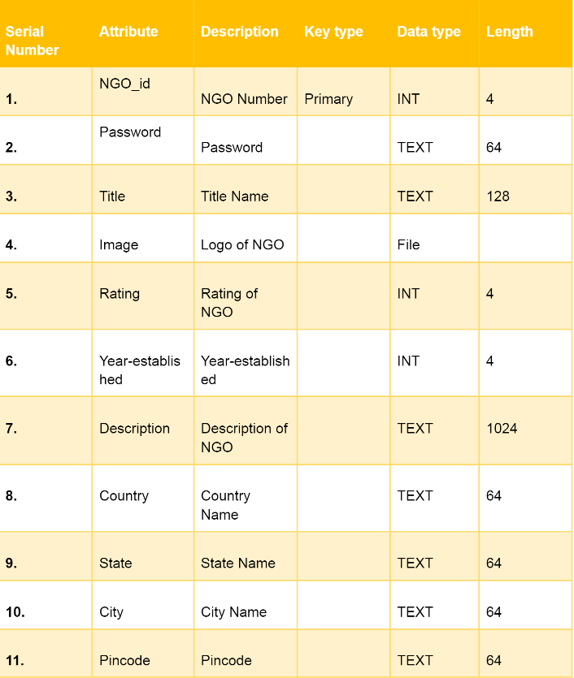
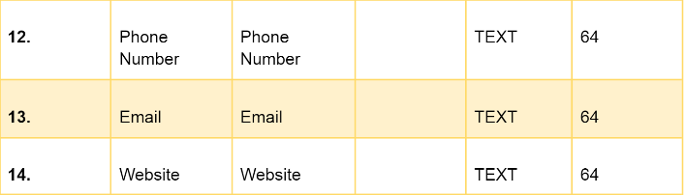
NGO_details

Slide 25
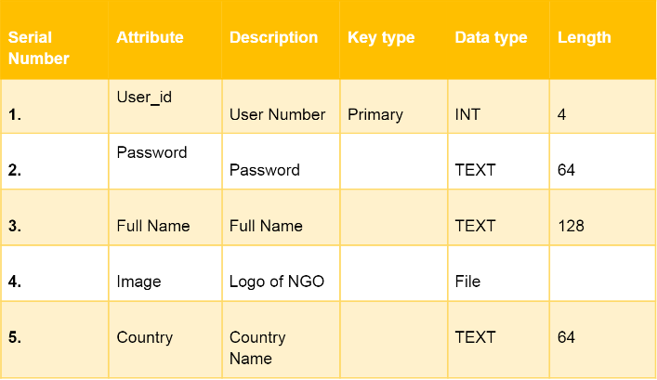
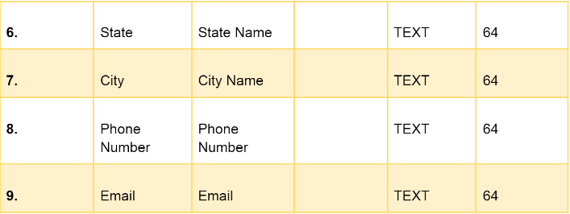
User_details
User Image
Notes:
Replace logo of ngo with User Image

Slide 26
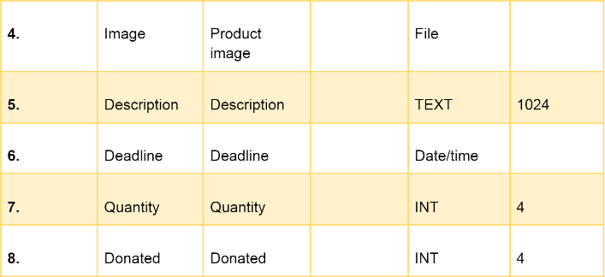
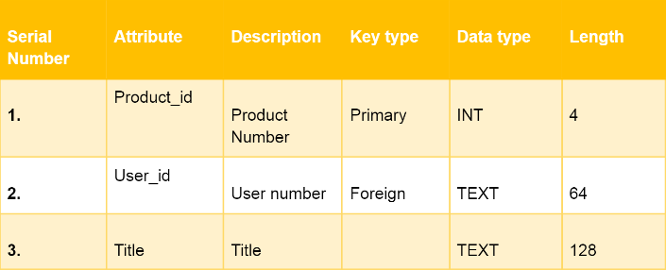
Product_details

Slide 27
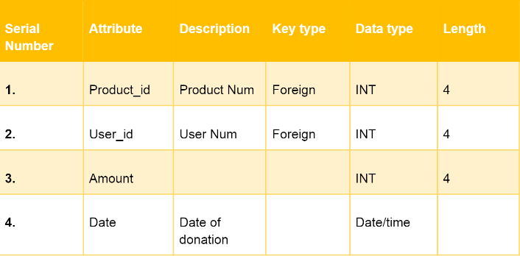
Donation

Slide 28
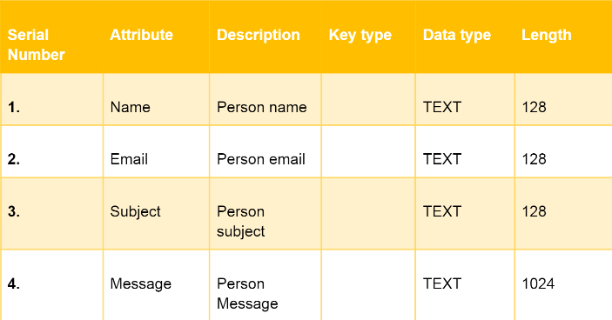
Contact Us

Slide 29
Installation
Clone to your local repo – git clone https://github.com/donateclub/donateclub-server.git
Install dependencies - pip install -r requirements.txt
Virtual Environment setup – env\Scripts\activate

