Slide 1
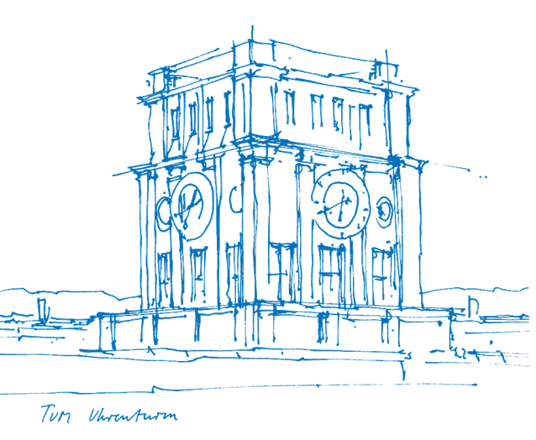
Implementation and Evaluation of a Reputation Framework to Increase Reputation Accuracy
Master’s Thesis
Presenter: Márton Donát Nagy
Supervisor: Emanuel Regnath

Slide 2

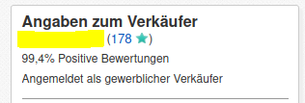
Introduction to Reputation Systems
ebay.de, amazon.de
Notes:
End: lets see a different one

Slide 3
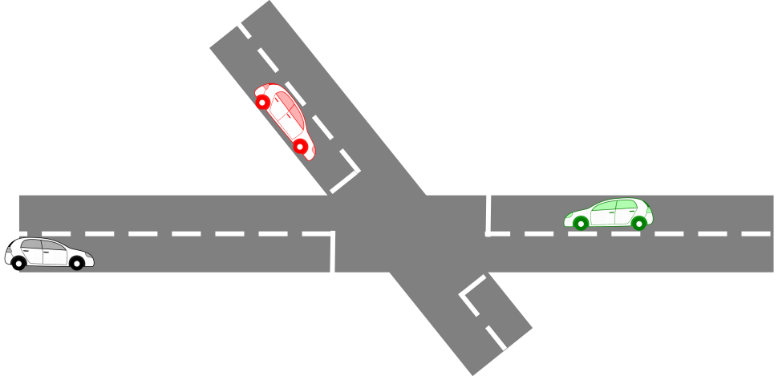
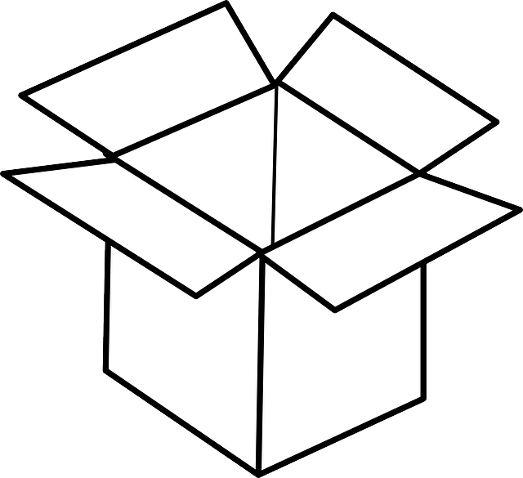
Who goes first?
Not OK
Review
I’m the closest
I go first
Content
Notes:
End: all cool whats problem

Slide 4
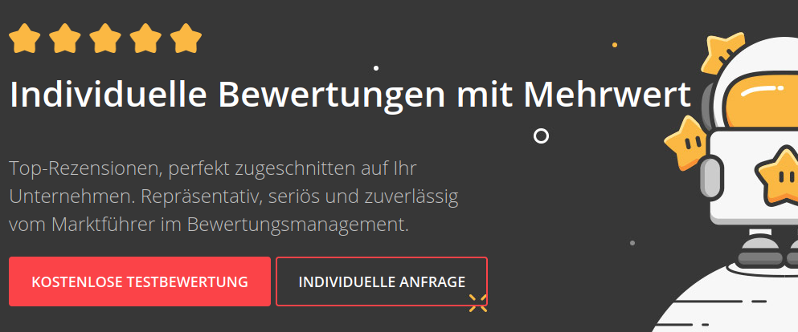
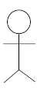

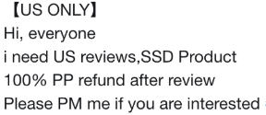
Problems: Attacks and Exploits
Unfair or biased ratings
Attacks to gain advantage or weaken others
Notes:
Good Self-rating → agencies even do this
End: ok, what do?

Slide 5
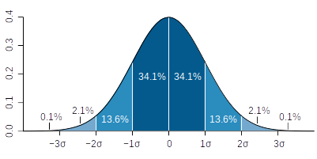
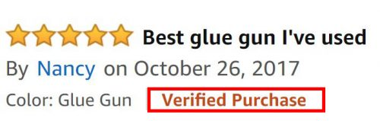
Answer: Build Defenses – Improvements
Step
#1
Step
#2
Step
#3
Step
#4
Issue?
Not collected
Not evaluated
No simulator
Reputation
Calculation
Wikimedia, amazon.com
Notes:
What is improved?
Attack resistance
Reduce / remove unfair ratings
Accuracy of rep. Scores
Enhance the reputation system
Steps before reputation calculation
Reusable building blocks
Identify patterns to use as improvs
Evaluate effectiveness
Make generic framework for evaluation

Slide 6
Improvement Techniques in Research
Focus
Attacks
Unfairness or bias
Blind rating
Goal
Prevention (proactive)
Correction (reactive)
Data source
Endogenous
Exogenous
Similarity-based
Aging
Weighting
Statistical outlier
filtering
Third-party
advice
Notes:
Central: CA, pre-trusted agents
Distrib: p2p, trustless
Glo Objective: CA, global reputation
Lo Subj: trust chain, recommendation, rater-based
Property: one or more property, stereotype systems
Observation: recommendation, indirect or direct obs
Discrete rating: on input or output
+-1, “usually trusted”, 5-star

Slide 7
Reputation Frameworks
Requirements
Source code available
Flexible, Extensible
  Simulation parameters
  Components
  Review values
  Evaluation metrics
Domain independent
Handle improvements
Agate&etal18 | Macau
ART | NEVER
ATB | QTM-P2P-Sim
C&E15 | Schlosser&etal04
DART | SIFT
EstarMom | TO-Sim
Euphemus | TREET
Irissappane&etal12 | TRM-EAT
Janiszewski17 | TRMSim-WSN
Liang&Shi08 | Youssef&etal17
Preferences
Wide acceptance
Contain reputation schemes
Notes:
Re reput/trust research: very divided, proliferated with methods

Slide 8
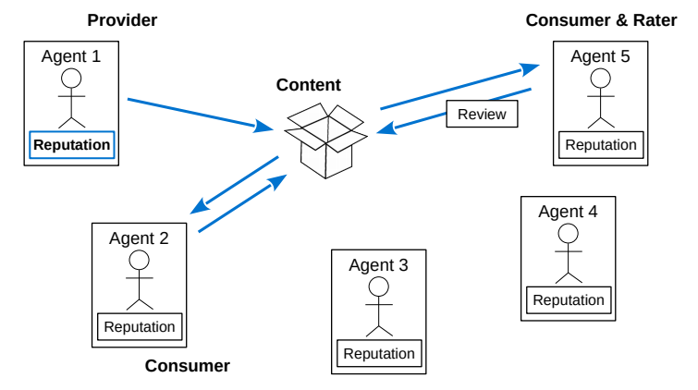
Model of a Reputation System

Slide 9
Claim
Claims represent content offers…
...but content is not modeled
Claim
Content
Author
Claims contain:
Author: Agent that made the claim (Claimer)
Ground Truth: Quality of provided content
objective and true, but unknown
Author Review: Author’s opinion on quality of content
Reviews: Consumer’s opinion on quality of content
Ground Truth
Author Review
Reviews
Reviews
Reviews
Notes:
Not modeled? We care abt the valuations, not the book / sensor value itself
Gr truth? In IOT clear, ETA is known AFTERwards
For a book? Movie? Not possible objectively
Still useful for evaluation..
Auth review? IOT: sensor reliability
Book? Not explicit, is implied, marketing msg…
Repstrat, improvs can use, or ignore if not needed

Slide 10
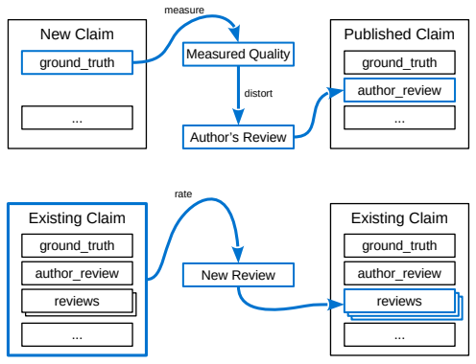
Claiming
1) Random Truth:
Not in the control of the claimer agent
2) Measure:
Try the content and make an opinion
3) Distort:
Willingly manipulate the measured opinion
4) Publish:
Claim is live, an author review is attached
Notes:
New claim w rand gr truth
Measure (assess) and distort it
Publish it

Slide 11
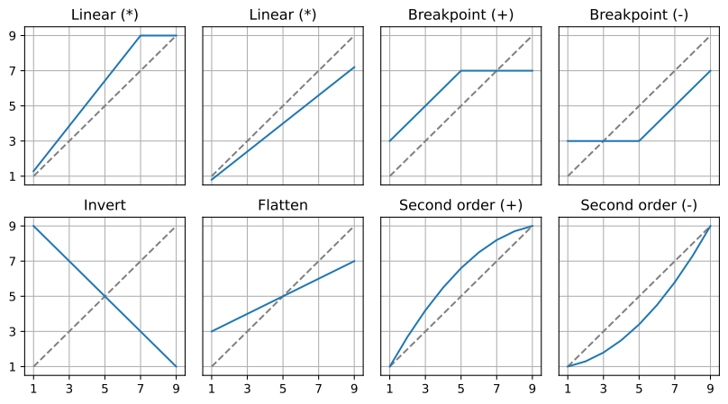
Reviews
Review
Reviews model feedback
They contain:
Author: Agent that made the review (Rater)
Value: Quality valuation
Author
Value
Claim
Notes:
Feedback on claims
Every review implies a transaction
One claim – many reviews
RATING: can use any data related to claim
Simple examples use one value (e.g. auth rev)

Slide 12
Reputation Calculation
Avg.
Diff.
Rating Range: [1,5]
Claim 1
Average
Diff.
Max Difference: 4
Author Review
3
0
Reviews
3
3
...
1.5
3
Claim 2
3
Author Review
5
2
New Reputation
3.5
Reviews
3
2
...
1
Notes:
Follow calc
Goal: reward honesty with author review

Slide 13
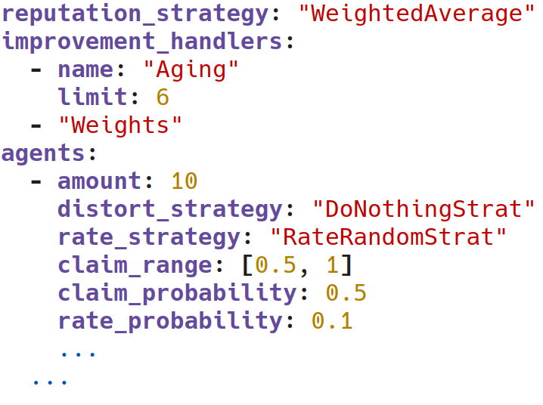
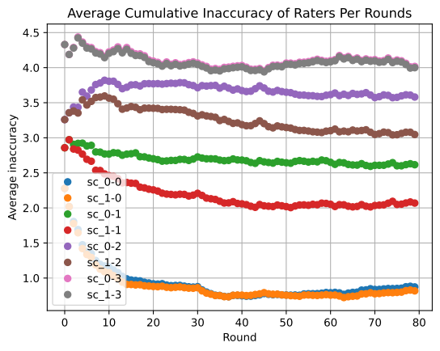
Pyrepsys Features
Implements generic model
Flexible configuration
… and more ...
Modular Strategies
Automatic pipeline
Distort
Behaviors
Distort
Behaviors
Distort
Behaviors
Distort
Behaviors
Distort
Behaviors
Distort
Behaviors
Improvement
Handlers
Reputation
Strategies
Distort
Behaviors
Distort
Behaviors
Distort
Behaviors
Distort
Behaviors
Distort
Behaviors
Distort
Behaviors
Distort
Behaviors
Rate
Behaviors
Notes:
Flexible, Modular, Extensible, Generic
Improvements handled, adding new is creating a child class
CFG: yaml files, two-level
Pipeline: compare&evaluate with 1 call
More: SC, CLI, rng repeatability

Slide 14
Pyrepsys Simulation Flow
Simulation Round
1. Make
Claims
2. Rate
New Claims
Read
Scenario
4. Calculate
Reputations
3. Apply
Improvements
Notes:
Scenario defines a reputation environment:
Agents, behaviors
Rep strat
Improvs
Type and range of ratings
Other params

Slide 15
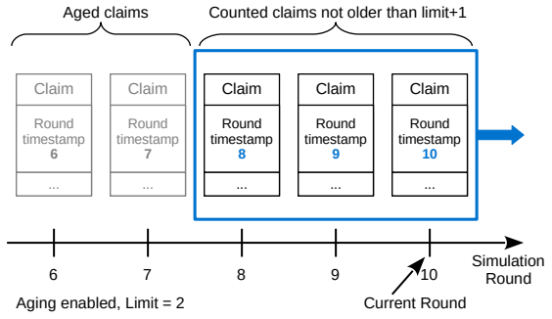
Aging

Slide 16
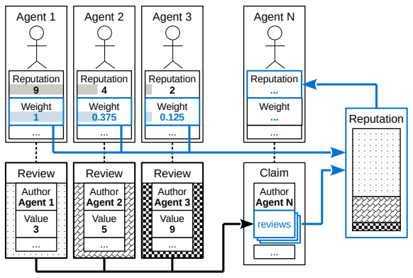
Weights

Slide 17
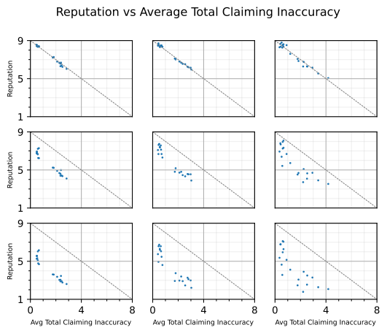
Evaluation: Aging
Aging: none 25 10
Malicious Raters:
Claimers
10 Honest
10 Dishonest
0%
50%
100%
Raters
60 total
Other
80 rounds
Ratings in [1,9]
Notes:
Malicious rate: invers slope
Dishonest claimer: sometimes max auth review
Not all agents on the diagram (claimers only)
RESULT: malicious brings all down
rep more spread out (less data)

Slide 18
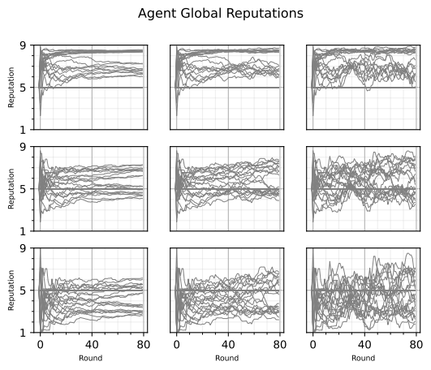
Evaluation: Aging
Aging: none 25 10
Malicious Raters:
Claimers
10 Honest
10 Dishonest
0%
50%
100%
Raters
60 total
Other
80 rounds
Ratings in [1,9]
Notes:
See rep is more scattered
Aging useful for changing behaviors

Slide 19
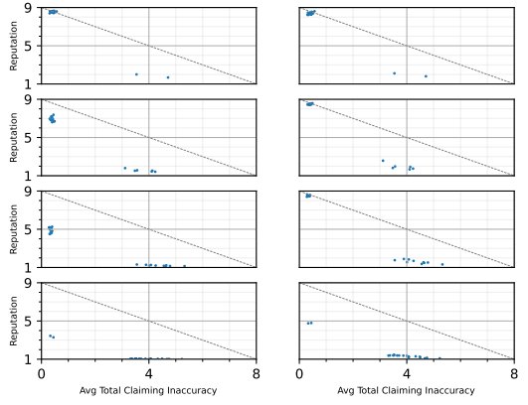
Evaluation: Weights
Weights: no yes
Dishonest : Honest
Agents
20 total
Raters-Claimers
Dogmatic rating
2:18
6:14
10:10
18:2
Other
80 rounds
Ratings in [1,9]
Notes:
Dishonest: sometimes maxes claims, downrates other honests
Dogmatic: disproportionately reward good-rep and punish bad-rep agents
All agents on the diagram (all are claimer-rater)
RESULT:
Weights salvages up to a point

Slide 20
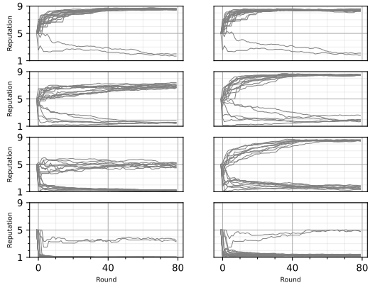
Evaluation: Weights
Weights: no yes
Dishonest : Honest
Agents
20 total
Raters-Claimers
Dogmatic rating
2:18
6:14
10:10
18:2
Other
80 rounds
Ratings in [1,9]
Notes:
But it takes relatively many rounds to settle

Slide 21
Summary & Conclusion
Why Improve Reputation Systems:
  Prevent attacks and malice (robustness)
  Correct unfair ratings or bias
Generic Model and Pyrepsys Simulator:
  Agents, Claims, Reviews
  Modular improvement techniques supported
  Flexibility: rate, distort, reputation, improvements
  extensive configuration possible
  Comparison: done in full pipeline
Evaluation of Improvements:
  Aging: only when changing behavior expected
  Weights: can salvage “good” agents

Slide 22
Questions?

Slide 23
References
A. Whitby, A. Jøsang, and J. Indulska, “Filtering Out Unfair Ratings in Bayesian Reputation Systems,” in Proceedings of the Workshop on Trust in Agent Societies, at the Autonomous Agents and Multi Agent Systems Conference, p. 12, 2014.

Slide 24
Problems: Attacks and Exploits
Challenges in Reputation Research
Overabundance of reputation methods in literature
Lack of comparison between them
Many methods and frameworks domain-dependent
Improvement Techniques in Research:
Identify patterns to use as improvement techniques
Evaluate their effectiveness
Collect and evaluate improvement methods
Provide a generic framework for improvement evaluation

Slide 25
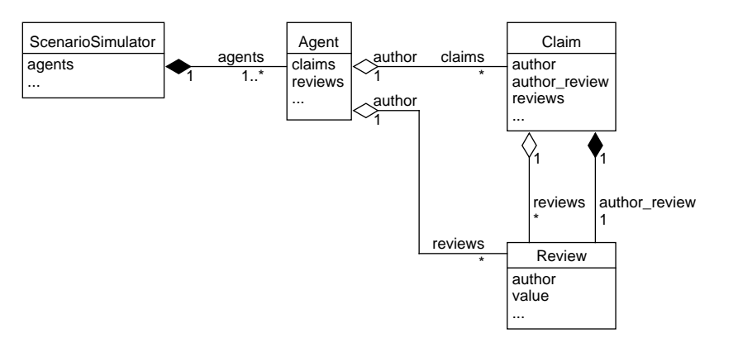
Data Structure

Slide 26
Frameworks and improvements

Slide 27
Pyrepsys Modules

Slide 28
Pyrepsys Performance

Slide 29
Implemented Reputation & Improvement Strategies

Slide 30
Implemented Metrics

Slide 31
Pyrepsys Configuration

