Slide 1
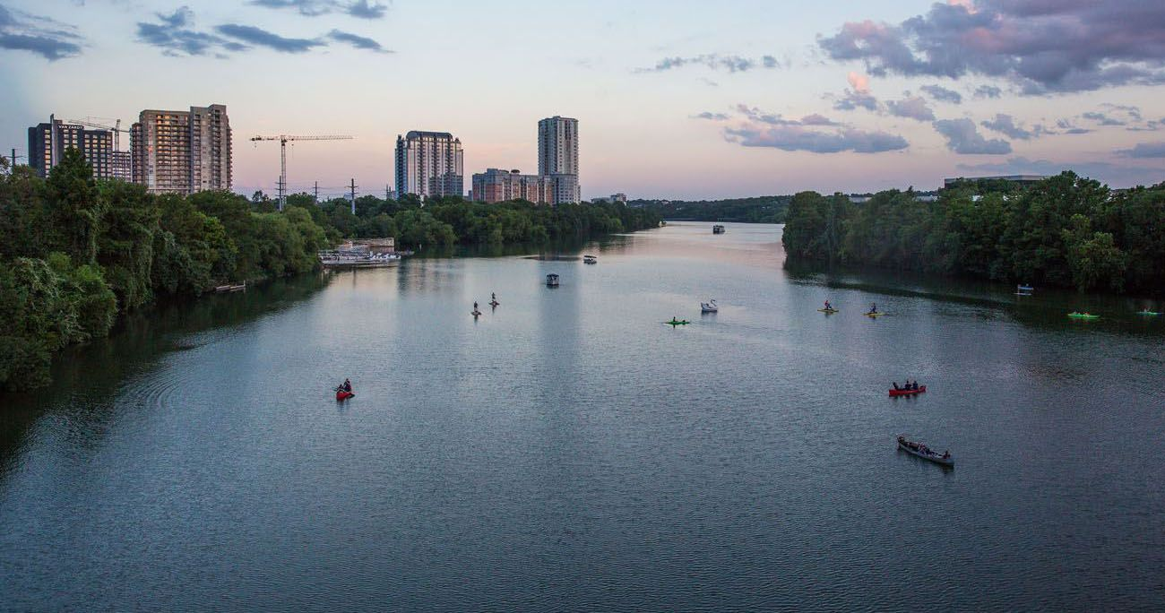
You and your Airbnb Pricing

Slide 2


Slide 3
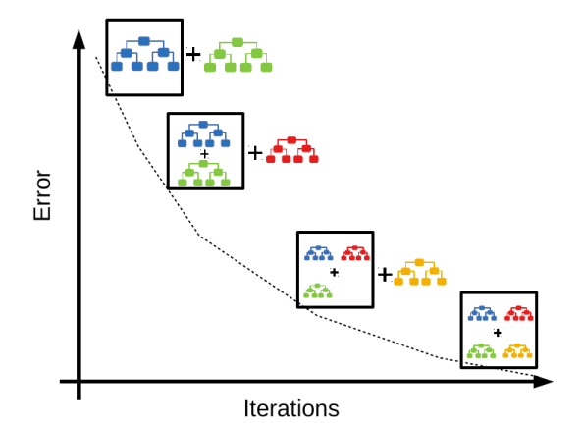
How Does the Model Work
XGBoost Regressor
Ensemble of Decision Trees

Slide 4
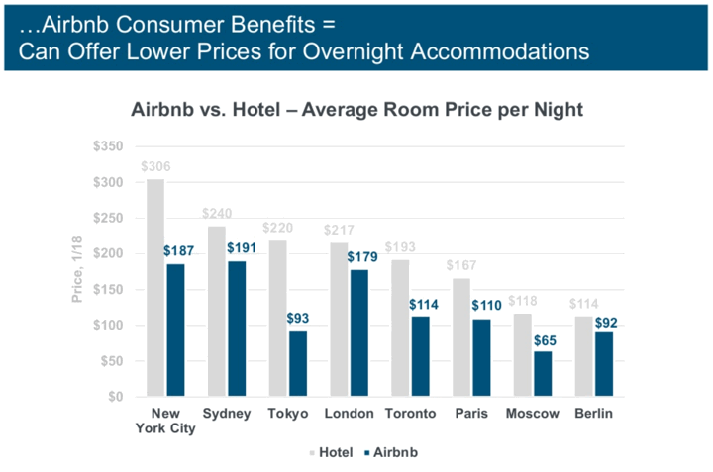
Why Airbnb?
Cheaper than a hotel room
Variety
Privacy
Authenticity
Become a Potential Earner

Slide 5
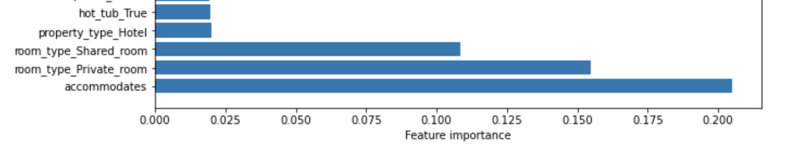
Model Description
Target Variable: Price
# of Predictors
Important predictors
# of People
Private Room?
Shared Room?
Hotel?
Hot Tub

Slide 6
Model Description
Target Variable: Price
# of Predictors
Important predictors
# of People
Private Room?
Shared Room?
Hotel?
Hot Tub

