Slide 1
Insight on Boat Sales

Slide 2
The Objective
What are the most viewed boats?
Does price correlate to boat views?
Features among the most viewed boats?
Note: Cost of boat was converted to USD in
order to have a uniform price for all boat listing

Slide 3
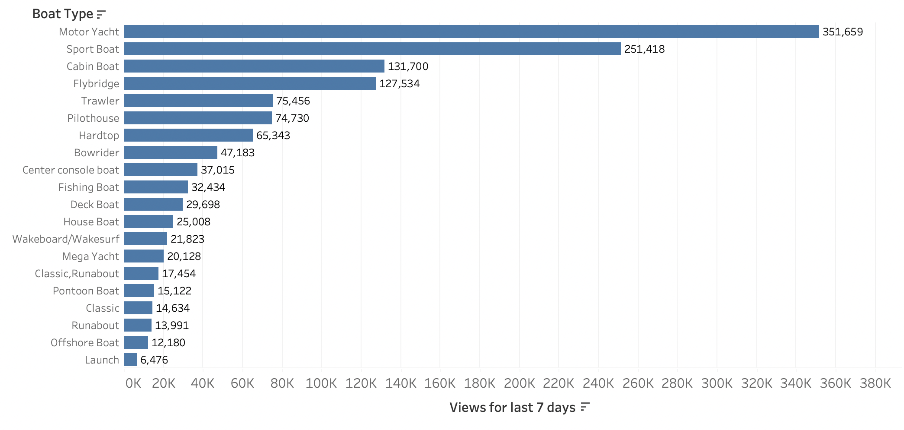
Total Views of the Top 20 Boat Type
Motor Yatcht tops the list as the most viewed boat type

Slide 4
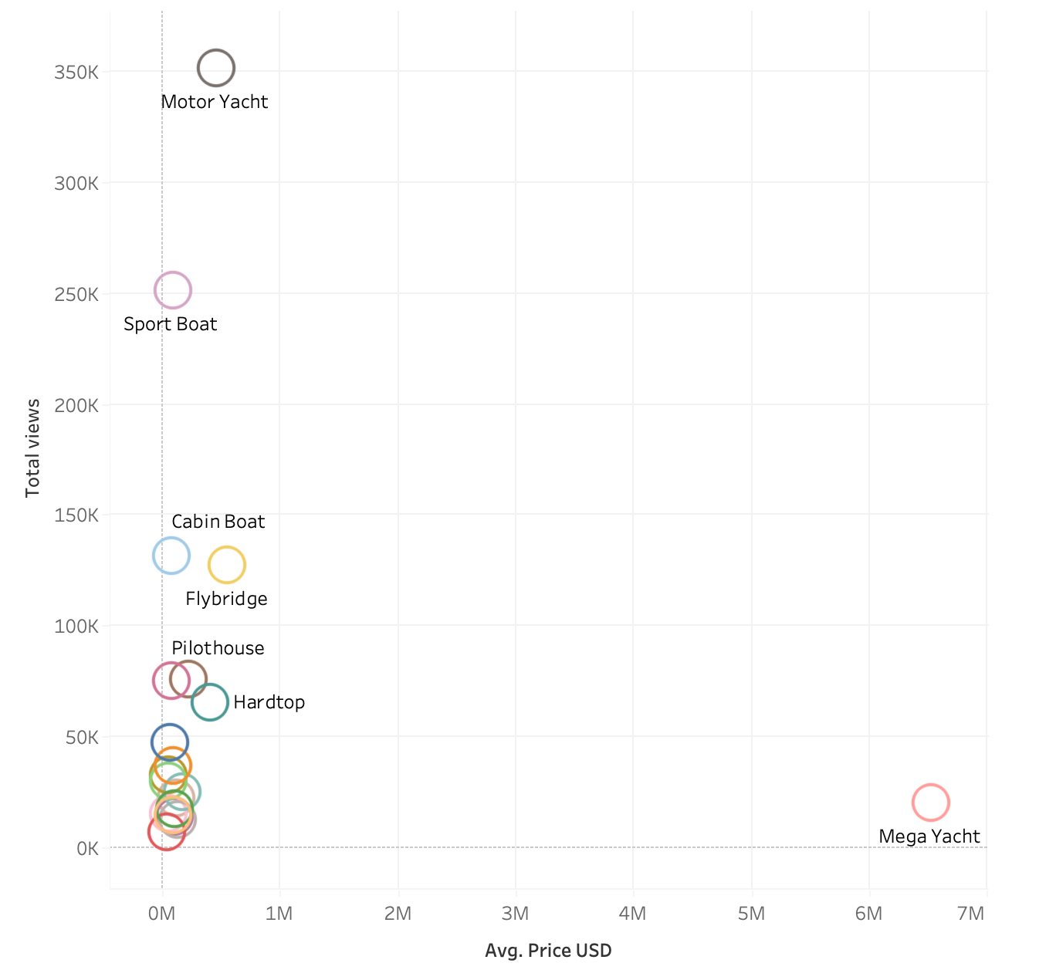
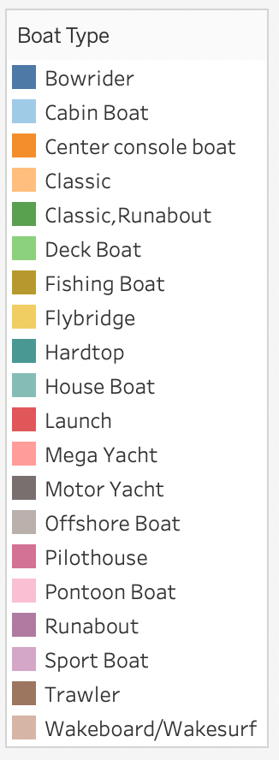
Total Views vs Average Cost of boats
There is no positive correlation between total views and cost of boat
Key
A positive correlation is a relationship between two variables that tend to move in the same direction.

Slide 5
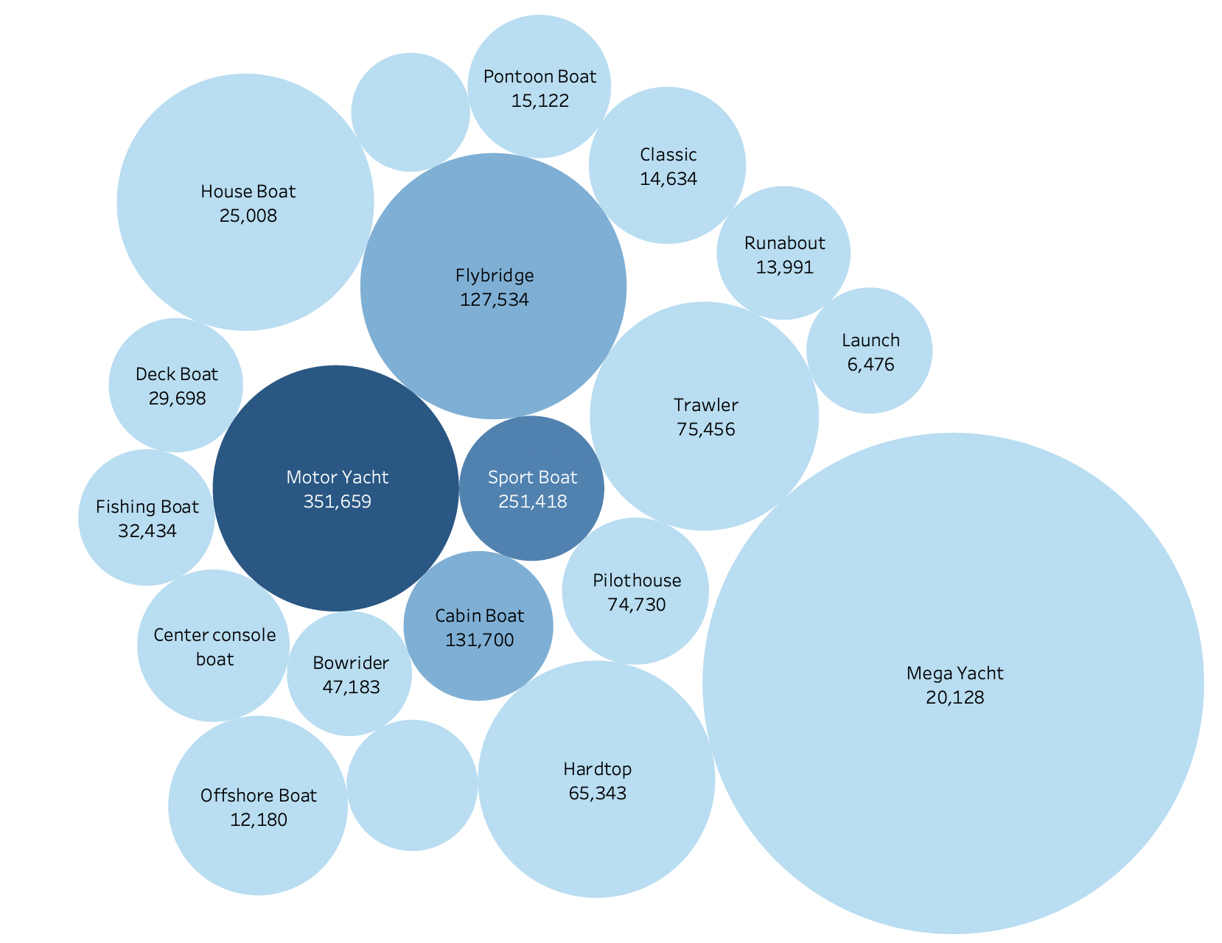
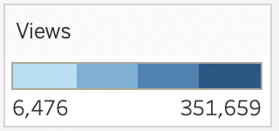
Size of Boat With The Total Views
The size of the boat did not influence views
The colour shows the total views
The Bigger the circle, the bigger the boat

Slide 6
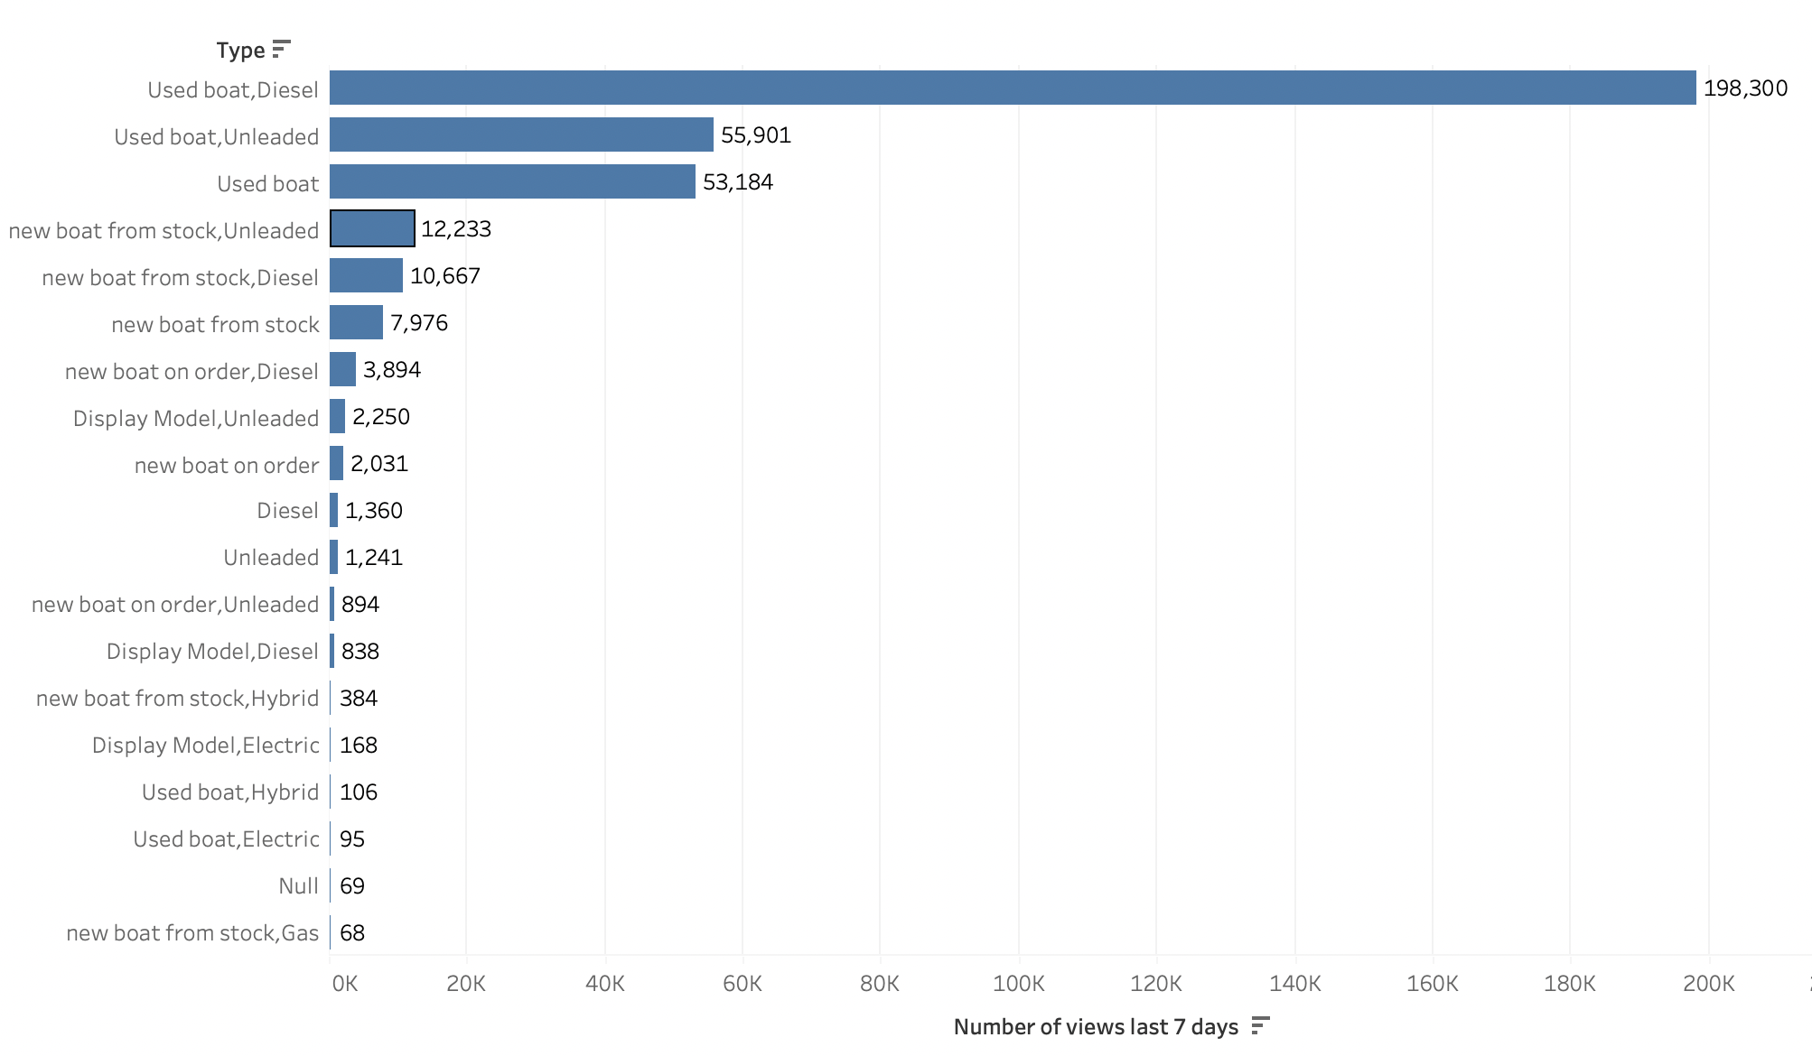
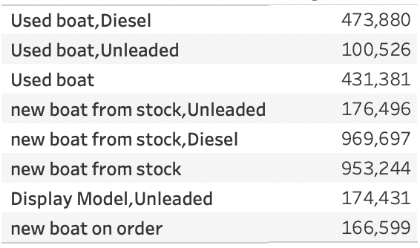
Break Down of Total Views for Motor Yatch
﻿Cost of Boat

Slide 7
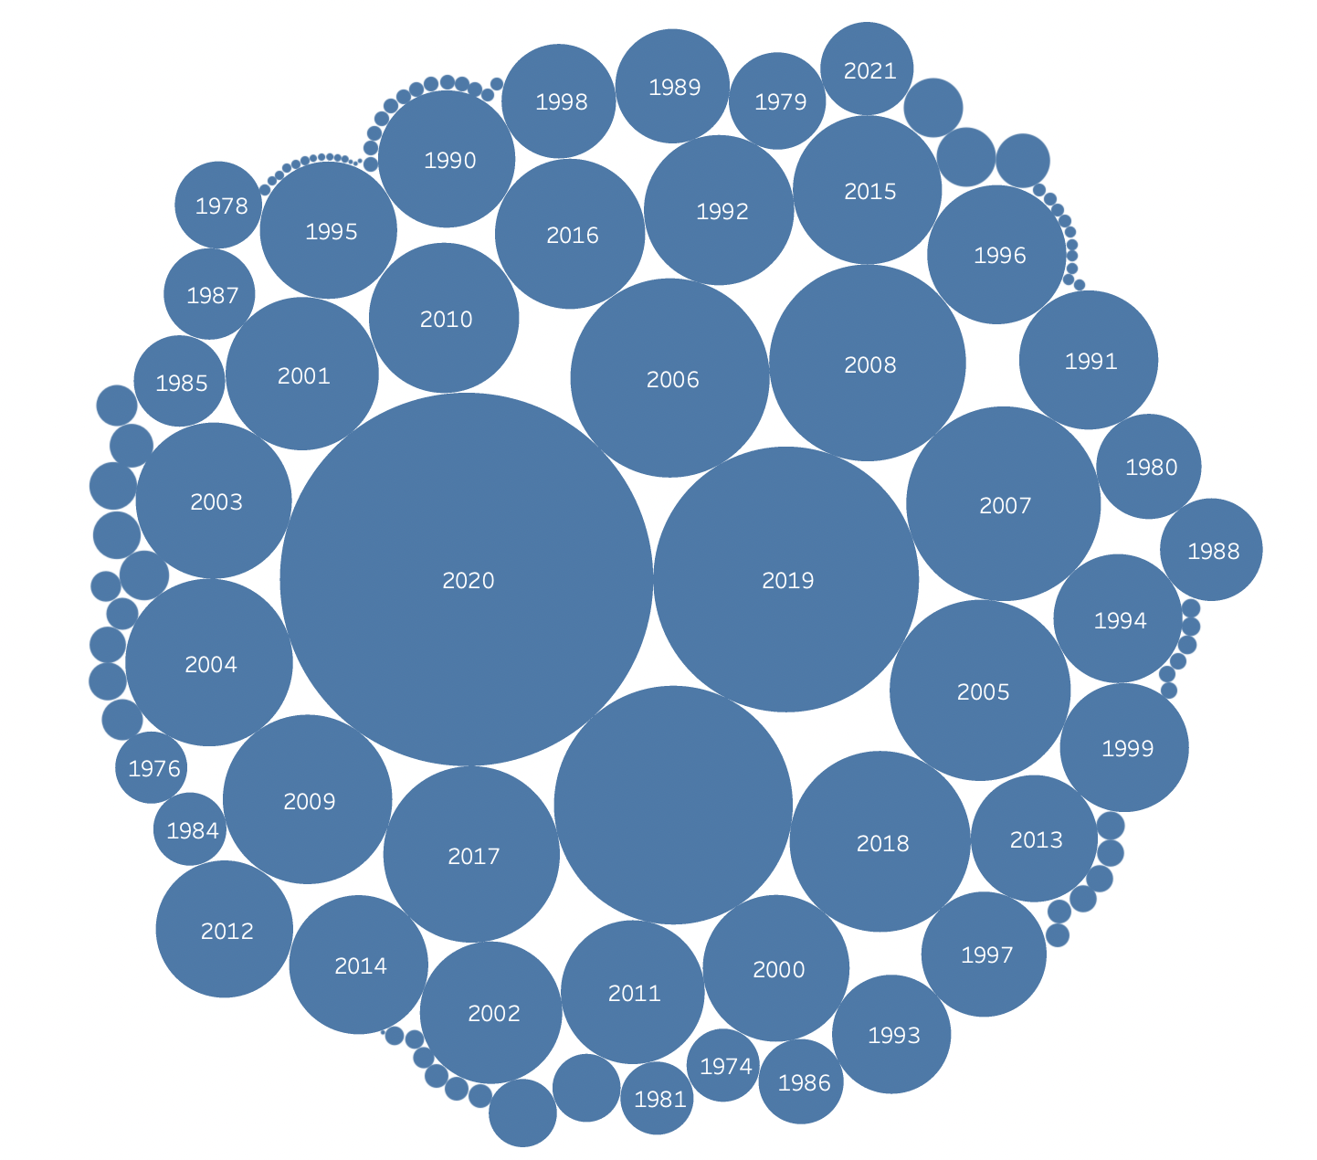
View Categorized by Year The Boats Where Built
Post 2000s had the highest views
Bigger the Circle indicates higher views

Slide 8
Conclusion
Boat being expensive does not determine or guarantee more views.
Size of boat does not determine or guarantee views.
Boats built in the the 21st century (2000s) had more views.
Motor Yacht was the most viewed boat.
Relatively affordable boats were viewed more
Diesel powered boats toped the charts for views
Specifically Used diesel boat.
Recommendation
Encourage the sale of affordable yatch since not many customers are intrested in the super expensive yacht.
Used boats are in higher demand, encurage the sale of used boats it is also good for the environment.
Modern era boats are in higer demand, encurrage the sale.

