Slide 1
Objectives
Case Study Project - Travel Insurance
What are the differences in travel habits between customers and non-customers.
Further Insight that can help marketing strategy.
Things to Note:
Customers are referred to as Insured
Non-Customers are referred to as Not Insured

Slide 2
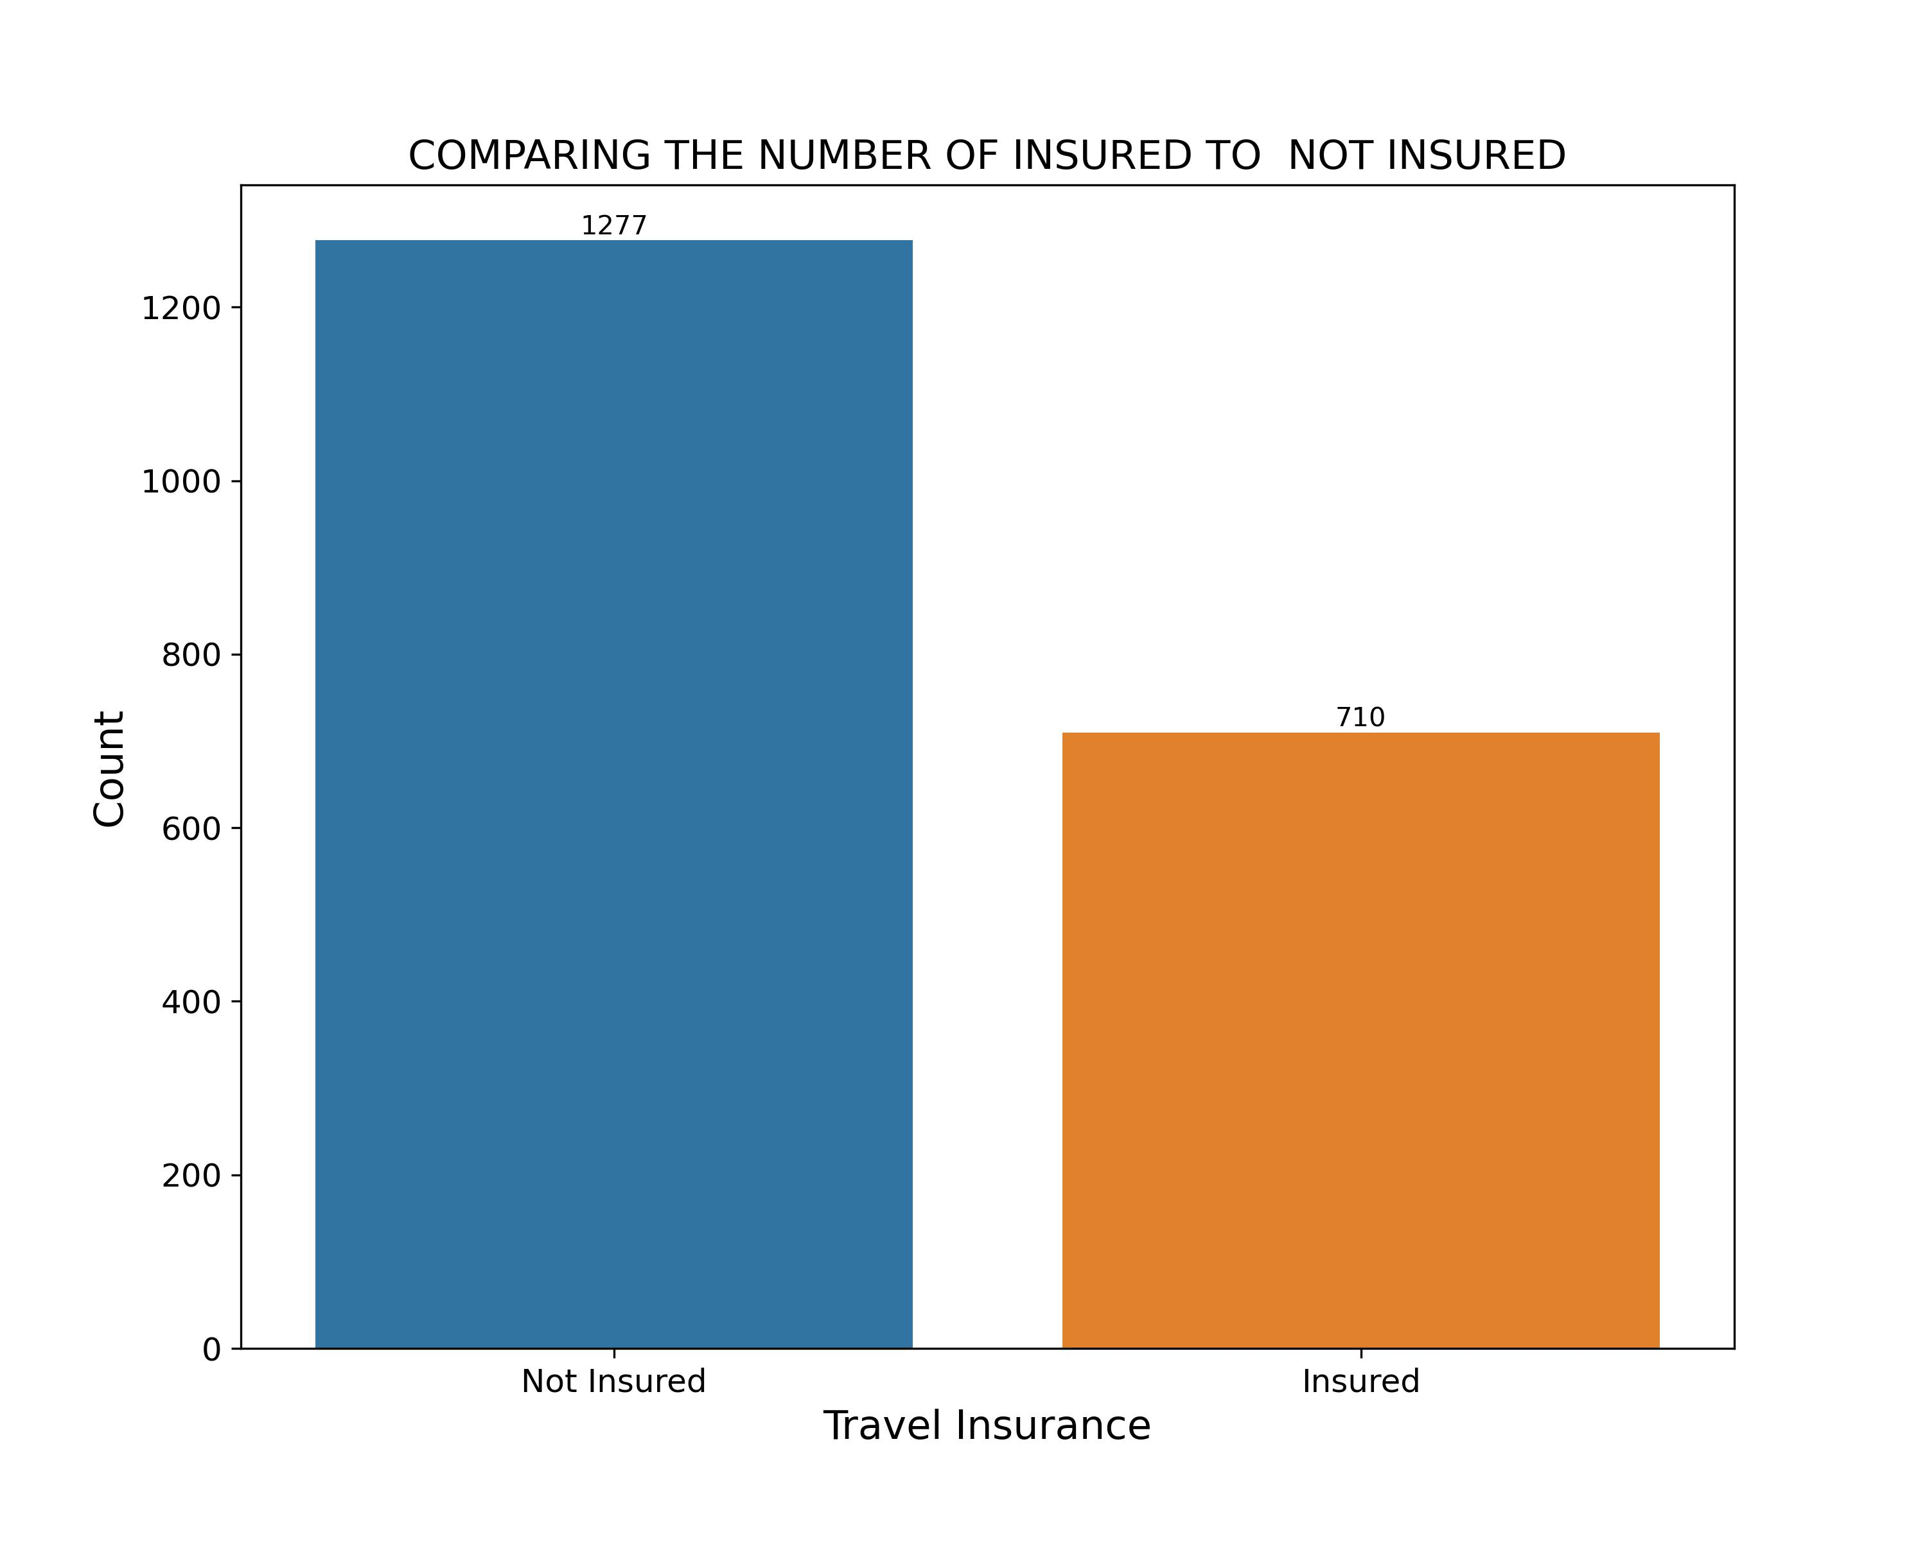
The Count of Insured & Not Insured
More people people got the qoute but did not buy the Insurance

Slide 3
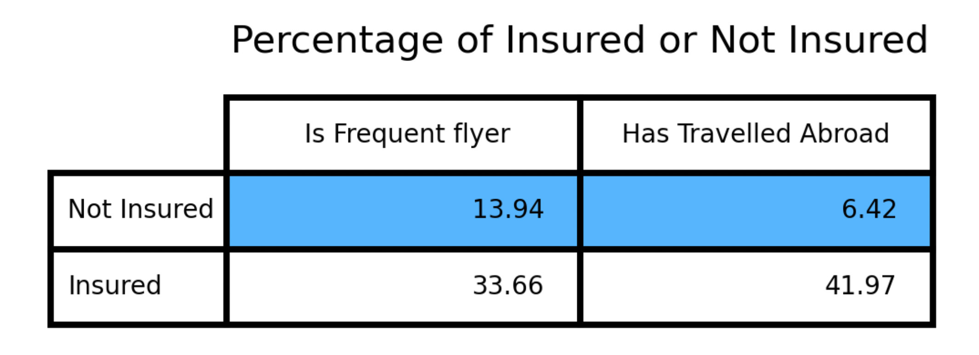
The Percentage of Insured and Not Insured
The area of focus is highlighted in blue
Only about 6.42% of people not insured have travelled abroad.
Only 13.94% of people not insured are frequent fliers, meaning about 86% of people who did not buy insurance are not frequent fliers.

Slide 4
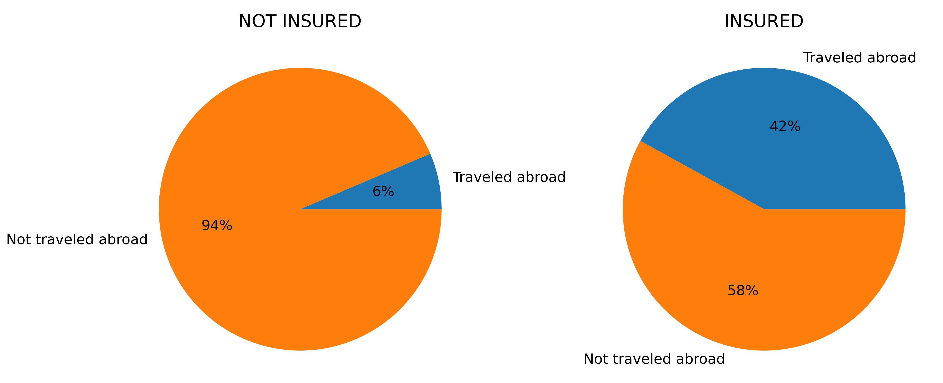
The Relationship Between Customers and Non-Customers
The chart of insured and not insured with respect to travelling abroad
About 6% of the people that got quotes but did not buy the insurance have travelled abroad.
42% of our customers travelled abroad.

Slide 5
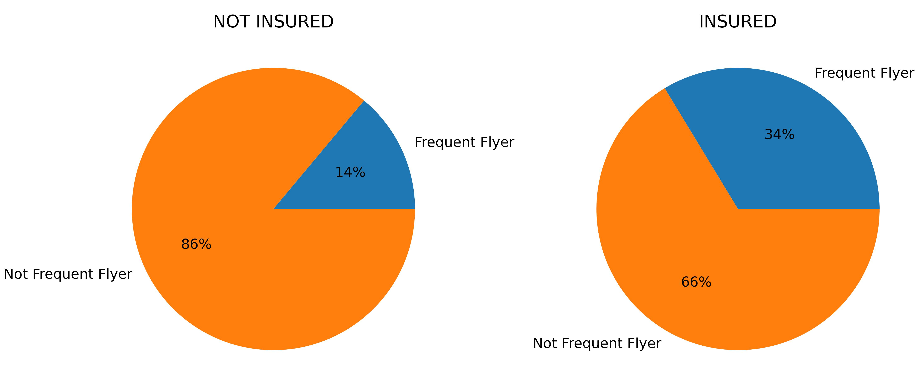
The Relationship Between Customers and Non-Customers
The chart of insured and not insured with respect to frequency of flying
86% of the people that got quotes but did not buy insurance are not frequent flyers.
34% of our customers are frequent flyers

Slide 6
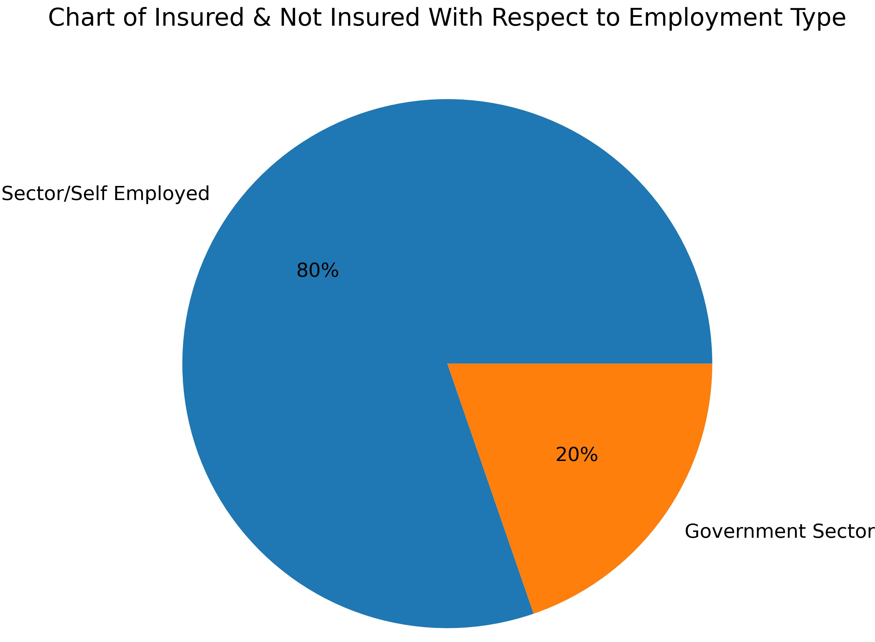
The Relationship Between Customers and Non-Customers
Over 80% of our customers are working in the private sector

Slide 7
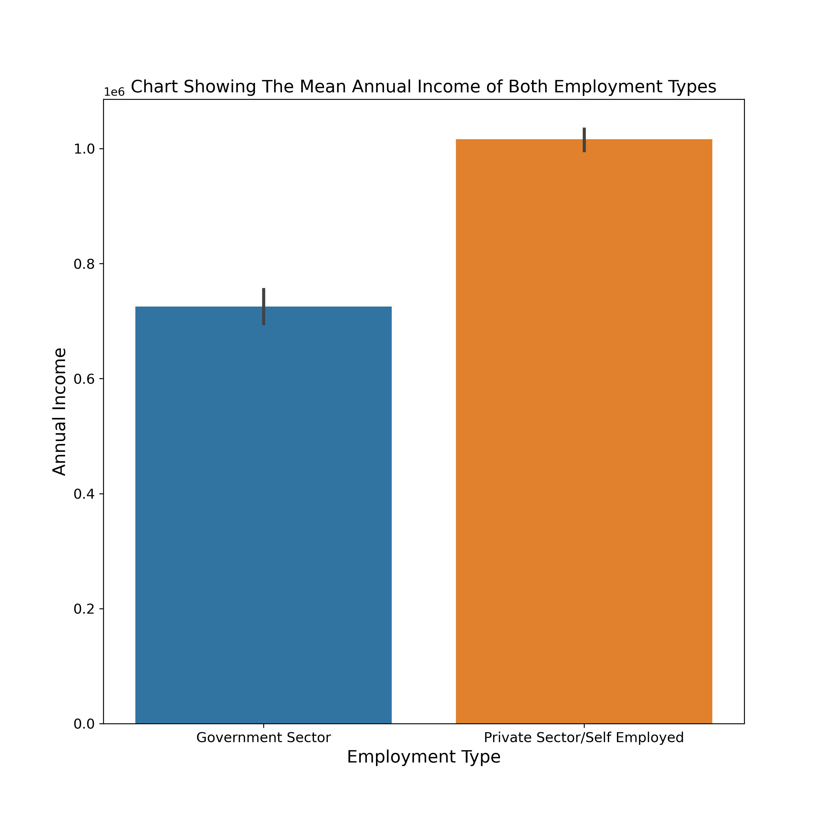
The Relationship Between Customers and Non-Customers
Over 80% of our customers are working in the private sector
Private Sector/Self Employed earn more than Government Sector workers.

Slide 8
Conclusion
Majority (about 80%) of Travel Assured customers are Private Sector/Self Employed.
About 42% of our customers have travelled abroad.
94% of the people that viewed the quote but did not get insurance have not travelled abroad
34% of our customers are frequent flyers.
86% of people that received the quote but did not buy are not frequent flyers.
Majority of our clients are high income earners
Recommendation
The new marketing strategy should target frequent flyers.
The new marketing strategy should target people who have travelled abroad.
Special consideration should be given to people who are both Frequent Flyers and have travelled abroad.
More consideration to the private sector/self employed workers since 80% of our clients are in private sector/self employed sector.
In its new marketing strategy, Travel Assured should create more insurance packages or coverages that can be tailored to the low-income earners. If that is not possible, Travel Assured should prioritize high-income earners.

