Slide 1
Changing Demographics and Tax Disrupters
Connecticut 2019 Non-Partisan Insights Conference
Hartford, CT
December 6, 2019
Don Boyd, Co-Director
State and Local Government Finance Project, Center for Policy Research
Download at github donboyd5: github.com/donboyd5/slides
With appreciation for support from the Pew Charitable Trusts
Includes slides on autonomous vehicles based on work by William F. Fox, University of Tennessee , with permission

Slide 2
Outline
Demographics and population aging
Population aging
Economic effects
Potential fiscal effects of population aging – income taxes, sales taxes, other issues
Potential impacts in case-study states
Technology & autonomous vehicles – based on work of William Fox, University of Tennessee
Conclusions and lessons

Slide 3
Population aging

Slide 4
Population aging
Two main causes of population aging
Improved longevity
Low fertility
Age groups
Elderly population will grow rapidly
Working-age population growth will slow
Younger, school-aged population will grow slowly.
“Old-age dependency” ratio will rise
Population aging will be more-rapid in 2020 to 2030 than in 2030 to 2040
Great variation around the country

Slide 5
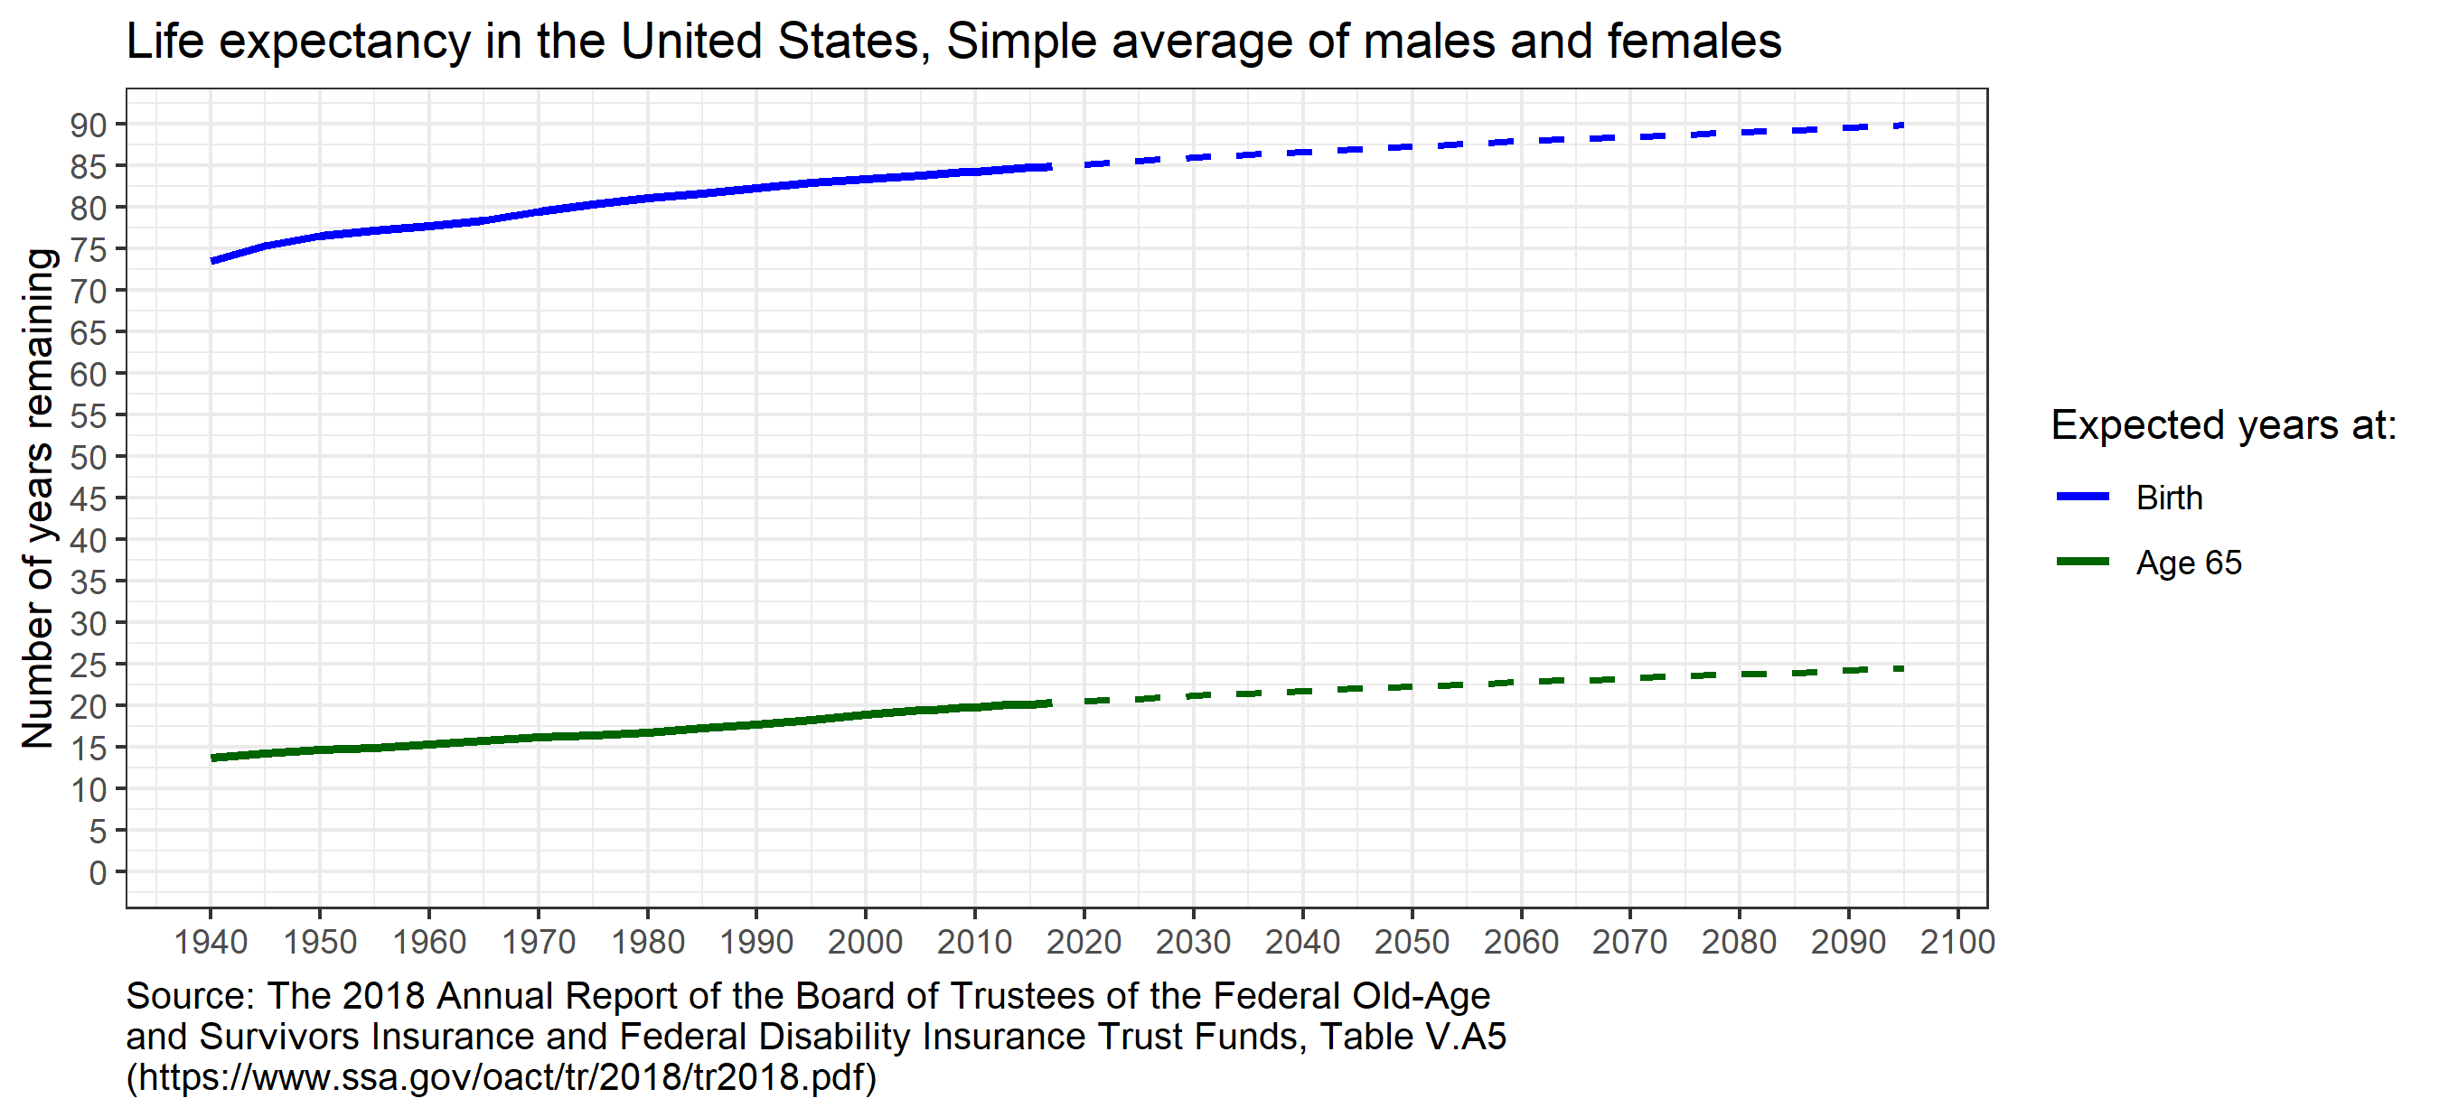
Life expectancy has been increasing and is projected to rise further

Slide 6
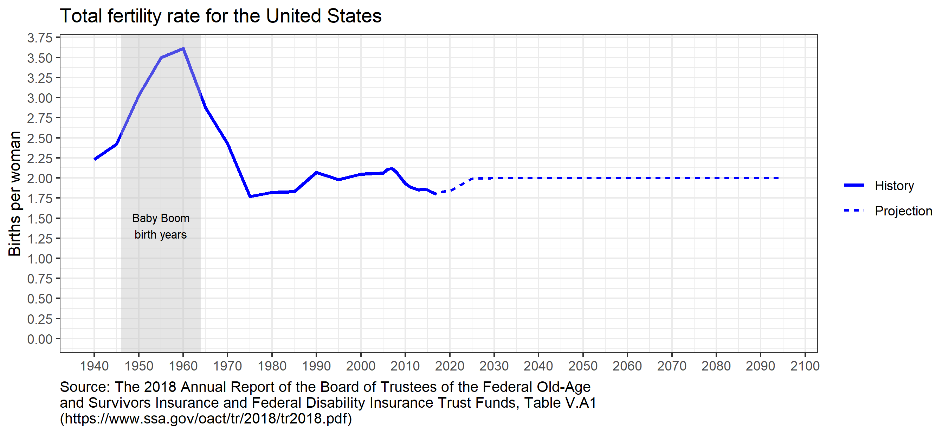
Fertility rates rose dramatically during the baby boom but have fallen and stayed low
This forecast may be optimistically high

Slide 7
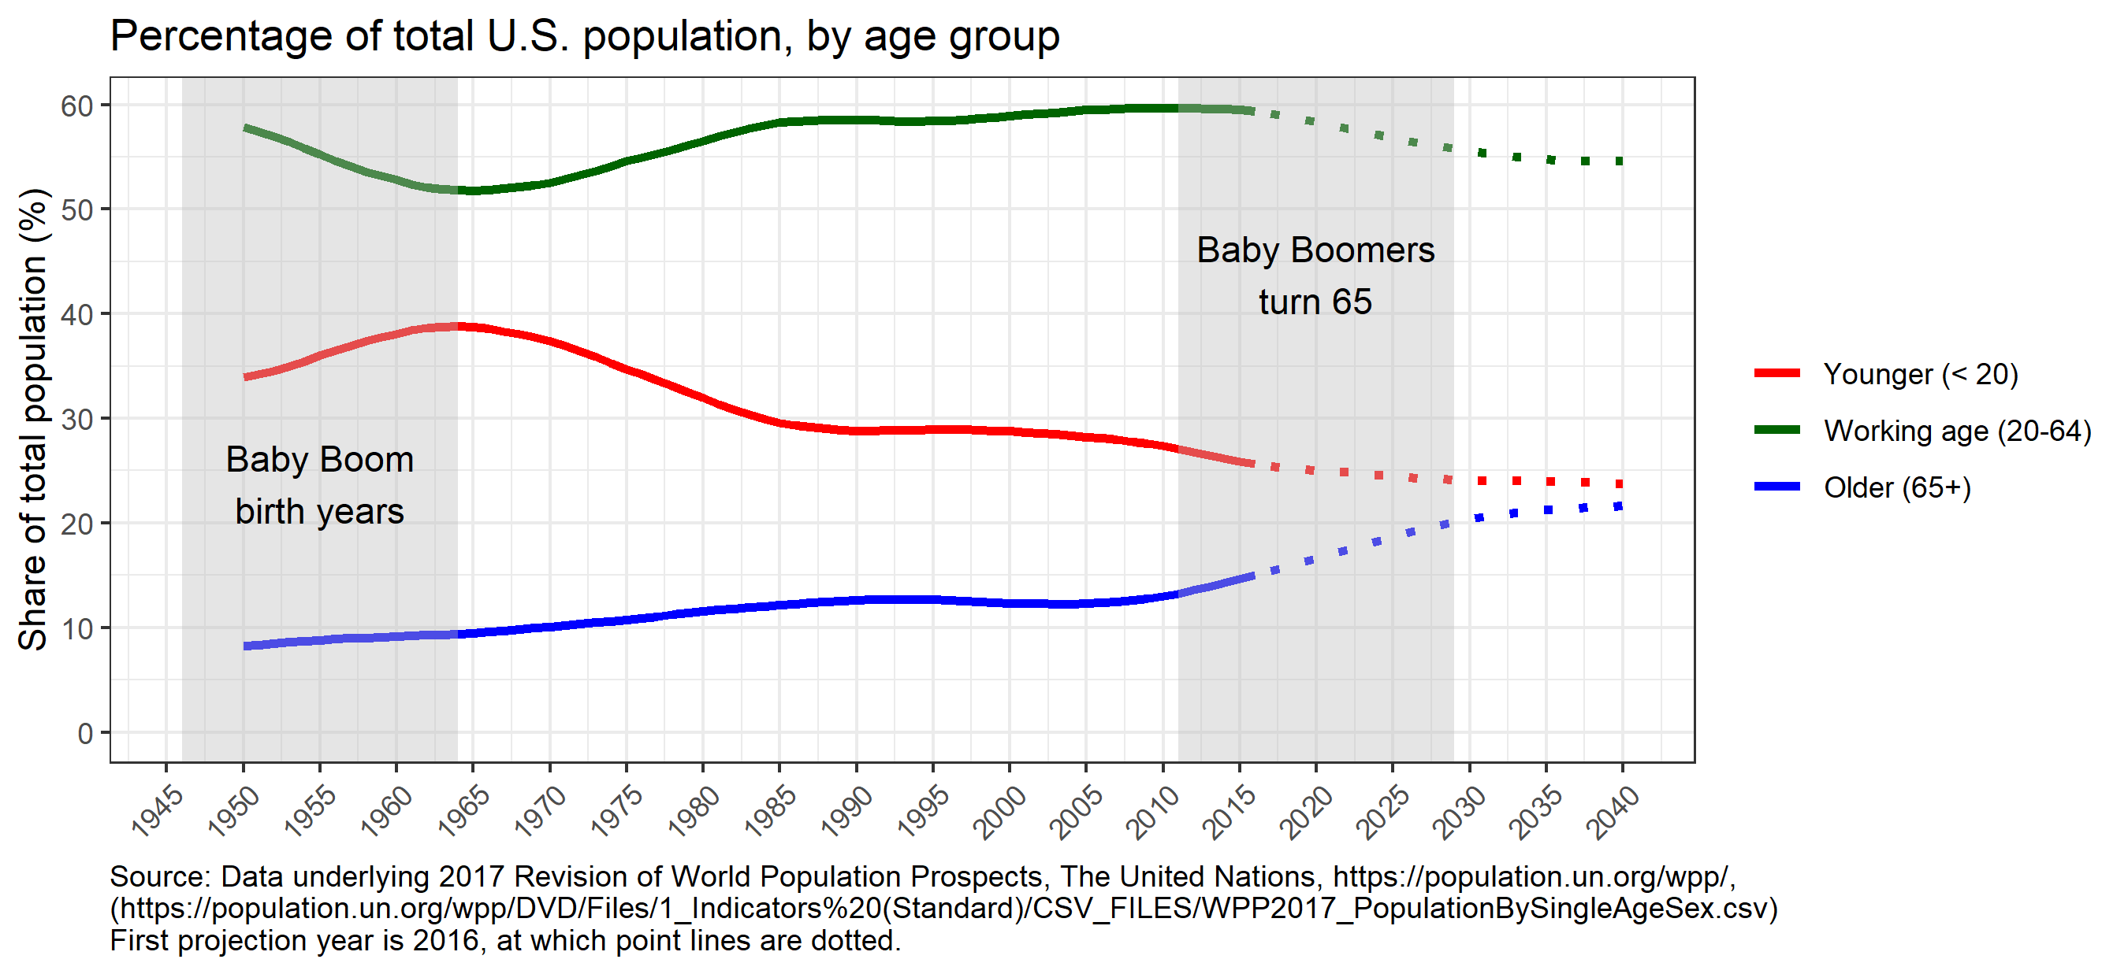
Combined impact of longer lives and low fertility: Rapidly rising age 65+ share

Slide 8
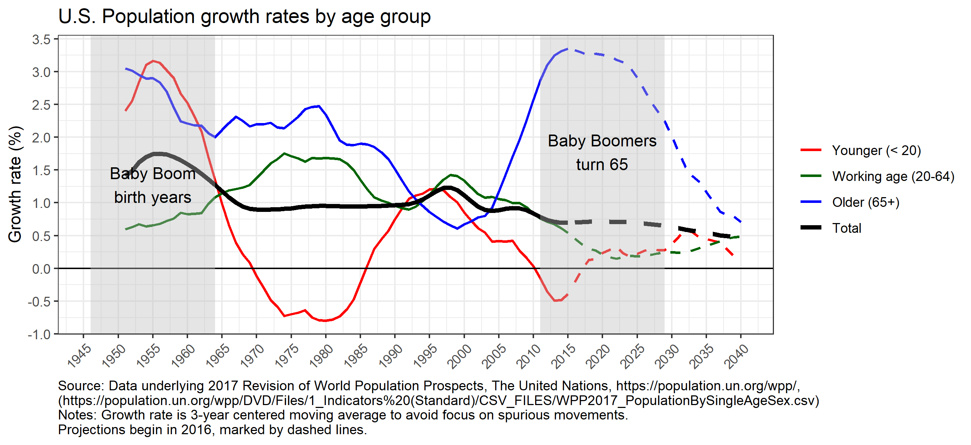
Another perspective: Slower growth in total and working age population

Slide 9
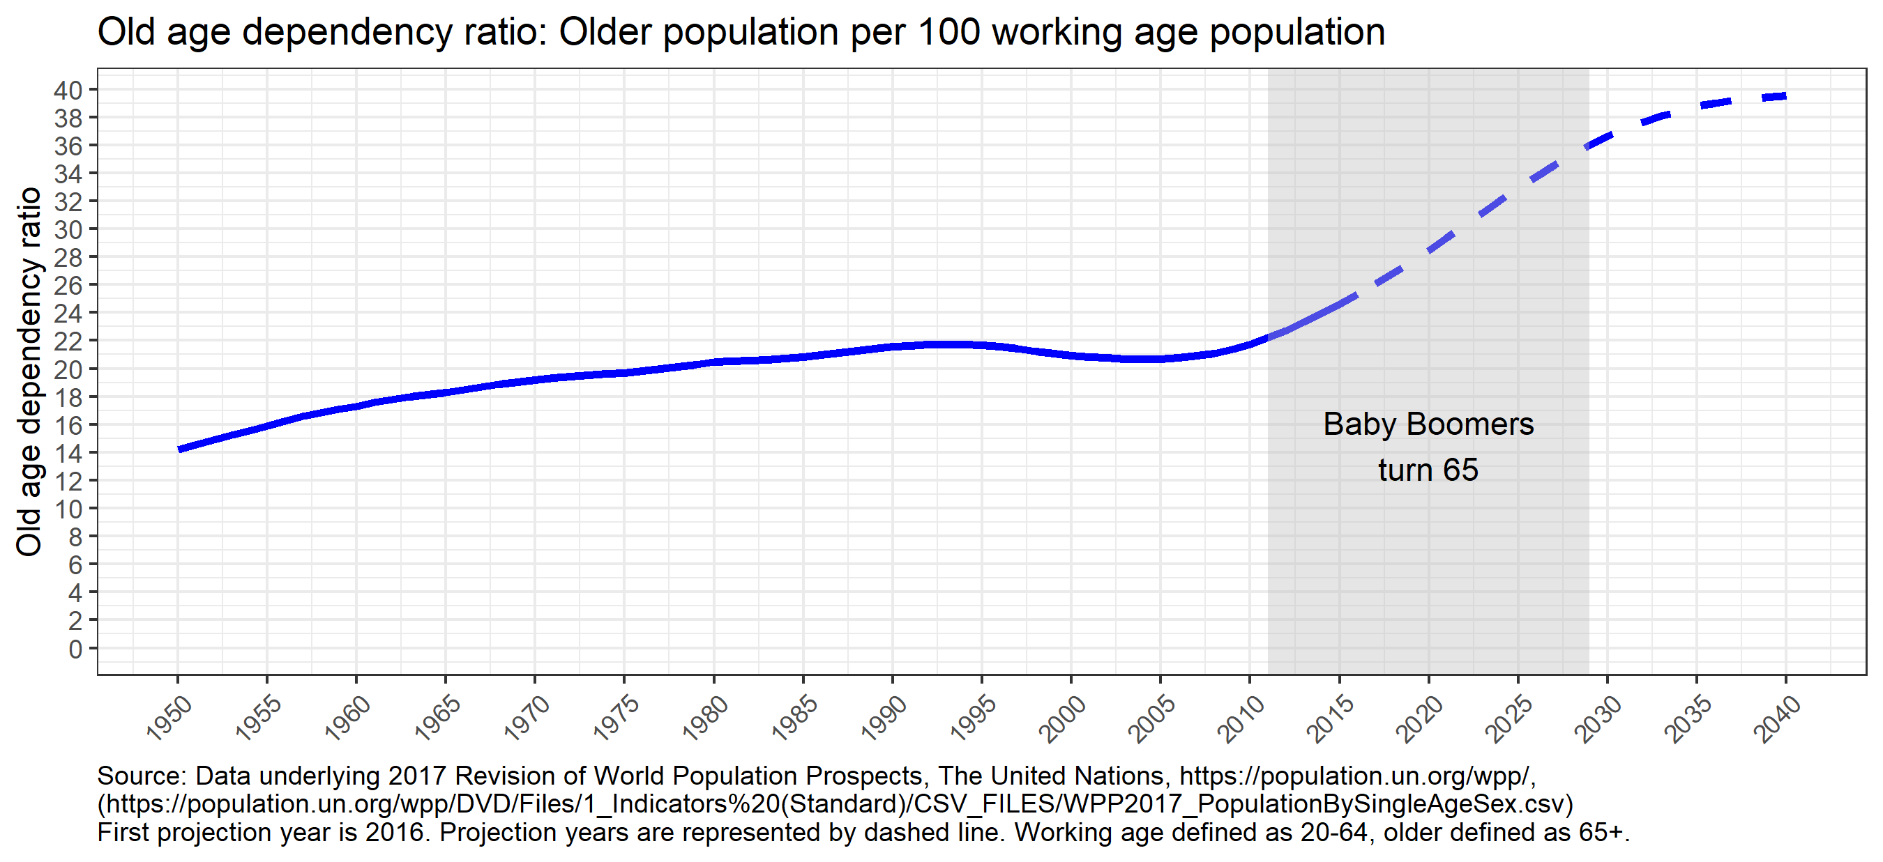
Old-age dependency ratio will rise sharply (Older pop relative to working-age pop)

Slide 10
Economic effects

Slide 11
Effects on economic growth
Economic growth often decomposed:
Growth in workforce
+ Growth in productivity of workforce
= Growth in potential productive output (e.g., GDP)
Workforce
Working-age population growth will slow
Labor force participation:
Traditional working-age population - modest declines in participation
Older population - potential increased participation
Productivity: some forecasters expect slower growth. No consensus.
On balance, economic growth expected to slow & has been slowing

Slide 12
Potential fiscal effects

Slide 13
Population aging and state income taxes
Income tends to be lower for people over age 50
State and local income taxes fall even more sharply
Composition changes:
Wages fall
Social Security, pensions, IRA withdrawals, interest and dividends rise
State tax policies exacerbate these impacts
Meanwhile, working-age population and wage growth likely to slow

Slide 14
States tax retirement income lightly
Social Security
Federal government taxes up to 85%
28 of 41 states w/broad-based PIT do not tax it at all (2014)
Private pensions
4 states exclude entirely
23 exclude partially
State & local pensions
8 states exclude entirely
26 exclude partially
Federal civilian pensions
11 states exclude entirely
23 exclude partially
Some states have special deductions and credits for older taxpayers
Illinois, struggling to pay public pensions, exempts virtually all retirement income!

Slide 15
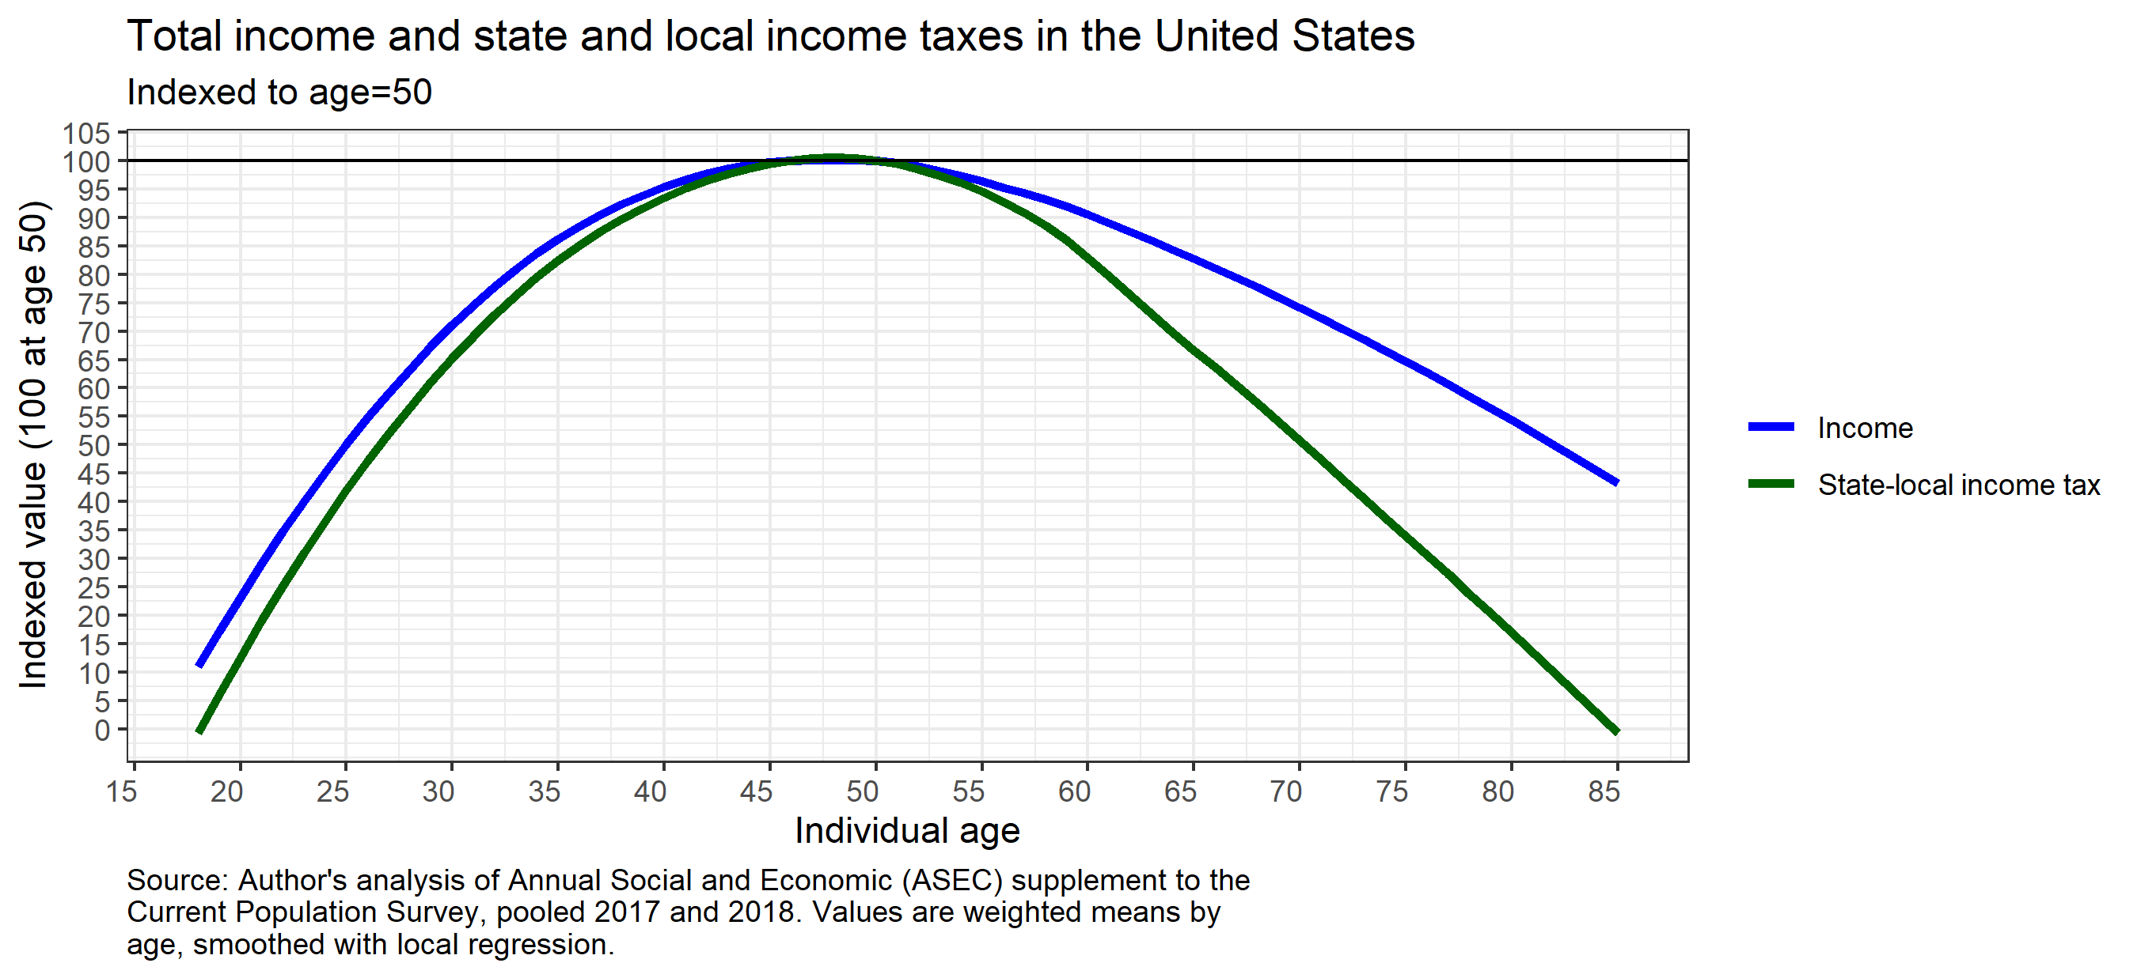
Income falls. Income taxes fall more sharply.

Slide 16
Retirement income growing rapidly

Slide 17
Population aging and state sales taxes
Expenditures on goods & services is lower among older households than slightly-younger cohorts
Expenditure falloff not as sharp as income falloff. Consistent with some household smoothing of consumption over lifetimes
Research suggests households do cut expenditures as they age. (It is not just that current older cohort has different preferences from current younger cohort.)
Sales taxes tend to tax necessities lightly, but sales tax preferences that explicitly target the elderly are rare

Slide 18
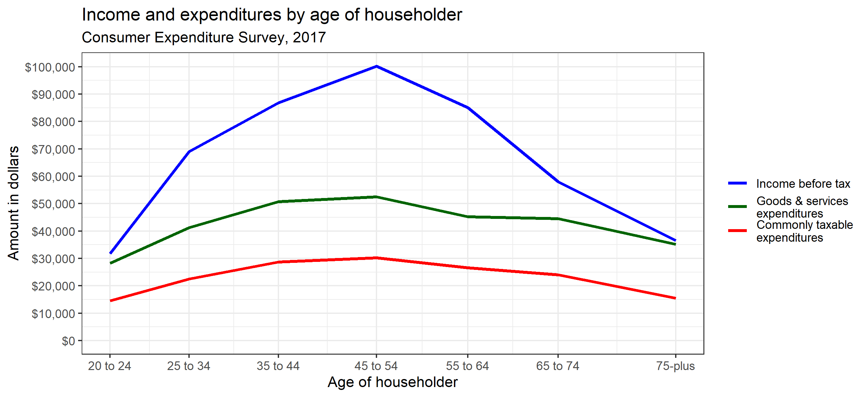
Spending falls among older households, but not as sharply as income falls

Slide 19
Population aging – other issues
Other taxes – not much research. Local property taxes could be affected:
Home values tend to be lower among household heads older than 50, and property taxes are lower still.
Many property tax preferences for older households. Special property tax provisions also can benefit the elderly.
Could cause some pressure on state finances.
Medicaid costs far higher for older households, likely to grow as the population ages.
Slow growth in school-age population could provide fiscal savings.
Population aging could be a risk to state and local pensions
Voting behavior and the “gray peril” – will older voters support taxes for services that do not benefit them directly?

Slide 20
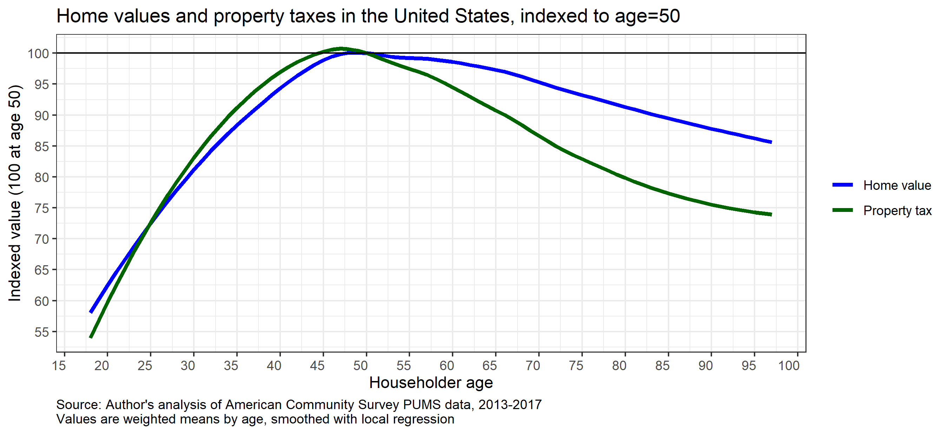
Home values are lower among older households, property taxes lower still

Slide 21
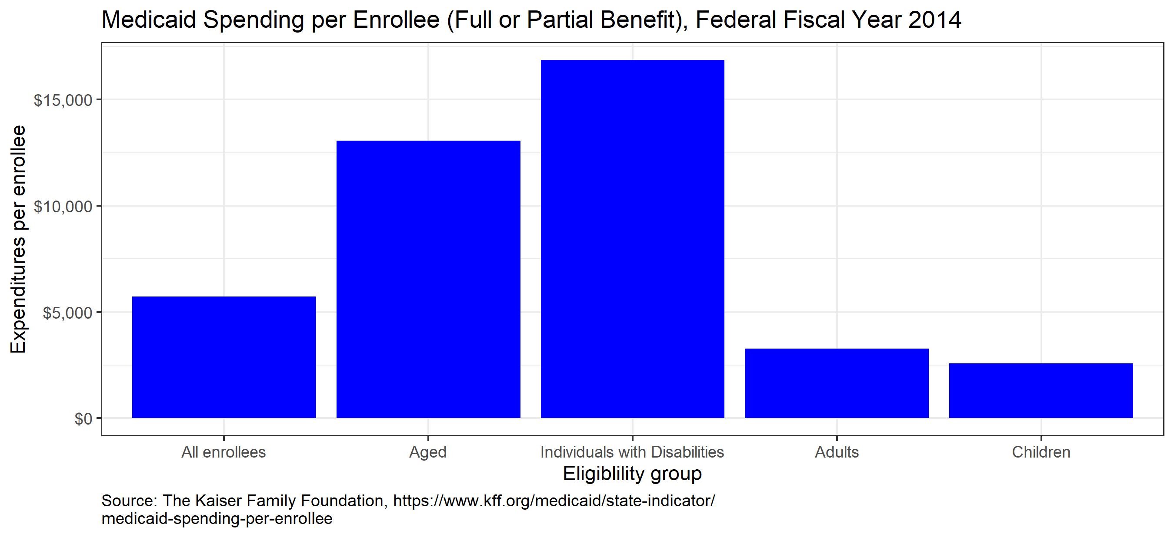
Medicaid spending for the aged is high

Slide 22
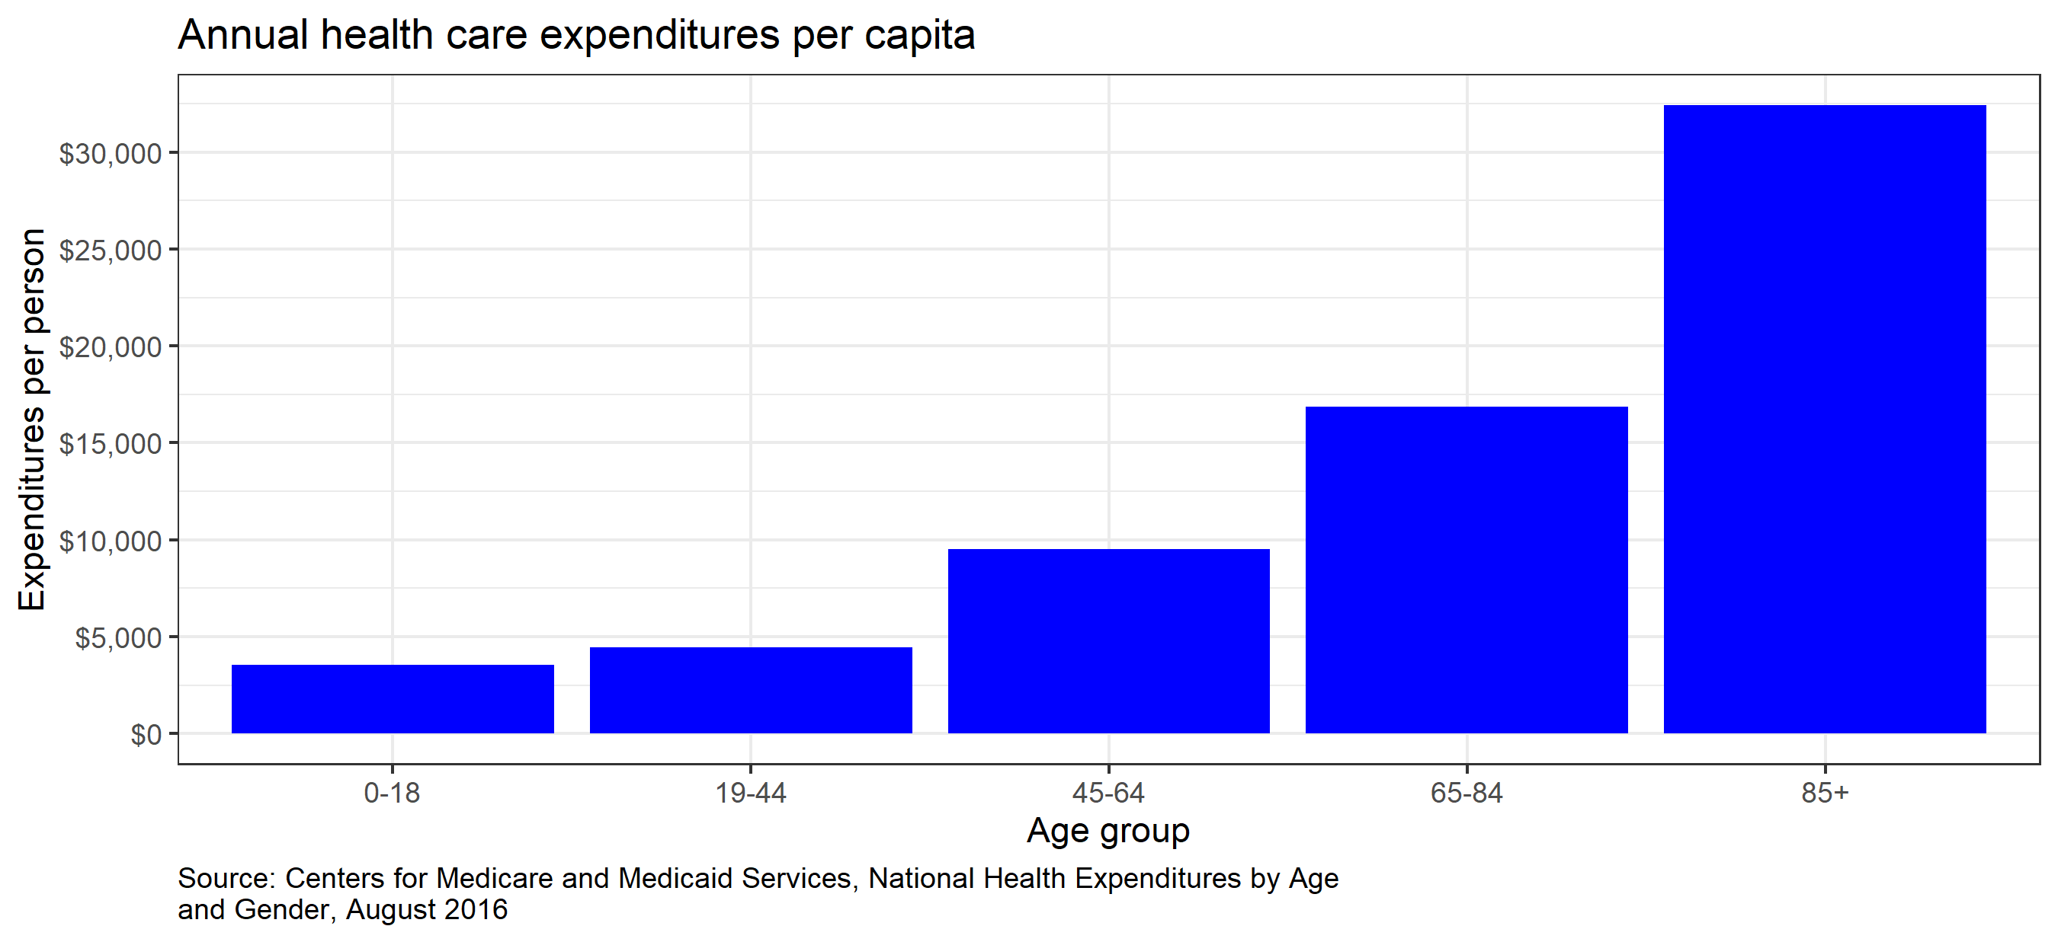
It is an issue for the general population, too

Slide 23
Voting behavior: The gray peril?
Will older voters support taxes for services that do not benefit them directly? Research suggests this is a nuanced issue.
Research has taken the form of:
Statistical analyses of older vs. younger communities
Statistical analyses of voter referenda
Opinion surveys
The issue appears to be real, but:
Not generally large, not the same everywhere
Appears to vary between longstanding residents and newcomers
Longstanding older residents may be a source of support
Older newcomers may not be
Tax policies such as state-financed property tax relief may offset the effect

Slide 24
Quantifying impacts with illustrations from case-study states

Slide 25
General approach (see appendix)
State population projections – Weldon Cooper Center, UVA
Income tax
How much lower would state income tax be with expected 2040 age-distribution than with 2020 distribution, all else equal including pop. size?
How fast would income tax grow between 2020 and 2040?
Sales tax
How much lower would state sales tax be with 2040 age-distribution than with 2020 distribution, all else equal including pop. size?
How fast would the sales tax grow?
How large are combined income and sales tax impacts relative to own-source revenue?

Slide 26
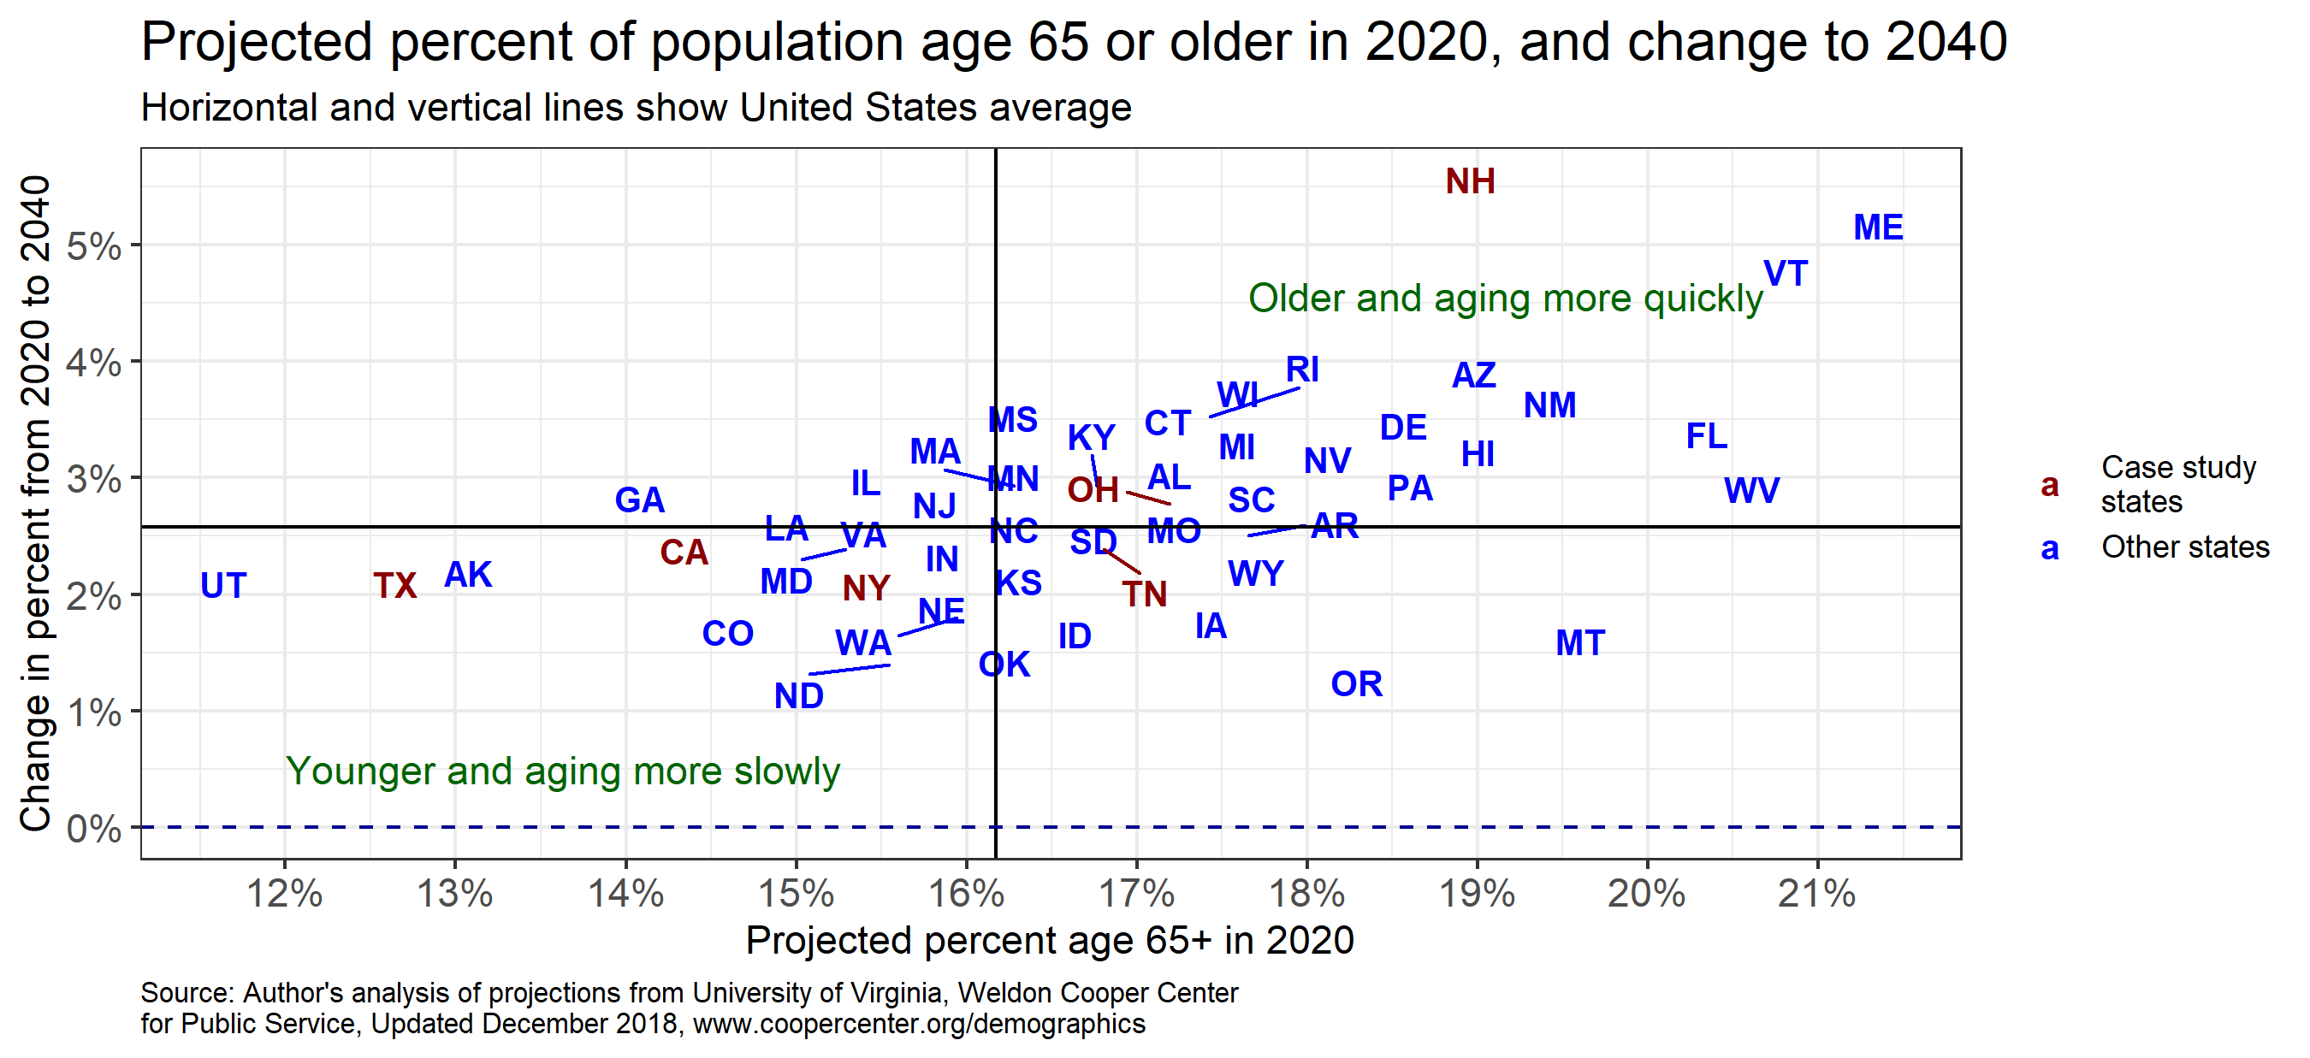
Great variation across states

Slide 27
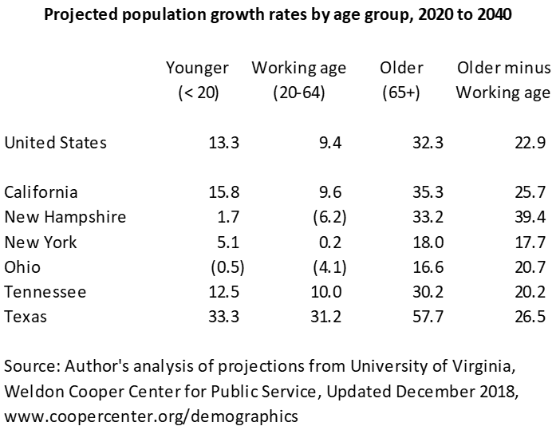
Note the outright declines in working-age population in NH and OH.

Slide 28
Note that far more aging (by this measure) occurs between 2020 and 2030 than between 2030 and 2040.

Slide 29
Widely varying revenue structures

Slide 30
Example: PIT results for Ohio
44% diff

Slide 31
Example: Sales results for Ohio
20% drop

Slide 32
Income tax summary

Slide 33
Sales tax summary

Slide 34
Income and sales tax per-capita effects vs own-source revenue

Slide 35
Aging fiscal impacts - conclusions
Negative impacts on major state tax revenue sources:
Income and sales taxes both lower than otherwise would be
Income tax impact larger than sales tax impact
States with slow-growing or declining populations could face outright declines in tax revenue (e.g., Ohio).
But changes seem small compared to sharp-sudden recessionary changes
E.g., CA single-year recessionary income tax decline in 2009 was 20.4%; OH was 15.5%; sales tax declines more modest but still significant
Aging-driven declines of 3 to 3.5% over 20 years seem small in comparison
Still, aging-related weakness comes on top of other state challenges, and states should monitor and plan
Aging-related spending pressures (e.g., Medicaid, services for elderly), and potential relief in the case of K-12 education, could be as large or larger than tax impacts, and merit monitoring and planning as well.

Slide 36
Autonomous Vehicles

Slide 37
William Fox of UTN examined potential impacts of autonomous vehicles
In a project for Pew Charitable Trusts:
I looked at population aging
Bill looked at autonomous vehicles as an example of how to think about technological change more generally.
Unlike demographics, where it is possible to make reasonable forecasts, technology development and adoption is far less certain, and alternative scenarios are crucial.
We examined the same case-study states
Slides that follow are based on his work, with permission. For additional details, please contact Bill.

Slide 38
Autonomous vehicles – key questions
What technology will be used in AVs?
How rapidly will they be adopted?
How many are necessary to replace internal combustion engines?
How will vehicle miles traveled (VMT) be affected?
Analysis assumes AVs will convert the U.S. to a regime of electric, shared fleet-owned vehicles
Beginning in the 2020s
Over a period of 3-4 decades

Slide 39
Potentially affected employment
Vehicle manufacturing
E.g., vehicle assembly, parts manufacturing
Currently 0.7% of U.S. employment
Shared fleet-owned AVs will require fewer vehicles, but VMT may rise
More electric; more software relative to hardware than traditional vehicles
Likely to lower manufacturing employment & alter its location
Vehicle support
E.g., repair, sales, financing, insurance, …
Nearly 4% of U.S. employment
Motor-vehicle-using occupations
E.g., MV operators such as truck drivers, taxi, first responders, delivery drivers
11.5% of U.S. employment
Tasks needed will change; some changes could increase employment, some could lower employment

Slide 40
Vehicle-related transportation employment is 1/6th of U.S. total
Sources: Quarterly Census of Employment and Wages, Occupational Employment Statistics, U.S. Bureau of Labor Statistics

Slide 41
Linkages to tax revenue
Taxes directly imposed on transportation, such as taxes on:
Motor fuel
Road use
Vehicle purchase, registration, or ownership
Drivers
Vehicle support services
Taxes indirectly linked with transportation-related industries, such as income, sales, and corporate taxes associated with earnings and production in vehicle-related industries & occupations (not estimated in the analysis)

Slide 42
Simulated potential impacts in 6 states, under alternative scenarios
Most direct transportation taxes are inelastic relative to economy even before considering tech changes, and shrinking as a share in baseline
Direct taxes generally will be reduced vs. baseline because many transport taxes are designed around internal consumption and personal ownership.
Impacts vary depending on AV scenario and state tax structures. Fuel tax revenue erodes more than vehicle-based tax revenue.
“Aggressive” scenario (electric vehicles fully replace internal combustion, & only half as many are needed): simulated reductions in total revenue by 2040 of 2% vs. baseline (NY) to 9% (TX).
Reductions were ~60-75% of transportation revenue – important given dedicated funding.

Slide 43
Potential reform options
Expanding sales taxes to all forms of mobility (include in general sales tax or tax at a selected rate)
Levying VMT taxes
Imposing congestion charges
Combinations of options and the current tax system

Slide 44
Conclusions and lessons

Slide 45
Conclusions and lessons
Population aging and AV adoption likely will reduce state & local tax revenue, and may create spending pressures
Impacts likely non-trivial but not as large as sudden impacts of recessions
Demographic impacts easier to predict than technological shifts
Scenario analysis & monitoring especially important for technological shifts
Effects will roll out over time, allowing some time for planning and adjusting
Tax structures NOT well-designed to adapt to these changes. Policy changes will be needed if avoiding revenue loss is important.
Opposition to reforms may have built-in growth – as time or tech adoption advances, relatively more older voters, relatively more businesses engaged in AVs

Slide 46
Appendix

Slide 47
State population projections
Census Bureau last released state projections by age group in 2005. Private forecasts (e.g., Moody’s), if available, are expensive.
I used December 2018 50-state population projections, by age group, from the Weldon Cooper Center, University of Virginia. They are widely used.
Methodology is the Hamilton-Perry approach. Low data demands. Does not consider migration explicitly. Tends to do quite well in 10-year forecasts.
States’ own forecasters tend to use the cohort-component method – more detailed, greater data demands, considers migration explicitly. (OTOH, very hard to predict migration patterns, and states’ current projections may not be keeping up with policy changes….)
I have now acquired states’ own projections for all 6 case-study states. They appear to show somewhat faster aging, primarily in CA, NY, NH. I should be able to update numbers to reflect these forecasts. I don’t think they will have a meaningful impact on conclusions.

Slide 48
Income tax methodology
Estimate average state income tax by age group, CPS (2017-2018)
Using these averages, calculate total income tax by age group and in total, using 2020 expectations and 2040 projections of age distribution.
Calculate % change in tax revenue due solely to the change in age distribution, keeping the total population fixed.
This is based upon the methodology in Felix, Alison, and Kate Watkins. “The Impact of an Aging U.S. Population on State Tax Revenues,” 2013, 34.
Also compute % change in income tax from 2020 to 2040, taking into account the projected change in population, but not changes in prices (i.e., growth is in real dollars).

Slide 49
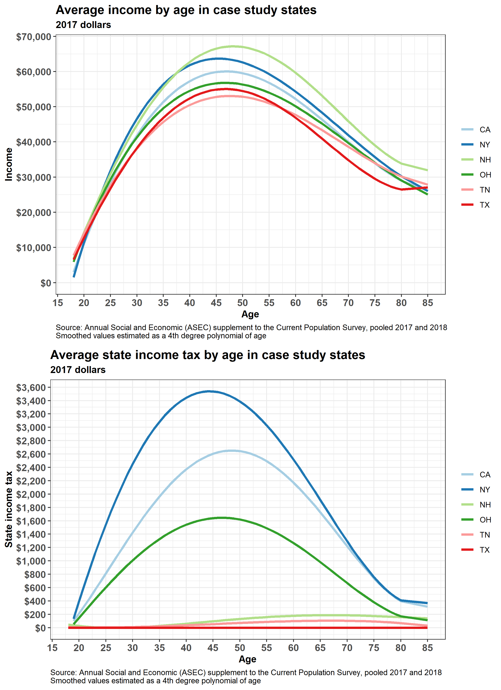
Income tax – underlying data
These graphs show the key source data in the income tax analysis, for 2017. Top panel is income by age, bottom panel is income tax.
Income taxes are large and fall off significantly with age in NY, CA, and OH. They are trivial in NH, TN, TX . (In TN the tax is being phased out.)
The methodology combines these data with projected population changes.

Slide 50
Example: PIT results for California
15% diff

Slide 51
Example: Sales results for Texas
18% drop

Slide 52
Sales tax methodology
Estimate average state-taxable sales by household-head age groups (CEX 2017) using state-specific estimates of which items are taxed and which are not (multiple sources, including Federation of Tax Administrators 2017 Sales Taxation of Services and analysis by the Tax Foundation).
Using these averages, calculate taxable sales by age group and in total, using 2020 expectations and 2040 projections of age distribution, after adjusting for the fact that the CEX age groups are by age of household head, and population projections are by age of person.
Calculate % change in taxable sales due solely to the change in age distribution, keeping the total # of households fixed. ASSUME that the full sales tax is affected in this way (in other words, sales tax on business purchases is passed through to consumers).
This also is based upon the methodology in Felix & Watkins (2013).
Also compute % change in taxable sales from 2020 to 2040, taking into account the projected change in population and households, but not changes in prices (i.e., growth is in real dollars).

