Slide 1
Public Pension Management Tools in Action
National Conference of State Legislatures Fall 2020 Fiscal Webinar Series
October 29, 2020
Don Boyd*, Gang Chen**, and Yimeng Yin***
The State and Local Government Finance Project
Center for Policy Research, Rockefeller College, University at Albany
*Co-Director (dboyd@albany.edu);
** Co-Director and Associate Professor (gchen3@albany.edu)
*** Economic Researcher and Modeler (yyin@albany.edu)

Slide 2
Major risks to pension funding
Investment returns
Government ability to pay contributions
These risks are correlated
Both are worrisome in the Covid-19 environment
Some risk- and cost-sharing policies can lower the investment-return risks to the employer
Stress-testing government finances and pension finances can help identify and manage the fiscal risks

Slide 3
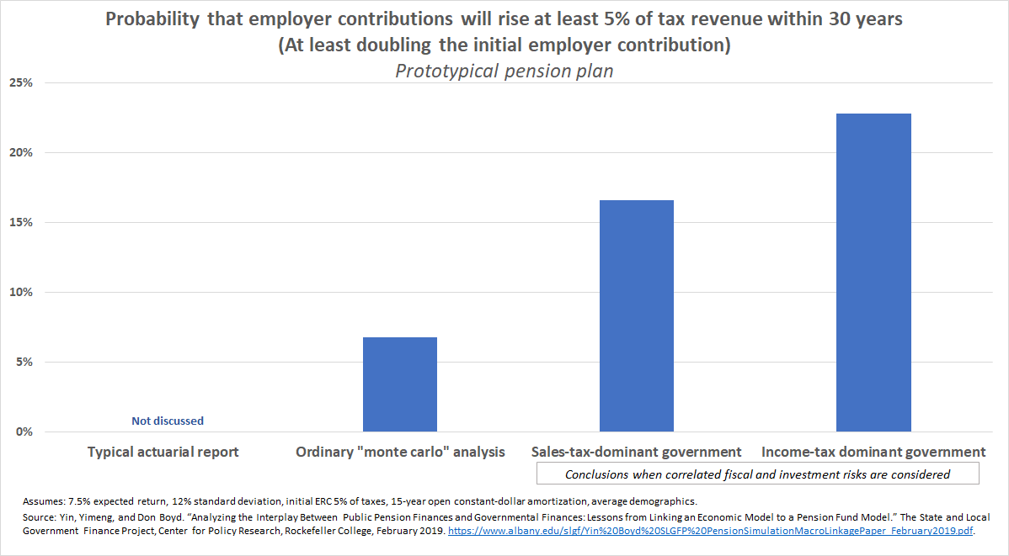
Notes:
Mention support of Arnold Foundation and Pew for this work.

Slide 4
Investment return risks in the Covid-19 era
Crash then recovery for plan fiscal years ending in June 2020:
Milliman market value funded ratios 100 largest public plans:
74.9% Dec 2019
66.0% !! crash (Mar 2020)
71.2% Jun 2020
Pew estimates typical returns fell 4-5% short in year ending June 2020 - bad but not catastrophe
S&P 500 up ~5.5% since June despite recent declines
But risks abound:
Near-term Covid-19 and econ downsides (next section)
Low interest-rate environment (Sheiner, Lenney, Lutz) appears here for a long time
Plans ~70+% invested in risky assets. Unless they lower return assumptions, they need to be.
Public plans perched on a precipice.

Slide 5
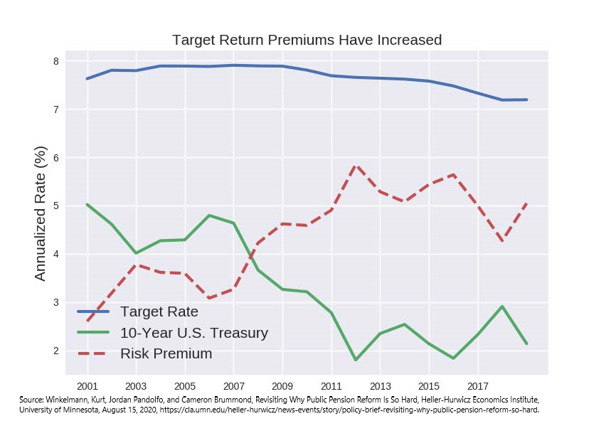
Low interest rates require lower assumed returns or more investment risk (or beat-the-market skill)
Decline in risk-free interest rates (green line), coupled with...
Only minimal decline in assumed returns (blue line), means...
Plans must seek a large risk premium (maroon dashed line), by…
Investing in riskier assets, and…
Risking both much better and much worse outcomes

Slide 6
Tax revenue risks
Economic news, while awful has been better than worst early estimates. Labor market better than expected. Stock market has not collapsed.
State tax revenue in Covid-19 period (Mar-Aug 2020) down 3.6% in median state vs. year ago. PIT -1.3%, sales tax -2.6%, corporate -10.8%.
Moody’s Analytics alternative severe scenario: biggest factors are (1) Covid-19 resurgence and lockdowns, (2) no fiscal stimulus; both seem quite realistic. They estimate combined state-local revenue-Medicaid shortfall over 2020-2022 of $450b in baseline, $650b in severe.
Major related risks: timing and effectiveness of vaccine, stock market
Hard policy choices after fiscal stimulus resolution known. Pension benefits and contributions will be on the table. (S&L contributions currently ~$170b annually.)
Sources: Economic Forecasting Survey, Wall Street Journal, https://www.wsj.com/graphics/econsurvey/; White, Dan, U.S. State and Local Government Shortfall Update, Moody’s Analytics, September 21, 2020; Dadayan, Lucy, Monthly State Revenue Highlights and State Tax and Economic Review, various issues, Urban Institute, 2020; Bureau of Economic Analysis, National Income and Product Accounts, Table 7.24. Transactions of State and Local Government Defined Benefit Pension Plans.

Slide 7
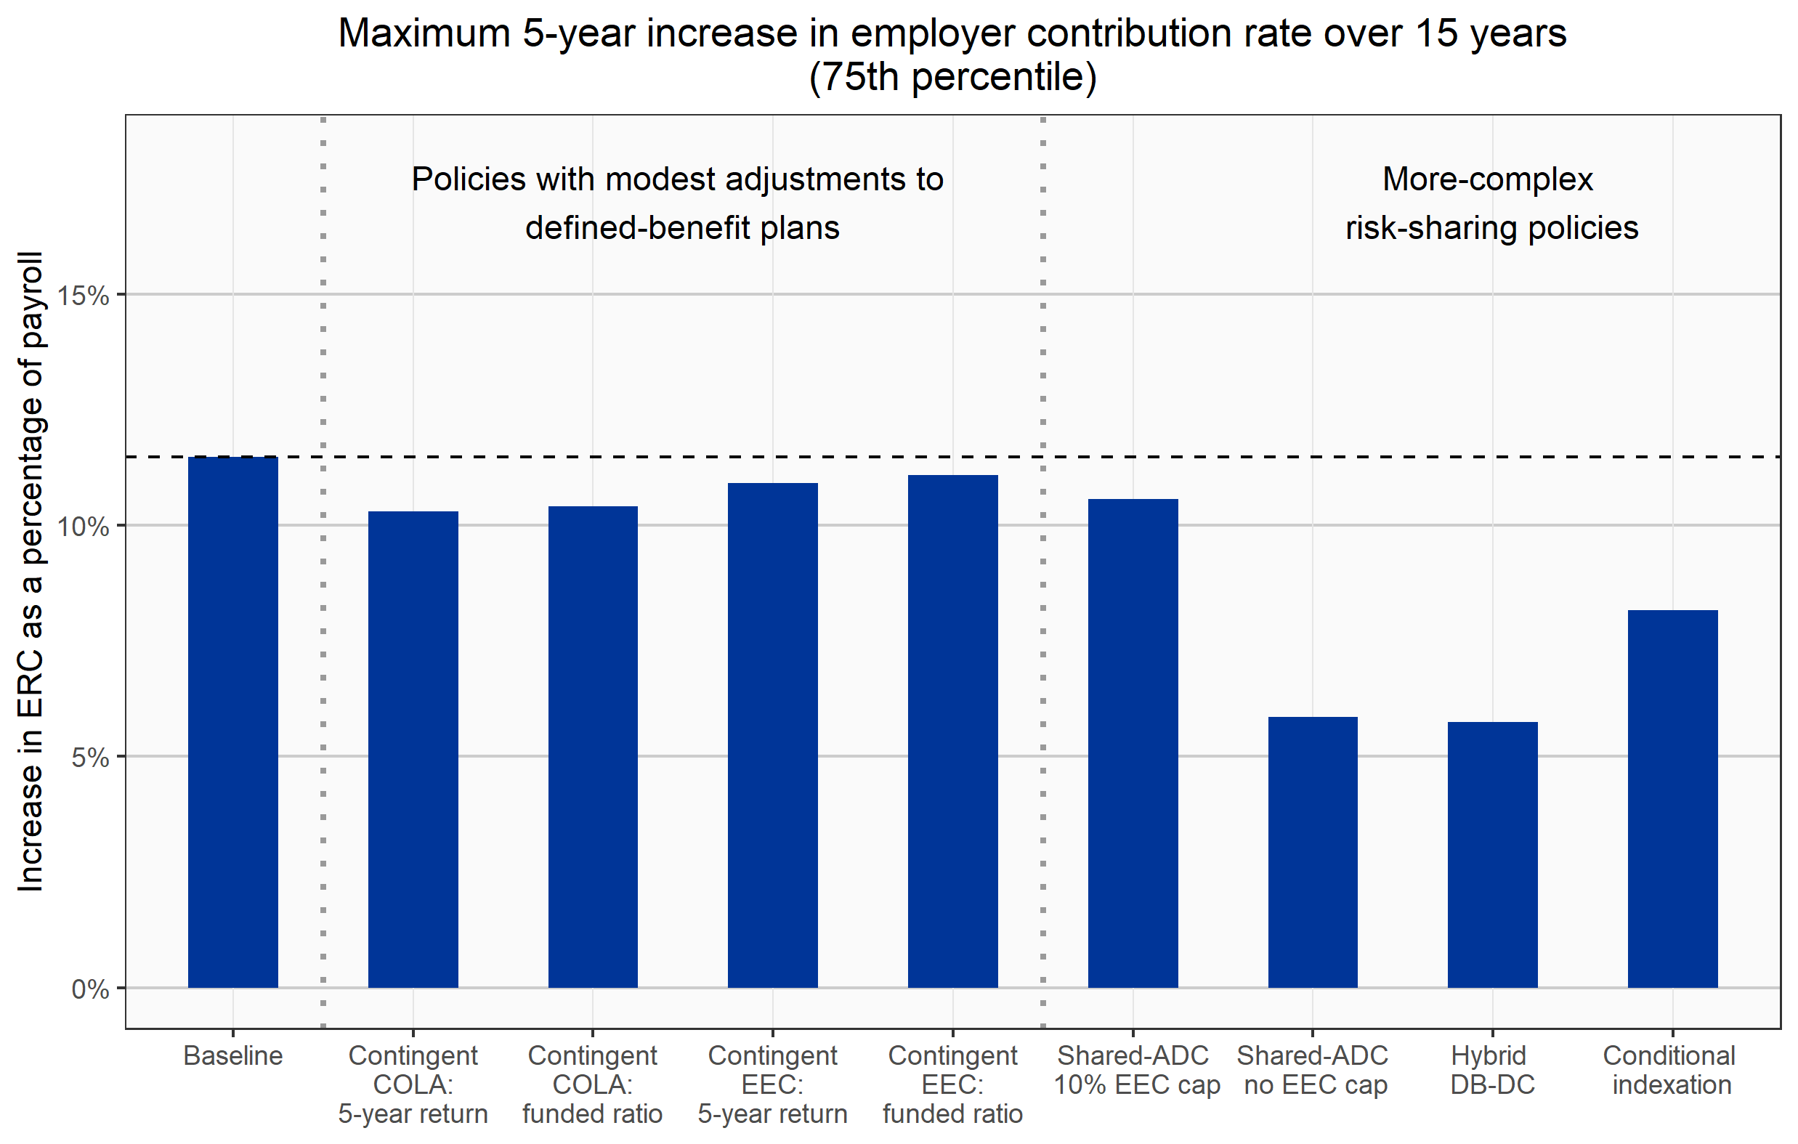
Risk-sharing policies can provide meaningful protection
Some contingent COLA and employee-contribution policies, when fully effective, can reduce risk of large employer contribution increases.
More-complex or -radical policies can achieve greater risk reduction.
Important to remember that risk-sharing means risk-transfer.
Motivating factor for introducing risk-sharing often is immediate cost reduction.
Plan is assumed to be 75% funded at beginning of simulation.
Notes:
Mention that SDRS-like is not on here but say a bit about it.

Slide 8
Conclusions
States and localities face major economic, fiscal, and pension investment risks. They are correlated in ways that exacerbate fiscal pressure.
Public plans are poised to be hit hard if markets fall.
Some risk- and cost-sharing policies can transfer meaningful risk and cost from employers to plan members. They need to be evaluated from multiple perspectives including impact on employer attractiveness.
Stress testing can help identify and manage fiscal risks and pension risks.
Better to have these procedures and policies in effect before downside risks occur than wish so afterward.
Stay tuned for our Arnold Ventures-supported guidebook on risk-sharing and for work with and for the Pew Charitable Trusts on these issues.

