Slide 1
The Public Pensions Crisis
Ravitch Fiscal Reporting Program
Craig Newmark Graduate School of Journalism, CUNY
Staybridge Suites, Times Square
New York, NY
June 9, 2021
Don Boyd, Co-Director
State and Local Government Finance Project, Center for Policy Research
dboyd@albany.edu; slides at github.com/donboyd5/slides

Slide 2
Questions
What are defined benefit pension plans?
What’s the problem?
Why do we have a problem?
How big is the problem? Where are problems biggest?
What can state and local governments do?
What will happen next?
What are some good information sources? (EMMA!)

Slide 3
What are defined benefit pension plans?

Slide 4
What is a defined benefit?
The typical defined benefit pension is calculated as follows:
Step 1: # of years worked (called “years of service”)
x
Step 2: “benefit factor”
x
Step 3: a measure of pay (usually related to late-career salaries)
Example: Mary Smith retires after 20 years, 2% benefit factor, $60,000 final salary:
Pension = 20 years x 2% x $60,000 = 40% x $60,000 = $24,000 annually until death
Usually there are complexities: vesting rules, salary averaged over several years, alternative benefit calculations, survivorship benefits, COLAs, etc. But this is the essence of it. The benefit is defined, and required contributions will depend upon benefits and investment earnings. By contrast, if contributions are defined, benefits will depend upon contributions plus investment earnings. (There are hybrids, too.)

Slide 5
State & local defined benefit plans
14+ million workers, 6+ million retirees
> 6,000 plans; 170 large plans have 90% of assets
$4.8 trillion invested assets
$169 billion gov’t contributions annually
About 50% greater than roads/bridges capital spending
About 20+% of K-12 spending
About 8.5% of all taxes (was 4.6% in 2000)
Sources: Census, PPD, FRB, BEA. Details available on request.

Slide 6
Which governments do what?
Varied administrative arrangements:
State-run systems, state and local workers (e.g., CalPERS, NYSLERS)
City and county locally-run plans, local workers (NYCERS; Chicago; etc.)
State-run plans, multiple municipalities (Illinois IMRF)
Varied contribution arrangements:
State contributes for state workers in state-run system (common)
State contributes for local gov’t workers in state-run system (NJ)
Local gov’t contributes for local workers, state-run system (NYSLERS)
Local gov’t contributes for local workers, locally-run system (common)
Greatly varying benefit levels and legal protections for benefits

Slide 7
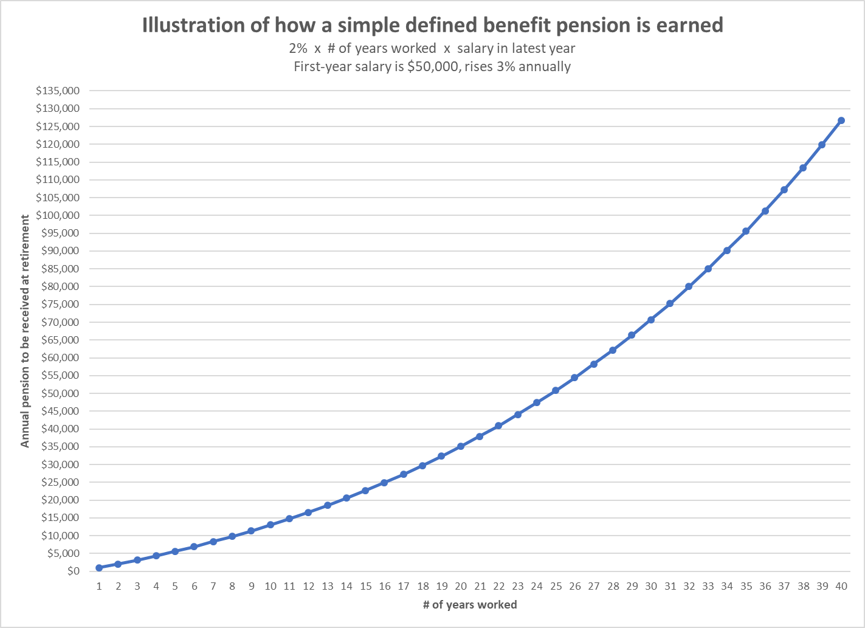
Benefits earned in a backloaded manner
Pensions increase significantly as careers lengthen – incentive to stay one more year.
Workers who leave early don’t get much.
If you cut the rate at which benefits will be earned for future service, it’s a big cut in expected pension for the current worker. (Think California Rule.)
If pensions were funded the way they are earned, contributions would have to rise as % of pay during worker’s career → Risky.

Slide 8
Why prefund pensions?
Current generation pays for services they receive.
Money is there to pay benefits when due. Legal protection vs. funding protection.
If strong legal protection, maybe workers and unions don’t need strong funding protection? Or does drastic underfunding create pressure to weaken legal protection?
Note: Some academics argue that full funding may not be the “right” policy. Dangerous, given real-world politics.

Slide 9
What’s the problem?

Slide 10
Usually governments, not workers, bear pension risk
If plan investments fall short, the government must increase contributions.
That means taxes must go up or spending on services, infrastructure, etc. must decline.
Many incentives encourage plans and governments to assume high investment returns and take investment risk. Other bad incentives, too.
The risks have not worked out well. Assumptions remain risky.

Slide 11
What is an unfunded liability?
The difference between:
Amount owed for benefits already earned* by current workers and retirees, and other past workers
and
Amount set aside for these benefits (assets)
* Policy implications?
Public plans measure these amounts differently than economists and the rest of the financial world.

Slide 12
Technical: What is an unfunded liability?
Actuary forecasts future benefit payments for current workers and retirees
Estimates present value of future benefits, using discount rate
Apportions present value: (a) amount already earned (Accrued Actuarial Liability, AAL), and (b) amount to be earned with future service.
Accrued Actuarial Liability minus “Actuarial Assets” equals
Unfunded Accrued Actuarial Liability (UAAL):
UAAL = Actuarial liability – Actuarial assets
What’s in this UAAL? What isn’t? Policy implications?
Notes: (1) more detail in appendix; (2) accounting terminology is different from actuarial terminology.

Slide 13
Why do we have a problem?

Slide 14
Bad incentives and no police
Attractive for 2- & 4-year elected officials to push costs to future. Institutional environment allows and encourages this.
Laws often are one-way streets: Governments can increase but rarely can reduce benefits. (Some exceptions.)
Unlike private plans, public plans not subject to ERISA and related federal laws; no federal funding requirements or minimum-contribution rules
Weak accounting standards compared to private. Unlike FASB:
GASB requires discount rate assumption based on plan’s own portfolio (incentive!)
No SEC oversight of accounting.
Governments effectively can veto appointments to the GASB board that oversees them.
Actuarial Standards Board guidance allows latitude and plans use it!
Congress has no role (so far) and is chary; Tower Amendment.
States can impose rules on local plans; hard to impose rules on themselves.
GASB = Governmental Accounting Standards Board; FASB = Financial Accounting Standards Board (for private sector accounting)
ERISA = Employee Retirement Income Security Act

Slide 15
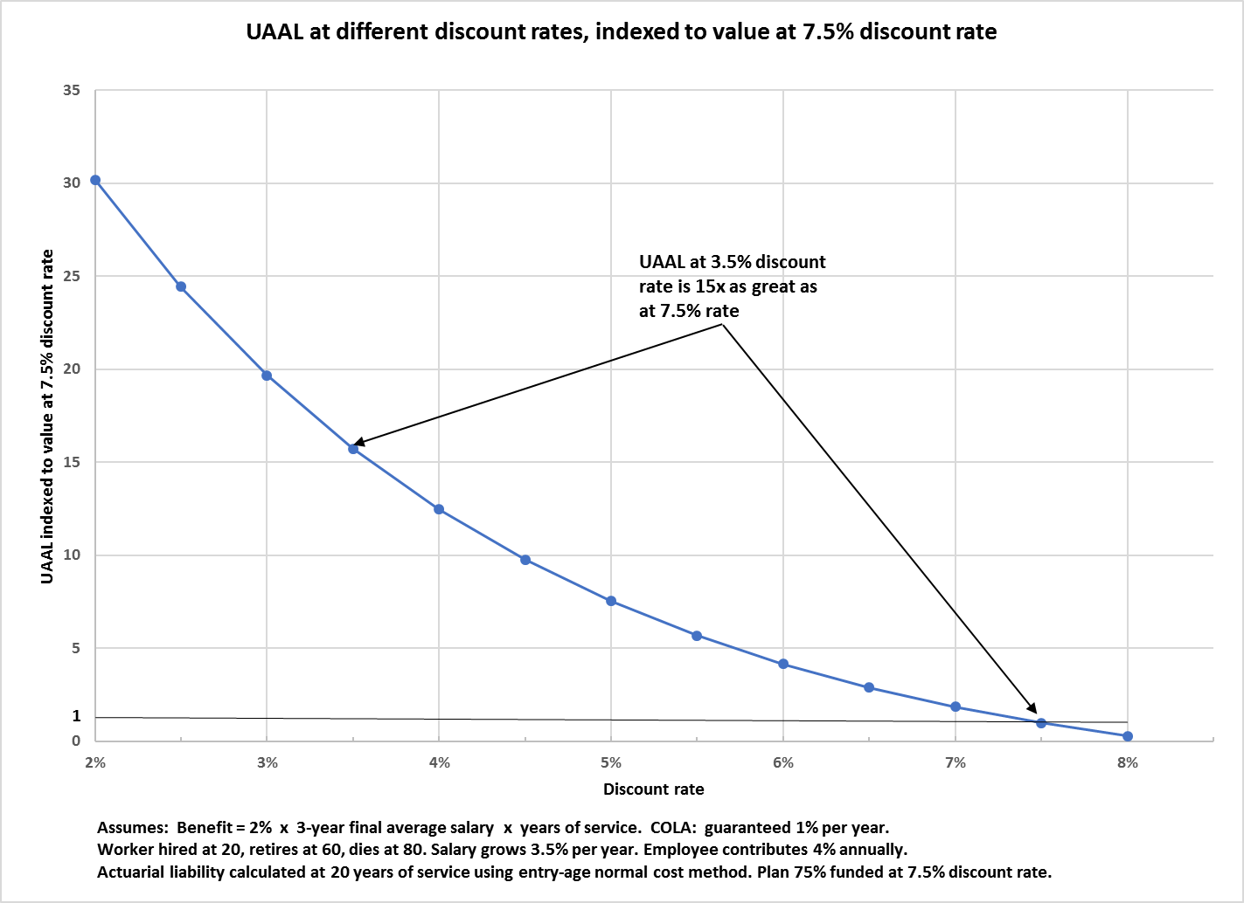
Higher discount rates → much better (reported) funded status

Slide 16
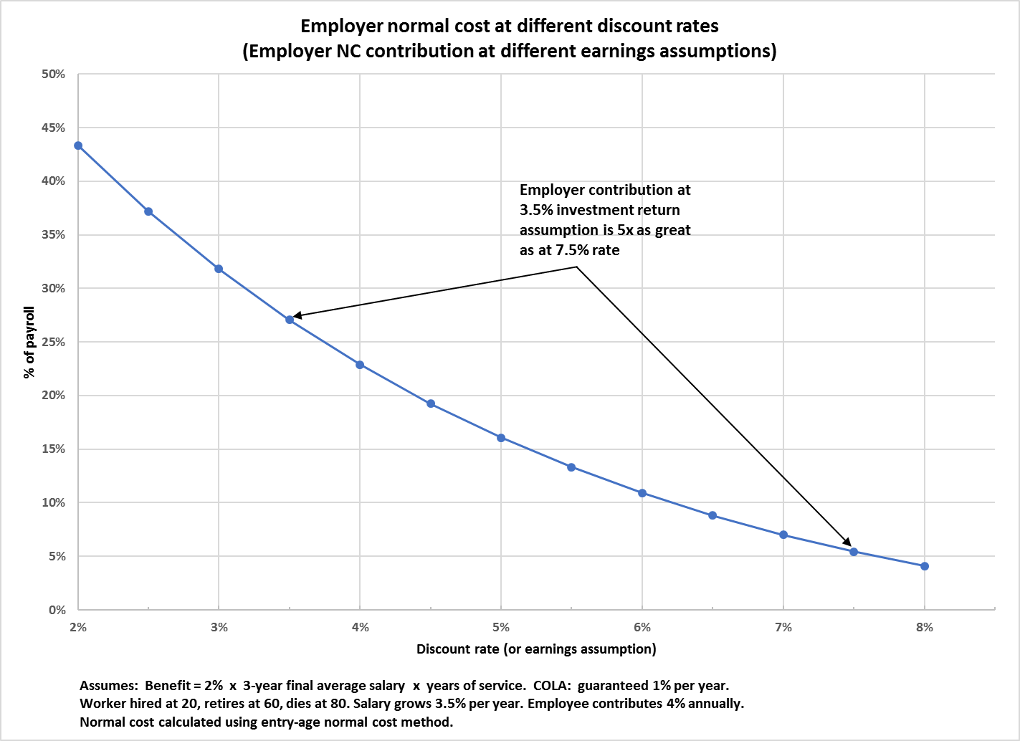
Higher assumed investment returns → much lower contributions

Slide 17
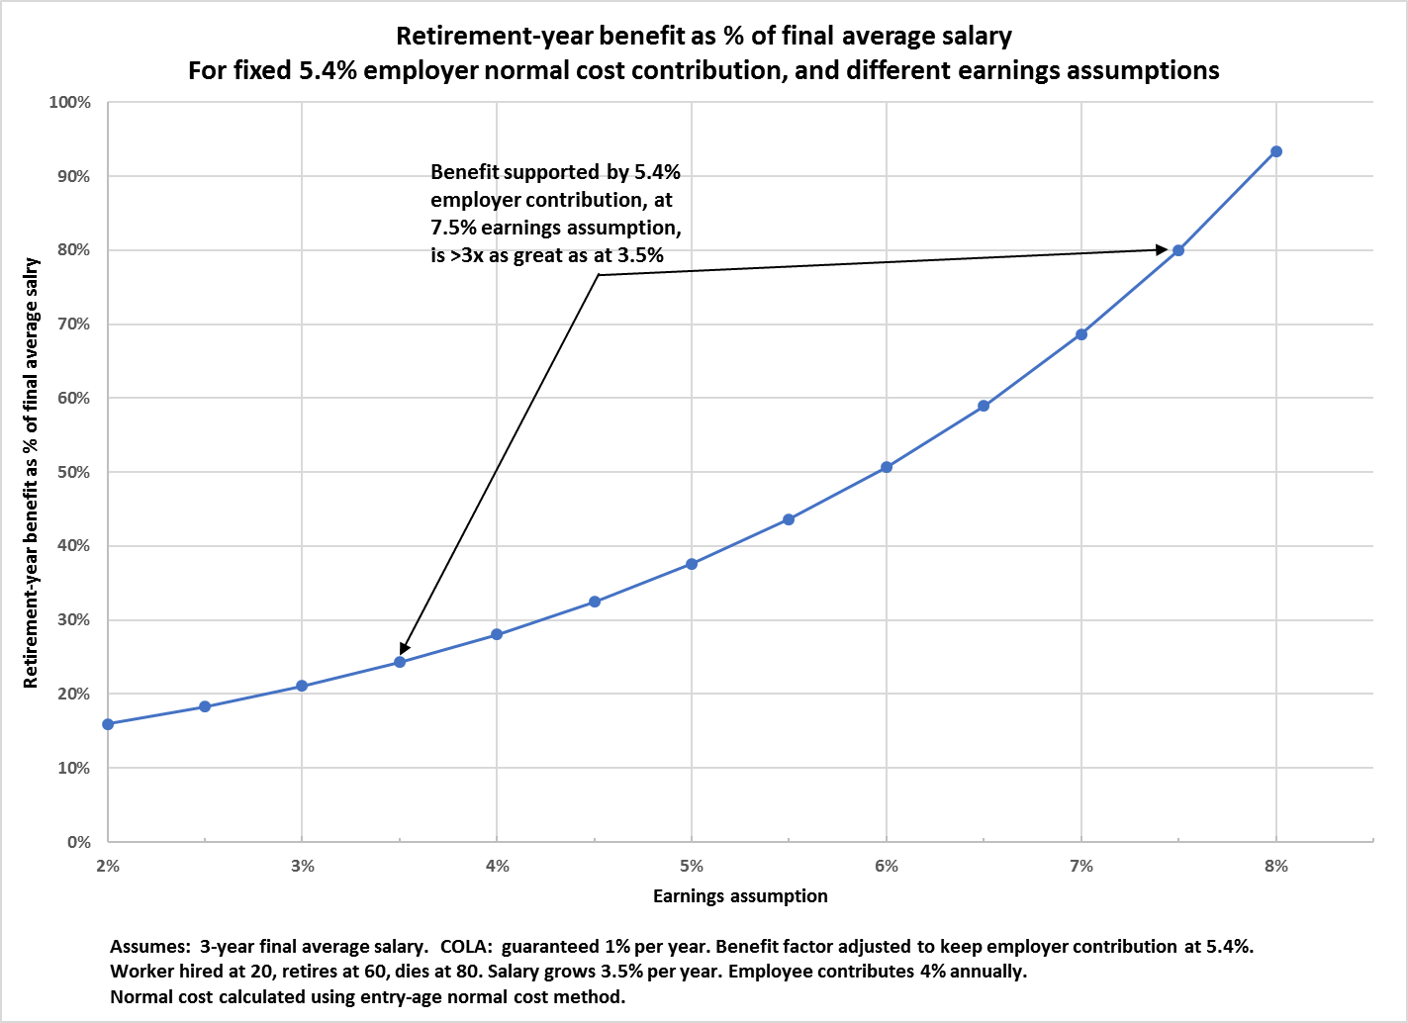
Also → Can offer higher benefits for a given contribution level

Slide 18
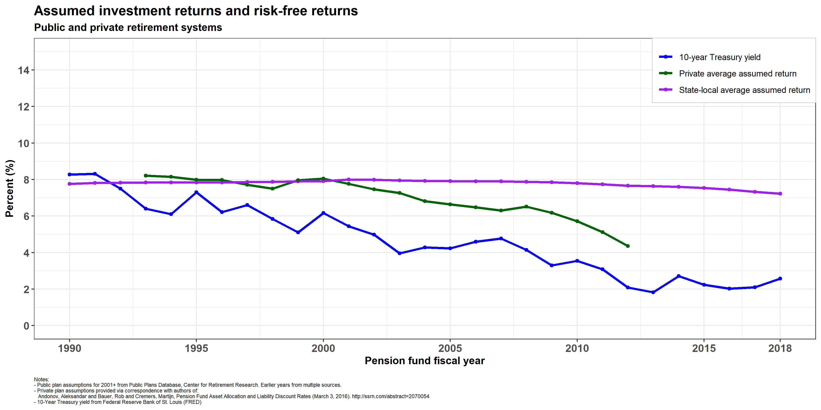
Public plans have lowered return assumptions only slightly in response to declining risk-free rates

Slide 19
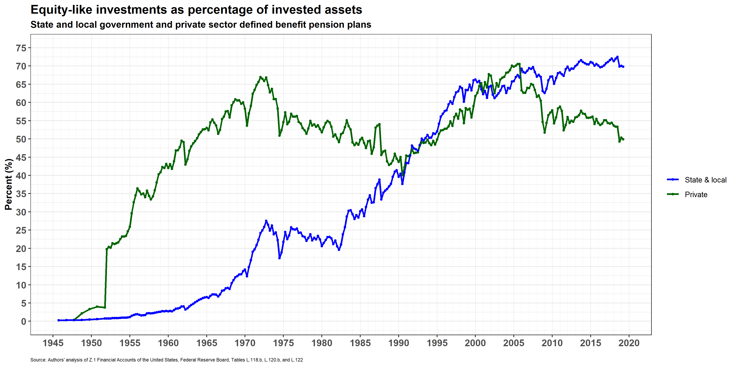
Public plans are increasingly invested in equity-like assets

Slide 20
Risk has increased relative to government budgets

Slide 21
U.S. public plans, with unique regulatory environment, have increased risk. Other plans have not.
Important paper: Andonov, Bauer, Cremers (2017). Examines, among other things, how U.S. public plans, private plans, and Canadian/European plans responded to Treasury rate declines.
Their statistical analysis shows that other plans reduced discount rates as market rates declined, but not U.S. public plans.
“U.S. public pension funds have become the biggest risk-takers among pension funds internationally”

Slide 22
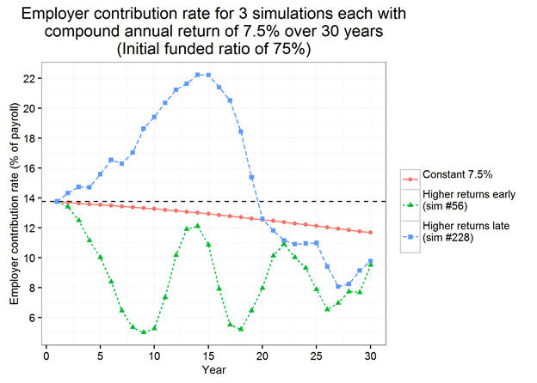
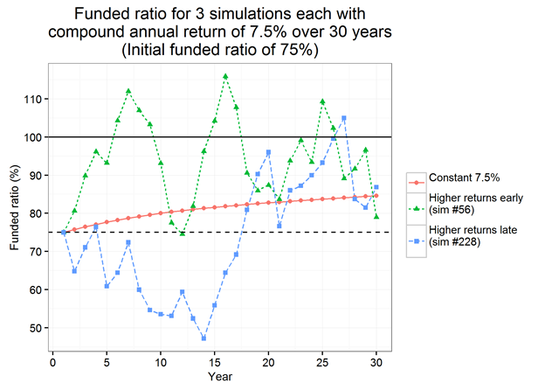
Even IF assumptions are correct, a roller coaster path
Three individual simulations, all with 7.5% discount rate & 30-year 7.5% compound annual returns.
Deterministic run: constant returns
Stochastic run: high returns in early years
Stochastic run: low returns in early years
People (politicians) interact with this system:
Will they support 50+% contribution increases?
Will they refrain from benefit increases and gimmicks if plan funding shoots above 100%?
And this is when return assumptions are met at 30 years. Most times, things will be better or worse than assumed.
Employer contribution rate
Funded ratio

Slide 23
How big is the problem?

Slide 24
Basic facts – underfunding
Controversy about how to measure liabilities
Per Federal Reserve Board 2020q3 unfunded liabilities were $4.3 trillion. By contrast public plan estimates are ~$1.5-2 trillion.
Great variation around country in extent of underfunding

Slide 25
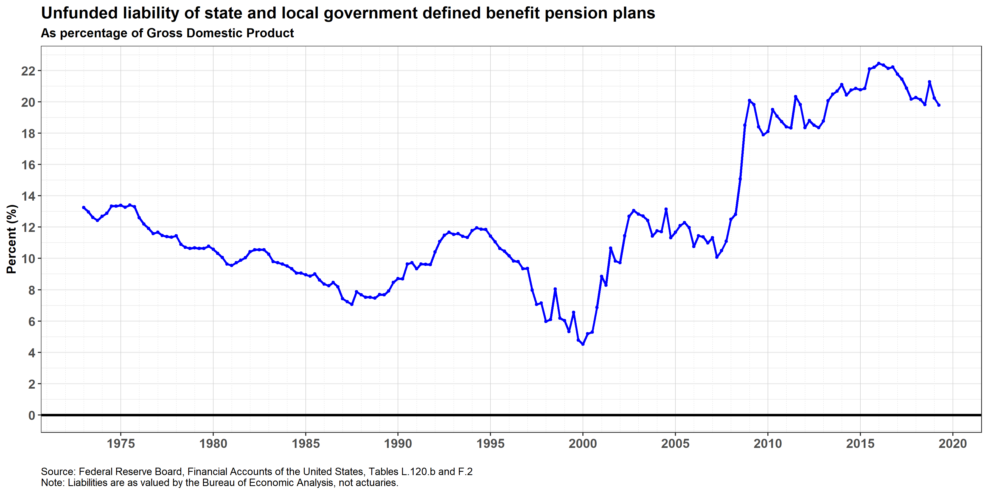
Despite contribution increases, unfunded liabilities are near record relative to economy

Slide 26
What does it take to tread water?
Tread water: Keep things from getting worse, i.e., keep unfunded liabilities from growing.
Requires contributions to cover costs of:
New benefits earned with a new year of service (the “normal cost”), plus
Interest on unfunded liability.

Slide 27
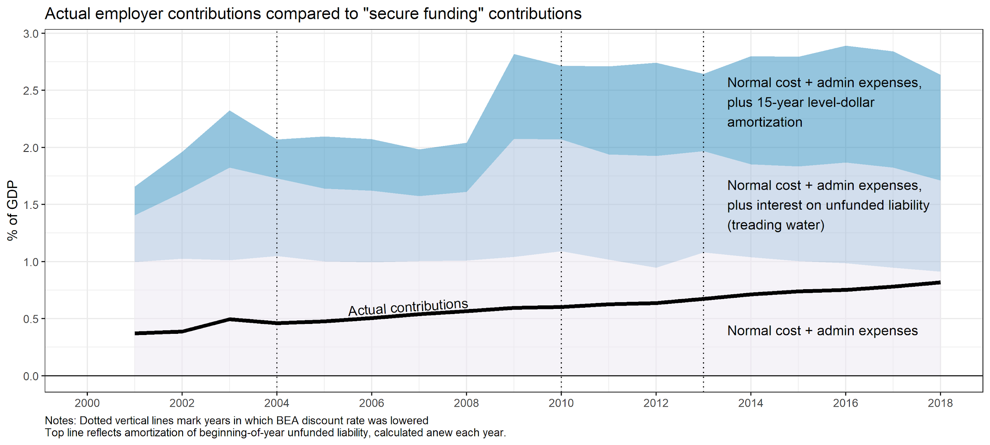
Huge gap between employer contributions and “secure funding”
Treadwater
gap – almost 1% of GDP

Slide 28
Where are problems the biggest?

Slide 29
Multiple overlapping underfunded plans must be funded by the same economic and tax base
For example, Illinois taxpayers (largely) must pay for multiple underfunded plans:
Illinois Teachers’ Retirement System
State Employees’ Retirement System
State Universities Retirement System
Chicago-area funds: Municipal Employees, Laborers’, Police, Firemen’s; Chicago Public Schools; Cook County Employees’; Chicago Transit Authority
Many lesser funds in the Chicago area and throughout the state, most of which are deeply underfunded
BEA data allow this. It is a valuable way to compare across states.
(It would be nice - but much harder still - to do this for smaller geographic areas.)

Slide 30
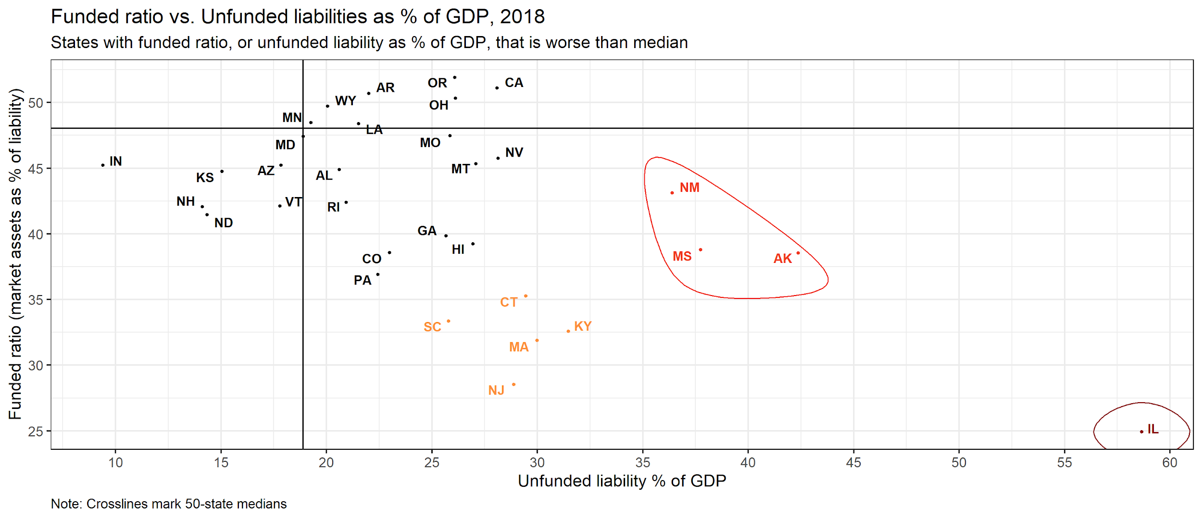
Comparing to the economy can be more revealing than simply looking at the funded ratio

Slide 31
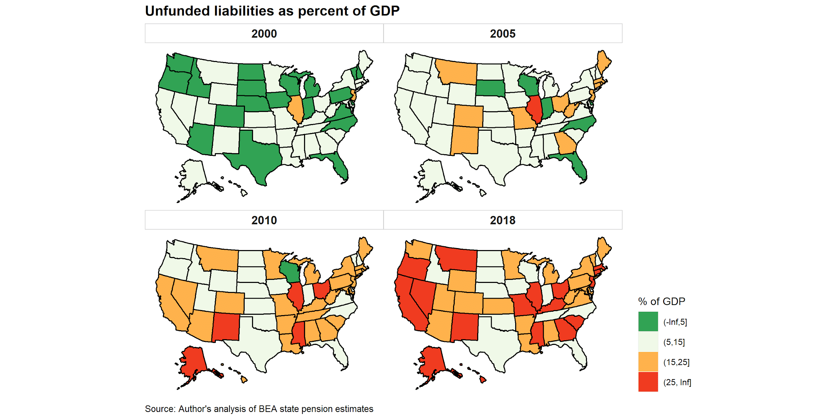
Unfunded liabilities have grown in most states

Slide 32
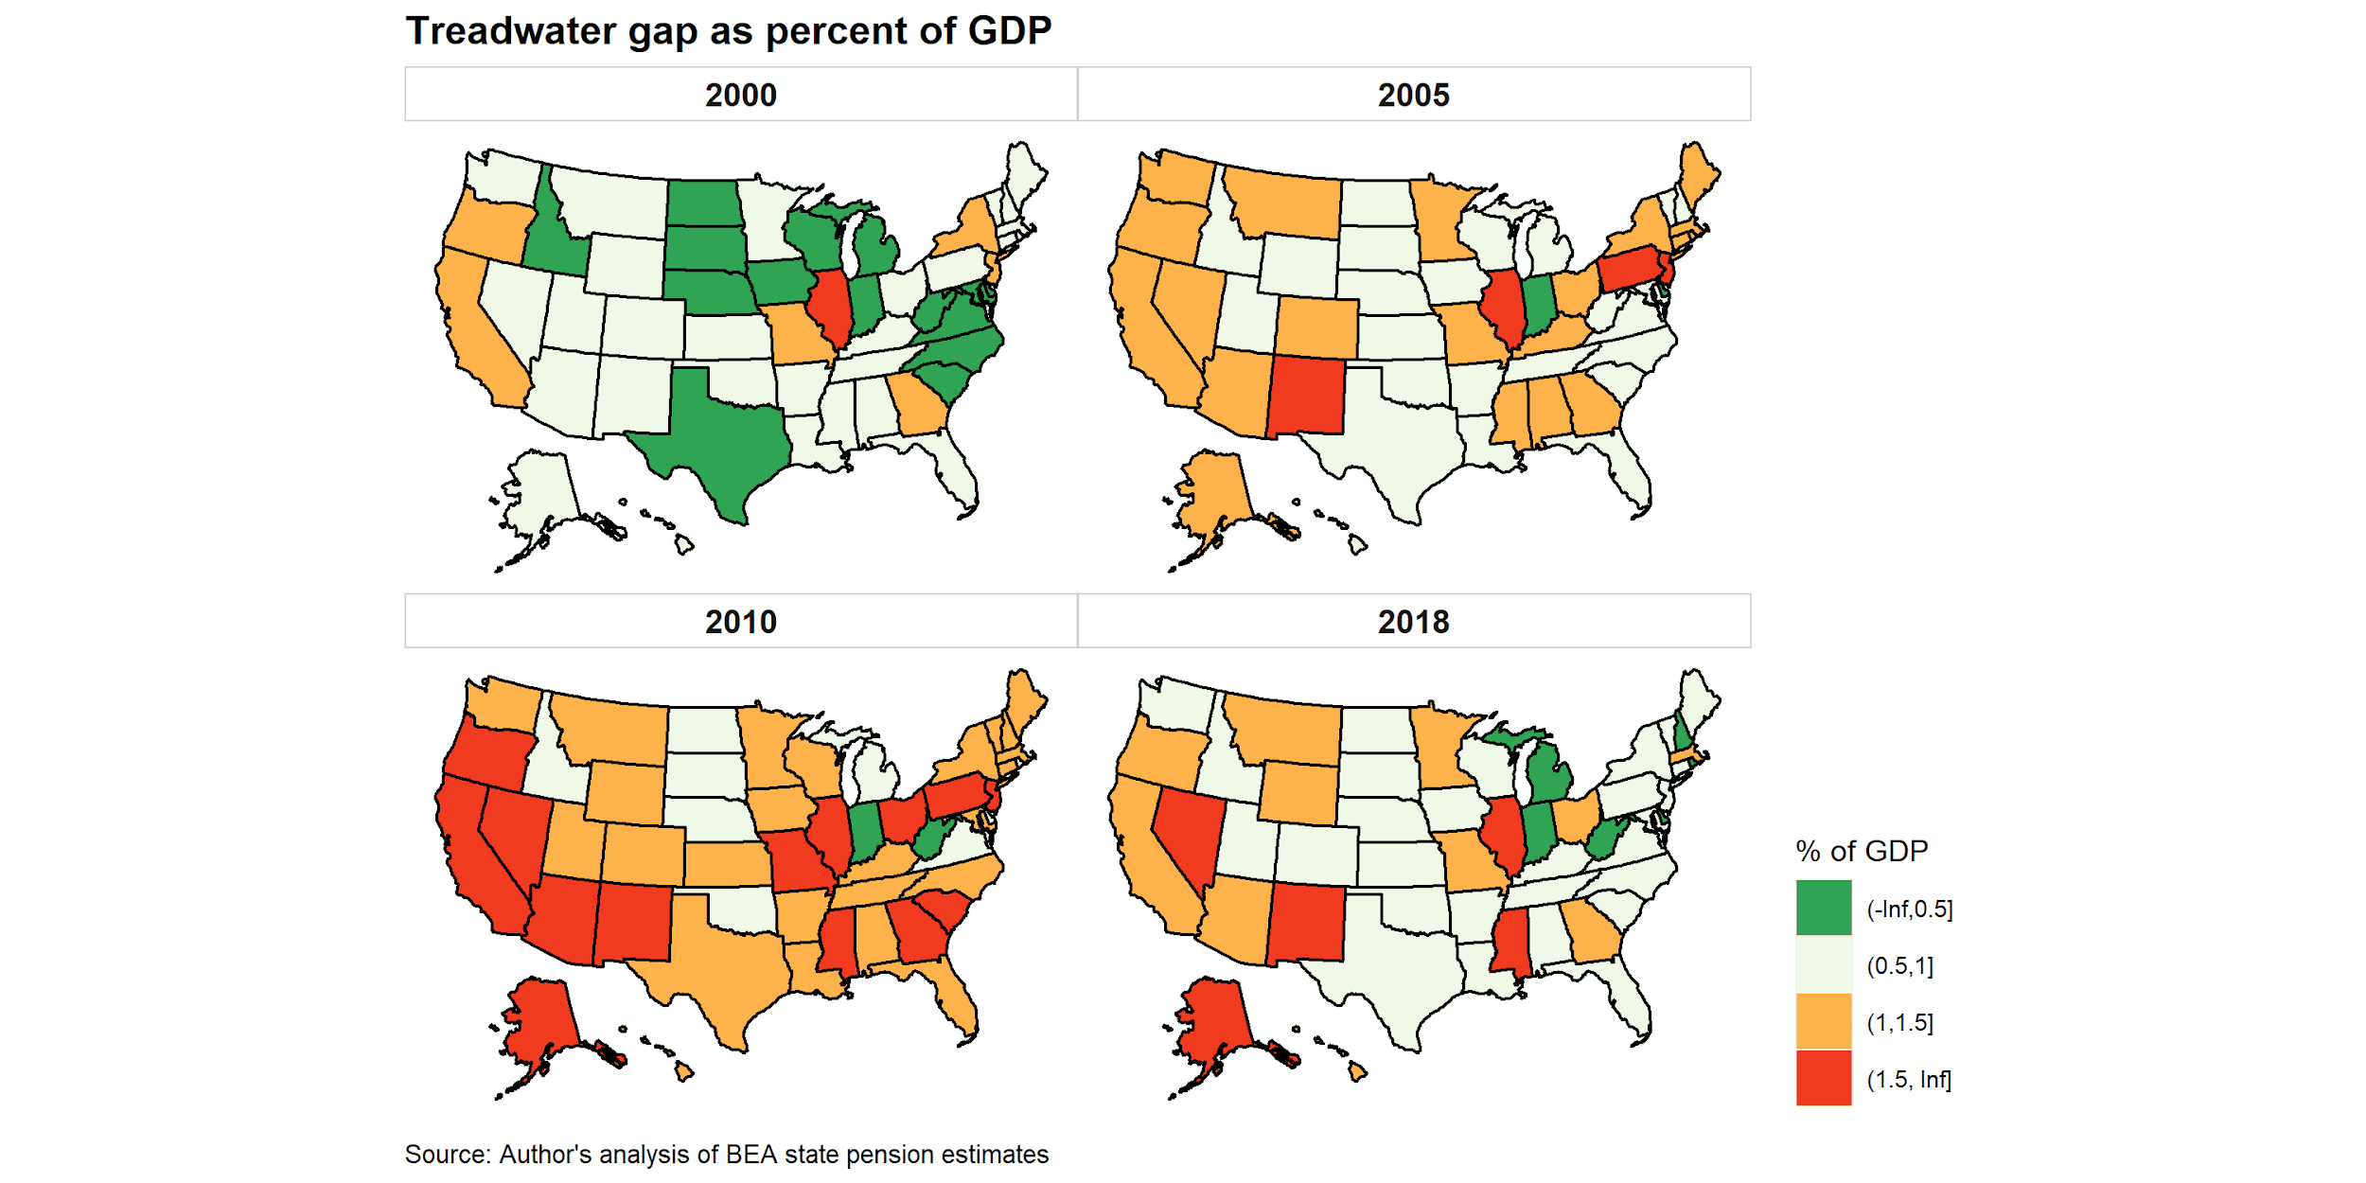
Contribution increase needed to “tread water” has fallen recently (due to contribution increases and benefit cuts)

Slide 33
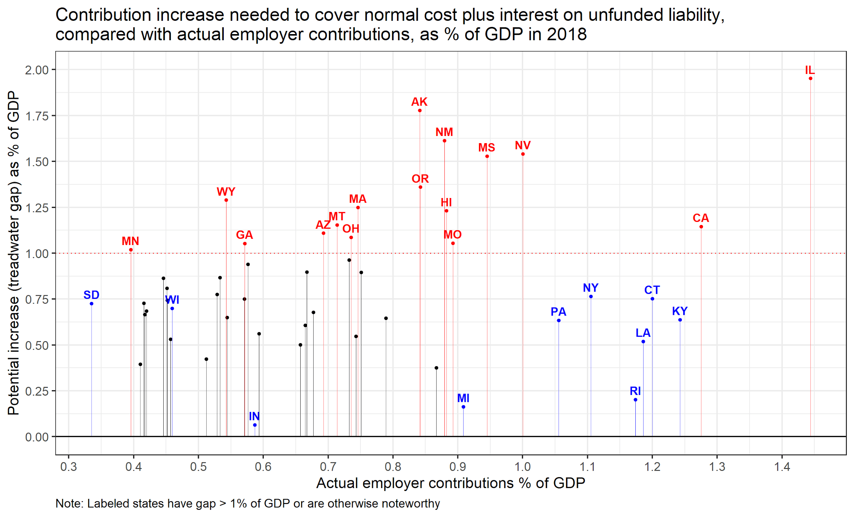
How hard would it be to tread water?
1% of GDP for US is roughly equivalent to:
49% of all state-local income or sales taxes, or
29% of all K12 spending, or
190% of all highway capital spending

Slide 34
What can state and local governments do?

Slide 35
Policy options highly constrained
Politicians understandably concerned about going back on commitments, especially to people who no longer work or are near retirement
Laws in some states are particularly constraining
Employee contribution increases often easier to do, legally than benefit cuts. Different impacts on plan members.
COLAs sometimes legally easier to do than other benefit changes.
“California rule” – an evolving issue – is especially constraining
Benefit cuts also can reduce a government’s attractiveness as an employer. Changes should be considered in this context.
Risk-sharing an option in some places: SD, WI; PA. Under consideration in some places.

Slide 36
Reducing unfunded liabilities – stylized view
People affected | What a government may be able to do* | Examples | Comments
1. People who don’t work for you yet | Anything | New tiers Hybrid DB-DC plans Risk-sharing | NONE OF THE UAAL IS HERE. A “stop digging” solution – can ease future costs, slowly. Competitiveness-as-employer issues. Most reforms have been here.
2. People who work for you now:
(a) Service they have yet to render | Depends. “California rule” may prevent cuts. In IL, state Supreme Court said cannot change. (Can lay off workers, but not change benefits) | Reduce benefit factor for future service Increase retirement age Change COLA | #3) SOME UAAL CAN BE IN HERE UNDER EAN COST METHOD BUT PROBABLY NOT MUCH. In some circumstances, can be substantial. Potentially important in distressed situations (e.g., Detroit). ERISA allows for private plans.
(b) Service they’ve already rendered | Hard to cut benefits, legally, politically, morally. | Haircuts, future benefits COLA cuts Contingent COLAs | #2) MOST REMAINING UAAL IS HERE. BIG IMPACT ON PROBLEM. Vested/non-vested distinctions matter, too.
3. People who used to work for you (e.g., retirees) | Hard to cut benefits, legally, politically, morally. Great variation. COLAs more susceptible to cuts than other benefits. | Haircuts, current benefits COLA cuts or suspension for retirees Contingent COLAs for retirees | #1) MOST OF THE UAAL IS HERE (Often 50-60%). BIG IMPACT ON PROBLEM.
* Varies greatly across states. See Monahan.

Slide 37
What will happen next?

Slide 38
Very difficult to predict
Covid-19 posed great risks to governments and pension funds. Fortunately, the main fears did not occur.
Investment risk remains a wild card. Plans could get lucky, or even do much worse.
Benefits for new workers already reduced widely; some reductions in benefits for current members.
Laws in some states are particularly constraining
Employee contribution increases often easier to do, legally than benefit cuts. Different impacts on plan members.
COLAs often legally easier to do than other benefit changes.
“California rule” – an evolving issue – is especially constraining
Benefit cuts also can reduce a government’s attractiveness as an employer. Changes should be considered in this context.

Slide 39
What if a government has made promises it cannot keep?
Local governments
Bankruptcy is an option, if allowed by state.
All bets are off – bankruptcy is about breaking deals (and contracts).
Pain can be spread – to bondholders and to other creditors of the gov’t, not just to workers and retirees.
In fact, in general, pensions have been relatively protected. Will they be if bankruptcy becomes more widespread?
State governments
No bankruptcy option – see David Skeel…
No explicit mechanism to spread pain beyond workers and retirees.
Taxpayers, service beneficiaries, infrastructure-users still hit through political process – crowd-out. Probably not bondholders.

Slide 40
Selected information sources

Slide 41
Information sources
Great sources on multiple plans and/or issues:
Center for Retirement Research: snapshots, research, data, AVs and CAFRs
NASRA (National Association of State Retirement Administrators)
Pew Charitable Trusts
Wharton Pension Research Council
State and Local Government Finance Project, Rockefeller College
Plus, several others (BEA, NCSL)
Deep dives on individual plans or governments:
CAFRs and AVs for individual plans
CAFRs for governments
EMMA and the OS (Official Statement) – broad, no-nonsense analysis

Slide 42
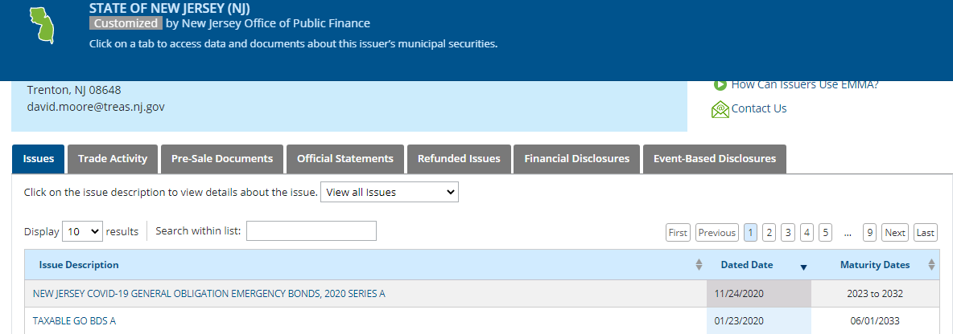
EMMA & NJ pensions: Get latest OS
(1) EMMA, (2) click NJ & accept, (3) click “state issuers” checkbox, (4) click “STATE OF NEW JERSEY”, (5) sort by Dated Date (descending), (6) download latest OS

Slide 43
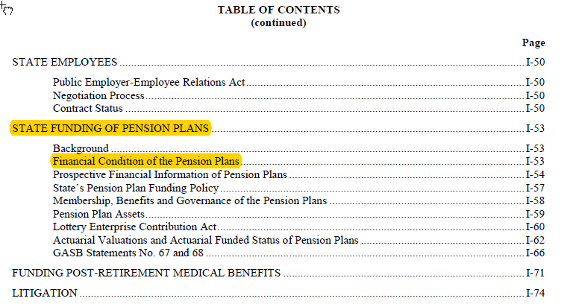
EMMA & NJ pensions: Find pensions info
look at TOC; search “pension” (ctrl-f); probably appendix

Slide 44
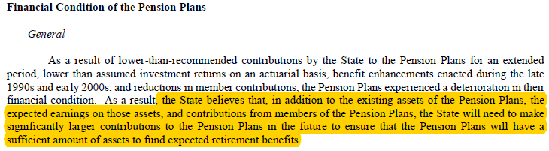
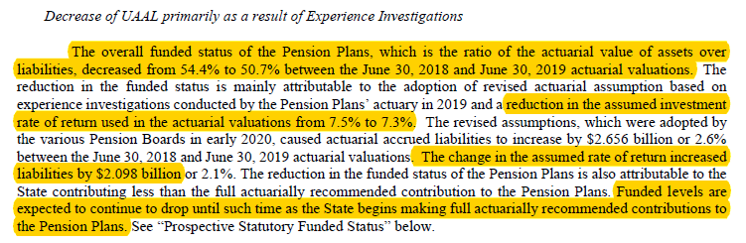
EMMA & NJ pensions: Key info

Slide 45
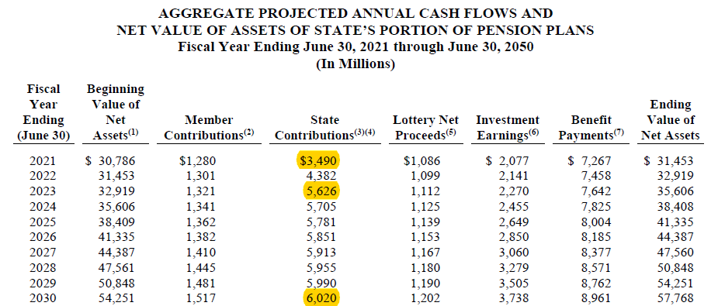
EMMA & NJ pensions: Projections!

Slide 46
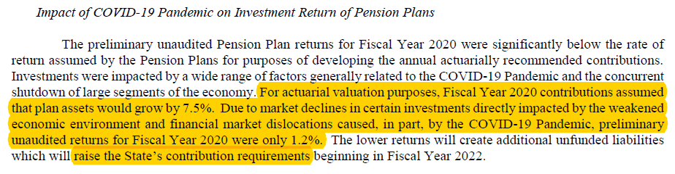
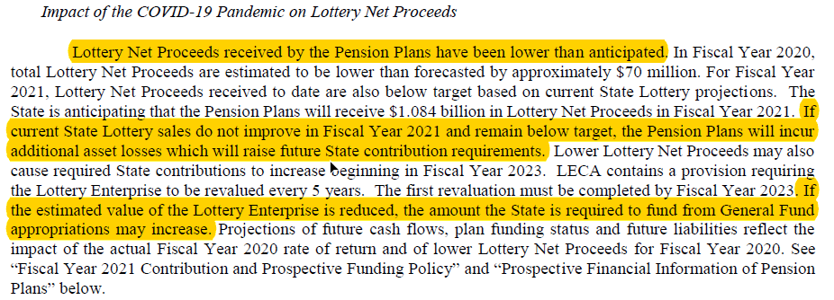
EMMA & NJ pensions: It could get worse...

Slide 47
Reprise: Conclusions
Liabilities and annual costs severely underestimated by plans.
ON AVERAGE, plans deeply underfunded.
Unless plans get lucky, investment returns won’t bail us out.
Benefit cuts for workers/retirees unlikely to be big part of solution.
Further tax increases and service cuts likely – “crowd out”.
Loss of political support for public defined benefits will encourage gradual movement to defined contribution plans and to risk-sharing DB plans.
And the system that allowed this will remain largely in place. The issue will be with us for many years.

