Slide 1
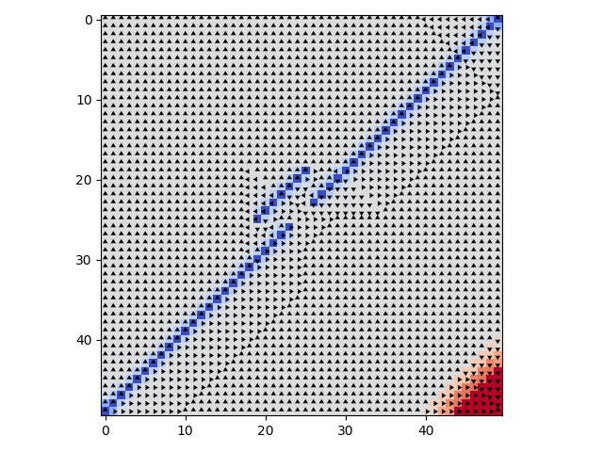
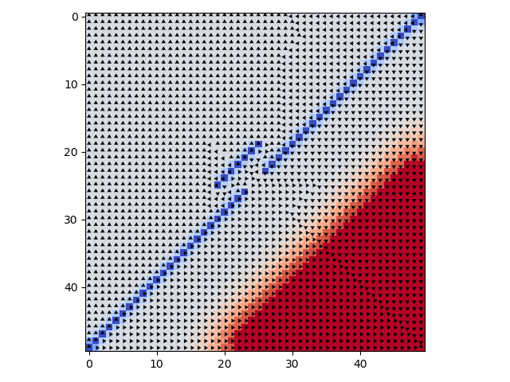
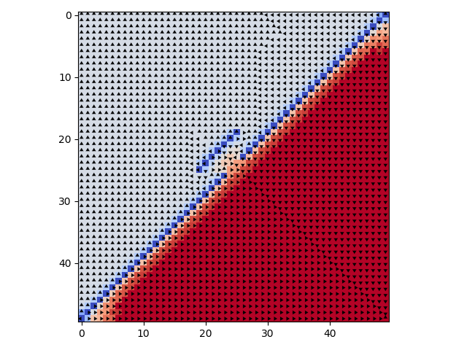
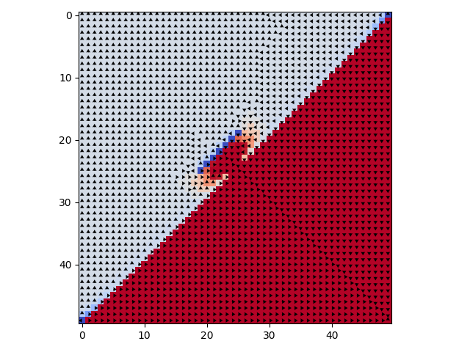
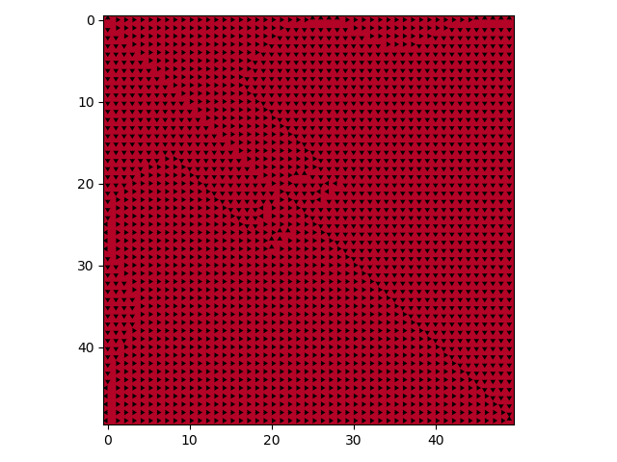
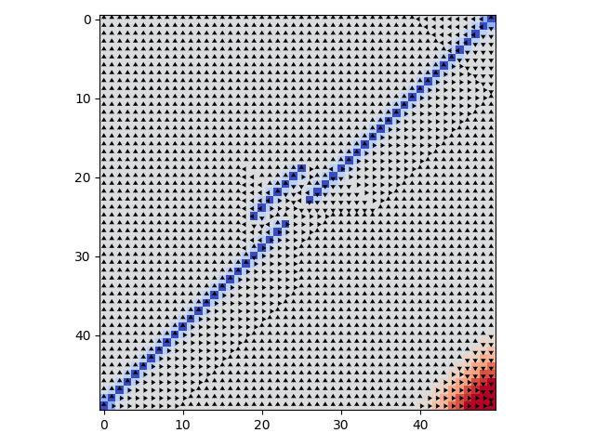
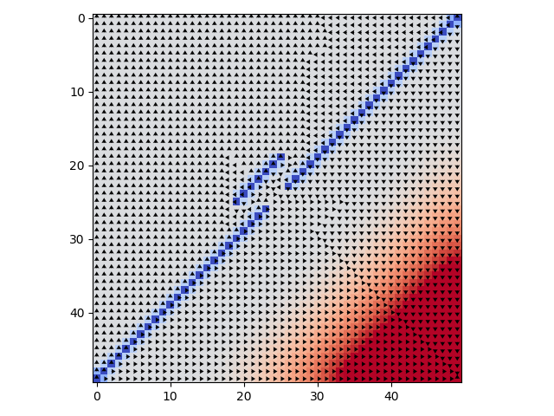
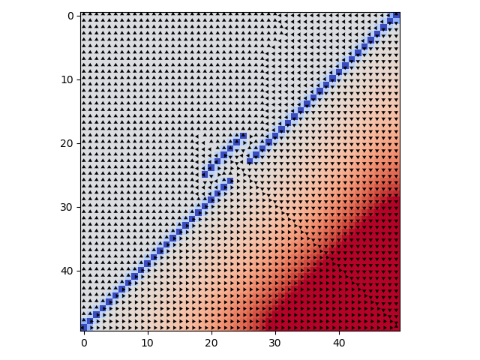
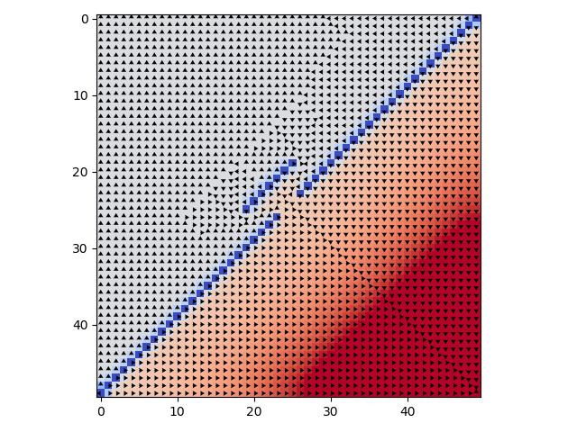
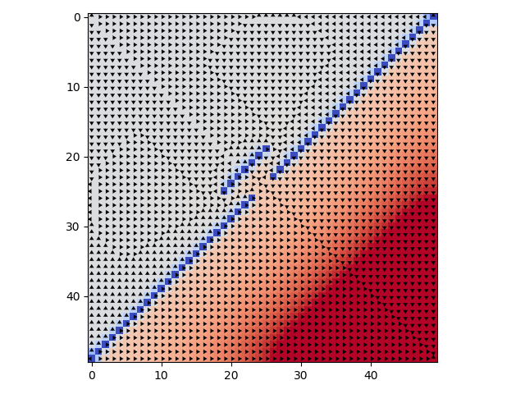
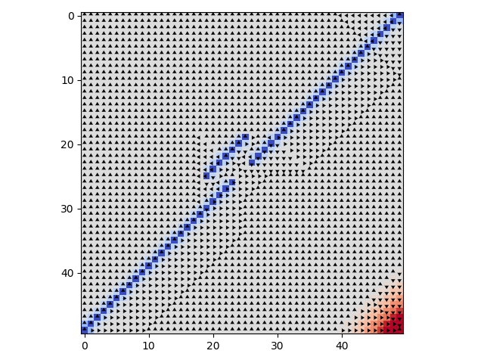
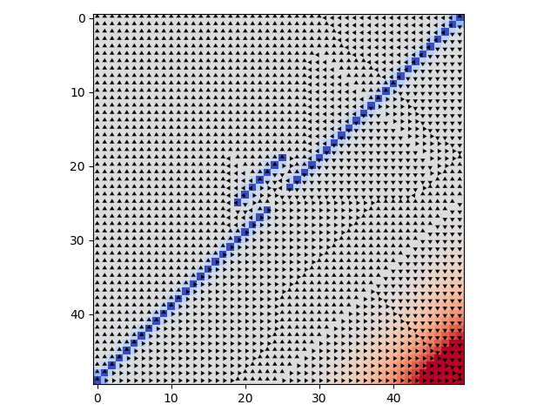
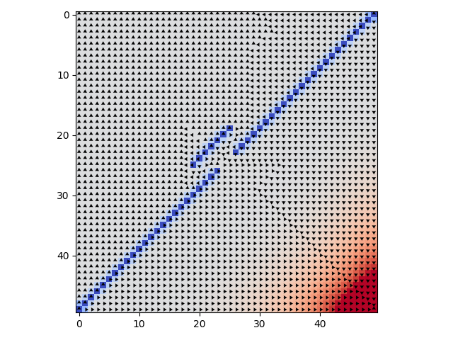
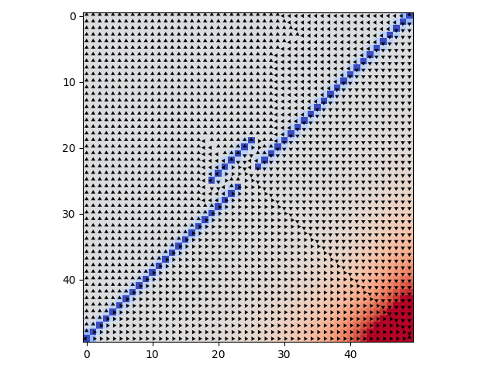

Value Iteration
Grid World
Discount 1
Converge = large
10 iterations
40 iterations
60 iterations
70 iterations
200 iterations
Value Iteration
Grid World
Discount .95
Converge = 164
10 iterations
40 iterations
60 iterations
100 iterations
164 iterations
Value Iteration
Grid World
Discount .9
Converge = 72
10 iterations
25 iterations
40 iterations
55 iterations
72 iterations

Slide 2
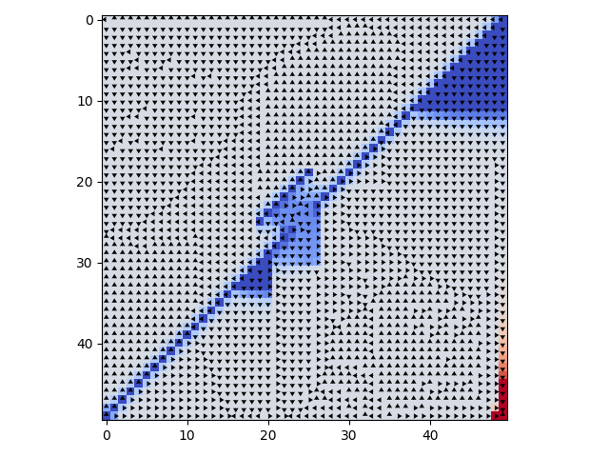
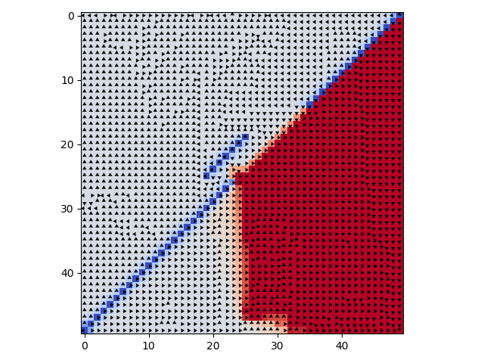
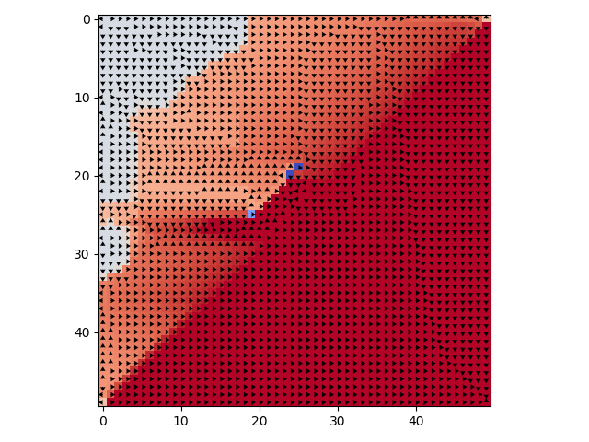
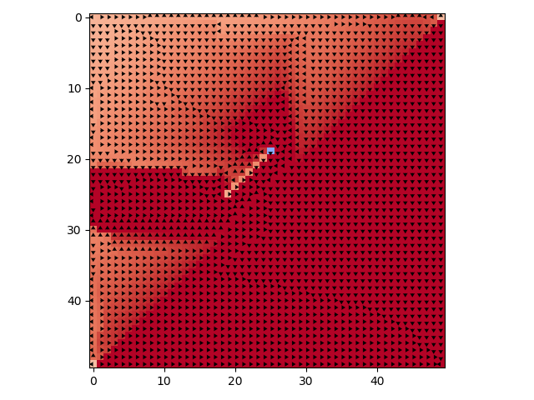
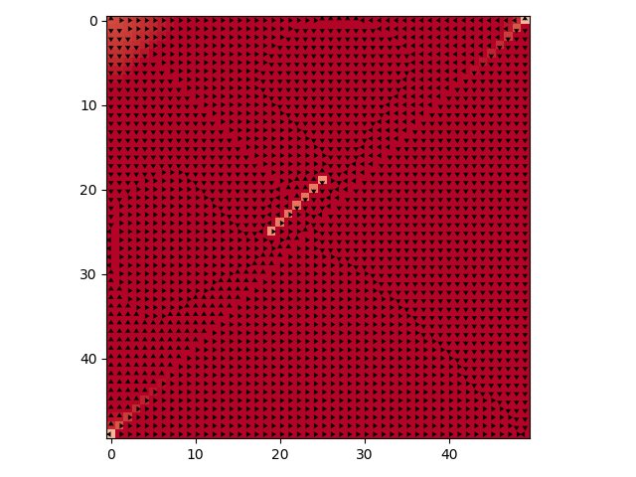
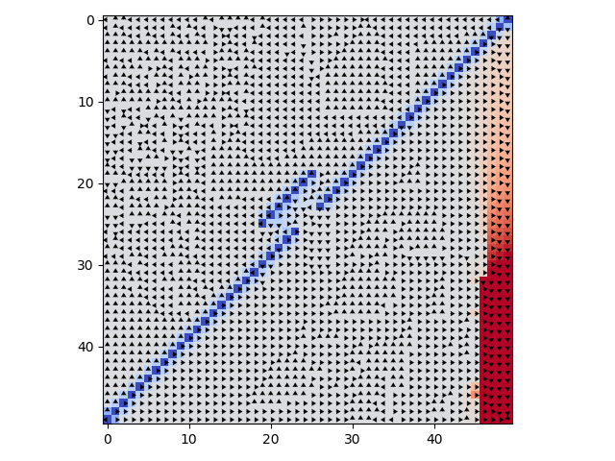
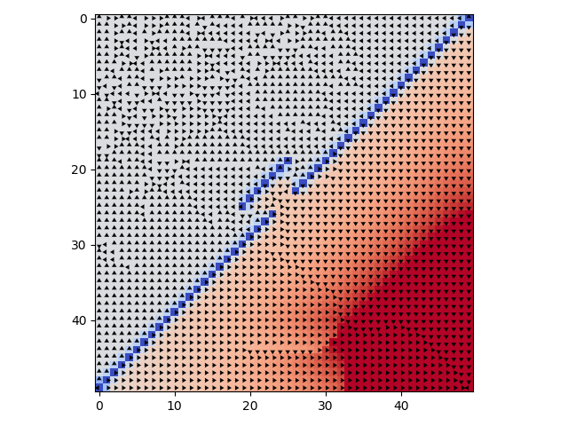
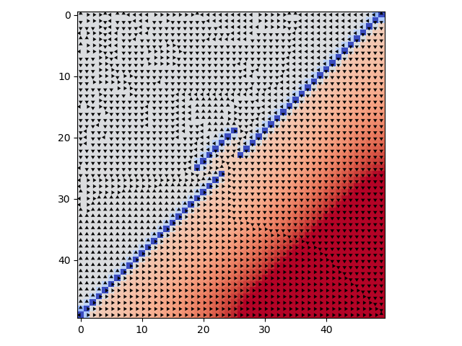


Policy Iteration
Grid World
Discount 1
Converge = >500
2 iterations
3 iterations
5 iterations
6 iterations
20 iterations
Policy Iteration
Grid World
Discount .95
Converge = >500
3 iterations
5 iterations
9 iterations
15 iterations
25 iterations

Slide 3
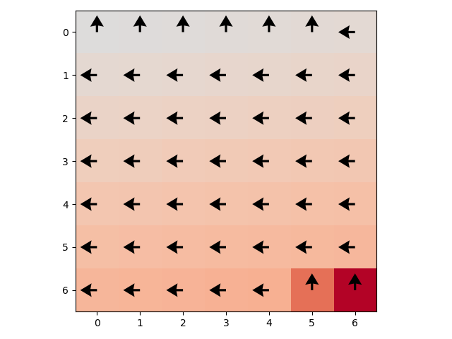
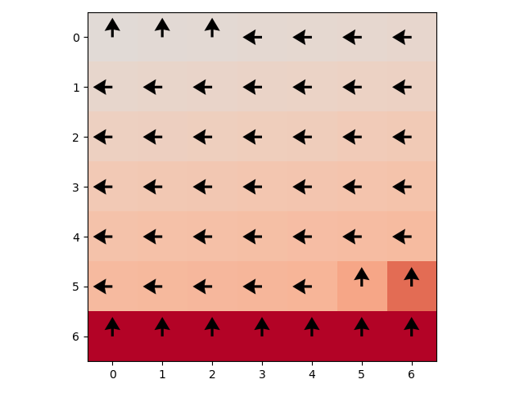
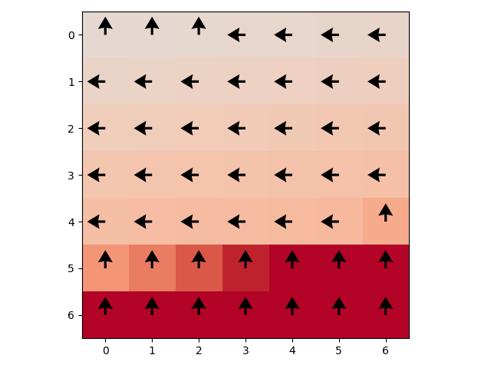
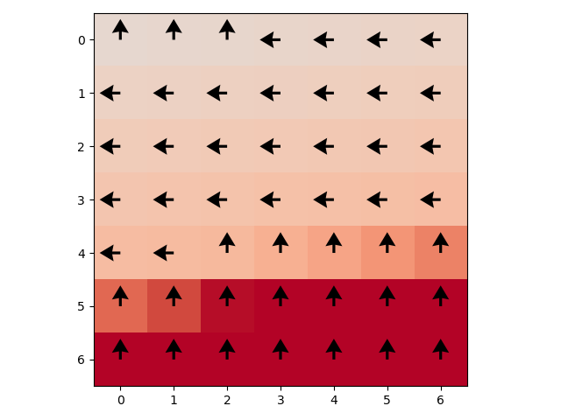
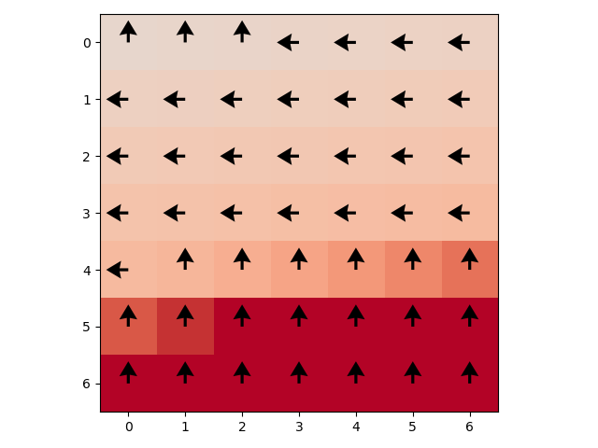
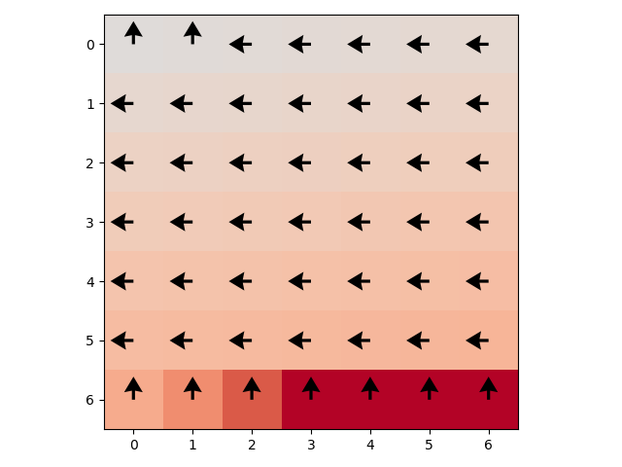
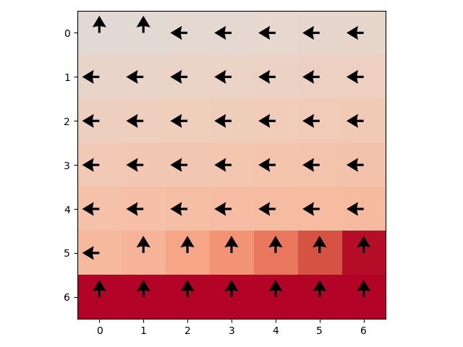
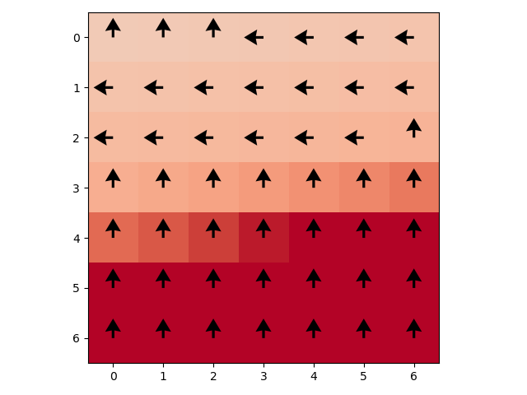
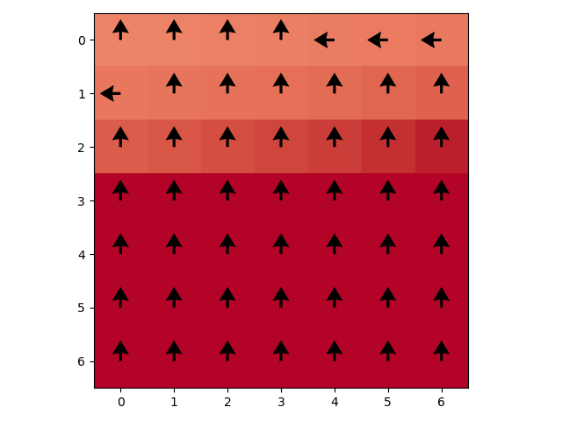
Value Iteration
Forest Managment
Discount .95
Converge = 58 iterations
2 iterations
10 iterations
20 iterations
30 iterations
58 iterations
Value Iteration
Grid World
.8 discount
Converge = 23
.9 discount
Converge = 39
.95 discount
Converge = 58
.98 discount
Converge = 79
.999 discount
Converge = 122

Slide 4
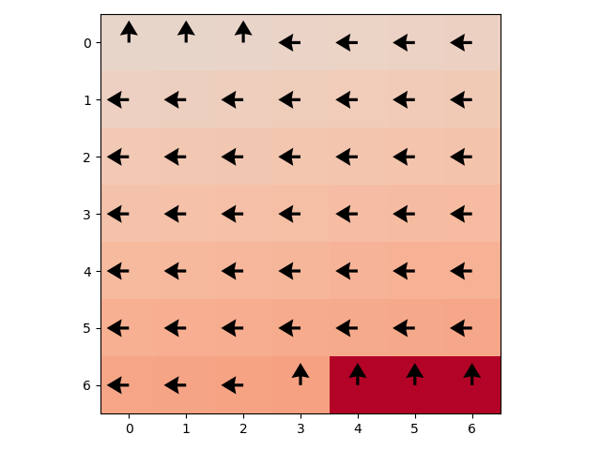
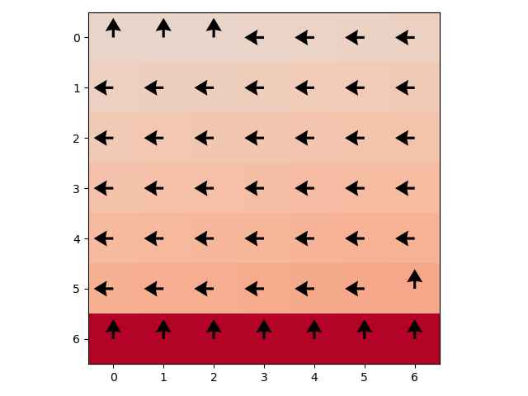
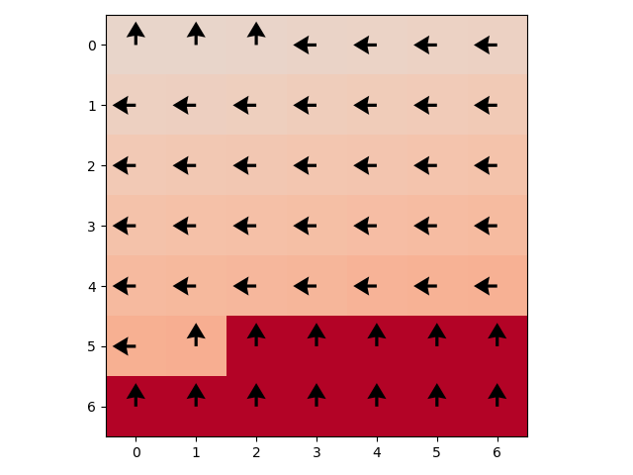
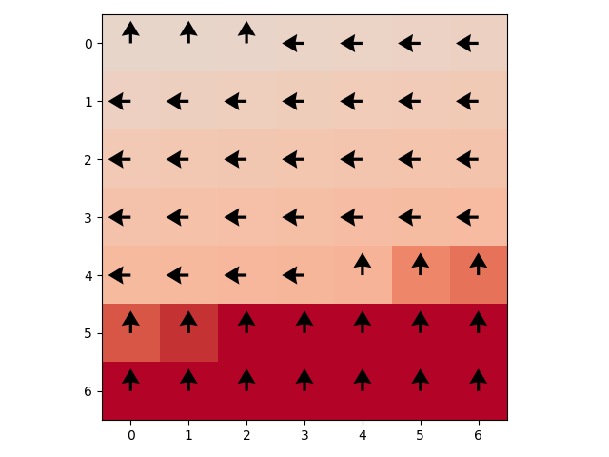
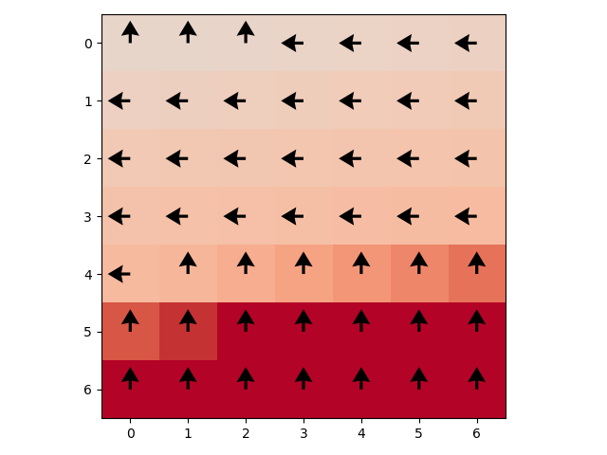


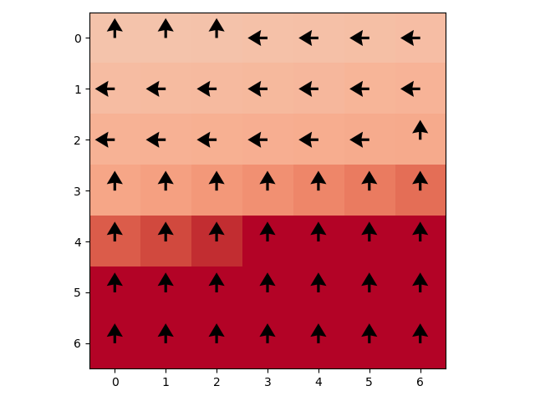
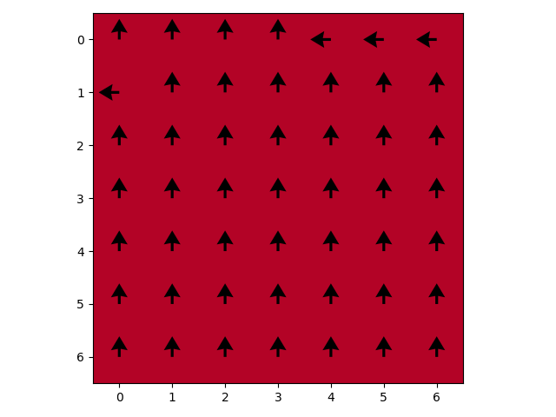
Policy Iteration
Grid World
Discount .95
Converge = 20 iterations
3 iterations
7 iterations
12 iterations
16 iterations
20 iterations
Policy Iteration
Grid World
.8 discount
Converge = 7
.9 discount
Converge = 13
.95 discount
Converge = 20
.98 discount
Converge = 29
.999 discount
Converge = 41

Slide 5
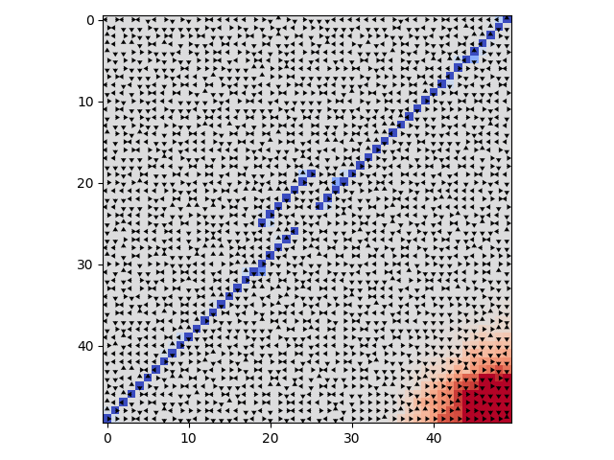
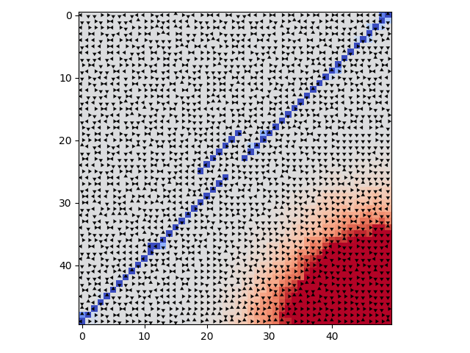
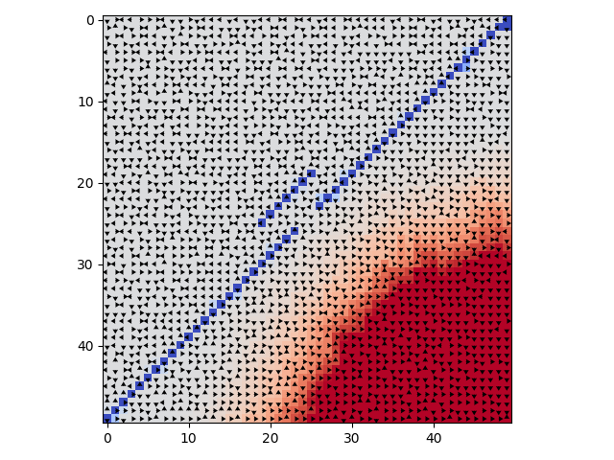
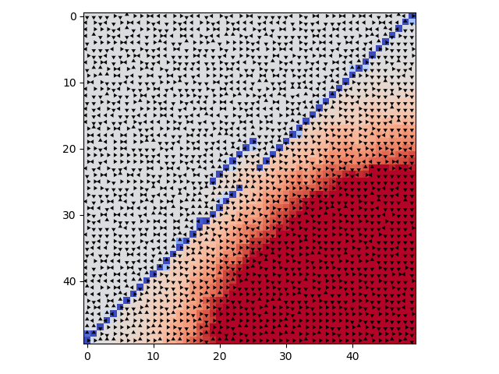
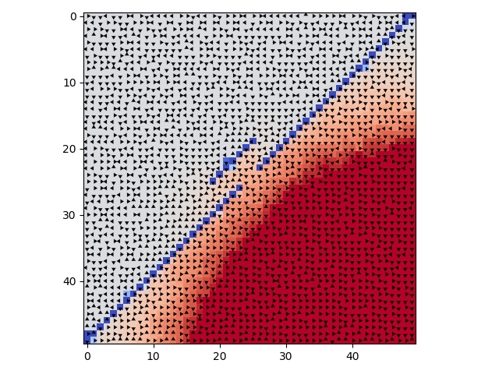
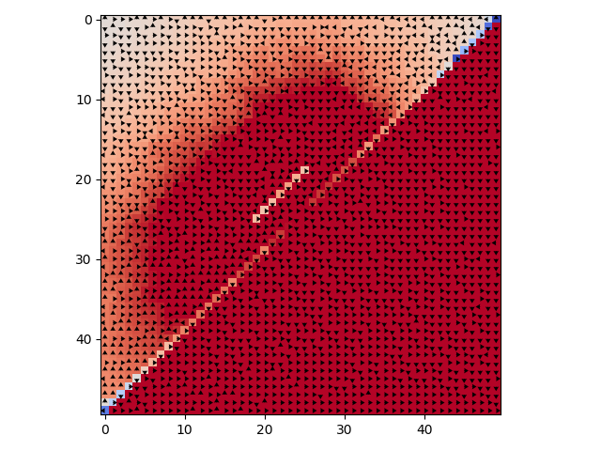
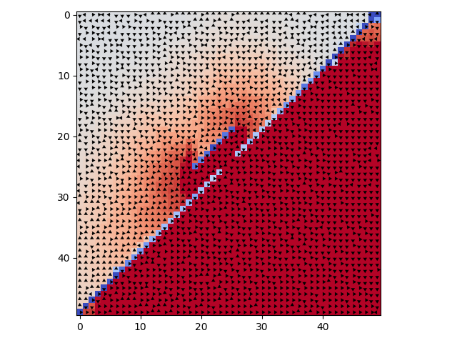
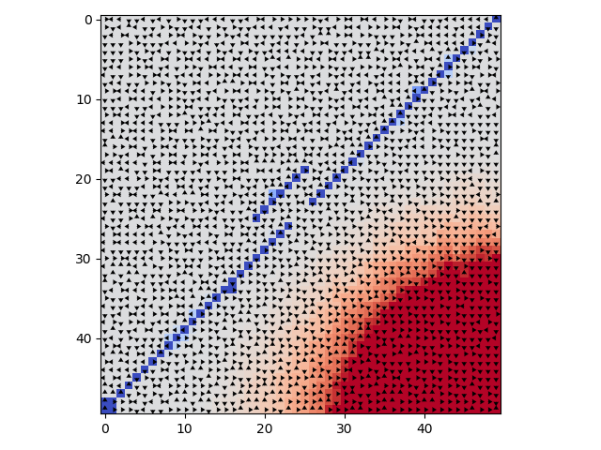
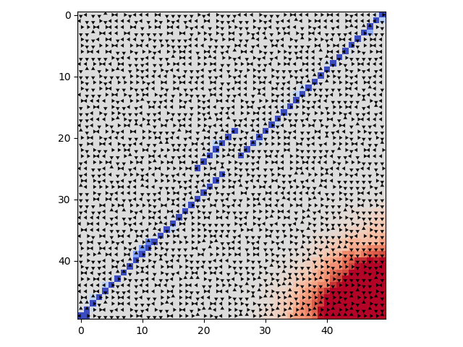
Q Learning
Grid World
Learn rate=.5, discount = .98, exploration = 10
200000 iterations
700000 iterations
1300000 iterations
2300000 iterations
3000000 iterations
Q Learning Grid World 3000000 iterations, learn rate =.5, discount = .98
Exploration = 3
Exploration = 5
Exploration = 10
Exploration = 20
Exploration = 50

Slide 6
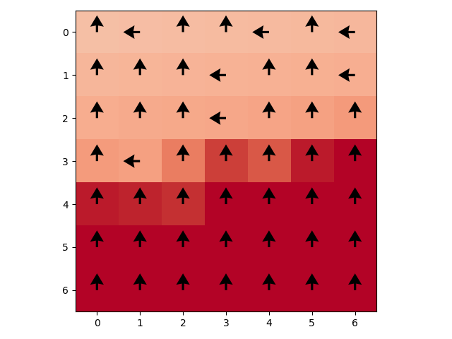
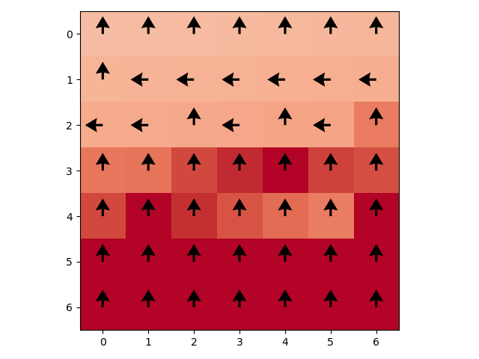
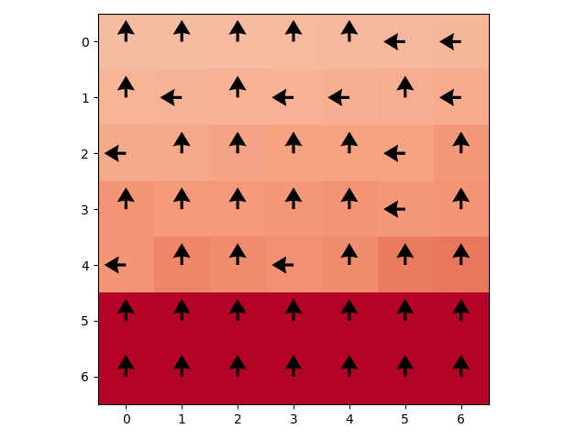






Q Learning
Forest
Learn rate=.5, discount = .98, exploration = 10
133333 iterations
333333 iterations
499999 iterations
766666 iterations
1000000 iterations
Q Learning Forest 100000 iterations, learn rate =.5, discount = .98
Exploration = 3
Exploration = 5
Exploration = 10
Exploration = 20
Exploration = 50

