Slide 1



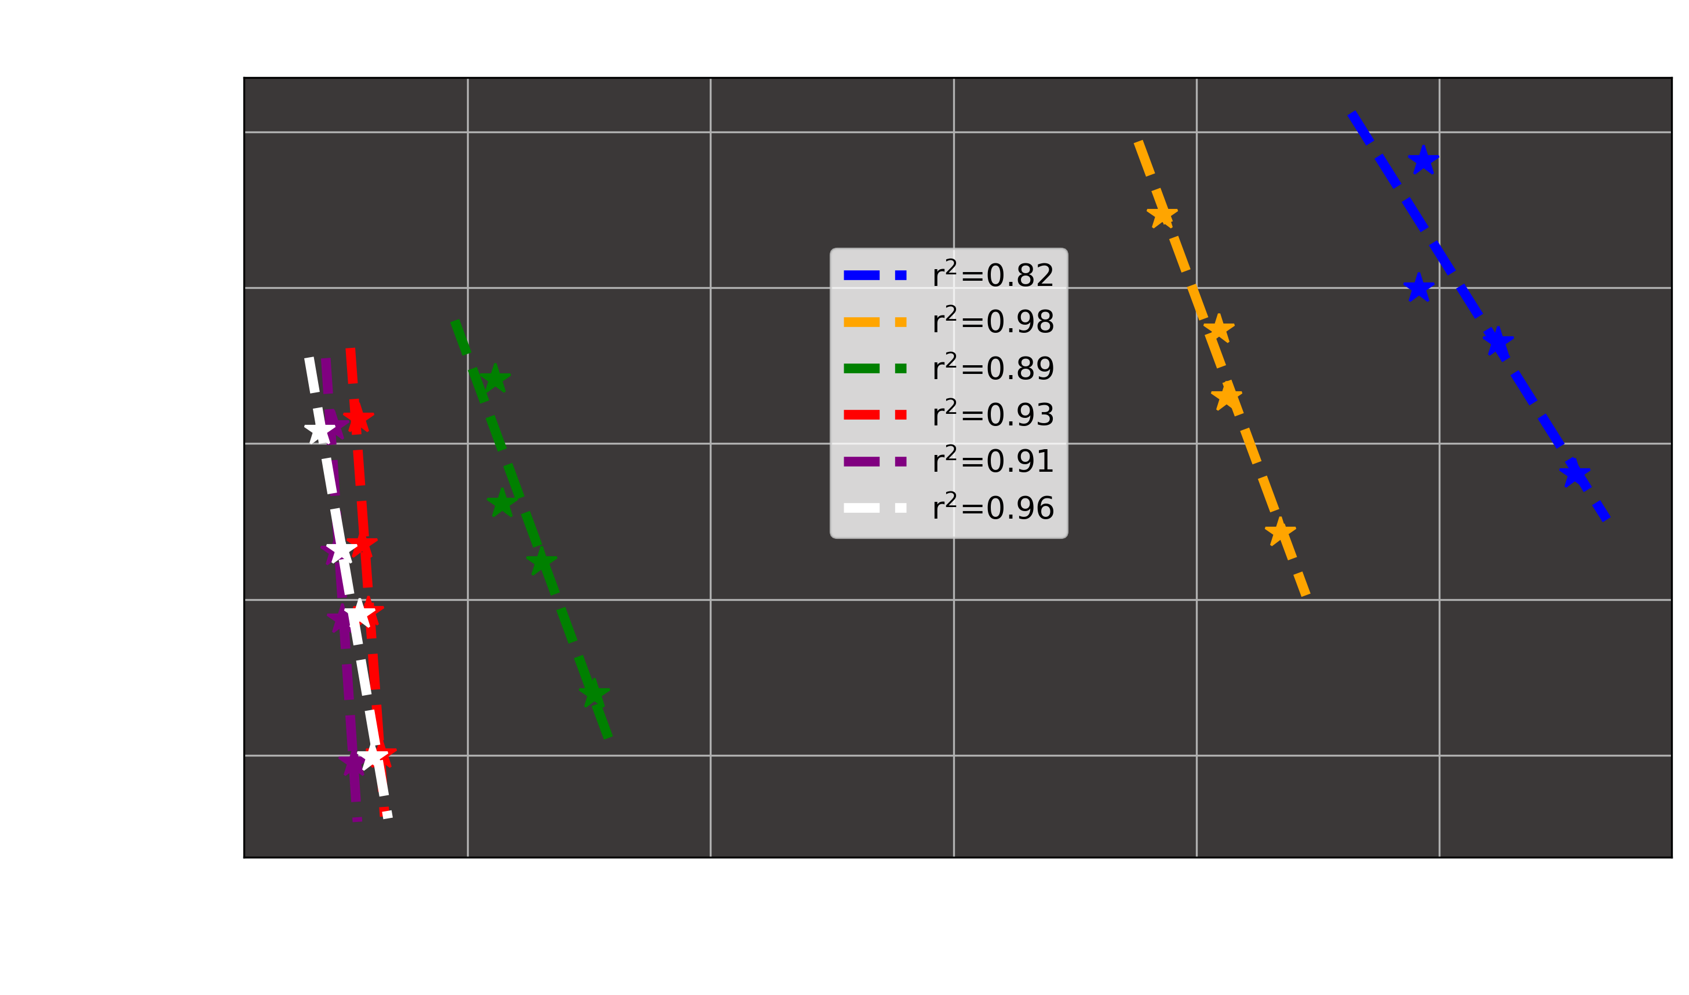
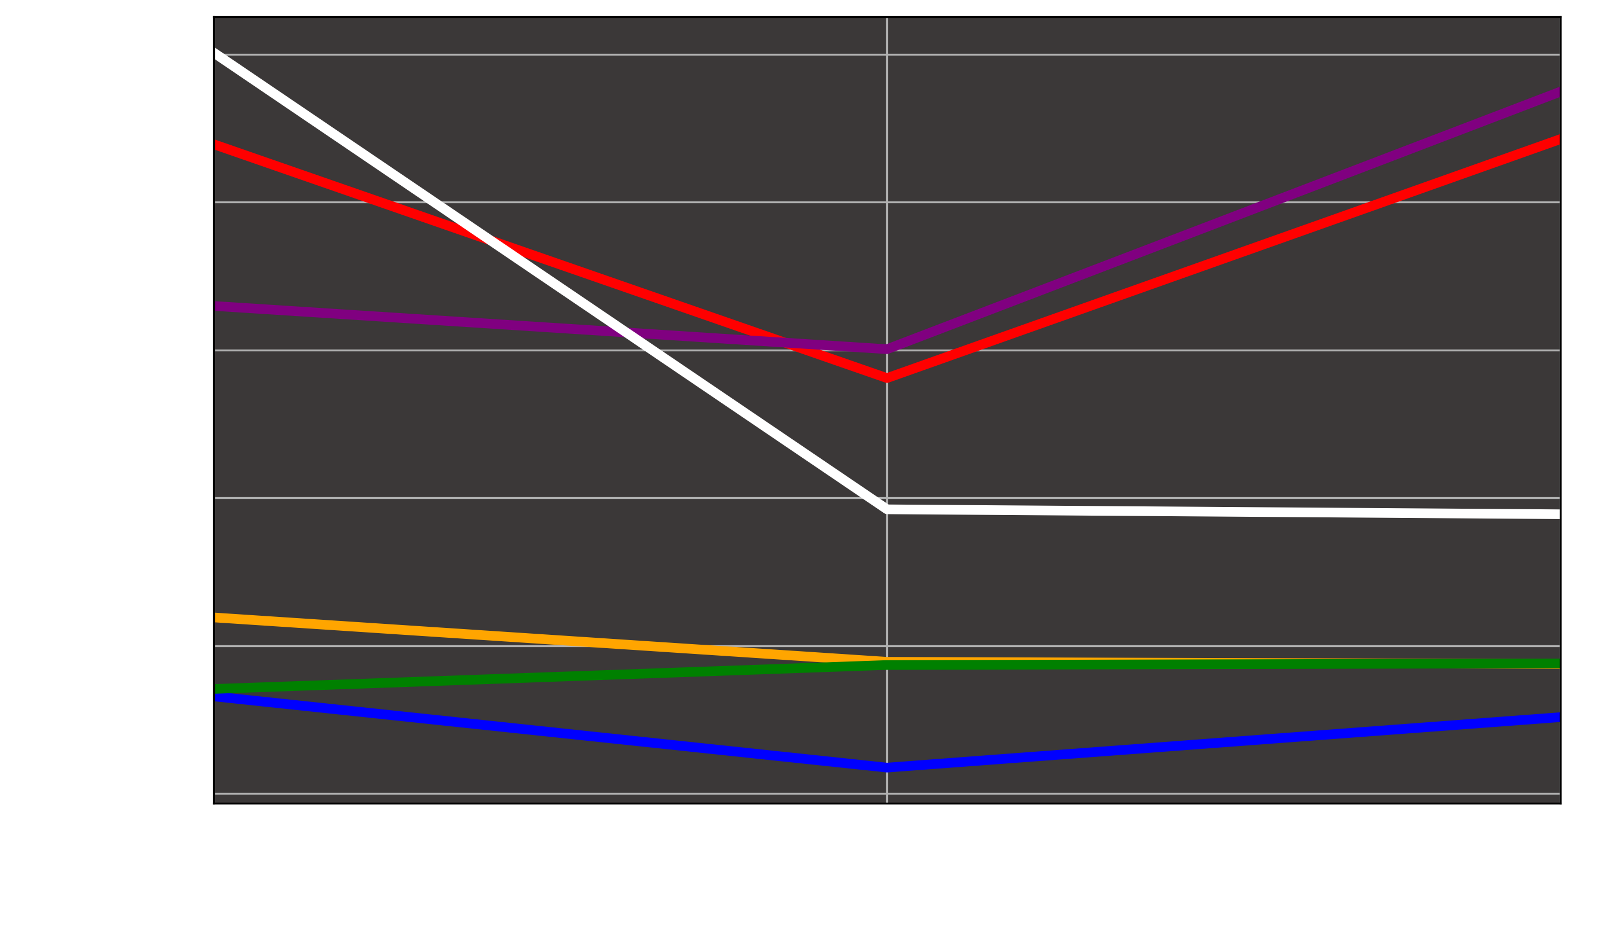
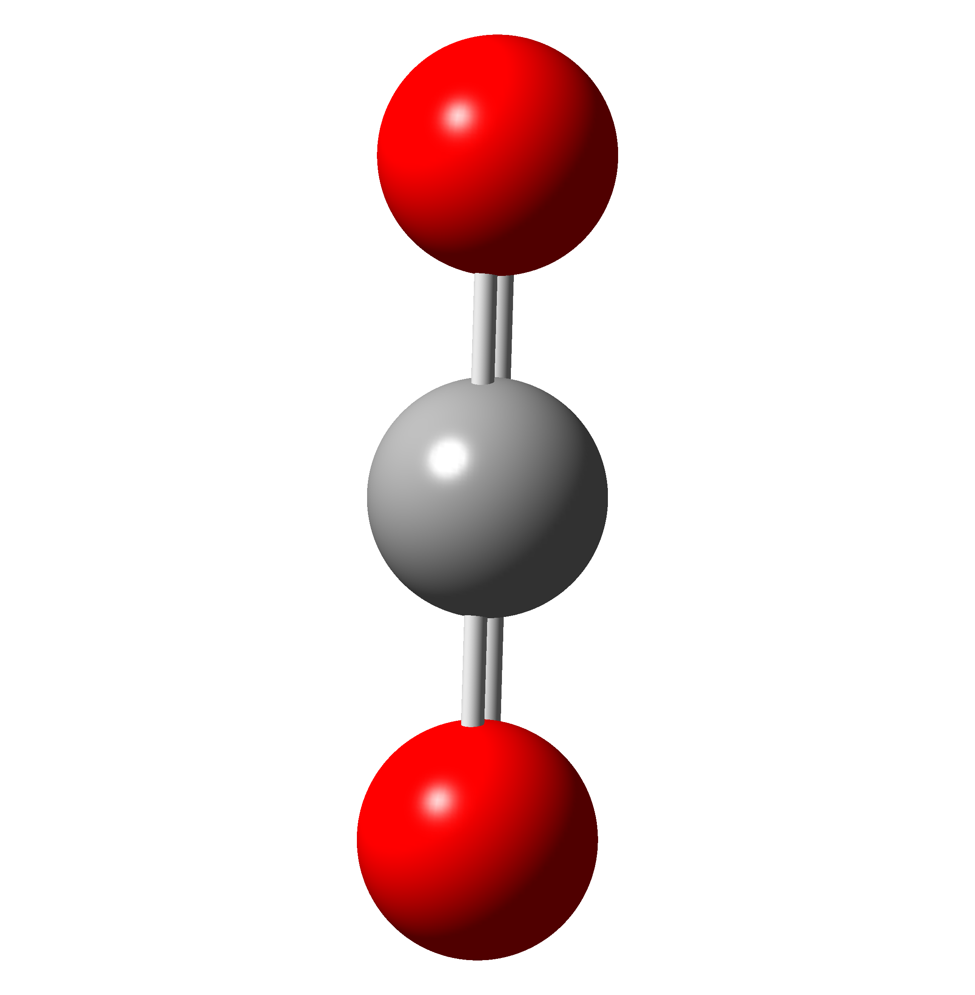
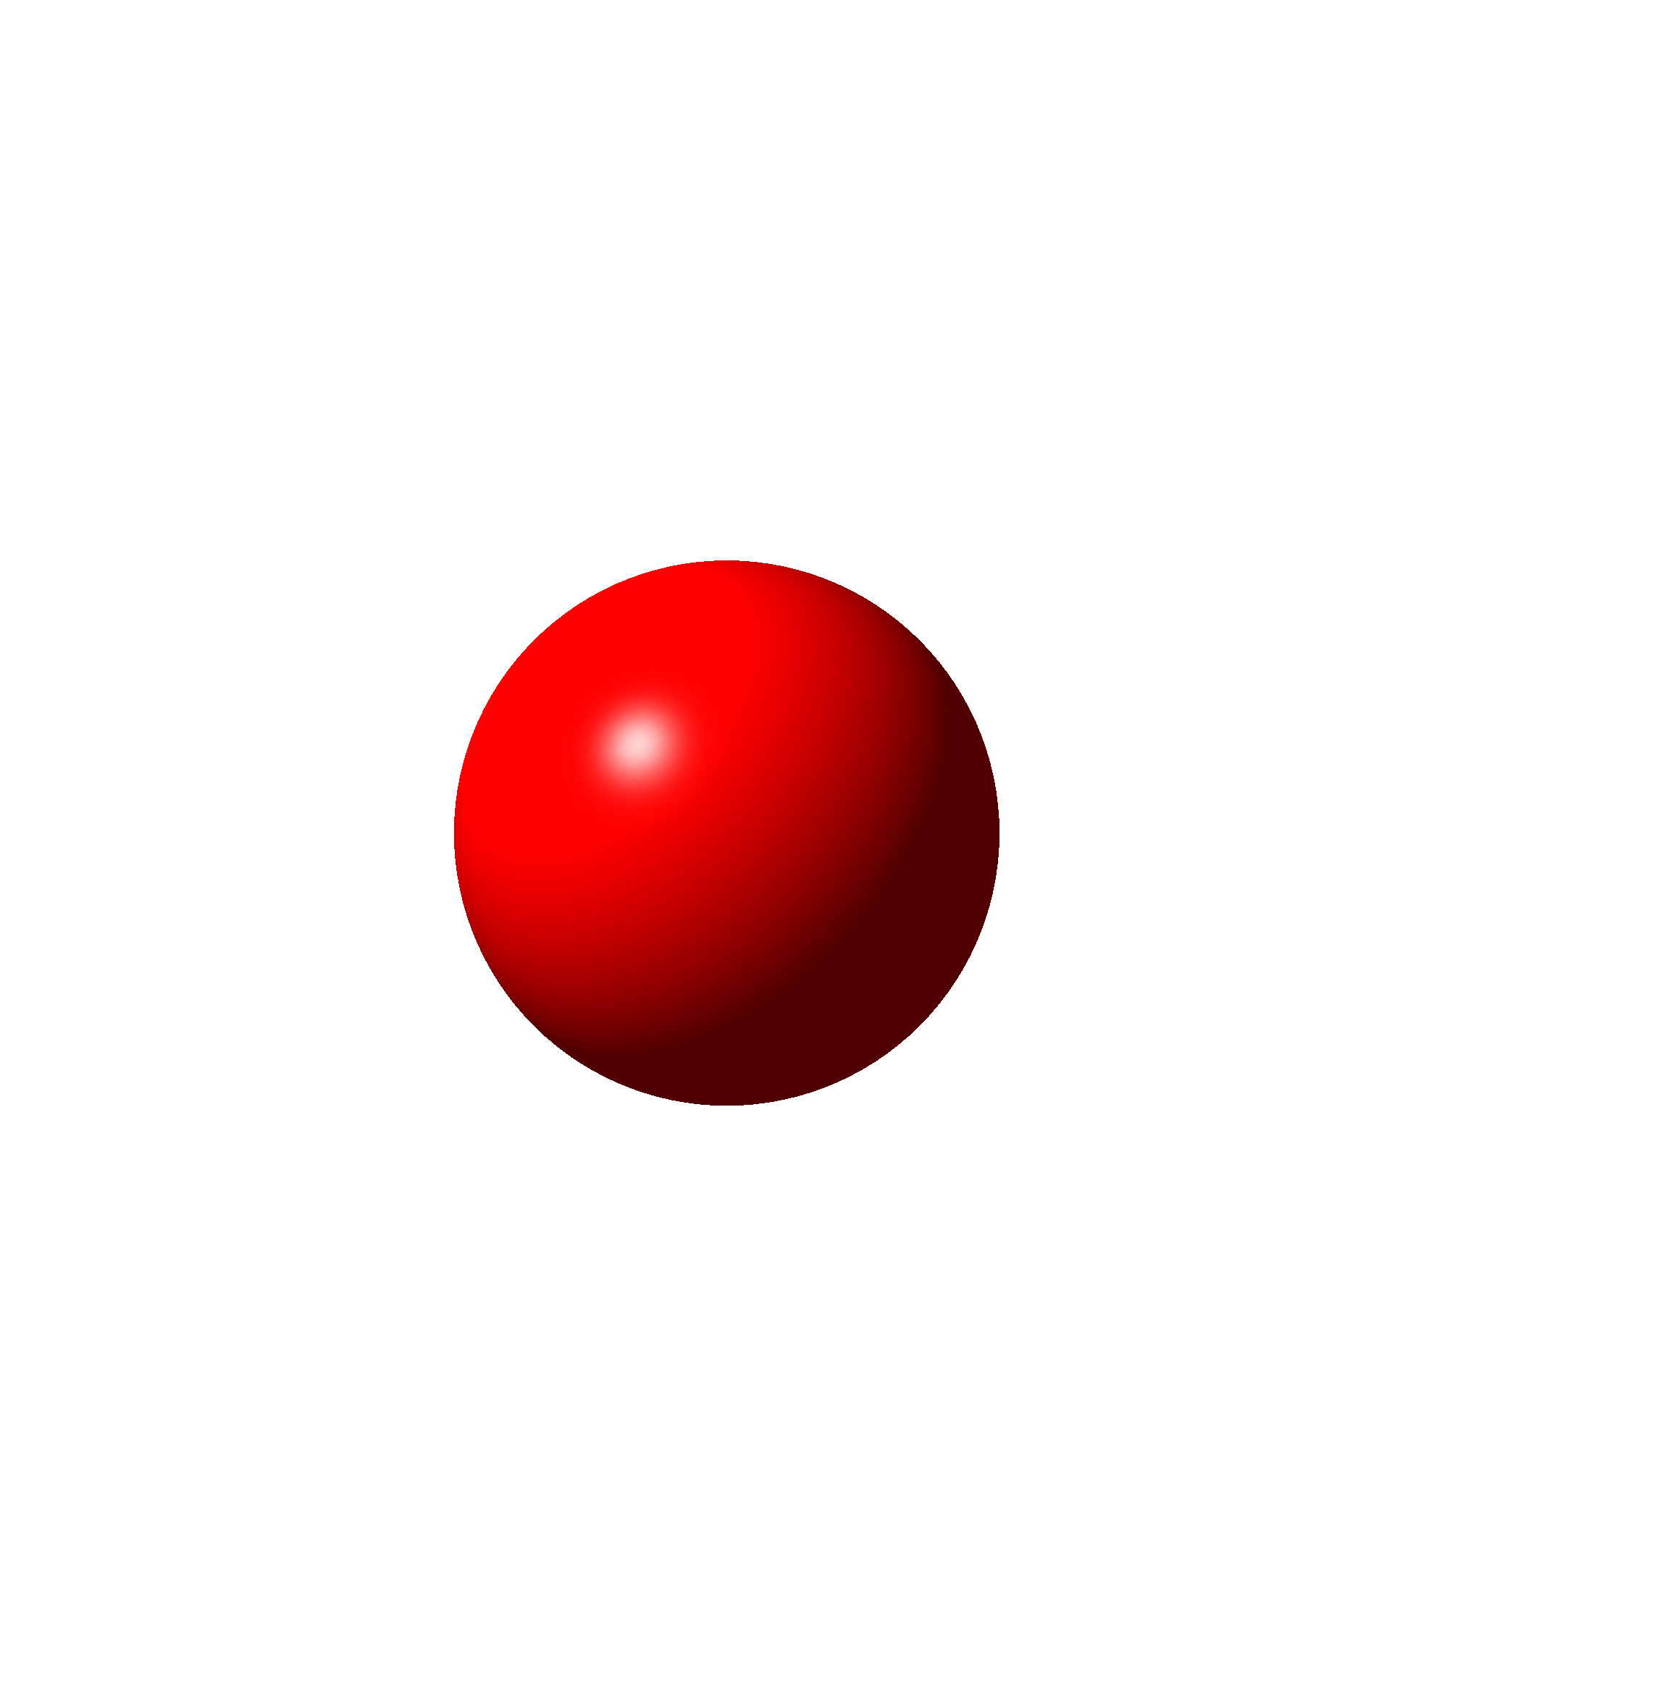

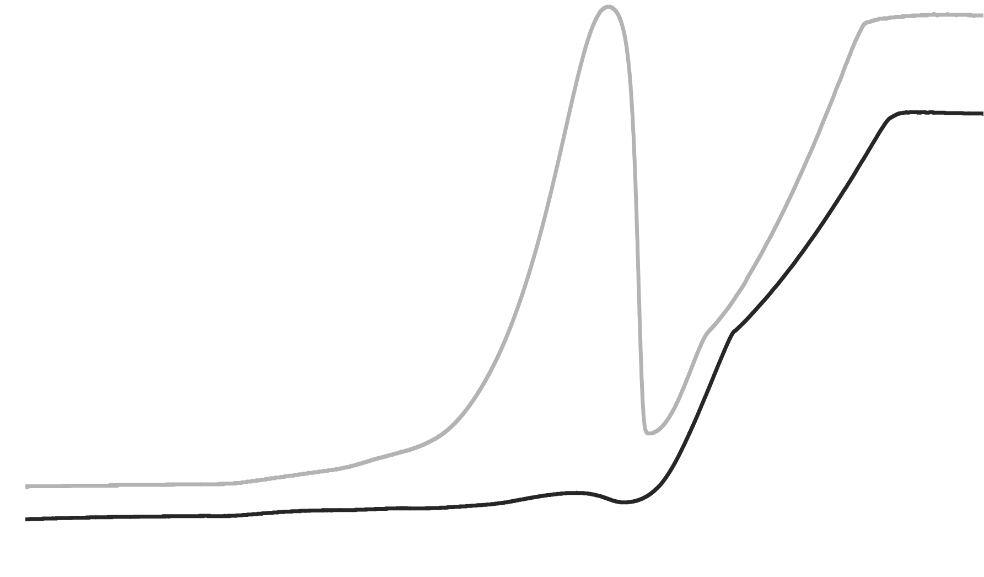
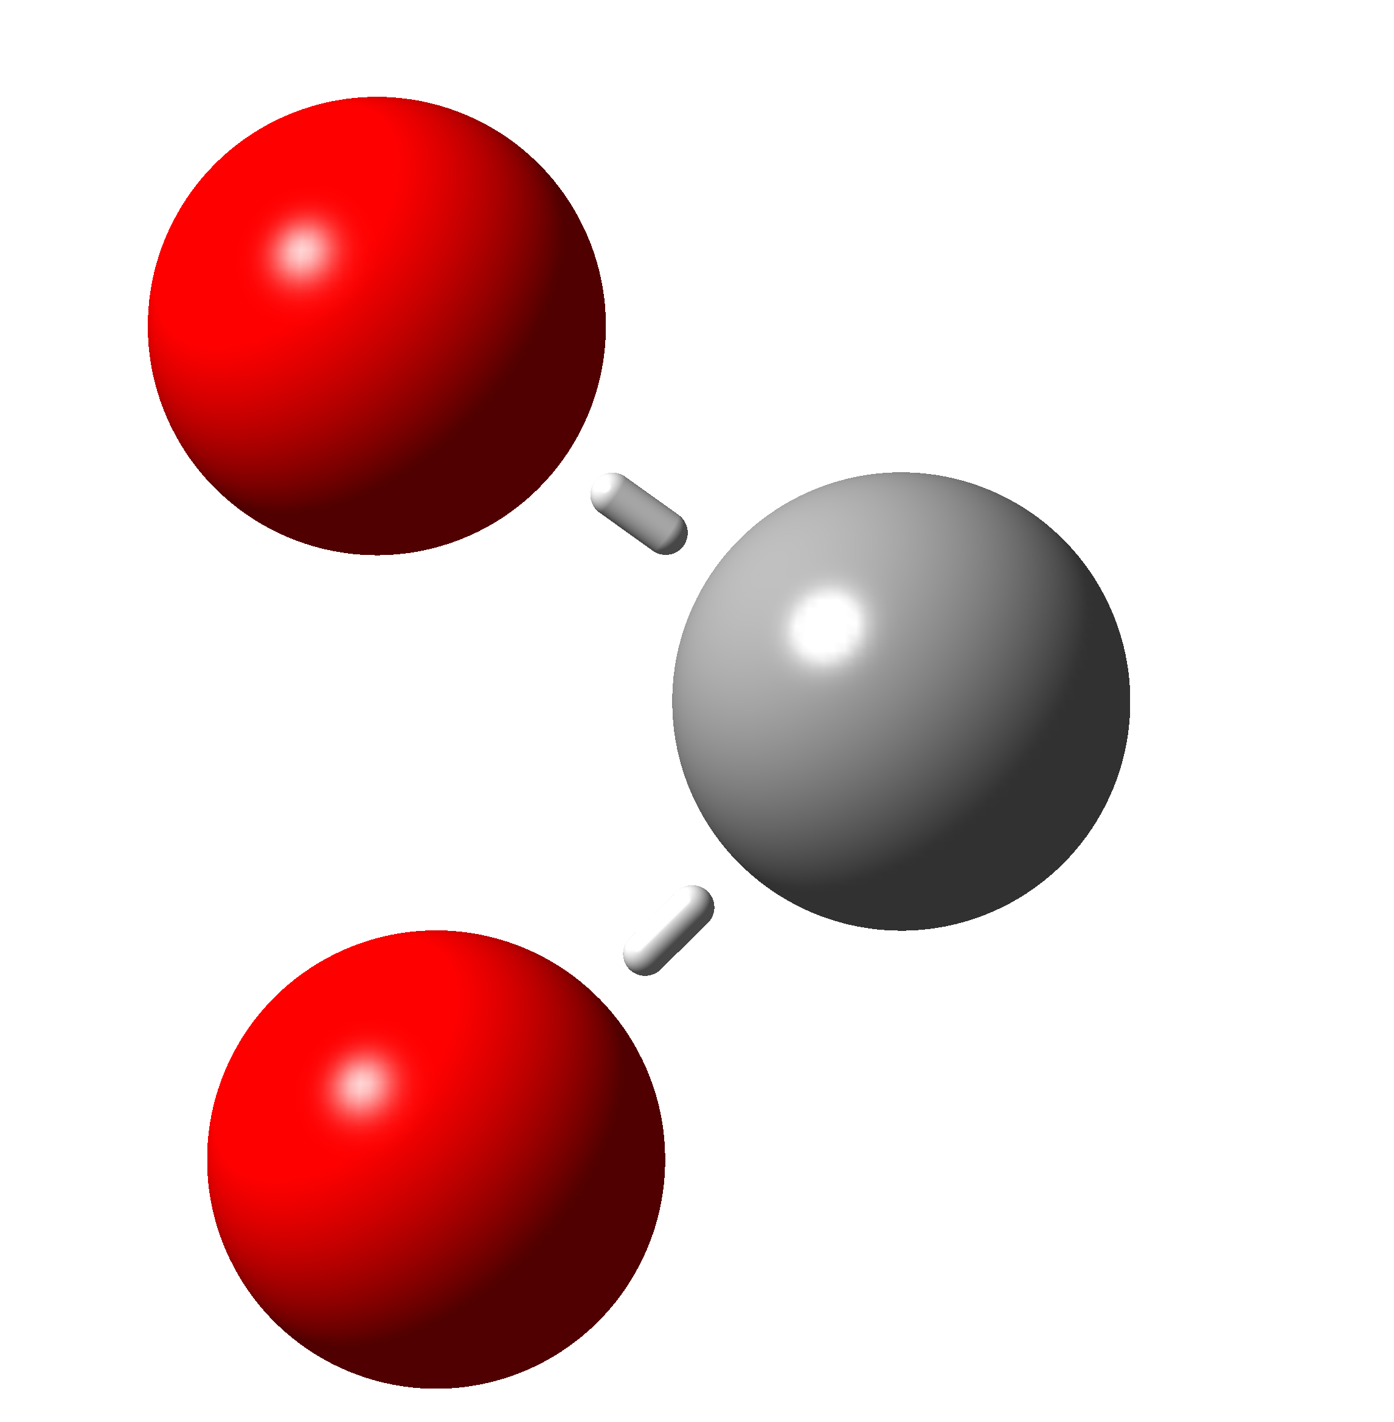
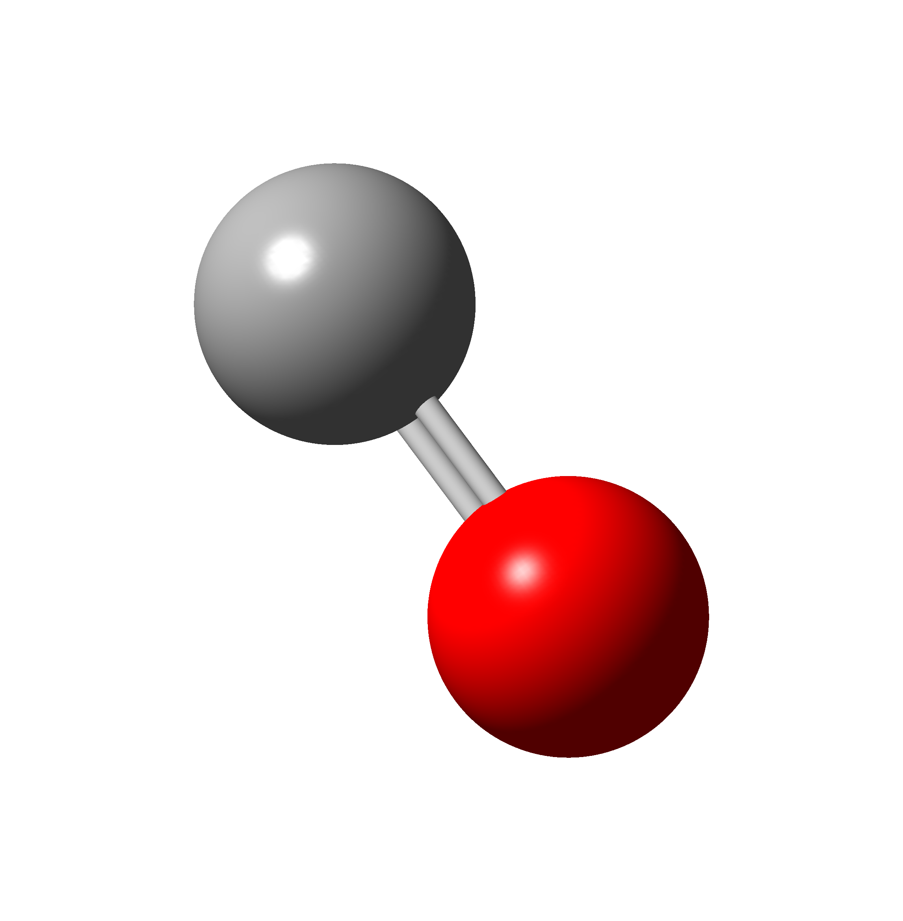
Machine Learning methods for a complete TGA analysis
Characterization of La_{1-x}Ca_{x}NiO_{3±δ} as catalyst precursors for dry methane reforming
Andres Marulanda-Bran
acamilo.marulanda@udea.edu.co
@marulandaandrec
Jose C-Salazar
jose.correas@udea.edu.co
@murderedhopes
Jaime Gallego
andres.gallego@udea.edu.co
@GallegoJaime_
Química de Recursos Energéticos y Medio Ambiente-QUIREMA., Instituto de Química, Universidad de Antioquia, Calle 70 no.52-21 Medellín, Colombia
Results
Conclusions
Problems such as multiple simultaneous chemical events make data analysis in chemistry a challenging issue. For that matter, more complex algorithms are needed to make sense out of the different processes behind these data. Machine learning brings powerful algorithms for data analysis, and their interpretability has recently been explored [1,2]. In this work we develop an interpretable-ML aided analytical framework for in-situ TGA process quantification, allowing us to estimate kinetic and thermodynamic parameters.
Arrhenius plot (automatic from script)
Ea vs Ca content
(automatic from script)
Interpretable neural networks were used to decompose and make sense of TGA data applied to key catalytic reactions, which allowed to estimate activation energies.
The non stoichiometry introduction of Ca into the material helps lower activation energies for key catalytical surface reactions.
Reaction Model
Massic calcium carbonate
NiO_{x}
Methodology
CaCO₃
~ 700
La₂O₃
CO₂ decompostion
Ni oxidatiom
CO production
Ni
~ 1180
A 0.3 Ca coefficient was found to be the most energetically efficient stoichiometry for CO₂ reduction on the catalytic surface.
Analytical framework: Fully-interpretable neuronal network
La₂O₃
NiO_{X}
La₂O₃
Weight (mg)
Ni
La₂O₃
Ni
CO₂ adsorption
On Ni nanoparticles
References
Initial catalysts
Superficial adsorption
Ni
~ 850
La₂O₃
CaO
Ni
Ni
La₂O₃
Rackauckas, C. et al. Universal Differential Equations for Scientific Machine Learning. (2020).
Zhang, Q., Wu, Y. N. & Zhu, S.-C. Interpretable Convolutional Neural Networks. (2017).
Gallego, J. et al. React. Kinet. Mech. Catal. 119, (2016).
La₂O₃
La₂O₃
~ 650
Carbonates decomposition
CO₂ desorption
Dry methane reforming reaction
In-situ CO₂ TGA and XRD
…doped with Ca
~250
~ 750
Ni
Reduced LaNiO₃
Ni
Ni
La₂O₂CO₃
La₂O₃
Temperature (℃)
La₂O₃
Ni
La₂O₃
La₂O₃
Superficial lanthanum
oxycarbonate
https://github.com/doncamilom/QuiremaTGADecomp

