Slide 1
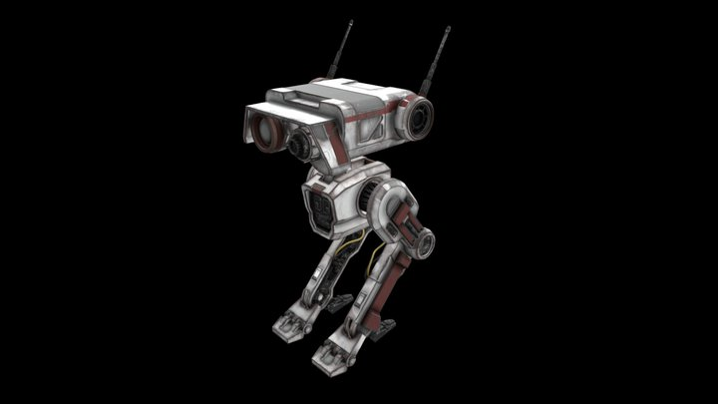
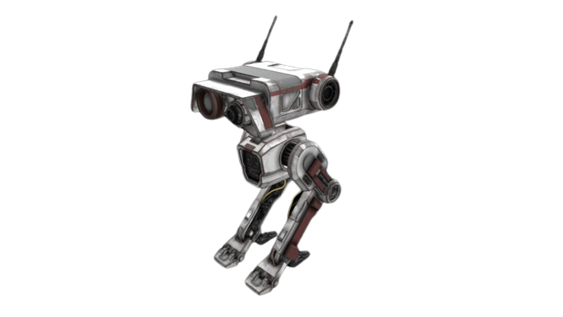
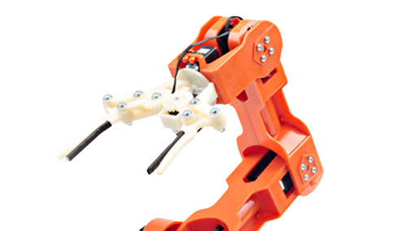
BIPEDAL ROBOTIC ARM RUNNER
An OpenGL-based game by Doncey Albin

