Slide 1
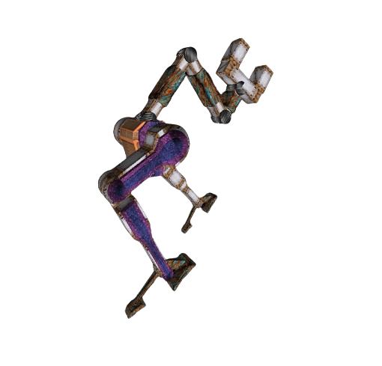
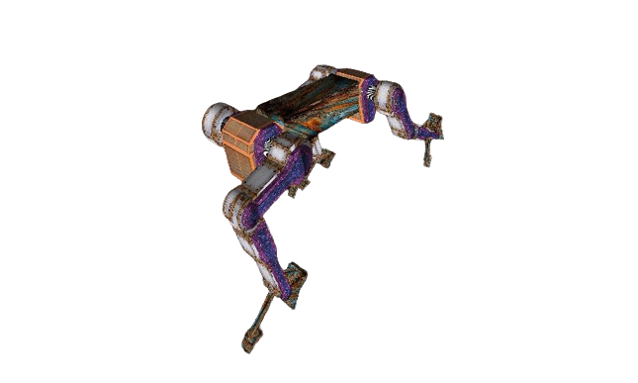
BRAR:
Bipedal Robotic Arm Runner
A Project by Doncey Albin

Slide 2
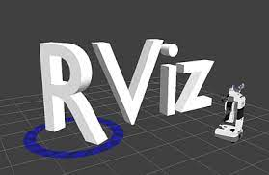
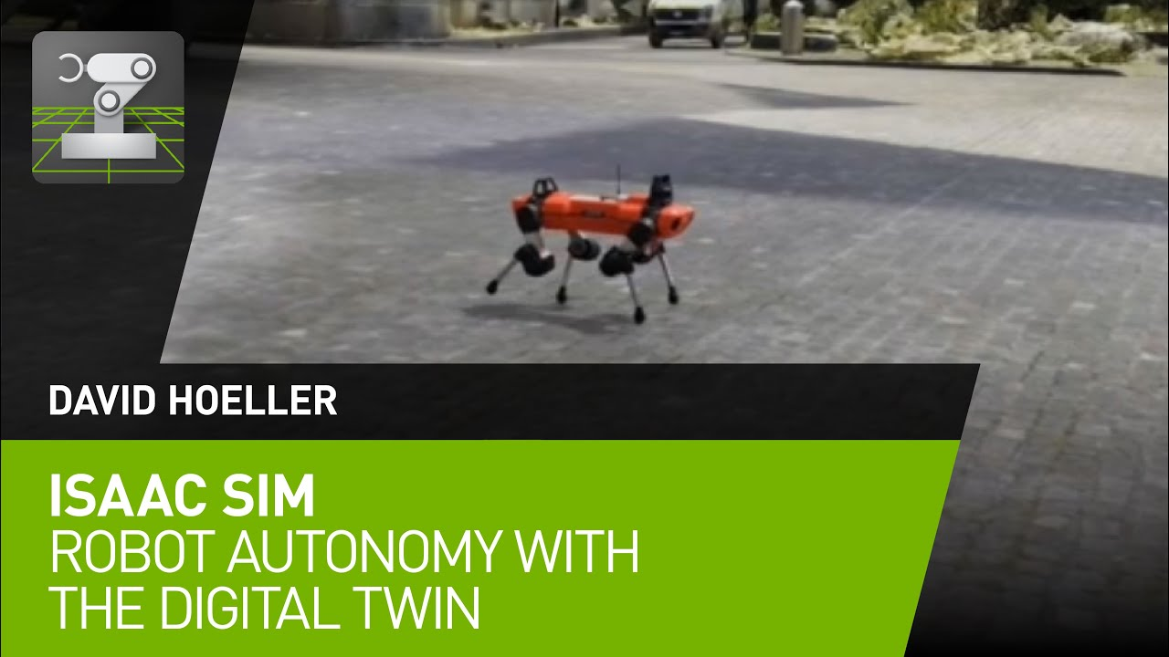
Introduction
Fuse robotics with interactive computer graphics for enhanced scientific visualization.
Slide 1

Slide 3
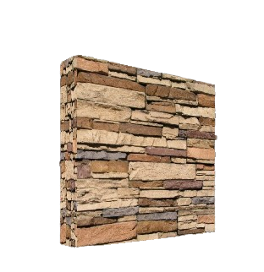
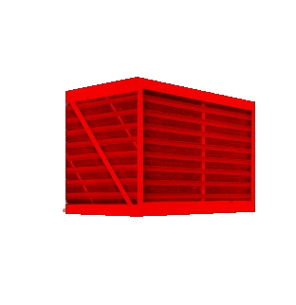
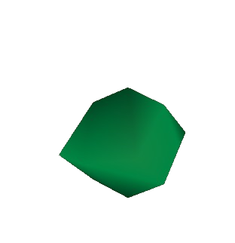
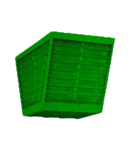
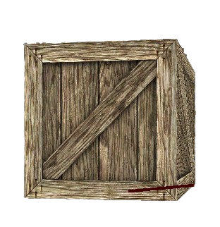
GAME MODES
1) RUNNER
+1 point
+1 point
+1 point
Slide 2

Slide 4

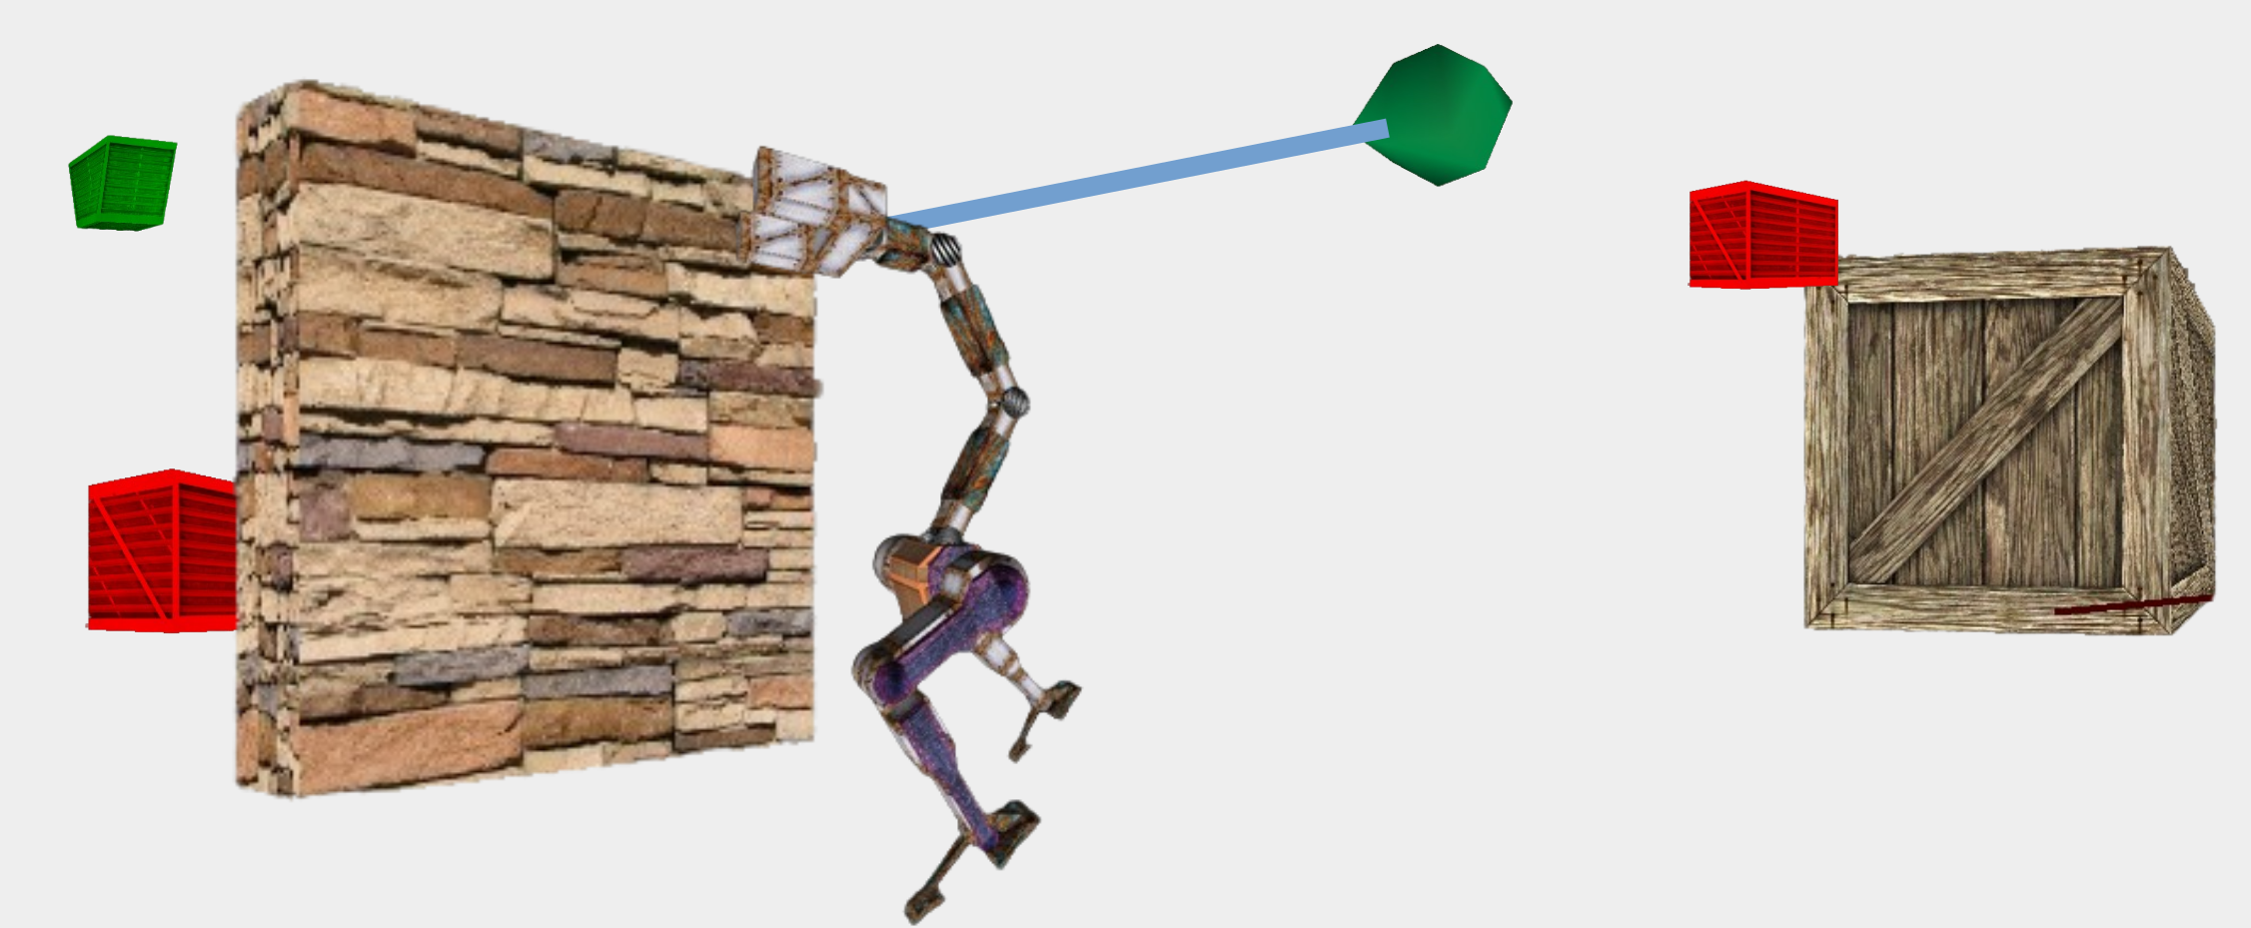
Introduction
1) RUNNER
2) TIME CRUNCH
+1 sec
+1 point
+1 sec
+1 point
-1 sec
-1 point
-1 sec
-1 point
Slide 2

Slide 5
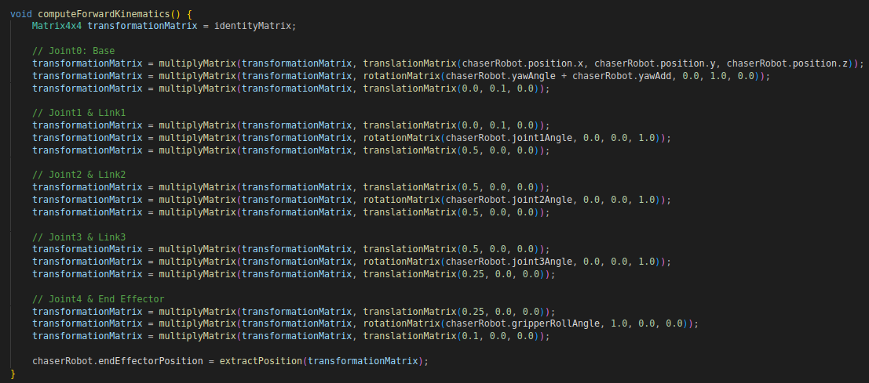
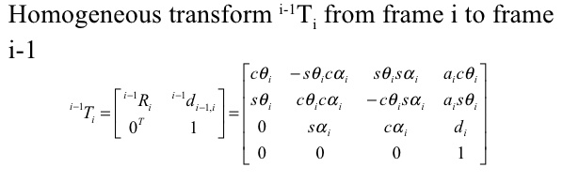
Robot Visualization and Control
Slide 3

Slide 6
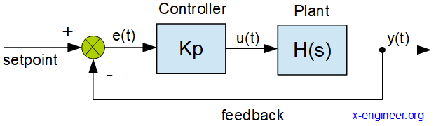
Robot Visualization and Control
Proportional Control
Slide 3

Slide 7
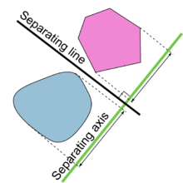
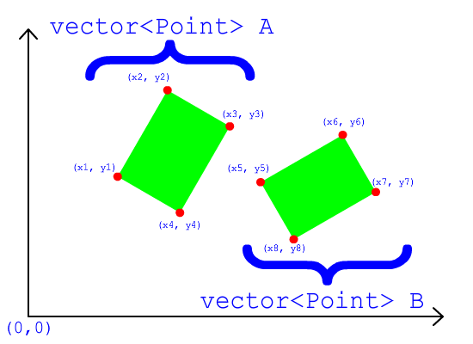
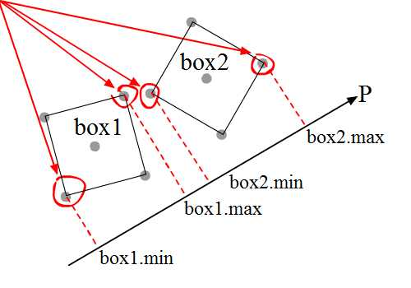
Object Collision Detection
Axis Aligned Bounding Boxes
Object Oriented Bounding Boxes
Slide 4

Slide 8
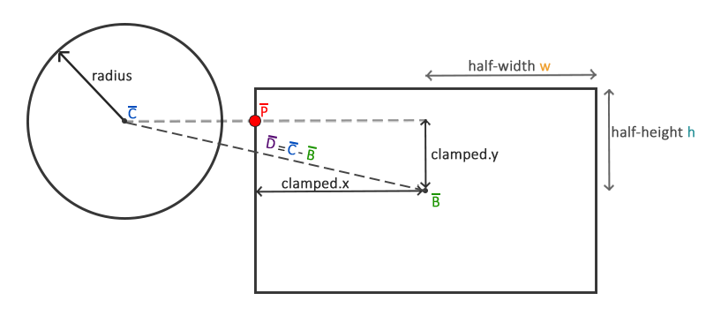
Object Collision Detection
Frame aligned Axis Aligned Bounding Boxes
Slide 4

Slide 9
Object Collision Detection
Slide 4

Slide 10
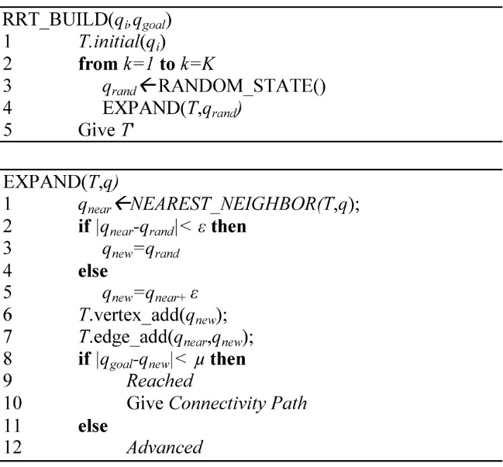
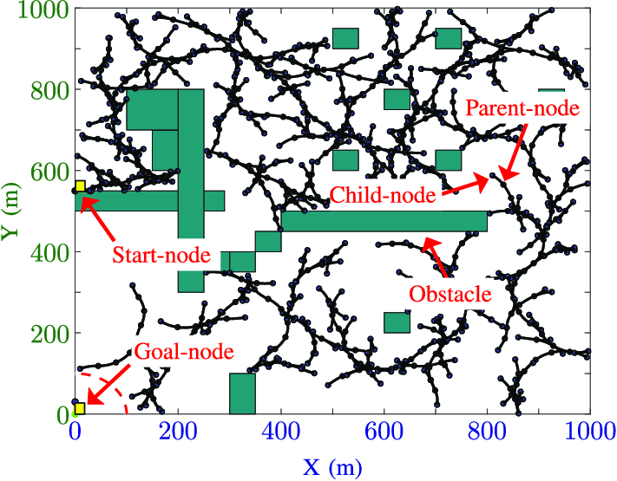
Path Finding in Dynamic Scenes
RRT*
Slide 5

Slide 11
Path Finding in Dynamic Scenes
Slide 5

Slide 12
Thank You

