Slide 1
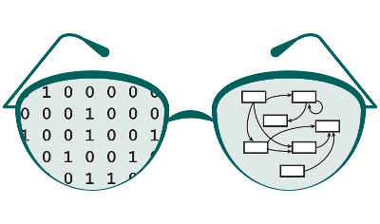
GRNsight Project Proposal
Nicole Anguiano
1/23/17
CMSI 402

Slide 2
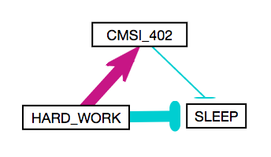
Project Description
Web app and service for visualizing models of small to medium-sized gene regulatory networks
Originally intended to work alongside GRNmap
Can theoretically be extended to anything that uses a matrix as a data model
Takes in an XLSX/SIF/GraphMl file and outputs a weighted or unweighted graph
Target Audience: Systems Biologists

Slide 3
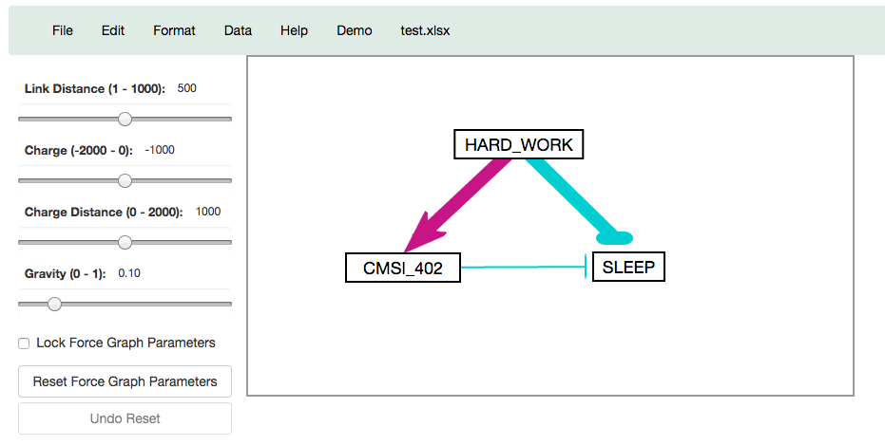
Users Point of View

Slide 4
Operations and Technologies
Two Major Parts: Server and Web-Client
Server: Node.js, Express, Node-Xlsx
Web-Client:
Visuals: Jade, Jekyll, Stylus, Bootstrap
Graph Visualization: D3.js
Testing Framework: Mocha and Chai

Slide 5
Preliminary Development Schedule
Weeks 1-4: Website Redesign
Weeks 5-8: Node Coloring
Weeks 8-12: Alternate Graph Layouts
Weeks 12-17: Graph Optimization
Reach Goal: User Login + Graph Saving
Ongoing: Optimizations/ES6 Conversion

Slide 6
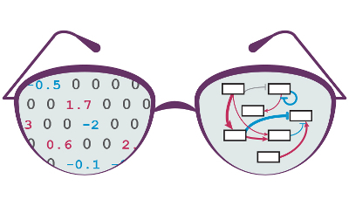
Questions?

