Slide 1
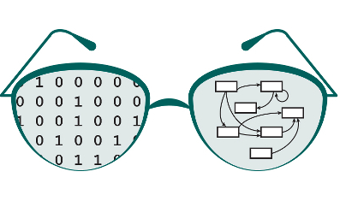


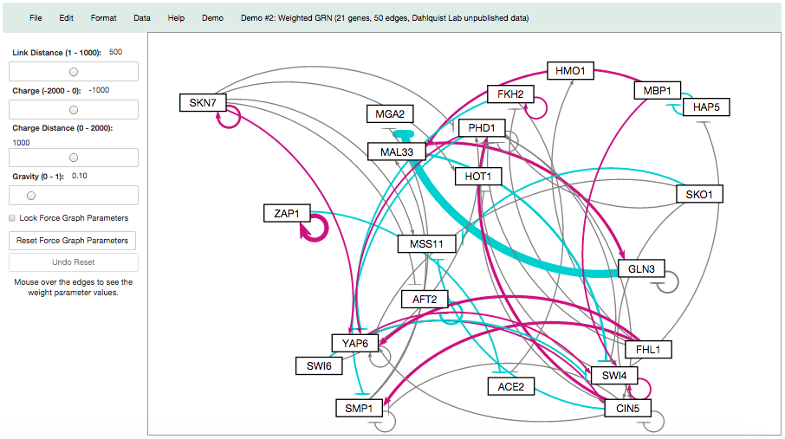
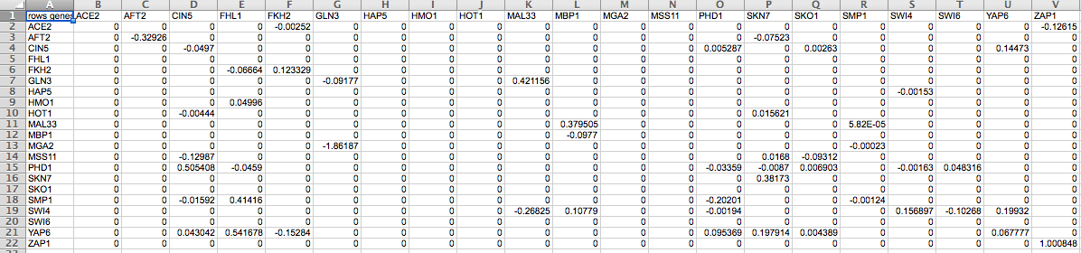

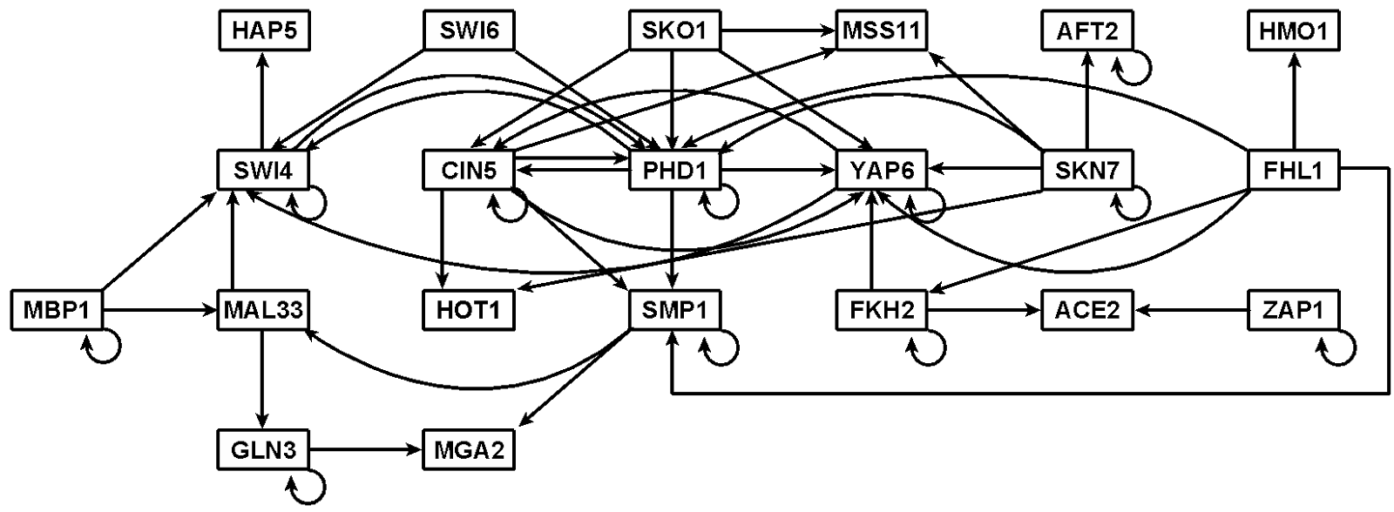
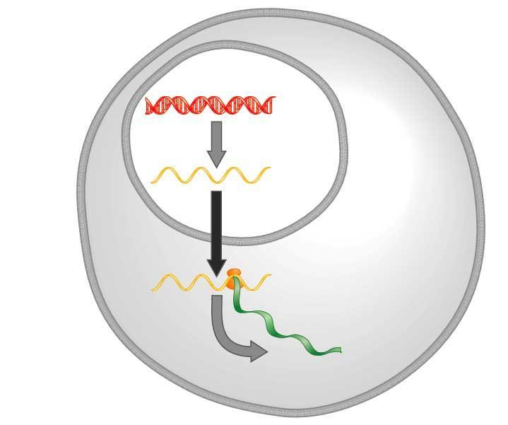
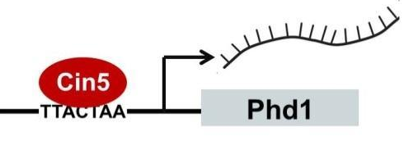
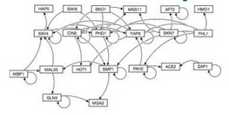

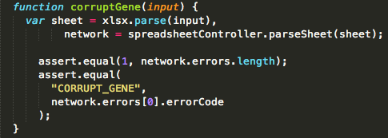
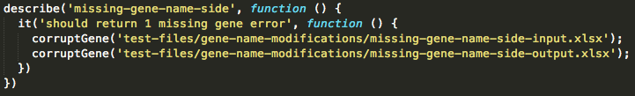
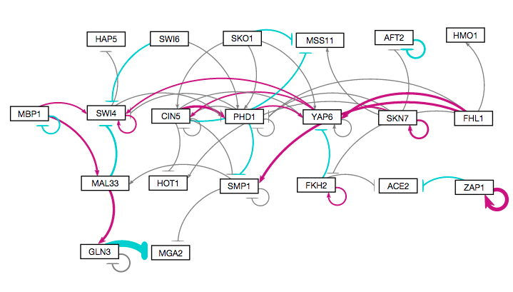
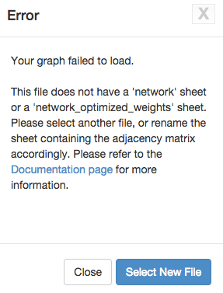
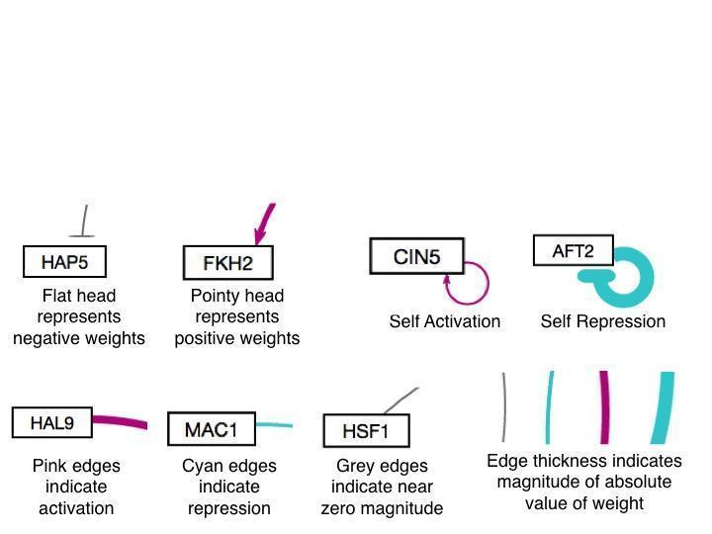
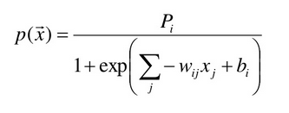
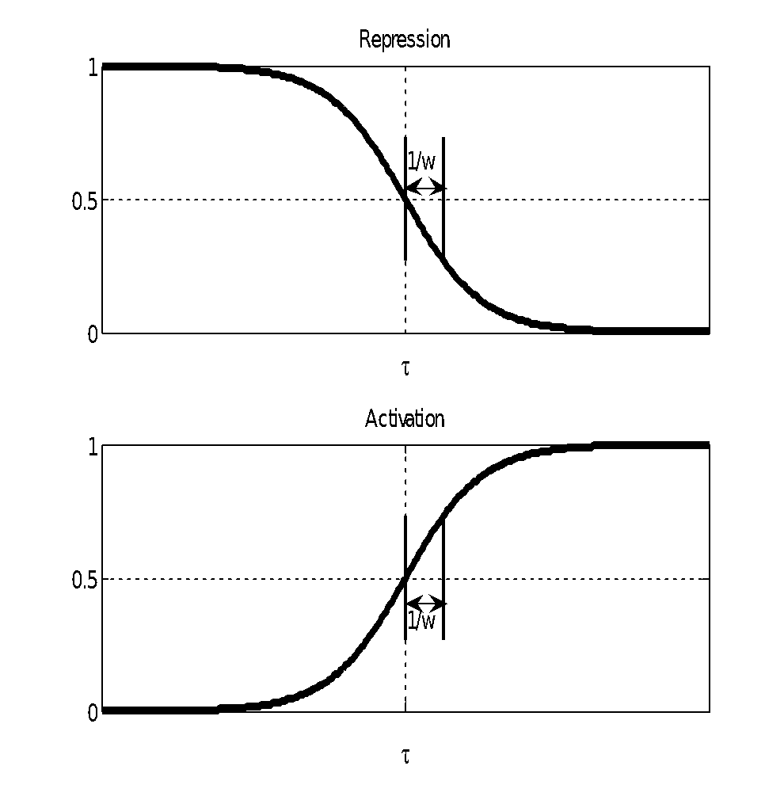
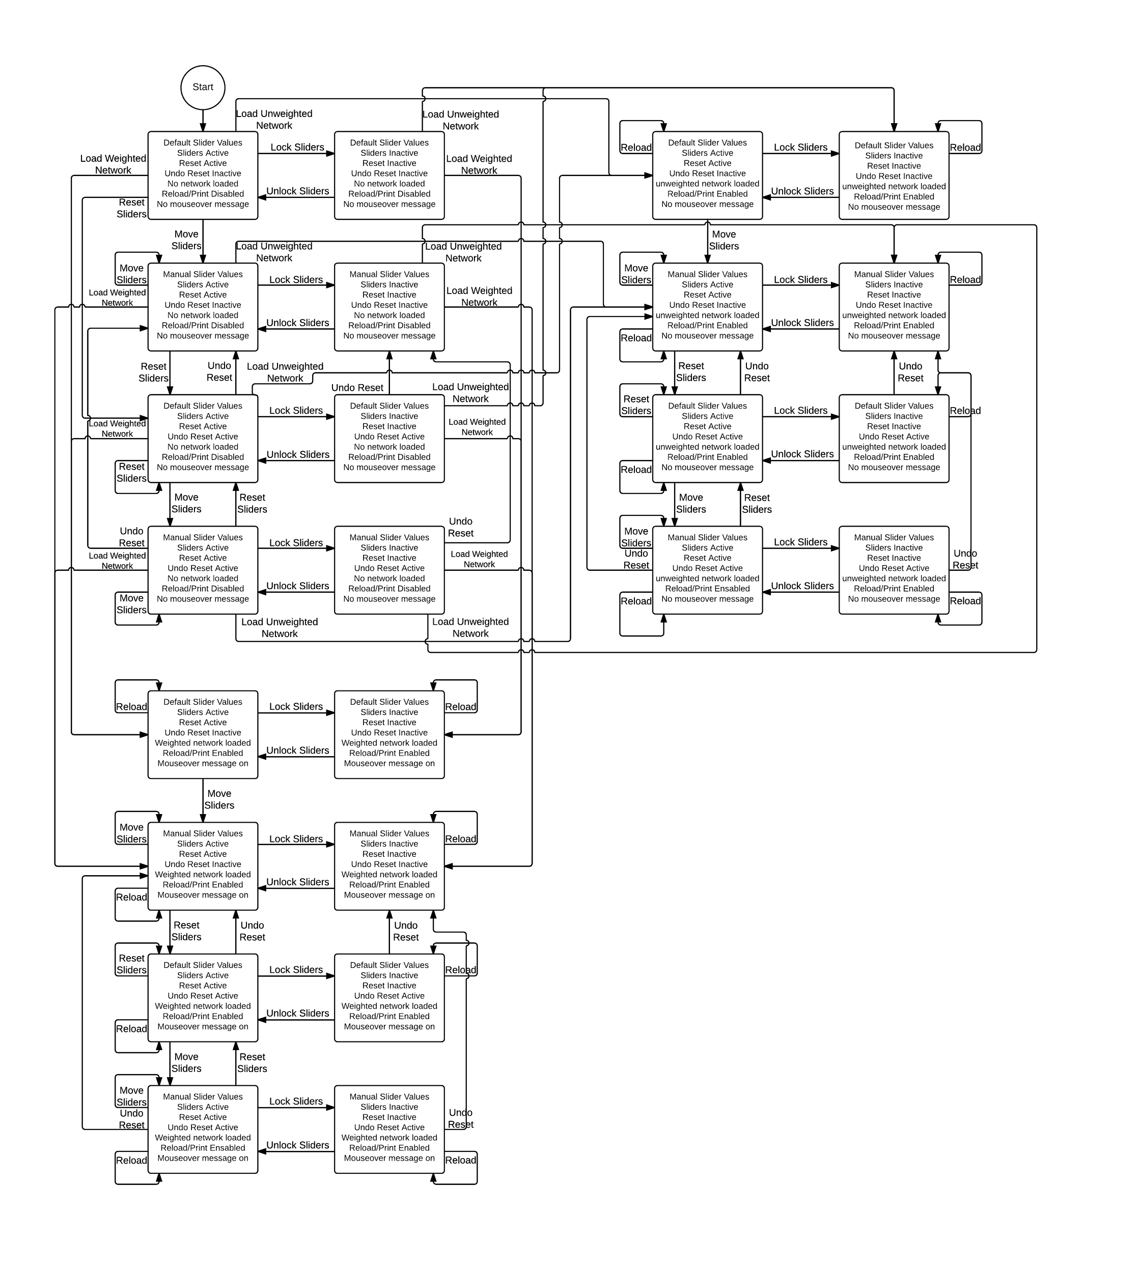
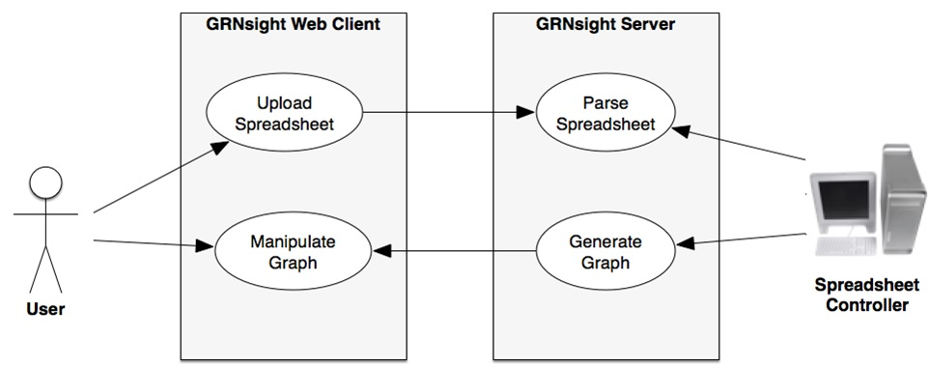
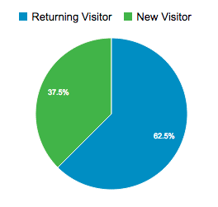
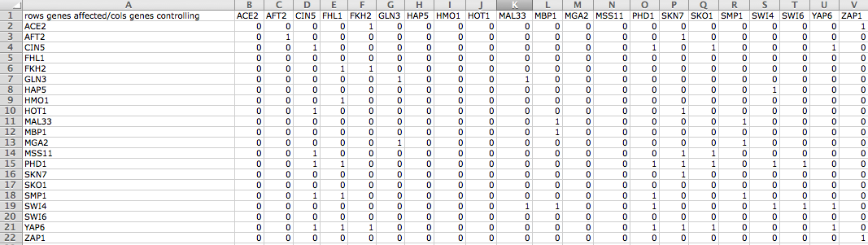
Improvements to GRNsight: a Web Application for
Visualizing Models of Gene Regulatory Networks
Nicole Anguiano*, Anindita Varshneya**, Kam D. Dahlquist**, John David N. Dionisio*, and Ben G. Fitzpatrick***
*Department of Electrical Engineering and Computer Science, **Department of Biology, ***Department of Mathematics, Loyola Marymount University, 1 LMU Drive, Los Angeles, CA 90045
http://dondi.github.io/GRNsight/
Gene Regulatory Networks Can Be Illustrated by Directed Graphs
GRNsight Automatically Lays Out Unweighted and Weighted Networks
Implemented Mocha Unit Testing Framework
The central dogma of molecular biology describes the flow of information in a cell during gene expression from DNA to RNA to protein.
Transcription factors control gene expression by binding to regulatory DNA sequences.
Activators increase gene expression.
Repressors decrease gene expression.
Transcription factors are themselves proteins encoded by genes.
Freeman (2002)
A gene regulatory network (GRN) consists of genes, transcription factors, and the regulatory connections between them, which govern the level of expression of mRNA and proteins from those genes.
Each node represents the gene, the mRNA, and the protein expressed from the gene.
Each edge represents a regulatory relationship.
All the nodes are transcription factors themselves.
Beta Version Allows for Testing of New Features
A beta version of GRNsight was created to allow for testing of new features and catching any potential new errors before releasing to the master set of code.
New Unit Testing Framework Implemented
Unit testing is a software testing method by which individual units of source code are tested to determine whether they are fit for use.
Prior to implementing the unit testing framework, each test spreadsheet was manually uploaded onto the website to test for errors.
Unit testing is now executed through Mocha, a JavaScript test framework running on node.js.
All tests are written in Chai, a behavior-driven development/test-driven development assertion library for node.js.
Sample Code
Excel Spreadsheet
1
3. Weighted graph laid out automatically
Unweighted Graph drawn manually with Adobe Illustrator
1. Menu Bar
Four demo files can be found in the “Demo” menu for users who do not have their own data.
Print functionality is accessed from the “File” menu option.
“File > Reload” reloads the current graph with the active settings.
In the “Edit > Preferences” menu, the user can select for weighted graphs to be displayed as unweighted graphs.
2
Produced in several hours
Unweighted graph laid out automatically by GRNsight and adjusted by hand
2. Force Graph Parameter Sliders
Link distance determines the minimum distance between nodes.
Nodes have a charge, which repels or attracts other nodes.
The charge distance determines at what range a node’s charge will affect other nodes.
Gravity determines the strength of the force holding the nodes to the center of the graph.
Reset functionality sets all parameters to default settings
Locking the parameters prevents any further changes
Produced in ~10 milliseconds
Produced in ~5 minutes
3. Nodes, Edges, and Arrows
Edge thickness is based on a linear scale.
The absolute value of each weight parameter is normalized to a value between 0 and 1. Then the thicknesses of the lines are adjusted to vary continuously from the minimum thickness (for normalized weights near zero) to the maximum thickness (weights of 1).
Edges with negative weights (repression) are colored cyan; edges positive weights (activation) are colored magenta.
Edges with normalized weight values between -0.05 and 0.05 are colored grey to signify a weak influence on the target gene.
Weighted graph laid out automatically by GRNsight and adjusted by hand
Error Catching was Greatly Improved
Robustness was greatly extended.
Instead of crashing when given an improperly formatted or incorrect file, GRNsight returns an error.
Information about the error is returned to the user in a modal window, without crashing the server.
GRNmap: Gene Regulatory Network Modeling and Parameter Estimation
Produced in ~5 min
The MATLAB model is available at http://kdahlquist.github.io/GRNmap/
GRNmap is a differential equations model of the changes in gene expression over time for a gene regulatory network.
Each gene (node) in the network has an equation.
The parameters in the model are estimated from laboratory data.
The weight parameter, w, gives the direction (activation or repression) and magnitude of the regulatory relationship.
GRNmap produces an Excel spreadsheet with an adjacency matrix representing the network.
Future Directions
GRNsight Has Sophisticated Architecture and Follows Open Source Development Practices
Further expand and refine the unit testing framework.
Add node coloring based on expression data.
Implement different sizes for the graph drawing area.
Implement draggable edges to allow further graph customization.
Availability
GRNsight is free and open to all users and there is no login requirement.
Web site content is available under the Creative Commons Attribution Non-Commercial Share Alike license.
GRNsight code is available under the open source BSD license.
Usage is being tracked through Google Analytics.
504 total visitors
as of 19 March 2015
GRNsight has a service-oriented architecture
GRNsight has two pieces: a server and a web client.
The server uses the node.js framework to receive and parse the Excel spreadsheet uploaded by the user.
The web client receives the data from the server and generates the graph visualization.
0 represents no relationship.
Initially, 1 represents a regulatory relationship where the gene specified by the column controls the gene specified by the rows.
After the parameters have been estimated, a positive weight value indicates activation and a negative weight value indicates repression.
The magnitude of the weight defines the strength of the relationship.
However, GRNmap does not generate a visual representation of GRNs
Acknowledgments
The User Interface is Compatible with Firefox and Chrome Browsers
File upload is through a simple HTML form element.
Nodes are displayed as interactive HTML elements, and can be clicked and moved.
GRNsight implementation takes advantage of other open source tools
GRNsight uses the Data-Driven Documents (D3) JavaScript library to generate a graph derived from input network data.
D3 dynamically manipulates HTML and Scalable Vector Graphics (SVG) to form the elements of the graph.
GRNsight implements D3’s force layout algorithm which applies a physics-based simulation to the graph.
D3 also allows for the fine tuning of Cascading Style Sheets (CSS), the code that styles web pages.
GRNsight follows an open development model using an open source github.com code repository and issue tracking.
This work is partially supported by NSF award 0921038 (Kam D. Dahlquist, Ben G. Fitzpatrick) and by the Loyola Marymount University Rains Research Assistant Program (Nicole Anguiano).
GRNsight Accepts Microsoft Excel Files (.xlsx) in the Proper Format
References
Excel workbooks need a “network” sheet (for unweighted graphs) or a “network_optimized_weights” sheet (for weighted graphs).
The adjacency matrix can be symmetrical or asymmetrical.
GRNmap input and output workbooks are accepted without adjustment.
Adjacency matrices generated from other databases, such as YEASTRACT, can be used with some modification.
Chai: http://chaijs.com/
D3.js: http://d3js.org/
Express Framework: http://expressjs.com/
Freeman, S. (2002) Biological Science. Upper Saddle River, New Jersey: Prentice Hall.
GRNmap: http://kdahlquist.github.io/GRNmap/
node.js: http://nodejs.org/
Mocha: http://mochajs.org/
Notes:
Kill abstract
Change to sans serif font
Make title bigger
Make title background white
Use full names
Super script to associate names with correct department
Background color: make it dark green, make writing on white background and writing in black/dark green
4 columns!!!
Smaller pictures
Bold titles
References can be 12pt
Acknowledgements can be 16pt
Everything else is 18-24pt
Titles don’t need to be bigger than 36pt
Remove circles from the arrowhead diagram, group the related labels together
Include menu bar
Testing/error handling – sample error (we don’t crash with errors!)
Mouseovers for edges screenshot

