Slide 1
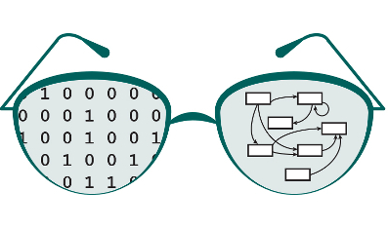

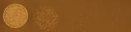
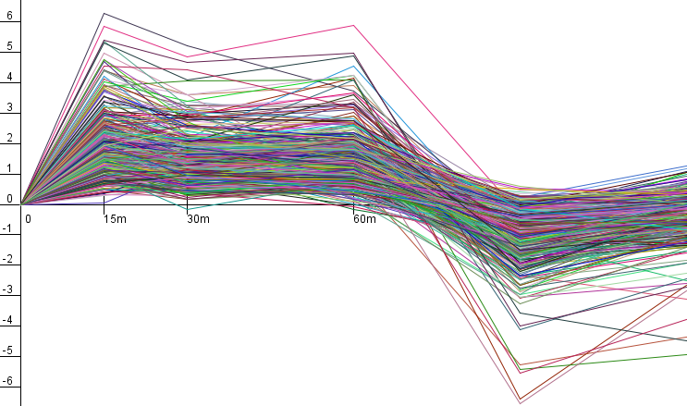
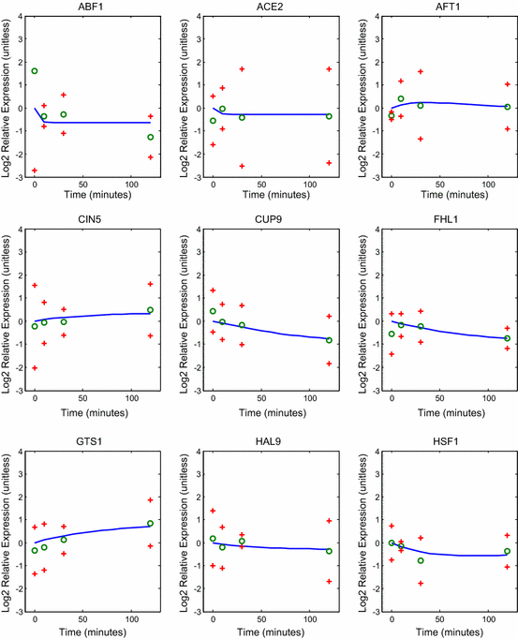
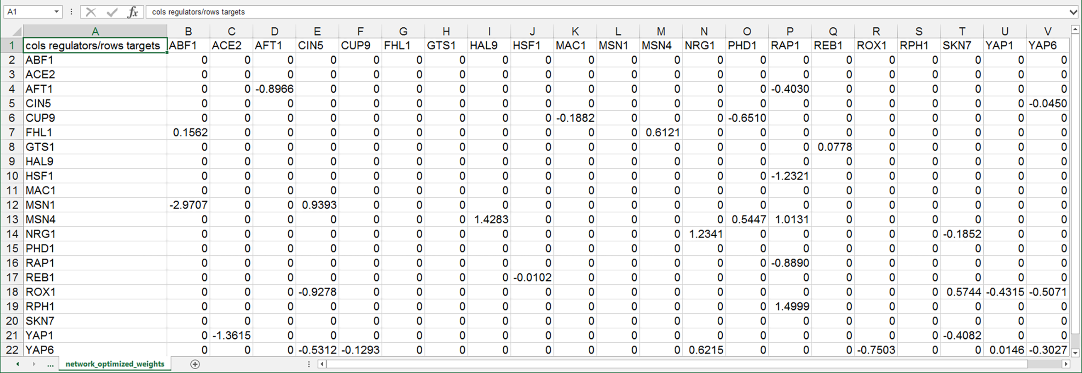
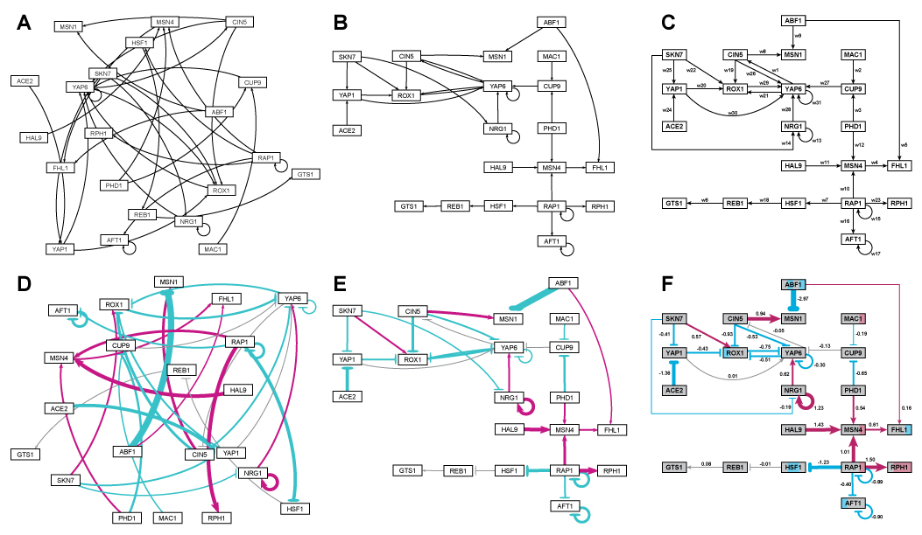
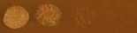
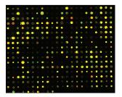
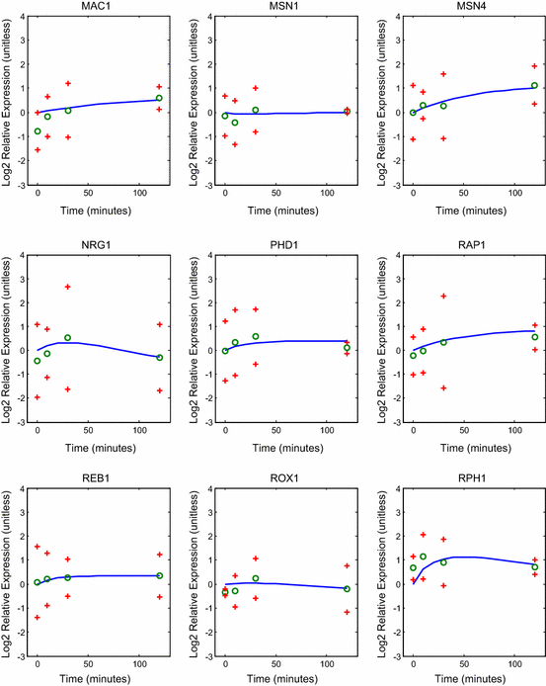
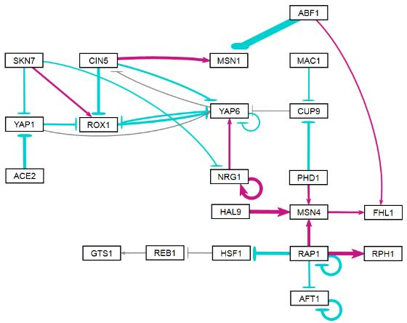
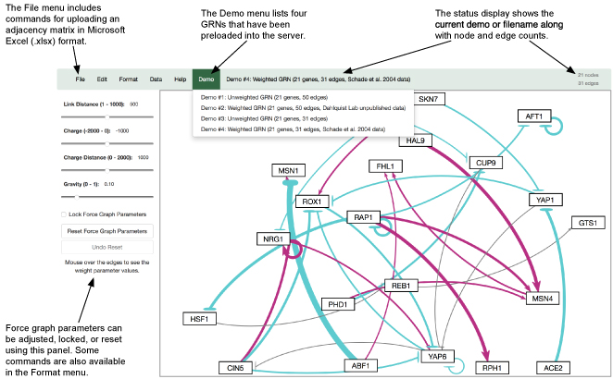
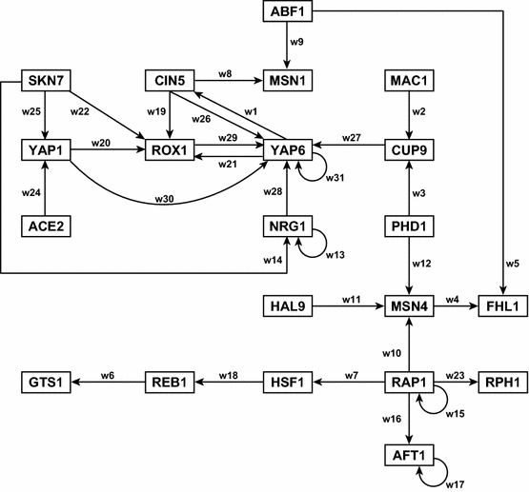
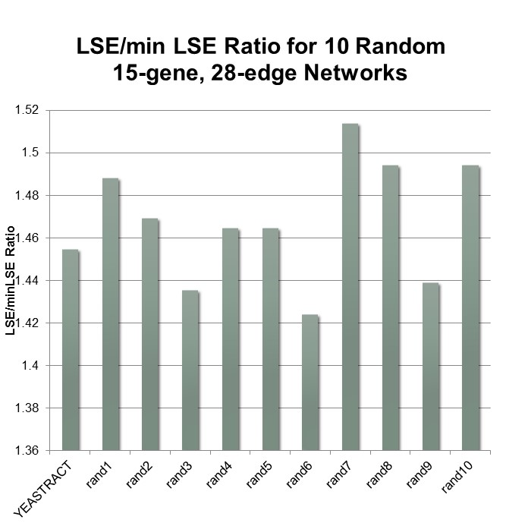
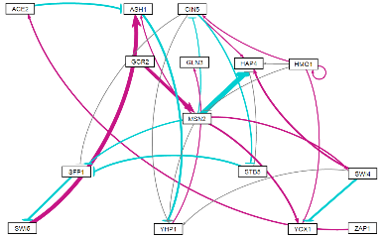
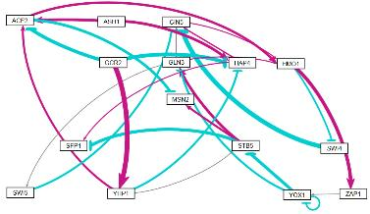
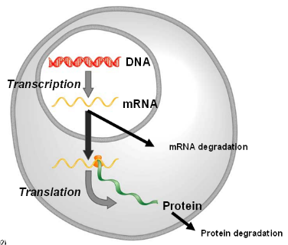
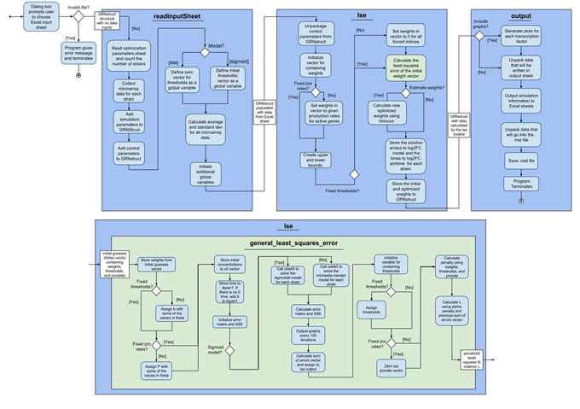
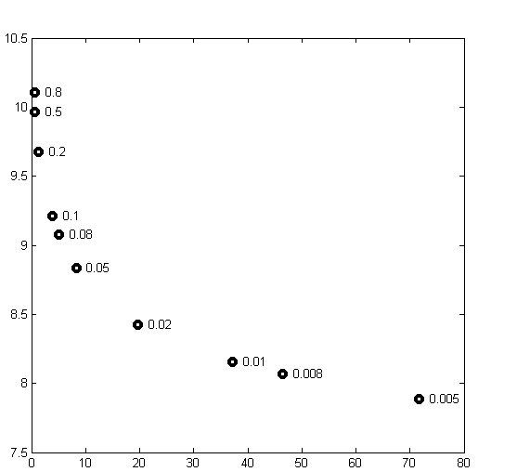
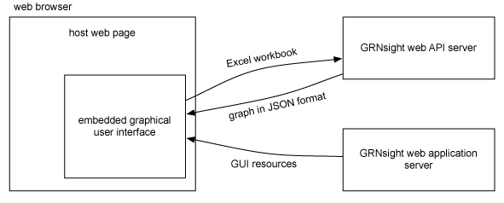
GRNmap and GRNsight: Open Source Software for Dynamical Systems
Modeling and Visualization of Medium-Scale Gene Regulatory Networks
Kam D. Dahlquist¹, Ben G. Fitzpatrick², John David N. Dionisio³, Nicole A. Anguiano^{1,3}, Juan S. Carrillo^{2,3}, Tessa A. Morris^{1,2}, Anindita Varshneya^{1,3}, Natalie E. Williams^{1,2},
K. Grace Johnson^{2,4}, Trixie Anne M. Roque², Kristen M. Horstmann^{1,2}, Mihir Samdarshi¹, Chukwuemeka E. Azinge³, Brandon J. Klein¹, Margaret J. O’Neil^{1,2}
Departments of ¹Biology, ²Mathematics, ³Electrical Engineering & Computer Science, ⁴Chemistry & Biochemistry, Loyola Marymount University, 1 LMU Drive, Los Angeles, CA 90045 USA
http://kdahlquist.github.io/GRNmap/ and http://dondi.github.io/GRNsight/
Systems biology approach to understanding the regulation of the cold shock response in yeast
Forward simulation of the model fits the data.
GRNmap produces a weighted adjacency matrix.
GRNsight facilitates the quick visualization and interpretation of GRN model results.
wt
15°C
Cold shock microarray data from wt and TF deletion strains
Relative expression level is plotted as Log₂ fold change (ratio) over time.
The solid blue curve in each panel gives the model with the best fit parameters.
The green circles represent the data, and the red crosses provide a 95 % confidence interval for the data.
The upper point of the confidence interval for ABF1 at t₀ extends outside of the graphic coordinate limits.
Δash1
Interpretation,
new questions, new experiments
Normalization, statistical analysis, clustering
Visualization of modeling results using GRNsight
Derivation of gene regulatory networks from YEASTRACT
Screenshot of the Excel worksheet produced by GRNmap containing the optimized regulatory weights.
This format is directly read by GRNsight.
Dynamical systems modeling using GRNmap
GRNsight, a web application and service for visualizing small- to medium-scale models of gene regulatory networks, automatically lays out the network graph.
A “medium-scale” gene regulatory network that regulates the cold shock response
Dahlquist et al. (2015)
Side-by-side comparison of the same adjacency matrices laid out by GRNsight and by hand. A) GRNsight automatic layout of the demonstration file, Demo #3: Unweighted GRN (21 genes, 31 edges); B) graph from (A) manually manipulated from within GRNsight; C) the same adjacency matrix from (A) and (B) laid out entirely by hand in Adobe Illustrator, corresponding to Figure 1 of Dahlquist et al., (2015); D) GRNsight automatic layout of the demonstration file, Demo #4: Weighted GRN (21 genes, 31 edges, Schade et al. 2004 data); E) graph from (D) manually manipulated from within GRNsight; F) the same adjacency matrix from (D) and (E) laid out entirely by hand in Adobe Illustrator, corresponding to Figure 8 of Dahlquist et al., (2015).
Note that this type of “by hand” manipulation of graphs is most useful for small- to medium-scale networks, the kind that GRNsight is designed to display, and would not be appropriate for large networks. GRNsight is best-suited for visualizing networks of fewer than 35 nodes and 70 edges, although it accepts networks of up to 75 nodes or 150 edges.
Assumptions made in our model:
Each node represents one gene encoding a transcription factor.
When a gene is transcribed, it is immediately translated into protein.
A node represents the gene, the mRNA, and the protein.
Each edge represents a regulatory relationship, either activation or repression, depending on the sign of the weight.
Generally, networks with the same nodes, but randomized edges perform more poorly.
YEASTRACT-derived
Dahlquist et al. (2015)
“random network 7”
Future Directions
GRNmap: Gene Regulatory Network modeling and parameter estimation
GRNsight’s diagrams are based on D3.js’s force graph layout algorithm (Bostock, Ogievetsky, and Heer, 2011), which was then extensively customized.
The nodes were made rectangular; a label of up to 12 characters was added; node size was varied, depending on the size of the label.
The edges display as directed edges. They are implemented as Bezier curves that straighten when nodes are close together and curve when nodes are far apart. A special case was added to form a looping edge if a node regulated itself.
When an unweighted adjacency matrix is uploaded, all edges are displayed as black with pointed arrowheads. When a weighted adjacency matrix is uploaded, edges are further customized based on the sign and magnitude of the weight parameter. Activation (for positive weights) is represented by pointed arrowheads, and repression (for negative weights) is represented by a blunt end marker.
The thickness of the edge also varies based on the magnitude of the absolute value of the weight. GRNsight divides all weight values by the absolute value of the maximum weight in the adjacency matrix to normalize all the values to between zero and 1. GRNsight then adjusts the thickness of the lines to vary continuously from the minimum thickness (for normalized weights near zero) to maximum thickness (normalized weight of 1).
Edges with positive normalized weight values from 0.05 to 1 are colored magenta; edges with negative normalized weight values from -0.05 to -1 are colored cyan. Edges with normalized weight values between -0.05 and 0.05 are colored grey to emphasize that their normalized magnitude is near zero and that they have a weak influence on the target gene.
When a user mouses over an edge, the numerical value of the weight parameter is displayed.
When the user drags nodes to customize his or her view of the network, edges adapt their anchor points to the movements of the nodes.
Due to GRNmap’s technical debt of a longstanding project, we need to improve its test coverage to match the coverage of GRNsight (right), a project which was initiated with test-driven development.
GRNsight will compute and present graph statistics.
GRNsight will add node coloring based on expression data, as shown in the figure above (part F).
GRNsight Test Coverage Statistics
Statements: | 112/162 (69.1%)
Branches: | 59/68 (86.8%)
Functions: | 15/24 (62.5%)
Lines: | 112/157 (71.3)%
Software refactoring facilitates new feature development.
Dahlquist et al. (2015)
Availability
Model is coded in MATLAB.
The user has a choice to model the dynamics based on a sigmoidal (shown) or Michaelis-Menten production function.
Weight parameter, w, gives the direction (activation or repression) and magnitude of regulatory relationship.
GRNsight is free and open to all users at http://dondi.github.io/GRNsight/, and there is no login requirement.
GRNsight code is available under the open source BSD license at our GitHub repository at https://github.com/dondi/GRNsight.
GRNmap MATLAB code and executable can be downloaded from http://kdahlquist.github.io/GRNmap/downloads.html under the BSD license.
Usage is being tracked through Google Analytics.
Although originally developed with yeast data, both GRNmap and GRNsight can be used with any species for which you have time course gene expression data or an unweighted or weighted adjacency matrix, respectively.
Freeman (2002)
Optimization of the large number of parameters required the use of a regularization (penalty) term.
Acknowledgments
We refactored the script-based software with global variables into a function-based package that uses an object to carry relevant information from function to function. This modular approach allows for cleaner, less ambiguous code and increased maintainability.
We have also implemented a unit-testing framework.
We have used the MATLAB compiler to create an executable file that can be run on any Windows machine without the need of a MATLAB license.
New features include an option to use a Michaelis-Menten production function as well as the sigmoidal production function, the ability to input replicate expression data instead of the means for each timepoint, and the option to include data for experiments in which a transcription factor was deleted from the network, among others.
This work is partially supported by NSF award 0921038 (K.D.D., B.G.F.), a Kadner-Pitts Research Grant (K.D.D.), the Loyola Marymount University Summer Undergraduate Research Program (J.S.C., T.A.M.R., A.V.), an LMU Honors Summer Research Fellowship (K.G.J., N.E.W.), and the LMU Rains Research Assistant Program (N.A.A, T.A.M.).
Total number of parameters is (2 X no. of genes) + no. of edges.
We added a penalty term so that MATLAB’s optimization algorithm would be able to minimize the function.
θ is the combined production rate, weight, and threshold parameters.
α is determined empirically from the “elbow” of the
L-curve.
References
GRNsight is written in JavaScript, with diagrams facilitated by D3.js, a data visualization library. Node.js and the Express framework handle server-side functions.
Bostock M., Ogievetsky V., & Heer J. (2011) D³: Data-Driven Documents. IEEE transactions on visualization and computer graphics, 17:2301–2309. DOI: 10.1109/TVCG.2011.185
Dahlquist, K.D., Fitzpatrick, B.G., Camacho, E.T., Entzminger, S.D., & Wanner, N.C. (2015) Parameter Estimation for Gene Regulatory Networks from Microarray Data: Cold Shock Response in Saccharomyces cerevisiae. Bulletin of Mathematical Biology, 77(8), 1457-1492. DOI: 10.1007/s11538-015-0092-6
Dahlquist, K.D., Dionisio, J.D.N., Fitzpatrick, B.G., Anguiano, N.A., Varshneya, A., Southwick, B.J., & Samdarshi, M. (2016) GRNsight: a web application and service for visualizing models of small- to medium-scale gene regulatory networks. PeerJ Preprints 4:e2068v1. DOI: 10.7287/peerj.preprints.2068v1
Freeman, S. (2002) Biological Science. Upper Saddle River, New Jersey: Prentice Hall.
Teixeira, M.C., Monteiro, P.T., Guerreiro, J.F., Gonçalves, J.P., Mira, N.P., dos Santos, S.C., ... & Madeira, S.C. (2014) The YEASTRACT database: an upgraded information system for the analysis of gene and genomic transcription regulation in Saccharomyces cerevisiae. Nucleic Acids Research, 42(D1), D161-D166. DOI: 10.1093/nar/gkt1015
Least Squares Residual
Parameter Penalty Magnitude
Dahlquist et al. (2015)
Notes:
Kill abstract
Change to sans serif font
Make title bigger
Make title background white
Use full names
Super script to associate names with correct department
Background color: make it dark green, make writing on white background and writing in black/dark green
4 columns!!!
Smaller pictures
Bold titles
References can be 12pt
Acknowledgements can be 16pt
Everything else is 18-24pt
Titles don’t need to be bigger than 36pt
Remove circles from the arrowhead diagram, group the related labels together
Include menu bar
Testing/error handling – sample error (we don’t crash with errors!)
Mouseovers for edges screenshot

