Slide 1
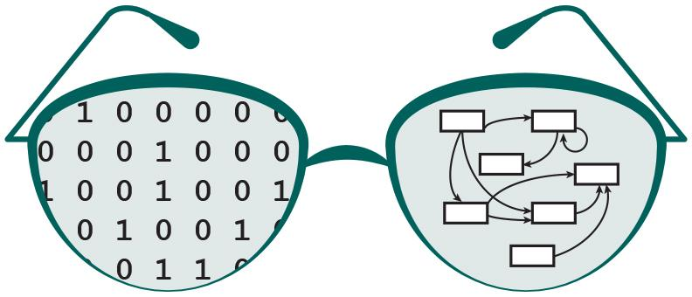

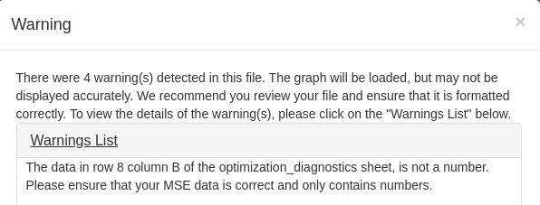
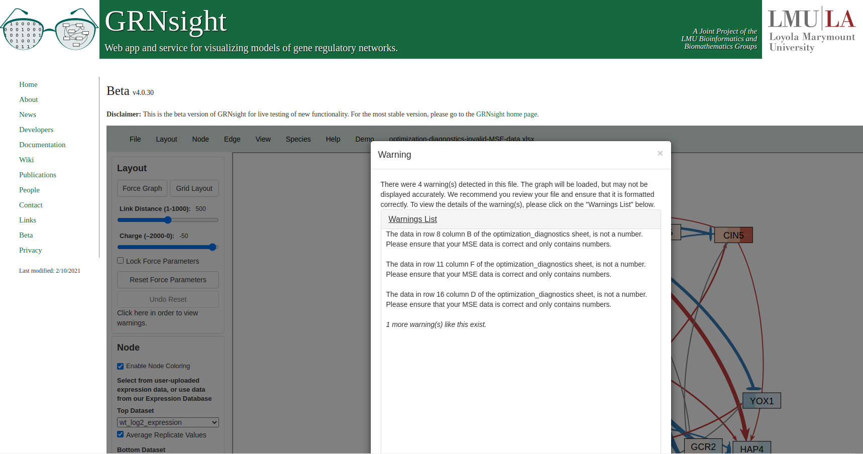
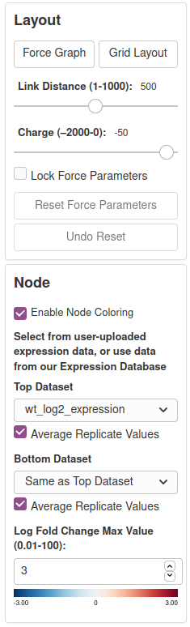
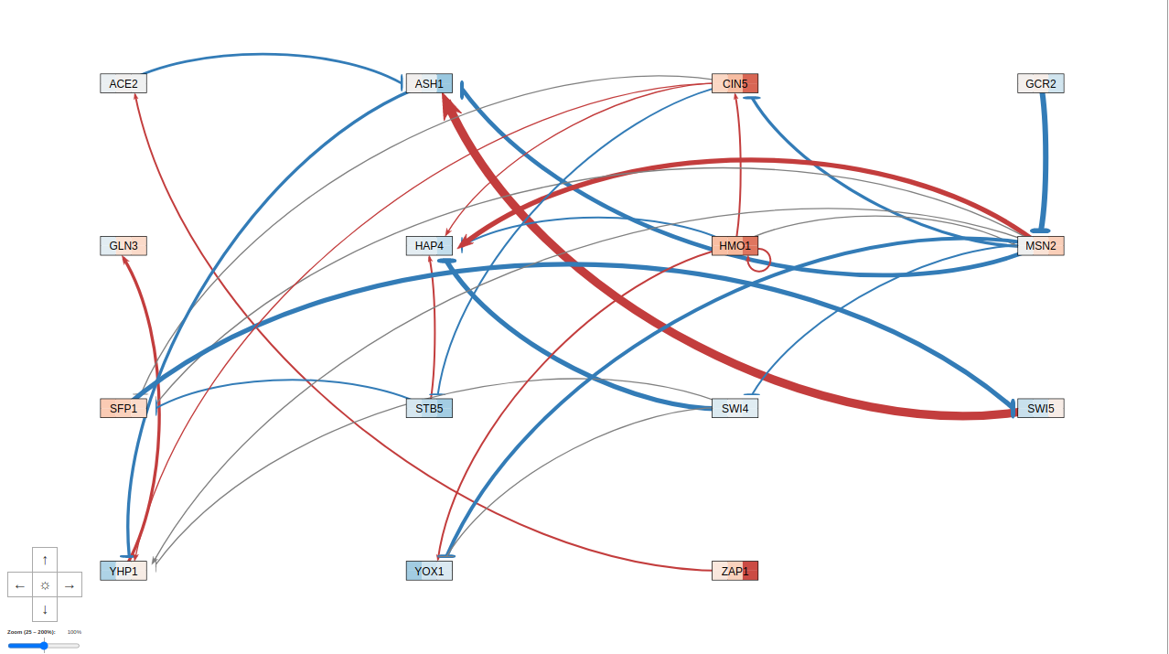

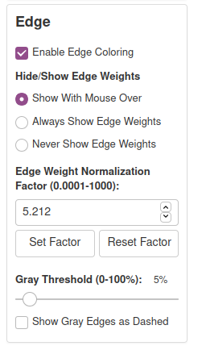
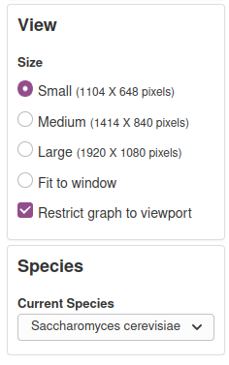
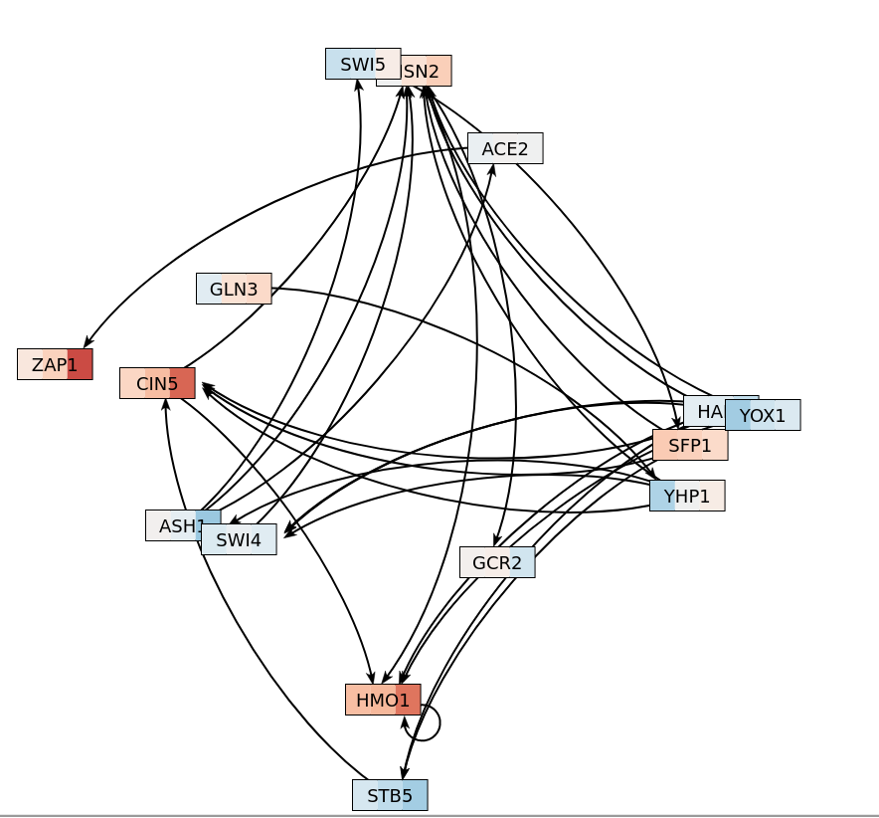
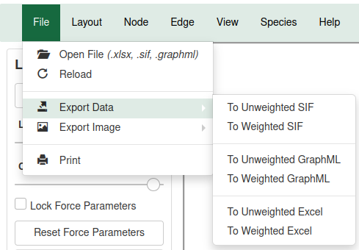
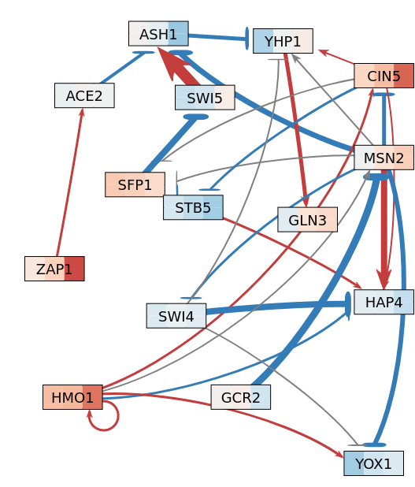
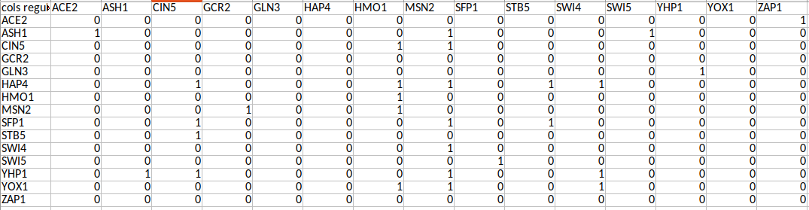
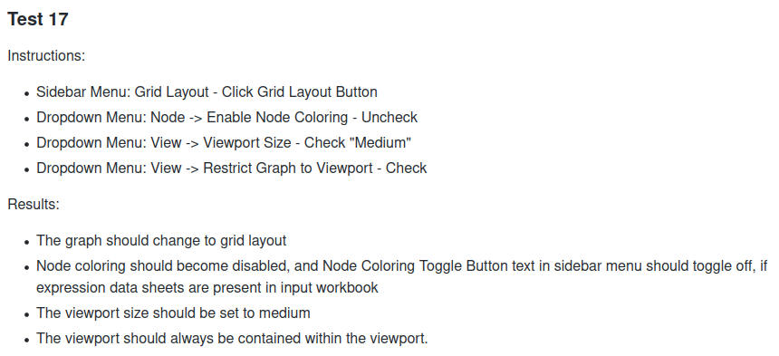
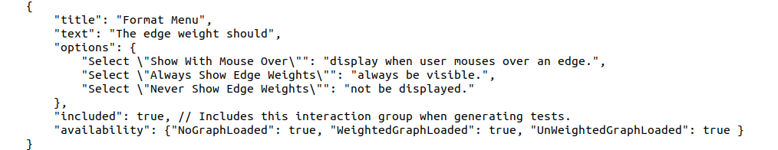
More Robust Testing of Data and UI for GRNsight: a Web Application for Visualizing Models of GRNs
Onariaginosa O. Igbinedion*, Ian M. Green*, Ahmad R. Mersaghian**, John David N. Dionisio*, Kam D. Dahlquist**
*Department of Computer Science, **Department of Biology Loyola Marymount University, 1 LMU Drive, Los Angeles, CA 90045
http://dondi.github.io/GRNsight/
GRNsight Automatically Lays Out Unweighted and Weighted Gene Regulatory Network Graphs
Testing Suite Can Test Import and Export Functionality
.
1. File Formats
Can import and export Excel, SIF, or GraphML files.
Demo files are provided.
1
2. Grid Layout
Grid Layout button allows the users to toggle the graph between a grid layout and a force graph layout.
3. Force Graph Parameter Sliders
Link distance determines the minimum distance between nodes.
Nodes have a charge, which repel or attract other nodes.
Reset functionality sets all parameters to default.
Locking the parameters prevents any further changes.
4. Node Coloring
This menu allows users to modify parameters of the node coloring visualization.
Dataset options are automatically generated from expression data sheets detected in an Excel input workbook.
5. GRNsight includes options to show or hide the weight values
Buttons enable the user to always see edge weights, never see edge weights, or see edge weights upon mouseover of the edges.
6. Edge Weight Normalization
Allows user to set normalization factor in user interface.
Edge thicknesses for different graphs can be rendered on the same scale.
7. Viewport
Graph bounding box can be separated from viewport.
Multiple viewport sizes available.
Zooming and scrolling enabled.
2
2
3
3
GRNsight as a validator for GRNmap
GRNmap is a user-hostile MATLAB software that models the dynamics of small- to medium-scale GRNs.
GRNsight expanded its testing capabilities to check sheets that are not necessary to display a gene regulatory network model, but are used in the GRNmap MATLAB software.
Users of GRNmap are able to upload a workbook through GRNsight and use the error and warning messages to fix their workbook before running it through the more user hostile software.
Error and warning messages became more descriptive and pinpointed which sheet the issue was found in, and the row, column, or cell that the error was located.
4
Key
4
gene
activation
repression
weak influence
5
7
5
Refactored Existing GRNsight import test, and expanded export tests
Refactored existing GRNsight code to consolidate error and warning messages, as well as added new tests for additional sheets in a GRNsight workbook.
Updated test to reflect additional features that GRNsight recently developed.
Expanded export tests to increase user visibility on possible errors that occurred during the import process.
Fixed bugs within the existing GRNsight export functionality and created a system to automatically fix minor issues within a workbook, alert the user of issues within a file that they must fix, or send an error message that something went wrong with the export process.
6
8
8. Species Selection
This dropdown allows the user to change the chosen species to any other species supported by GRNsight.
Graph Visualization Was Refined
Library Updates Protect against Security Vulnerabilities
Feature Addition
Improved edge detection for nodes, eliminating issues with nodes going out of the viewport.
Gray Edge Threshold was fixed to properly gray out all edges at 100% threshold.
Toggle buttons were fixed so that all buttons properly represent the state of the program.
Viewport resizing was modified to account for window resizing.
Test Passes
Updated Dependencies
GRNsight directly uses 52 libraries. Including dependencies of those libraries, GRNsight relies on 1533 libraries.
Dependencies had grown out of date and were updated.
Security vulnerabilities were identified within the dependencies as a result of outdated versions.
Began Migration of Deprecated Dependencies
Some dependencies, notably Jade, have been deprecated, threatening future iterations of GRNsight.
Migration of these libraries to their contemporary versions has begun to address this problem.
Future Directions
The Client-Side Testing Documents Streamline Testing of User Interface
Availability
Update Client-Side Test Generator Script
Automated user interface testing is difficult as it requires data analysis of the graph state to determine if the desired feature was changed. Instead, a set of instructions can be given to a human to perform these tests.
Client-side tests are generated for a subset of features by permuting all possible combinations of feature states, creating steps for the user to follow.
These features are listed in JSON files, separated by their location in the user interface. These JSON files are read by the script and the requested features are used to generate the tests.
Each feature is given a unique static ID that is used to reference it easily.
The generator script can include features based on an activation state in the features JSON, by command line arguments, or by a separate JSON file created by the tester.
The client-side testing document was updated so that the features include their ID and the wiki was updated.
GRNsight is free and open to all users and there is no login requirement.
Web site content is available under the Creative Commons Attribution Non-Commercial Share Alike license.
GRNsight code is available under the open source BSD license.
Usage is being tracked through Google Analytics.
New Users: 7,160
Complete the testing and refinement of the graph visualization and user interface, including expanded client-side testing.
Expand the export functionality to include additional worksheets not used by GRNsight, but used by GRNmap.
Add more species to the database.
File Uploads: 7,610
Sessions: 17,412
Pageviews: 36,413
References
Acknowledgments
Dahlquist, K.D., Dionisio, J.D.N., Fitzpatrick, B.G., Anguiano N.A., Varshneya A., Southwick, B.J., Samdarshi, M. (2016) GRNsight: a web application and service for visualizing models of small- to medium-scale gene regulatory networks. PeerJ Computer Science 2:e85 https://doi.org/10.7717/peerj-cs.85
Dahlquist, K.D., Fitzpatrick, B.G., Camacho, E.T., Entzminger, S.D., and Wanner, N.C. (2015) Parameter Estimation for Gene Regulatory Networks from Microarray Data: Cold Shock Response in Saccharomyces cerevisiae. Bulletin of Mathematical Biology, 77(8), 1457-1492 https://doi.org/0.1007/s11538-015-0092-6
GRNmap: http://kdahlquist.github.io/GRNmap/
GRNsight: https://dondi.github.io/GRNsight/
GRNsight’s GitHub: https://github.com/dondi/GRNsight
We would like to thank the prior developers on this project: Alexia M. Filler, Kevin B. Patterson, Mihir Samdarshi, John L. Lopez, Justin Kyle T. Torres, Eileen J. Choe, Yeon-Soo (Jen) Shin, Edward B. Bachoura, Nicole A. Anguiano, Anindita Varshneya, Katrina Sherbina, Britain J. Southwick.
Notes:
Kill abstract
Change to sans serif font
Make title bigger
Make title background white
Use full names
Super script to associate names with correct department
Background color: make it dark green, make writing on white background and writing in black/dark green
4 columns!!!
Smaller pictures
Bold titles
References can be 12pt
Acknowledgements can be 16pt
Everything else is 18-24pt
Titles don’t need to be bigger than 36pt
Remove circles from the arrowhead diagram, group the related labels together
Include menu bar
Testing/error handling – sample error (we don’t crash with errors!)
Mouseovers for edges screenshot

