Slide 1
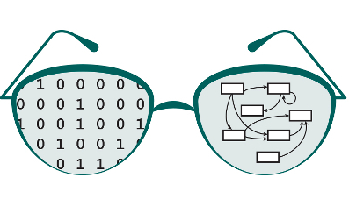

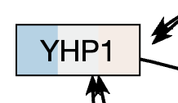
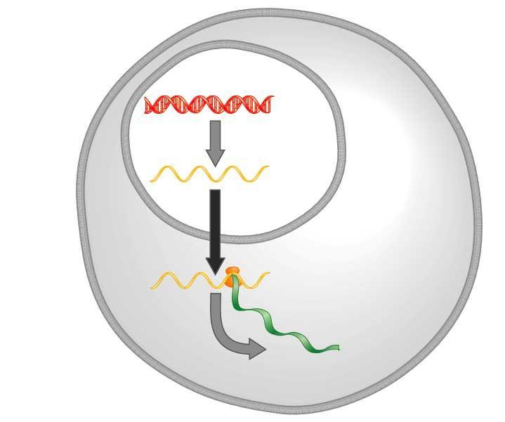
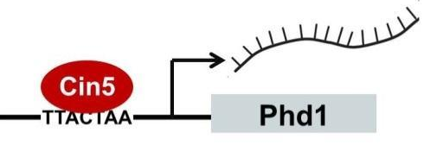
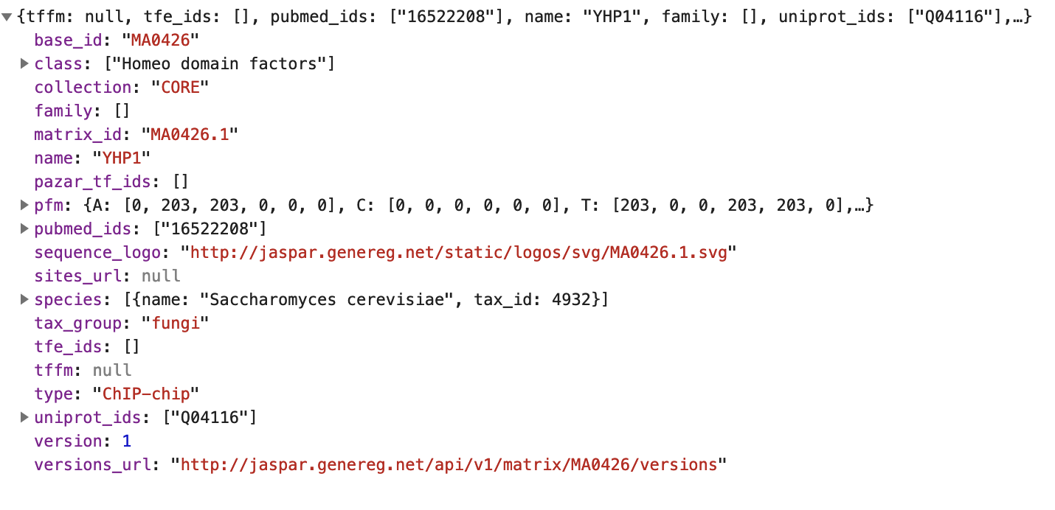
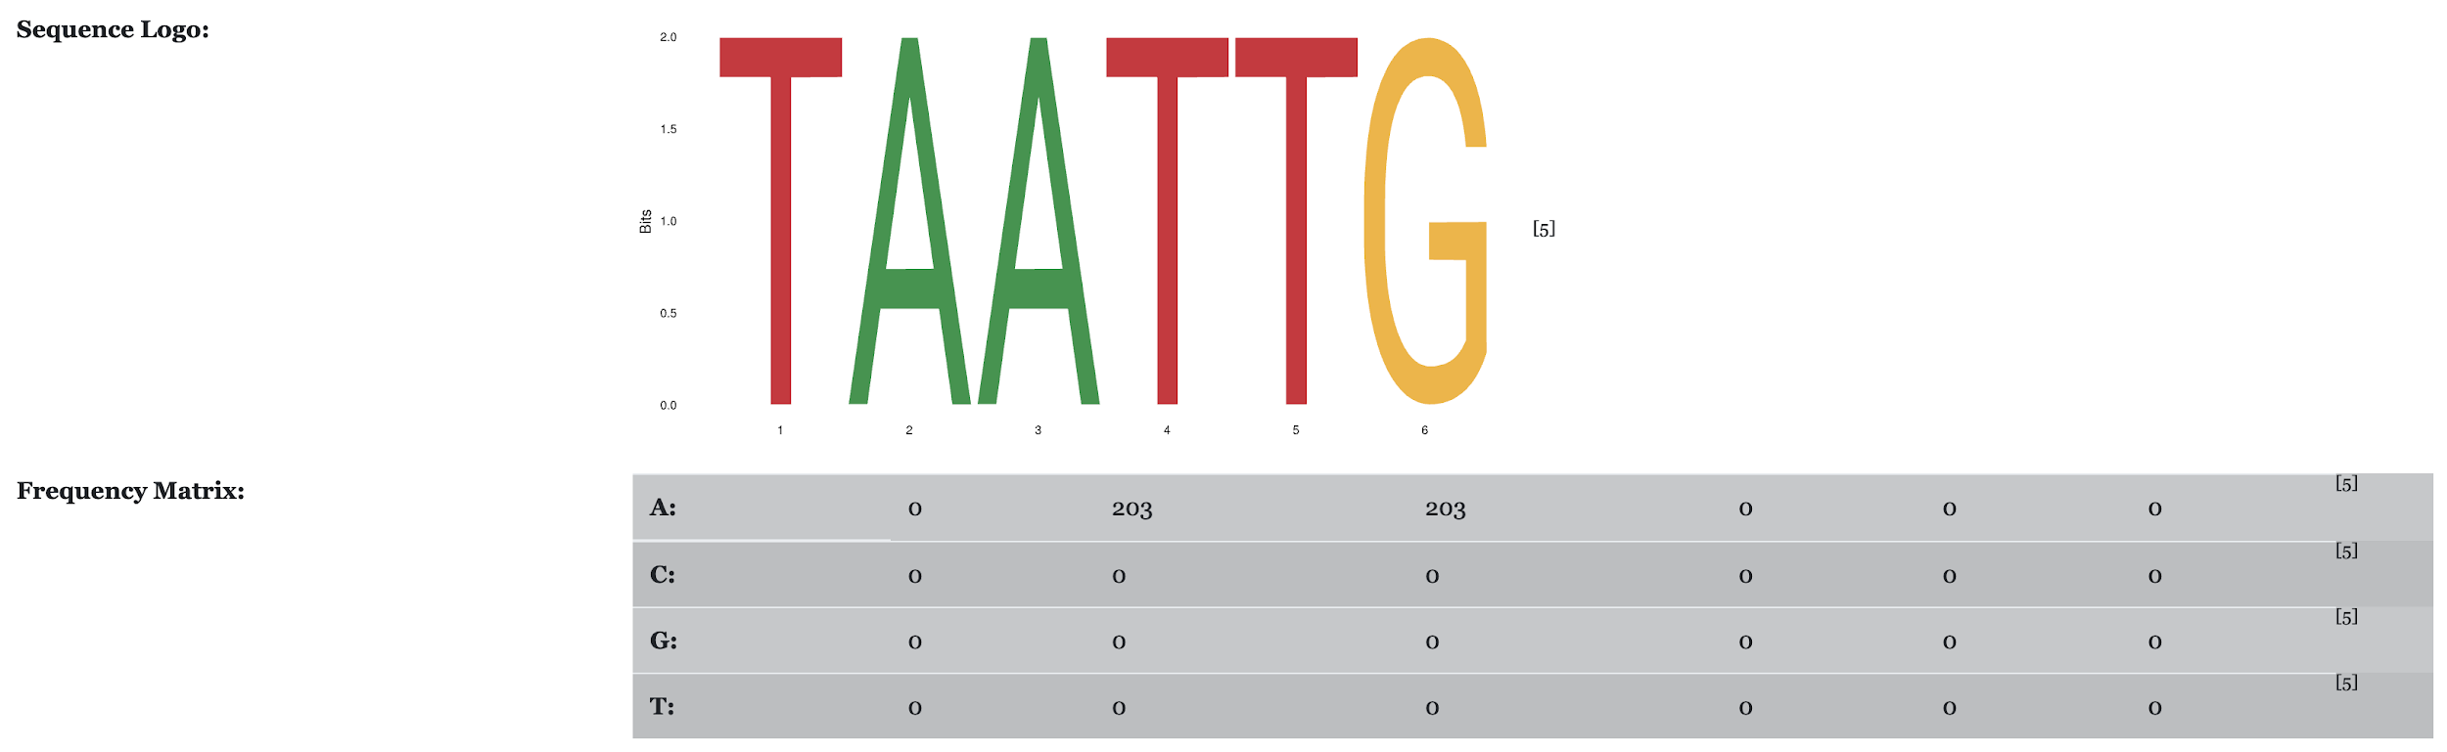
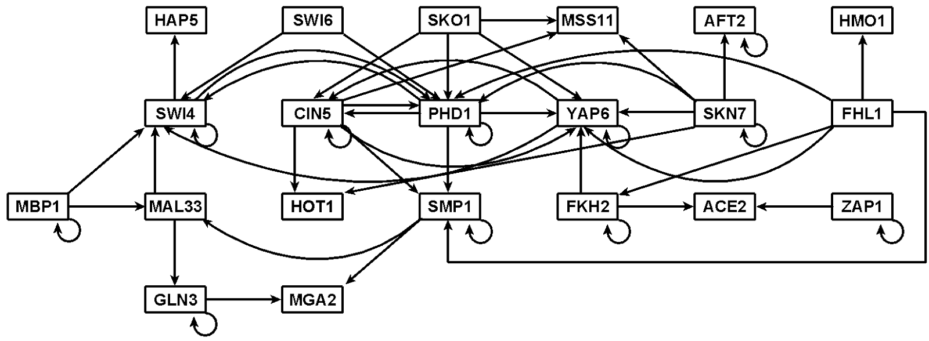
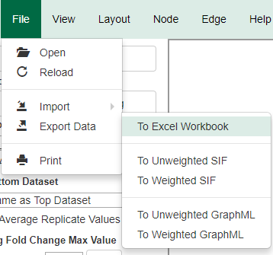
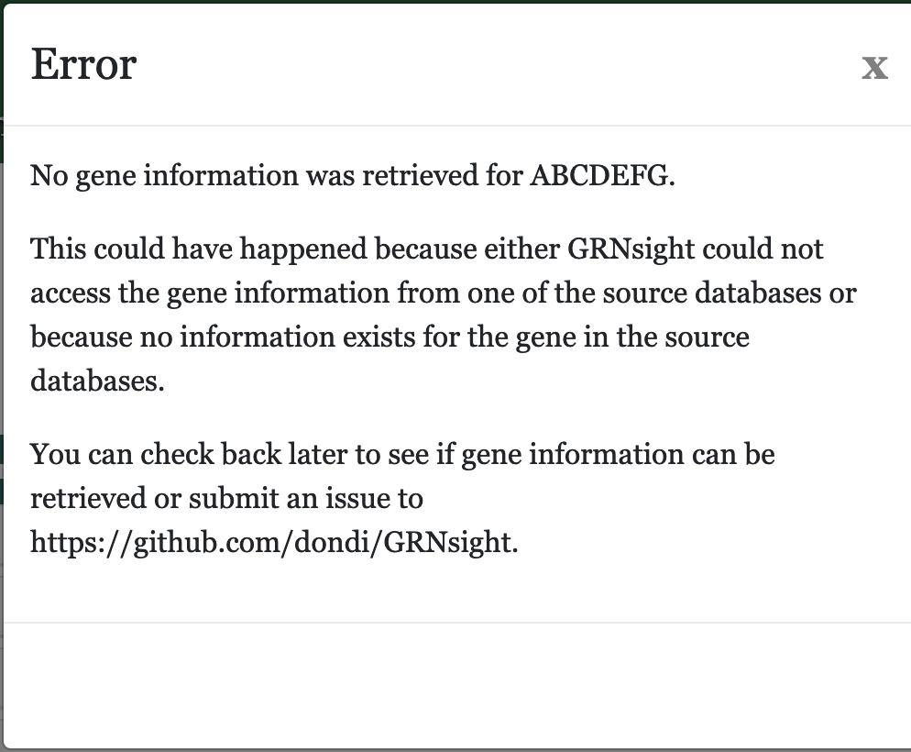
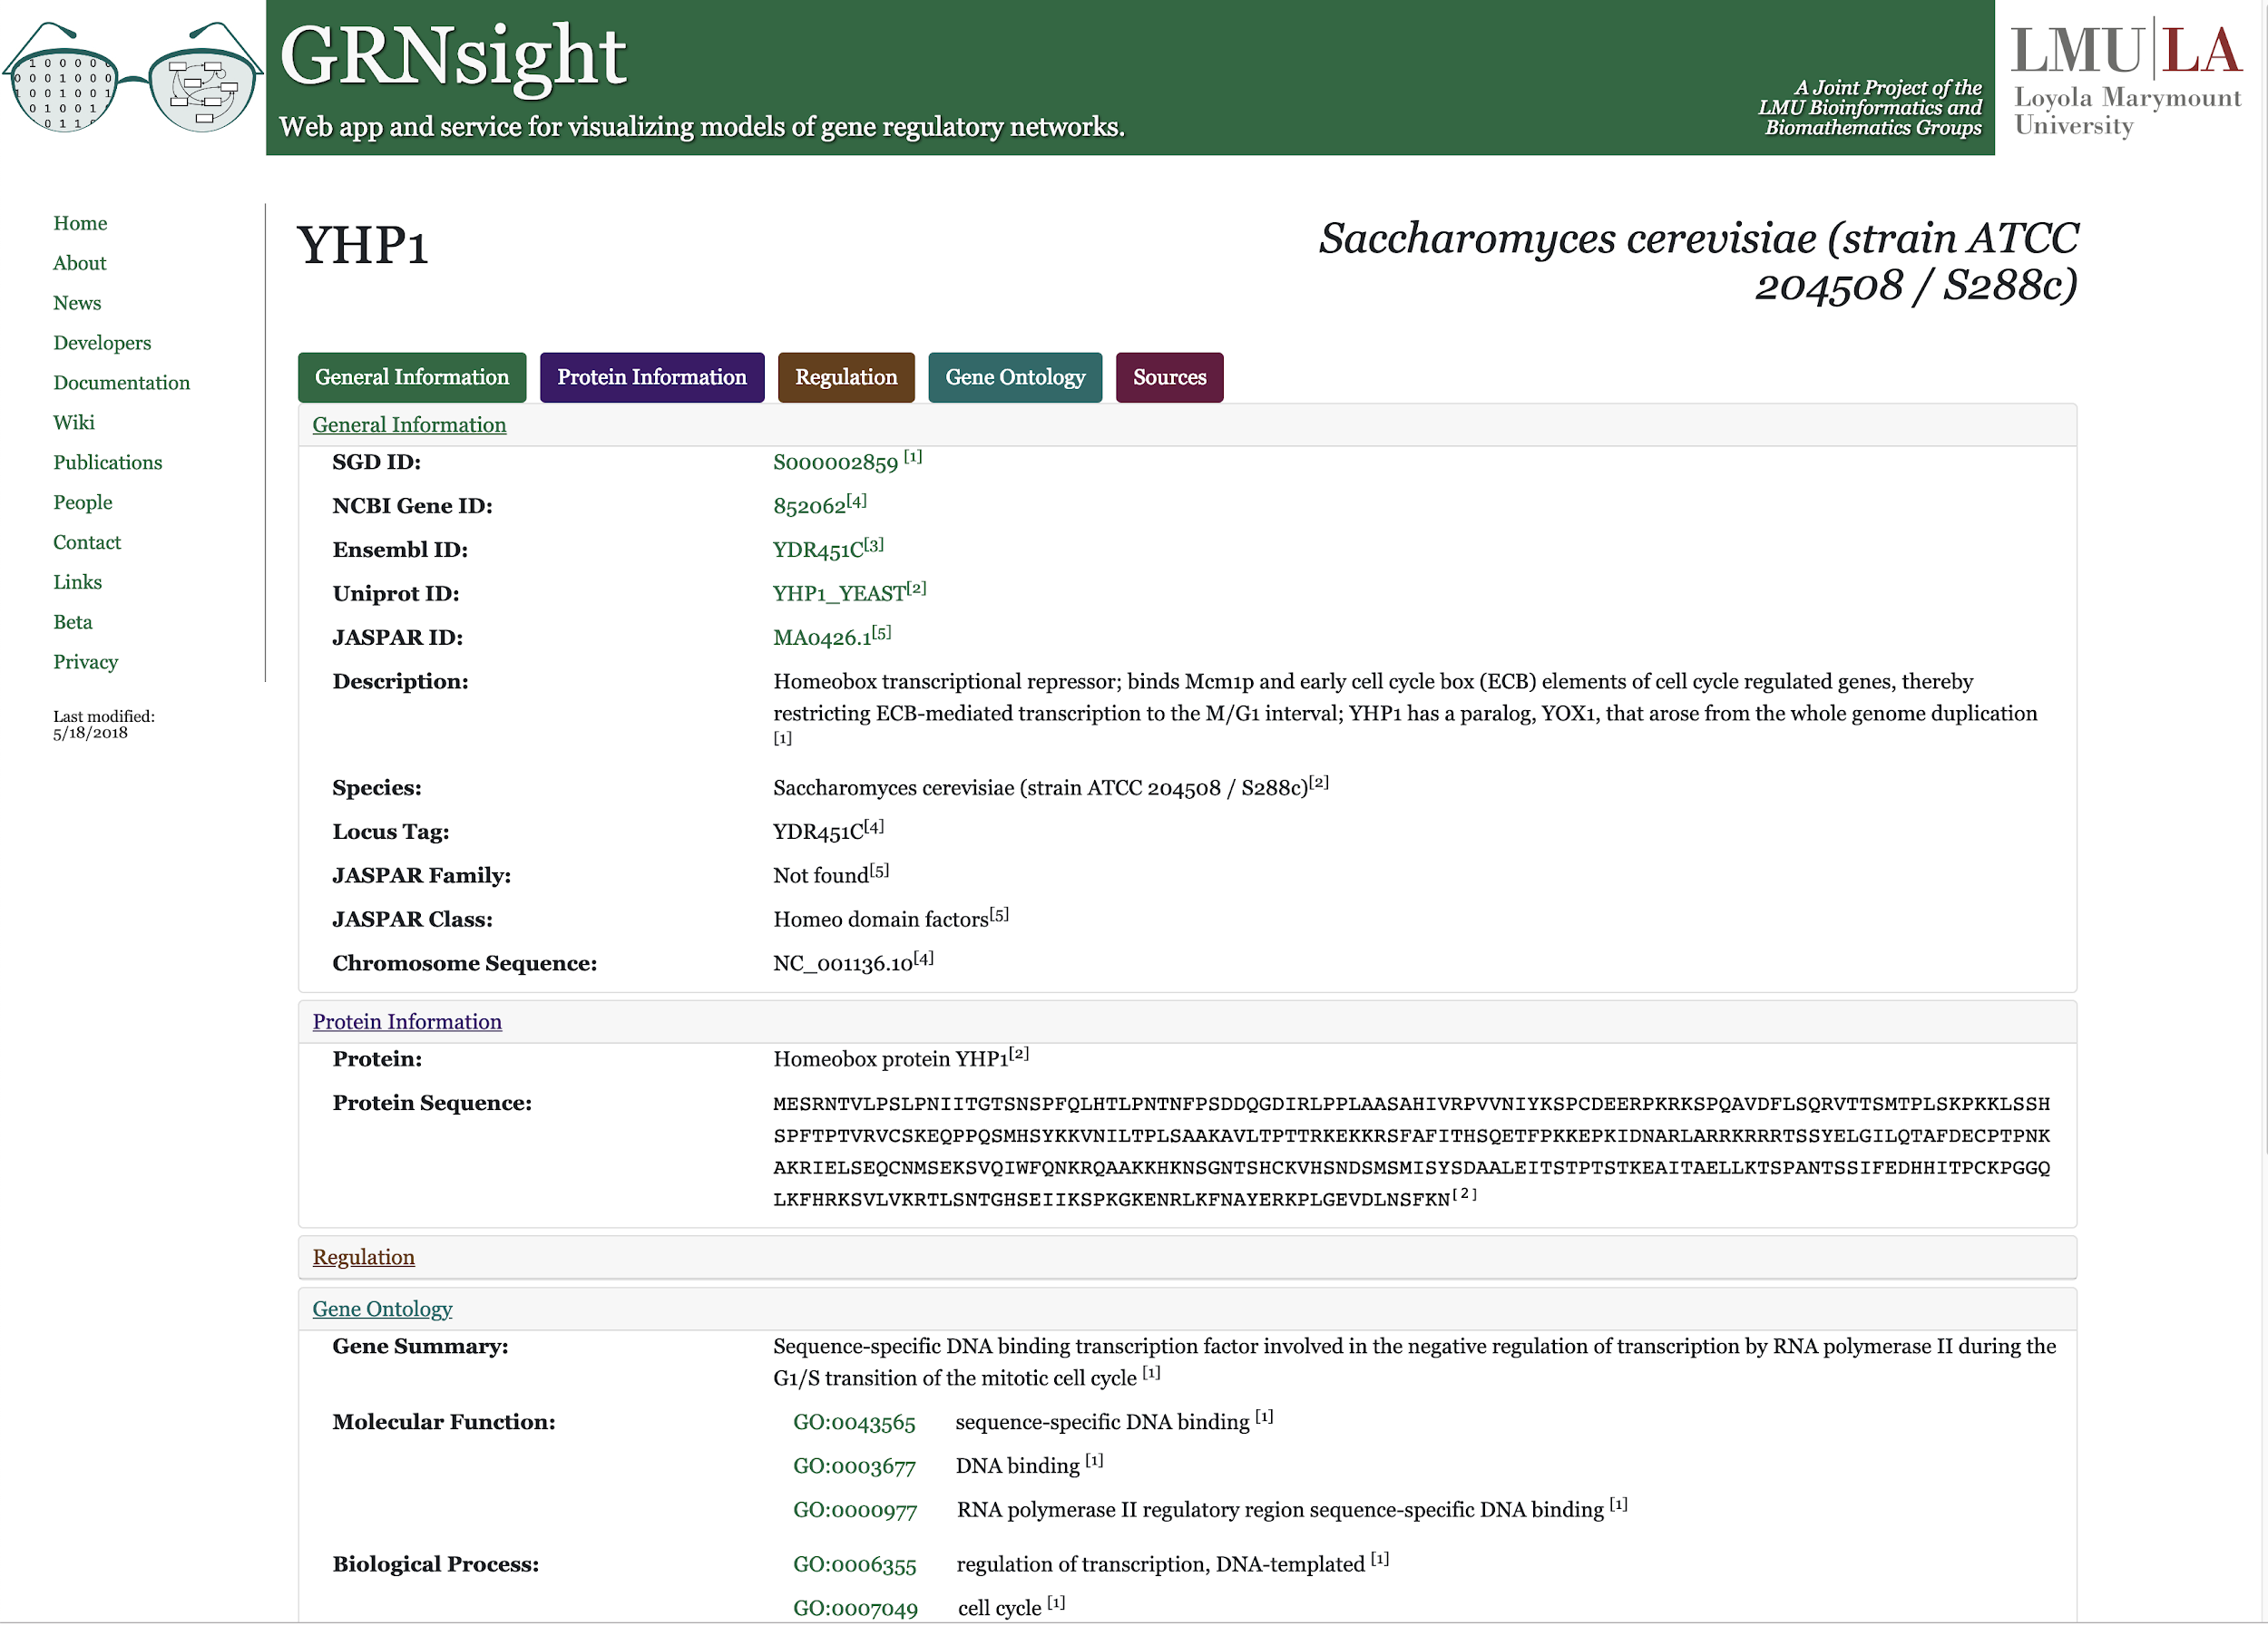
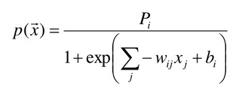
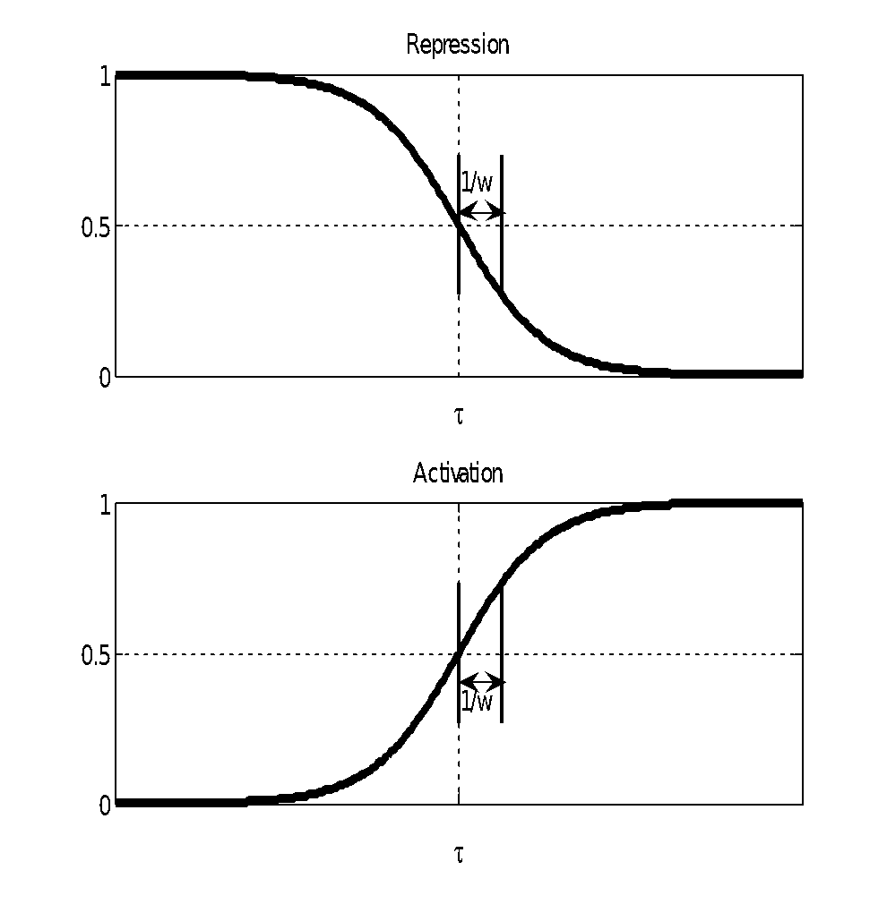
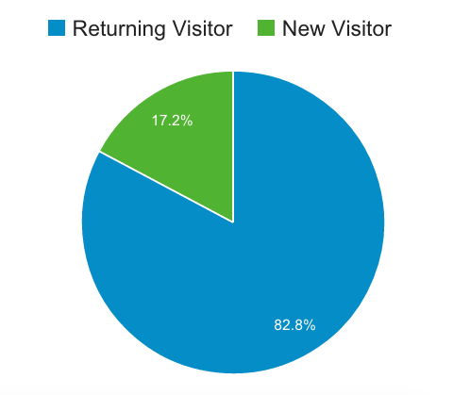
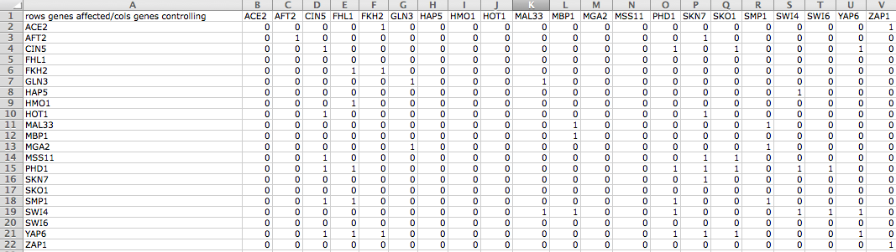

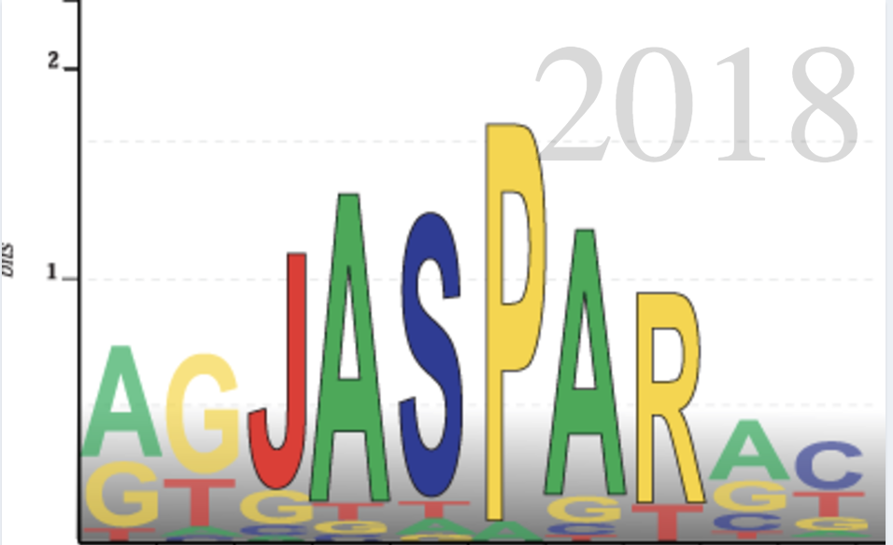


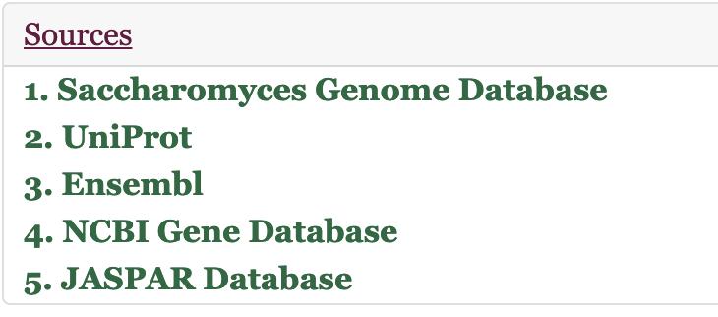
A Dynamic Gene Page Feature for GRNsight: a Web Application for Visualizing Models of Gene Regulatory Networks
John L. Lopez*, Alexia M. Filler*, John David N. Dionisio*, Kam D. Dahlquist**
*Department of Electrical Engineering and Computer Science, **Department of Biology Loyola Marymount University, 1 LMU Drive, Los Angeles, CA 90045
http://dondi.github.io/GRNsight/
Gene Regulatory Networks Can Be Illustrated by Directed Graphs
Gene Page Feature Displays Curated Data for a Selected Saccharomyces cerevisiae Node
Documentation Updates
The central dogma of molecular biology describes the flow of information in a cell during gene expression from DNA to RNA to protein.
Transcription factors control gene expression by binding to regulatory DNA sequences.
Activators increase gene expression.
Repressors decrease gene expression.
Transcription factors are themselves proteins encoded by genes.
Freeman (2002)
A gene regulatory network (GRN) consists of genes, transcription factors, and the regulatory connections between them, which govern the level of expression of mRNA and proteins from those genes.
Each node represents the gene, the mRNA, and the protein expressed from the gene.
Each edge represents a regulatory relationship.
All the nodes are transcription factors themselves.
Every Node in a Graph Model Can Access a Dynamic Gene Page
Upon right-clicking any given node in a loaded graph, GRNsight generates a blank “gene page” in a new page tab.
The gene page makes live Asynchronous Javascript and XML requests to four biological databases containing the species name and taxon ID from a graph’s “GRNstate” data structure and the gene name given by the node.
Updated Wiki Layout
Reorganized Wiki categories into First Steps, Instructions and Tutorials, Procedures, Design, Testing, Troubleshooting, Abstracts and Documentation, and Appendices to enhance organization and encourage continual updates to documentation.
New Documentation
Updated previously out-of-date library requirement guidelines.
Added detailed instructions in Wiki to facilitate process of familiarizing new research team members with the materials and processes.
Added Troubleshooting section to Wiki to allow for continual addition from team members on how to solve common problems.
DNA
Application Processing Interfaces (APIs) Allow the Gene Page to Gather Data
AJAX requests allow gene page to communicate with the NCBI, UniProt, JASPAR, and Saccharomyces Genome databases and request data.
Data is returned in either eXtensible Markdown Language (XML) or JavaScript Object Notation (JSON) format.
Data is returned as pure text, links to an image, or arrays of data which are visualized by the page into lines of text, images, and data stored in tables.
If no data is returned from any database, an error message is given to the user.
RNA
Protein
New Export to Excel Feature
Feature Addition
Added an element to the user interface that gives the user the option to export GRNsight data to an Excel workbook.
Initial Errors and Troubleshooting
Initially, exported Excel files failed to open after download.
Once this was resolved, data that was input using GRNmap format exported correctly, but other formats failed.This problem has since been resolved.
Test Passes
GRNmap: Gene Regulatory Network Modeling and Parameter Estimation
The Gene Page Uses a Variety of Modern Web Application Technologies
The gene page is styled using Bootstrap, a library for the page’s Cascading Style Sheets.
The page was written using ES6 Javascript and the jQuery library.
To connect to the APIs, the page implements a relay from the primary GRNsight server to the API calls.
The MATLAB model is available at http://kdahlquist.github.io/GRNmap/
GRNmap is a differential equations model of the changes in gene expression over time for a gene regulatory network (Dahlquist et al. 2015).
Each gene (node) in the network has an equation.
The parameters in the model are estimated from laboratory data.
The weight parameter, w, gives the direction (activation or repression) and magnitude of the regulatory relationship.
GRNmap produces an Excel spreadsheet with an adjacency matrix representing the network.
Future Directions
Allow the Gene Page feature to support species beyond Saccharomyces cerevisiae by identifying the species name from a given datasheet.
Implement tests for the Gene Page through the SinonJS testing framework.
Add detailed tests for Excel export feature to ensure success with all data input formats.
Availability
GRNsight is free and open to all users and there is no login requirement.
Web site content is available under the Creative Commons Attribution Non-Commercial Share Alike license.
GRNsight code is available under the open source BSD license.
Usage is being tracked through Google Analytics.
2048 total visitors and
1440 files uploaded as of
8 March 2016
The Gene Page Curates Data from Established Biological Databases
0 represents no relationship.
Initially, 1 represents a regulatory relationship where the gene specified by the column controls the gene specified by the rows.
After the parameters have been estimated, a positive weight value indicates activation and a negative weight value indicates repression.
The magnitude of the weight defines the strength of the relationship.
However, GRNmap does not generate a visual representation of GRNs.
Selected Data is Curated and Displayed
From the NCBI Database, the page gathers the NCBI ID, chromosome sequence, and the locus tag. This locus tag is used to provide a link to the gene’s corresponding page on the Ensembl Database website.
From the UniProt Database, the page gathers the UniProt ID, protein sequence, protein type, and full species name.
From the JASPAR Database, the page gathers the JASPAR ID, class name, family name, frequency matrix, and JASPAR sequence logo.
From the Saccharomyces Genome Database, the page gathers a list of regulators and targets in addition to the SGD ID and gene summary. SGD is also used to collect the Gene Ontology summary and lists of molecular function, biological process, and cellular component terms.
The source is provided for each piece of collected data, and links are displayed at the bottom of the page to the corresponding database.
If no data is found for a selected characteristic, the page informs the user where it tried to collect the data.
Acknowledgments
This work is partially supported by NSF award 0921038 (K.D.D., B.G.F.), a Kadner-Pitts Research Grant (K.D.D.), the Loyola Marymount University Rains Research Assistant Program (N.A.A.), and the Loyola Marymount University Summer Undergraduate Research Program (A.V.).
GRNsight Accepts Microsoft Excel Files (.xlsx) in the Proper Format
References
Excel workbooks need a “network” sheet (for unweighted graphs) or a “network_optimized_weights” sheet (for weighted graphs).
The adjacency matrix can be symmetrical or asymmetrical.
GRNmap input and output workbooks are accepted without adjustment.
Adjacency matrices generated from other databases, such as YEASTRACT (Miguel et al., 2014), can be used with some modification.
Bootstrap: https://getbootstrap.com/
Dahlquist, K.D., Fitzpatrick, B.G., Camacho, E.T., Entzminger, S.D., and Wanner, N.C. (2015) Parameter Estimation for Gene Regulatory Networks from Microarray Data: Cold Shock Response in Saccharomyces cerevisiae. Bulletin of Mathematical Biology, 77(8), 1457-1492, DOI: 10.1007/s11538-015-0092-6
Ensembl: https://uswest.ensembl.org/index.html
Freeman, S. (2002) Biological Science. Upper Saddle River, New Jersey: Prentice Hall.
GRNmap: http://kdahlquist.github.io/GRNmap/
JASPAR: jaspar.genereg.net
jQuery: https://jquery.com/
National Center for Biotechnology InformationI: https://www.ncbi.nlm.nih.gov/
Saccharomyces Genome Database: https://www.yeastgenome.org/
SinonJS: https://sinonjs.org/
Notes:
Kill abstract
Change to sans serif font
Make title bigger
Make title background white
Use full names
Super script to associate names with correct department
Background color: make it dark green, make writing on white background and writing in black/dark green
4 columns!!!
Smaller pictures
Bold titles
References can be 12pt
Acknowledgements can be 16pt
Everything else is 18-24pt
Titles don’t need to be bigger than 36pt
Remove circles from the arrowhead diagram, group the related labels together
Include menu bar
Testing/error handling – sample error (we don’t crash with errors!)
Mouseovers for edges screenshot

