Slide 1
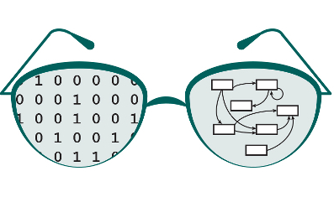

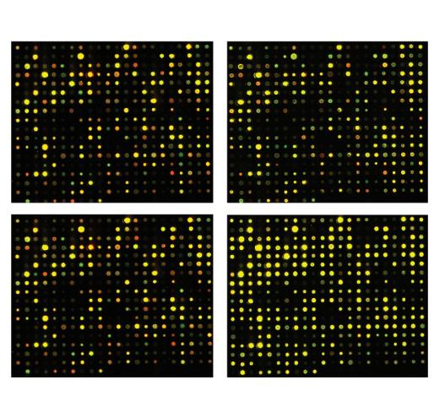
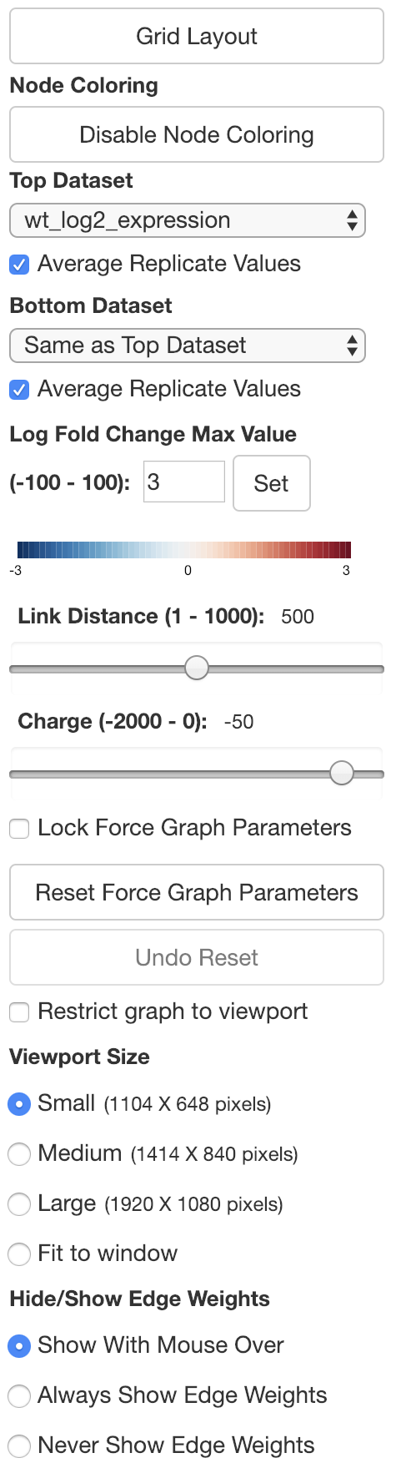
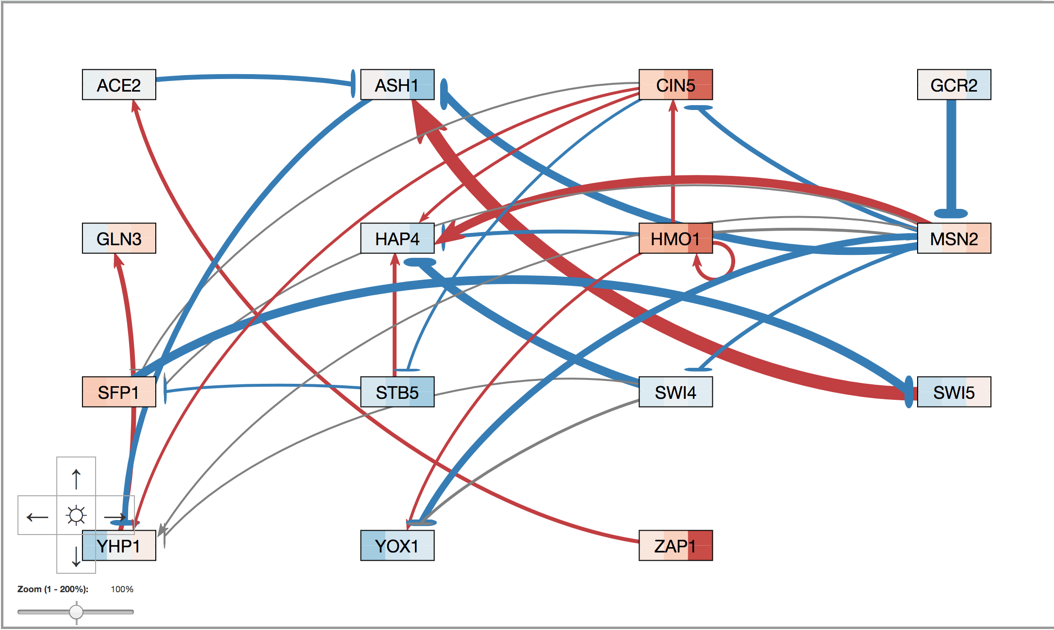
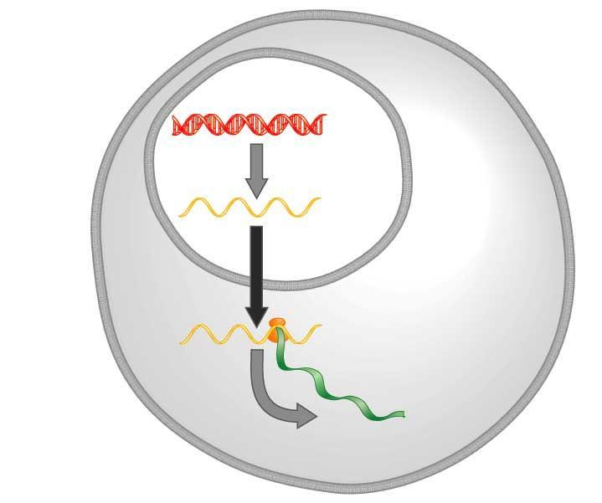
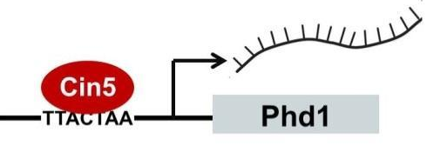
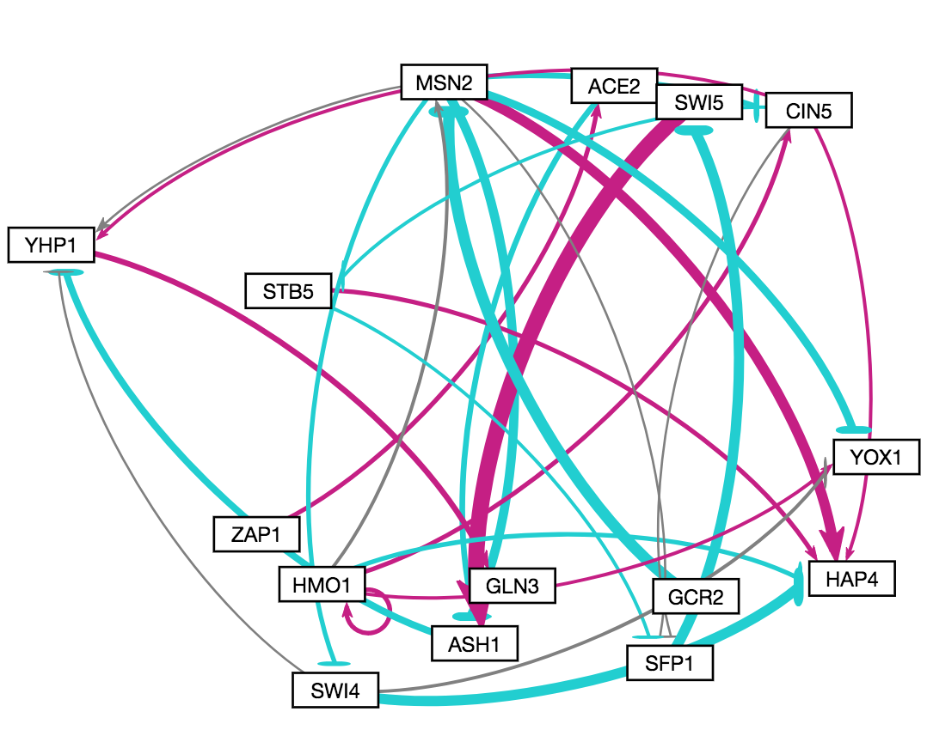
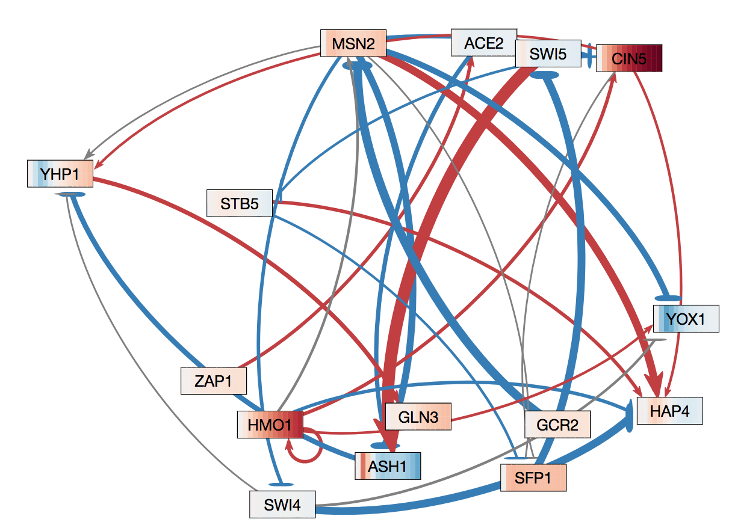

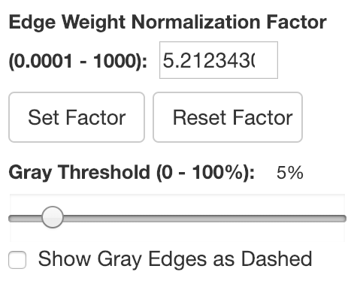
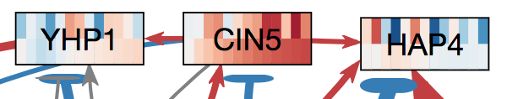
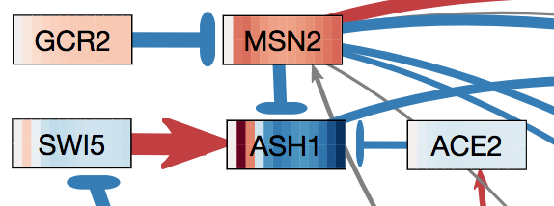

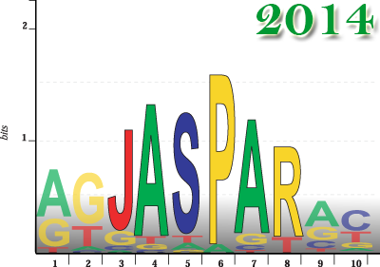

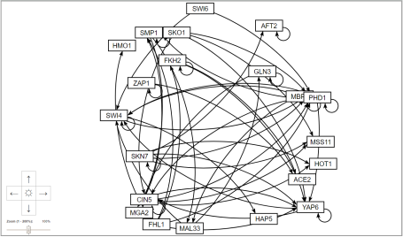
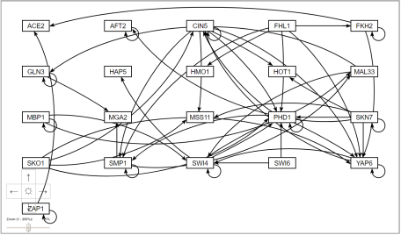
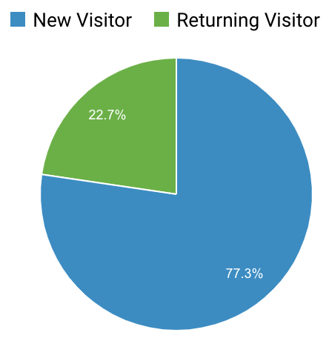

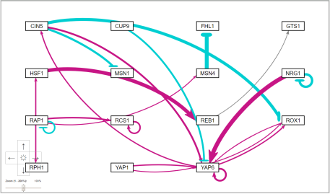
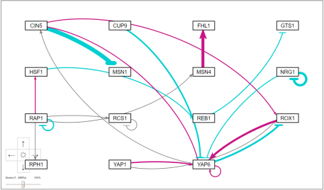
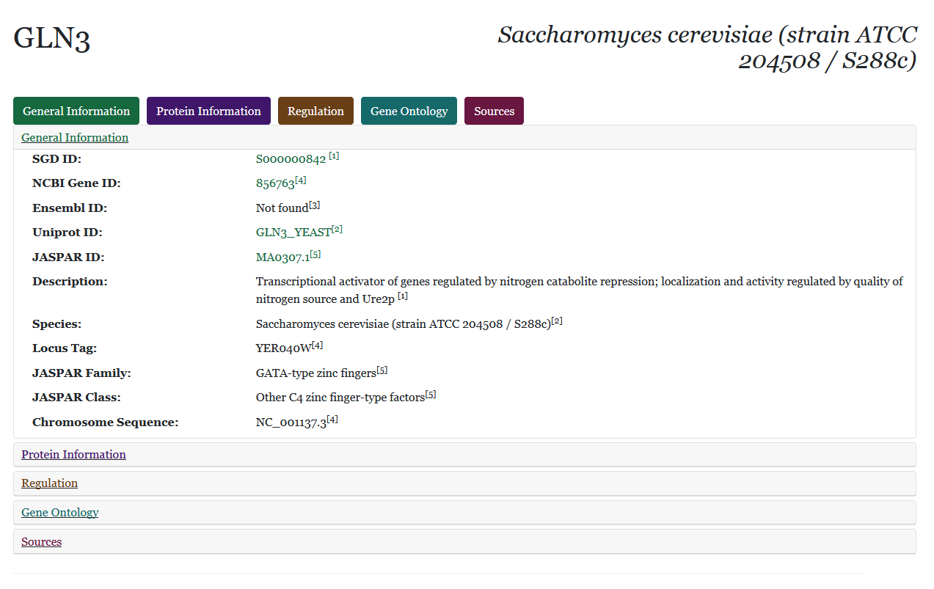
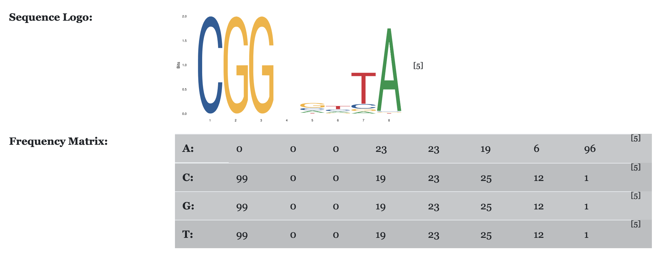
New Layouts, Data Types, and Architecture for GRNsight 3:
a Web Application for Visualizing Gene Regulatory Networks
Mihir Samdarshi*, John L. Lopez**, John David N. Dionisio**, Kam D. Dahlquist*
*Department of Biology, **Department of Electrical Engineering and Computer Science, Loyola Marymount University, 1 LMU Drive, Los Angeles, CA 90045
http://dondi.github.io/GRNsight/
Gene Regulatory Networks (GRNs) Can Be Illustrated by Directed Graphs
GRNsight Automatically Lays Out Unweighted and Weighted Network Graphs
Node Coloring Visualization for
Gene Expression Data
.
1. File Formats
Can import and export Excel, SIF, or GraphML files.
Demo files are provided.
2. Grid Layout
Grid Layout button allows the users to toggle the graph between a grid layout and a force graph layout.
3. Node Coloring
This menu allows users to modify parameters of the node coloring visualization.
Dataset options are automatically generated from expression data sheets detected in an Excel input workbook.
4. Force Graph Parameter Sliders
Link distance determines the minimum distance between nodes.
Nodes have a charge, which repel or attract other nodes.
Reset functionality sets all parameters to default.
Locking the parameters prevents any further changes.
5. Viewport
Graph bounding box can be separated from viewport.
Multiple viewport sizes available.
Zooming and scrolling enabled.
6. GRNsight includes options to show or hide the weight values
Buttons enable the user to always see edge weights, never see edge weights, or see edge weights upon mouseover of the edges.
7. Zoom and Scroll
8. Edge Weight Normalization
Allows user to set normalization factor in user interface.
Edge thicknesses for different graphs can be rendered on the same scale.
Facilitates accurate visual comparison.
sf
The central model of molecular biology describes how the flow of information in a cell during gene expression goes from DNA to RNA to protein.
Transcription factors control gene expression by binding to regulatory DNA sequences.
Activators increase gene expression.
Repressors decrease gene expression.
Transcription factors are themselves proteins encoded by genes.
Freeman (2002)
A gene regulatory network (GRN) consists of genes, transcription factors, and the regulatory connections between them, which govern the level of expression of mRNA and proteins from those genes.
Each node in a GRN graph represents a regulatory transcription factor, with each edge representing a regulatory relationship, either an activation or repression relationship.
1
Data collected from gene microarray experiments capture gene expression levels at specified time points
Node coloring feature overlays a heat map on nodes corresponding to gene expression levels over time
The color of each vertical “slice” corresponds to the expression value of that gene at the particular time point
t₃₀/t₀ cold shock
t₆₀/t₀ cold shock
2
Legend
3
t₉₀/t₀ cold shock
t₁₂₀/t₀ cold shock
DNA
GRNsight v3 Visualization Legend
RNA
 | Red | Blue
Edges | Gene Activation | Gene Repression
Nodes | Increase in mRNA | Decrease in mRNA
Protein
7
Key
4
gene
GRNsight v2
GRNsight v3
activation
Users can select multiple datasets to visually compare experimental and simulated expression data.
repression
weak influence
8
9. Gray Edge Threshold
Slider allows the gray edge threshold to be customized.
Gray edges allow users to visually gauge whether a particular regulatory relationship is not important.
By default, edges are colored gray if the magnitude of its value is <= 5% of the absolute value of the maximum edge weight.
As the threshold value increases, only the highest magnitude regulatory relationships are rendered in color.
Gray edges can also be rendered as dashed lines to further distinguish the edges.
wt_log2_expression
GRNsight Fulfills a Specific Software Niche for Visualizing Small- to Medium-scale GRNs
9
wt_log2_optimized_expression
Although other open source software, such as Cytoscape or Gephi, exist to lay out large networks, they were too cumbersome for our needs.
GRNsight is targeted at both experienced biology investigators and novice undergraduate users and has the following requirements:
Exist as a web application.
Be simple and intuitive to use.
3. Accept Excel (.xlsx) files directly from our sister project, GRNmap, as well as, SIF (.sif), or GraphML (.graphml) input files.
Read a weighted or unweighted adjacency matrix.
Automatically lay out and display unweighted and weighted, directed network graphs.
5
Visual inspection of gene expression is crucial to verifying the correctness of the GRNmap simulation
Node coloring of ASH1 is explained by incoming edges, but not MSN2
There may be another factor missing in the network causing MSN2’s increase in expression
6
Snippet of wt_log2_expression visualization
Grid Layout
Gene Information Pages
Future Directions
s
A dynamic gene information webpage now opens when a user right-clicks on a node in a graph.
The node must be named properly and a gene of Saccharomyces cerevisiae.
The page sends a series of Asynchronous JavaScript and XML (AJAX) data requests, written using the jQuery
Generate gene information pages for genes from species other than yeast.
Automatically display GRNs from public databases, such as YEASTRACT, through API calls. Automatically retrieve gene expression data.
Export data to Excel (.xlsx) format to facilitate automatic creation of input workbooks for GRNmap.
GRNsight Now Follows a Strict MVC Architecture
Grid layout feature allows the users to:
Toggle between force graph and grid layout using a button on the top of the left menu bar.
Organize the nodes in a grid pattern.
Sort the nodes in alphabetical order.
Model-View-Controller (MVC) refers to an architectural pattern in software development for developing user interfaces.
MVC separates the software into 3 main, interconnected parts, which control various different parts of the software. The Model is the store for the application’s current state. The View contains the code for what the end user actually sees. The Controller listens for any changes to the application state enacted by the user.
GRNsight’s previous architecture, while following the Model-View-Controller architectural pattern, was a little more haphazard, without centralized code store for the Model, View and Controller.
GRNsight version 3 now contains approximately 60% of user-facing code in three main files.
Following strict MVC reduces bugs, simplifies the codebase, makes it much simpler for developers to revise and add new features to GRNsight, and makes code readability much easier.
Force Graph
Grid Layout
Availability
GRNsight is free and open to all users and there is no login requirement.
Web site content is available under the Creative Commons Attribution Non-Commercial Share Alike license.
GRNsight code is available under the open source BSD license.
6526 total visitors and 4521 files uploaded as as of 6 February 2019
JavaScript library, to the JASPAR, NCBI Gene, UniProt, Ensembl, and Saccharomyces Genome Databases.
These databases are some of the largest repositories for information regarding Saccharomyces cerevisiae.
The webpage is then populated with data returned regarding the gene’s description, protein sequence, DNA binding motif frequency matrix and sequence logo, and Gene Ontology terms.
All information is linked back to the original source, making citations much easier.
Usage is being tracked through Google Analytics.
GRNsight has been tested with and confirmed to be working in Chrome version 58 or higher and Firefox version 53 or higher on Windows 7 and Mac OS X.
Initial state when graph is first loaded.
Nodes float and move with applied force.
Nodes do not float like in force graph.
Users can move the nodes around like in force graph.
test-data1
test-data2
Acknowledgments
This work is partially supported by NSF award 0921038 (K.D.D., B.G.F.), a Kadner-Pitts Research Grant (K.D.D.), the Loyola Marymount University Rains Research Assistant Program (M.S.), and LMU SURP (J.L.L.)
Updates
Model
Manipulates
References
View
Controller
Cytoscape: http://cytoscape.org
Dahlquist, K.D., Dionisio, J.D.N., Fitzpatrick, B.G., Anguiano, N.A., Varshneya, A., Southwick, B.J., Samdarshi, M. (2016) GRNsight: a web application and service for visualizing models of small- to medium-scale gene regulatory networks. PeerJ Computer Science 2:e85. DOI: 10.7717/peerj-cs.85).
Dahlquist, K.D., Fitzpatrick, B.G., Camacho, E.T., Entzminger, S.D., and Wanner, N.C. (2015) Parameter Estimation for Gene Regulatory Networks from Microarray Data: Cold Shock Response in Saccharomyces cerevisiae. Bulletin of Mathematical Biology, 77(8), 1457-1492, DOI: 10.1007/s11538-015-0092-6
D3.js: http://d3js.org/
Freeman, S., (2002). Biological science, 1st edition. Upper Saddle River, NJ:: Prentice Hall.
Gephi: https://gephi.org
GRNmap: http://kdahlquist.github.io/GRNmap/
Sees
User
Uses
The nodes are laid out in a grid pattern with columns and rows.
The nodes are equally spaced out with margins around them.
Allows users to compare and analyze data in a easier and faster way.
Notes:
Kill abstract
Change to sans serif font
Make title bigger
Make title background white
Use full names
Super script to associate names with correct department
Background color: make it dark green, make writing on white background and writing in black/dark green
4 columns!!!
Smaller pictures
Bold titles
References can be 12pt
Acknowledgements can be 16pt
Everything else is 18-24pt
Titles don’t need to be bigger than 36pt
Remove circles from the arrowhead diagram, group the related labels together
Include menu bar
Testing/error handling – sample error (we don’t crash with errors!)
Mouseovers for edges screenshot

