Slide 1
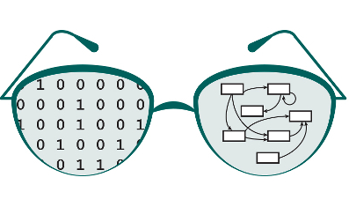

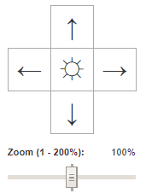

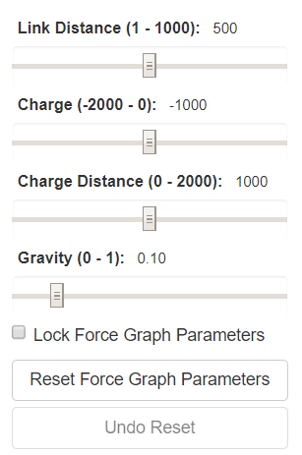
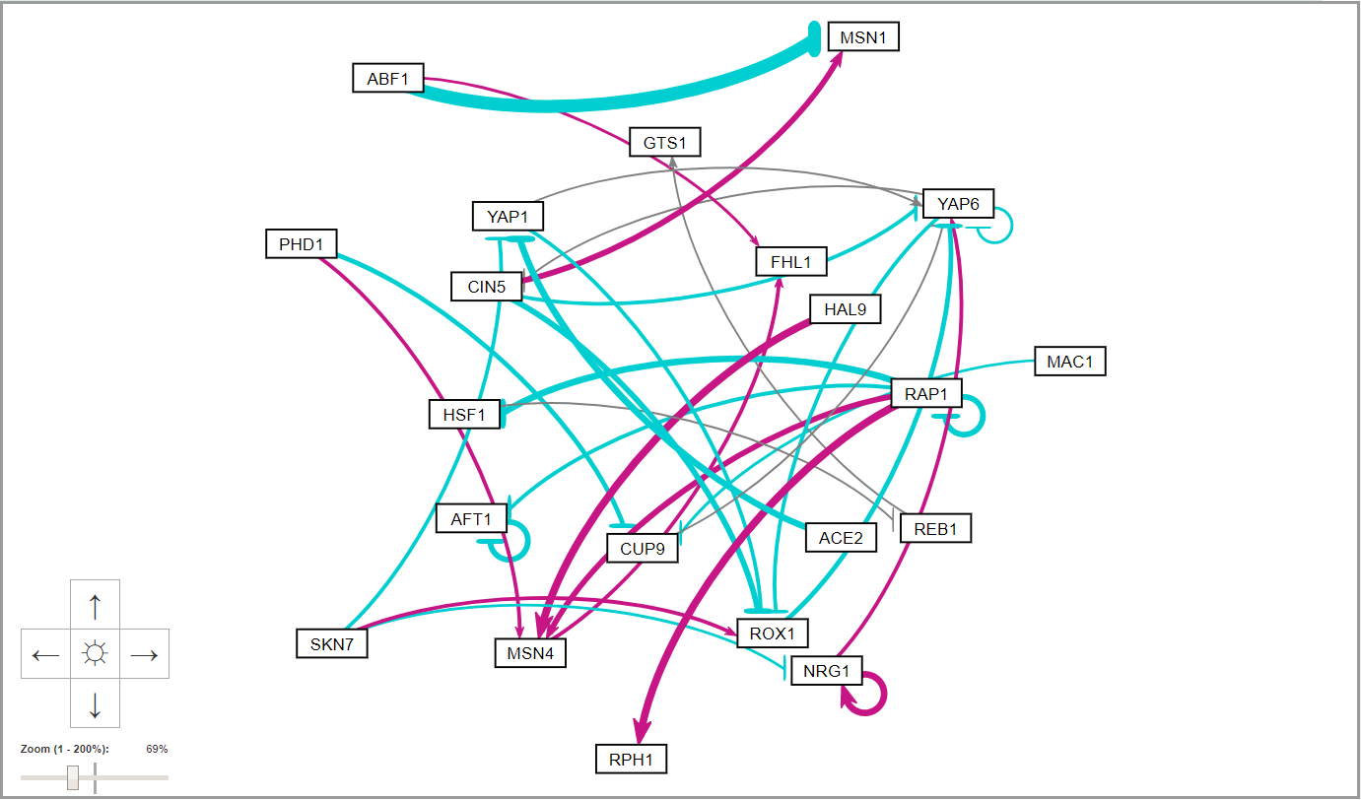
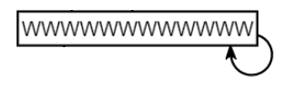
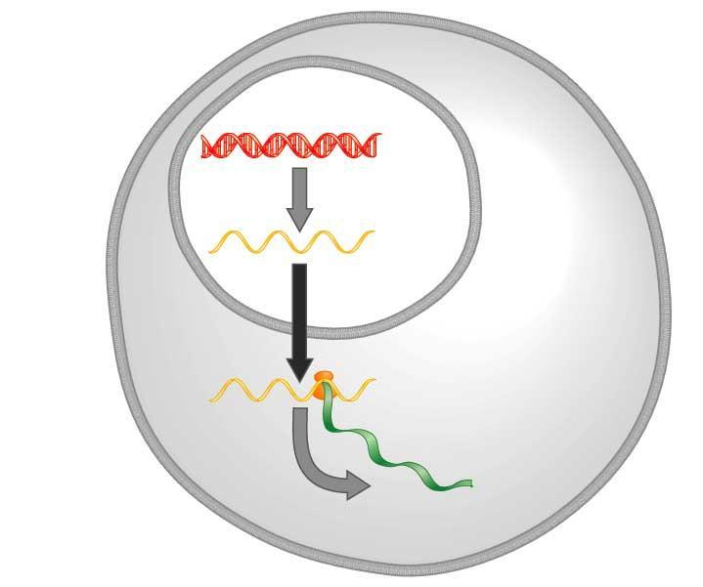
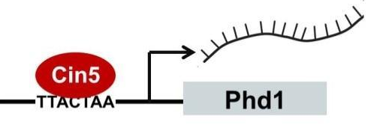
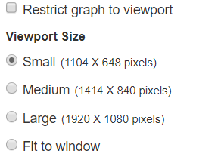
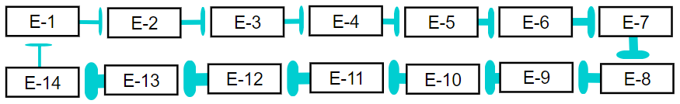
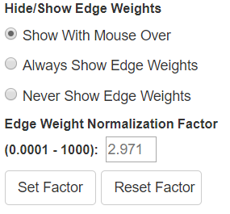
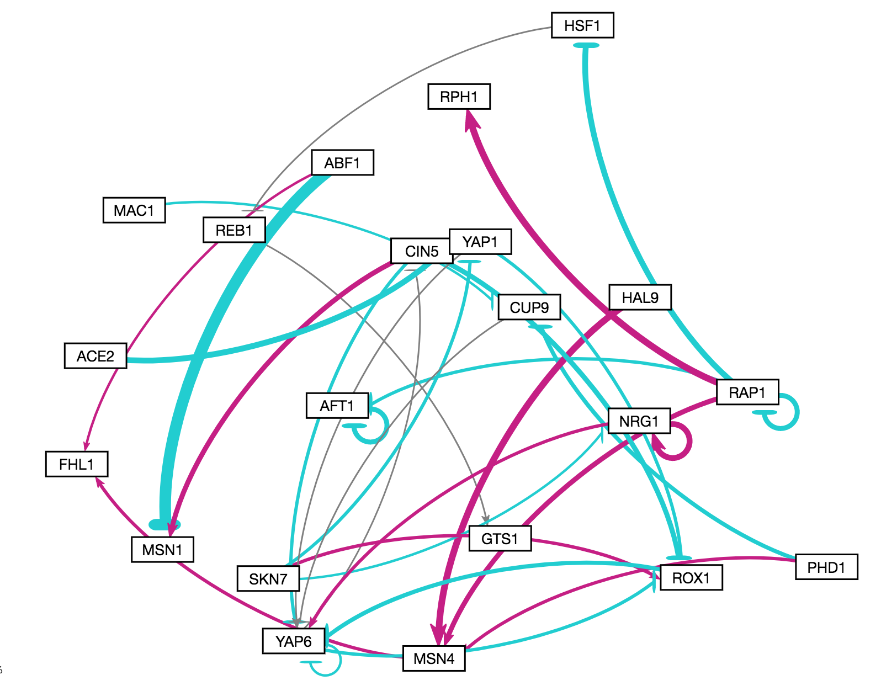
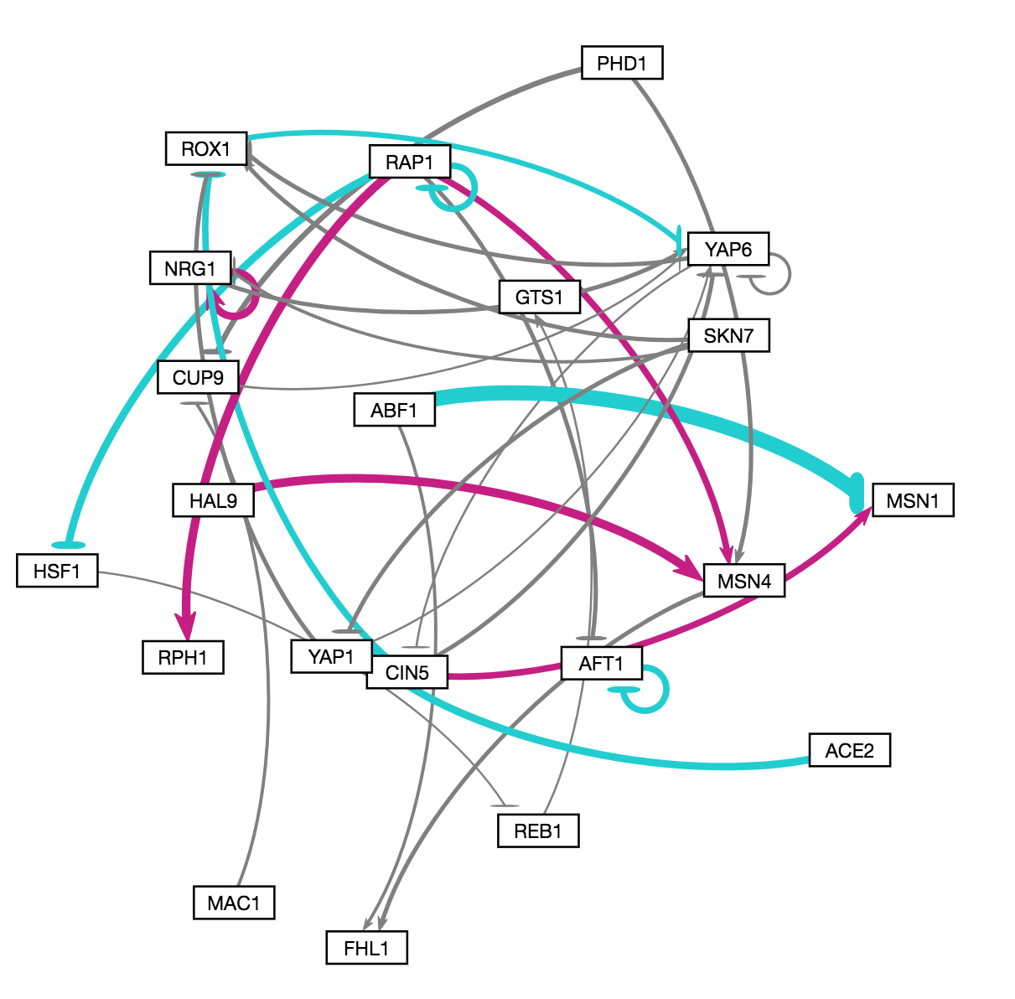
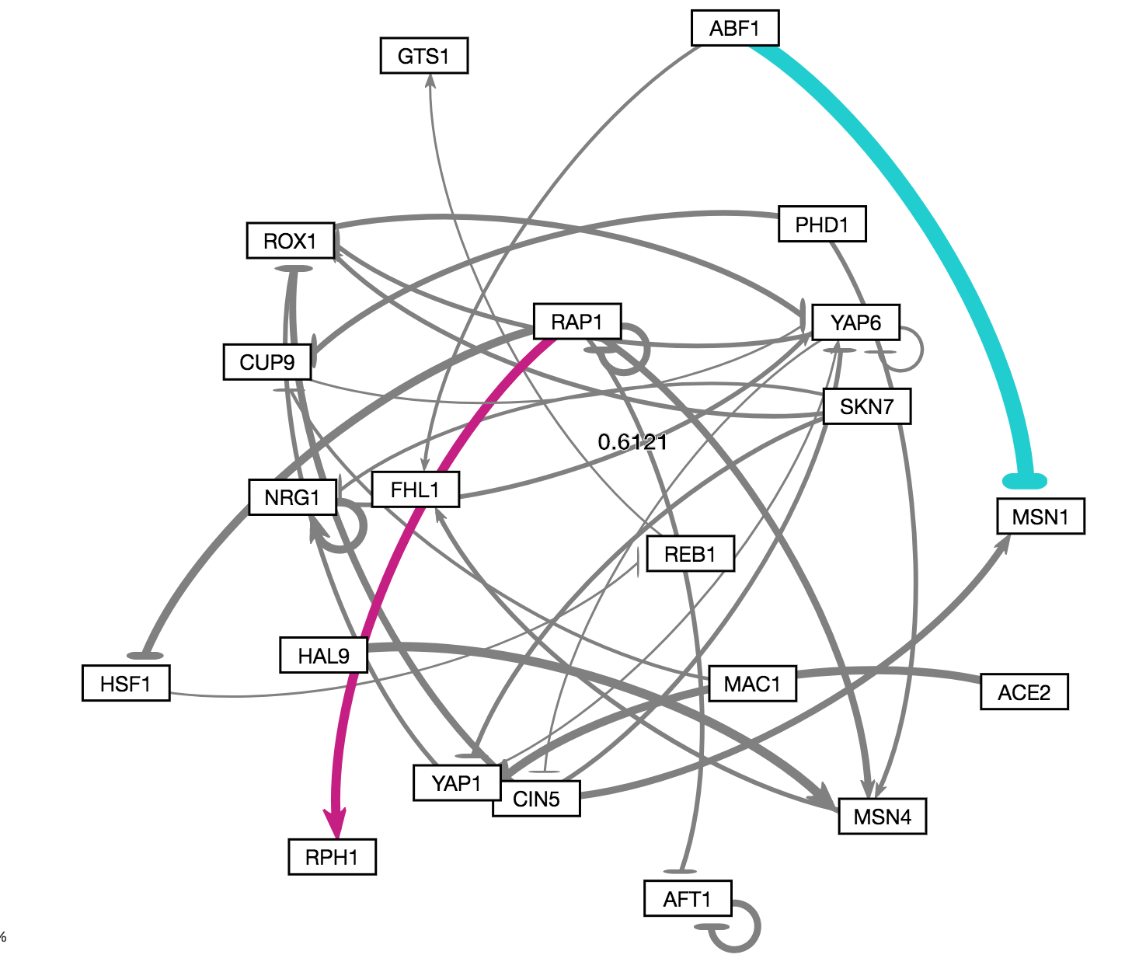
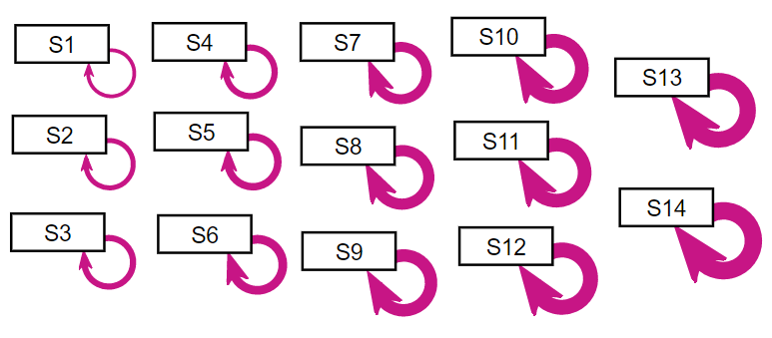


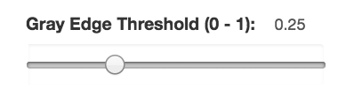
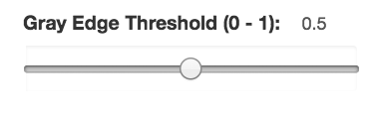
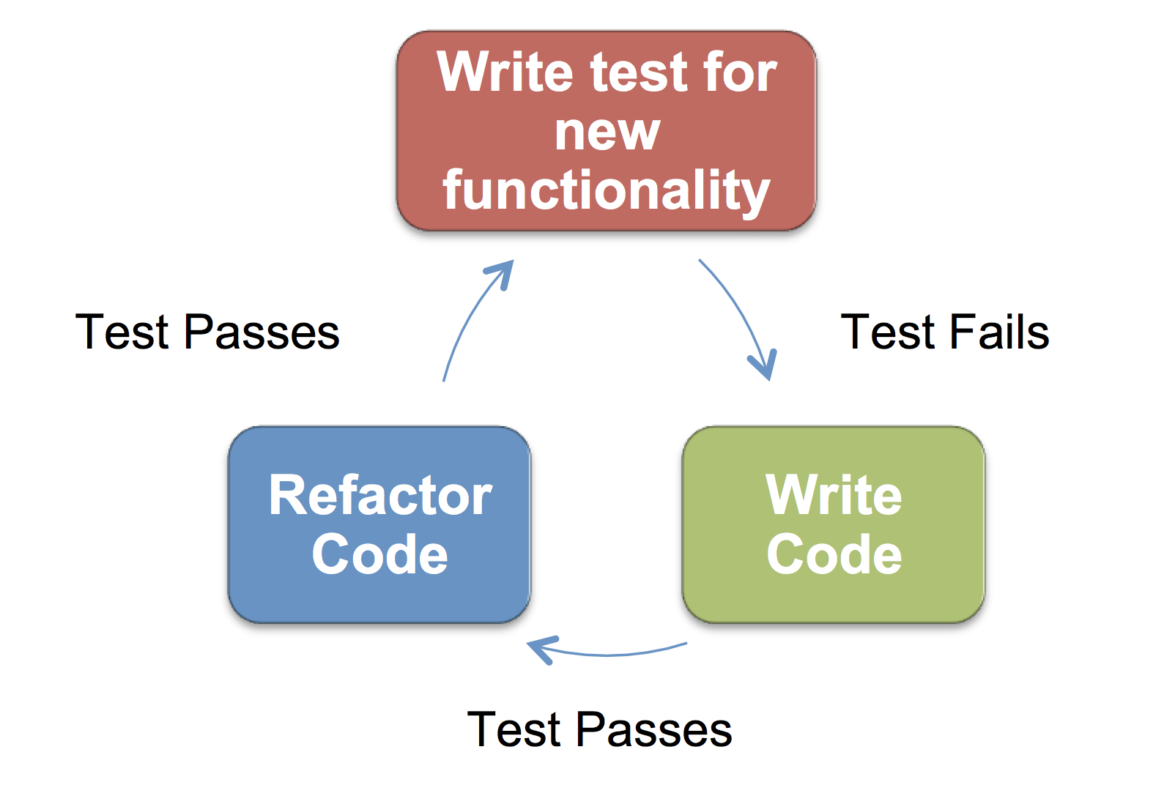


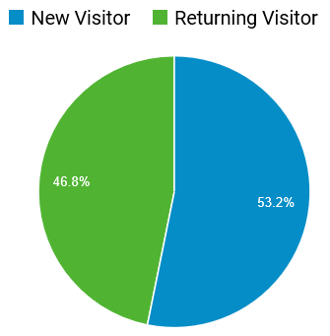

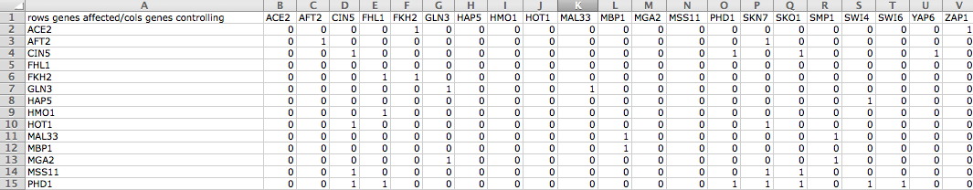
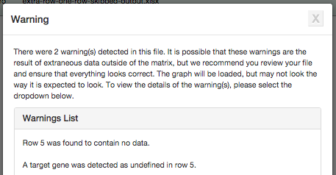
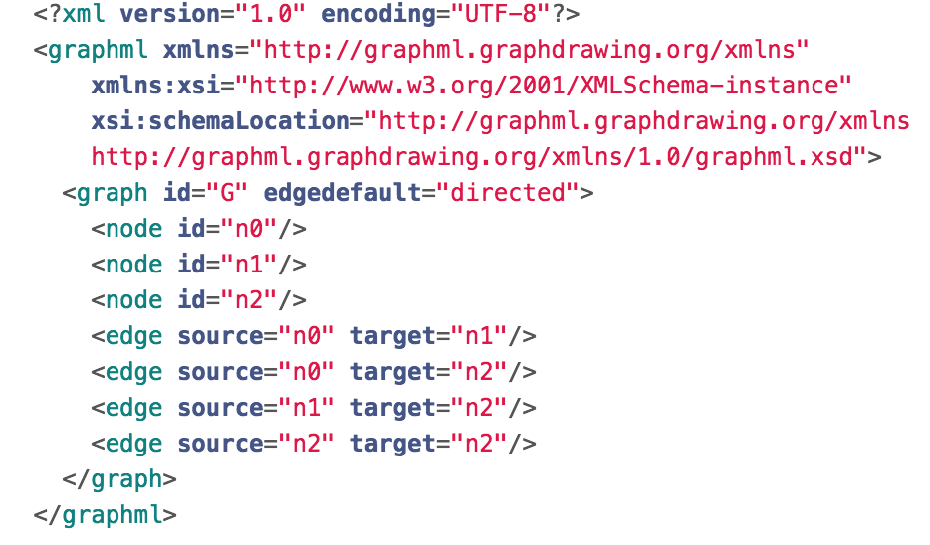
Improved Visual Performance and Enhanced Test Files for Different File Formats for
GRNsight: a Web Application for Visualizing Models of Gene Regulatory Networks
Yeon-Soo Shin**, Edward Bachoura**, Eileen Choe**, John David N. Dionisio**, Kam D. Dahlquist*
*Department of Biology, **Department of Electrical Engineering and Computer Science, Loyola Marymount University, 1 LMU Drive, Los Angeles, CA 90045
http://dondi.github.io/GRNsight/
Gene Regulatory Networks (GRNs) Can Be Illustrated by Directed Graphs
GRNsight automatically produces visualizations of weighted networks from adjacency matrix inputs
Improved Visual Performance
The central dogma of molecular biology describes how the flow of information in a cell during gene expression goes from DNA to RNA to protein.
Transcription factors control gene expression by binding to regulatory DNA sequences.
Activators increase gene expression.
Repressors decrease gene expression.
Transcription factors are themselves proteins encoded by genes.
Freeman (2002)
A gene regulatory network (GRN) consists of genes, transcription factors, and the regulatory connections between them, which govern the level of expression of mRNA and proteins from those genes.
Each node in a GRN graph represents the gene, mRNA, and protein expressed from the gene; each edge represents a regulatory relationship.
All the nodes are transcription factors themselves.
File Formats
Can open an Excel workbook and import SIF or GraphML.
Can export graph to above formats.
Demo files with weighted and unweighted graphs.
GRNsight Beta displays enhanced visual performance
Node adjustments
Long node labels with unpleasing self-regulatory arrows are now adjusted to start from the end of the node regardless of the length of the node and the thickness of the edge.
DNA
Force Graph Parameter Sliders
Link distance determines the minimum distance between nodes.
Nodes have a charge, which repels or attracts other nodes.
The charge distance determines at what range a node’s charge will affect other nodes.
Gravity determines the strength of the force holding the nodes to the center of the graph.
Reset functionality sets all parameters to default settings.
Locking the parameters prevents any further changes.
Viewport
Graph bounding box can be separated from viewport.
Zoom and Scrolling enabled.
Multiple viewport sizes available.
Blunt Marker Adjustments
The blunt markers are centered.
The edges now display equivalent spacing for both cases: when the target node is to the right from the source node and when it is to the left of the source node.
The blunt markers are centered.
RNA
Protein
GRNsight Fulfills a Specific Software Niche for Visualizing Small- to Medium-scale GRNs
Gray Edge Threshold
Slider allows the gray edge threshold to be customized.
As the threshold value increases, only the highest magnitude regulatory relationships are rendered in color.
Arrowhead Adjustments
The arrowheads are centered on the edge.
The tips of the arrowheads are not comparably shown instead of being hidden underneath the node.
Each visual adjustments were carefully tested with according test files.
Although other open source software, such as Cytoscape or Gephi, exists to lay out large networks, they were too cumbersome for our needs.
GRNsight is targeted at both experienced biology investigators and novice undergraduate users and has the following requirements:
Exist as a web application.
Be simple and intuitive to use.
3. Accept Excel (.xlsx) files directly from our sister project, GRNmap, as well as, SIF (.sif), or GraphML (.graphml) input files.
Read a weighted or unweighted adjacency matrix.
Automatically lay out and display unweighted and weighted, directed network graphs.
Edge Weight Normalization
Allows user to set normalization factor in user interface.
Edge thicknesses for different graphs can be rendered on the same scale.
Facilitates accurate visual comparison.
Unit Testing Framework Was Optimized
Technology Stack and TDD
GRNsight Accepts Microsoft Excel, SIF, and GraphML Files in the Proper Format
Mocha and Chai JavaScript testing framework
The unit testing framework consists of 216 passing tests covering over
500 test files.
The addition of SIF and GraphML file format options besides the existing Excel imports, required re-organization of the testing framework.
Testing is now split into two different test groups, with semantic tests being file-format independent, and individualized syntactic tests being based on the different file formats.
Errors found in the semantic checker test are generally considered fatal, whereas most of the syntactic checker tests return warnings and still display the graph.
GRNsight is written in JavaScript and follows software engineering best practices
Availability
Excel
Excel workbooks need a “network” sheet (for unweighted graphs) or a “network_optimized_weights” sheet (for weighted graphs). The adjacency matrix can be symmetrical or asymmetrical.
GRNmap input and output workbooks are accepted without adjustment.
Adjacency matrices generated from other databases, such as YEASTRACT (Teixeira et al., 2014), can be used with some modification.
GRNsight now accepts SIF and GraphML files without any modification
GRNsight is free and open to all users and there is no login requirement.
Web site content is available under the Creative Commons Attribution Non-Commercial Share Alike license.
GRNsight code is available under the open source BSD license.
Usage is being tracked through Google Analytics.
GRNsight has been tested with and confirmed to be working in Chrome version 43 or higher and Firefox version 38 or higher on Windows 7 and Mac OS X.
Import Excel
Excel Syntax Checker
11,311 total sessions and
3,894 files uploaded as of
6 November 2017
SIF
A SIF file is a tab-delimited text file with the file extension .sif originally created for use with Cytoscape.
Lines in the SIF file specify a source node, a relationship type (or edge type), and one or more target nodes separated by tab characters.
Import SIF
SIF Syntax Checker
Semantic Checker
GRNsight
Test-driven development cycle
GRNsight technology stack
Import GraphML
GraphML Syntax Checker
Acknowledgments
Error catching was greatly improved
Robustness was greatly extended.
Instead of crashing when given an improperly formatted or incorrect file, GRNsight returns an error in a modal window.
Conclusion
This work is partially supported by NSF award 0921038 (K.D.D., B.G.F.), a Kadner-Pitts Research Grant (K.D.D.), the Loyola Marymount University Rains Research Assistant Program (N.A.A.), and the Loyola Marymount University Summer Undergraduate Research Program (A.V.).
We would like to thank Nicole Anguiano, Anindita Varshneya, and Mihir Samdarshi for their work on GRNsight.
GraphML
A GraphML file is an Extensible Markup Language (XML) file with the extension .graphml.
GRNsight parses GraphML to extract nodes and edges.
GraphML has the ability to specify additional graph features that GRNsight cannot display, but may be useful additional data.
Warnings are returned in cases of non-fatal improper spreadsheets
Long node self referring edges are no longer hidden behind the node.
Distance between source and target node is appropriately adjusted to be equivalent.
Arrowhead and blunt markers are centered and the tips no longer hide behind the node.
Zoom and Scrolling feature is enabled.
Graph bounding box is separated from the view port.
Slider allows the gray edge threshold to be customized.
Allows users to customize normalization factor for edge thicknesses.
Full GraphML and SIF support with thorough error and warning details.
References
In cases where non-fatal errors exist in the format or data of an uploaded spreadsheet, the graph is displayed, and a warning box appears.
Cytoscape: http://cytoscape.org
Dahlquist, K.D., Dionisio, J.D.N., Fitzpatrick, B.G., Anguiano, N.A., Varshneya, A., Southwick, B.J., Samdarshi, M. (2016) GRNsight: a web application and service for visualizing models of small- to medium-scale gene regulatory networks. PeerJ Computer Science 2:e85. DOI: 10.7717/peerj-cs.85).
Dahlquist, K.D., Fitzpatrick, B.G., Camacho, E.T., Entzminger, S.D., and Wanner, N.C. (2015) Parameter Estimation for Gene Regulatory Networks from Microarray Data: Cold Shock Response in Saccharomyces cerevisiae. Bulletin of Mathematical Biology, 77(8), 1457-1492, DOI: 10.1007/s11538-015-0092-6
D3.js: http://d3js.org/
Freeman, S., (2002). Biological science, 1st edition. Upper Saddle River, NJ:: Prentice Hall.
Gephi: https://gephi.org
GRNmap: http://kdahlquist.github.io/GRNmap/
Teixeira, M. C., Monteiro, P. T., Guerreiro, J. F., Gonçalves, J. P., Mira, N. P., dos Santos, S. C., ... & Madeira, S. C. (2014). The YEASTRACT database: an upgraded information system for the analysis of gene and genomic transcription regulation in Saccharomyces cerevisiae. Nucleic Acids Research, 42(D1), D161-D166, DOI: 10.1093/nar/gkt1015
Warnings clearly state which row(s) or cell(s) may have incorrect data.
The warning box can be closed and reopened at any time via a hyperlink underneath Force Graph Parameter sliders.
Notes:
Kill abstract
Change to sans serif font
Make title bigger
Make title background white
Use full names
Super script to associate names with correct department
Background color: make it dark green, make writing on white background and writing in black/dark green
4 columns!!!
Smaller pictures
Bold titles
References can be 12pt
Acknowledgements can be 16pt
Everything else is 18-24pt
Titles don’t need to be bigger than 36pt
Remove circles from the arrowhead diagram, group the related labels together
Include menu bar
Testing/error handling – sample error (we don’t crash with errors!)
Mouseovers for edges screenshot

