Slide 1
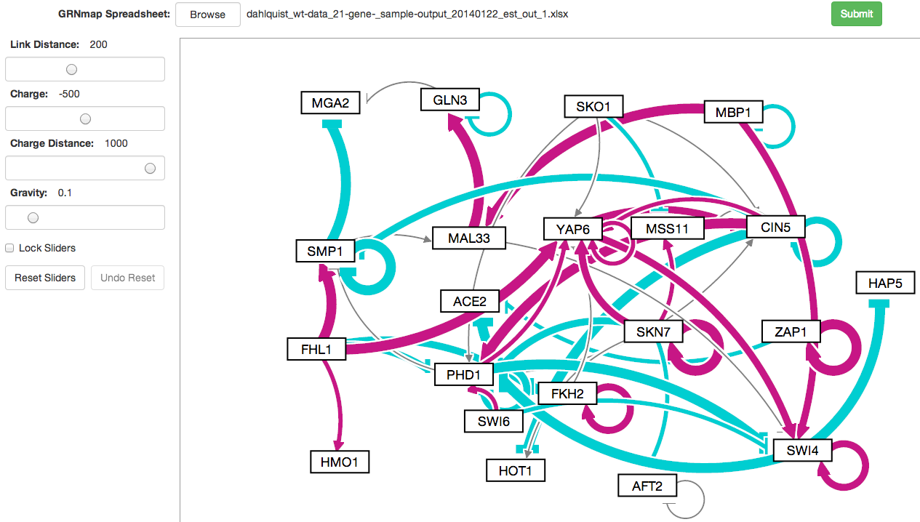
GRNsight: A Web Application for Visualizing Models of Gene Regulatory Networks Britain Southwick CMSI 402 Spring 2014
Gene Regulatory Networks
A gene regulatory network (GRN) consists of genes, transcription factors, and the regulatory connections between them, which govern the level of expression of mRNA and protein from those genes.
Graph Features
Each node generated by GRNsight denotes a gene in the network
Each edge represents a connection
Red edges denote activation
Blue edges denote repression
Edge thickness denotes relationship strength.
Service-Oriented Design:
Node.js based server extracts Gene Regulatory Network data from an Excel Spreadsheet uploaded to the web client.
Web client uses the D3 Javascript library to generate an interactive graph derived from the network data.

