Slide 1

GRNmap and GRNsight: Open Source Software for Dynamical Systems Modeling and Visualization of Medium-Scale Gene Regulatory Networks
Kam D. Dahlquist, Ph.D.
Department of Biology
Loyola Marymount University
July 9, 2016
Bioinformatics Open Source Conference (BOSC)

Slide 2
Open Science Ecosystem
Open Access
(creative commons)
Open
Source
Code
Open Pedagogy
Open Data
Open Science
(open process)
Reproducible
Research
Research
Integrity
Citizen
Science
With thanks to John Jungck

Slide 3



Students Benefit from Open Source and Open Data
BioQUEST Curriculum Consortium
30th Anniversary this year!
http://www.bioquest.org
The Genome Consortium for Active Teaching NextGen Sequencing Group
http://gcat-seek.weebly.com/
HHMI Science Education Alliance
Phage Hunters Advancing Genomics and Evolutionary Science Program
http://seaphages.org/

Slide 4

GRNsight: http://dondi.github.io/GRNsight/ GRNmap: http://kdahlquist.github.io/GRNmap/
Back row (left to right)
Brandon Klein
Mihir Samdarshi
Kevin McGee
Kevin Wyllie
K. Grace Johnson
Kristen Horstmann
Tessa Morris
Front row (left to right)
Maggie O’Neil
Monica Hong
Kam Dahlquist
Anindita Varshneya
Kayla Jackson
Not pictured
John David N. Dionisio
Ben G. Fitzpatrick
Nicole Anguiano
Juan Carrillo
Trixie Anne Roque
Chukwuemeka Azinge
Funding: NSF RUI, Kadner-Pitts Research Grant, LMU SURP,
LMU Honors Program, LMU Rains Research Assistant Program

Slide 5
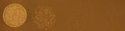
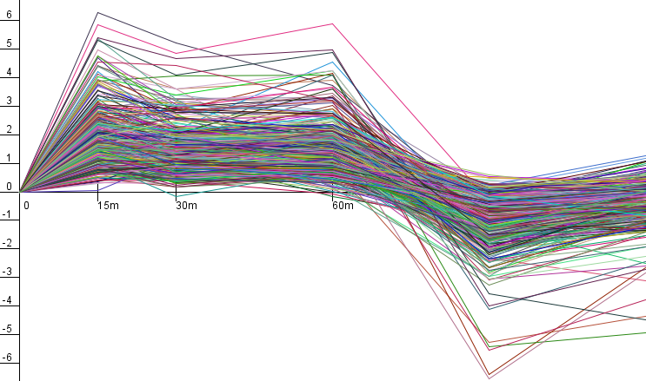
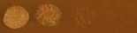
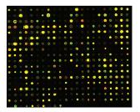
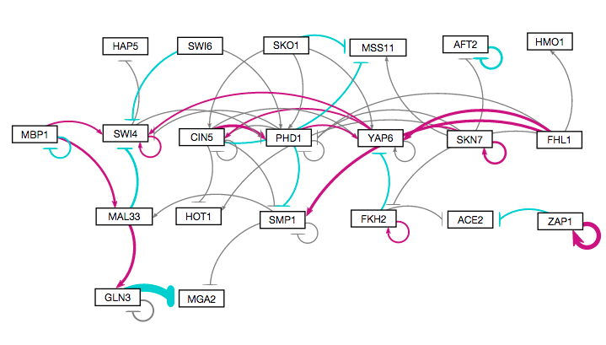
Systems Biology Approach to Understanding the Regulation of the Cold Shock Response in Yeast
wt
Cold shock microarray data from wt and TF deletion strains
15°C
Δash1
Interpretation,
new questions, new experiments
Normalization, statistical analysis, clustering
Visualization of modeling results using GRNsight
Derivation of gene regulatory networks from YEASTRACT
Dynamical systems modeling using GRNmap

Slide 6
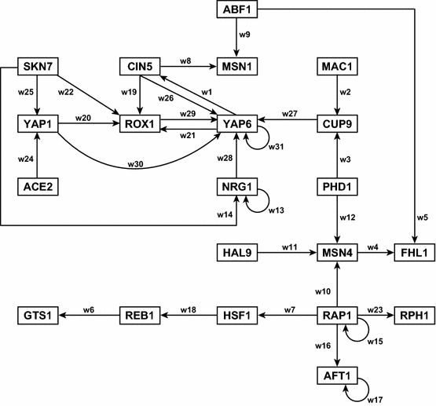
GRNmap: Gene Regulatory Network Modeling and Parameter Estimation
Weight parameter, w, gives the direction (activation or repression) and magnitude of regulatory relationship.

Slide 7
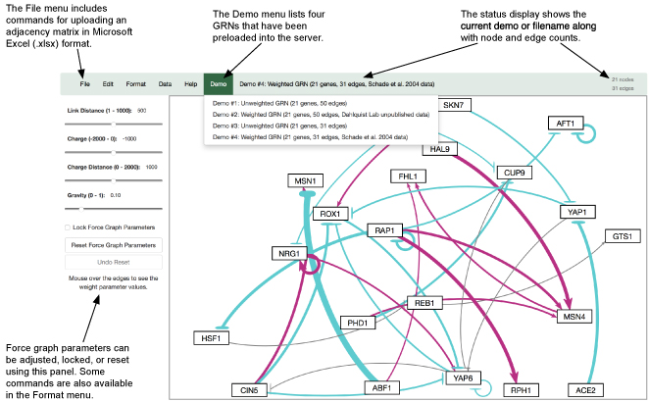
GRNsight is written in JavaScript, customizing the D3.js library. Node.js and the Express framework handle server-side functions.

Slide 8
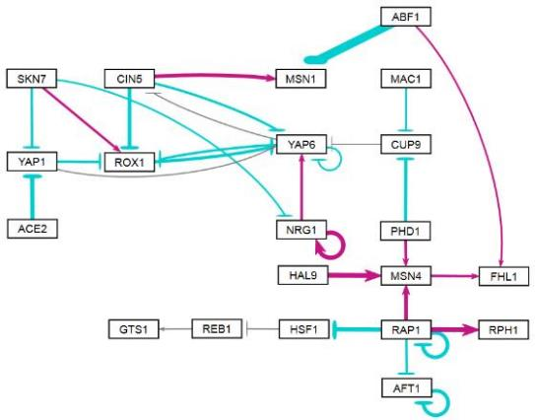
Users Click and Drag to Customize Layout, Mouse-over Edge Displays Value of Weight Parameter

Slide 9
A Tale of Two Open Source Projects. . .
GRNmap
GRNsight
Developed in MATLAB by successive math students over nearly a decade
Shifted to open development on GitHub in the last two years
Free executable now available
Still in the midst of software refactoring and “paying off our technical debt”
New features arise through interplay between student “coding” and “data analysis” teams
Goal is reproducible research
Why “yet another graph layout tool”?
Specific use-case of displaying output from GRNmap directly in a web application
Reduced learning curve for student users
Do one thing well
Teach software engineering best practices while creating a useful tool
New features arise through interplay with GRNmap team, leverage other open source tools

Slide 10
Summary
GRNmap models the dynamics of “medium-scale” gene regulatory networks using differential equations.
A penalized least squares approach was used successfully to estimate parameters from yeast cold shock microarray data.
Can be used with time course gene expression data from any species.
GRNsight automatically generates weighted network graphs from the spreadsheets produced by GRNmap.
This facilitates visualization of the relative influence of each transcription factor in controlling the cold shock response.
Can be used to visualize any small- to medium-scale network in adjacency matrix format (< 35 nodes, < 70 edges).
Challenges in bridging the cultures of mathematics and computing were overcome.
Shifting a longstanding project to open development and software engineering best practices, versus...
Building an open source project with test-driven development, “standing on the shoulders of giants”.

