Slide 1

GRNmap and GRNsight: Open Source Software for Dynamical Systems Modeling and Visualization of Medium-Scale Gene Regulatory Networks
Kam D. Dahlquist, Ph.D.
Department of Biology
Loyola Marymount University
April 4, 2016
ASBMB Annual Meeting

Slide 2
Outline
Yeast respond to cold shock by changing gene expression.
But little is known about which transcription factors regulate the response.
GRNmap models the dynamics of “medium-scale” gene regulatory networks using differential equations.
A penalized least squares approach was used successfully to estimate parameters from cold shock microarray data.
GRNsight automatically generates weighted network graphs from the spreadsheets produced by GRNmap.
This facilitates visualization of the relative influence of each transcription factor in controlling the cold shock response.

Slide 3
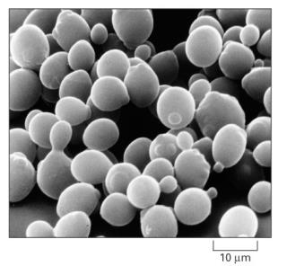
Yeast Respond to Cold Shock by Changing Gene Expression
Unlike heat shock, cold shock is not well-studied.
Cold shock temperature range for yeast is
10-18°C.
Previous studies indicated that the cold shock response can be divided into an early and late response.
General Environmental Stress Response (ESR) genes are induced in the late response.
Late response is regulated by the Msn2/Msn4 transcription factors.
No “canonical” factor responsible for early response.
Alberts et al. (2004)

Slide 4
Yeast Respond to Cold Shock by Changing Gene Expression
Unlike heat shock, cold shock is not well-studied.
Cold shock temperature range for yeast is
10-18°C.
Previous studies indicated that the cold shock response can be divided into an early and late response.
General Environmental Stress Response (ESR) genes are induced in the late response.
Late response is regulated by the Msn2/Msn4 transcription factors.
No “canonical” factor responsible for early response.
Alberts et al. (2004)
Which transcription factors control the early response?
What are their relative levels of influence?
I.e., what are the indirect effects of other transcription factors in the network?

Slide 5
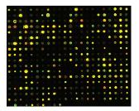
Systems Biology Approach to Understanding the Regulation of the Cold Shock Response in Yeast
Cold shock microarray data from wt and TF deletion strains

Slide 6
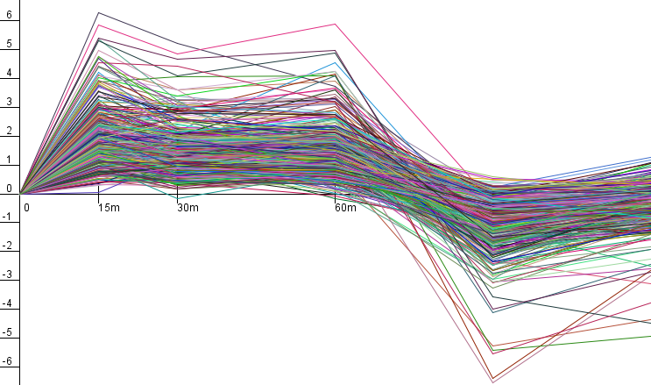
Systems Biology Approach to Understanding the Regulation of the Cold Shock Response in Yeast
Cold shock microarray data from wt and TF deletion strains
Normalization, statistical analysis, clustering

Slide 7
Systems Biology Approach to Understanding the Regulation of the Cold Shock Response in Yeast
Cold shock microarray data from wt and TF deletion strains
Normalization, statistical analysis, clustering
Derivation of gene regulatory networks from YEASTRACT

Slide 8
Systems Biology Approach to Understanding the Regulation of the Cold Shock Response in Yeast
Cold shock microarray data from wt and TF deletion strains
Normalization, statistical analysis, clustering
Derivation of gene regulatory networks from YEASTRACT
Dynamical systems modeling using GRNmap

Slide 9
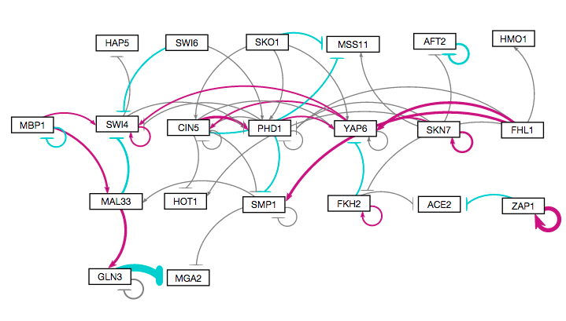
Systems Biology Approach to Understanding the Regulation of the Cold Shock Response in Yeast
Cold shock microarray data from wt and TF deletion strains
Normalization, statistical analysis, clustering
Visualization of modeling results using GRNsight
Derivation of gene regulatory networks from YEASTRACT
Dynamical systems modeling using GRNmap

Slide 10
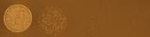
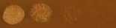
Systems Biology Approach to Understanding the Regulation of the Cold Shock Response in Yeast
wt
Cold shock microarray data from wt and TF deletion strains
15°C
Δash1
Interpretation,
new questions, new experiments
Normalization, statistical analysis, clustering
Visualization of modeling results using GRNsight
Derivation of gene regulatory networks from YEASTRACT
Dynamical systems modeling using GRNmap

Slide 11
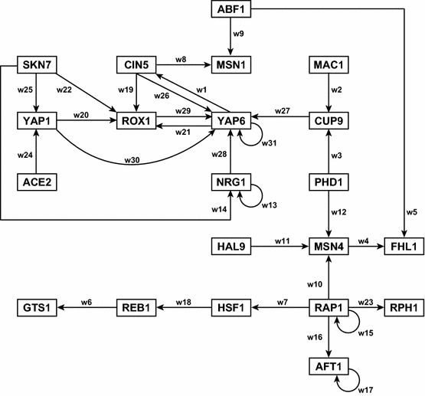
A “Medium-Scale” Gene Regulatory Network that Regulates the Cold Shock Response
Assumptions made in our model:
Each node represents one gene encoding a transcription factor.
When a gene is transcribed, it is immediately translated into protein.
A node represents the gene, the mRNA, and the protein.
Each edge represents a regulatory relationship, either activation or repression, depending on the sign of the weight.
Dahlquist et al. (2015) Bulletin of Mathematical Biology 77: 1457.

Slide 12
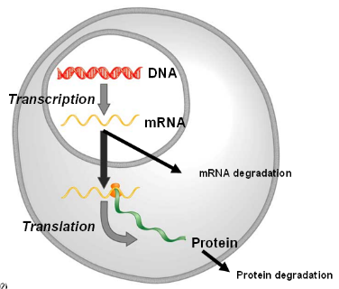
GRNmap: Gene Regulatory Network Modeling and Parameter Estimation
The user has a choice to model the dynamics based on a sigmoidal (shown) or Michaelis-Menten production function.
Weight parameter, w, gives the direction (activation or repression) and magnitude of regulatory relationship.
http://kdahlquist.github.io/GRNmap/

Slide 13
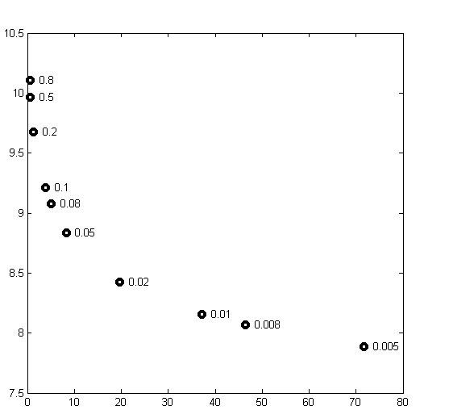
Optimization of the Large Number of Parameters Required the Use of a Regularization (Penalty) Term
Total number of parameters is
(2 X no. of genes) + no. of edges.
We added a penalty term so that MATLAB’s optimization algorithm would be able to minimize the function.
θ is the combined production rate, weight, and threshold parameters.
α is determined empirically from the “elbow” of the L-curve.
Least Squares Residual
Parameter Penalty Magnitude
Notes:
Define alpha and beta and K

Slide 14
Forward Simulation of the Model Fits the Microarray Data
Notes:
Define alpha and beta and K

Slide 15
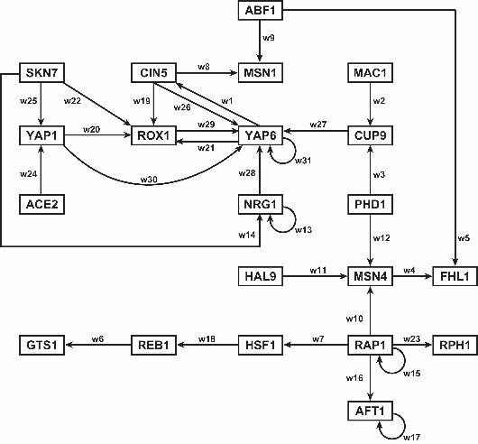
GRNsight Rapidly Generates GRN graphs Using Our Customizations to the Open Source D3 Library
Adobe Illustrator: several hours to create

Slide 16
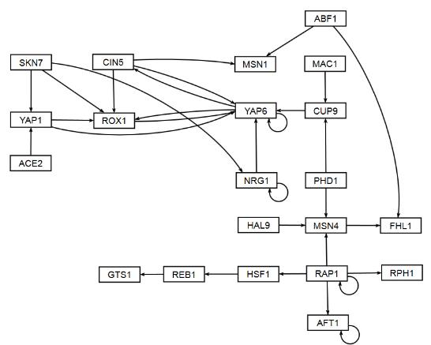
GRNsight Rapidly Generates GRN graphs Using Our Customizations to the Open Source D3 Library
GRNsight: 10 milliseconds to generate, 5 minutes to arrange

Slide 17
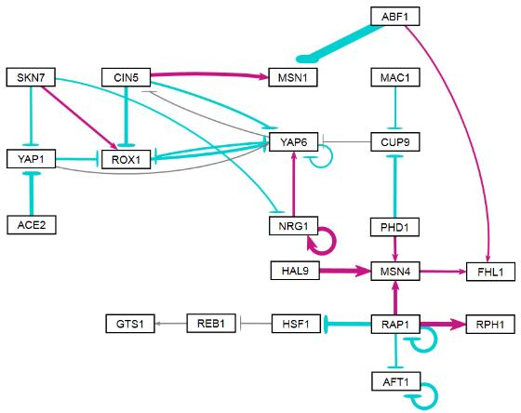
GRNsight Rapidly Generates GRN graphs Using Our Customizations to the Open Source D3 Library
activation
repression
weak influence
GRNsight: colored and variable thickness edges reveal patterns in data

Slide 18
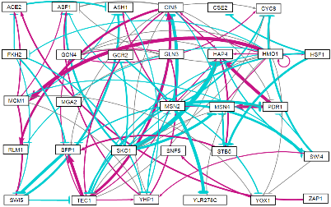
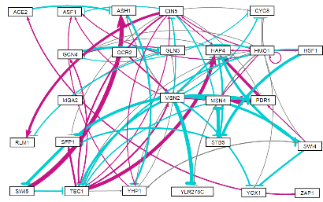
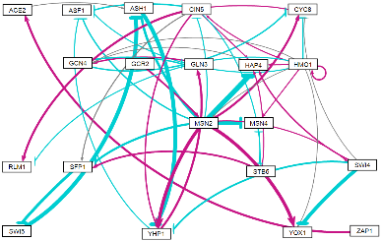
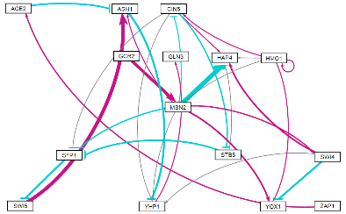
LSE to Minimum Theoretical LSE Ratio Does Not Change Drastically with Network Size
30 genes, 90 edges
LSE/min LSE = 1.41
25 genes, 68 edges
LSE/min LSE = 1.44
20 genes, 46 edges
LSE/min LSE = 1.44
15 genes, 28 edges
LSE/min LSE = 1.46

Slide 19
But Weights, Production Rates, and Threshold Parameter Values Do Fluctuate Based on Connectivity

Slide 20
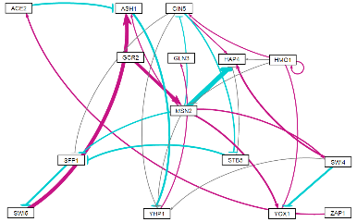
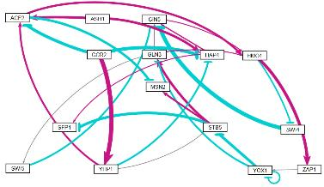
Generally, Networks with the Same Nodes, but Randomized Edges Perform More Poorly
YEASTRACT-derived
“random network 7”

Slide 21
Conclusions and Future Directions
Modeling and experimental evidence suggests that Gln3, Hap4, Hmo1, and Swi4 are involved in regulating the early response to cold shock in yeast.
Indirect effects are important as shown by comparing different size related networks and random networks.
Interesting, but inconclusive modeling results for Ash1 prompted us to investigate the phenotype of the deletion strain, which has shown to be cold sensitive.
We are investigating what data/network properties influence an individual gene’s model fit to data.

Slide 22
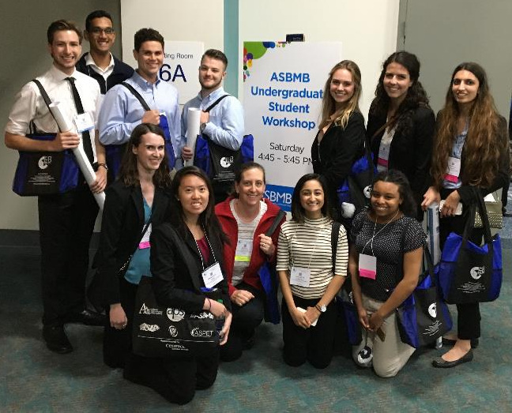
GRNsight: http://dondi.github.io/GRNsight/ GRNmap: http://kdahlquist.github.io/GRNmap/
Back row (left to right)
Brandon Klein
Mihir Samdarshi
Kevin McGee
Kevin Wyllie
K. Grace Johnson
Kristen Horstmann
Tessa Morris
Front row (left to right)
Maggie O’Neil
Monica Hong
Kam Dahlquist
Anindita Varshneya
Kayla Jackson
Not pictured
John David N. Dionisio
Ben G. Fitzpatrick
Nicole Anguiano
Juan Carrillo
Trixie Anne Roque
Chukwuemeka Azinge
Funding: NSF RUI, Kadner-Pitts Research Grant, LMU SURP,
LMU Honors Program, LMU Rains Research Assistant Program

Slide 23

Five Major Pragmatic Uses for Models in Biology and their Associated Benefits
Simple, unrealistic models help scientists explore complex systems.
Models can be used to explore unknown possibilities.
Models can lead to the development of conceptual frameworks.
Models can make accurate predictions.
Models can generate causal explanations.
Odenbaugh quoted in Svoboda & Passmore (2011)

