Slide 1

GRNmap and GRNsight: Open Source Software for Dynamical Systems Modeling and Visualization of Medium-Scale Gene Regulatory Networks
Kam D. Dahlquist, Ph.D.
Department of Biology
Loyola Marymount University
January 31, 2015
Southern California Systems Biology Conference

Slide 2
Outline
Yeast respond to cold shock by changing gene expression.
But little is known about which transcription factors regulate the response.
GRNmap models the dynamics of “medium-scale” gene regulatory networks using differential equations.
A penalized least squares approach was used successfully to estimate parameters from cold shock microarray data.
GRNsight automatically generates weighted network graphs from the spreadsheets produced by GRNmap.
This facilitates visualization of the relative influence of each transcription factor in controlling the cold shock response.

Slide 3
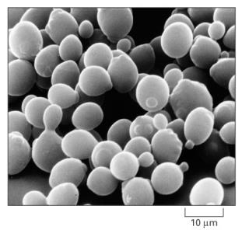
Yeast Respond to Cold Shock by Changing Gene Expression
Unlike heat shock, cold shock is not well-studied.
Cold shock temperature range for yeast is
10-18°C.
Previous studies indicated that the cold shock response can be divided into an early and late response.
General Environmental Stress Response (ESR) genes are induced in the late response.
Late response is regulated by the Msn2/Msn4 transcription factors.
No “canonical” factor responsible for early response.
Alberts et al. (2004)

Slide 4
Yeast Respond to Cold Shock by Changing Gene Expression
Unlike heat shock, cold shock is not well-studied.
Cold shock temperature range for yeast is
10-18°C.
Previous studies indicated that the cold shock response can be divided into an early and late response.
General Environmental Stress Response (ESR) genes are induced in the late response.
Late response is regulated by the Msn2/Msn4 transcription factors.
No “canonical” factor responsible for early response.
Alberts et al. (2004)
Which transcription factors control the early response?
What is the extent of ESR pathway overlap?
Which part of the early response is due to indirect effects of other transcription factors?

Slide 5
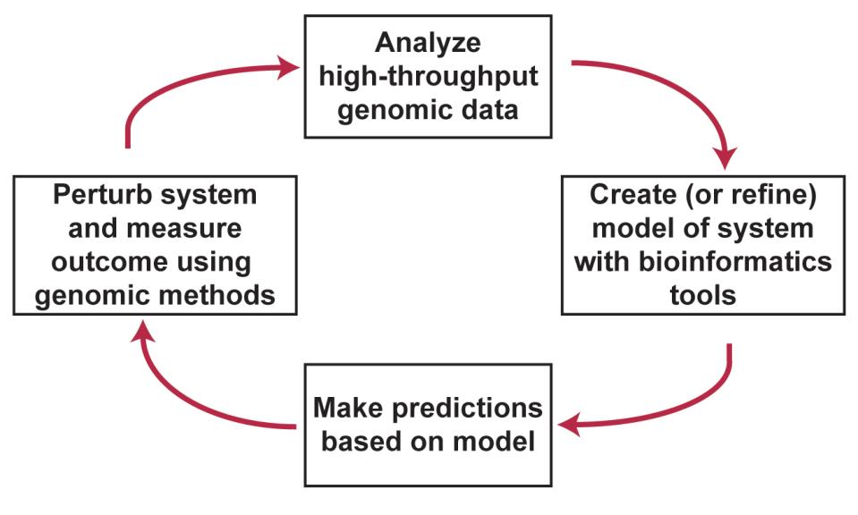
Systems Biology Approach to Understanding the Regulation of the Cold Shock Response in Yeast

Slide 6
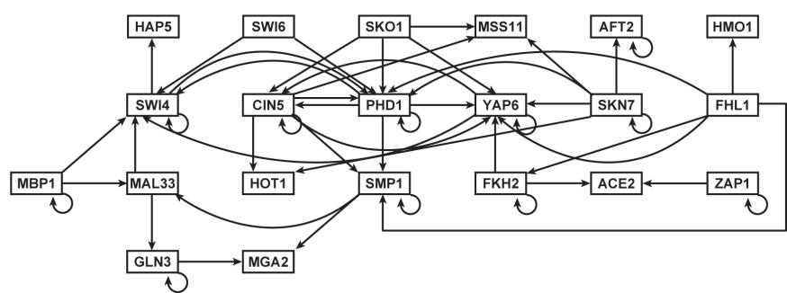
A “Medium-Scale” Gene Regulatory Network that Regulates the Cold Shock Response
Assumptions made in our model:
Each node represents one gene encoding a transcription factor.
When a gene is transcribed, it is immediately translated into protein; a node represents the gene, the mRNA, and the protein.
Each edge represents a regulatory relationship, either activation or repression, depending on the sign of the weight.

Slide 7
GRNmap: Gene Regulatory Network Modeling and Parameter Estimation
The user has a choice to model the dynamics based on a sigmoidal (shown) or Michaelis-Menten function.
Parameters are estimated from DNA microarray data from wild type and transcription factor deletion strains subjected to cold shock conditions.
Weight parameter, w, gives the direction (activation or repression) and magnitude of regulatory relationship.

Slide 8
The “Worst” Rate Equation is:
Notes:
Define alpha and beta and K

Slide 9
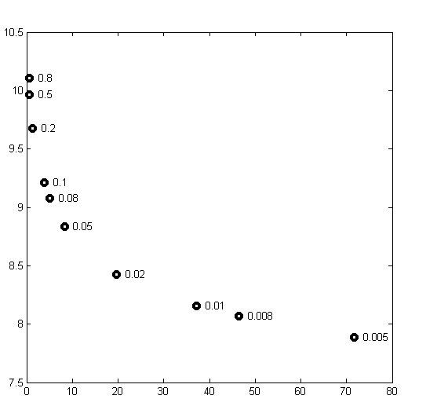
Optimization of the 92 Parameters Required
the Use of a Regularization (Penalty) Term
Plotting the least squares error function showed that not all the graphs had clear minima.
We added a penalty term so that MATLAB’s optimization algorithm would be able to minimize the function.
θ is the combined production rate, weight, and threshold parameters.
α is determined empirically from the “elbow” of the L-curve.
Least Squares Residual
Parameter Penalty Magnitude
Notes:
Define alpha and beta and K

Slide 10
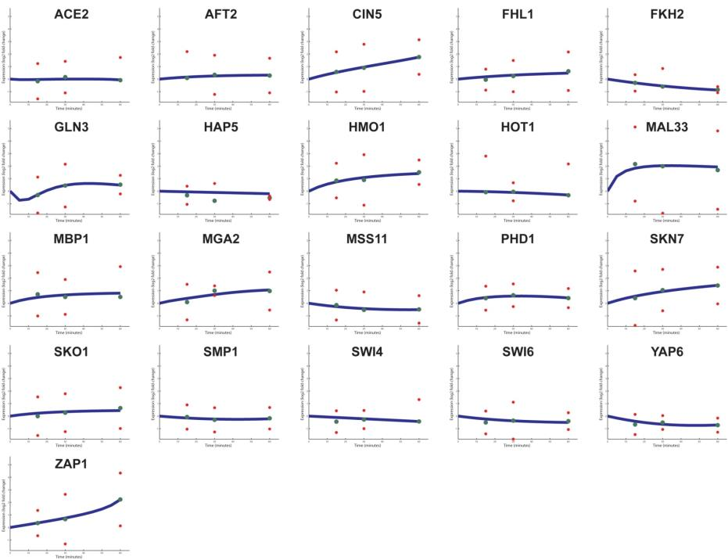
Forward Simulation of the Model Fits the Microarray Data
Notes:
Define alpha and beta and K

Slide 11
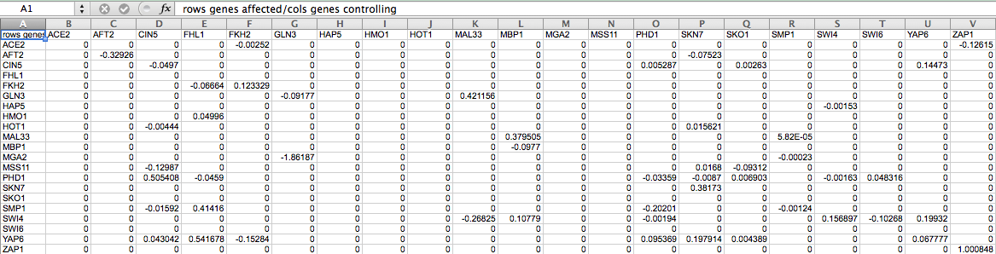
GRNmap Produces an Excel Spreadsheet with an Adjacency Matrix Representing the Network
However, GRNmap does not generate any visual representation of the gene regulatory network.
Illustrating the weights of edges to would allow us to visualize the relative influence of individual TFs.

Slide 12

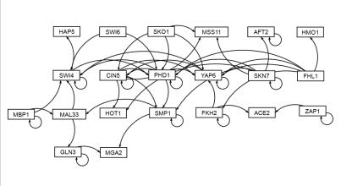
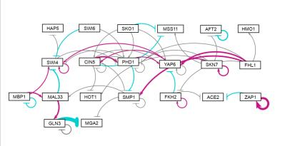
GRNsight Rapidly Generates GRN graphs Using Our Customizations to the Open Source D3 Library
Adobe Illustrator: several hours to create
GRNsight: 10 milliseconds to generate, 5 minutes to arrange
GRNsight: colored edges for weights reveal patterns in data

Slide 13

The First Round of Modeling Has Suggested Future Experiments

Slide 14
Summary
Yeast respond to cold shock by changing gene expression.
Through modeling and experiment we are starting to get a handle on which transcription factors control the response.
GRNmap models the dynamics of “medium-scale” gene regulatory networks using differential equations and a penalized least squares approach.
Code and executable (no MATLAB license required) available.
GRNsight automatically generates weighted network graphs from the spreadsheets produced by GRNmap.
The set of transcription factors in the densely connected core of our current network model have the strongest influence on other factors.

Slide 15
GRNsight: http://dondi.github.io/GRNsight/ GRNmap: http://kdahlquist.github.io/GRNmap/
Faculty Collaborators
Dr. John David N. Dionisio, (LMU EE/CS)
Dr. Ben G. Fitzpatrick, (LMU Math)
GRNsight
Nicole A. Anguiano ’16
Britain J. Southwick ’14
Anindita Varshneya ’17
GRNmap
Juan S. Carrillo ’16
Nicholas A. Rohacz ’13
Katrina Sherbina ’14
NSF-RUI 0921038
Microarray Data
Cybele Arsan ’11
Wesley Citti ’08
Kevin Entzminger ’09
Andrew Herman ’12
Heather King ’06
Lauren Kubeck ’11
Stephanie Kuelbs ’09
Elizabeth Liu ’08
Matthew Mejia ’07
Kenny Rodriguez ’09
Olivia Sakhon ’08
Alondra Vega ’12
New Lab Members
Monica Hong ’17
Grace Johnson ’17
Trixie Roque ’17
Natalie Williams ’17
Kevin Wyllie ’16

