Slide 1
GRNsight: A Web Application for Visualizing Models of Gene Regulatory Networks
Britain Southwick
Nicole Anguiano
March 29, 2014
LMU Undergraduate Research Symposium

Slide 2
Outline
Transcription factors interact with each other in a complex network of activation and repression.
GRNmap, a network modeling and simulation application, does not generate a visualization of the network.
GRNsight is an open source tool to create network graphs from the Excel spreadsheets used by GRNmap.
Implementation consists of a web client for visualization and a server for reading uploaded spreadsheets.
Future enhancements to GRNsight aim to include more GRN information in the graph visualization.

Slide 3
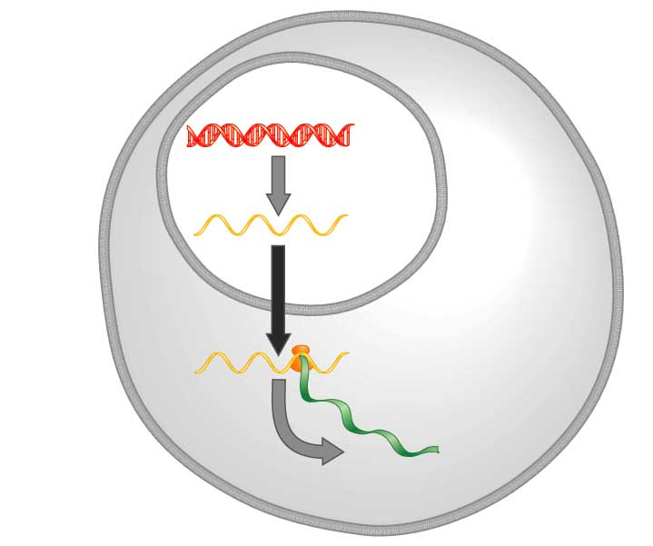
Central Dogma of Molecular Biology
DNA
Transcription
mRNA
Translation
Protein
Freeman (2002)

Slide 4
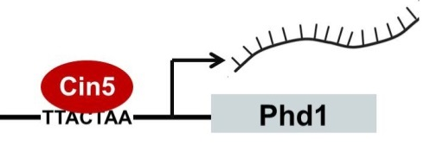
Transcription Factors Control Gene Expression by Binding to Regulatory DNA Sequences
Activators increase gene expression.
Repressors decrease gene expression.
Transcription factors are themselves proteins that are encoded by genes.

Slide 5
Gene Regulatory Networks Can Be Illustrated By Directed Graphs
A gene regulatory network (GRN) consists of genes, transcription factors, and the regulatory connections between them, which govern the level of expression of mRNA and protein from those genes.
Each node represents the gene, the mRNA, and the protein expressed from the gene.
Each edge represents a regulatory relationship.
All of the nodes are transcription factors themselves.

Slide 6
GRNmap: Gene Regulatory Network Modeling and Parameter Estimation
Matlab application written by Katrina Sherbina.
Differential equation model of change in gene expression over time.
Each gene (node) in the network has an equation.
Parameters in model are estimated from laboratory data.
Weight parameter, w, gives the direction (activation or repression) and magnitude of regulatory relationship.

Slide 7
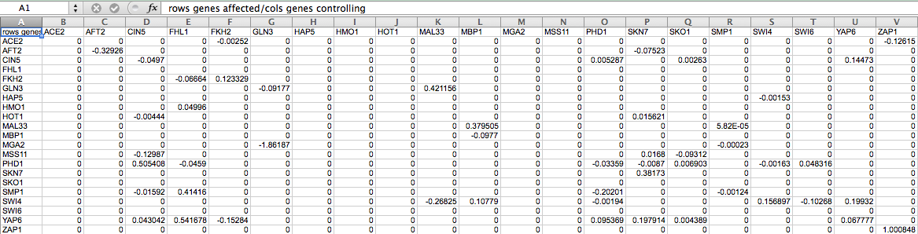
GRNmap Produces an Excel Spreadsheet with an Adjacency Matrix Representing the Network
0 represents no correlation.
A positive number shows activation.
A negative weight signifies repression.
The magnitude of the weight is the strength of the relationship.

Slide 8
GRNmap Does Not Generate a Visual Representation of the Gene Regulatory Network
Representations of the network have been made by hand in Adobe Illustrator.
This method is time consuming and makes it difficult to quickly visualize changes to the network.
Our goal was to create a fast and easy to use application that visualizes the graph automatically and is able to represent activation and repression relationships.

Slide 9
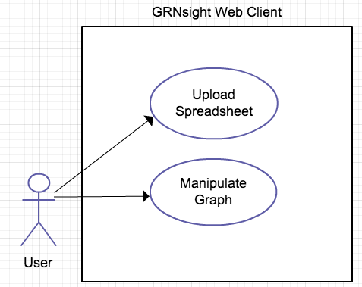
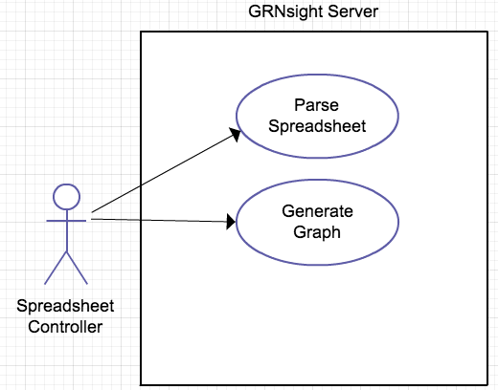
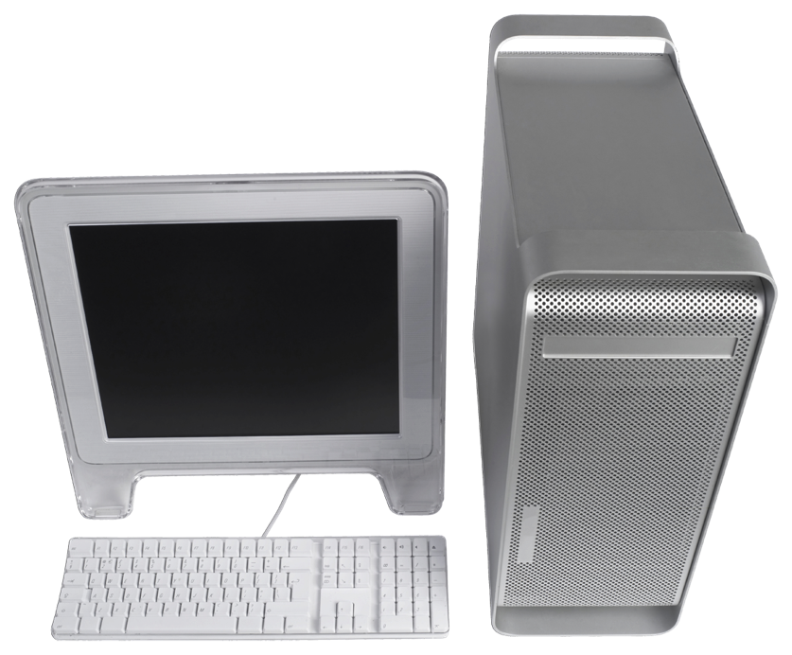
How GRNsight Works: Use Case Diagram
The user uploads an Excel spreadsheet with network data.
GRNsight generates and displays the resulting graph.
The user can manipulate and refine the graph.

Slide 10
GRNsight Implementation Takes Advantage of Other Open Source Tools
Uses the Data-Driven Documents (D3) JavaScript library to generate a graph derived from input network data.
D3 dynamically manipulates HTML and Scalable Vector Graphics (SVG) to form the elements of the graph.
D3 also allows for the fine tuning of Cascading Style Sheets (CSS), the code that styles web pages.

Slide 11
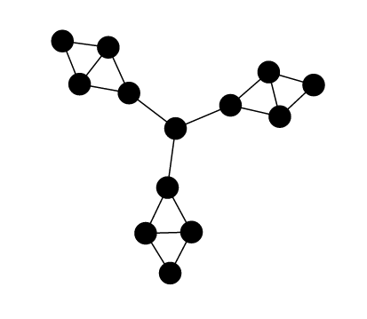
Additional Features were Required
SVG paths were added as markers to create arrowheads.
A special case was added to add a looping edge if a node regulated itself.
SVG paths and an offset were added for the blunt arrowheads representing repression.
Edges adapt their anchor points to the movements of the nodes.
Default implementation simply had nodes and edges. We added several features, including:
Labels on nodes.
Rectangular nodes.
Variant node size.
GRNsight implements D3’s force layout, which
applies a physics-based simulation to the graph.

Slide 12
GRNsight has a Service Oriented Architecture
GRNsight has two pieces: a server and a web client.
The server is responsible for receiving and parsing the spreadsheet.
The web client receives data from the server and generates the graph visualization.
GRNsight code is open source and available on GitHub.

Slide 13

The User Interface is Compatible with Firefox and Chrome Browsers
File upload via simple HTML form element
Nodes displayed as interactive HTML elements
Advanced users can utilize setting sliders to refine the visualization
Nodes have a charge, which repels or attracts other nodes.
The charge distance determines at what range a node’s charge
will affect other nodes.
The link distance determines the minimum distance maintained between nodes.

Slide 14




Edges Were Customized to Show Activation, Repression, and Self-Regulation
Activation
Repression
Self-Regulation
Self-Regulation

Slide 15
Accomplishments to Date
GRNsight allows the user to upload a spreadsheet and generate a graph.
The user can drag nodes to customize their view of the network.
The graph is able to represent the different types of edges (activation, repression, and self-regulation).
The sliders allow the user to customize the force parameters of the graph.
Customized the style of the nodes and added different edge types.
Hosted on dondi.github.io/GRNsight/demo

Slide 16
Demonstration

Slide 17
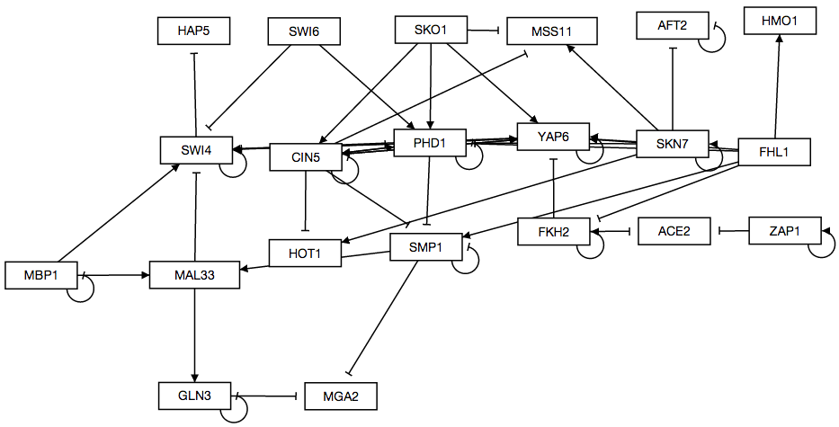
A Graph Generated by GRNsight as Compared to One Drawn by Hand
GRNsight
10 milliseconds to generate the graph
5 minutes to arrange it.
Adobe Illustrator
1 day to create

Slide 18
Future Goals
Vary the thickness of edges based on magnitude of weight.
Vary the color of edges based on type of relation (activation or repression).
Change the background color of nodes based on the expression data.
Snapping nodes to a rough grid would improve the organization of the graph.
Implementing edges that curve around other nodes would increase the readability of the graph.

Slide 19
Summary
Transcription factors interact with each other in a complex network of activation and repression.
GRNmap is a network modeling and simulation application.
GRNmap does not generate a visualization of the network.
GRNsight was developed as an open source tool to create network graphs based on the GRNmap simulation program.
GRNsight uses a variety of open source libraries to generate networks from Excel spreadsheets.
Future enhancements to GRNsight aim to include more GRN information in the graph visualization.

Slide 20
Thanks
Dr. Dahlquist
Dr. Dionisio
Dr. Fitzpatrick
Katrina Sherbina
Masao Kitamura

Slide 21
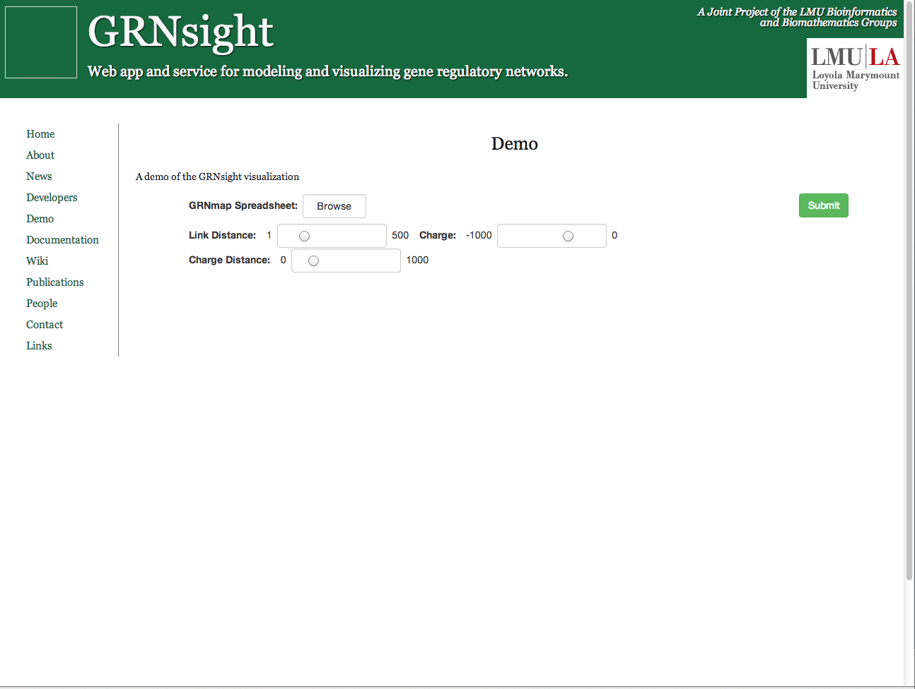
Upload Page

Slide 22
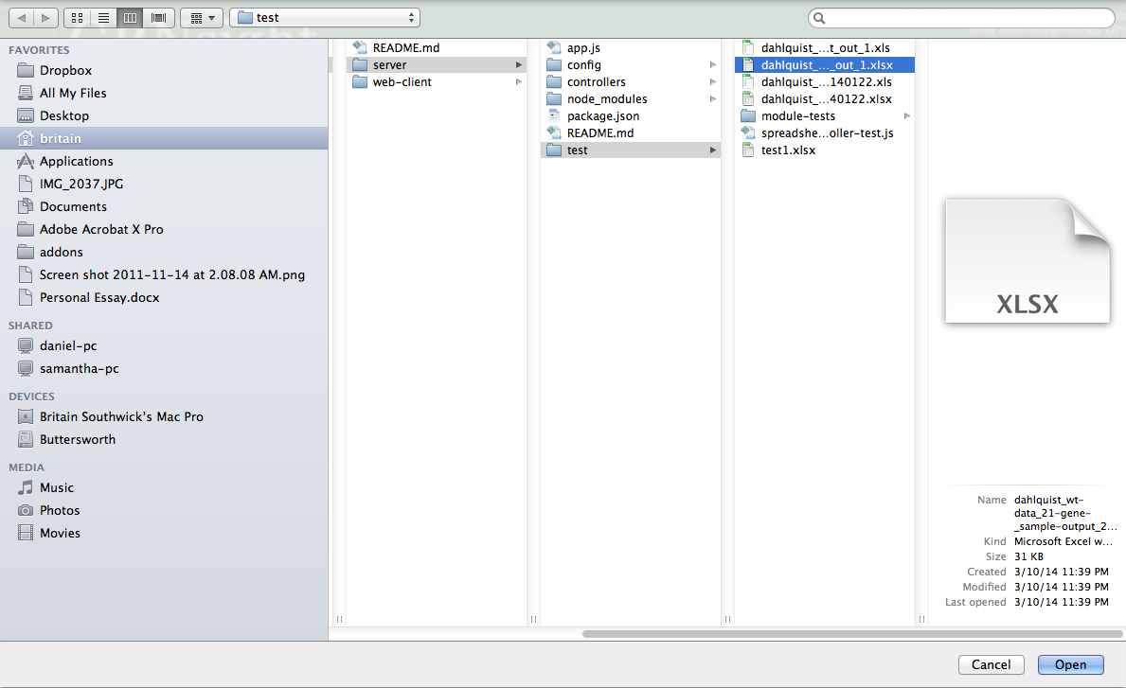
File Selection Screen

Slide 23

Upload Screen After a Selection is Made

Slide 24
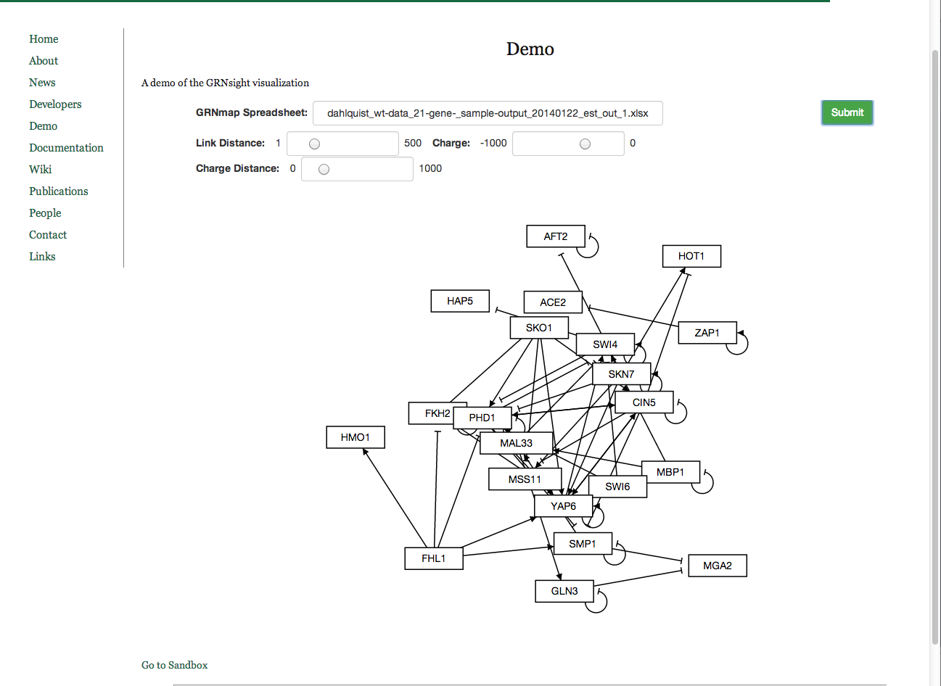
Initial Graph Layout

Slide 25
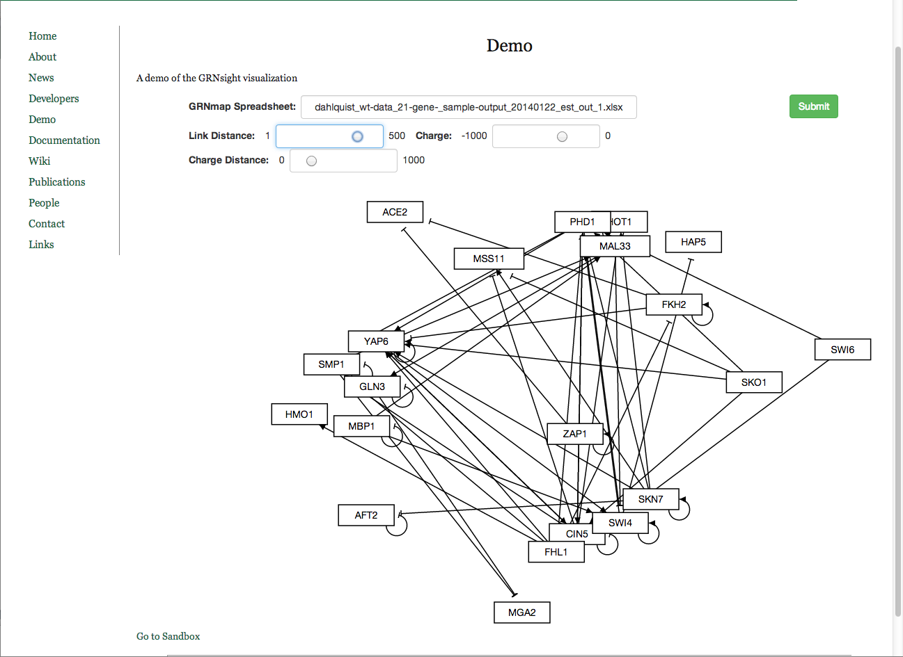
Initial Layout with Increased Link Distance

Slide 26
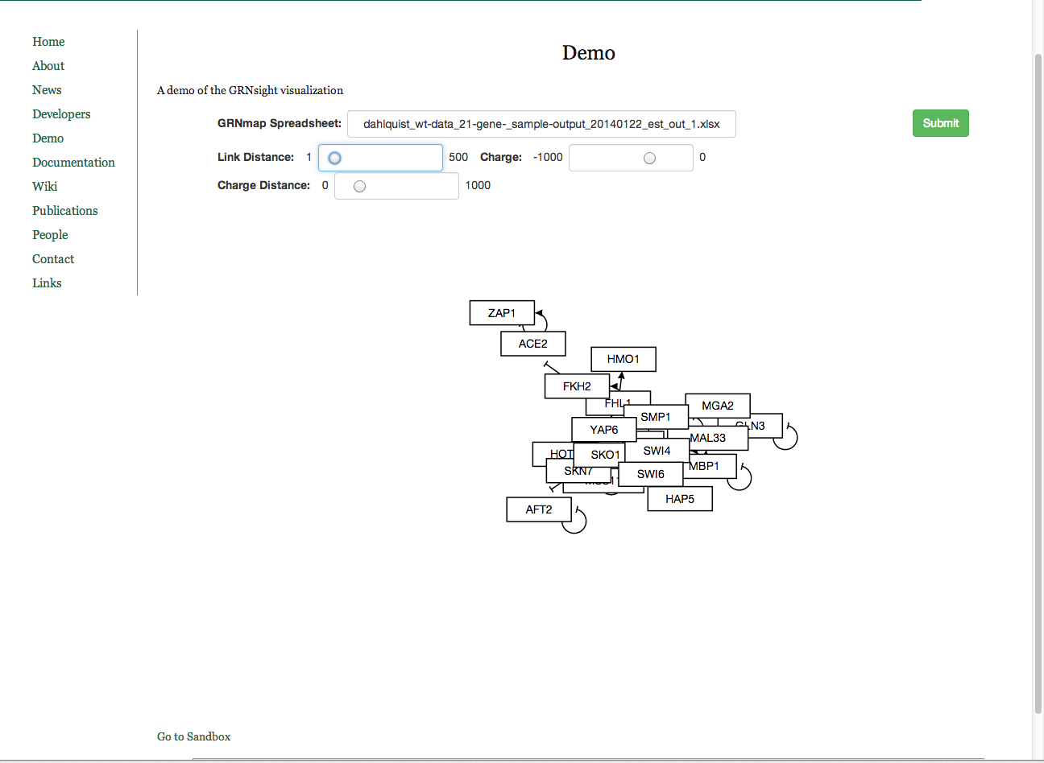
Layout with Decreased Link Distance

Slide 27
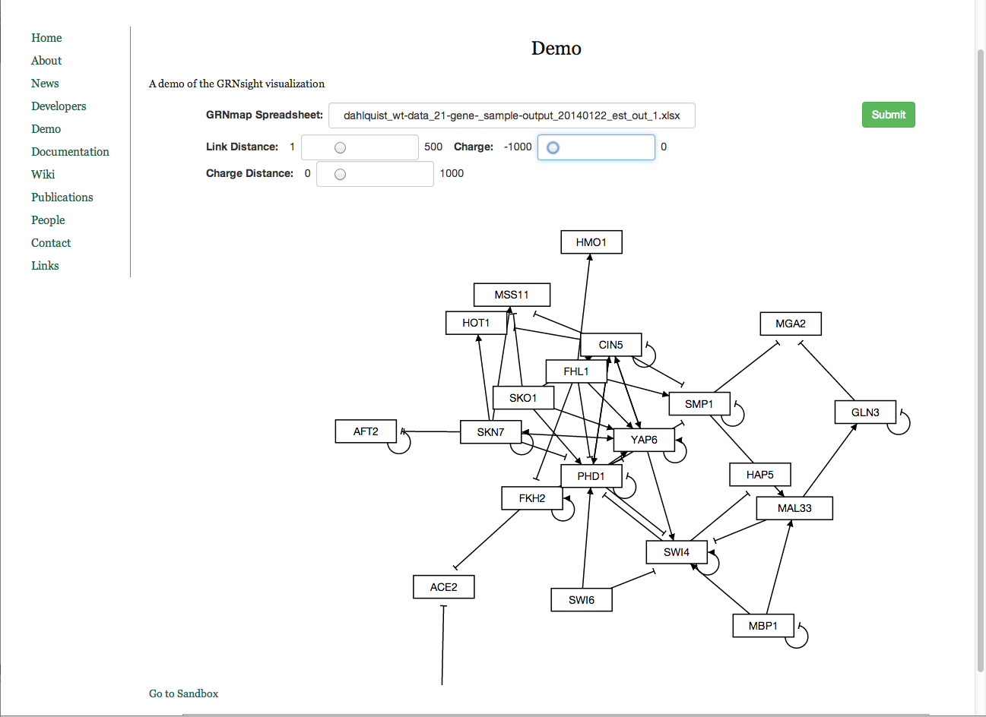
Increased Charge

Slide 28
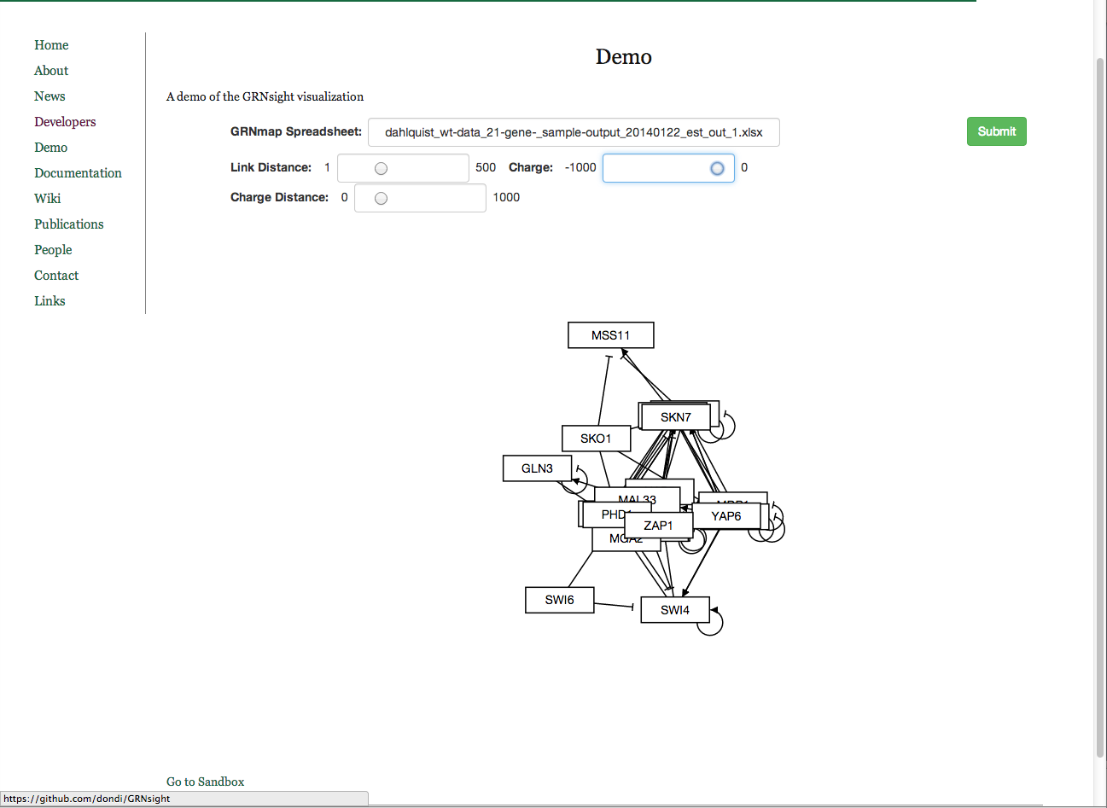
Decreased Charge

Slide 29
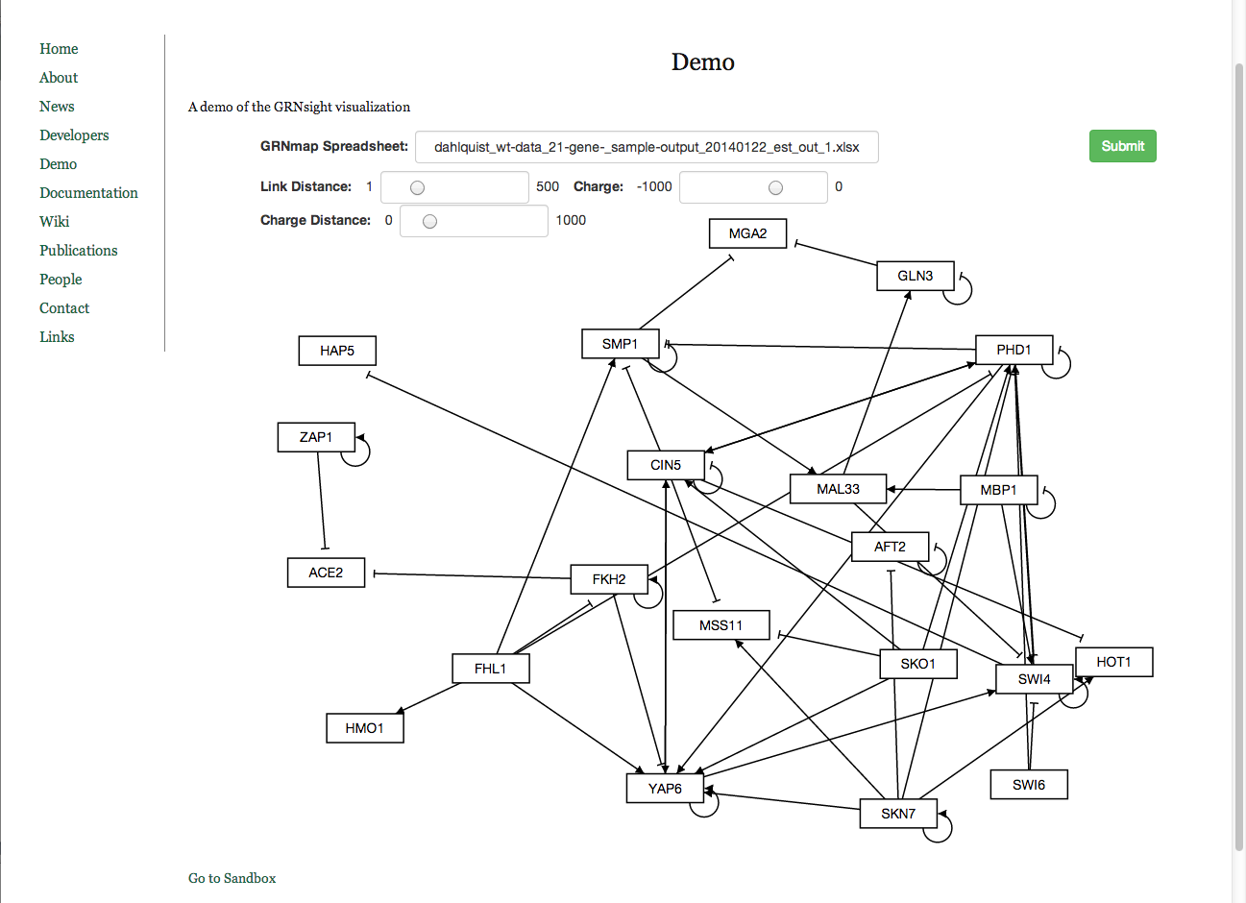
Graph Layout After Some Manipulation

