Slide 1
GRNsight: A Web Application for Visualizing Models of Gene Regulatory Networks
Britain Southwick
May 8, 2014
CMSI 402 Presentation

Slide 2
Outline
Transcription factors interact with each other in a complex gene regulatory network (GRN) of activation and repression.
GRNmap, a network modeling and simulation application, does not generate a visualization of the network.
GRNsight is an open source tool to create network graphs from the Excel spreadsheets produced by GRNmap.
Implementation consists of a web client for visualization and a server for reading uploaded spreadsheets.
Additional features were added to a basic D3 force layout to customize the layout of the graph.
Future enhancements will be to visualize additional GRN data from the model and improve customization/intelligent layout behavior in the graph.

Slide 3
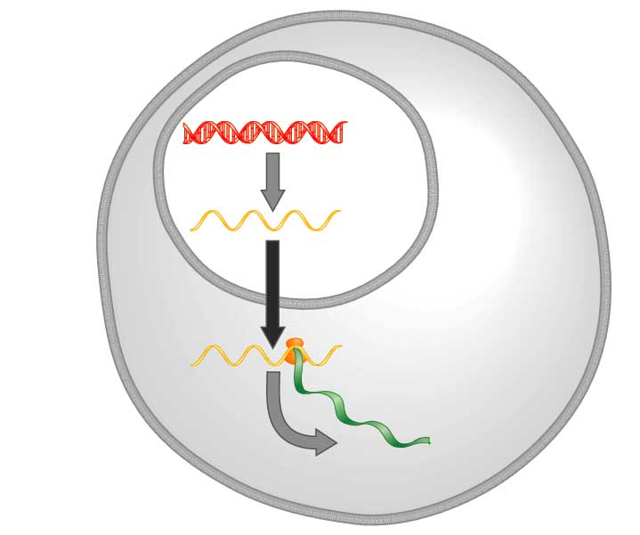
Central Dogma of Molecular Biology
DNA
Transcription
mRNA
Translation
Protein
Freeman (2002)

Slide 4
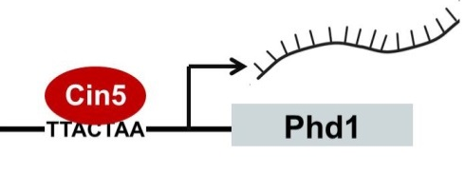
Transcription Factors Control Gene Expression by Binding to Regulatory DNA Sequences
Activators increase gene expression.
Repressors decrease gene expression.
Transcription factors are themselves proteins that are encoded by genes.

Slide 5
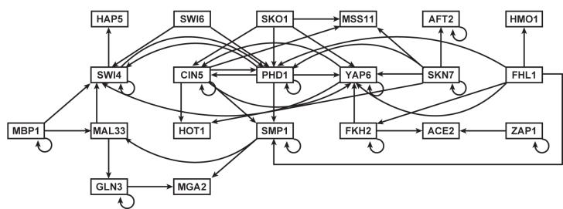
Gene Regulatory Networks Can Be Illustrated By Directed Graphs
A gene regulatory network (GRN) consists of genes, transcription factors, and the regulatory connections between them, which govern the level of expression of mRNA and protein from those genes.
Each node represents the gene, the mRNA, and the protein expressed from the gene.
Each edge represents a regulatory relationship.
All of the nodes are transcription factors themselves.

Slide 6
GRNmap: Gene Regulatory Network Modeling and Parameter Estimation
Matlab application written by Katrina Sherbina.
Differential equation model of change in gene expression over time.
Each gene (node) in the network has an equation.
Parameters in model are estimated from laboratory data.
Weight parameter, w, gives the direction (activation or repression) and magnitude of regulatory relationship.

Slide 7
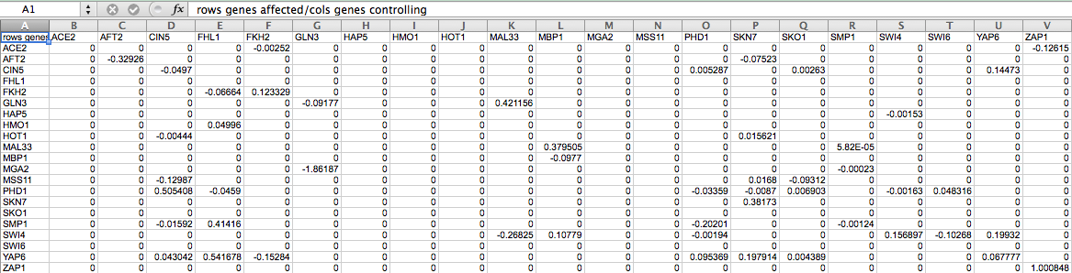
GRNmap Produces an Excel Spreadsheet with an Adjacency Matrix Representing the Network
0 represents no relationship.
A positive number shows activation.
A negative weight signifies repression.
The magnitude of the weight is the strength of the relationship.
However, GRNmap does not generate any visual representation of the Gene Regulatory Network.

Slide 8

GRNsight has a Service-Oriented Architecture
GRNsight has two pieces: a server and a web client.
The server is responsible for receiving and parsing an Excel spreadsheet uploaded by the user.
The server uses the Node.js framework.
The web client receives data from the server and generates the graph visualization.
GRNsight code is open source and available on GitHub.

Slide 9
GRNsight Implementation Takes Advantage of Other Open Source Tools
Uses the Data-Driven Documents (D3) JavaScript library to generate a graph derived from input network data.
D3 dynamically manipulates HTML and Scalable Vector Graphics (SVG) to form the elements of the graph.
GRNsight implements D3’s force layout, which applies a physics-based simulation to the graph.
D3 also allows for the fine tuning of Cascading Style Sheets (CSS), the code that styles web pages.

Slide 10
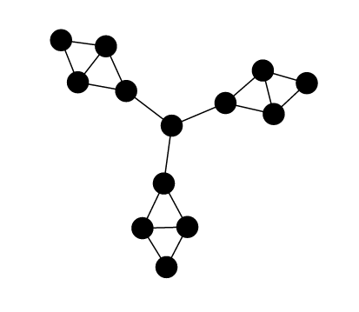
Additional Features were Implemented
Default implementation simply had nodes and edges. We added several features, including:
Labels on nodes.
Rectangular nodes.
Variant node size.
Edge thickness based on weight.
Edge color based on type of relation. Low value edges are gray.
Tooltips to display the value of an edge on hover.
Edges were given an outline to better distinguish them.
The user can drag nodes to customize their view of the network.
Edges adapt their anchor points to the movements of the nodes.
Dragging a node will highlight all adjacent edges.

Slide 11
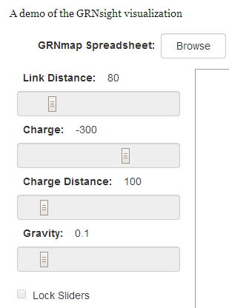
The User Interface is Compatible with Firefox and Chrome Browsers
File upload via simple HTML form element
Nodes displayed as interactive HTML elements
Advanced users can utilize setting sliders to refine the visualization
Nodes have a charge, which repels or attracts other nodes.
The charge distance determines at what range a node’s charge will affect other nodes.
The link distance determines the minimum distance maintained between nodes.
Sliders can be locked to prevent changes.

Slide 12




Edges Were Customized to Show Activation, Repression, and Self-Regulation
Multiple arrowheads were created as to represent the different types of edges depicted by the graph (activation, repression, and self-regulation).
A special case was added to add a looping edge if a node regulated itself.
Activation
Repression
Self-Activation
Self-Regulation

Slide 13
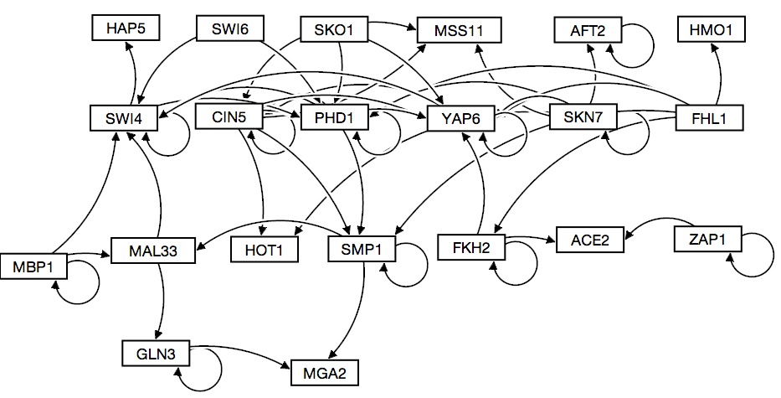

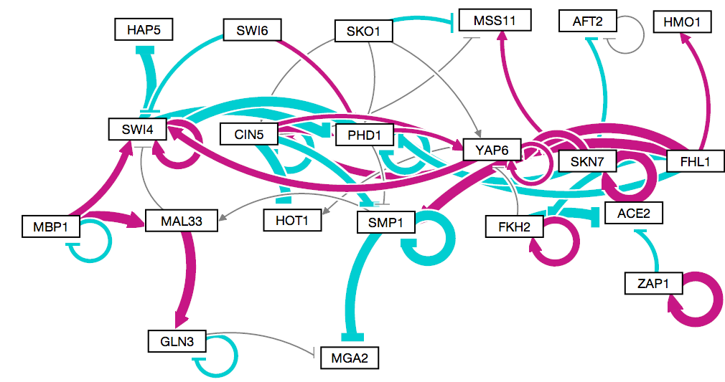
A Graph Generated by GRNsight as Compared to One Drawn by Hand
GRNsight
10 milliseconds to generate the graph
5 minutes to arrange it.
Adobe Illustrator
Several hours to create
GRNsight
Weighted values allow for more precision in representing the data.

Slide 14
Future Goals
Change the background color of nodes based on the expression data provided by GRNmap.
Snapping nodes to a rough grid would improve the organization of the graph.
Implementing edges that curve around other nodes and could be dragged by the user would increase the readability of the graph.

Slide 15
Summary
Transcription factors interact with each other in a complex gene regulatory network (GRN) of activation and repression.
GRNmap, a network modeling and simulation application, does not generate a visualization of the network.
GRNsight is an open source tool to create network graphs from the Excel spreadsheets produced by GRNmap.
Implementation consists of a web client for visualization and a server for reading uploaded spreadsheets.
Additional features were added to a basic D3 force layout to customize the layout of the graph.
Future enhancements will be to visualize additional GRN data from the model and improve customization/intelligent layout behavior in the graph.

Slide 16
Thanks
Dr. Kam Dahlquist
Dr. John David Dionisio
Dr. Ben Fitzpatrick
Katrina Sherbina
Masao Kitamura
BJ Johnson
Nicole Anguiano

