Slide 1

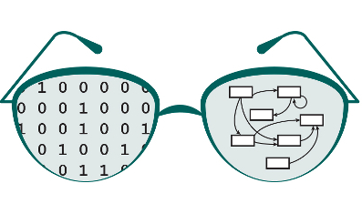
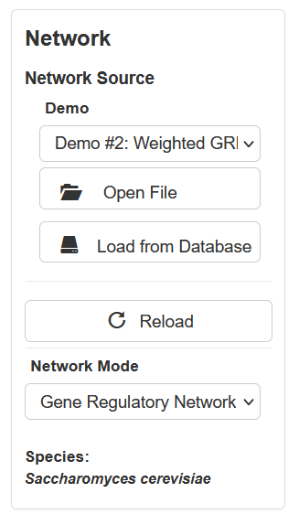
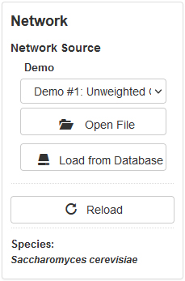
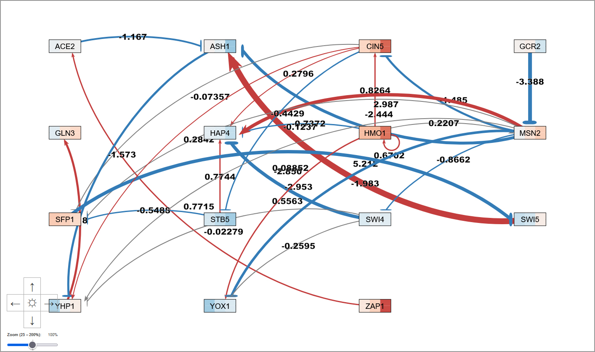
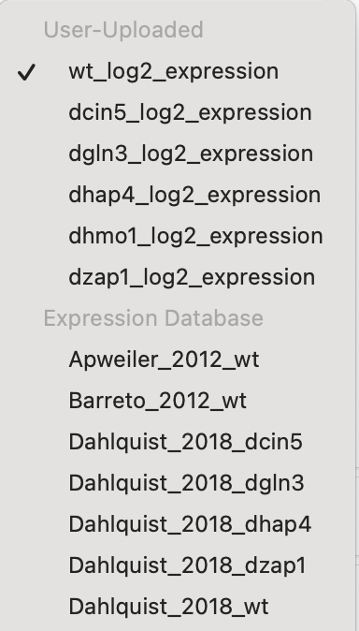
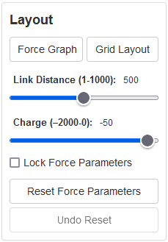

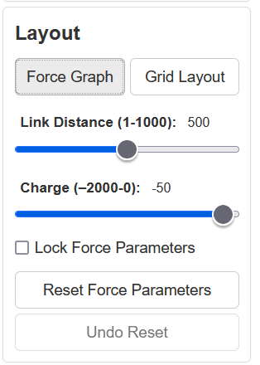
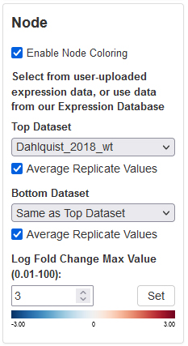
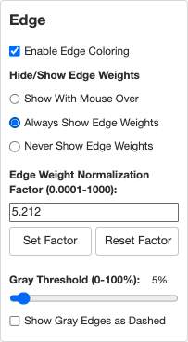
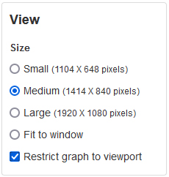
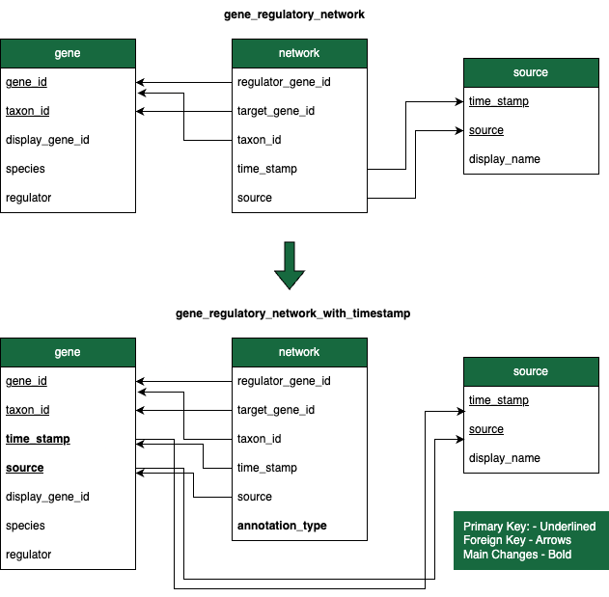
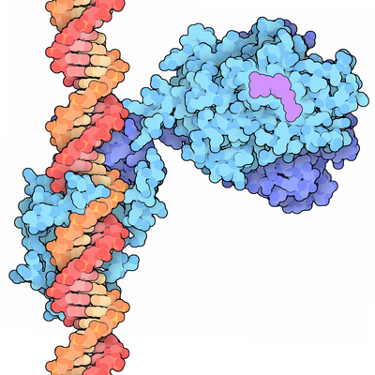
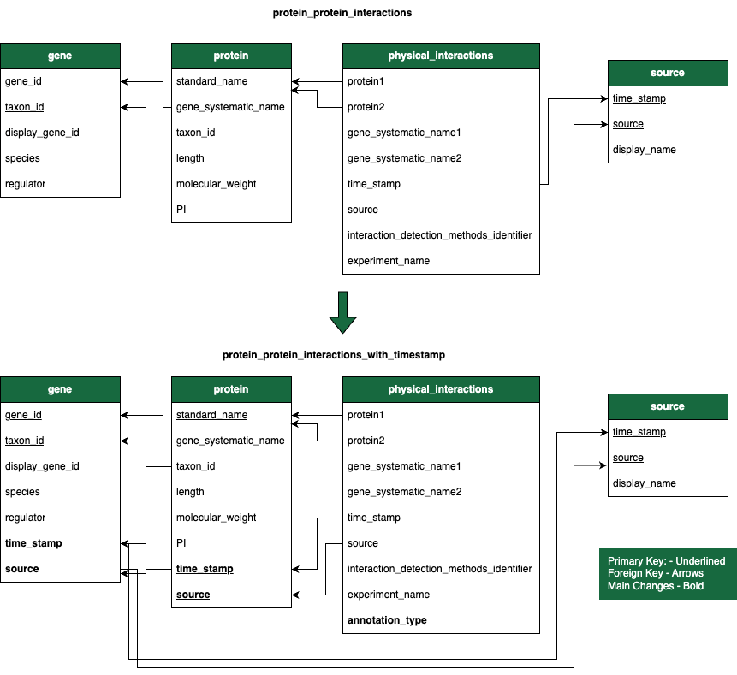
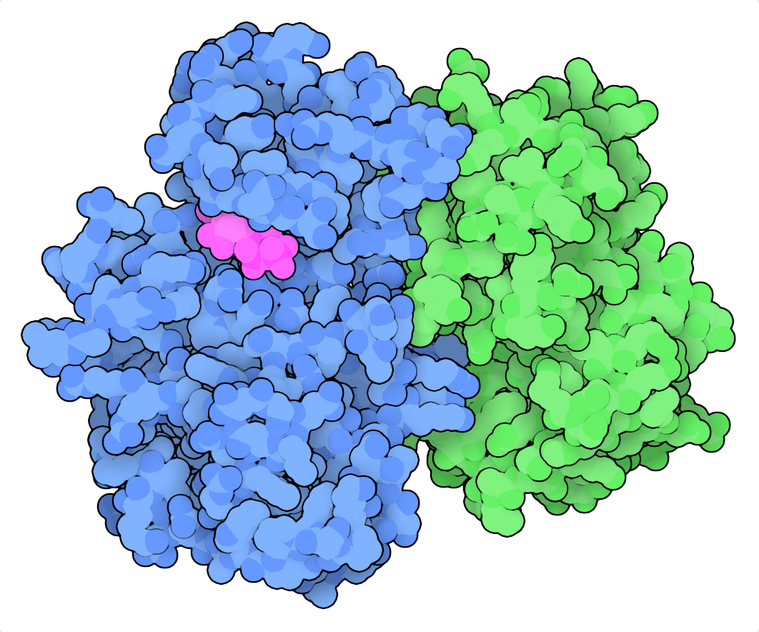
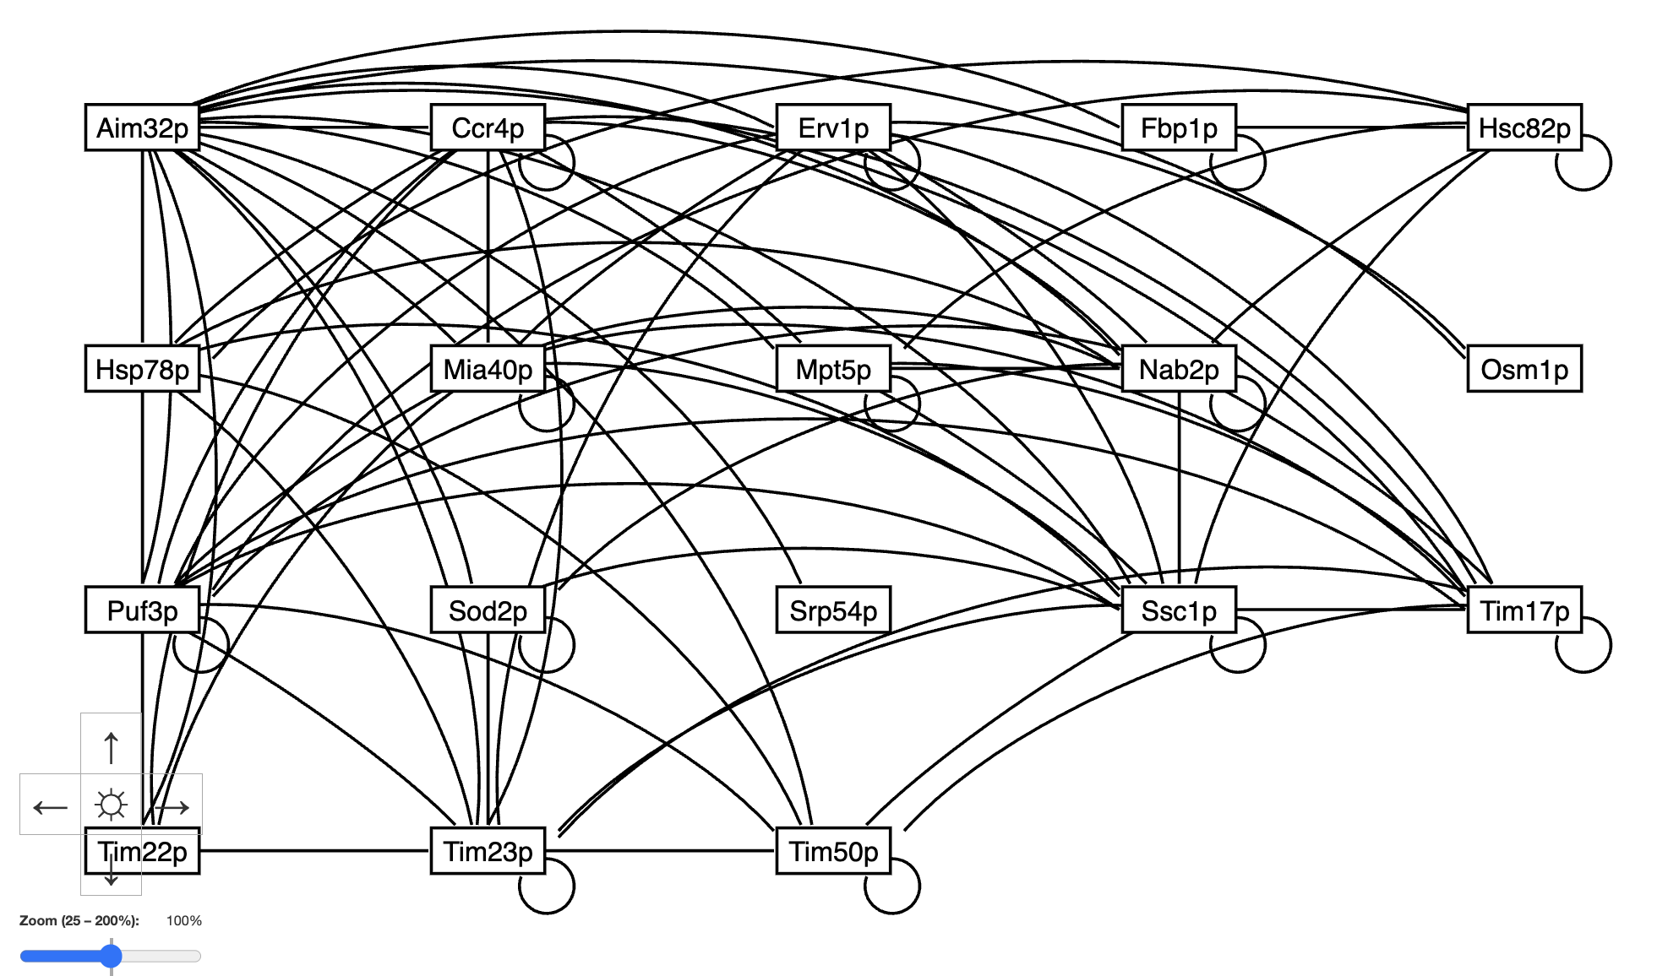
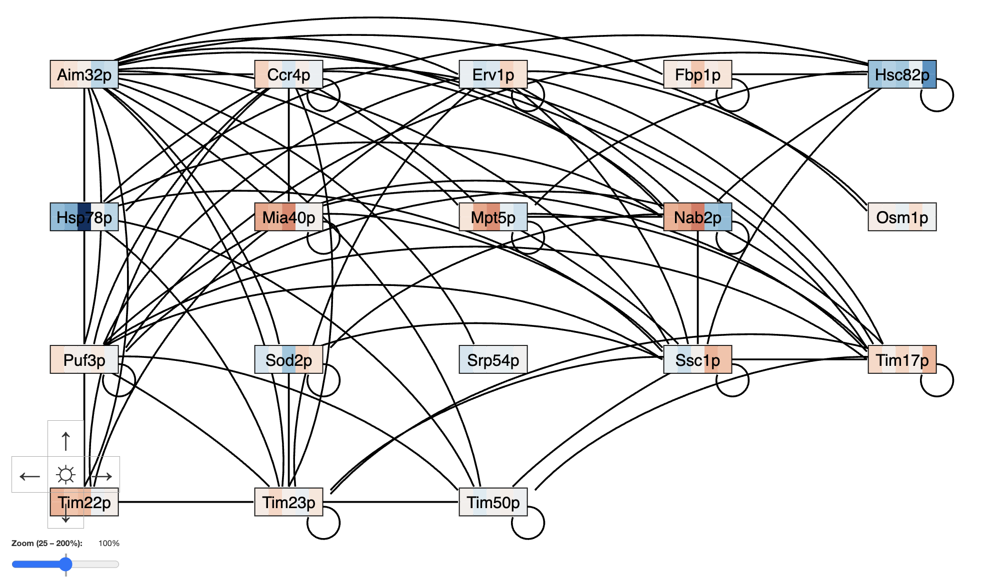
Database, Display, and DevOps Improvements for GRNsight 7.2, a Web Application for Visualizing Gene Regulatory and Protein-Protein Interaction Network Models
Ngoc K. Tran¹, Cecilia J. Zaragoza¹, A'Kaia L. Phelps¹, Amelie T. Dinh¹, Milka Y. Zekarias¹, Kam D. Dahlquist², John David N. Dionisio¹
Departments of ¹Computer Science and ²Biology, Loyola Marymount University, 1 LMU Drive, Los Angeles, CA 90045 USA
http://dondi.github.io/GRNsight/
I’
d!.
4. Import and Export ​
GRNsight, automatically lays out a gene regulatory network (GRN) graph, coloring the edges based on regulatory weights, and the nodes based on experimental or simulated expression data
Background & Motivation Behind Latest Updates
Migrating the CI/CD Pipeline
Our prior addition of PPI support has not yet permeated the app fully, and we have an on-going task of integrating PPIs into more of the app’s functionality.
YeastMine, the original provider of our network and expression data, was shut down, necessitating a search for a new data source, AllianceMine.
Travis CI, our original provider for continuous integration/development (CI/CD) services, ended free support.
GRNsight’s increasing functionality resulted in a range of UI loose ends and bugs that need to be addressed in order to support a wider audience.
Transitioning GRNsight's Pipeline
Transitioned GRNsight's CI/CD pipeline from Travis CI to GitHub Actions and integrated automated workflows for builds, unit tests, and linting to streamline development and enhance maintainability.
Impact of These Changes:
Developers do not have to manually run tests or check for errors, GRNsight is easier to maintain and update since potential issues are detected early, and transitioning to a modern pipeline will ensure compatibility with future JavaScript versions and improve performance.
Network
Demo files are provided.
Can import and export Excel, SIF, or GraphML files.
Can construct a network from SGD regulation or PPI data stored in a backend database.
Layout
Users can select a force graph layout or grid layout.
Force graph parameter sliders:
Link distance determines the minimum distance between nodes.
Nodes have a charge which repels or attracts other nodes.
Node
Coloring can be based on user-uploaded expression data or from published expression datasets stored in a backend database.
Datasets available:
Apweiler et al. 2012, GSE33098
Barreto et al. 2012, GSE24712
Dahlquist et al. 2018, GSE83656
Kitagawa et al. 2002, GSE9336
Thorsen et al. 2007, GSE6068
Edge
Edge coloring can be toggled on and off.
Buttons enable the user to always see edge weights, never see edge weights, or see edge weights upon mouseover.
Allows user to set normalization factor so that edge thicknesses for different graphs can be rendered on the same scale.
Changing the gray threshold deemphasizes weaker edges in the visualization.
Presenting gray edges as dashed lines further deemphasizes weak edges.
View
Multiple viewport sizes available.
Graph bounding box can be separated from viewport.
Zooming and scrolling available.
1
User Interface Dropdown Bug Resolutions
New GRNsight database source and schema
Clear Differentiation Between User-Uploaded Data and Expression Database
The data options in the dropdown menu were separated into two different opt-groups: User-Uploaded data and Expression Database data.
Updating Demo Dropdown
The demo dropdown was updated to align with proper code structure and protocol, improving the resetting functionality when uploading custom workbooks.
A demo dropdown grnstate value was created to refer to the workbook state, connecting the demo dropdown value and the front facing user interface display.
New Database Source: AllianceMine
GRNsight has transitioned to AllianceMine as our new database source, replacing YeastMine, which is currently unavailable.
New Schemas
GRNsight has updated its database schema to include:
Timestamps for gene and protein tables – Each gene and protein entry now includes a timestamp, allowing us to distinguish data across different yearly database updates. If a gene does not exist within a specific timestamp, it cannot be queried, ensuring clear separation of data from different updates.
Annotation type – Each regulatory relationship is either manually curated from the literature or from high-throughput experiments. Eventually, there will be the ability to select whether to look at manually curated, high-throughput, or both types of interactions on GRNs and PPIs that are loaded from the database
Key
gene
activation
2
repression
3
4
5
weak influence
Graph View Controls
Enabling Controls of D-pad, Zoom Slider, and Cursor Grab When Restrict Graph to Viewport is Selected
The D-pad, Zoom Slider, and Cursor Grab controls can be utilized while ensuring the nodes remain clamped inside the bounding box of the viewport, outlined in gray, which enhances interaction with the graph.
Previously, nodes would be restricted to the chosen viewport size of the graph, which limited interaction with the graph.
Fit Graph to Window
The size of the bounding box that contains the nodes can dynamically adjust to fit the bottom and right edges of a browser window.
Previously, when Fit to Window was selected, the graph would shrink to the size of one node because the asynchronous communication between GRNsight and the iFrame it is contained within causes a delay, so the graph was being loaded with undefined dimensions.
*Some new features are only available in GRNsight v7.2.3 beta.
GRNsight can now be used to visualize protein-protein physical interaction (PPI) networks
Future Directions
A gene regulatory network consists of genes, transcription factors, and the regulatory connections between them which govern the level of expression of mRNA and protein from genes.
Nodes represent both the regulatory transcription factor protein and the gene that encodes it.
An arrow represents a regulatory transcription factor either activating (arrowhead, red color) or repressing (blunt end, blue color) the gene for another regulatory transcription factor.
A PPI is when two proteins bind to each other.
Each node represents a protein, and each edge represents their binding interaction.
Unlike GRNs, PPI graphs have undirected edges of uniform thickness and black color and previously did not display expression data on the nodes.
Node Coloring Support for PPI Networks
Prioritize bug resolution to enhance platform stability and reliability.
Improve documentation for clearer and more comprehensive user guidance.
Publish a research paper detailing GRNsight’s advancements and methodologies since the prior publication.
Migrate to React to modernize the platform and improve performance.
Why PPI Node Coloring?
Previously, node coloring was only enabled for GRNs because node coloring is a visualization of the level of mRNA expression using data provided by the user or from GRNsight’s expression database.
2. PPI Node Coloring Implementation
Now, when a PPI demo or network without expression data in the workbook is loaded, node coloring defaults to disabled.
When node coloring is enabled for a PPI, a warning message displays that informs users mRNA-level expression data is being displayed on a PPI network.
The query on the expression database for gene names required a “p” at the end of the gene name to account for the proper protein nomenclature.
Regulatory Transcription Factor Bound to DNA
Image from:
https://pdb101.rcsb.org/motm/155
Availability
GRNsight is free and open to all users at http://dondi.github.io/GRNsight/, and there is no login requirement.
GRNsight code is available under the open source BSD license at our GitHub repository at https://github.com/dondi/GRNsight.
Some new GRNsight features are only available in
GRNsight v7.2.3 beta.
Protein-Protein Interaction
Image from:
https://pdb101.rcsb.org/motm/236
Acknowledgments
We would like to thank Nikki C. Chun and the previous developers on the GRNsight project. A'Kaia Phelps and Cecilia J. Zaragoza would like to thank the HHMI STEM Research Learning Community for funding.
References
Dahlquist, K.D., Fitzpatrick, B.G., Camacho, E.T., Entzminger, S.D., & Wanner, N.C. (2015) Parameter Estimation for Gene Regulatory Networks from Microarray Data: Cold Shock Response in Saccharomyces cerevisiae. Bulletin of Mathematical Biology, 77(8), 1457-1492. doi: 10.1007/s11538-015-0092-6
Dahlquist, K.D., Dionisio, J.D.N., Fitzpatrick, B.G., Anguiano, N.A., Varshneya, A., Southwick, B.J., & Samdarshi, M. (2016) GRNsight: a web application and service for visualizing models of small- to medium-scale gene regulatory networks. PeerJ Preprints 4:e2068v1. doi: 10.7287/peerj.preprints.2068v1
Goodsell, D. (2012). Vitamin D receptor bound to DNA, with vitamin D shown in magenta. [Online Image]. PDB-101. https://pdb101.rcsb.org/motm/155
Goodsell, D. (2019). Cyclin A (green) and cyclin-dependent kinase 2 (blue) with ATP (magenta). [Online Image]. PDB-101. https://pdb101.rcsb.org/motm/236
Wong, E. D., Miyasato, S. R., Aleksander, S., Karra, K., Nash, R. S., Skrzypek, M. S., Weng, S., Engel, S. R., & Cherry, J. M. (2023). Saccharomyces genome database update: server architecture, pan-genome nomenclature, and external resources. Genetics, 224(1), iyac191. doi: 10.1093/genetics/iyac191
The Alliance of Genome Resources Consortium. (2024). Updates to the Alliance of Genome Resources central infrastructure. Genetics, 227(1), iyae049. https://doi.org/10.1093/genetics/iyae049
Demo #5: PPI with Node Coloring Disabled
Demo #5: PPI with Node Coloring Enabled
Notes:
Kill abstract
Change to sans serif font
Make title bigger
Make title background white
Use full names
Super script to associate names with correct department
Background color: make it dark green, make writing on white background and writing in black/dark green
4 columns!!!
Smaller pictures
Bold titles
References can be 12pt
Acknowledgements can be 16pt
Everything else is 18-24pt
Titles don’t need to be bigger than 36pt
Remove circles from the arrowhead diagram, group the related labels together
Include menu bar
Testing/error handling – sample error (we don’t crash with errors!)
Mouseovers for edges screenshot

