Slide 1

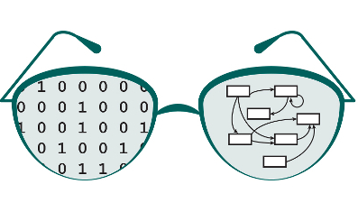

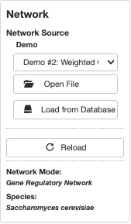
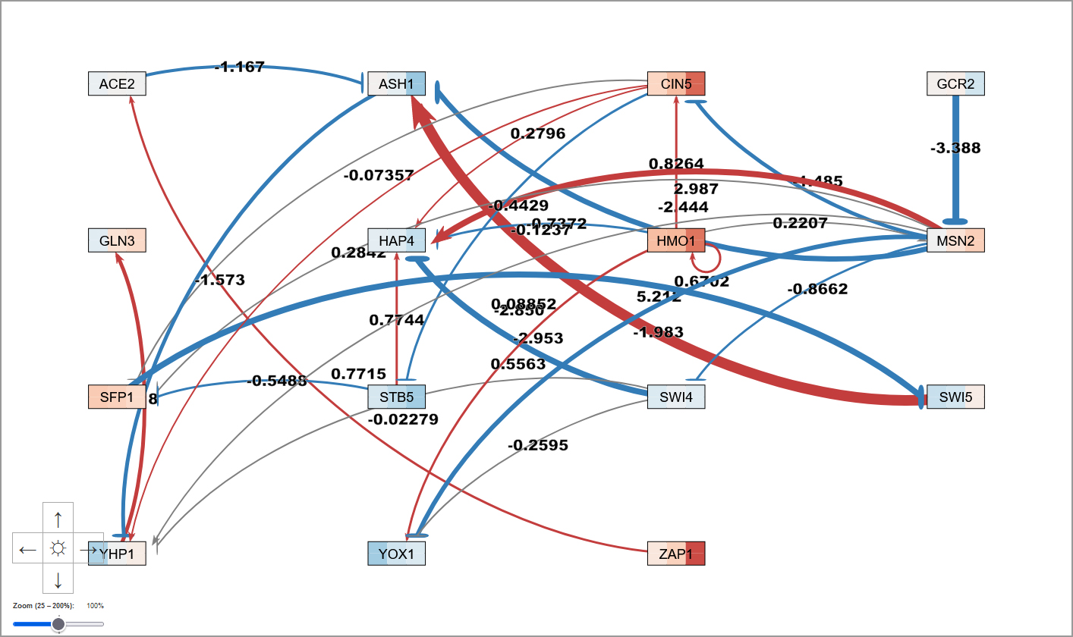
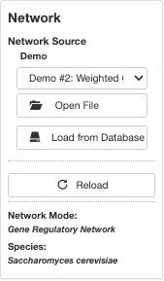
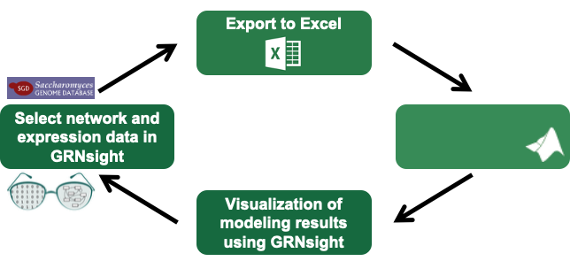
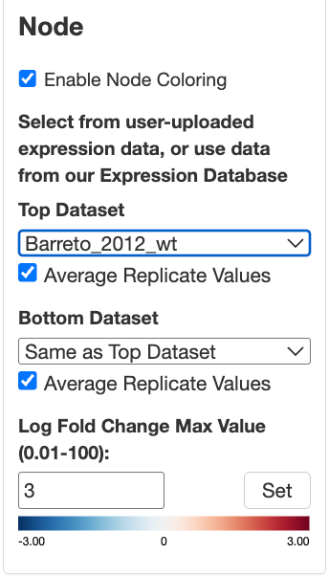
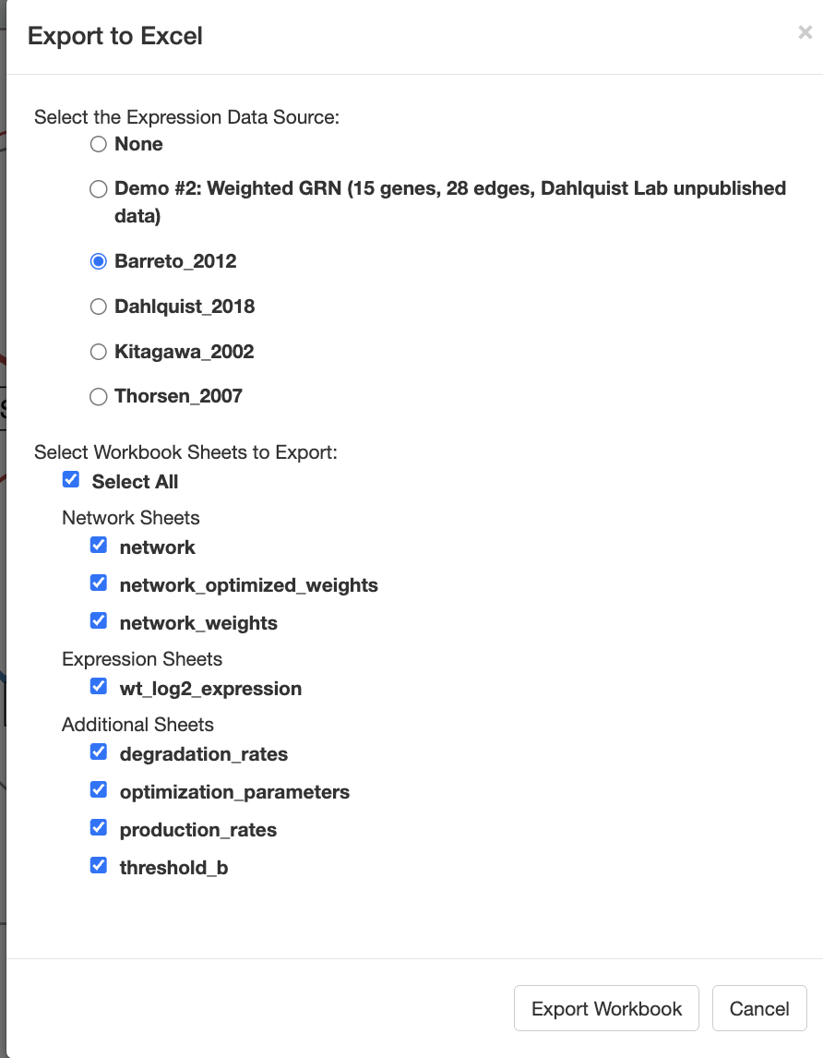
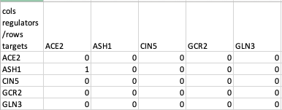


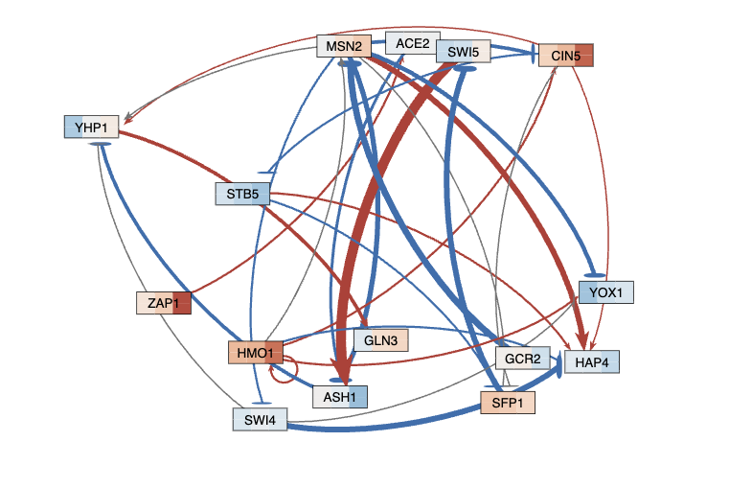
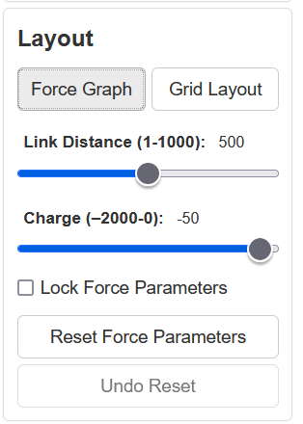
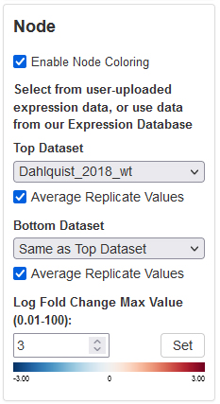
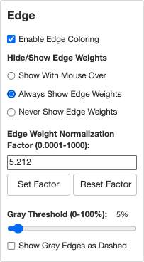
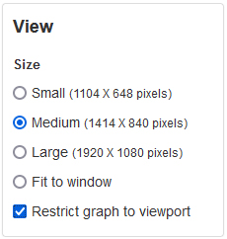
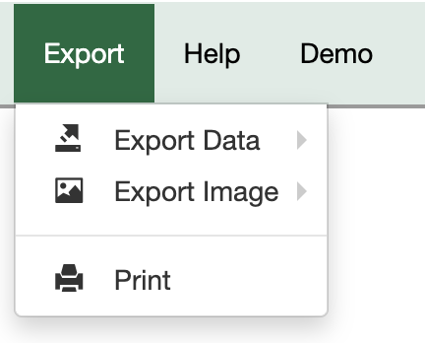
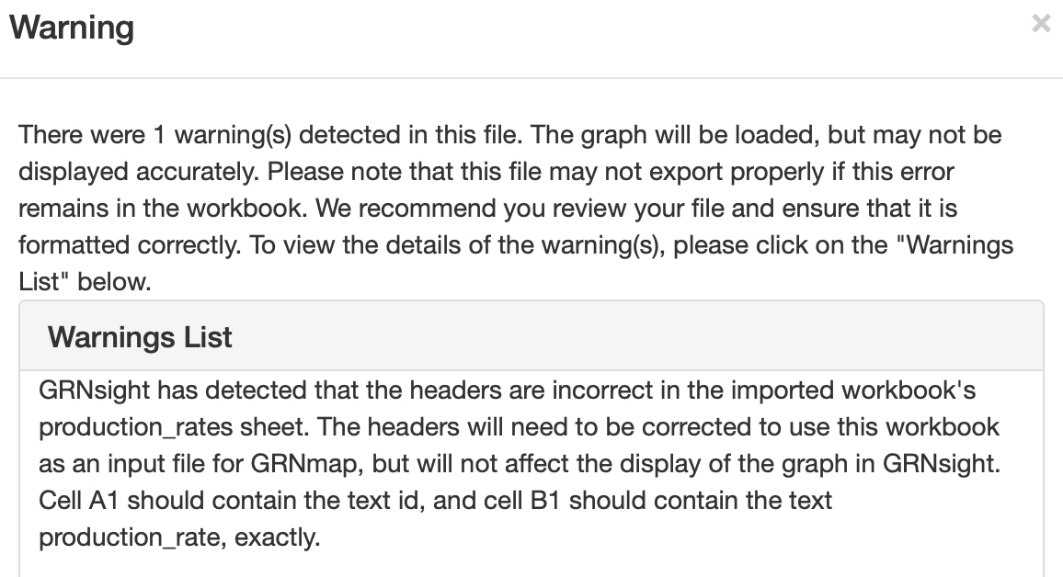
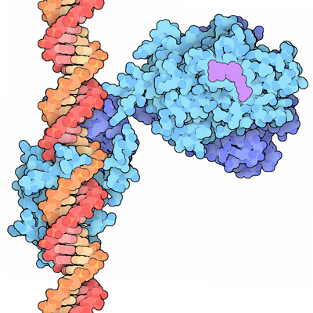
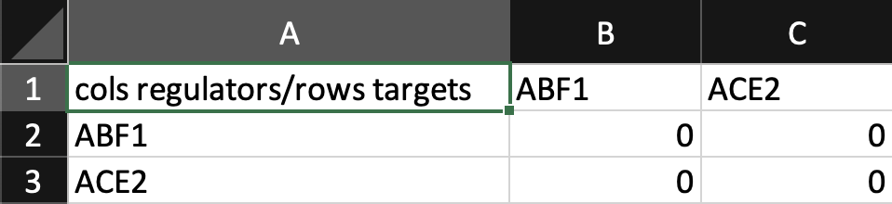
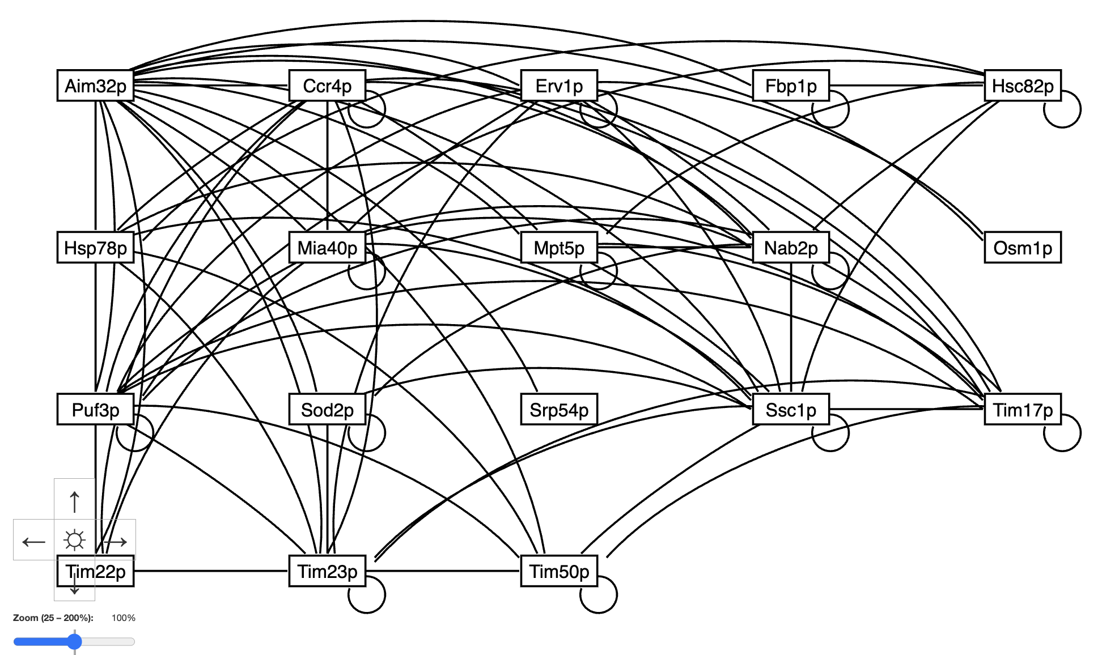
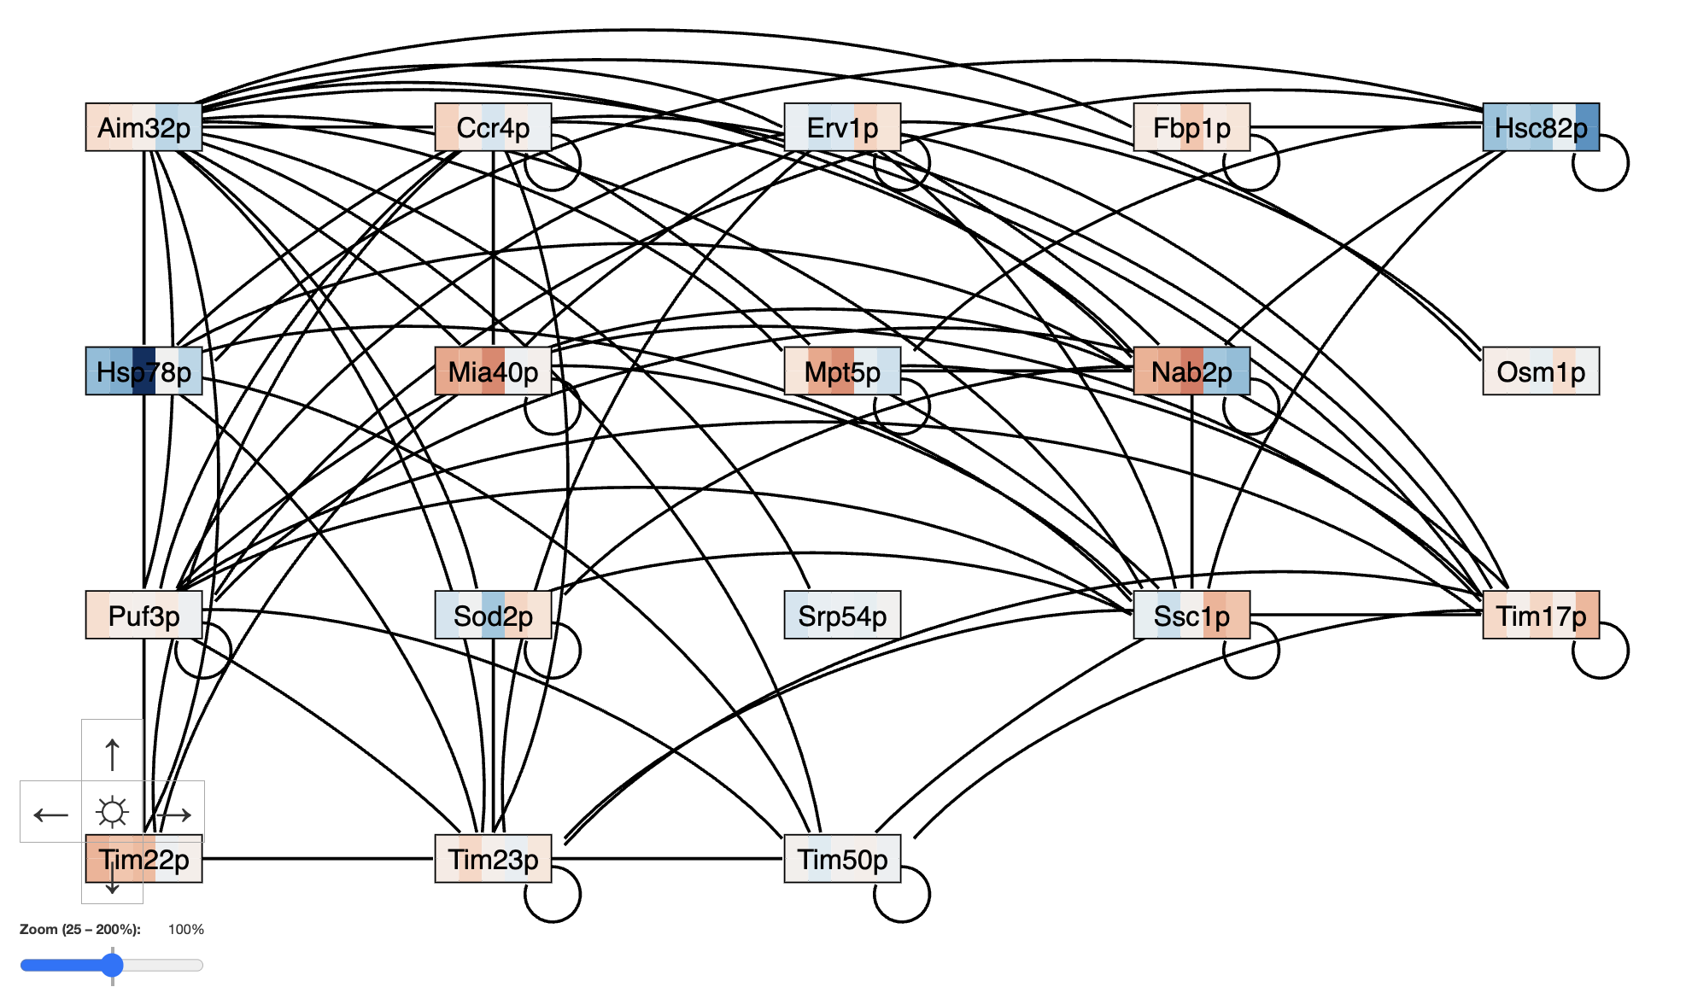
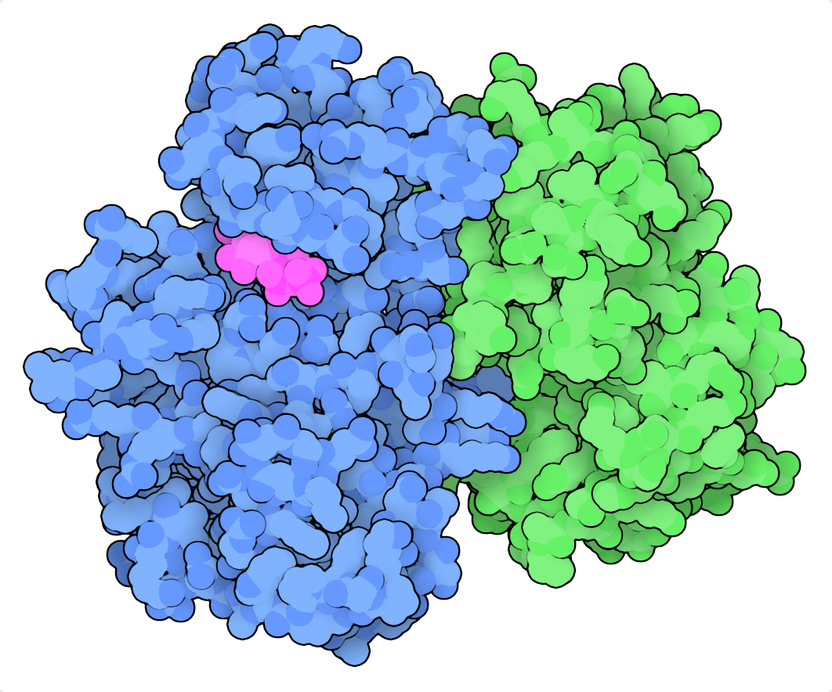
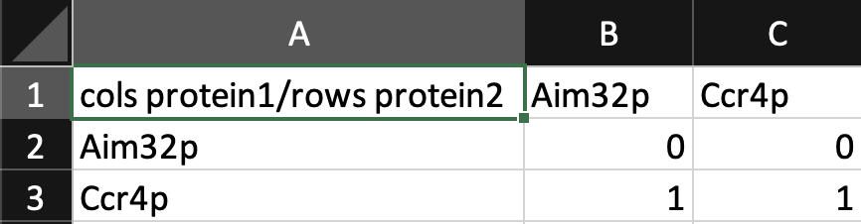
Improved User Interface and Export Functionality for GRNsight 7.6, a Web Application for Visualizing Gene Regulatory and Protein-Protein Interaction Network Models
Amelie T. Dinh¹, Milka Y. Zekarias¹, Jia S. Garcia¹, Alex J. Miller¹, Cindy L. Tong¹, Kam D. Dahlquist², John David N. Dionisio¹
Departments of ¹Computer Science and ²Biology, Loyola Marymount University, 1 LMU Drive, Los Angeles, CA 90045 USA
http://dondi.github.io/GRNsight/
I’
engagement
4. Import and Export ​
GRNsight, automatically lays out a gene regulatory network (GRN) graph, coloring the edges based on regulatory weights, and the nodes based on experimental or simulated expression data
Nodes can be colored with mRNA-level expression data imported by the user or from the backend expression database
GRNsight is an integral part of a data analysis workflow for biologists who model GRNs
Node coloring can also be toggled on or off. GRNsight needs to take this switch into account when exporting data to an Excel workbook.
The user can select an option to export without expression data.
The user may upload a file without expression data or want to export a file without expression data.
The selection defaults to the current expression data source.
If node coloring is disabled, selection defaults to the original source.
If all expression sheets are deselected, then the selected source automatically moves to None.
GRNsight data can be exported to an Excel workbook for use with our sister MATLAB software, GRNmap.
GRNmap = Gene Regulatory Network Modeling, and Parameter estimation.
Ensuring data export is free of bugs is crucial to maintaining the integrity and organization of the data while minimizing the risk of errors.
GRNsight should also be able to import all GRNmap data and make it available for export.
Network
Demo files are provided.
Can import and export Excel, SIF, or GraphML files.
Can construct a network from SGD regulation or PPI data stored in a backend database.
Layout
Users can select a force graph layout or grid layout.
Force graph parameter sliders:
Link distance determines the minimum distance between nodes.
Nodes have a charge which repels or attracts other nodes.
Node
Coloring can be based on user-uploaded expression data or from published expression datasets stored in a backend database.
Datasets available:
Apweiler et al. 2012, GSE33098
Barreto et al. 2012, GSE24712
Dahlquist et al. 2018, GSE83656
Kitagawa et al. 2002, GSE9336
Thorsen et al. 2007, GSE6068
Edge
Edge coloring can be toggled on and off.
Buttons enable the user to always/never see edge weights or see them upon mouseover.
Allows user to set normalization factor so that edge thicknesses for different graphs can be rendered on the same scale.
Changing the gray threshold deemphasizes weaker edges in the visualization.
Presenting gray edges as dashed lines further deemphasizes weak edges.
View
Multiple viewport sizes available.
Graph bounding box can be separated from viewport.
Zooming and scrolling available.
1
Key
gene
activation
2
repression
3
4
5
weak influence
New warning implementation for importing and exporting files help user catch errors
Enhanced Error Handling
Comprehensive warnings have been integrated for both file import and export processes to provide users with clear, actionable feedback.
6
Nodes in PPI networks can now be colored using mRNA expression data
6. Export
Basic data export to SIF or GraphML or full GRNmap-compatible Excel workbook, with yeast mRNA degradation rates from Neymotin et al. (2014).
Image export to PNG, SVG, or PDF.
Why PPI Node Coloring?
Previously, node coloring was only enabled for GRNs because node coloring is a visualization of the level of mRNA expression using data provided by the user or from GRNsight’s expression database.
PPI Node Coloring Implementation
Now, when a PPI demo or network without expression data in the workbook is loaded, node coloring defaults to disabled.
When node coloring is enabled for a PPI, a warning message displays that informs users that mRNA-level expression data is being displayed on a PPI network.
The query on the expression database for gene names had to strip the "p" at the end of the protein name to account for the difference in yeast gene and protein nomenclature. For example, ACE2 represents the gene and Ace2p represents the protein.
GRNsight can also be used to visualize protein-protein physical interaction (PPI) networks
Future Directions
Prioritize bug resolution to enhance platform stability and reliability.
Improve documentation for clearer and more comprehensive user guidance.
Migrating to React to modernize the platform and improve performance.
A gene regulatory network consists of genes, transcription factors, and the regulatory connections between them which govern the level of expression of mRNA and protein from genes.
Nodes represent both the regulatory transcription factor protein and the gene that encodes it.
An arrow represents a regulatory relationship either activating (arrowhead, red color) or repressing (blunt end, blue color) the expression of another regulatory transcription factor.
A PPI is when two proteins bind to each other.
Each node represents a protein, and each edge represents their binding interaction.
Unlike GRNs, PPI graphs have undirected edges of uniform thickness and black color and previously did not display expression data on the nodes.
Regulatory Transcription Factor Bound to DNA
Image from:
https://pdb101.rcsb.org/motm/155
GRNsight was originally developed to handle gene regulatory networks.
As functionality expanded to also include protein-protein interaction networks, we found that there were features and functionalities that didn't automatically transfer over and needed individualized debugging.
We have continued to update GRNsight and make its handling and integration of PPIs more robust through:
Determining whether a user-uploaded workbook contains a GRN or PPI by reading cell A1 of the "network" worksheet in the input Excel workbook.
This differentiation logic was updated to accurately detect GRNs vs. PPIs.
Ability to export PPI workbooks to Excel and SIF formats.
Menu bar no longer unnecessarily expands when the browser window resizes to load PPIs from the database.
Consistent node coloring functionality for PPIs.
Availability
GRNsight is free and open to all users at http://dondi.github.io/GRNsight/,
and there is no login requirement.
GRNsight code is available under the open source BSD license at our
GitHub repository at https://github.com/dondi/GRNsight.
Cell A1 of the “network” input worksheet for a GRN:
Acknowledgments
We would like to thank Nikki C. Chun, Ngoc Kim Ngan Tran, Cecilia J. Zaragoza and the previous developers on the GRNsight project.
References
Apweiler, E., Sameith, K., Margaritis, T., Brabers, N., van de Pasch, L., Bakker, L. V., ... & Kemmeren, P. (2012). Yeast glucosepathways converge on the transcriptional regulation of trehalose biosynthesis. BMC genomics, 13(1), 1-14. DOI: 10.1186/1471-2164-13-239
Barreto, L., Canadell, D., Valverde‐Saubí, D., Casamayor, A., & Ariño, J. (2012). The short‐term response of yeast to potassium starvation. Environmental microbiology, 14(11), 3026-3042. DOI: 10.1111/j.1462-2920.2012.02887.x
Dahlquist, K.D., Fitzpatrick, B.G., Camacho, E.T., Entzminger, S.D., & Wanner, N.C. (2015) Parameter Estimation for GeneRegulatory Networks from Microarray Data: Cold Shock Response in Saccharomyces cerevisiae. Bulletin of Mathematical Biology,77(8), 1457-1492. doi: 10.1007/s11538-015-0092-6
Dahlquist, K.D., Dionisio, J.D.N., Fitzpatrick, B.G., Anguiano, N.A., Varshneya, A., Southwick, B.J., & Samdarshi, M. (2016)GRNsight: a web application and service for visualizing models of small- to medium-scale gene regulatory networks. PeerJPreprints 4:e2068v1. doi: 10.7287/peerj.preprints.2068v1
Goodsell, D. (2012). Vitamin D receptor bound to DNA, with vitamin D shown in magenta. [Online Image]. PDB-101.https://pdb101.rcsb.org/motm/155
Goodsell, D. (2019). Cyclin A (green) and cyclin-dependent kinase 2 (blue) with ATP (magenta). [Online Image]. PDB-101.https://pdb101.rcsb.org/motm/236
Kitagawa, E., Takahashi, J., Momose, Y., & Iwahashi, H. (2002). Effects of the pesticide thiuram: genome-wide screening of indicator genes by yeast DNA microarray. Environmental science & technology, 36(18), 3908-3915. DOI: 10.1021/es015705v
The Alliance of Genome Resources Consortium. (2024). Updates to the Alliance of Genome Resources central infrastructure.Genetics, 227(1), iyae049. https://doi.org/10.1093/genetics/iyae049
Thorsen, M., Lagniel, G., Kristiansson, E., Junot, C., Nerman, O., Labarre, J., & Tamás, M. J. (2007). Quantitative transcriptome, proteome, and sulfur metabolite profiling of the Saccharomyces cerevisiae response to arsenite. Physiological genomics, 30(1), 35-43. DOI: 10.1152/physiolgenomics.00236.2006
Wong, E. D., Miyasato, S. R., Aleksander, S., Karra, K., Nash, R. S., Skrzypek, M. S., Weng, S., Engel, S. R., & Cherry, J. M. (2023).Saccharomyces genome database update: server architecture, pan-genome nomenclature, and external resources. Genetics,224(1), iyac191. doi: 10.1093/genetics/iyac191
Protein-Protein Interaction
Image from:
https://pdb101.rcsb.org/motm/236
Demo #5: PPI with Node Coloring Disabled
Demo #5: PPI with Node Coloring Enabled
Cell A1 of the “network” input worksheet for a PPI:
New file naming scheme for exported files simplifies information provided to the user
Upon export, a file is named according to type, number of genes/proteins and edges, and expression data source.
Eg.: GRN_15-genes_28-edges_weighted_Dahlquist_2018.xlsx

