Slide 1
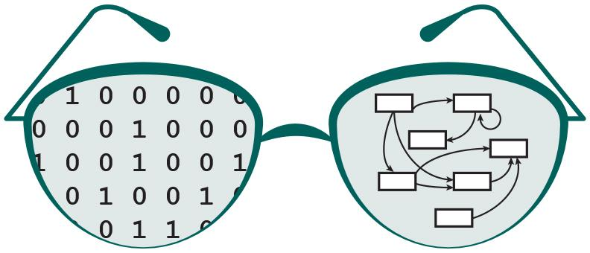

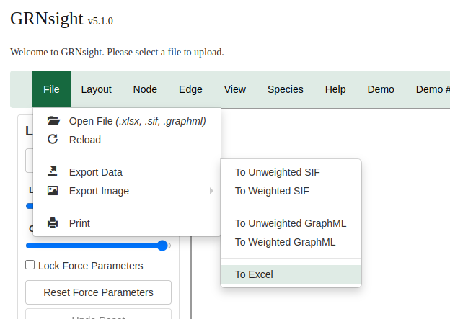
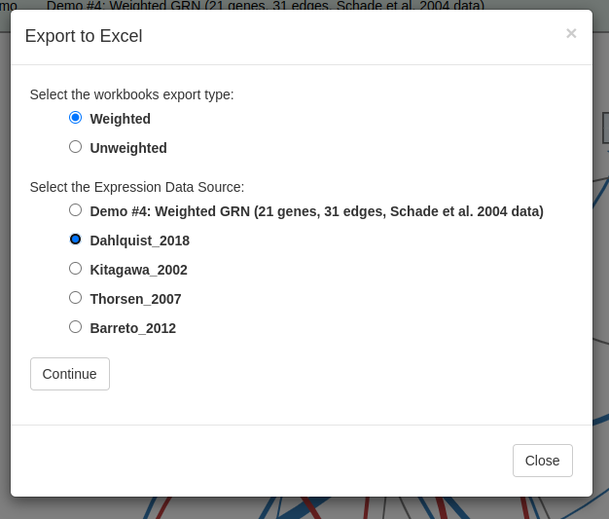
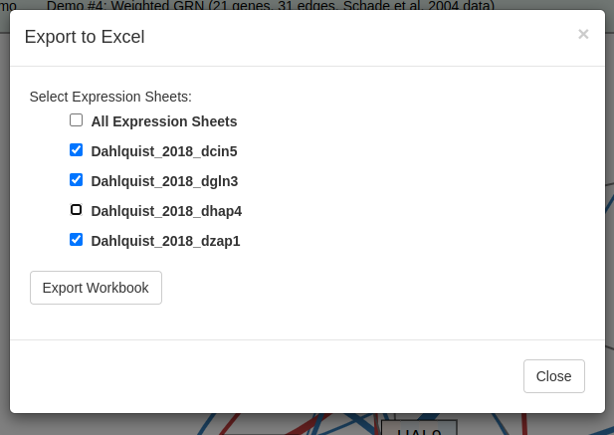
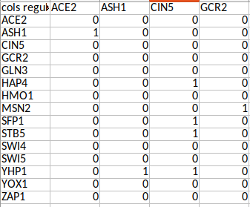
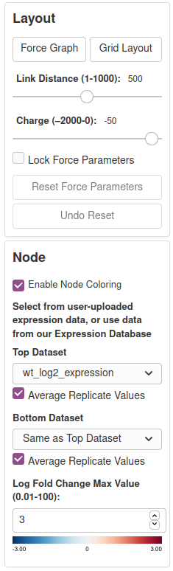
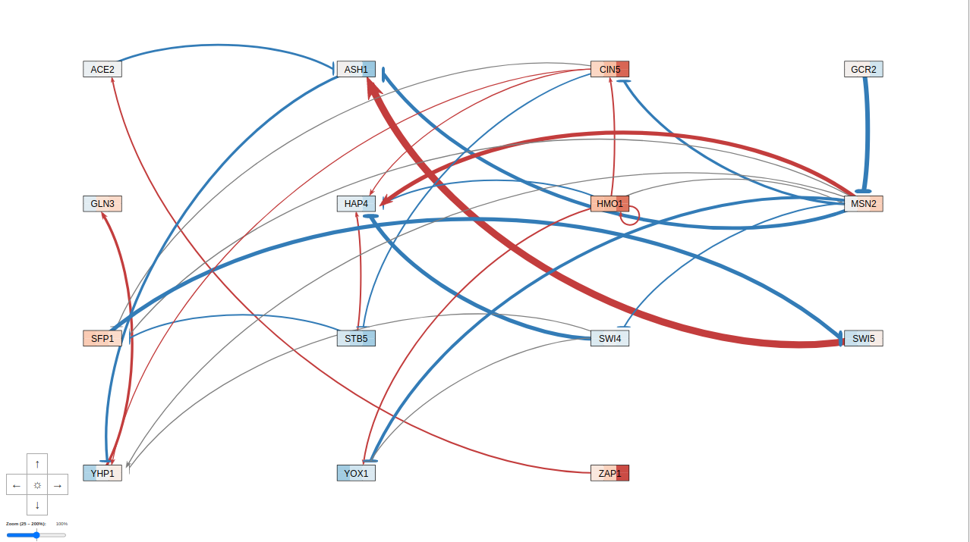

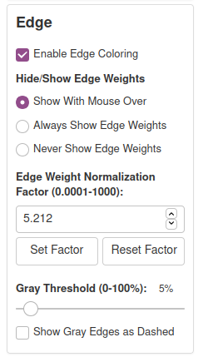
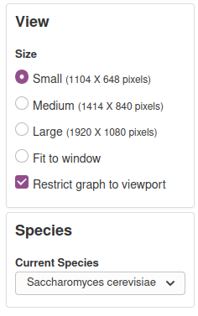
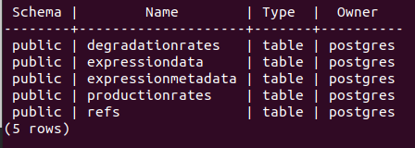
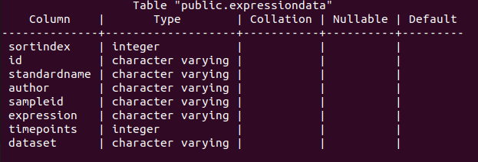
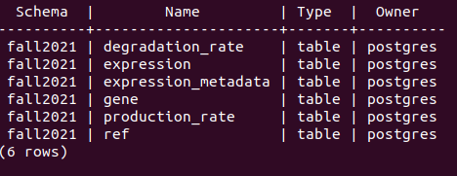
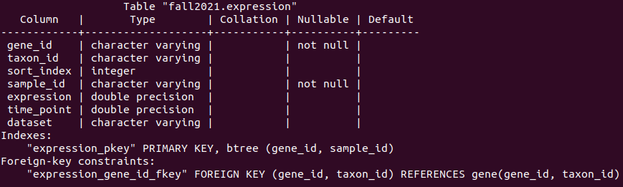

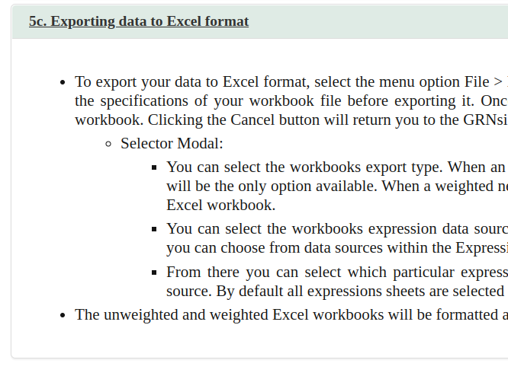
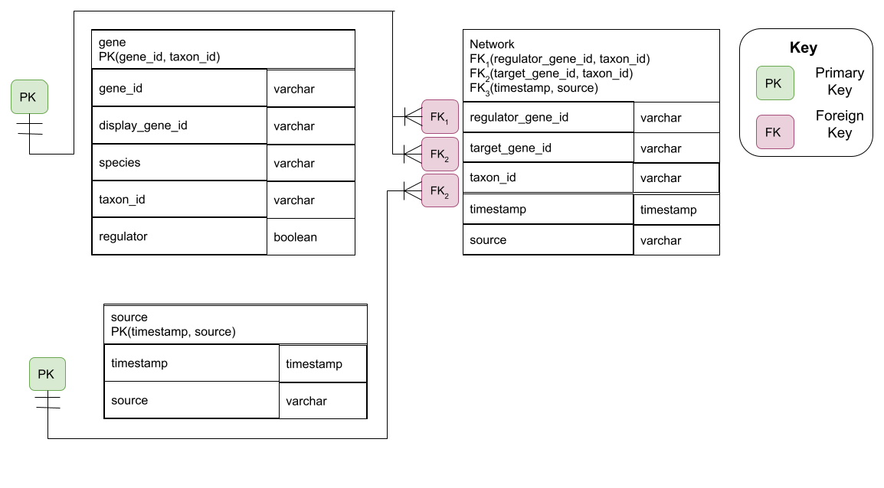
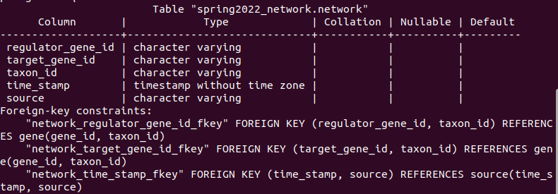
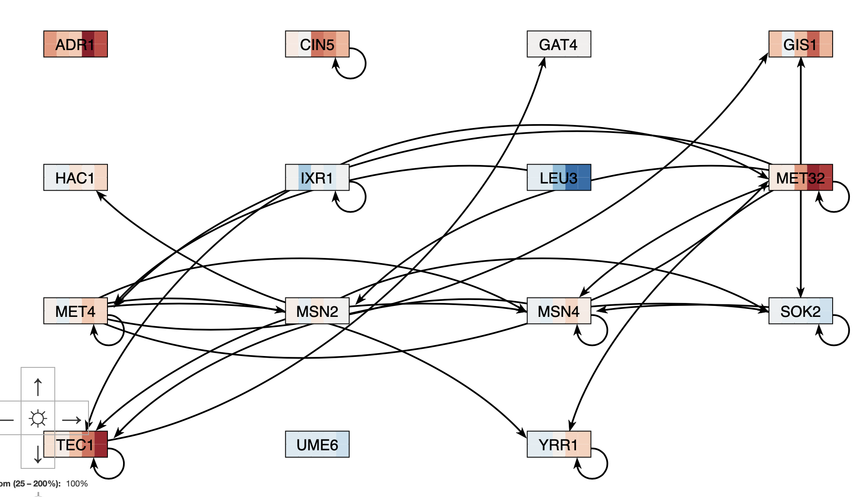
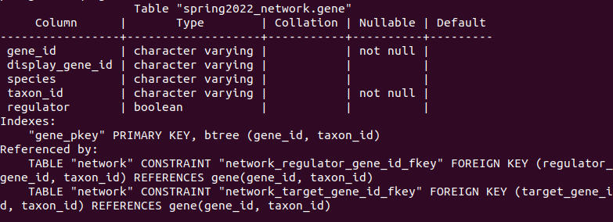
New Databases and Export Features for GRNsight:
a Web Application for Visualizing Models of GRNs
Onariaginosa O. Igbinedion*, John David N. Dionisio*, Kam D. Dahlquist**
*Department of Computer Science, **Department of Biology Loyola Marymount University, 1 LMU Drive, Los Angeles, CA 90045
http://dondi.github.io/GRNsight/
Export to Excel Functionality was Refined and Enhanced to Facilitate Usage with GRNmap
GRNsight Automatically Lays Out Unweighted and Weighted Gene Regulatory Network Graphs
1. File Formats
Can import and export Excel, SIF, or GraphML files.
Demo files are provided.
.
1
2. Grid Layout
Grid Layout button allows the users to toggle the graph between a grid layout and a force graph layout.
3. Force Graph Parameter Sliders
Link distance determines the minimum distance between nodes.
Nodes have a charge, which repel or attract other nodes.
Reset functionality sets all parameters to default.
Locking the parameters prevents any further changes.
4. Node Coloring
This menu allows users to modify parameters of the node coloring visualization.
Dataset options are automatically generated from expression data sheets detected in an Excel input workbook.
A back-end PostgreSQL gene expression database can also be used to color Nodes.
There is a total of four datasets available.
5. GRNsight includes options to show or hide the weight values
Buttons enable the user to always see edge weights, never see edge weights, or see edge weights upon mouseover of the edges.
6. Edge Weight Normalization
Allows user to set normalization factor in user interface.
Edge thicknesses for different graphs can be rendered on the same scale.
2
3
Ready to Load in GRNmap
Enhancement of Export to Excel User Interface
Expanded Export to Excel User Interface from two buttons with the options to export a weighted or unweighted workbook, to a two-paged modal system.
Modal allows users to further customize the exported workbook.
This decreases the need for extensive user manipulation on exported workbooks.
Refinement of Export to Excel Functionality
We updated the export mechanism so that it exports exactly what the user asks for, instead of a weighted network and all expression data sheets used during the session.
Additionally, we connected the Expression Database to the feature, so that we can query the database for the specified expression data for the genes within the given network adjacency matrix.
We refined the logic used in formatting the raw data in order to create GRNsight workbooks that are compatible with both GRNsight and GRNmap.
4
Key
gene
activation
repression
weak influence
8. Species Selection
This dropdown allows the user to change the chosen species to any other species supported by GRNsight.
5
7
Expression Database Was Reworked and Expanded for Greater Fidelity with Real World Usage
Reworked Expression Database Schema
We changed the schema so that relational data can be captured appropriately, as well as expanded the database in order to be compatible with the addition of more species.
We added the gene table to specify which genes in which species is being referenced in the expression table.
As genes in many species have the dual name approach similar to Saccharomyces cerevisiae “standard name” and “systematic name,” we extrapolated that to be the display gene id (standard-like name) and the gene id (systematic-like name).
The display gene id is what we typically return to the user, while the gene id is part of the Primary key in which we refer to that gene throughout the relational database.
We also added the species name and taxon id of the gene, so that we could differentiate between genes of different species that share the same name.
Throughout the database, all genes are referenced by their gene id and their taxon id.
We connected the tables by the use of primary and foreign keys, to ensure that each row is identifiable and unique, as well as to maintain referential integrity within the database.
6
7. Viewport
Graph bounding box can be separated from viewport.
Multiple viewport sizes available.
Zooming and scrolling enabled.
8
Documentation Updates Reflect New GRNsight Features
Availability
Revised the Export to Excel Documentation to reflect the new modal system.
Export to Excel Documentation includes information on how to export expression data from sources located within the Expression Database.
Test Passes
GRNsight is free and open to all users and there is no login requirement.
Web site content is available under the Creative Commons Attribution Non-Commercial Share Alike license.
GRNsight code is available under the open source BSD license.
Usage is being tracked through Google Analytics.
New Users: 7,346
Changed data types to further match the data represented
We updated the selected data types to match the data that was being inputted and specified whether certain values were optional or mandatory to include.
This allowed for more meaningful database operations to be performed on the data.
For example, sorting through expression data became more useful when it was represented as a double rather than a string type.
File Uploads: 7,811
Sessions: 18,091
Pageviews: 38,472 3
We Created a Gene Regulatory Network Database With Data
from the Saccharomyces Genome Database (SGD)
Library Updates Protect against Security Vulnerabilities
Acknowledgments
Created Network Database to Store GRN Adjacency Matrix Data
Created a 3-table database to store GRN adjacency matrix data, compatible with data taken from different sources at different timepoints, and from different species.
Updated Dependencies
GRNsight directly uses 52 libraries. Including dependencies of those libraries, GRNsight relies on 1533 libraries.
Dependencies had grown out of date and were updated.
Security vulnerabilities were identified within the dependencies as a result of outdated versions.
Migrated Deprecated Dependencies
Some dependencies, notably Jade, have been deprecated, threatening future iterations of GRNsight.
Migration of these libraries to their contemporary versions has begun to address this problem.
We would like to thank the prior developers on this project: Ahmad R. Mersaghian, Sarron A. Tadesse, Ian M. Green, Lauren L. Amparo, Alexia M. Filler, Kevin B. Patterson, Mihir Samdarshi, John L. Lopez, Justin Kyle T. Torres, Eileen J. Choe, Yeon-Soo (Jen) Shin, Edward B. Bachoura, Nicole A. Anguiano, Anindita Varshneya, Katrina Sherbina, Britain J. Southwick.
Uses For Network Database
One use is to make a user interface for the Network Database, so that GRNsight users can select genes to view in a GRN from within GRNsight itself.
Another use is to allow users to bypass manual Excel workbook creation, previously needed to use GRNsight.
In conjunction with the export to Excel feature, this automates the process of GRNsight- and GRNmap-compatible workbook creation.
Within this user interface, we intend to allow the user to select the species, data source, and version of the network data.
This allows for reproducible research because users can refer to a specific version of the data if the database is updated.
Gene table stores gene names (via gene id and display gene id), gene species (via species and taxon id) and whether or not that gene encodes a transcriptional regulator.
Network table organizes all regulator-target pairings. It holds the regulator gene id, the target gene id, their taxon id, and the source information (name and timestamp).
If a regulator gene and a target gene are connected, this is represented by a 1 value in an adjacency matrix.
References
Dahlquist, K.D., Dionisio, J.D.N., Fitzpatrick, B.G., Anguiano N.A., Varshneya A., Southwick, B.J., Samdarshi, M. (2016) GRNsight: a web application and service for visualizing models of small- to medium-scale gene regulatory networks. PeerJ Computer Science 2:e85 https://doi.org/10.7717/peerj-cs.85
Dahlquist, K.D., Fitzpatrick, B.G., Camacho, E.T., Entzminger, S.D., and Wanner, N.C. (2015) Parameter Estimation for Gene Regulatory Networks from Microarray Data: Cold Shock Response in Saccharomyces cerevisiae. Bulletin of Mathematical Biology, 77(8), 1457-1492 https://doi.org/0.1007/s11538-015-0092-6
Cherry JM, Hong EL, Amundsen C, Balakrishnan R, Binkley G, Chan ET, Christie KR, Costanzo MC, Dwight SS, Engel SR, Fisk DG, Hirschman JE, Hitz BC, Karra K, Krieger CJ, Miyasato SR, Nash RS, Park J, Skrzypek MS, Simison M, Weng S, Wong ED (2012) Saccharomyces Genome Database: the genomics resource of budding yeast. Nucleic Acids Res. Jan;40(Database issue):D700-5. [PMID: 22110037]
YeastMine: https://yeastmine.yeastgenome.org/yeastmine/begin.do
GRNmap: http://kdahlquist.github.io/GRNmap/
GRNsight: https://dondi.github.io/GRNsight/
GRNsight’s GitHub: https://github.com/dondi/GRNsight
Gene Regulatory Network using SGD Database
Future Directions
Create a user interface where users can select the source and timestamp taken for the relational data.
Create a refined search mechanism, so that users can easily search for genes in the network database.
Expand the Expression Database Sources to include data from additional research sources.
Add additional species and additional data sources to the Network database.
Notes:
Kill abstract
Change to sans serif font
Make title bigger
Make title background white
Use full names
Super script to associate names with correct department
Background color: make it dark green, make writing on white background and writing in black/dark green
4 columns!!!
Smaller pictures
Bold titles
References can be 12pt
Acknowledgements can be 16pt
Everything else is 18-24pt
Titles don’t need to be bigger than 36pt
Remove circles from the arrowhead diagram, group the related labels together
Include menu bar
Testing/error handling – sample error (we don’t crash with errors!)
Mouseovers for edges screenshot

