Slide 1
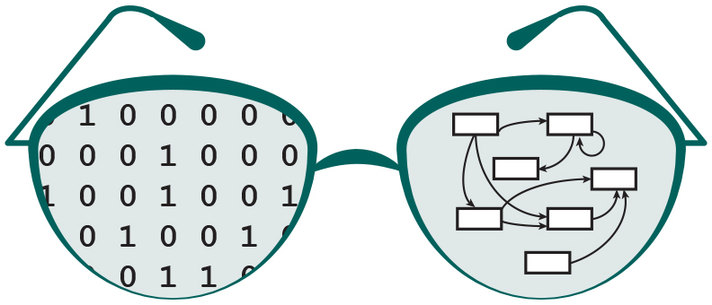

Extending the visualization capabilities of GRNsight: a web application for visualizing models of gene regulatory networks
Eileen J. Choe
Department of Electrical Engineering and Computer Science
Loyola Marymount University
Saturday, March 24, 2018
LMU Undergraduate Research Symposium

Slide 2
Outline
Gene regulatory networks (GRNs) consist of genes, transcription factors, and the regulatory relationships between them.
GRNsight is an open source web application and service for visualizing models of gene regulatory networks.
In GRNsight version 3.0, the Excel spreadsheet controller was redesigned to process data from the entire GRNmap input or output workbook.
In GRNsight version 3.0, a node coloring feature for visualizing gene expression was added.

Slide 3
Outline
Gene regulatory networks (GRNs) consist of genes, transcription factors, and the regulatory relationships between them.
GRNsight is an open source web application and service for visualizing models of gene regulatory networks.
In GRNsight version 3.0, the Excel spreadsheet controller was redesigned to process data from the entire GRNmap input or output workbook.
In GRNsight version 3.0, a node coloring feature for visualizing gene expression was added.

Slide 4
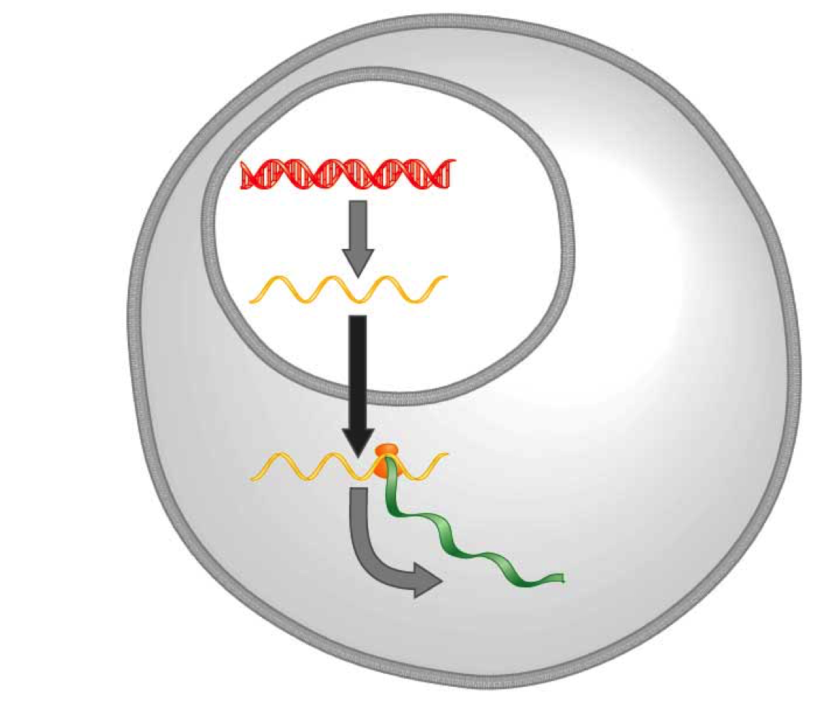
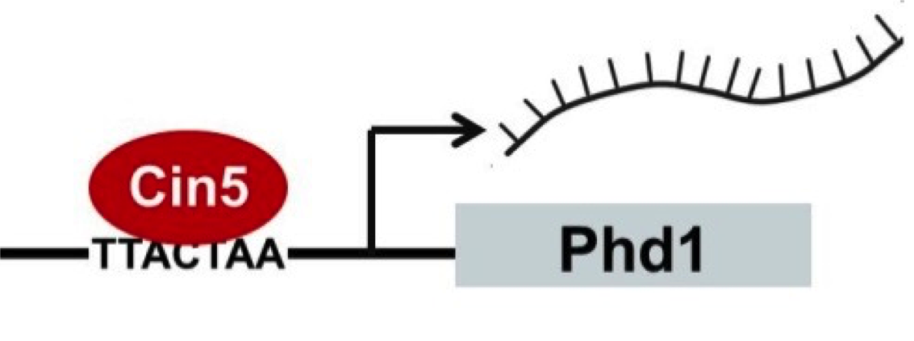
A gene regulatory network (GRN) controls the level of expression of genes and proteins
Transcription factors activate or repress expression.
To understand GRNs we want to quantify the weight values of these regulatory relationships
DNA
Transcription
mRNA
Translation
Protein
Gene regulatory process
Notes:
A GRN’s mechanism of control is transcription factors…

Slide 5
GRNmap models the dynamics of GRNs to estimate weight parameters (w)
Magnitude of weights represent the influence of the transcription factor on its target gene
Positive weights = activation of gene expression.
Negative weights = repression of gene expression.
GRNmap differential equation
Notes:
Weights represent the magnitude and sign of regulatory relationships.
Positive weights mean activation of gene expression.
Negative weights mean repression of gene expression.

Slide 6
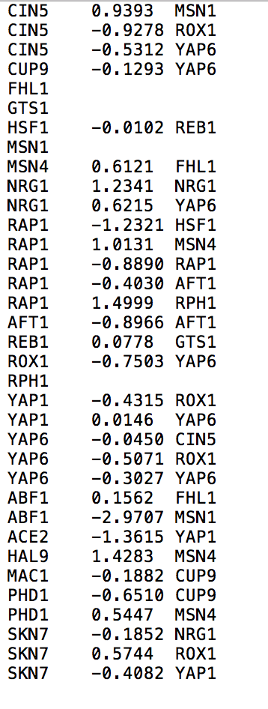
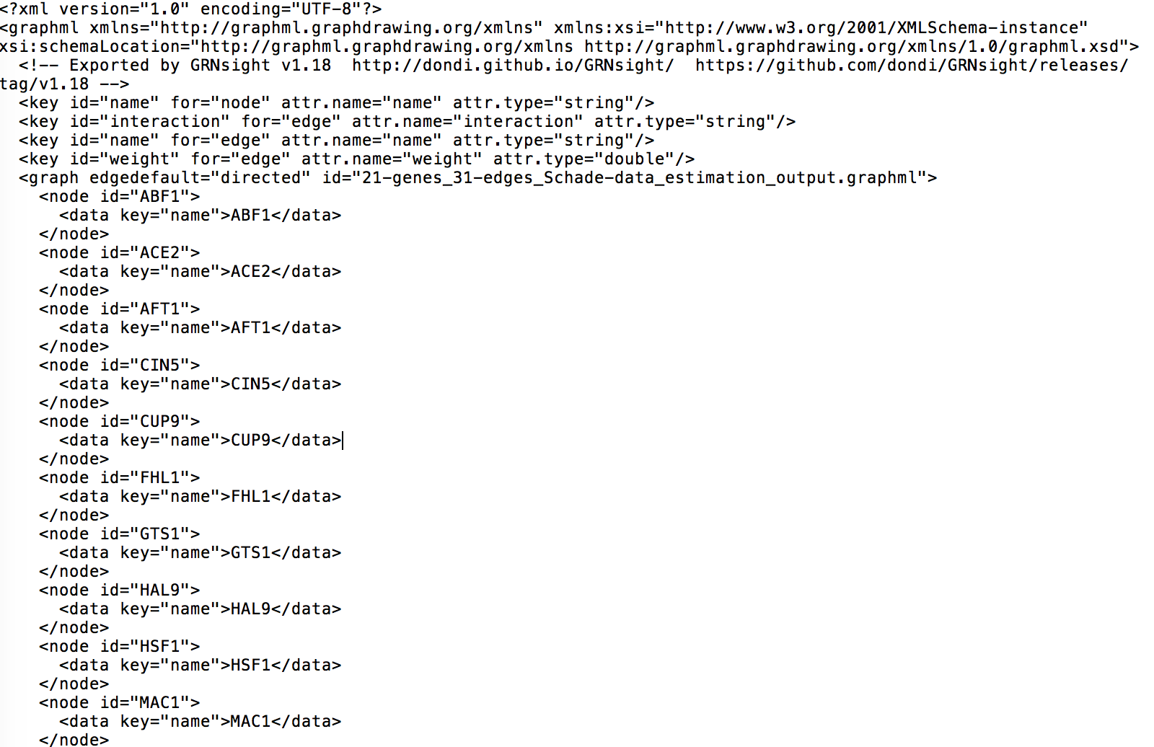
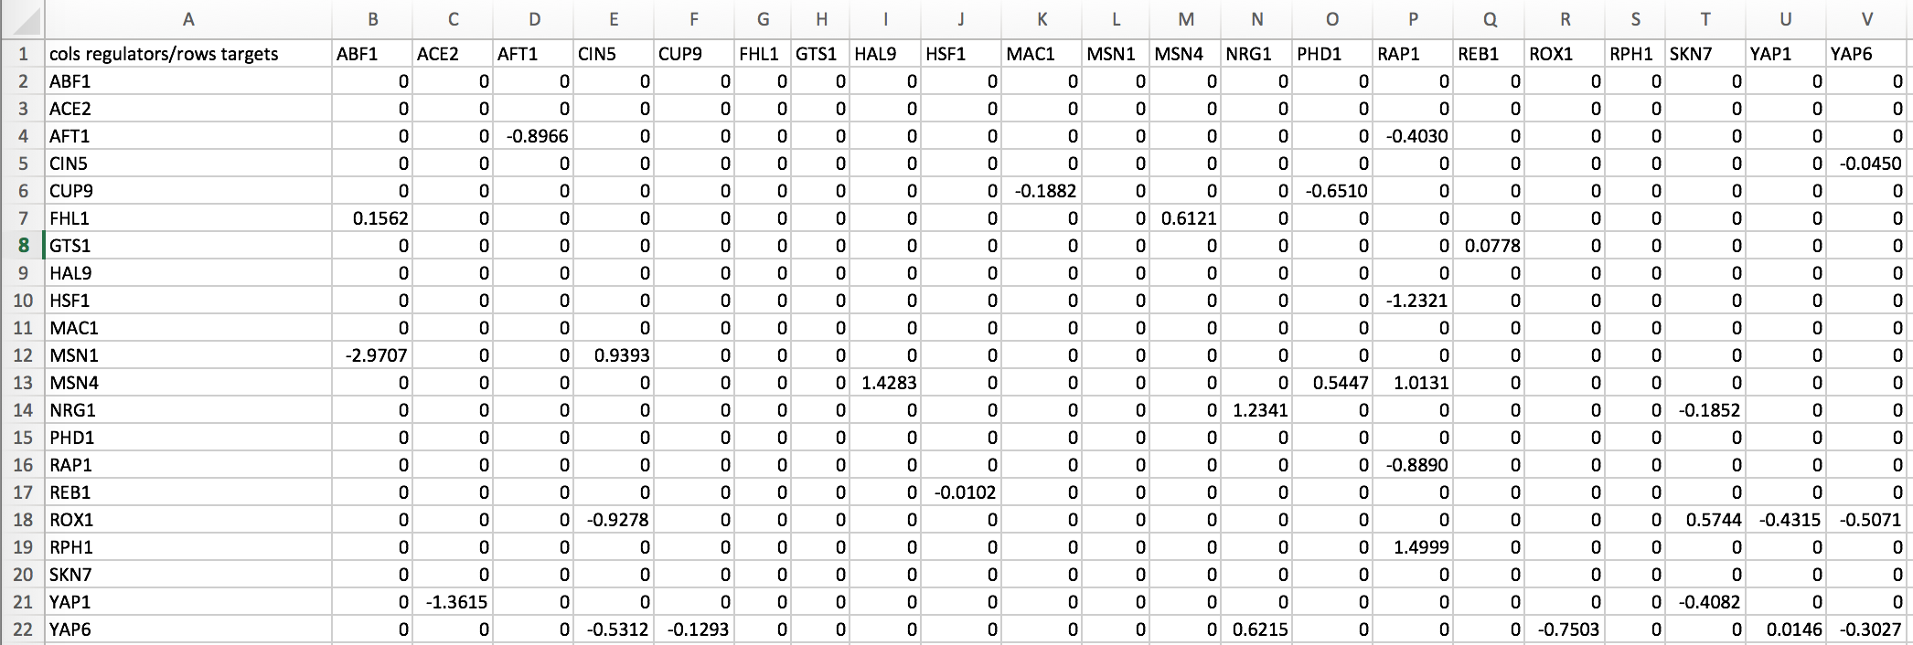
GRNmap outputs Excel spreadsheets, with estimated weight parameters
.xlsx
.graphml
.sif
21 gene, 31 edge weighted network output from GRNmap
Notes:
But it can also be represented in these other two file format (layer on the .sif and .graphml screenshots)

Slide 7
Outline
Gene regulatory networks (GRNs) consist of genes, transcription factors, and the regulatory relationships between them.
GRNsight is an open source web application and service for visualizing models of gene regulatory networks.
In GRNsight version 3.0, the Excel spreadsheet controller was redesigned to process data from the entire GRNmap input or output workbook.
In GRNsight version 3.0, a node coloring feature for visualizing gene expression was added.

Slide 8
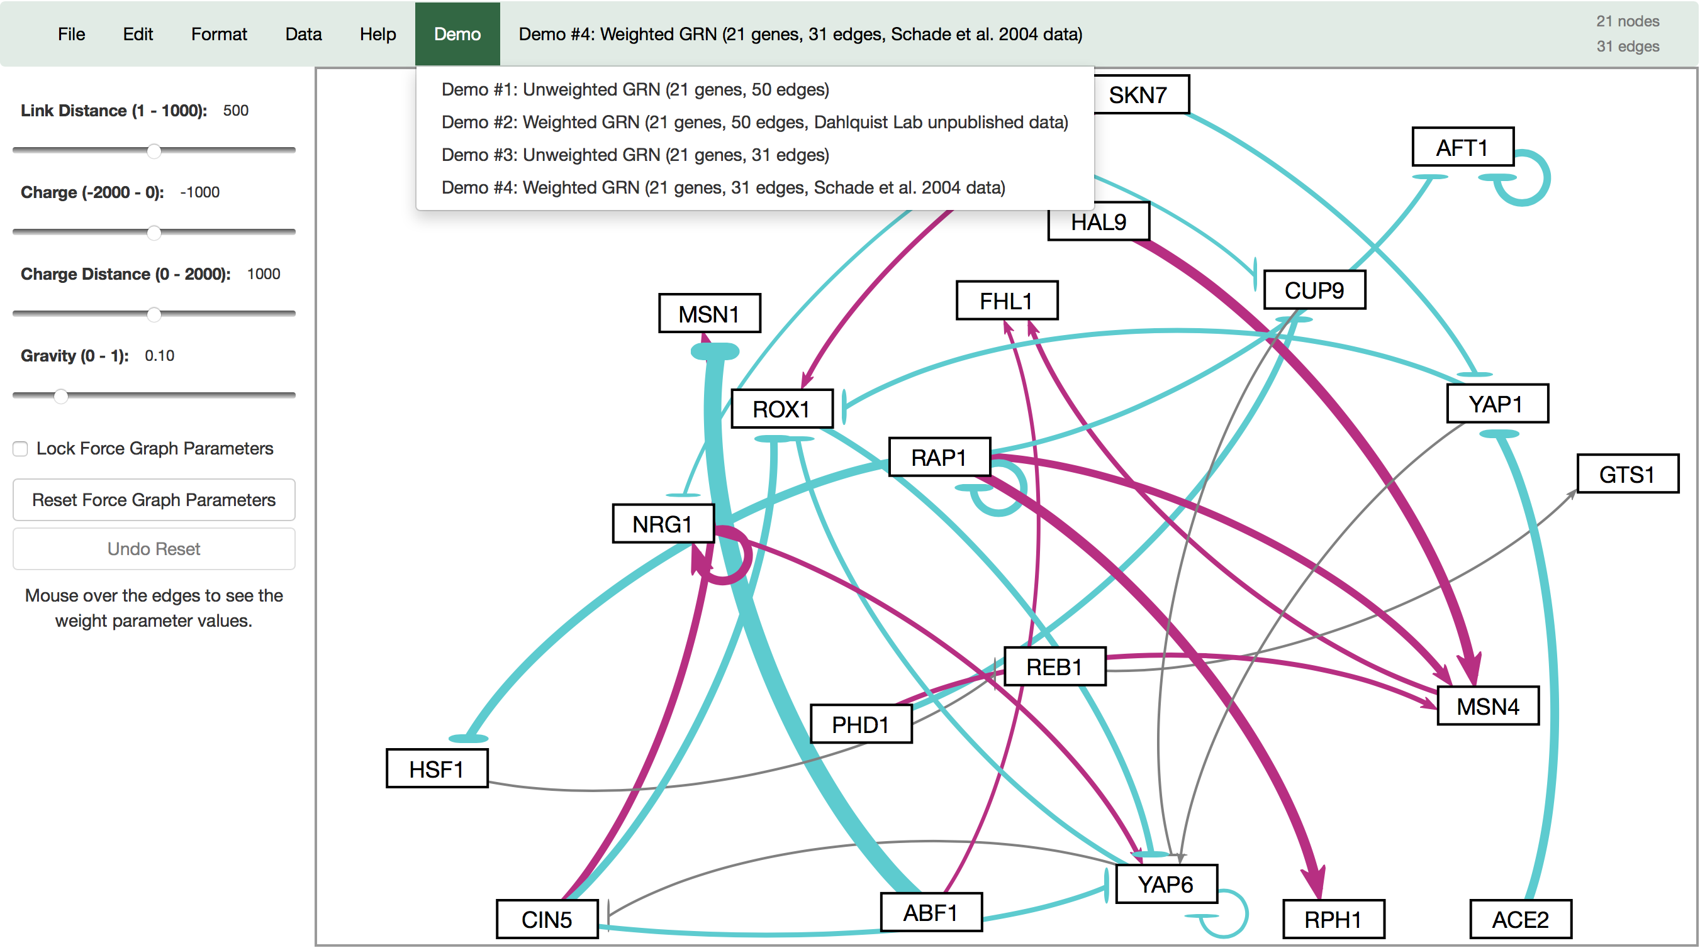

GRNsight automatically produces visualizations of weighted networks from adjacency matrix inputs
Key:
gene
activation
repression
weak influence
Screenshot of GRNsight v1, released Aug 2016
Notes:
Our solution is GRNsight, a web application which automatically produces visualizations of weighted networks from adjacency matrix inputs.
In a GRNsight visualization, rectangular nodes represent genes, and the thickness of arrows represent the strength of regulatory relationships.
The interface on the left panel, allows the user to modify force graph parameters, which apply physics simulation to the graph.
From user feedback of GRNsight v1, our research objective was to expand GRNsight’s visual and analytic features.
In this talk I will focus on two features developed for GRNsight v2.

Slide 9
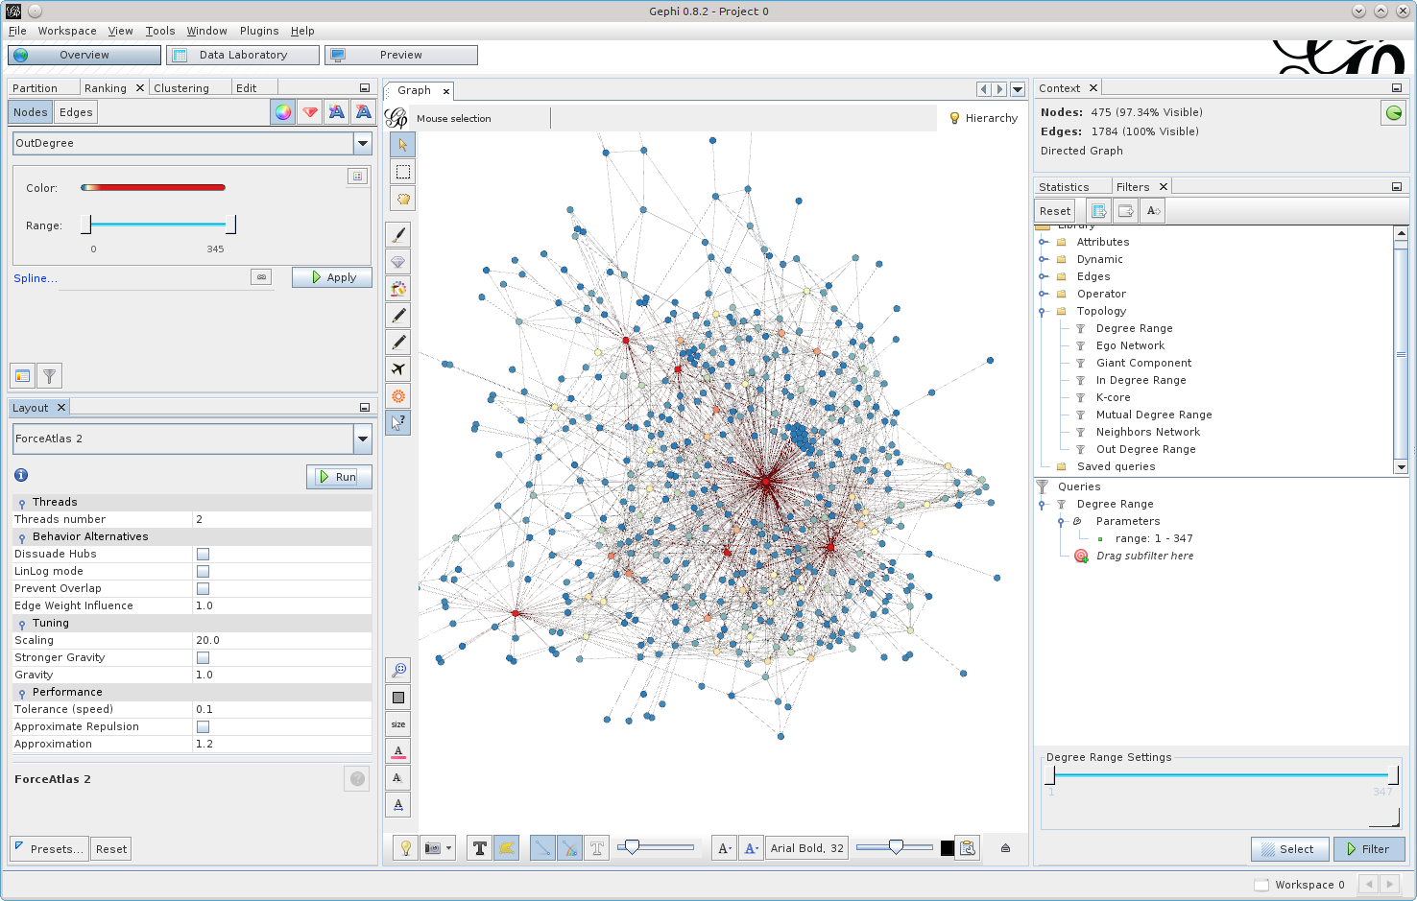
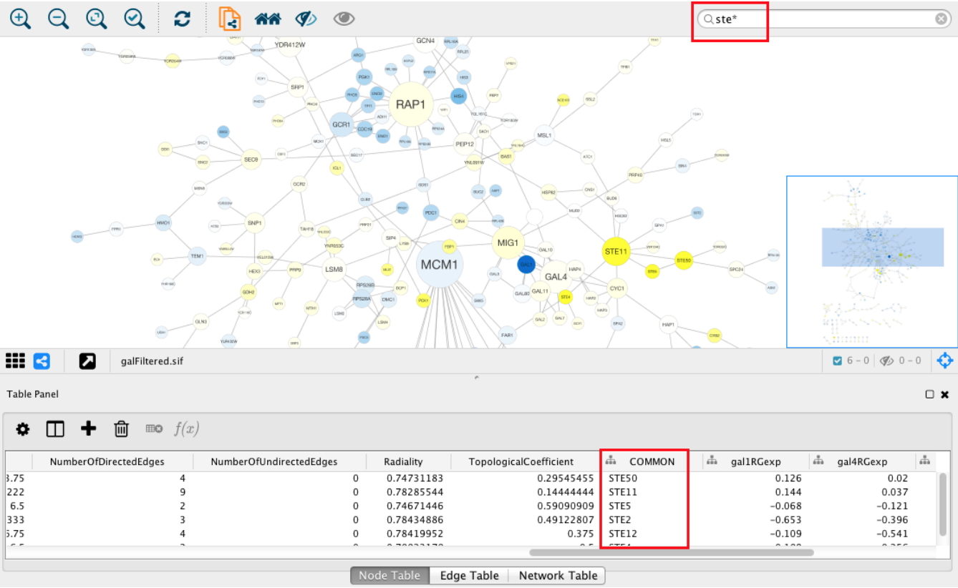
Existing visualization software must be installed and is optimized for large-scale graphs
Cytoscape – cytoscape.org
Gephi - gephi.org

Slide 10
GRNsight fills a niche in bioinformatics visualization software
Cytoscape and Gephi | GRNsight
Optimized for large-scale graphs. | Optimized for small- to medium- scale graphs.
Must be installed. | Exists as a web application.
Several complex features in addition to visualization. | Easy to use, and easily interpretable visualizations.

Slide 11
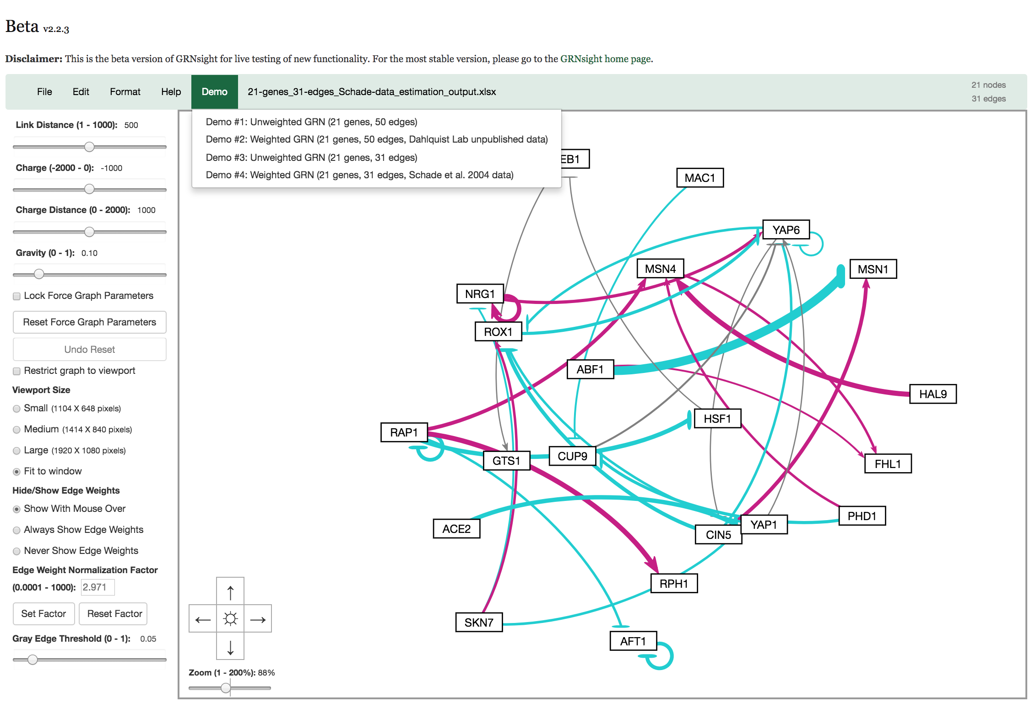
In GRNsight v2, we’ve expanded GRNsight’s visual and analytic feature set
Screenshot of GRNsight v2, released June 2017
Allow graph to reach steady state
Allow users to customize normalization factor for edge thickness
Allow users to customize gray edge threshold

Slide 12
GRNsight v3 is focused on expanding visualization features
What are are alternative ways to visualize weighted networks other than the current force-directed graph?
Block Layout (Jen Shin, 2018)
What are other datasets GRNsight can process and visualize?
GRNsight data structure redesign (Eileen Choe, 2018)
Node coloring (Eileen Choe, 2018)

Slide 13
Outline
Gene regulatory networks (GRNs) consist of genes, transcription factors, and the regulatory relationships between them.
GRNsight is an open source web application and service for visualizing models of gene regulatory networks.
In GRNsight version 3.0, the Excel spreadsheet controller was redesigned to process data from the entire GRNmap input or output workbook.
In GRNsight version 3.0, a node coloring feature for visualizing gene expression was added.

Slide 14
GRNsight was originally designed to process the “network” or “network_optimized_weights” sheet from a GRNmap input or output Excel workbook
Adjacency matrix values correspond to the magnitude of a regulatory relationship of a regulator to a target
Notes:
These sheets contain data in a matrix form used to produce a weighted or unweighted graph

Slide 15
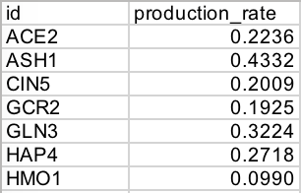
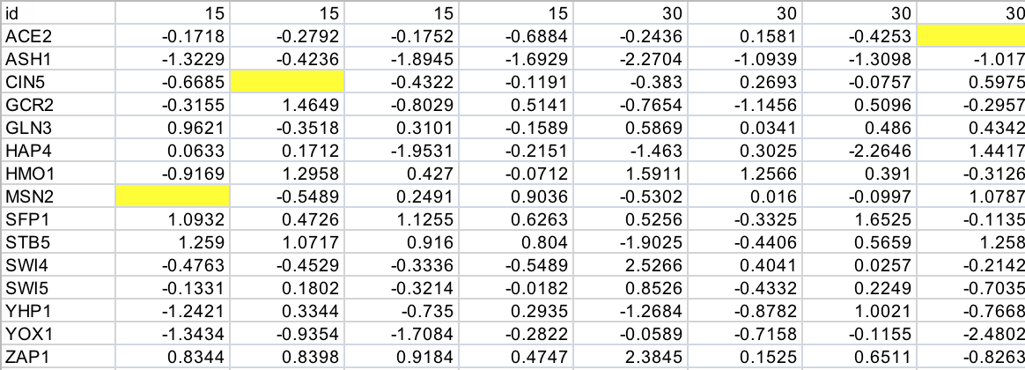
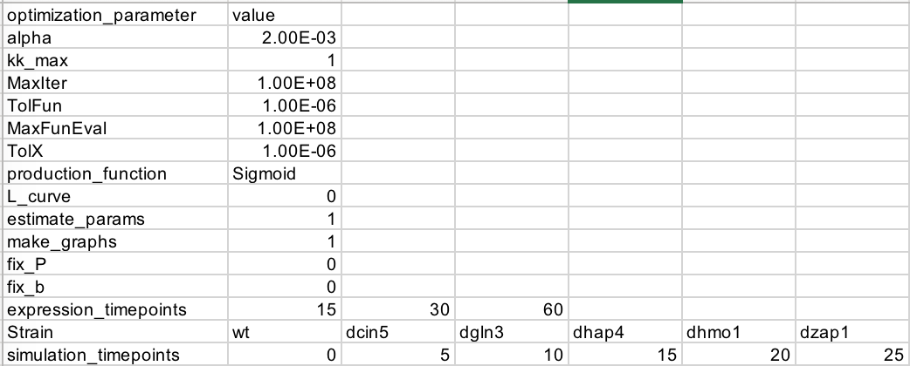
GRNmap workbooks have other worksheets that contain additional data about the GRN
3 structural categories of GRNmap Excel sheets:
2-column worksheets
Simple target – value structure for each gene
e.g. “production_rates”, “degradation_rates”
expression
Time Series data
e.g. “wt_log2_expression”, “wt_log2_optimized_espression”
metadata
Data about GRNmap simulation parameters
e.g. “optimization_parameters”
Notes:
3 main structural categories of GRNmap Excel workbook data

Slide 16
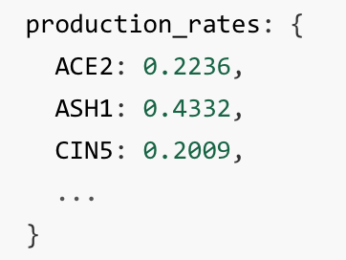
GRNsight’s Excel spreadsheet parser was redesigned to process the entire GRNmap output
Parse, or analyze, the syntax (structure) of data and break it down into logical components
Transform data from Excel spreadsheets into JSON
JSON (JavaScript Object Notation) is a lightweight data format optimal for use in data visualization
Complete internal JSON representation of Excel input is first step towards expanding visualization capabilities of GRNsight

Slide 17
Outline
Gene regulatory networks (GRNs) consist of genes, transcription factors, and the regulatory relationships between them.
GRNsight is an open source web application and service for visualizing models of gene regulatory networks.
In GRNsight version 3.0, the Excel spreadsheet controller was redesigned to process data from the entire GRNmap input or output workbook.
In GRNsight version 3.0, a node coloring feature for visualizing gene expression was added.
Notes:
Now I’m going to talk about how we improved the client and server tests behind the scenes.

Slide 18
Microarray experiments capture gene expression levels at specified time points
background info + diagram
// TODO work on this slide
Gene expression data was one type of data added to the GRNsight internal JSON data structure in v3
Node coloring framework developed to increase the density of information visualized by GRNsight, allowing users to learn more about data through visual inspection

Slide 19
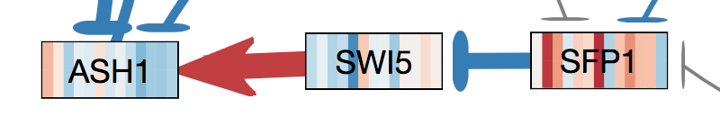
Gene expression is visualized in GRNsight by coloring the nodes with a heat map corresponding to expression levels over time
Rectangular nodes are horizontally subdivided by the number of data time points
The color of each horizontal “slice” corresponds to the expression value of that gene at the particular time point
Red = activation (+ expression)
Blue = repression (- expression)

Slide 20
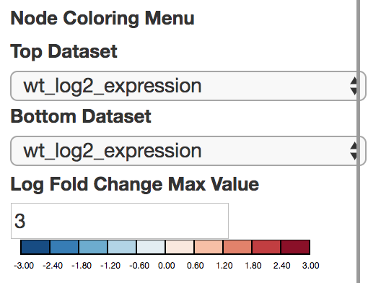
A node coloring menu allows users to modify parameters of node coloring

Slide 21
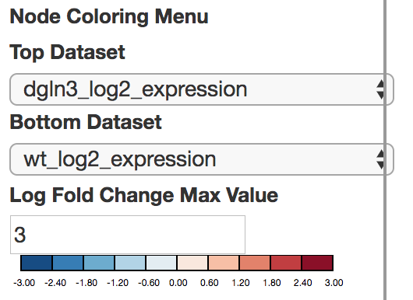
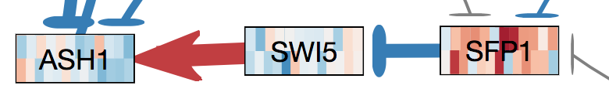
Users can manually select the dataset(s) to use for node coloring
Options are auto generated by automatically detecting the expression sheets in the Excel workbook
Two different datasets can be selected to visually compare expression data

Slide 22
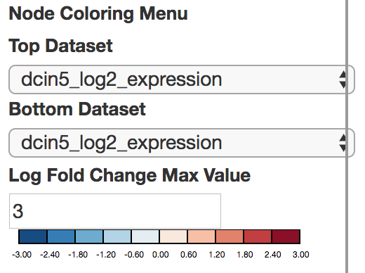
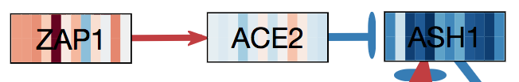


Users may override the default log fold change max value
Log fold change max value determines how expression values “map” to the coloring legend
Default value arbitrarily set to 3
Users may change value to increase/decrease color intensity of their visualization
Log Fold Change Max Value
2
3
5

Slide 23
Visual inspection of gene expression is crucial to verifying the correctness of the GRNmap network simulation
For example…

Slide 24
Conclusion
Gene regulatory networks (GRNs) consist of genes, transcription factors, and the regulatory relationships between them.
GRNsight is an open source web application and service for visualizing models of gene regulatory networks.
In GRNsight version 3.0, the Excel spreadsheet controller was redesigned to process data from the entire GRNmap input or output workbook.
In GRNsight version 3.0, a node coloring feature for visualizing gene expression was added.
Notes:
In this talk, I’ve introduced you to the concept of gene regulatory networks, which consist of genes, transcription factors, and the regulatory relationships between them. We’ve developed GRNsight which is open source software which allows biologists to understand GRNs through visualization. Building from GRNsight v1, we’ve improved the visual and analytic features (three of which were highlighted in this talk), as well as expanded the client and server side tests.

Slide 25
GRNsight application and code are available under the open source BSD license
http://dondi.github.io/GRNsight/
https://github.com/dondi/GRNsight
Current and future work documented via Github Issues
User interface menu redesign
Additional options for node coloring
User selected color scheme
Animation

Slide 26

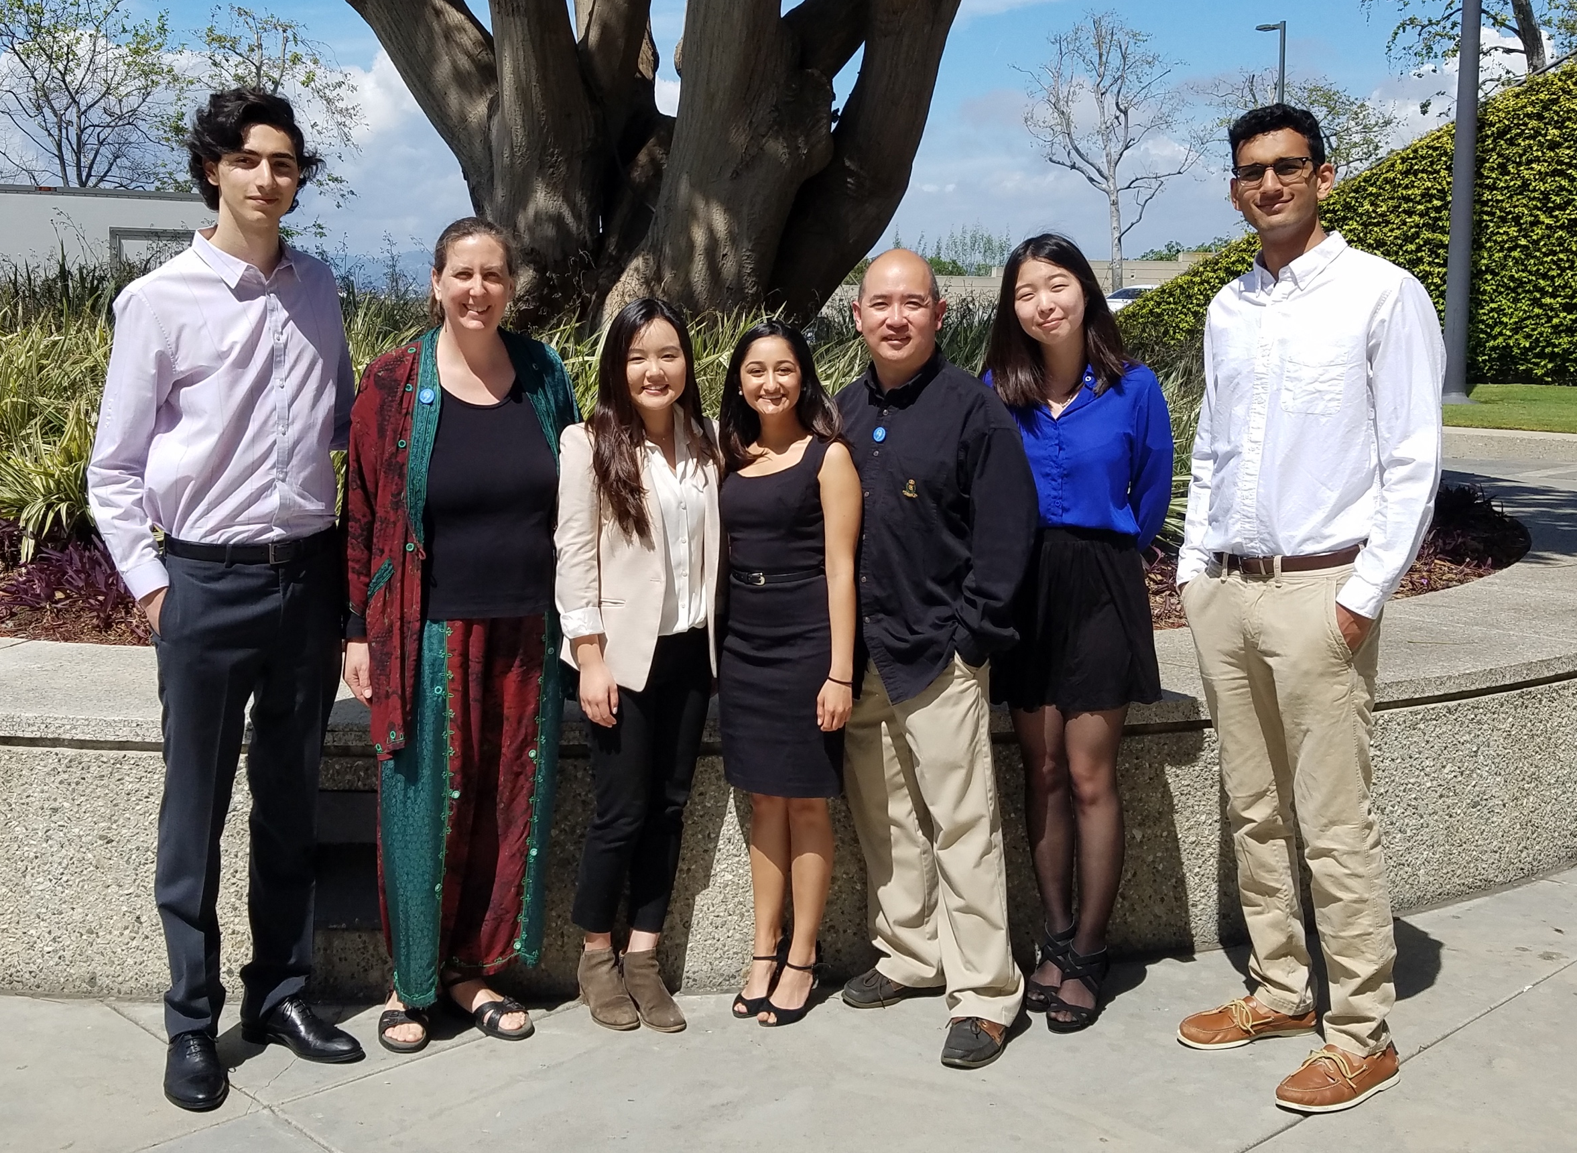
Acknowledgements
Loyola Marymount University
Dr. Kam D. Dahlquist
Dr. John David N. Dionisio
Dr. Ben G. Fitzpatrick
GRNsight Team
Mihir Samdarshi
Jen Shin
Eileen Choe
GRNmap Team
Eddie Azinge
Maggie O’Neil
Brandon Klein
Justin Kyle Torres
Wet Lab Team
Nika Vafadari
Katherine Scheker
Nick Collins

