Slide 1


New Graph Layouts for GRNsight: a web application for visualizing models of gene regulatory networks
Jen Y. Shin
Department of Electrical Engineering and Computer Science
Loyola Marymount University
Saturday, November 24th 2018
Research Symposium

Slide 2
Outline
Gene regulatory networks (GRNs) consist of genes, transcription factors, and the regulatory relationships between them.
GRNsight is an open source web application and service for visualizing models of gene regulatory networks.
In GRNsight version 3.0, grid layout function was implemented.

Slide 3
Outline
Gene regulatory networks (GRNs) consist of genes, transcription factors, and the regulatory relationships between them.
GRNsight is an open source web application and service for visualizing models of gene regulatory networks.
In GRNsight version 3.0, grid layout function was implemented.

Slide 4
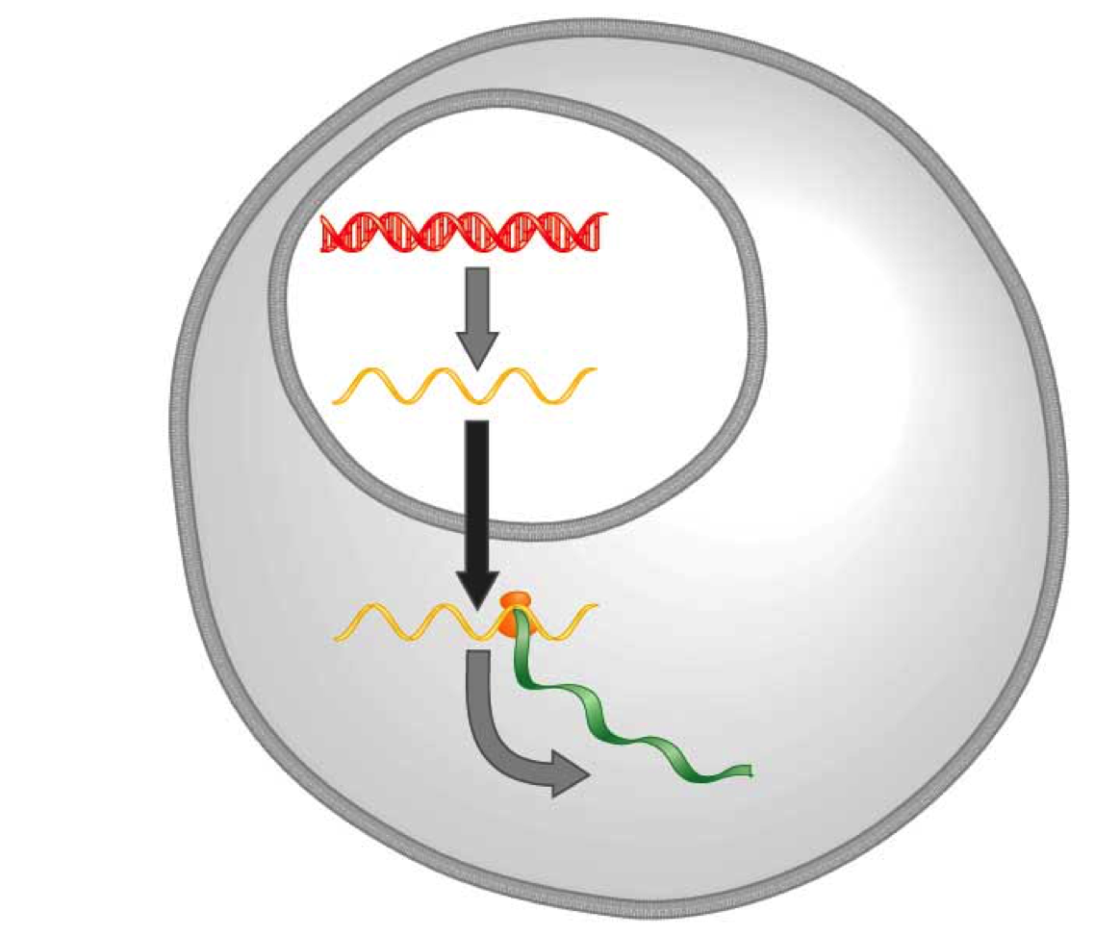
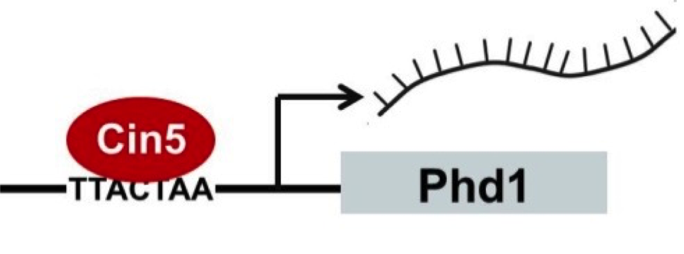
A gene regulatory network (GRN) controls the level of expression of genes and proteins
Transcription factors activate or repress expression.
To understand GRNs we want to quantify the weight values of these regulatory relationships
DNA
Transcription
mRNA
Translation
Protein
Gene regulatory process
(Freeman, 2002)
Notes:
A GRN’s mechanism of control is transcription factors…

Slide 5
GRNmap models the dynamics of GRNs to estimate weight parameters (w)
Magnitude of weights represent the influence of the transcription factor on its target gene.
Positive weights = activation of gene expression.
Negative weights = repression of gene expression.
GRNmap differential equation
Notes:
Weights represent the magnitude and sign of regulatory relationships.
Positive weights mean activation of gene expression.
Negative weights mean repression of gene expression.

Slide 6
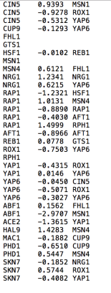
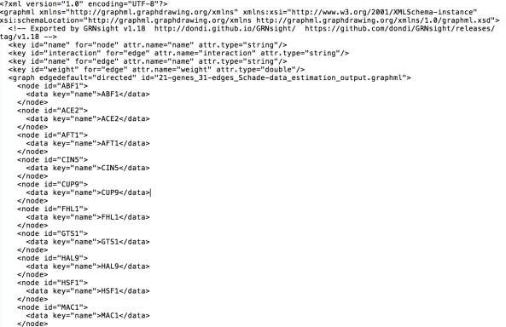
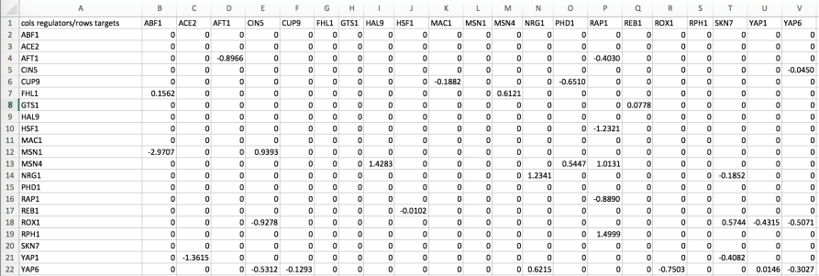
GRNmap outputs Excel spreadsheets, with estimated weight parameters
.xlsx
.graphml
.sif
21 gene, 31 edge weighted network output from GRNmap
Notes:
But it can also be represented in these other two file format (layer on the .sif and .graphml screenshots)

Slide 7
Outline
Gene regulatory networks (GRNs) consist of genes, transcription factors, and the regulatory relationships between them.
GRNsight is an open source web application and service for visualizing models of gene regulatory networks.
In GRNsight version 3.0, grid layout function was implemented.

Slide 8
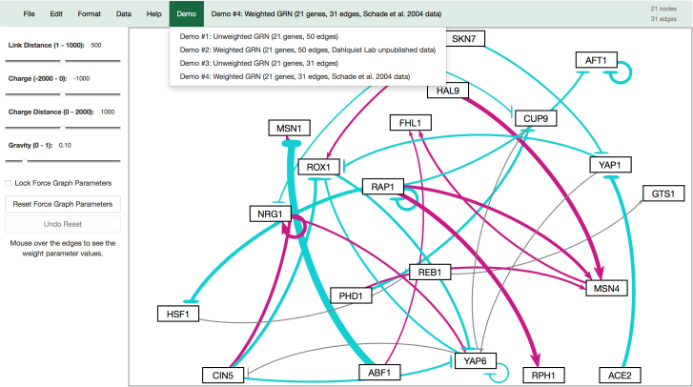

GRNsight automatically produces visualizations of weighted networks from adjacency matrix inputs
Key:
gene
activation
repression
weak influence
Screenshot of GRNsight v1, released Aug 2016
Notes:
Our solution is GRNsight, a web application which automatically produces visualizations of weighted networks from adjacency matrix inputs.
In a GRNsight visualization, rectangular nodes represent genes, and the thickness of arrows represent the strength of regulatory relationships.
The interface on the left panel, allows the user to modify force graph parameters, which apply physics simulation to the graph.

Slide 9
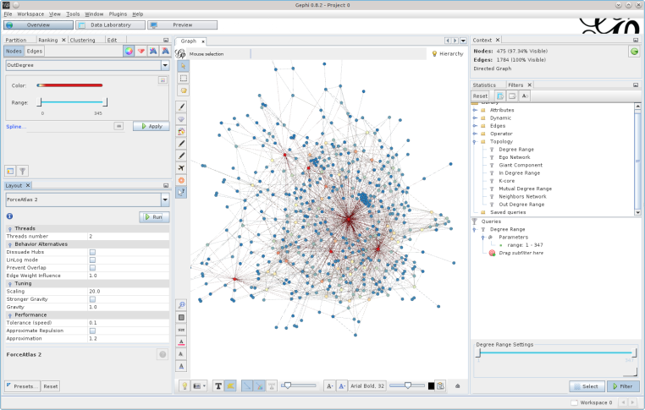
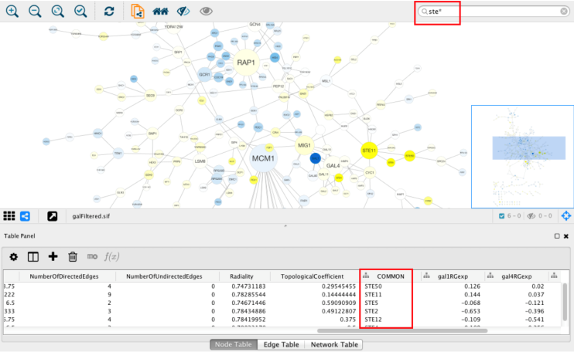
Existing visualization software must be installed and is optimized for large-scale graphs
Cytoscape – cytoscape.org
Gephi - gephi.org

Slide 10
GRNsight fills a niche in bioinformatics visualization software
Cytoscape and Gephi | GRNsight
Optimized for large-scale graphs. | Optimized for small- to medium- scale graphs.
Must be installed. | Exists as a web application.
Several complex features in addition to visualization. | Easy to use, and easily interpretable visualizations.

Slide 11
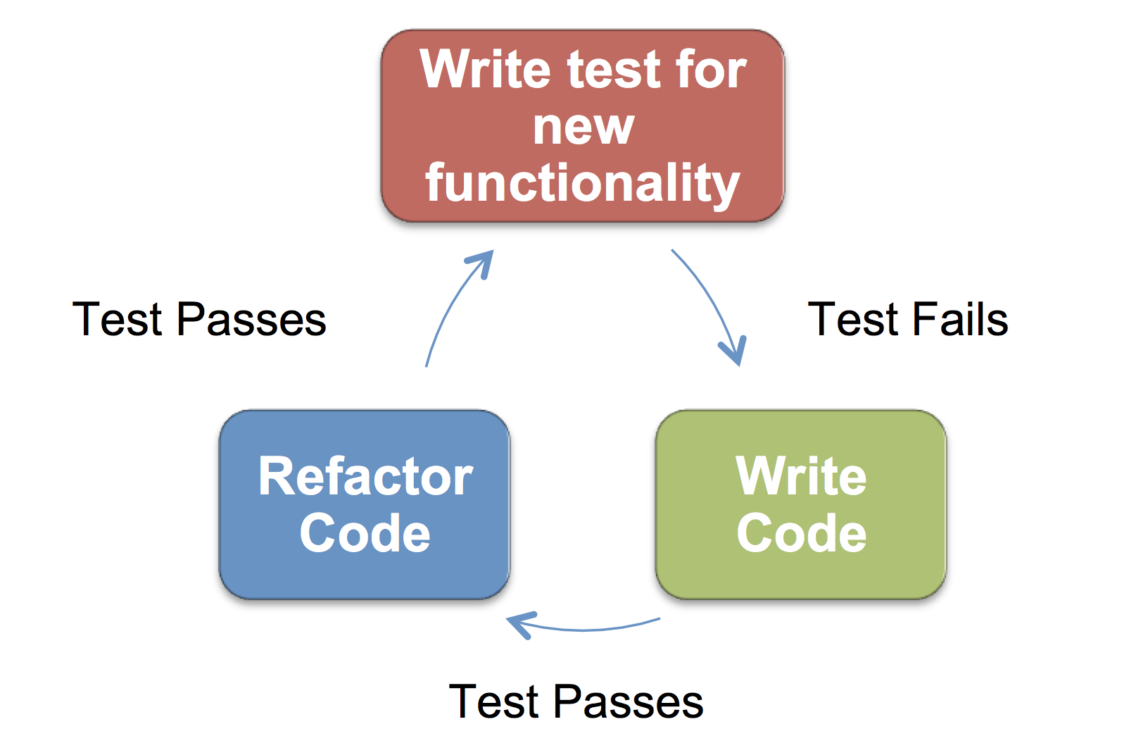



GRNsight is written in JavaScript and follows software engineering best practices
Test Passes
Test Fails
Test Passes
GRNsight technology stack
Test-driven development cycle
Notes:
Client, server, and tests written in the JavaScript programming language, assisted by the following libraries displayed on the left.
GRNsight follows the software engineering best practice of test driven development, in which tests are written for new functionality prior to the feature being developed.
TDD and tech stack
JS main language,
express framework,
nodeJS server library
mocha test suite
D3 visualization library
We follow TDD
Test written -> fail nothing is written -> add features
-> fix accordingly so all the test passes
-

Slide 12
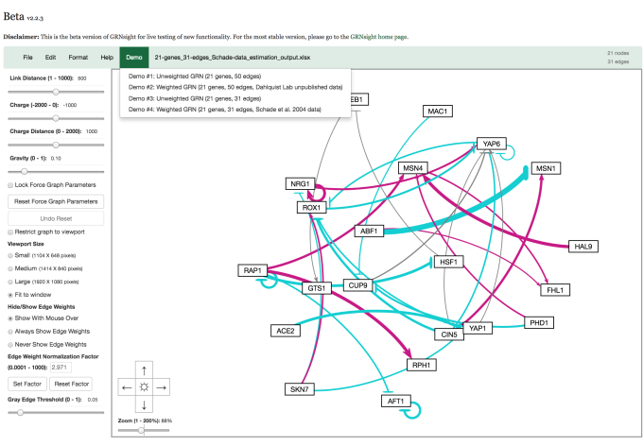
GRNsight v2 (beta) Screenshot
Separated bounding box from the viewport to allow graph to reach steady state
Allow users to zoom and scroll within the graph viewport
Allow users to customize normalization factor for edge thickness so that multiple graphs can be generated at the same scale
Allow users to customize gray edge threshold so that a user can decide the threshold to determining if a relationship is weak
Notes:
In summary, the three visual and analytic features highlighted:

Slide 13


GRNsight changes from v.2 to v.3
Refactored GRNsight code using D3 library to v.4 from v3.
Simple changes with keyword replacement
Zooming
Force Simulation
Two force sliders removed
Charge Distance
Gravity
Node coloring by Eileen Choe 2018
Grid Layout by Jen Shin 2018
Included Webpack in the package to import and export methods and objects within GRNsight files
Notes:
Adapted zooming work to v4
Investigated force simulation and understand the changes
eileens node coloring
removed two of our sliders

Slide 14
Outline
Gene regulatory networks (GRNs) consist of genes, transcription factors, and the regulatory relationships between them.
GRNsight is an open source web application and service for visualizing models of gene regulatory networks.
In GRNsight version 3.0, grid layout function was implemented.

Slide 15
Grid layout feature developed for GRNsight v3 is highlighted in this presentation
Corresponding Objectives:
Allow the user to toggle between force graph and grid layout
Organize the nodes in a grid pattern
Sort the nodes in alphabetical order
Full list of v3 features documented in the release notes: http://dondi.github.io/GRNsight/about.html#releaseContent
Notes:
In this presentation, I will focus on a subset of these features developed for v2, which correcspond to the following three research objective.

Slide 16
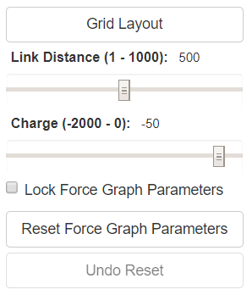
Allow the user to toggle between force graph and grid layout
Objective #1
Toggle Button
Users can easily apply grid layout by clicking the button on the left menu bar.
Users can switch back to the force graph layout by clicking the grid layout button again.
Toggling back and forth triggers a graph reload.
Future plans to reorganize the menu in order to display the grid layout and force graph layout options more distinctively.
Notes:
Changing to the force graph layout from grid layout means that the nodes are released to be freely floating instead of forced to a fixed place.
Toggling back and forth triggers a graph reload, which means that the values of link distance and charges will be reset whenever the toggle happens..

Slide 17
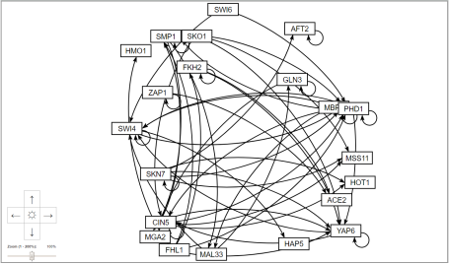
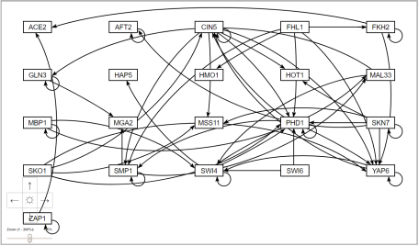
Allow the user to toggle between force graph and grid layout
Objective #1
Force Graph
Grid Layout
Initial state when graph is first loaded.
Nodes float and move with applied force.
Nodes do not float like in force graph.
Users can move the nodes around like in force graph.
Notes:
Grid layout does not float like force but still allows the users to do other things

Slide 18
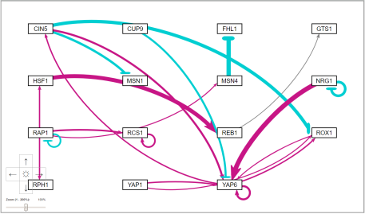
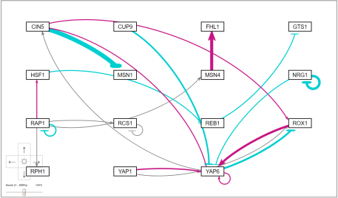
Organize the nodes in a grid pattern
Objective #2
test-data1
test-data2
The nodes are laid out in a grid pattern with columns and rows.
The nodes are equally spaced out with margins around them.
Allows users to compare and analyze data in a easier and faster way.
Notes:
Maggie, presenter before me from GRNmap, had to manually move the nodes now she does not have to do that

Slide 19
Sort the nodes in alphabetical order
Objective #3
Before Grid Layout
After Grid Layout
The nodes are organized in alphabetical order, left to right first then top to bottom.
Allows for easier comparison from graph to graph.

Slide 20
Conclusion
Gene regulatory networks (GRNs) consist of genes, transcription factors, and the regulatory relationships between them.
GRNsight is an open source web application and service for visualizing models of gene regulatory networks.
In GRNsight version 3.0, grid layout function was implemented.
Notes:
In this talk, I’ve introduced you to the concept of gene regulatory networks, which consist of genes, transcription factors, and the regulatory relationships between them. We’ve developed GRNsight which is open source software which allows biologists to understand GRNs through visualization. Building from GRNsight v1, we’ve improved the visual and analytic features (three of which were highlighted in this talk), as well as expanded the client and server side tests.

Slide 21
GRNsight application and code are available under the open source BSD license
http://dondi.github.io/GRNsight/
https://github.com/dondi/GRNsight
Current and future work documented via Github Issues
Organizing the menu
Adding alternate graph layout options such as hierarchical

Slide 22

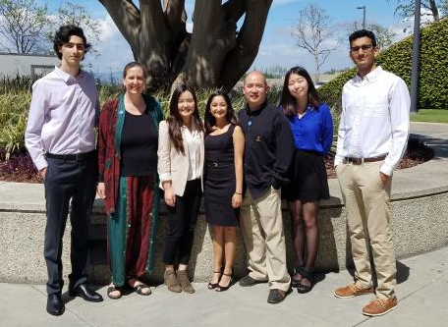
Acknowledgements
Loyola Marymount University
Dr. Kam D. Dahlquist
Dr. John David N. Dionisio
GRNsight Team
Mihir Samdarshi
Jen Shin
Eileen Choe
GRNmap Team
Maggie O’Neil
Brandon Klein
Justin Kyle Torres
John Lopez
Wet Lab Team
Nika Vafadari
Katherine Scheker
Nick Collins

