Slide 1


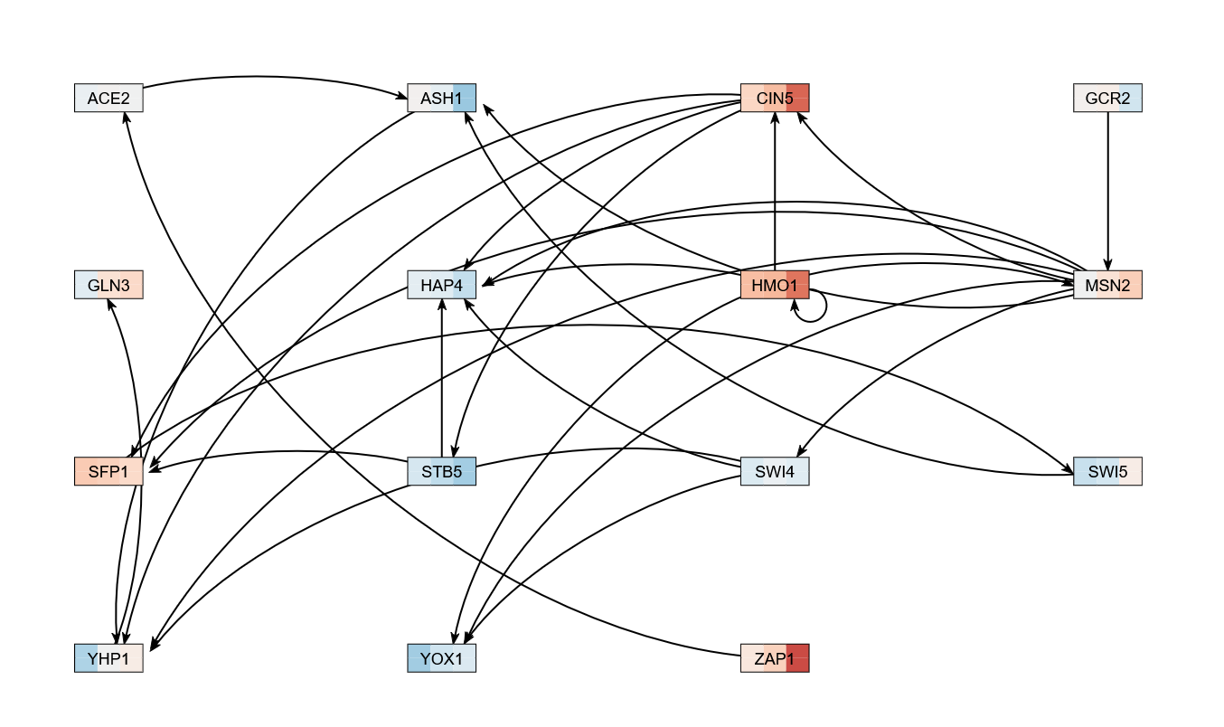
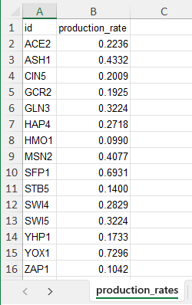
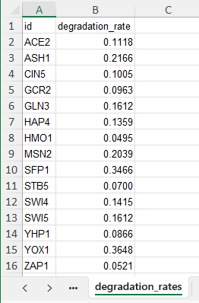
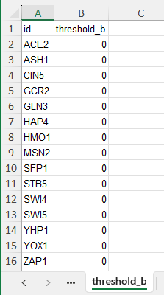

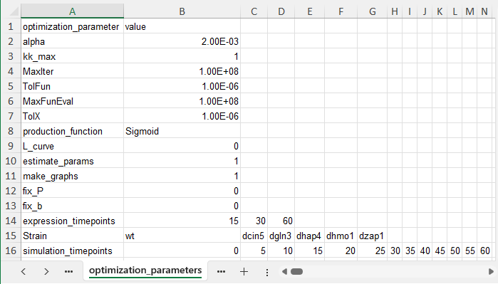
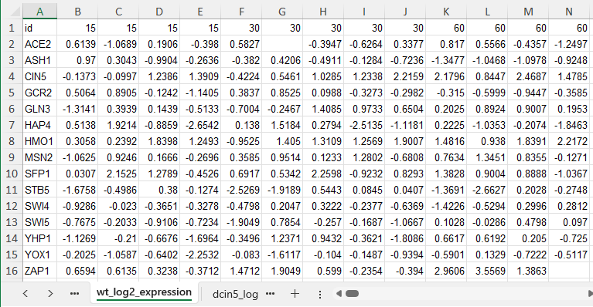
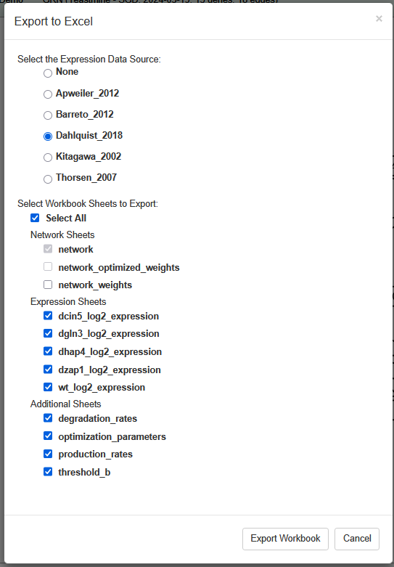
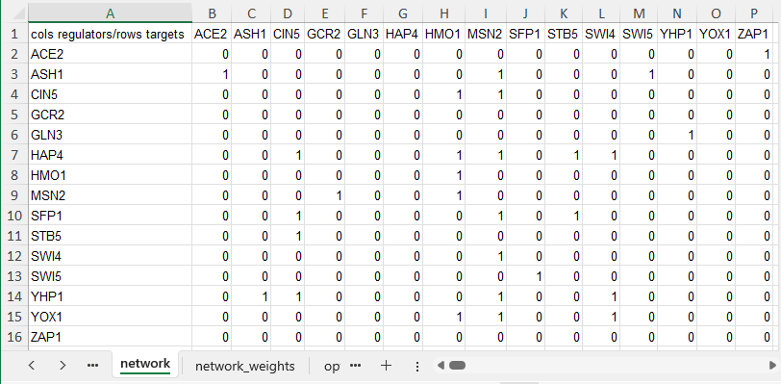
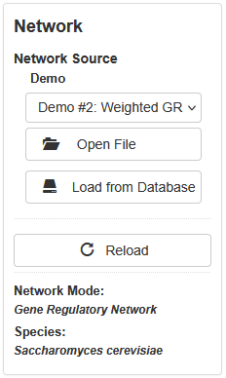

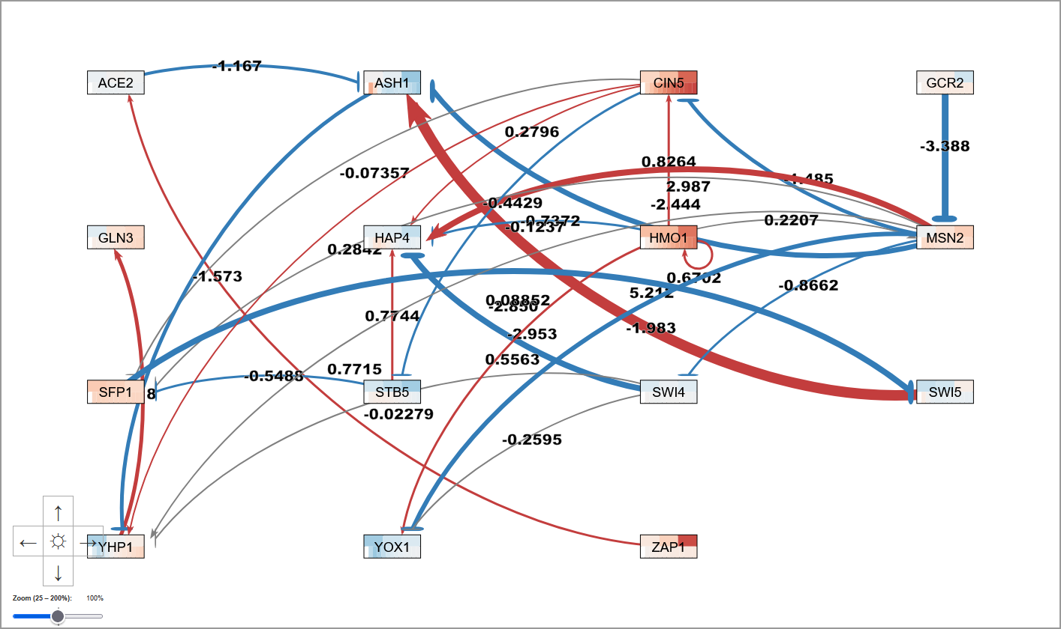



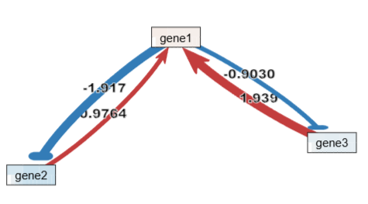
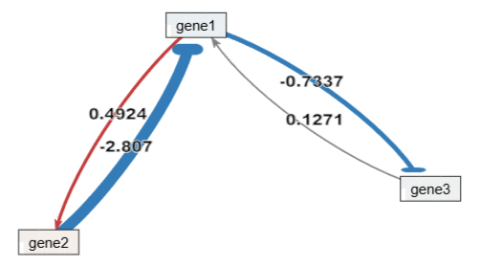
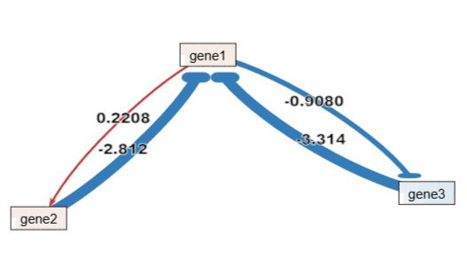
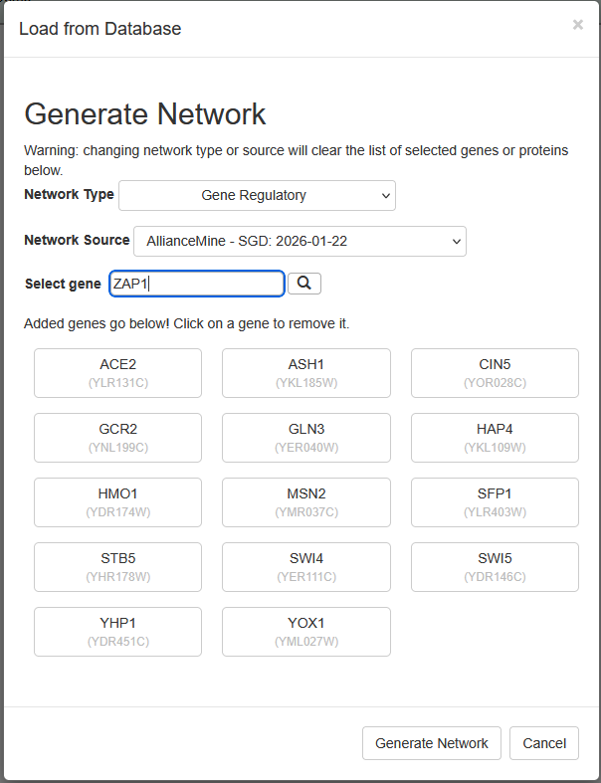
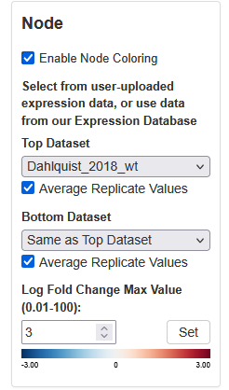
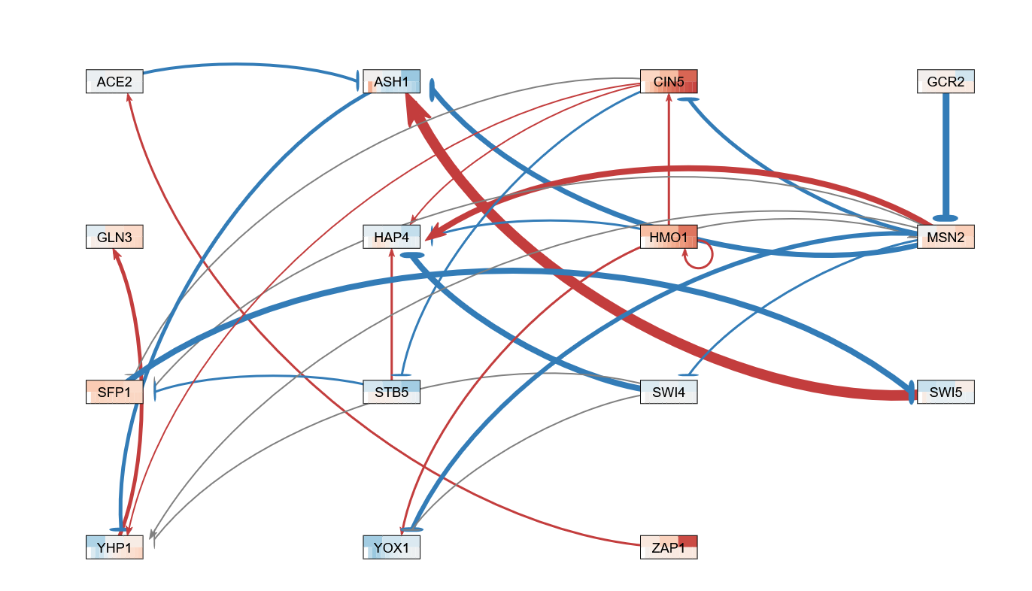
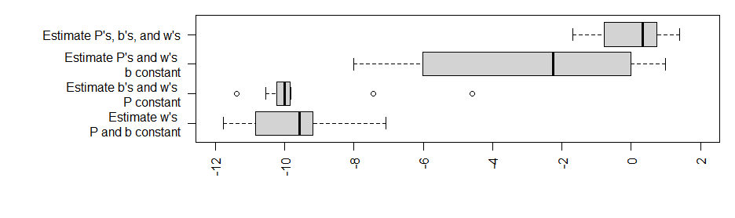
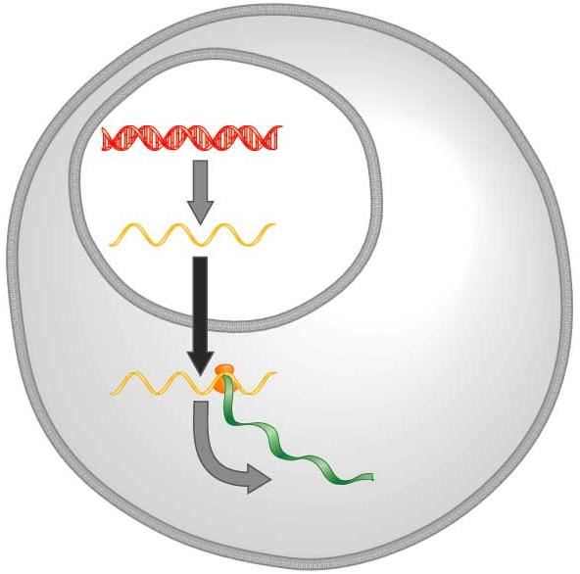
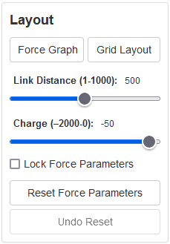
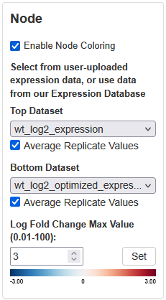
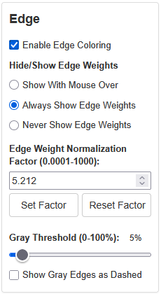

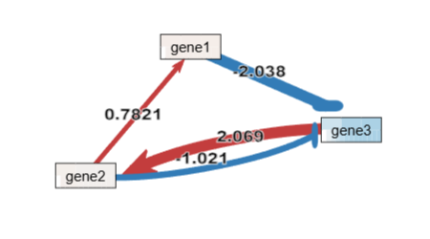
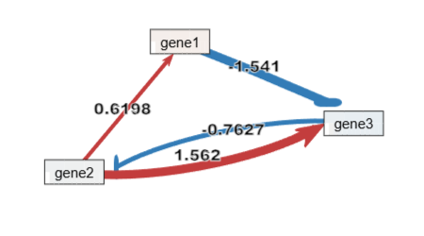
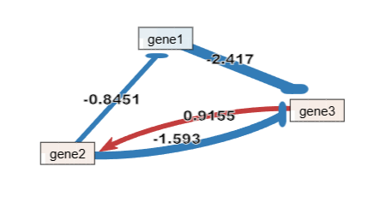
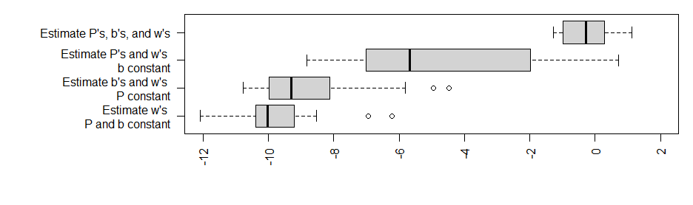

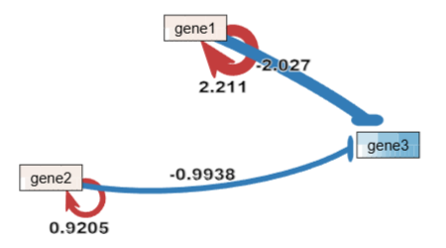
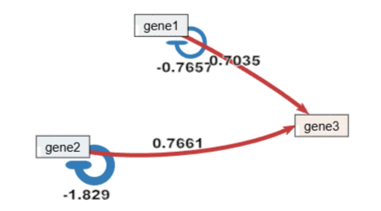
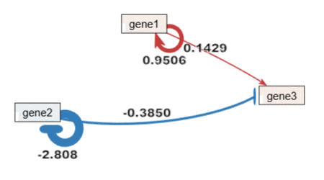
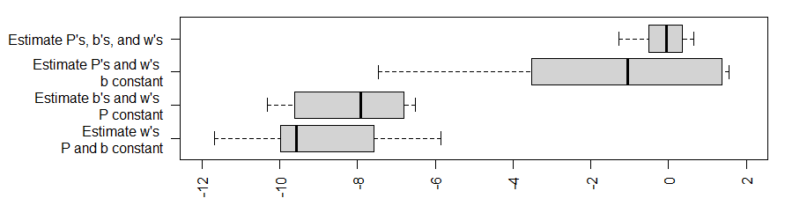
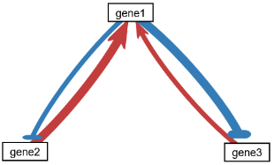
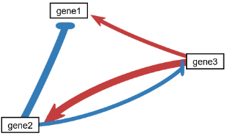
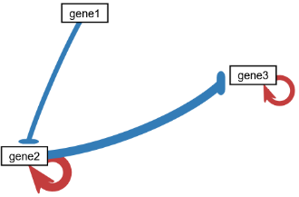
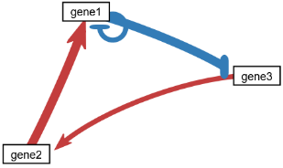
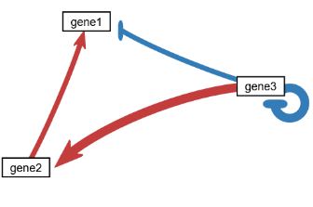
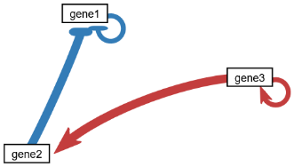
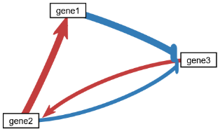
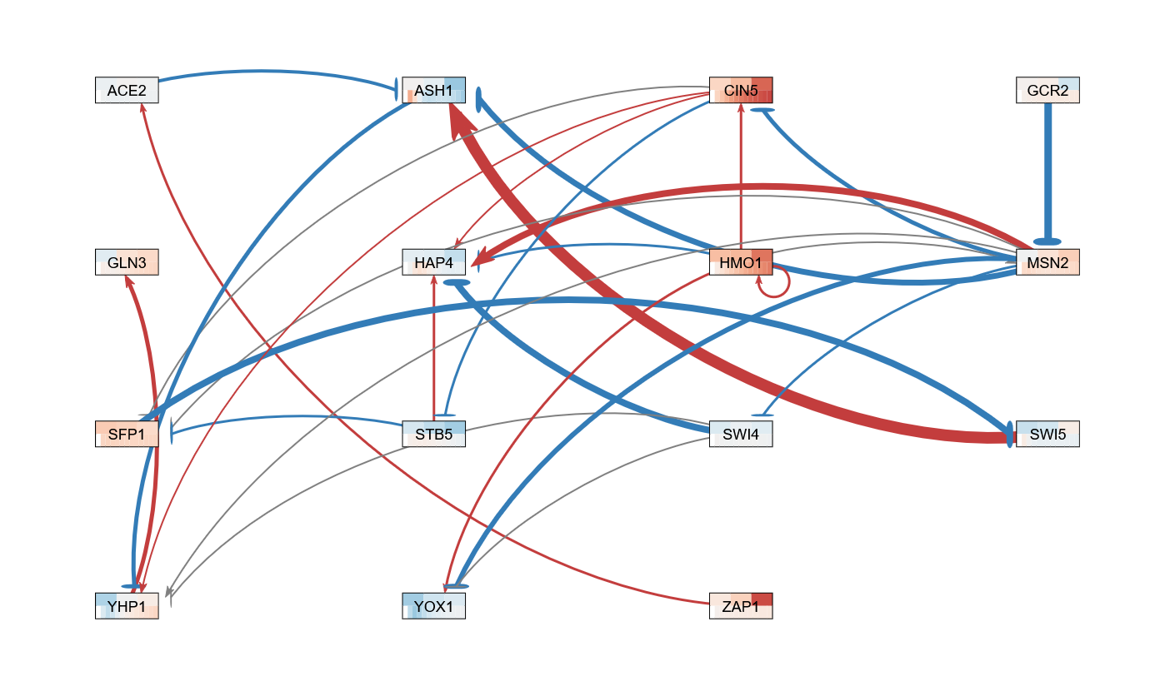
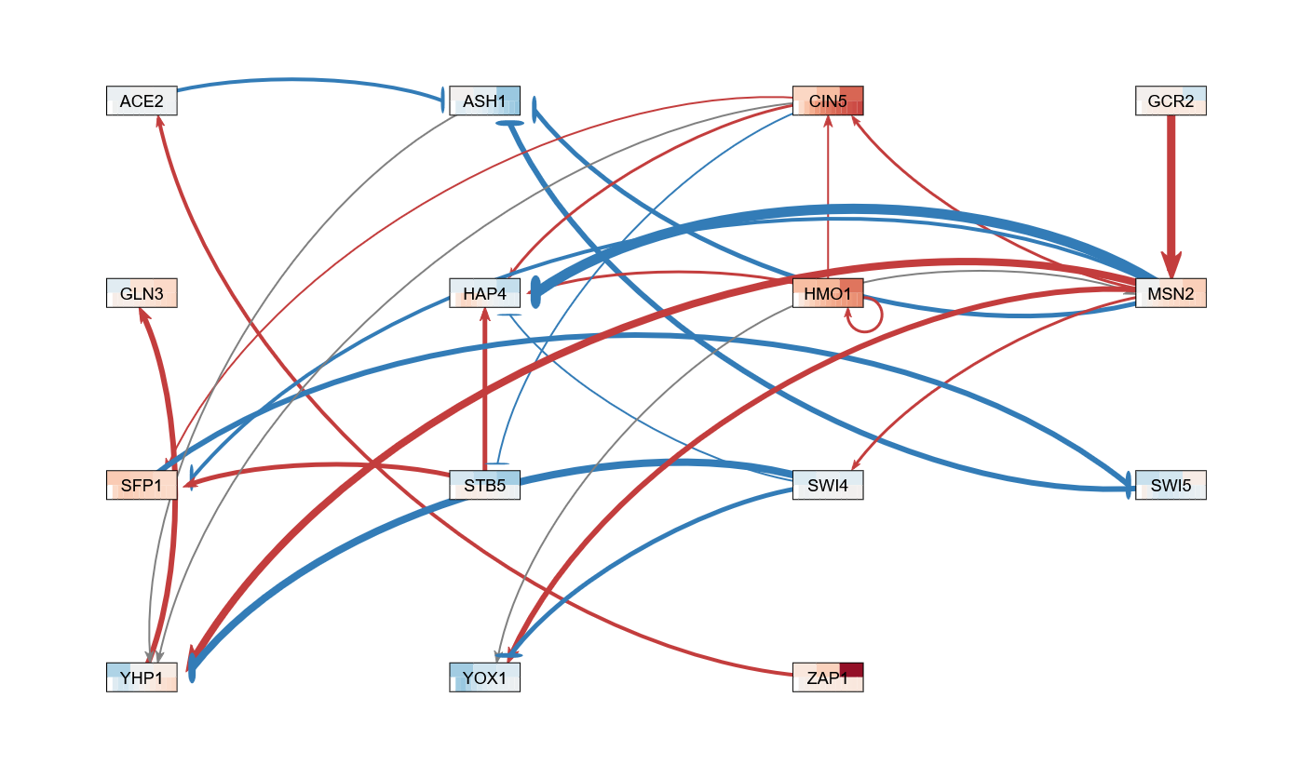
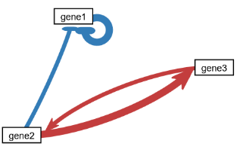
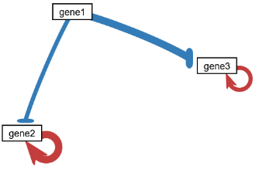
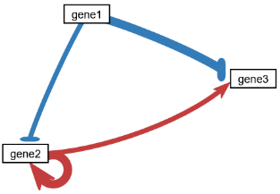
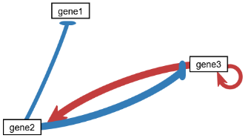
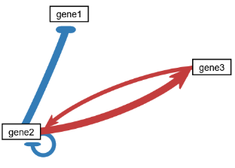
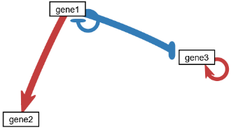
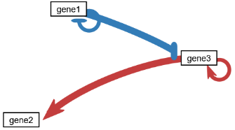
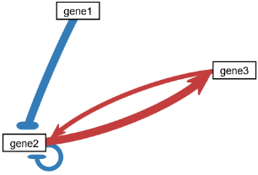
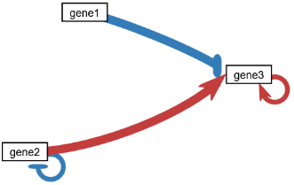
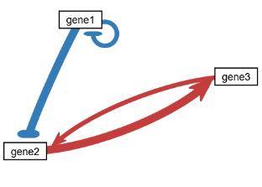
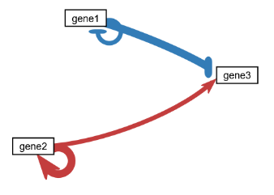
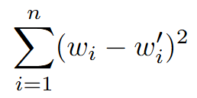








Sensitivity analysis of GRNmap and new features for GRNsight: open source software for dynamical systems modeling and visualization of small-scale gene regulatory networks in yeast
Kam D. Dahlquist¹, Ben G. Fitzpatrick², John David N. Dionisio³, Ngoc K. Tran³, Nikki C. Chun^{1,2},
Cecilia J. Zaragoza³, Amelie T. Dinh³, Milka Y. Zekarias³, Jia S. Garcia³, Alex J. Miller³, Cindy L. Tong³
Departments of ¹Biology, ²Mathematics, and ³Computer Science, Loyola Marymount University, 1 LMU Drive, Los Angeles, CA 90045 USA
https://kdahlquist.github.io/GRNmap/ and https://dondi.github.io/GRNsight/
Poster
GRNsight
GRNmap
GRNmap and GRNsight are part of an integrated workflow to model and visualize GRNs in yeast
GRNsight automatically lays out the network graph, coloring the edges based on weight values, and the nodes based on experimental or simulated expression data
For the 3-gene, 4-edge “toy” networks, weight estimation precision is dependent on weight values
Export to Excel
Network
Demo files are provided.
Can import and export Excel, SIF, or GraphML files.
Can construct a network from SGD regulation or PPI data stored in a backend database.
Layout
Users can select a force graph layout or grid layout.
Force graph parameter sliders:
Link distance determines the minimum distance between nodes.
Nodes have a charge which repels or attracts other nodes.
Node
Coloring can be based on user-uploaded expression data or from published expression datasets stored in a backend database.
Datasets available:
Apweiler et al. 2012, GSE33098
Barreto et al. 2012, GSE24712
Dahlquist et al. 2018, GSE83656
Kitagawa et al. 2002, GSE9336
Thorsen et al. 2007, GSE6068
Edge
Edge coloring can be toggled on and off.
Buttons enable the user to always/never see edge weights or see them upon mouseover.
Allows user to set normalization factor so that edge thicknesses for different graphs can be rendered on the same scale.
Changing the gray threshold deemphasizes weaker edges in the visualization.
Presenting gray edges as dashed lines further deemphasizes weak edges.
View
Multiple viewport sizes available.
Graph bounding box can be separated from viewport.
Zooming and scrolling available.
Since weights were arbitrarily assigned (1, -1, 2, or -2), we also investigated if the rankings were solely based on network structure, or if they were also impacted by the weights assigned to the edges.
All 24 permutations of the weight assignments to edges were modeled for the networks originally ranked 1st, 7th, and 19th to determine the impact of the weights.
The LSE of the weights were calculated for each trial as before.
Select network and expression data in GRNsight
Dynamical systems modeling using GRNmap
1
bi-mutual
†
†
†
Log₁₀ LSE of Weight Permutations for Network Ranked 1st
w estimated only (dark); P, b, & w all estimated (light)
†
†
†
Visualization of modeling results using GRNsight
Expected and observed weights when P, b, and w are all estimated
*
median = 2.121
Expected | Observed
-2 | -1.917
-1 | -0.903
1 | 0.976
2 | 1.939
Expected | Observed
1 | 0.492
-1 | -0.734
-2 | -2.807
2 | 0.127
Expected | Observed
1 | 0.221
-1 | -0.908
2 | -2.812
-2 | -3.314
Log₁₀ of the weight LSE
median = 2.671 x 10⁻¹⁰
GRNmap: Gene Regulatory Network modeling and parameter estimation
Key
gene
Weight 1
Weight 2
w_{j}
activation
Log₁₀ of the weight LSE for all permutations across four modeling conditions
Weight 3
Transcription
P_{i}
DNA
2
repression
Weight 4
P_{i}
mRNA
weak influence
mutual cascade
Log₁₀ LSE of Weight Permutations for Network Ranked 7th
w estimated only (dark); P, b, & w all estimated (light)
The change in mRNA expression of
each gene in the network is modeled as
production – degradation with a
sigmoidal production function where:
P_{i} is mRNA production rate for gene i.
d_{i} is the mRNA degradation rate for gene i.
w is the weight term, determining the magnitude of activation or repression
of regulatory transcription factor(s) j on gene i.
b_{i} is the threshold of expression for each gene.
†
†
†
†
d_{i}
d_{i}
3
4
5
†
†
*
x_{i}(t)
mRNA degradation
median = 0.539
Translation
Protein
Expected and observed weights when P, b, and w are all estimated
Image adapted
from Freeman (2002)
Expected | Observed
1 | 0.782
-1 | -1.021
-2 | -2.038
2 | 2.069
Expected | Observed
1 | 0.620
2 | 1.562
-2 | -1.541
-1 | -0.763
Expected | Observed
-1 | -0.845
2 | -1.593
-2 | -2.417
1 | 0.916
median = 9.670 x 10⁻¹¹
Protein degradation
Log₁₀ of the weight LSE
P, b, and w parameters are estimated
using a penalized least squares approach.
α is determined empirically to find the best balance between minimizing both the penalty term (θ ) and the error term (E).
When all three parameters are estimated, the total number of parameters is twice the number of genes plus the number of edges.
In the 15-gene, 28-edge network, there are 58 parameters being estimated, which are a lot given the amount of input data.
GRNmap can also:
hold P and b constant and only estimate w,
hold b constant and estimate P and w, or
hold P constant and estimate b and w.
Weight 1
6
Weight 2
Log₁₀ of the weight LSE for all permutations across four modeling conditions
Weight 3
fan in, 2 autoregulation
Weight 4
†
†
†
Log₁₀ LSE of Weight Permutations for Network Ranked 19th
w estimated only (dark); P, b, & w all estimated (light)
†
†
*
†
6. Export
Network data export to SIF or GraphML or full data to GRNmap-compatible Excel workbook, with yeast mRNA degradation rates from Neymotin et al. (2014).
Image export to PNG, SVG, or PDF.
Expected and observed weights when P, b, and w are all estimated
median = 0.876
Expected | Observed
2 | 2.211
-2 | -2.027
1 | 0.921
-1 | -0.994
Expected | Observed
-1 | -0.766
1 | 0.704
-2 | -1.829
2 | 0.766
Expected | Observed
1 | 0.951
2 | 0.143
-2 | -2.808
-1 | -0.385
Log₁₀ of the weight LSE
median = 2.652 x 10⁻¹⁰
The LSE:minLSE ratio is computed from the least squares error (E) from the estimation and the minimum theoretical error given the variance in the experimental expression data.
The LSE:minLSE ratio can then be used as a metric to compare model performance for different networks.
Model sensitivity was tested using all possible 3-gene, 4-edge “toy” networks.
Simulated data was generated based on known parameters. Then the simulated data was used to estimate parameters to see if the model returned the known values.
Weight 1
Weight 2
Log₁₀ of the weight LSE for all permutations across four modeling conditions
Weight 3
Weight 4
Three small candidate GRNs for regulating the cold shock response vary in sensitivity to small changes in input expression data
Least squares error, LSE, was used to rank the performance of the networks relative to one another.
The error between the known weights and the estimated weights was computed as follows:
LSE =
where w_{i} are the actual weights
and w’_{i} are the estimated weights.
Generally, when only w is estimated, the LSE is very low (10⁻¹² – 10⁻⁶), so we ranked model performance when P, b, and w were all estimated, LSE = 10⁻² – 10¹ (see bar charts).
The box and whisker plots show the same pattern that we saw previously where the median LSE is smaller in the two conditions where P is held constant.
The mutual cascade family of networks performs better than the other two network families with smaller median LSEs for all estimation conditions.
1*
2
3
4
5
6
7*
missing expression data values
no missing expression data values
bi-mutual
regulating
mutual
cascade
2 autoregulation
feedback loop
1 autoregulation
feedforward loop
1 autoregulation
cascade
2 autoregulation
mutual cascade
Conclusions
*
*
*
*
*
*
*
*
*
*
YEASTRACT-derived networks modeled with Dahlquist et al. (2018) expression data and visualized with GRNsight.
P, b, w all estimated.
Log₂ expression data from wt yeast subjected to 15, 30, and 60 minutes of cold shock at 13°C.
“missing”: missing some expression values due to microarray data quality filters.
“no missing”: missing data values replaced with average value for that gene and timepoint.
Top stripe in each node is actual log₂ fold change expression data for each timepoint, bottom stripe is model-simulated data.
Edge thickness is normalized to a max weight of 5.212 (from top-left network).
8
9
10
11
12
13
14
GRNmap and GRNsight are part of an integrated workflow to model and visualize GRNs in yeast.
Investigation of 3-gene, 4-edge “toy” networks showed that performance of the model estimation is influenced by a combination of network structure and edge weights.
15-genes
28-edges
*
*
*
*
mutual out
1 autoregulation
fan out
2 autoregulation
feedforward loop
1 autoregulation
mutual out
1 autoregulation
mutual out
1 autoregulation
fan out
2 autoregulation
cascade
2 autoregulation
*
*
*
*
*
*
LSE:minLSE = 1.408
LSE:minLSE = 1.427
References
15
16
17
18
19*
20
21
Apweiler, E., Sameith, K., Margaritis, T., Brabers, N., van de Pasch, L., Bakker, L. V., ... & Kemmeren, P. (2012). Yeast glucose pathways converge on the transcriptional regulation of trehalose biosynthesis. BMC genomics, 13(1), 1-14.
https://doi.org/10.1186/1471-2164-13-239
Barreto, L., Canadell, D., Valverde‐Saubí, D., Casamayor, A., & Ariño, J. (2012). The short‐term response of yeast to potassium starvation. Environmental microbiology, 14(11), 3026-3042. https://doi.org/10.1111/j.1462-2920.2012.02887.x
Dahlquist, K., Abdulla, H., Arnell, A., Baker, J., Carson, R., Citti, W., De Las Casas, S., Ellis, L., Entzminger, K., Entzminger, S., Fitzpatrick, B. G., Flores, S., Harmon, N., Hennessy, K., Herman, A., Hong, M., King, H., Kubeck, L., LaAnyane, O., … Zapata, B. (2018, January 22). NCBI. GEO Accession Display GSE83656. https://www.ncbi.nlm.nih.gov/geo/query/acc.cgi?acc=GSE83656
Dahlquist, K.D., Fitzpatrick, B.G., Camacho, E.T., Entzminger, S.D., & Wanner, N.C. (2015) Parameter Estimation for Gene Regulatory Networks from Microarray Data: Cold Shock Response in Saccharomyces cerevisiae. Bulletin of Mathematical Biology, 77(8), 1457-1492. https://doi.org/10.1007/s11538-015-0092-6
Dahlquist, K.D., Dionisio, J.D.N., Fitzpatrick, B.G., Anguiano, N.A., Varshneya, A., Southwick, B.J., & Samdarshi, M. (2016) GRNsight: a web application and service for visualizing models of small- to medium-scale gene regulatory networks. PeerJ Computer Science 2:e85. https://doi.org/10.7717/peerj-cs.85
Engel, S. R., Aleksander, S., Nash, R. S., Wong, E. D., Weng, S., Miyasato, S. R., ... & Cherry, J. M. (2025). Saccharomyces Genome Database: advances in genome annotation, expanded biochemical pathways, and other key enhancements. Genetics, 229(3), iyae185. https://doi.org/10.1093/genetics/iyae185
Freeman, S. (2002) Biological Science. Upper Saddle River, New Jersey: Prentice Hall.
Kitagawa, E., Takahashi, J., Momose, Y., & Iwahashi, H. (2002). Effects of the pesticide thiuram: genome-wide screening of indicator genes by yeast DNA microarray. Environmental science & technology, 36(18), 3908-3915. https://doi.org/10.1021/es015705v
Teixeira, M. C., Viana, R., Palma, M., Oliveira, J., Galocha, M., Mota, M. N., ... & Monteiro, P. T. (2023). YEASTRACT+: a portal for the exploitation of global transcription regulation and metabolic model data in yeast biotechnology and pathogenesis. Nucleic acids research, 51(D1), D785-D791. https://doi.org/10.1093/nar/gkac1041
The Alliance of Genome Resources Consortium. (2024) Updates to the Alliance of Genome Resources central infrastructure. Genetics, 227(1), iyae049. https://doi.org/10.1093/genetics/iyae049
Thorsen, M., Lagniel, G., Kristiansson, E., Junot, C., Nerman, O., Labarre, J., & Tamás, M. J. (2007). Quantitative transcriptome, proteome, and sulfur metabolite profiling of the Saccharomyces cerevisiae response to arsenite. Physiological genomics, 30(1), 35-43. https://doi.org/10.1152/physiolgenomics.00236.2006
16-genes
36-edges
*
*
*
*
mutual in
1 autoregulation
fan in
2 autoregulation
feedforward loop
1 autoregulation
mutual in
1 autoregulation
fan in
2 autoregulation
regulated
mutual
mutual in
1 autoregulation
Ranking based on the sum of the LSEs under the four conditions.
LSE:minLSE = 1.421
LSE:minLSE = 1.397
Estimate P, b, w
When P and b were held constant, only the 4 weight parameters were estimated, compared to the 10 estimated when P, b, and w were all estimated.
The performance of the model when P and b were held constant and when only P was held constant were relatively similar, suggesting that the issue is estimating the production rate,
not necessarily the number of parameters estimated.
Estimate P and w
b constant
14-genes
25-edges
*
*
*
*
Estimate b and w
P constant
*
*
LSE:minLSE = 1.344
*
LSE:minLSE = 1.358
Estimate w
P and b constant
Weight values that changed sign between estimations with missing input expression values and no missing values.
The 15-gene, 28-edge network is far more sensitive to the input expression data than the bottom two networks.
To investigate, we performed a parameter sensitivity analysis on smaller 3-gene, 4-edge synthetic networks.
Acknowledgments
Log₁₀ of the weight LSE for all 21 network structures across four modeling conditions
We would like to thank the previous developers on the GRNmap and GRNsight projects. This work was partially funded by an LMU Rains Research Assistantship (N.C.C.) and an HHMI Driving Change, Seaver STEM Research Learning Community Fellowship (C.T.Z.).

