Slide 1

Major Front-End Migration for GRNsight, a Web Application for Visualizing Gene Regulatory and Protein-Protein Interaction Network Models
Cecilia J. Zaragoza
Department of Computer Science
Loyola Marymount University
West Coast Biological Sciences
Undergraduate Research Conference
April 11, 2026

Slide 2
Outline
GRNsight is an open-source tool that allows for easier visualization
of Gene Regulatory Network (GRN) and Protein-Protein Interactions (PPI).
GRNsight is an integral part of a data analysis workflow for biologists who model GRNs.
GRNsight’s interface was originally built using older web tools, leading to repeated code and difficult user interface updates.
I have migrated GRNsight’s user interface to React Vite and Grommet UI which are modern, scalable, and industry-standard frameworks.
GRNsight React migration has resulted in user interface improvements and bug fixes that enhance the user experience for biologists.
Notes:
Maika

Slide 3
Outline
GRNsight is an open-source tool that allows for easier visualization
of Gene Regulatory Network (GRN) and Protein-Protein Interactions (PPI).
GRNsight is an integral part of a data analysis workflow for biologists who model GRNs.
GRNsight’s interface was originally built using older web tools, leading to repeated code and difficult user interface updates.
I have migrated GRNsight’s user interface to React Vite and Grommet UI which are modern, scalable, and industry-standard frameworks.
GRNsight React migration has resulted in user interface improvements and bug fixes that enhance the user experience for biologists.
Notes:
Maika

Slide 4
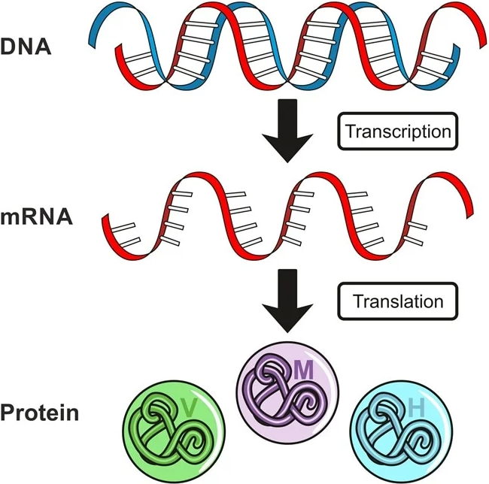
Gene expression is the flow of information in a cell from DNA to RNA to protein
Image from Dr. Surat P, Ph.D. on AZO Life Sciences

Slide 5
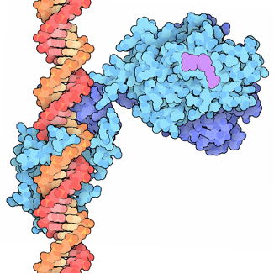
Regulatory Transcription Factors bind to DNA and turn on (activate) or turn off (repress) gene expression
In yeast ~250 regulatory transcription factors regulate ~6000 genes.
In humans, ~500 regulatory transcription factors regulate ~20,000 genes
“PDB101: Molecule of the Month: Vitamin D receptor,”
RCSB: PDB-101. https://pdb101.rcsb.org/motm/155

Slide 6
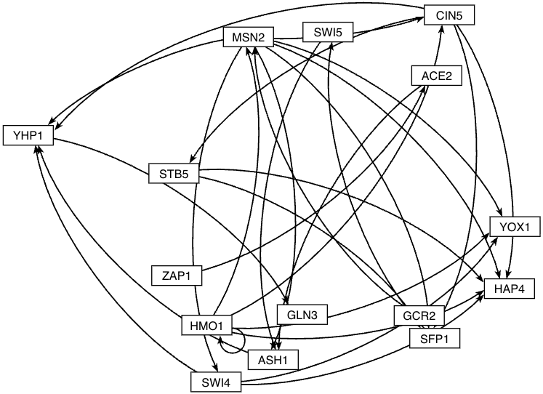
A Gene Regulatory Network (GRN) consists of genes, transcription factors and the regulatory connections between them which govern the level of expression of mRNA and protein from genes
Yeast GRN that controls the cold shock response
Node = transcription factor / gene
Arrow edge = regulatory relationship
“PDB101: Molecule of the Month: Vitamin D receptor,” RCSB: PDB-101. https://pdb101.rcsb.org/motm/155
Notes:
Each node represents a regulatory transcription factor and each edge is a regulatory relationship

Slide 7
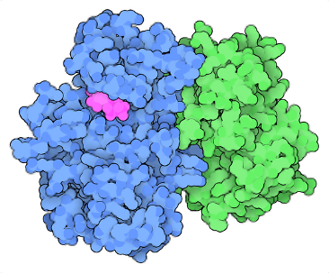
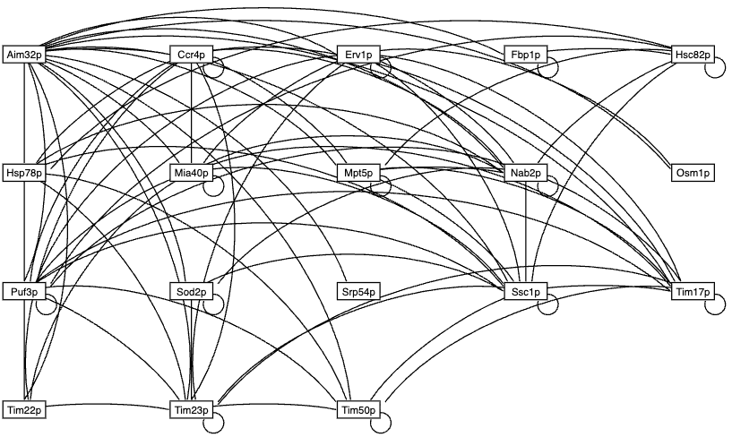
Protein-Protein Interactions refer to physical interactions of proteins binding to each other - the basis of nearly all cell functions
PPI network for yeast mitochondrial protein Aim32p
Node = proteins
Edge = binding relationship
“PDB101: Molecule of the Month: Cyclin and cyclin-dependent kinase,” RCSB: PDB-101. https://pdb101.rcsb.org/motm/236
Notes:
Maika: Nearly all cell functions occur because proteins bind to each other. These physical interactions are called protein-protein interactions (PPI). It might be useful to re-show your central model figure on one side and then highlight that a PPI is what happens when the proteins bind to each other.

Slide 8
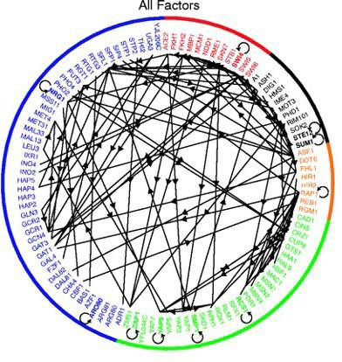
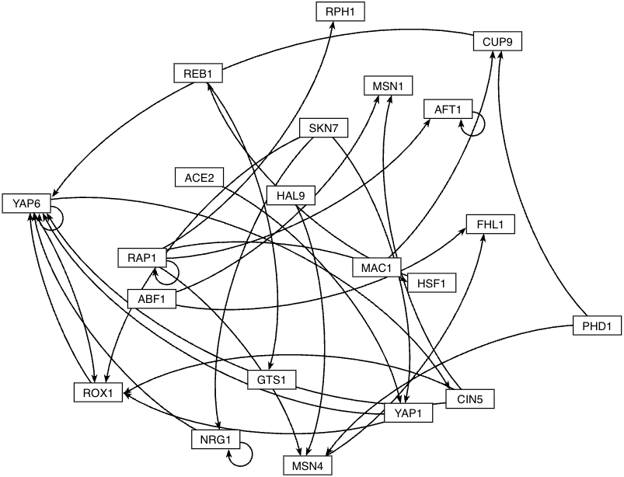
Large gene regulatory networks are difficult to visualize, and GRNsight makes it easier to visualize networks of 35 nodes or fewer
GRN of 106 transcription factors in yeast
GRN subnetwork of 21 transcription factors that
regulate the environmental stress response in yeast
Lee et al. (2002)
GRNsight

Slide 9
Outline
GRNsight is an open-source tool that allows for easier visualization
of Gene Regulatory Network (GRN) and Protein-Protein Interactions (PPI).
GRNsight is an integral part of a data analysis workflow for biologists who model GRNs.
GRNsight’s interface was originally built using older web tools, leading to repeated code and difficult user interface updates.
GRNsight has migrated its user interface to React Vite and Grommet UI which are modern, scalable industry-standard frameworks.
GRNsight React migration has resulted in user interface improvements and bug fixes that enhance the user experience for biologists.
Notes:
Maika

Slide 10
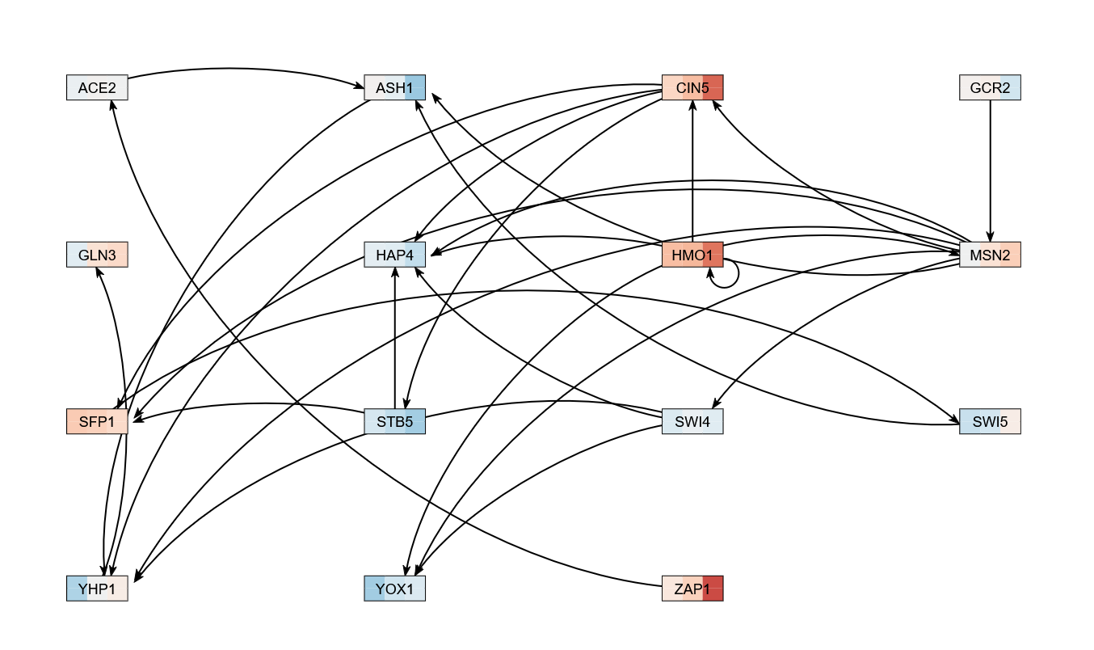



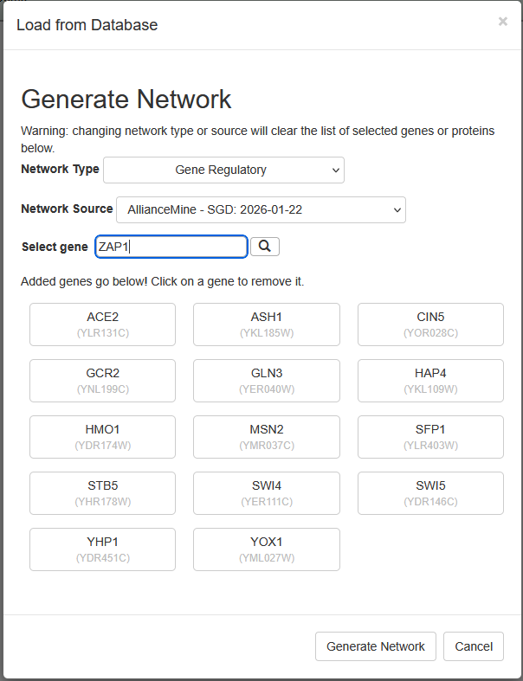
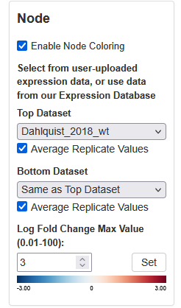
GRNsight is an integral part of a data analysis workflow for biologists who model GRNs
Export to Excel
Select network and expression data from GRNsight database
Notes:
Maika

Slide 11
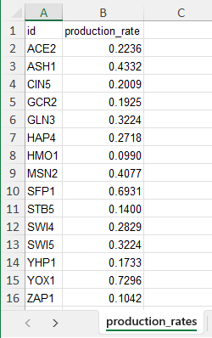
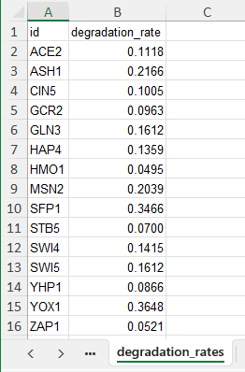
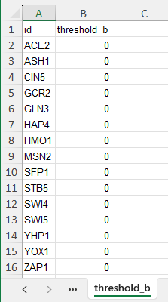
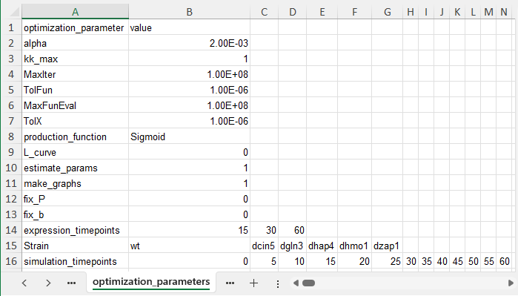
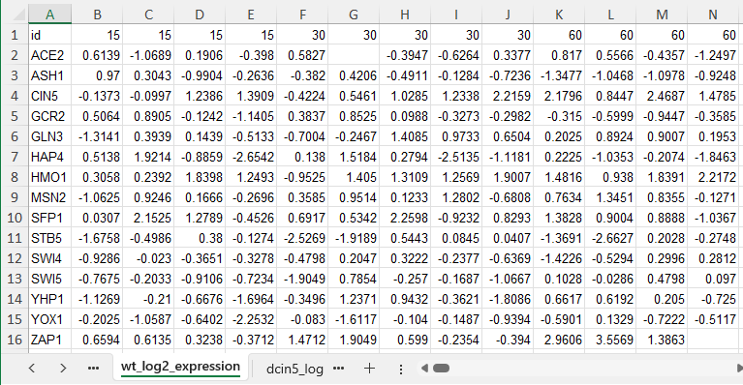

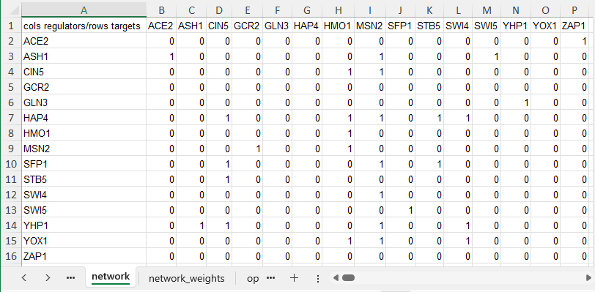
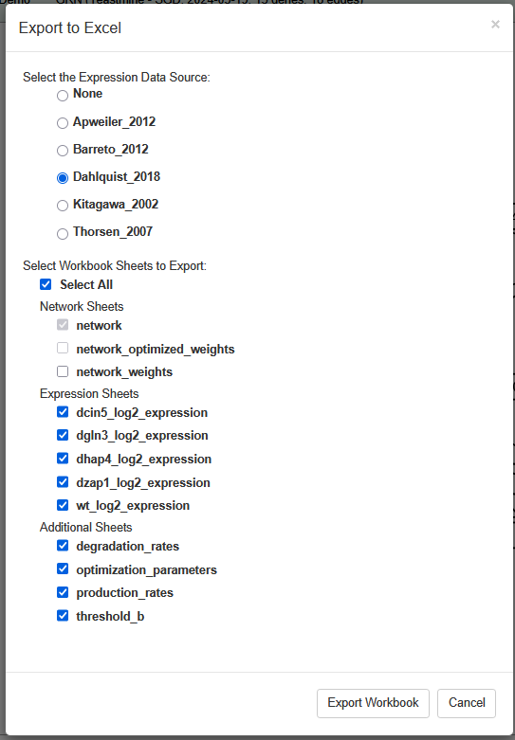
GRNsight is an integral part of a data analysis workflow for biologists who model GRNs
Export to Excel
Select network and expression data from GRNsight database

Slide 12

GRNsight is an integral part of a data analysis workflow for biologists who model GRNs
Export to Excel
Select network and expression data from GRNsight database
Dynamical systems modeling using GRNmap
Visualization of modeling results using GRNsight
Notes:
GRNmap: MATLAB software that uses differential equations on timecourse gene expression data to empirically calculate the production rates of transcription factors to determine whether they activate or repress one another and it outputs edge weight values

Slide 13
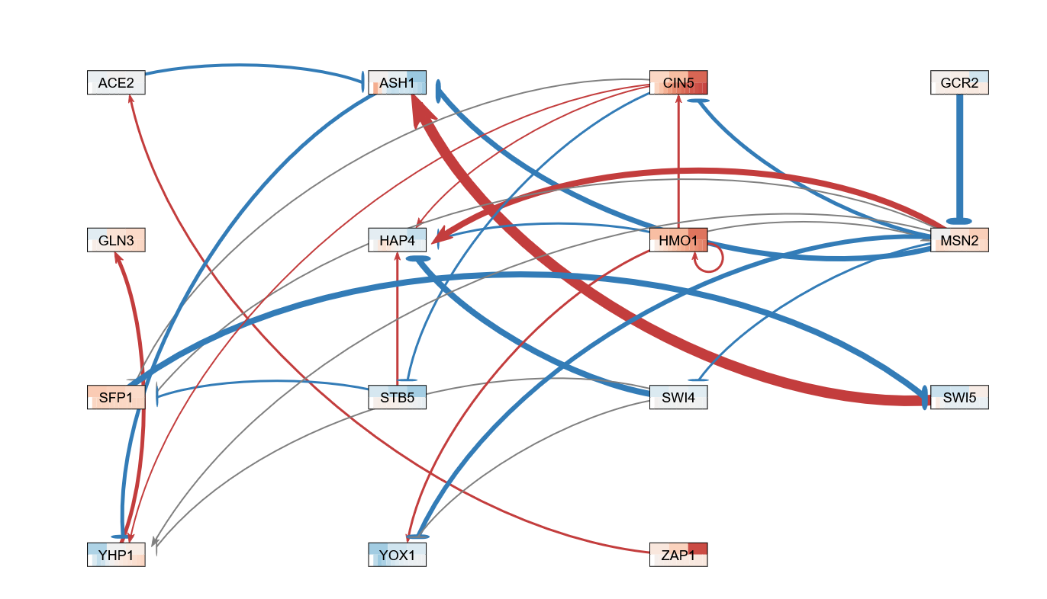
GRNsight is an integral part of a data analysis workflow for biologists who model GRNs
Export to Excel
Select network and expression data from GRNsight database
Dynamical systems modeling using GRNmap
Visualization of modeling results using GRNsight
Notes:
Maika

Slide 14
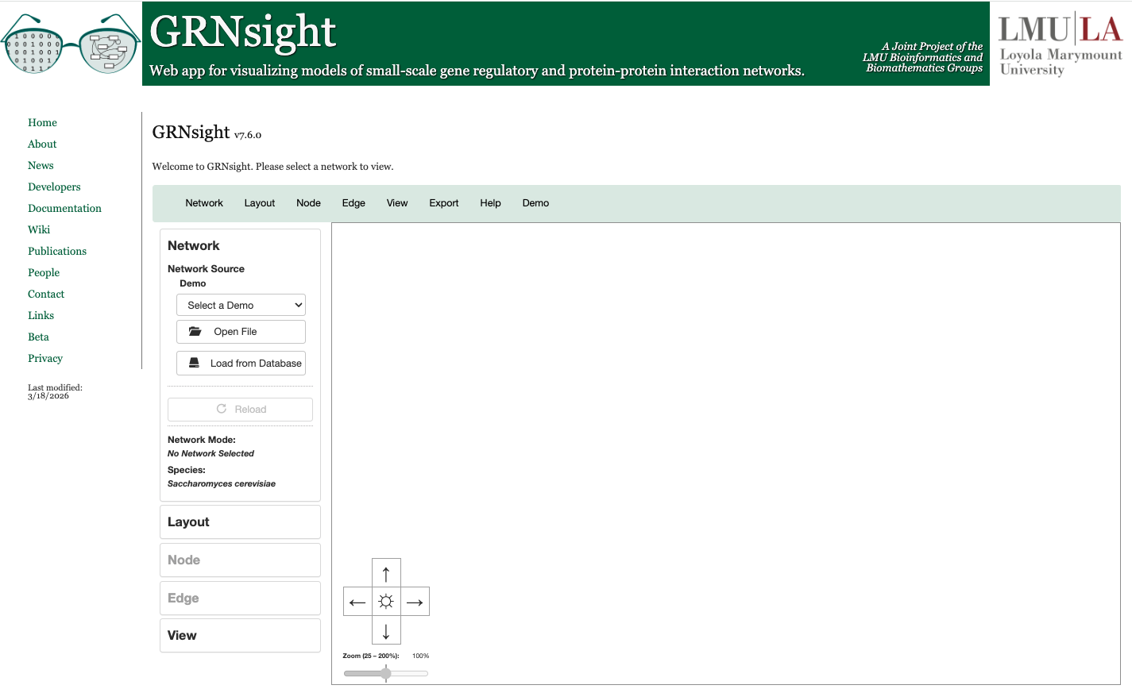
Users can import networks via the file upload functionality in a supported format (SIF, GraphML, or Excel)
Dahlquist et al. (2016) PeerJ Computer Science; Version 1 available March 20, 2014

Slide 15
Users can load networks from our database, which contains regulation
data from the Saccharomyces Genome Database (SGD)

Slide 16
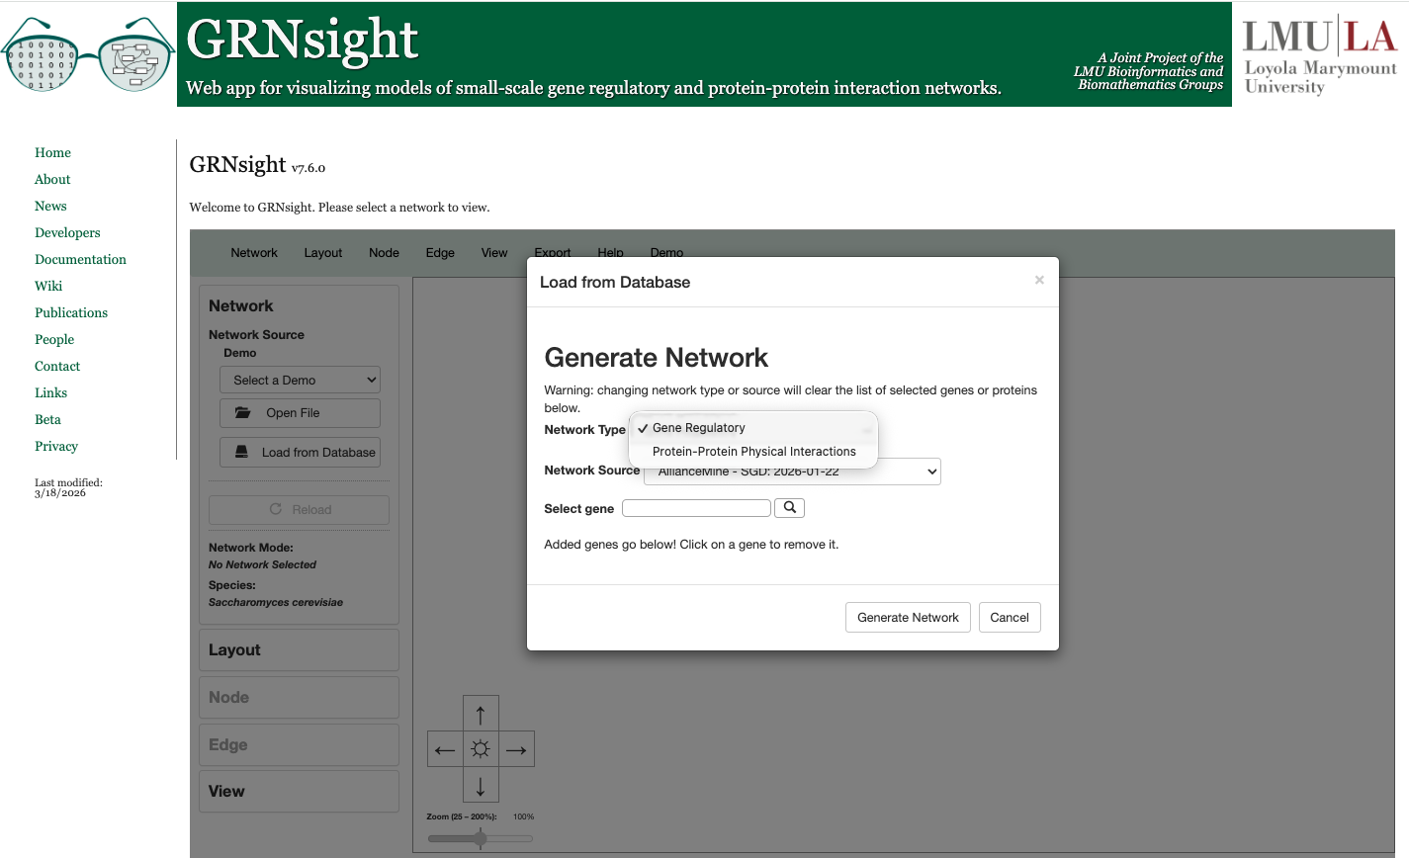
Users can load different network types, either GRN or PPI

Slide 17
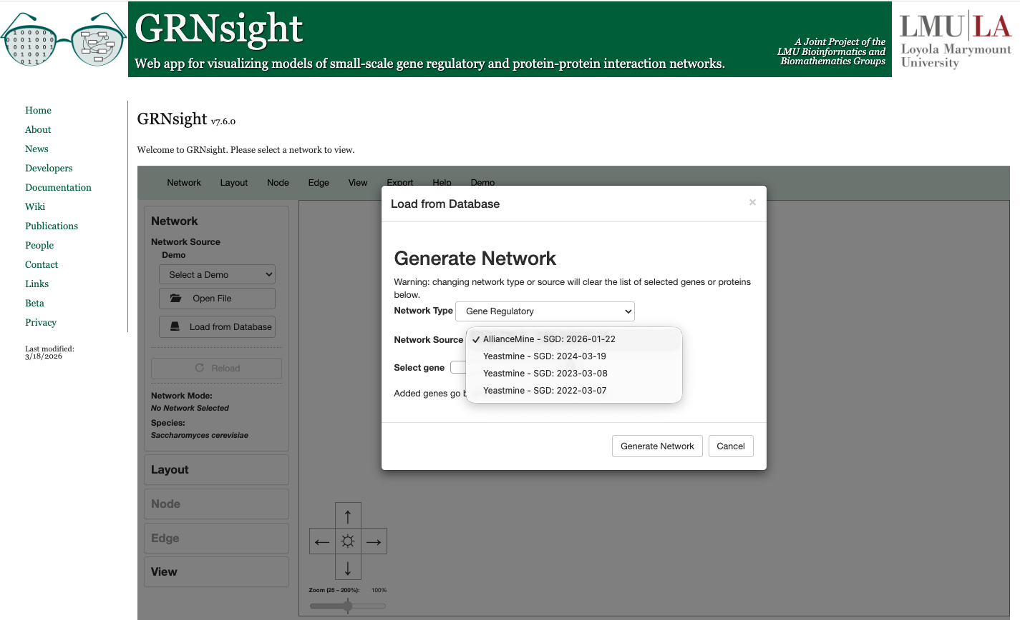
Users can choose different network sources
since GRNsight refreshes with new data each year

Slide 18
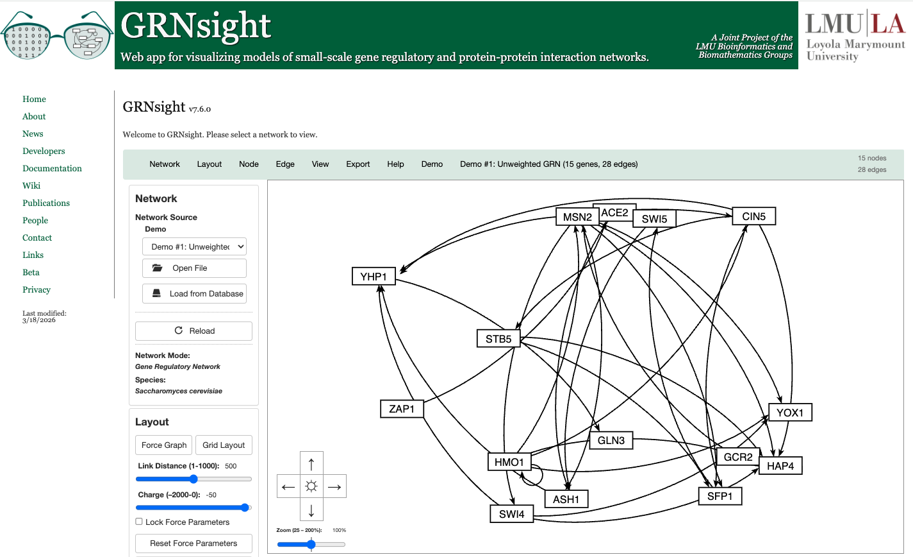
GRNsight rapidly generates GRN graphs using
our customizations to the open source D3 library

Slide 19
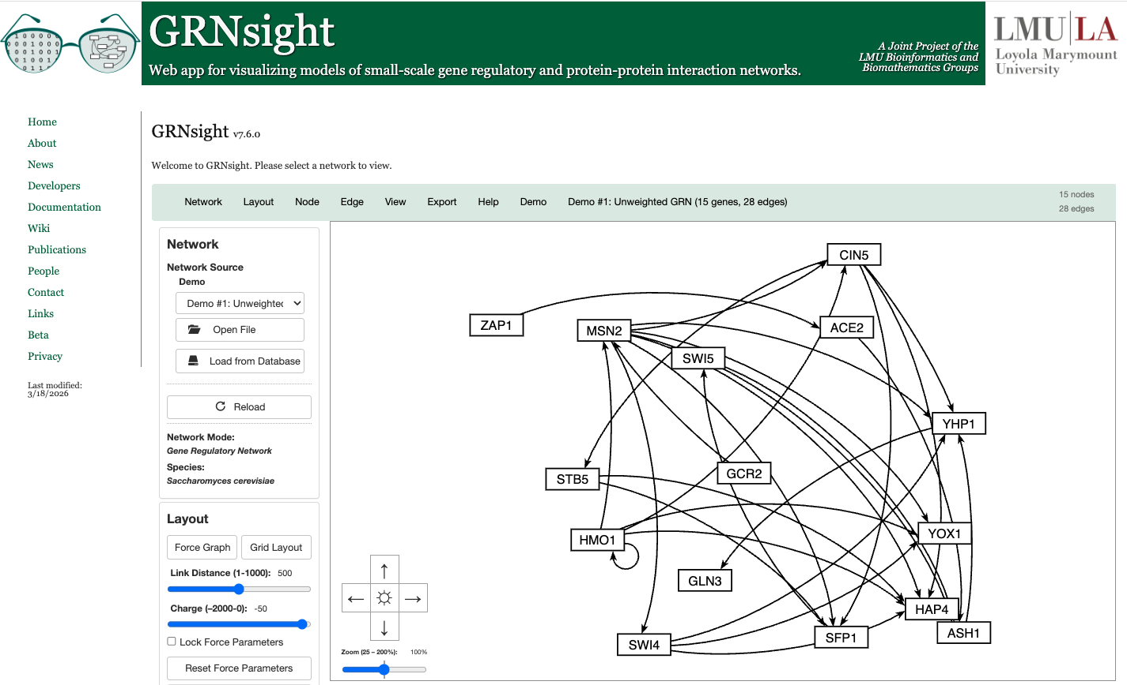
Besides the Force Graph Layout, Users Can Rearrange the Nodes by Hand

Slide 20
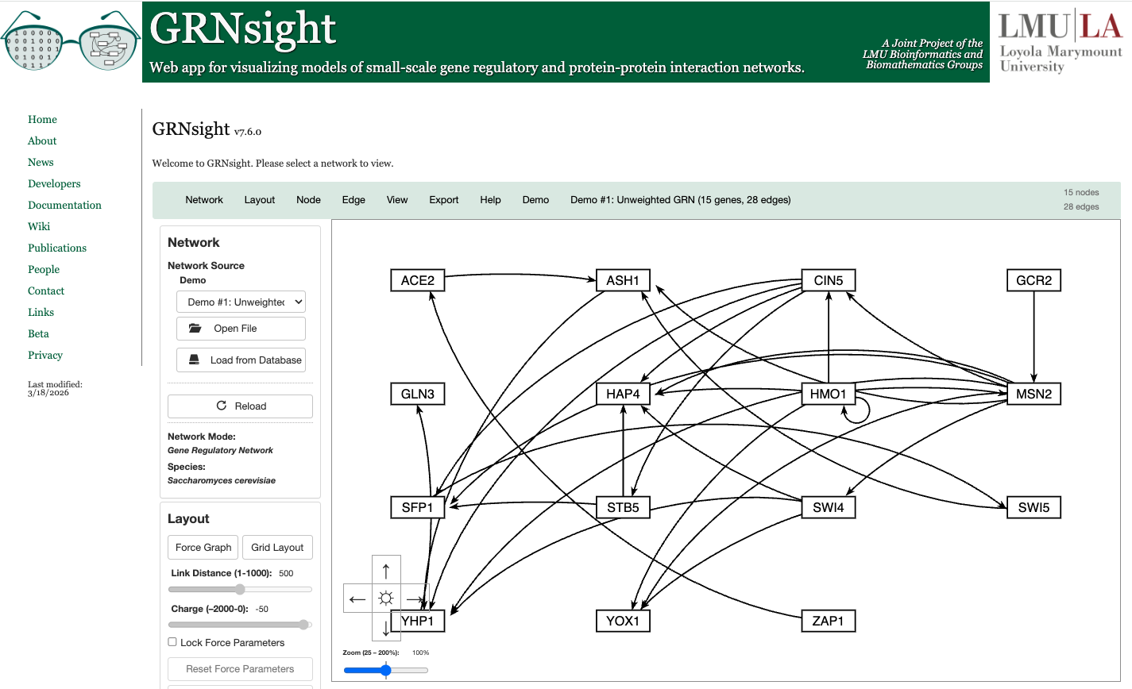
Or Choose the Convenient Block Layout Option

Slide 21
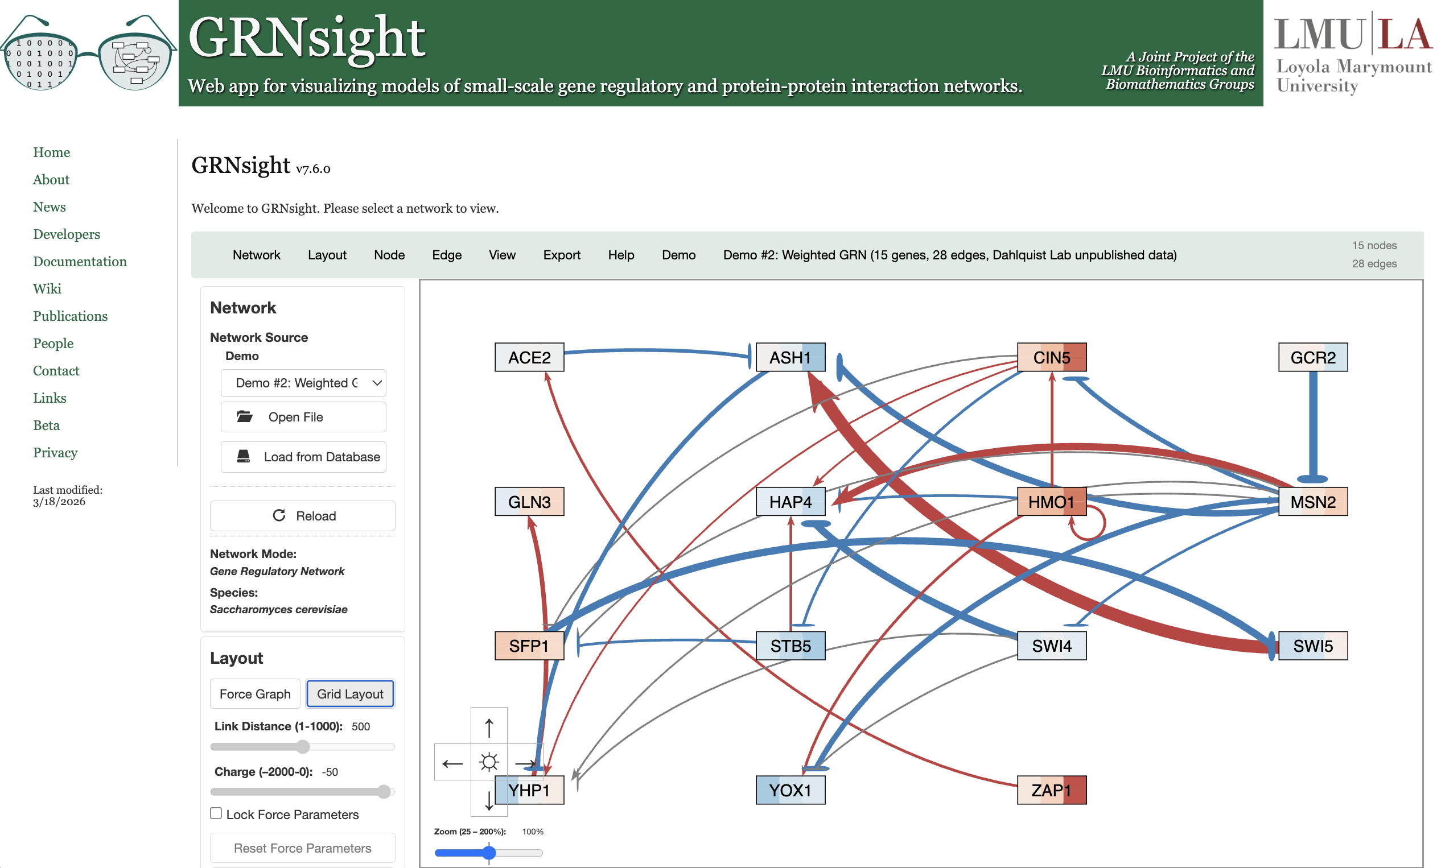
When Model Results are Loaded, Edge Weight Values
Are Indicated by Color, Thickness, and End Marker

Slide 22
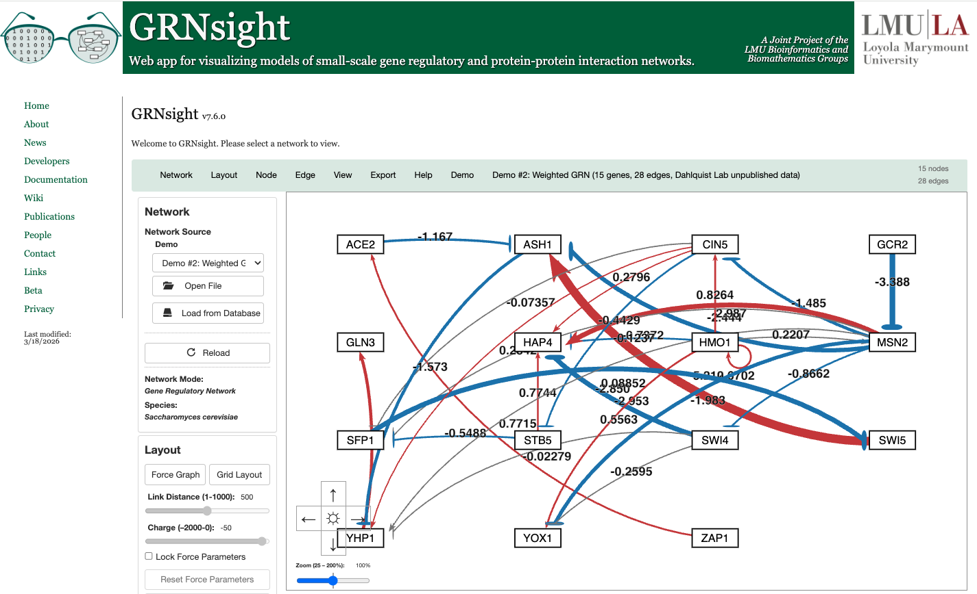
Numerical Weight Values Can Be Displayed on the Graph

Slide 23

Edge Thicknesses are Normalized to the Largest Magnitude Weight Value
Normalization Factor = 5.21

Slide 24
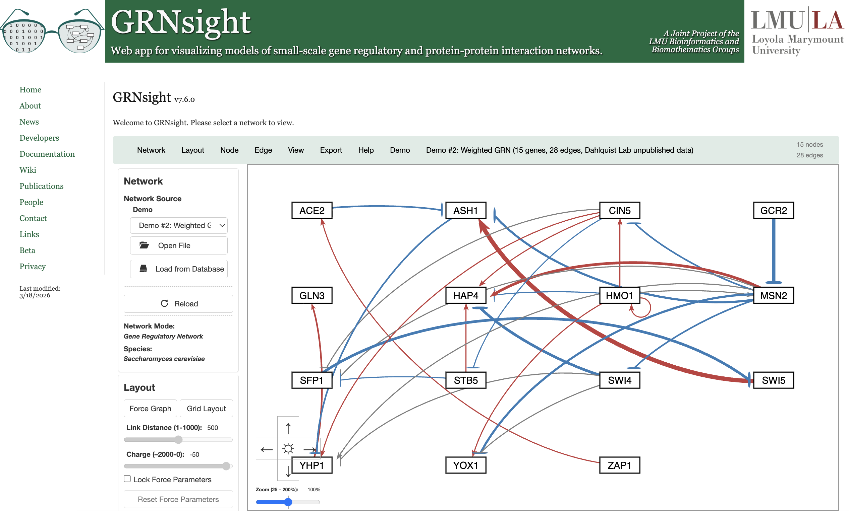
And Can Be Modified to Allow Fair Visual Comparison between Different Graphs
Normalization Factor = 10

Slide 25
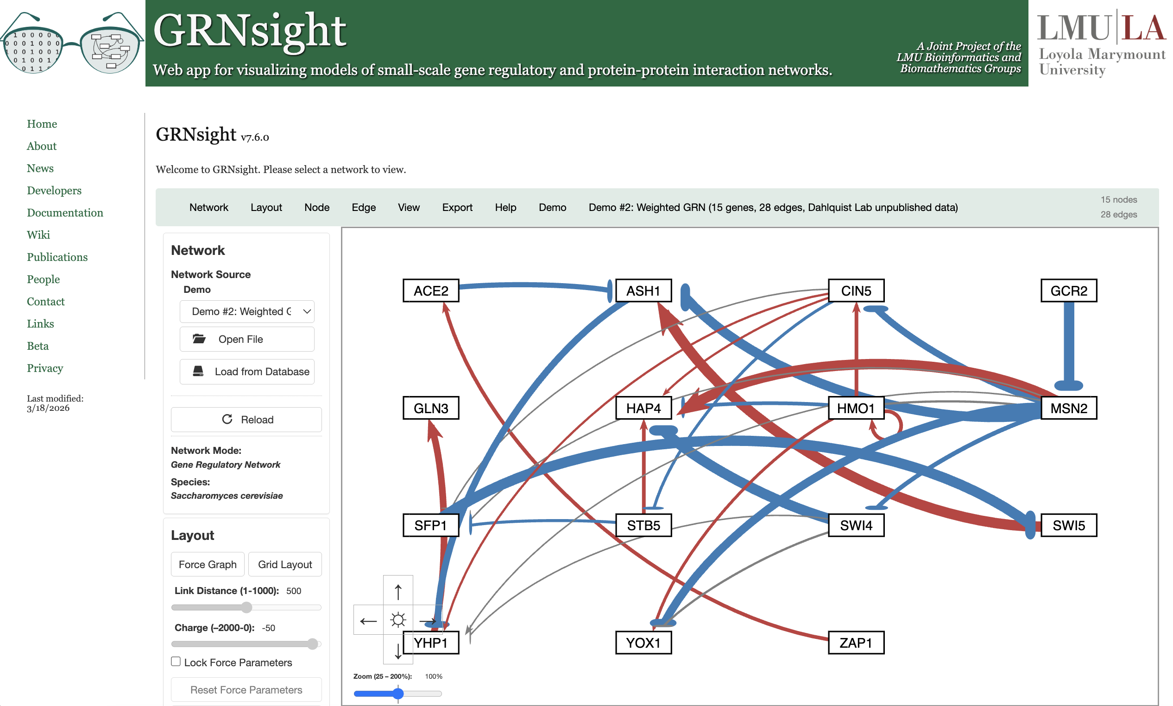
And Can Be Modified to Allow Fair Visual Comparison between Different Graphs
Normalization Factor = 2.5

Slide 26

Edges with Normalized Weight Values within 5% of 0
Are Displayed as Gray to Minimize Their Visual Strength
Normalization Factor = 5.21
Gray Threshold = 5%

Slide 27

Users Can Change the Gray Threshold with a Slider
Normalization Factor = 5.21
Gray Threshold = 10%

Slide 28

Users Can Change the Gray Threshold with a Slider
Normalization Factor = 5.21
Gray Threshold = 25%

Slide 29
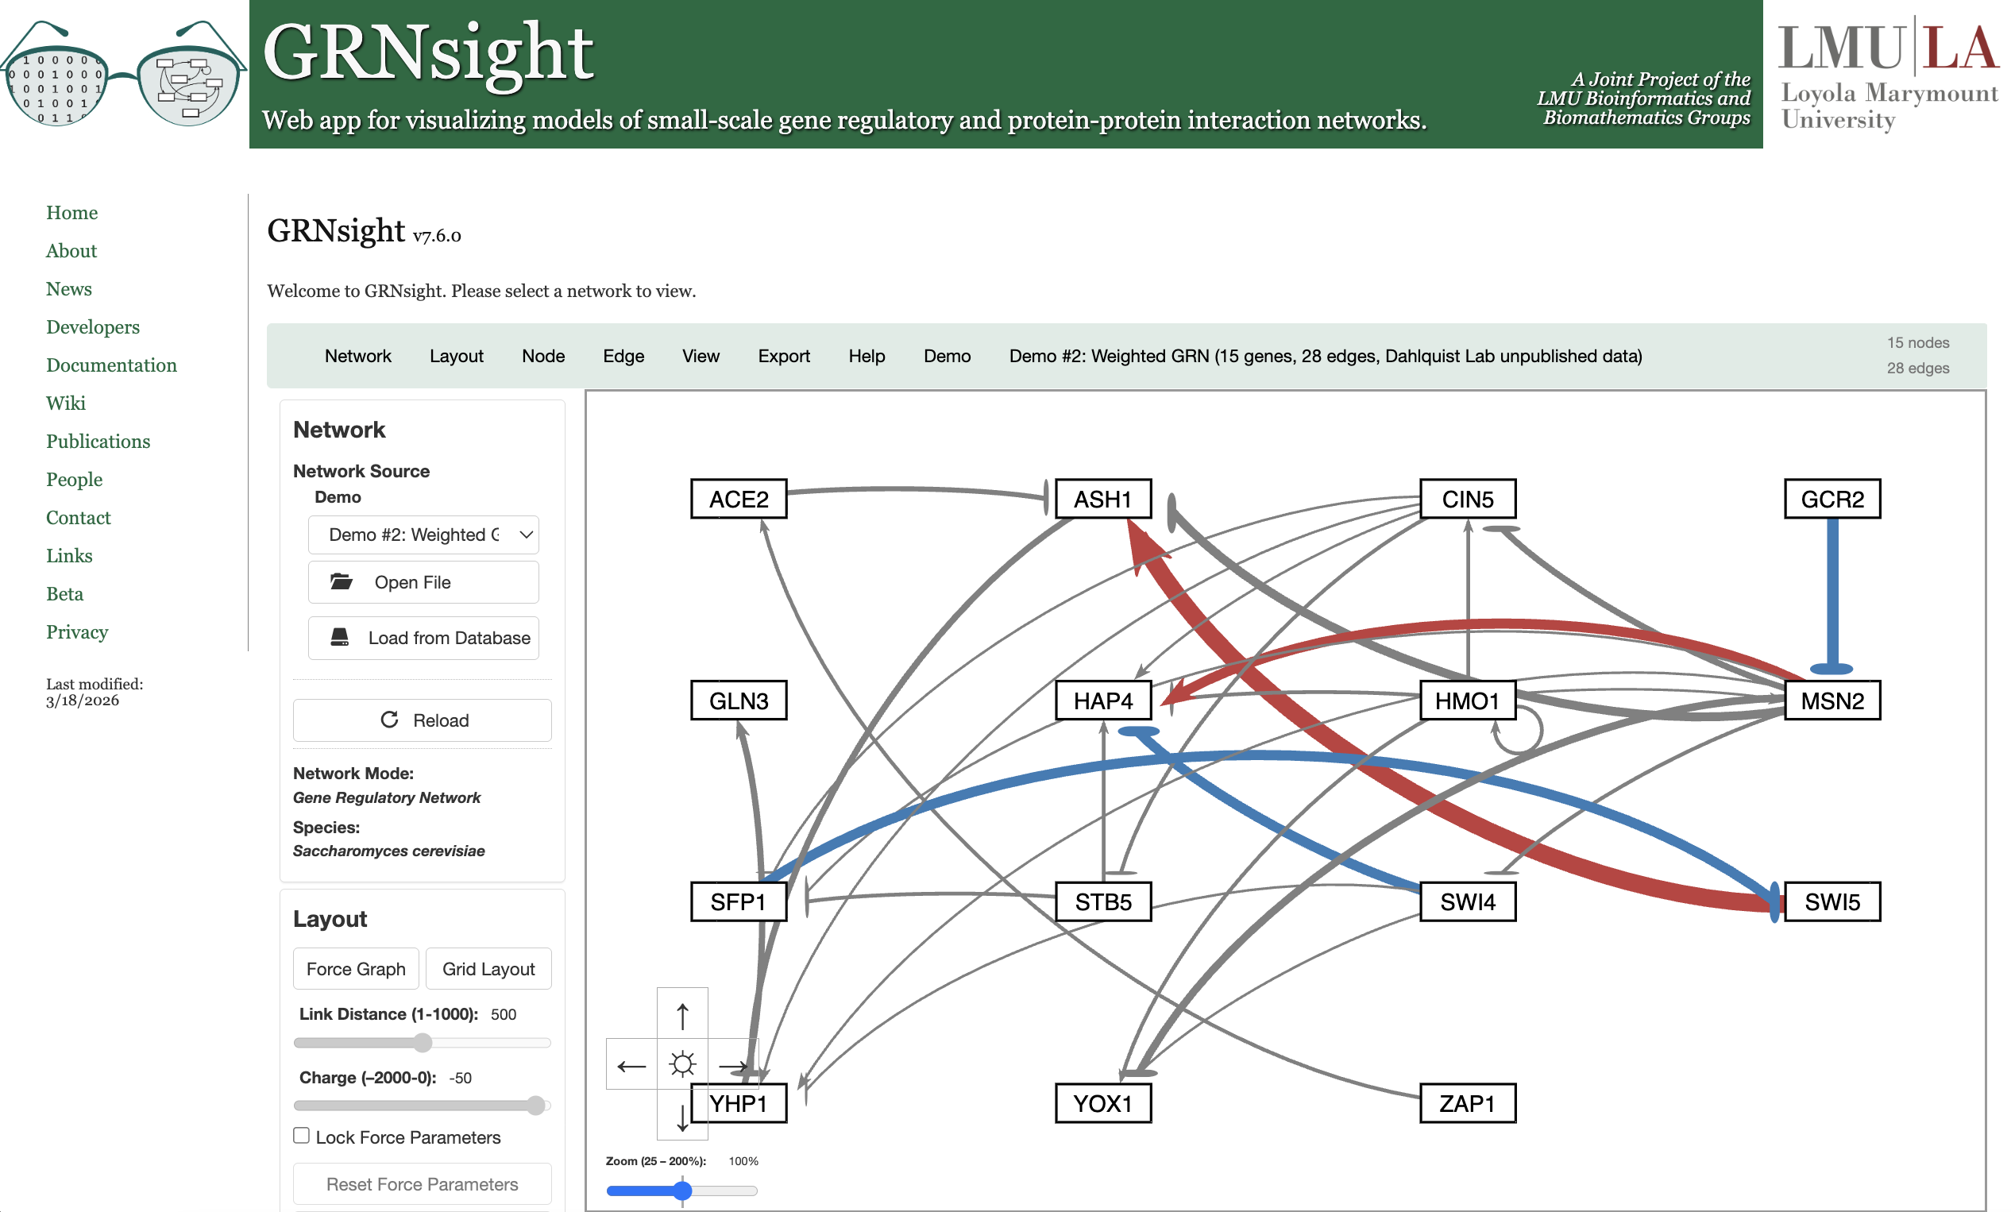
Users Can Change the Gray Threshold with a Slider
Normalization Factor = 5.21
Gray Threshold = 50%

Slide 30

Gray Edges Can Also Be Shown as Dashed Lines to Facilitate Visualization by Color Blind Users
Normalization Factor = 5.21
Gray Threshold = 5%

Slide 31

Nodes Can Display the Measured and/or Simulated Expression Data Uploaded by the User as Individual Heat Maps
Top = wild type yeast microarray data (Dahlquist lab)
Bottom = wild type yeast model simulated data

Slide 32
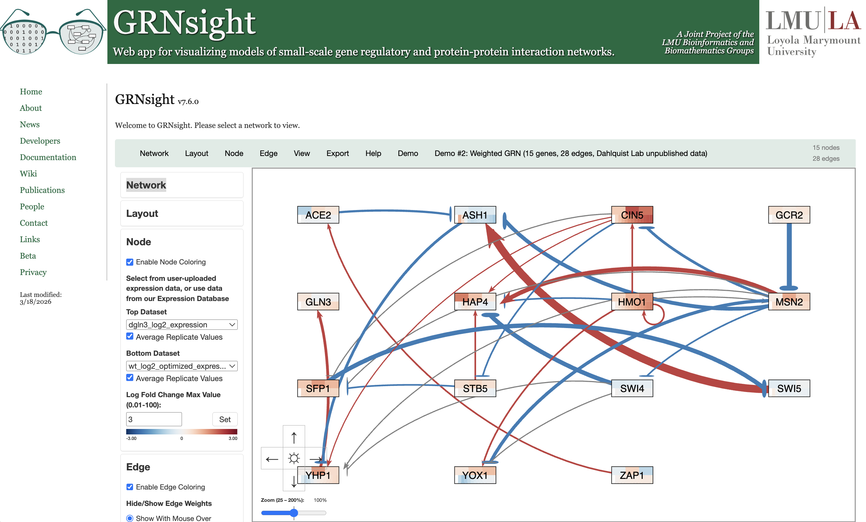
Additional datasets from a backend PostgreSQL expression database can be used to color nodes

Slide 33
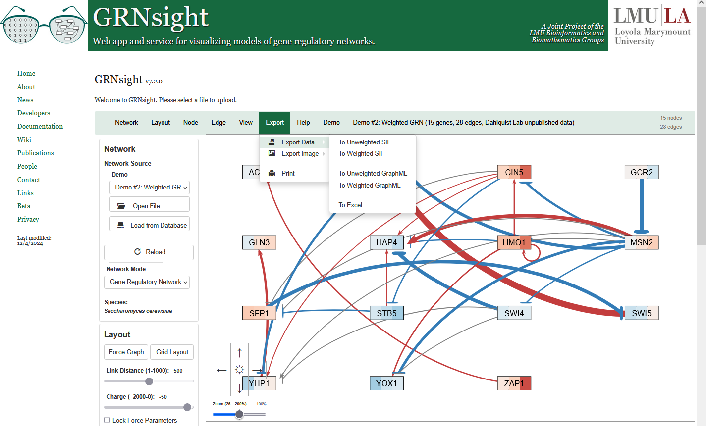
Network and expression data can be exported to a GRNmap-compatible Excel Workbook for modeling

Slide 34
Outline
GRNsight is an open-source tool that allows for easier visualization
of Gene Regulatory Network (GRN) and Protein-Protein Interactions (PPI).
GRNsight is an integral part of a data analysis workflow for biologists who model GRNs.
GRNsight’s interface was originally built using older web tools, leading to repeated code and difficult user interface updates.
I have migrated GRNsight’s user interface to React Vite and Grommet UI which are modern, scalable, and industry-standard frameworks.
GRNsight React migration has resulted in user interface improvements and bug fixes that enhance the user experience for biologists.
Notes:
Maika

Slide 35
GRNsight separates what users see (frontend),
from how the data is handled (backend)
Web Browser
SQL Query
Excel, SIF, GraphML
GRNsight web
API server
Host web page
Open/import cycle
Query Result
graph in JSON format
PostgreSQL
Database
Embedded graphical
user interface
graph in JSON format
Export cycle
Excel, SIF, GraphML
GUI Resources
GRNsight web
application server
Frontend
Backend
Notes:
Cecilia

Slide 36















React migration resulted in tech stack improvements for developer experience and shorter build time
Feature | Classic | React / New Updates
State Management | Manual tracking of user interaction and input, and interface updates are tedious. | Automatic re-rendering of app based on user interaction and input, simplifying code.
Bug Fixes | Repetitive and complicated code makes bugs more likely and harder to find. | Modular code allows for easier discovery of bugs and fewer bugs created.
Frontend
Backend
Build Tool
Testing
Notes:
Cecilia
Improved code readability and state-management
code is more modular because of the nature of component behavior
migrated testing framework over to vitest because it is built-in framework for vite, which allows us to create optimized builds of web app for development and release to production. in Classic just use Node.js
Advanced interactive features
GRNsight positioned to continue expanding functionality as new visualization needs arise

Slide 37
Outline
GRNsight is an open-source tool that allows for easier visualization
of Gene Regulatory Network (GRN) and Protein-Protein Interactions (PPI).
GRNsight is an integral part of a data analysis workflow for biologists who model GRNs.
GRNsight’s interface was originally built using older web tools, leading to repeated code and difficult user interface updates.
I have migrated GRNsight’s user interface to React Vite and Grommet UI which are modern, scalable, and industry-standard frameworks.
GRNsight React migration has resulted in user interface improvements and bug fixes that enhance the user experience for biologists.
Notes:
Maika

Slide 38
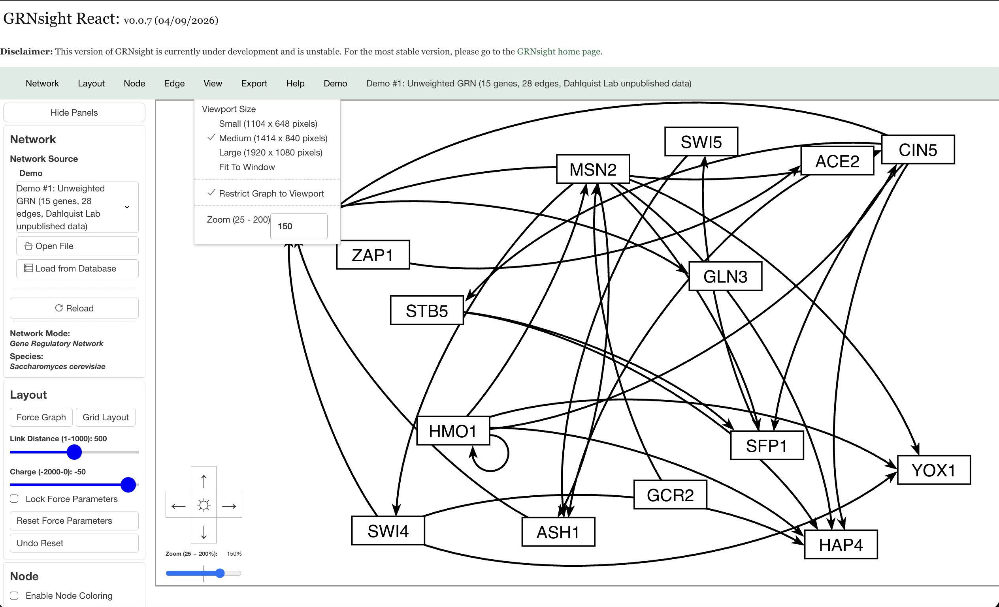
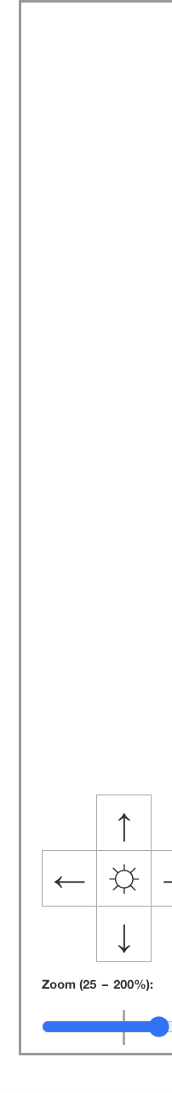
GRNsight React went live on October 15, 2025,
and can now display graphs
https://dondi.github.io/GRNsight/react-thesis-4081/
Viewport size, panning, and zoom are available graph features
Notes:
Cecilia
can display graphs and demos

Slide 39
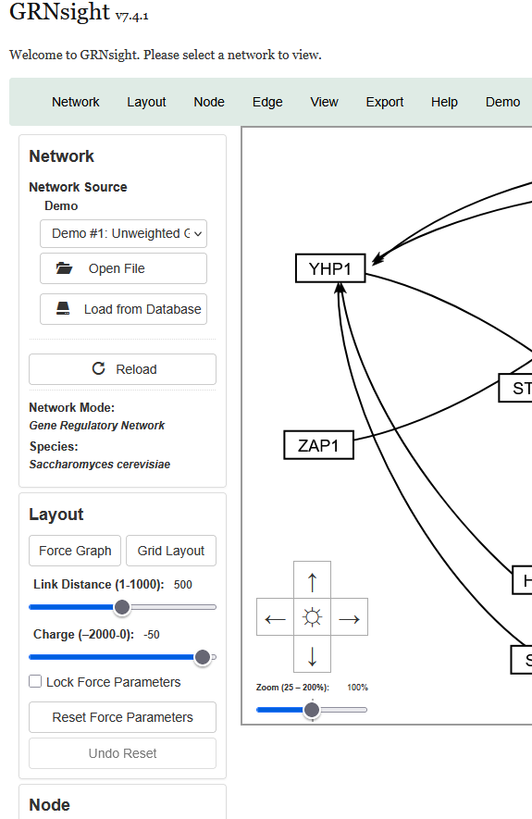
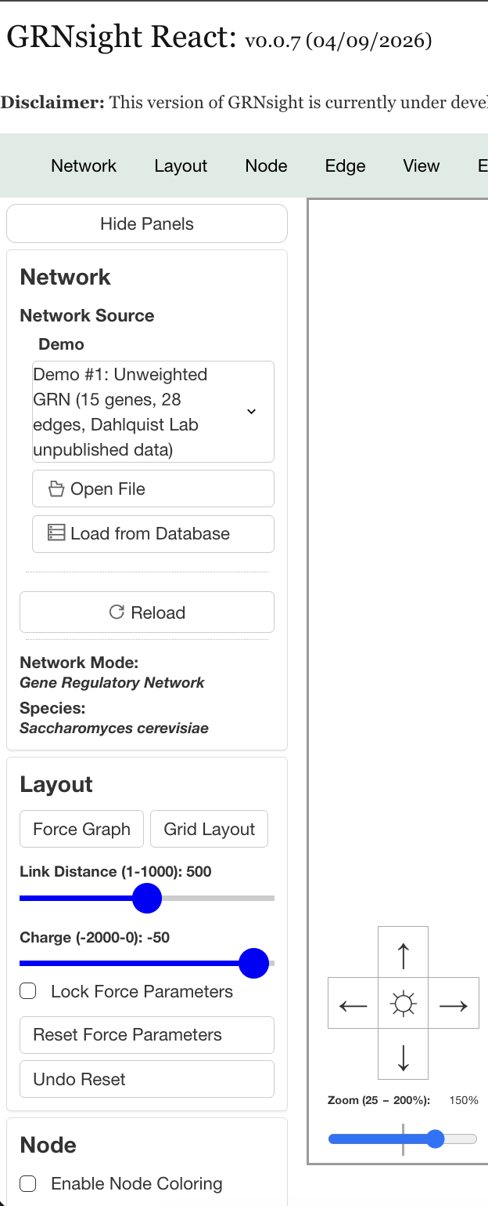
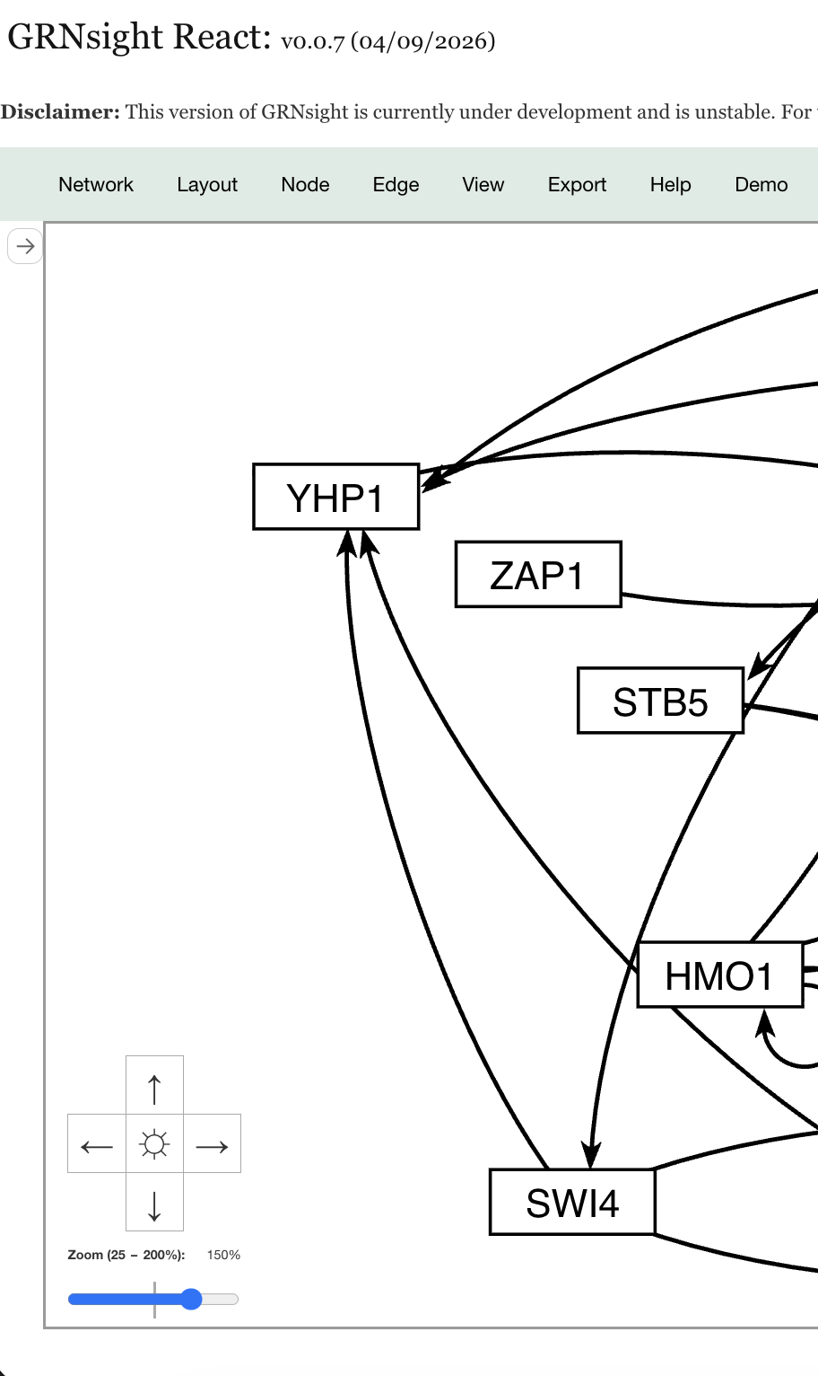
React allows the fast implementation of collapsible side panels
Notes:
Cecilia
State management and component structure allows for more complex UI manipulation
easier to pass value across the app, and any changes made to a variable in one place in the app can cause a re-render of the graph, see updates immediately without any extra work
Also easier to enhance user interaction
Can easily hide or show panels without too much extra work (because of state variables)

Slide 40
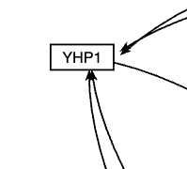
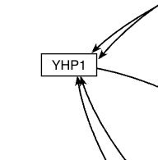
The high-level code review facilitated the fixing of a long-standing arrowhead bug in GRNsight Classic
Classic Arrowheads with space between the perimeter
React Arrowheads touching the perimeter of the node
Notes:
we had a bug in classic where the arrowhead for the edge was too far to one side of the node, and this was fixed in react code over
illustrates that benefit to migrating code over, although it may require time and effort, can allow for improvements of app and resolution of long-standing bug issues

Slide 41
Summary
GRNsight is an open-source tool that allows for easier visualization
of Gene Regulatory Network (GRN) and Protein-Protein Interactions (PPI).
GRNsight is an integral part of a data analysis workflow for biologists who model GRNs.
GRNsight’s interface was originally built using older web tools, leading to repeated code and difficult user interface updates.
I have migrated GRNsight’s user interface to React Vite and Grommet UI which are modern, scalable, and industry-standard frameworks.
GRNsight React migration has resulted in user interface improvements and bug fixes that enhance the user experience for biologists.
Notes:
Cecilia

Slide 42
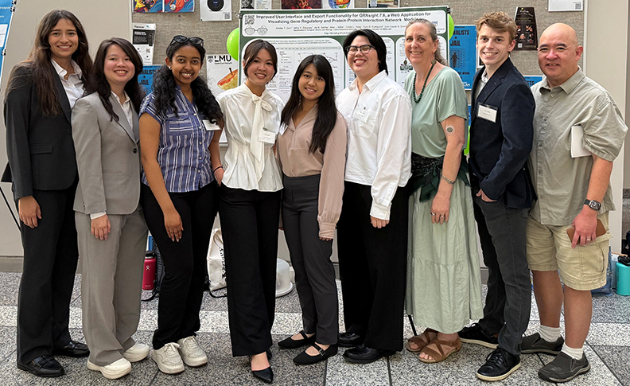



Acknowledgements
Pictured Left to Right:
Ngoc Kim Ngan Tran
Milka Y. Zekarias
Amelie T. Dinh
Jia S. Garcia
Cindy L. Tong
Kam D. Dahlquist
Alex J. Miller
John David N. Dionisio
LMU Department of Biology
HHMI STEM Research Learning Community
http://dondi.github.io/GRNsight/
https://github.com/dondi/GRNsight
Notes:
In the slides I provide, there is a QR code for GRNsight and the picture of you all from the LMU URS last Spring.

Slide 43
References
AZoLifeSciences. “A Guide to Understanding Gene Expression.” AZoLifeSciences, 27 Jan. 2021, www.azolifesciences.com/article/A-Guide-to-Understanding-Gene-Expression.aspx.
“PDB101: Molecule of the Month: Vitamin D Receptor.” RCSB: PDB-101, pdb101.rcsb.org/motm/155.
“PDB101: Molecule of the Month: Cyclin and Cyclin-dependent Kinase.” RCSB: PDB-101, pdb101.rcsb.org/motm/236.
Lee, T. I., Rinaldi, N. J., Robert, F., Odom, D. T., Bar-Joseph, Z., Gerber, G. K., ... & Young, R. A. (2002). Transcriptional regulatory networks in Saccharomyces cerevisiae. science, 298(5594), 799-804. https://doi.org/10.1126/science.1075090
Dahlquist, K. D., Dionisio, J. D. N., Fitzpatrick, B. G., Anguiano, N. A., Varshneya, A., Southwick, B. J., & Samdarshi, M. (2016). GRNsight: a web application and service for visualizing models of small-to medium-scale gene regulatory networks. PeerJ Computer Science, 2, e85. https://doi.org/10.7717/peerj-cs.85

