Slide 1
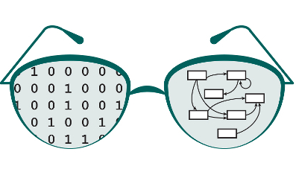

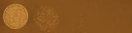
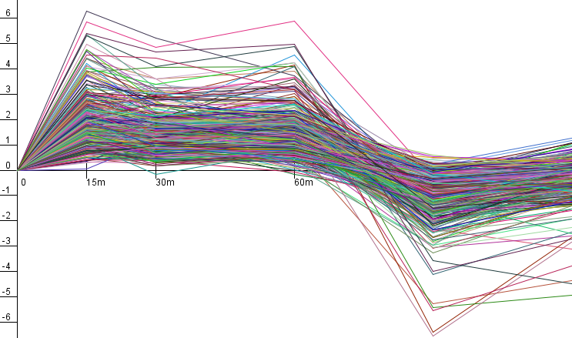
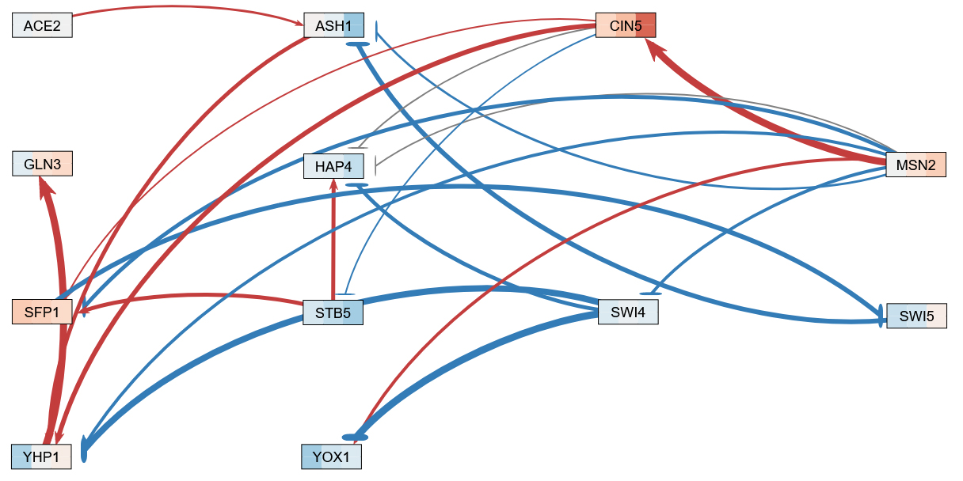
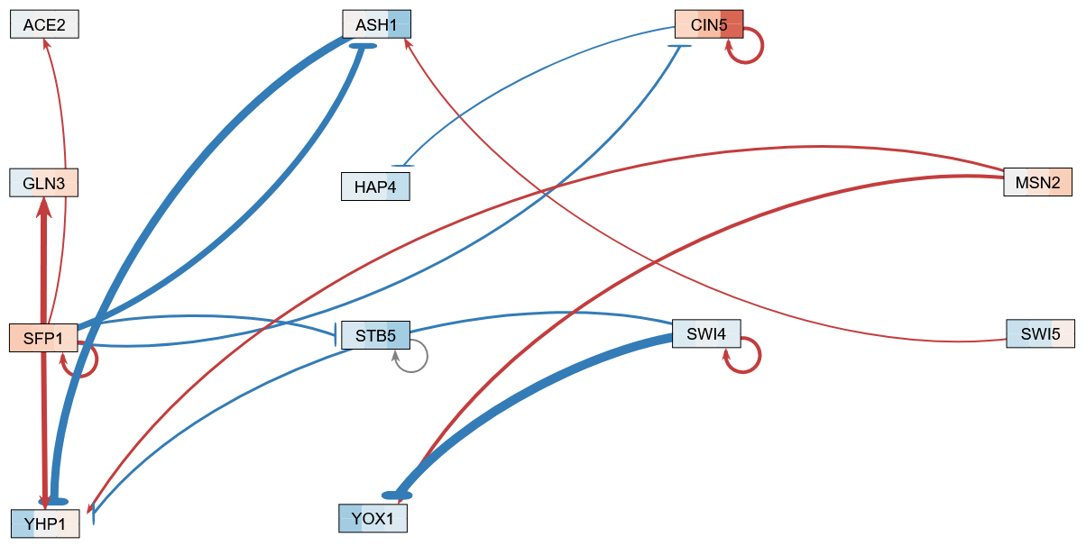
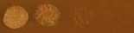
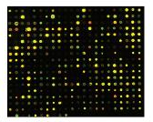
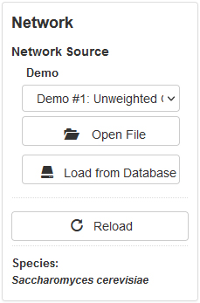
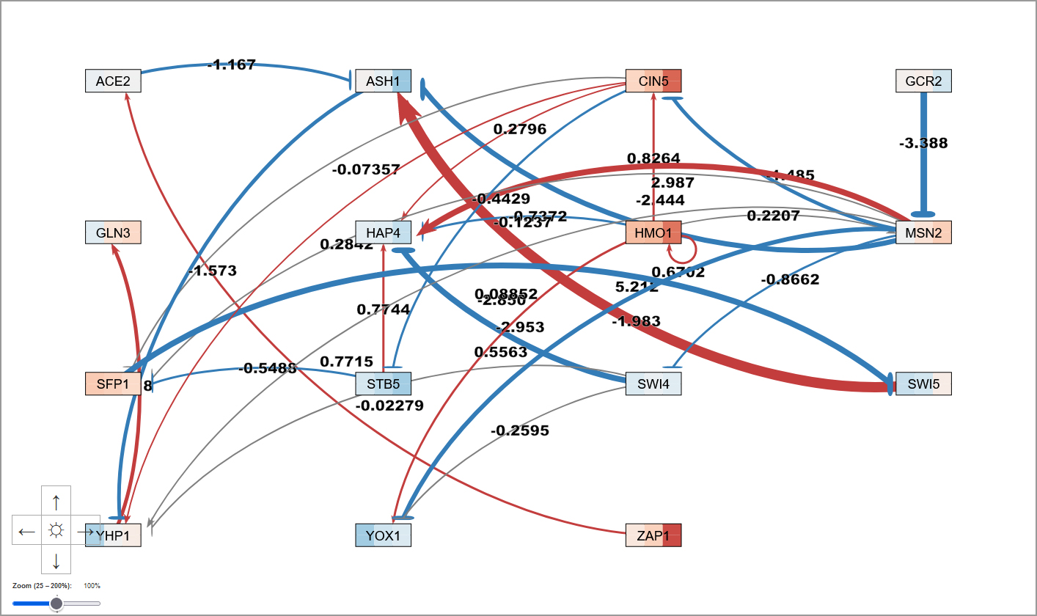
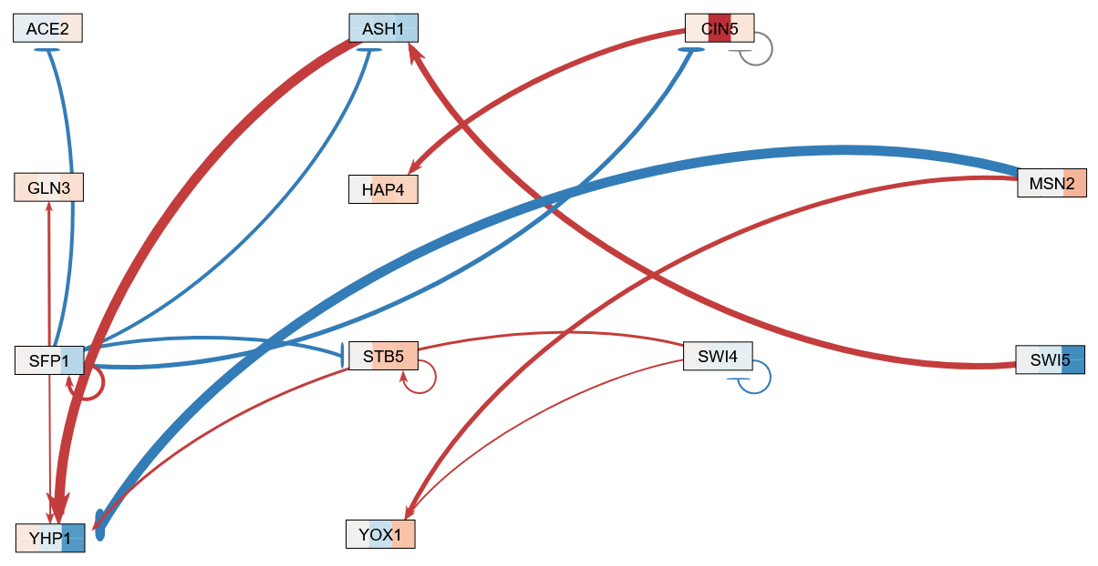
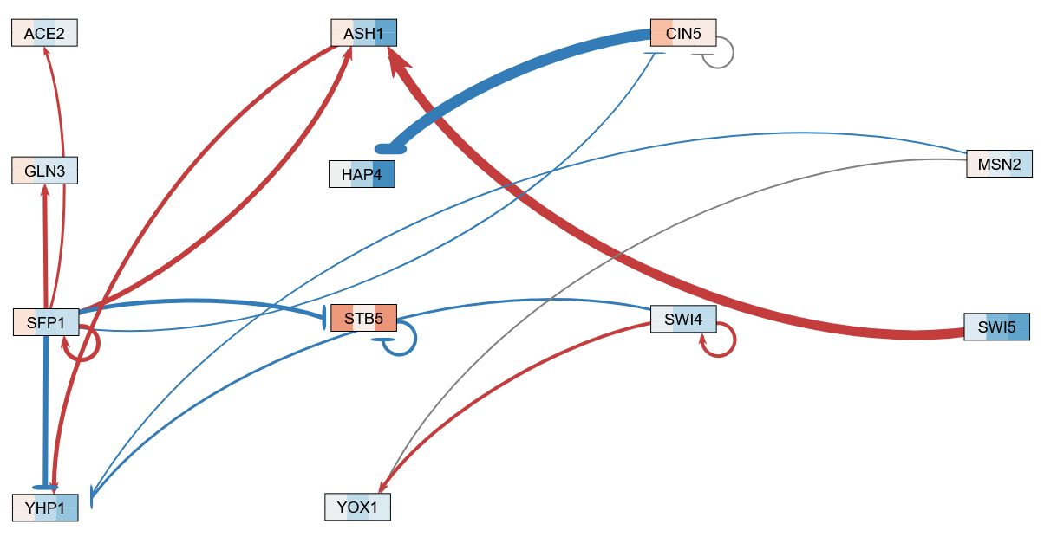
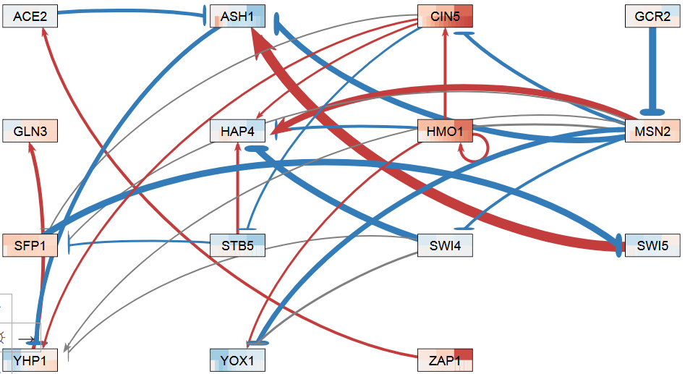
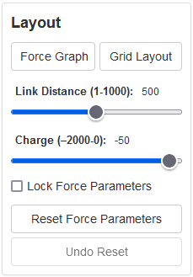

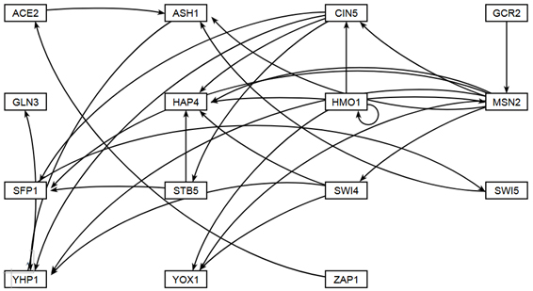
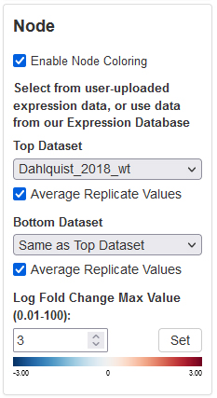
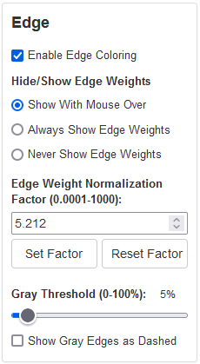
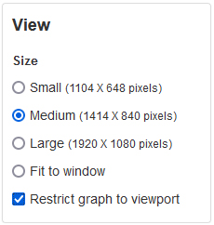
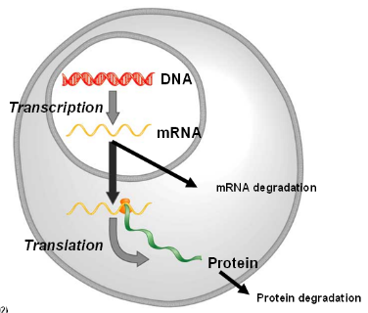
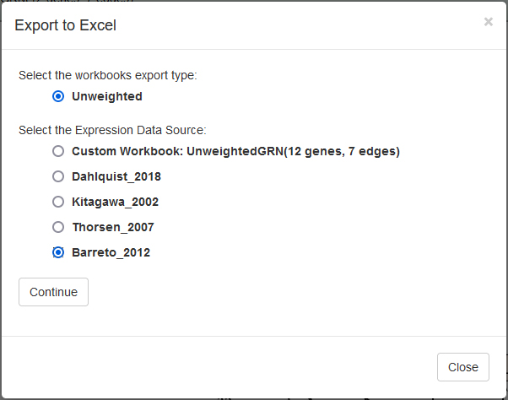
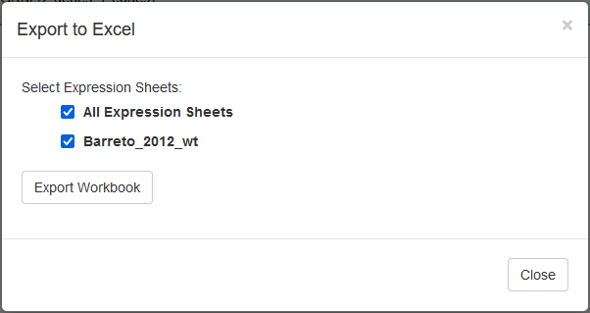
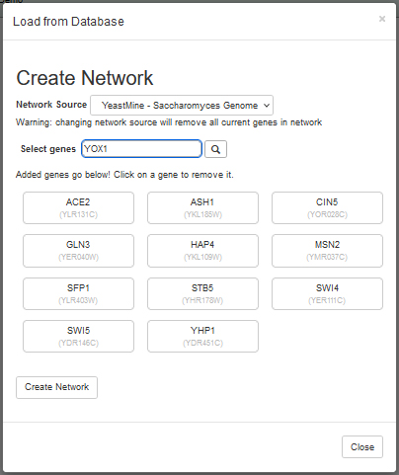
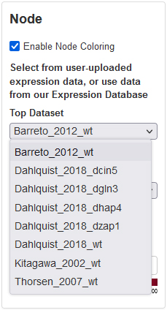
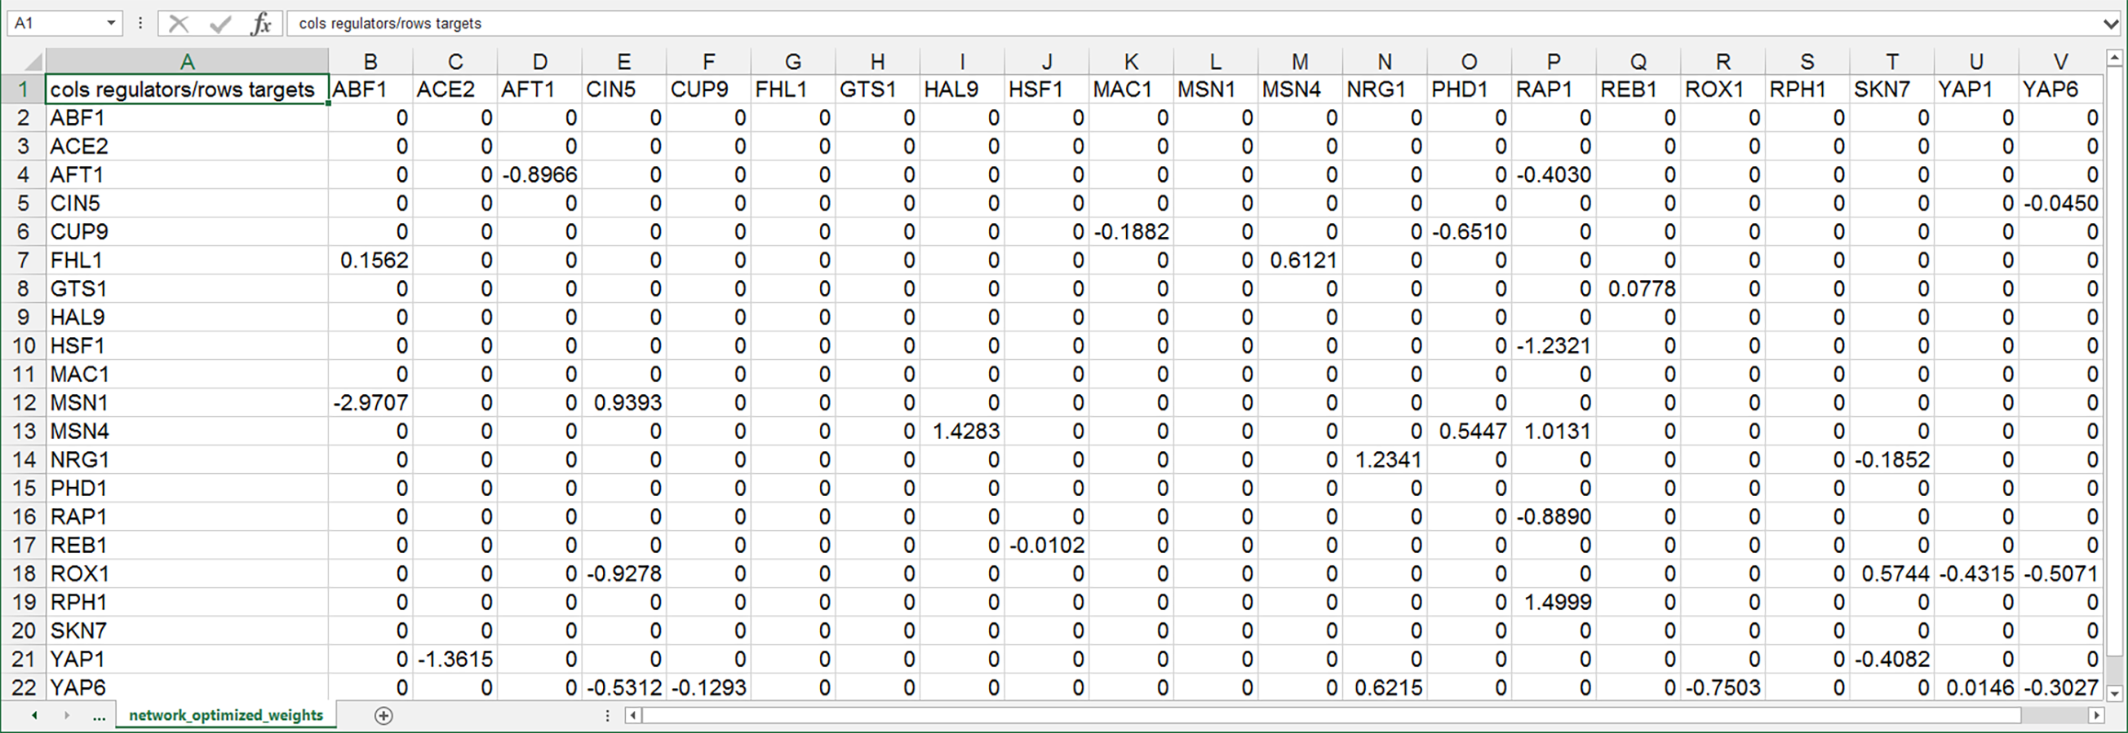



Integration of SGD regulatory and expression data into the GRNmap and GRNsight applications for modeling and visualizing small-to-medium gene regulatory networks
Kam D. Dahlquist¹, Onariaginosa O. Igbinedion², Ahmad R. Mersaghian¹, Sarron A. Tadesse², John David N. Dionisio²
Departments of ¹Biology and ²Computer Science, Loyola Marymount University, 1 LMU Drive, Los Angeles, CA 90045 USA
http://kdahlquist.github.io/GRNmap/ and http://dondi.github.io/GRNsight/
We have previously used a systems biology approach to understand the regulation of the cold shock response in yeast
GRNsight, automatically lays out the network graph, coloring the edges based on weight values, and the nodes based on experimental or simulated expression data
Improved workflow facilitates comparisons
between models
wt
15°C
Cold shock microarray data from wt and TF deletion strains
Network
Demo files are provided.
Can import and export Excel, SIF, or GraphML files.
Can construct a network from SGD regulation data stored in a backend database.
Layout
Users can select a force graph layout or grid layout.
Force graph parameter sliders:
Link distance determines the minimum distance between nodes.
Nodes have a charge which repels or attracts other nodes.
Node
Coloring can be based on user-uploaded expression data or from published expression datasets stored in a backend database.
Datasets available:
Apweiler et al. 2012, GSE33098
Barreto et al. 2012, GSE24712
Dahlquist et al. 2018, GSE83656
Kitagawa et al. 2002, GSE9336
Thorsen et al. 2007, GSE6068
Edge
Edge coloring can be toggled on and off.
Buttons enable the user to always see edge weights, never see edge weights, or see edge weights upon mouseover.
Allows user to set normalization factor so that edge thicknesses for different graphs can be rendered on the same scale.
Changing the gray threshold deemphasizes weaker edges in the visualization.
Presenting gray edges as dashed lines further deemphasizes weak edges.
View
Multiple viewport sizes available.
Graph bounding box can be separated from viewport.
Zooming and scrolling available.
Δash1
1
Interpretation,
new questions, new experiments
Normalization, statistical analysis, clustering
LSE/minLSE: 1.0348
LSE/minLSE: 1.0438
12-gene, 21 edge network from YEASTRACT
Modeled with Dahlquist et al. (2018) expression data
wt yeast subjected to 15, 30, and 60 minutes of
cold shock at 13°C
12-gene, 17 edge network from SGD
Modeled with Dahlquist et al. (2018) expression data
wt yeast subjected to 15, 30, and 60 minutes of
cold shock at 13°C
Visualization of modeling results using GRNsight
Derivation of gene regulatory networks from databases
Dynamical systems modeling using GRNmap
LSE/minLSE: 1.8707
LSE/minLSE: 1.0781
2
Key
12-gene, 17 edge network from SGD
Modeled with Kitagawa et al. (2002) expression data
wt yeast treated with 75 μM thiuram for 15, 30, and 120 minutes
12-gene, 17 edge network from SGD
Modeled with Thorsen et al. (2007) expression data
wt yeast treated with 1 mM As(III) for 15, 30, and
60 minutes
A “medium-scale” gene regulatory network that regulates the cold shock response
gene
activation
repression
Discussion
Each node represents one gene encoding a transcription factor.
Each edge represents a regulatory relationship, either activation or repression, depending on the sign of the weight.
This network was derived from the YEASTRACT database.
3
4
5
weak influence
Gene regulatory networks created from SGD data have fewer edges than those derived from YEASTRACT.
The GRNs shown in the left and center panels derived from YEASTRACT have 15 genes and 28 edges.
When building the network from SGD data, GCR2, HMO1, and ZAP1 were no longer connected, resulting in a 12-gene, 17-edge network.
The new workflow eliminates manual manipulation of Excel workbooks, speeding up the rate of research.
Edge weight normalization allows the edge thickness to be fairly compared between graphs. (Normalization factor = 5.498)
Nodes are colored with stripes, representing expression of that gene at each timepoint in the data.
Least Squares Error (LSE) to minimum theoretical LSE (min LSE) is an overall measure of how well the parameters fit the data.
In this set of models, the YEASTRACT network with Dahlquist et al. (2018) data had the smallest LSE/minLSE ratio.
GRNmap: Gene Regulatory Network modeling and parameter estimation
*Some new features are only available in GRNsight v5.1.0 beta.
Future Directions
However, creating GRNmap or GRNsight input Excel workbooks by hand was time-consuming, error-prone, and was a rate-limiting step in analysis
We plan to expand the number of datasets available in the backend expression database.
We plan to further model a large number of small gene regulatory networks to learn the network identities and features that explain patterns of gene expression in yeast.
Dahlquist et al. (2015)
P_{i}
Model is coded in MATLAB.
Input Excel workbook contains:
Network adjacency matrix
Timecourse expression data
mRNA degradation rates
Output workbook contains optimized:
Production rates, P
Threshold b
Weight parameters, w, give the direction (activation or repression) and magnitude of the regulatory relationship
Thus, we created a backend database for GRNsight with SGD regulation data gathered from YeastMine.
Users can now select genes that they want to include in the network from within GRNsight.
We also created a backend expression database for GRNsight.
With assistance from SGD staff, microarray datasets with timecourse data were identified from the SPELL compendium.
Users can now color nodes with data from several stored datasets.
Availability
d_{i}
GRNsight is free and open to all users at http://dondi.github.io/GRNsight/, and there is no login requirement.
GRNsight code is available under the open source BSD license at our GitHub repository at https://github.com/dondi/GRNsight.
GRNmap MATLAB code and executable can be downloaded from http://kdahlquist.github.io/GRNmap/downloads.html
under the BSD license.
Some new GRNsight features are only available in
GRNsight v5.1.0 beta.
Freeman (2002)
GRNmap produces a Excel workbook with optimized parameters
Acknowledgments
Users can then export both the network and expression data to a GRNmap-compatible Excel workbook to perform modeling.
We would like to thank the previous developers on the GRNmap and GRNsight projects as well as the students enrolled in the Fall 2019 Biology 367 Biological Databases course who piloted creating the expression database with the Barreto et al. (2012), Kitagawa et al. (2002), and Thorsen et al. (2007) datasets. We would especially like to thank Edith Wong from SGD for providing timecourse expression data from SPELL.
New Workflow
References
Export to Excel
Apweiler, E., Sameith, K., Margaritis, T., Brabers, N., van de Pasch, L., Bakker, L. V., ... & Kemmeren, P. (2012). Yeast glucose pathways converge on the transcriptional regulation of trehalose biosynthesis. BMC genomics, 13(1), 1-14.
DOI: 10.1186/1471-2164-13-239
Dahlquist, K.D., Fitzpatrick, B.G., Camacho, E.T., Entzminger, S.D., & Wanner, N.C. (2015) Parameter Estimation for Gene Regulatory Networks from Microarray Data: Cold Shock Response in Saccharomyces cerevisiae. Bulletin of Mathematical Biology, 77(8), 1457-1492. DOI: 10.1007/s11538-015-0092-6
Dahlquist, K.D., Dionisio, J.D.N., Fitzpatrick, B.G., Anguiano, N.A., Varshneya, A., Southwick, B.J., & Samdarshi, M. (2016) GRNsight: a web application and service for visualizing models of small- to medium-scale gene regulatory networks. PeerJ Preprints 4:e2068v1. DOI: 10.7287/peerj.preprints.2068v1
Freeman, S. (2002) Biological Science. Upper Saddle River, New Jersey: Prentice Hall.
Hibbs, M. A., Hess, D. C., Myers, C. L., Huttenhower, C., Li, K., & Troyanskaya, O. G. (2007). Exploring the functional landscape of gene expression: directed search of large microarray compendia. Bioinformatics, 23(20), 2692-2699.
DOI: 10.1093/bioinformatics/btm403
Kitagawa, E., Takahashi, J., Momose, Y., & Iwahashi, H. (2002). Effects of the pesticide thiuram: genome-wide screening of indicator genes by yeast DNA microarray. Environmental science & technology, 36(18), 3908-3915. DOI: 10.1021/es015705v
Teixeira, M.C., Monteiro, P.T., Guerreiro, J.F., Gonçalves, J.P., Mira, N.P., dos Santos, S.C., ... & Madeira, S.C. (2014) The YEASTRACT database: an upgraded information system for the analysis of gene and genomic transcription regulation in Saccharomyces cerevisiae. Nucleic Acids Research, 42(D1), D161-D166. DOI: 10.1093/nar/gkt1015
Thorsen, M., Lagniel, G., Kristiansson, E., Junot, C., Nerman, O., Labarre, J., & Tamás, M. J. (2007). Quantitative transcriptome, proteome, and sulfur metabolite profiling of the Saccharomyces cerevisiae response to arsenite. Physiological genomics, 30(1), 35-43. DOI: 10.1152/physiolgenomics.00236.2006
Screenshot of the Excel worksheet containing the optimized regulatory weights in the form of an adjacency matrix.
This format is directly read by GRNsight.
Select network and expression data in GRNsight
Dynamical systems modeling using GRNmap
Visualization of modeling results using GRNsight
Notes:
Kill abstract
Change to sans serif font
Make title bigger
Make title background white
Use full names
Super script to associate names with correct department
Background color: make it dark green, make writing on white background and writing in black/dark green
4 columns!!!
Smaller pictures
Bold titles
References can be 12pt
Acknowledgements can be 16pt
Everything else is 18-24pt
Titles don’t need to be bigger than 36pt
Remove circles from the arrowhead diagram, group the related labels together
Include menu bar
Testing/error handling – sample error (we don’t crash with errors!)
Mouseovers for edges screenshot

