Slide 1


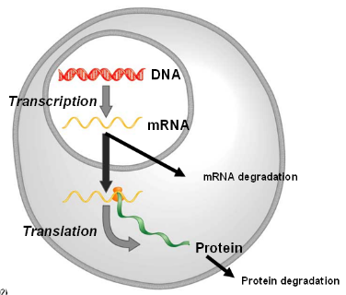



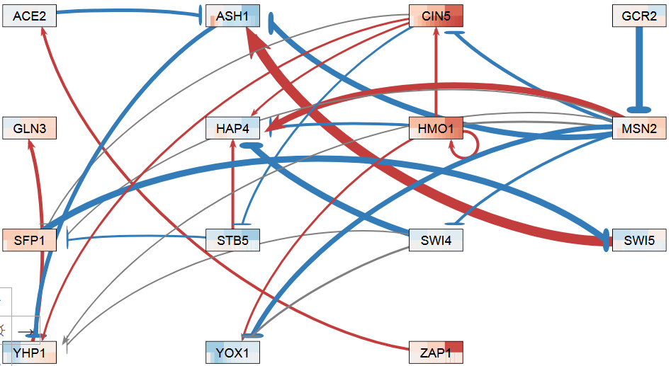
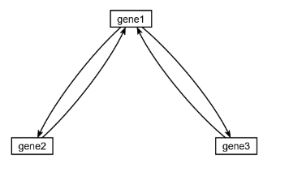
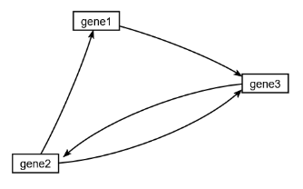
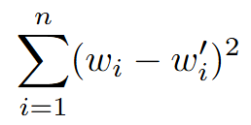
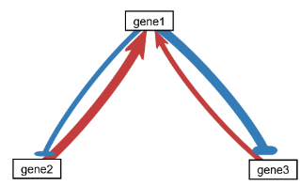
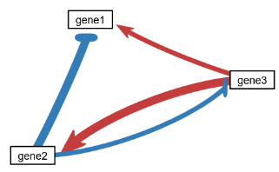
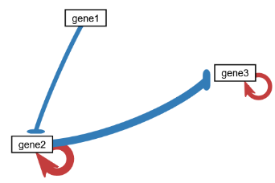
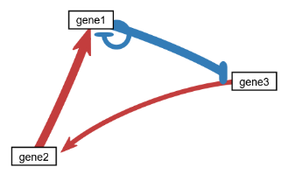
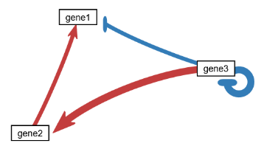
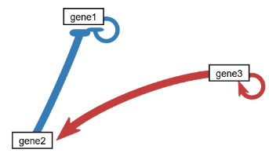
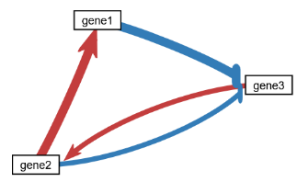
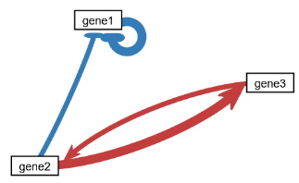
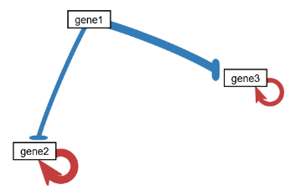
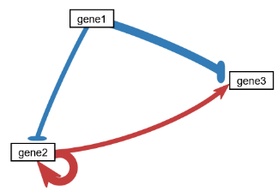
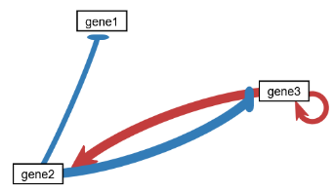
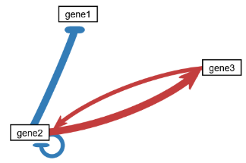
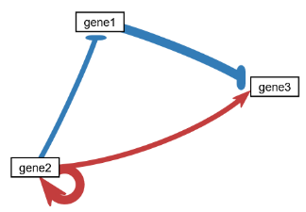
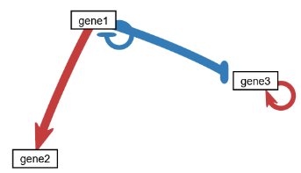
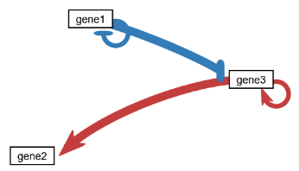
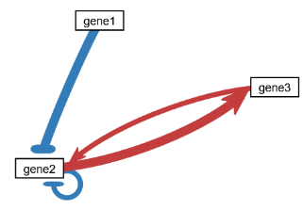
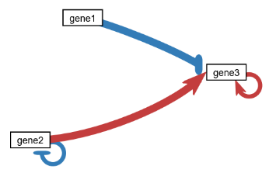
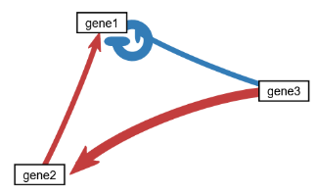
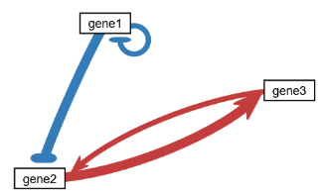
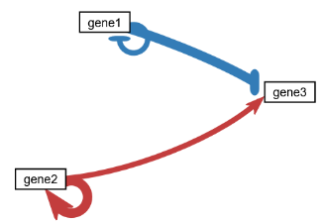
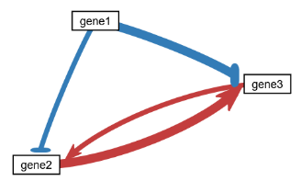
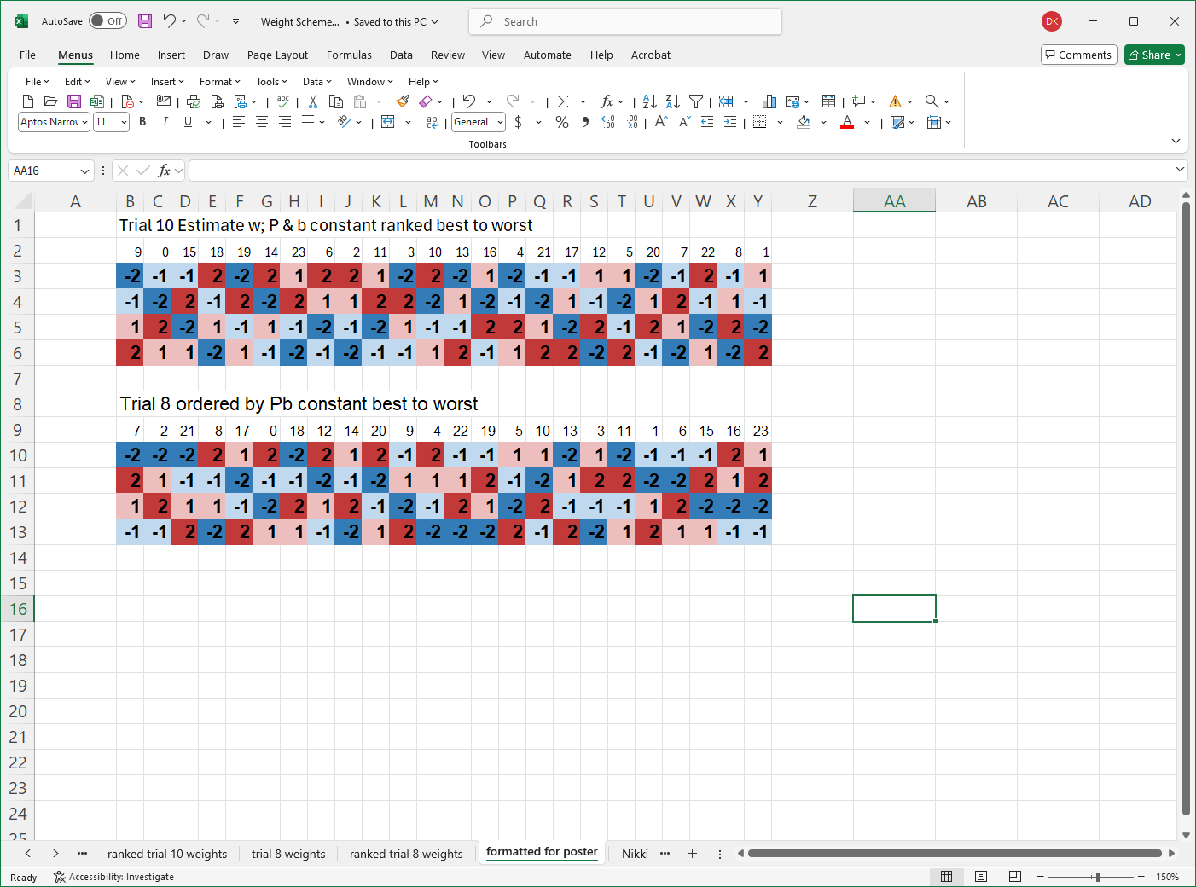
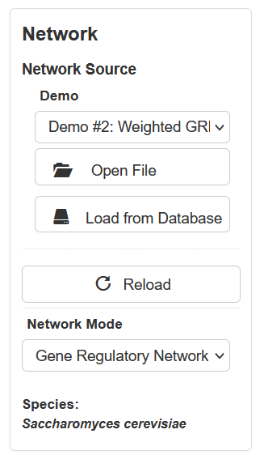
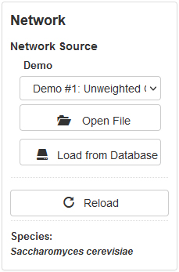
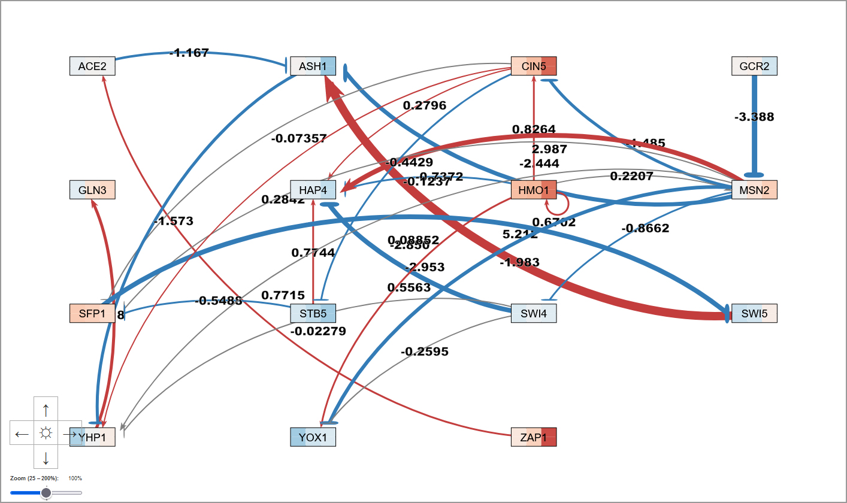
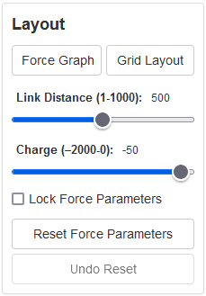

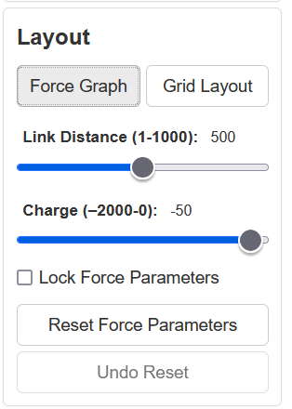
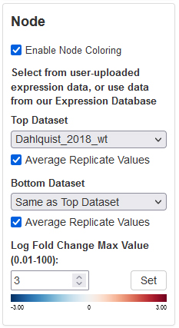
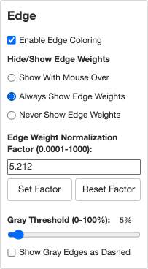

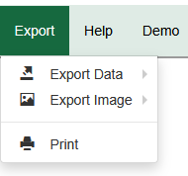
Sensitivity analysis of GRNmap and new features for GRNsight: open source software for dynamical systems modeling and visualization of small-scale gene regulatory networks
Kam D. Dahlquist¹, Ben G. Fitzpatrick², John David N. Dionisio³, Ngoc K. Tran³, Nikki C. Chun^{1,2},
Cecilia J. Zaragoza³, A'Kaia L. Phelps³, Amelie T. Dinh³, Milka Y. Zekarias³
Departments of ¹Biology, ²Mathematics, and ³Computer Science
Loyola Marymount University, 1 LMU Drive, Los Angeles, CA 90045 USA
http://kdahlquist.github.io/GRNmap/ and http://dondi.github.io/GRNsight/
Trial 8 – best performing network
The LSE of the weights when the models were run with no parameters held constant were calculated resulting in the following:
Minimum of 0.069, median of 0.54, SD of 4.34, and maximum of 14.93
Trial 8 – best performing network
The LSE of the weights when the models were run with no parameters held constant were calculated resulting in the following:
Minimum of 0.069, median of 0.54, SD of 4.34, and maximum of 14.93
GRNmap: Gene Regulatory Network modeling and parameter estimation
Weight estimation precision increases when production rates are held constant
P_{i}
d_{i}
Estimate P, b, w
When P and b were held constant, only the 4 weight parameters were estimated, compared to the 10 estimated when P, b, and w were all estimated.
The performance of the model when P and b were held constant and when only P was held constant were relatively similar, suggesting that the issue is estimating the production rate, not necessarily the number of parameters estimated.
We did not discern a clear pattern in the network structures that corresponded to model performance.
Estimate P and w
b held constant
Parameters are optimized using a penalized least squares error function
Freeman (2002)
Estimate b and w
P held constant
Export to Excel
Estimate w
P and b held constant
-12
-10
-8
-6
-4
-2
0
2
log₁₀ of the weight LSE for each network
Each node represents one gene
encoding a transcription factor.
Each edge represents a regulatory
relationship.
Model is coded in MATLAB.
Input Excel workbook requires:
Network adjacency matrix
Timecourse expression data, x(t)
mRNA degradation rates, d
Output workbook provides optimized:
Production rates, P
Expression threshold, b
Weight parameters, w, give the direction (activation or repression) and magnitude of the regulatory relationship
When Ps, bs, and ws are all estimated, the total number of parameters is
(2 X no. of genes) + no. of edges.
However, P, b, or P and b can be held constant, reducing the number of parameters to be estimated.
Weight estimation precision is dependent on weight values
Select network and expression data in GRNsight
Dynamical systems modeling using GRNmap
Since weights were chosen arbitrarily (1, -1, 2, or -2), we also investigated whether the model performance was solely based on network structure, or whether it was also impacted by the assignment of a particular weight value to each edge.
All 24 permutations of the weight assignments to edges were modeled for the networks originally ranked 1st and 7th to determine the impact of the weights.
The LSE of the weights were calculated for each trial as before.
Visualization of modeling results using GRNsight
†
††
Network Originally Ranked 1st
Network Originally Ranked 7th
Weight 1
Weight 2
Weight 1
Weight 3
Weight 3
Weight 4
Weight 4
Weight 2
15-gene, 28-edge network modeled with Dahlquist et al. (2018) expression data and visualized with GRNsight. P, b, w estimated.
wt yeast subjected to 15, 30, and 60 minutes of cold shock at 13°C.
Top stripe in each node is actual log₂ fold change expression data for each timepoint, bottom stripe is model-simulated data.
*Best | Actual Weights | Weight estimates with P and b held constant | Weight estimates when P and b also estimated
Weight 1 | -2 | -2.0000 | -1.9172
Weight 2 | -1 | -1.0000 | -0.9030
Weight 3 | 1 | 1.0000 | 0.9764
Weight 4 | 2 | 2.0000 | 1.9388
**Best | Actual Weights | Weight estimates with P and b held constant | Weight estimates when P and b also estimated
Weight 1 | -2 | -2.0000 | -2.0121
Weight 2 | 2 | 1.9999 | 2.3139
Weight 3 | 1 | 1.0000 | 1.1456
Weight 4 | -1 | -1.0000 | -0.9312
Model sensitivity was tested using all 21 possible 3 gene, 4 edge “toy” networks.
Simulated data was generated based on known arbitrary parameters. Then the
simulated data was used to estimate parameters to see if the model returned the known values.
#Worst | Actual Weights | Weight estimates with P and b held constant | Weight estimates when P and b also estimated
Weight 1 | 1 | 1.0000 | 0.4924
Weight 2 | -1 | -1.0000 | -0.7337
Weight 3 | -2 | -1.9999 | -2.8069
Weight 4 | 2 | 1.9997 | 0.1271
##Worst | Actual Weights | Weight estimates with P and b held constant | Weight estimates when P and b also estimated
Weight 1 | 1 | 1.0000 | 0.6198
Weight 2 | 2 | 1.9993 | 1.5623
Weight 3 | -2 | -1.9996 | -1.5411
Weight 4 | -1 | -1.0000 | -0.7627
Least squares error (LSE) was used to rank the performance of the networks relative to one another.
The error between the known weights and the estimated weights was computed as follows:
LSE =
where w_{i} are the actual weights and w'_{i} are the estimated weights.
1
2
3
4
5
6
7
100
Log₁₀ LSE of Weight Permutations for Network Ranked 1st
w estimated only (dark); P, b, & w all estimated (light)
#
100
Log₁₀ LSE of Weight Permutations for Network Ranked 7th
w estimated only (dark); P, b, & w all estimated (light)
10
10
††
##
1
†
1
**
8
9
10
11
12
13
14
-1
*
-1
-2
-2
-3
-3
-4
-4
-5
-5
-6
-6
-7
-7
15
16
17
18
19
20
21
-8
-8
-9
-9
-11
-11
-10
-10
Rank | Estimate P, b, w | Estimate P and w b held constant | Estimate b and w P held constant | Estimate w P and b held constant | Sum
1 | 0.0209 | 1.02E-07 | 3.60E-08 | 1.69E-12 | 0.0209
7 | 2.2486 | 1.9650 | 8.12E-10 | 3.92E-11 | 4.2136
14 | 4.4742 | 2.67E-07 | 4.5016 | 4.4999 | 13.4757
21 | 26.9602 | 22.4204 | 9.9182 | 9.9871 | 69.2858
-12
-12
-13
-13
Weight 1
Weight 1
LSE values for representative networks when different parameters were estimated.
Weight 2
Weight 2
Weight 3
Weight 3
Weight 4
Weight 4
The LSE’s varied dramatically over several orders of magnitude, showing that performance depended on the weight values assigned to edges, not solely on the network structure.
I’
Datasets available:
Apweiler et al. 2012, GSE33098
Barreto et al. 2012, GSE24712
Dahlquist et al. 2018, GSE83656
Kitagawa et al. 2002, GSE9336
Thorsen et al. 2007, GSE6068
GRNsight, automatically lays out a gene regulatory network (GRN) graph, coloring the edges based on regulatory weights, and the nodes based on experimental or simulated expression data
Conclusions
Estimating production rates from gene expression data is difficult for GRNmap to do, and we plan to determine production rates from experiments.
Investigation of 3-gene, 4-edge “toy” networks shows that the performance
of the GRNmap model is influenced by a combination of network structure and edge weights.
The GRNmap – GRNsight system will speed up the rate of modeling and analysis of many networks.
Network
Demo files are provided.
Can import Excel, SIF, or GraphML files.
Can construct a network from SGD regulation or PPI data stored in a backend database.
Layout
Users can select force graph or grid layout.
Force graph parameter sliders:
Link distance determines the minimum distance between nodes.
Nodes have a charge which repels or attracts
other nodes.
Node
Coloring can be based on user-uploaded expression data or from published expression datasets stored in a backend database.
Datasets available:
Apweiler et al. 2012, GSE33098
Barreto et al. 2012, GSE24712
Dahlquist et al. 2018, GSE83656
Kitagawa et al. 2002, GSE9336
Thorsen et al. 2007, GSE6068
Edge
Edge coloring can be toggled on and off.
Buttons enable the user to always/never see edge weights, or see them upon mouseover.
Allows user to set normalization factor so that edge thicknesses for different graphs can be rendered on the same scale.
Changing the gray threshold deemphasizes weaker edges in the visualization.
Presenting gray edges as dashed lines further deemphasizes weak edges.
1
Availability
GRNmap and GRNsight are free and open to all users and there is no login requirement.
http://kdahlquist.github.io/GRNmap/
http://dondi.github.io/GRNsight/
GRNmap and GRNsight code are available under the open source BSD license at our GitHub repositories.
https://github.com/kdahlquist/GRNmap/
https://github.com/dondi/GRNsight
The GRNmap model can be run from code only on Windows with MATLAB versions 2014b or 2024b.
Although originally developed with yeast data, both GRNmap and GRNsight can be used with any species for which you have time course gene expression data or an unweighted or weighted adjacency matrix, respectively.
Key
gene
Acknowledgments
activation
2
repression
We would like to thank the previous developers on the GRNmap and GRNsight projects. This work was partially funded by an LMU Rains Research Assistantship (N.C.C.) and an HHMI Driving Change, Seaver STEM Research Learning Community Fellowship (C.T.Z, A.L.P.).
3
4
5
weak influence
References
Apweiler, E., Sameith, K., Margaritis, T., Brabers, N., van de Pasch, L., Bakker, L. V., ... & Kemmeren, P. (2012). Yeast glucose pathways converge on the transcriptional regulation of trehalose biosynthesis. BMC genomics, 13(1), 1-14. DOI: 10.1186/1471-2164-13-239
Barreto, L., Canadell, D., Valverde‐Saubí, D., Casamayor, A., & Ariño, J. (2012). The short‐term response of yeast to potassium starvation. Environmental microbiology, 14(11), 3026-3042. DOI: 10.1111/j.1462-2920.2012.02887.x
Dahlquist, K.D., Abdulla, H., Arnell, A.J., Arsan, C., Baker, J.M., Carson, R.M., … & Zapata, B.B. (2018). Global transcriptional response of wild type and transcription factor deletion strains of Saccharomyces cerevisiae to the environmental stress of cold shock and subsequent recovery. GEO Dataset GSE83656. https://www.ncbi.nlm.nih.gov/geo/query/acc.cgi?acc=GSE83656
Dahlquist, K.D., Fitzpatrick, B.G., Camacho, E.T., Entzminger, S.D., & Wanner, N.C. (2015) Parameter Estimation for Gene Regulatory Networks from Microarray Data: Cold Shock Response in Saccharomyces cerevisiae. Bulletin of Mathematical Biology, 77(8), 1457-1492. DOI: 10.1007/s11538-015-0092-6
Dahlquist, K.D., Dionisio, J.D.N., Fitzpatrick, B.G., Anguiano, N.A., Varshneya, A., Southwick, B.J., & Samdarshi, M. (2016) GRNsight: a web application and service for visualizing models of small- to medium-scale gene regulatory networks. PeerJ Computer Science, 2, e85. DOI: 10.7717/peerj-cs.85
Engel, S. R., Aleksander, S., Nash, R. S., Wong, E. D., Weng, S., Miyasato, S. R., ... & Cherry, J. M. (2025). Saccharomyces Genome Database: advances in genome annotation, expanded biochemical pathways, and other key enhancements. Genetics, 229(3), iyae185. DOI: 10.1093/genetics/iyae185
Freeman, S. (2002) Biological Science. Upper Saddle River, New Jersey: Prentice Hall.
Kitagawa, E., Takahashi, J., Momose, Y., & Iwahashi, H. (2002). Effects of the pesticide thiuram: genome-wide screening of indicator genes by yeast DNA microarray. Environmental science & technology, 36(18), 3908-3915. DOI: 10.1021/es015705v
Neymotin, B., Athanasiadou, R., & Gresham, D. (2014). Determination of in vivo RNA kinetics using RATE-seq. Rna, 20(10), 1645-1652. DOI: 10.1261/rna.045104.114
Thorsen, M., Lagniel, G., Kristiansson, E., Junot, C., Nerman, O., Labarre, J., & Tamás, M. J. (2007). Quantitative transcriptome, proteome, and sulfur metabolite profiling of the Saccharomyces cerevisiae response to arsenite. Physiological genomics, 30(1), 35-43. DOI: 10.1152/physiolgenomics.00236.2006
5. View
Multiple viewport sizes available.
Graph bounding box can be separated from viewport.
Zooming and scrolling available.
6
6. Export
Basic data export to SIF or GraphML or full GRNmap-compatible Excel workbook, with yeast mRNA degradation rates from Neymotin et al. (2014).
Image export to PNG, SVG, or PDF.

