Slide 1
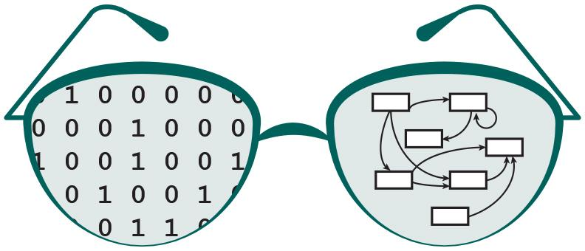

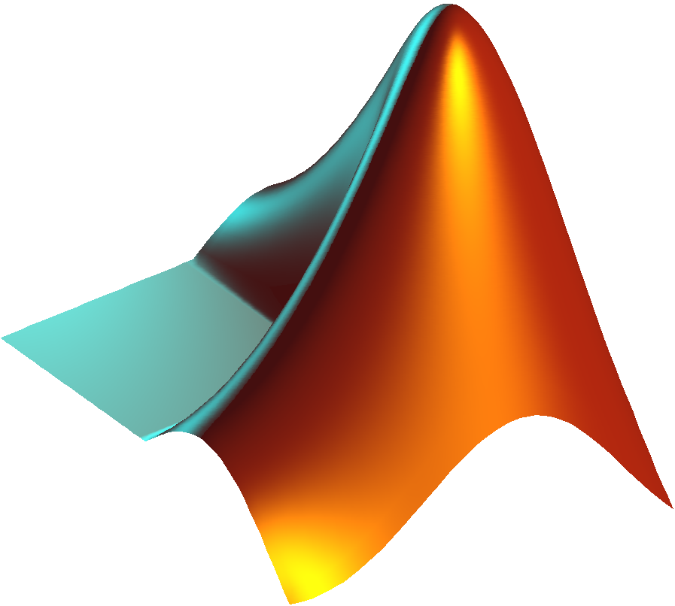
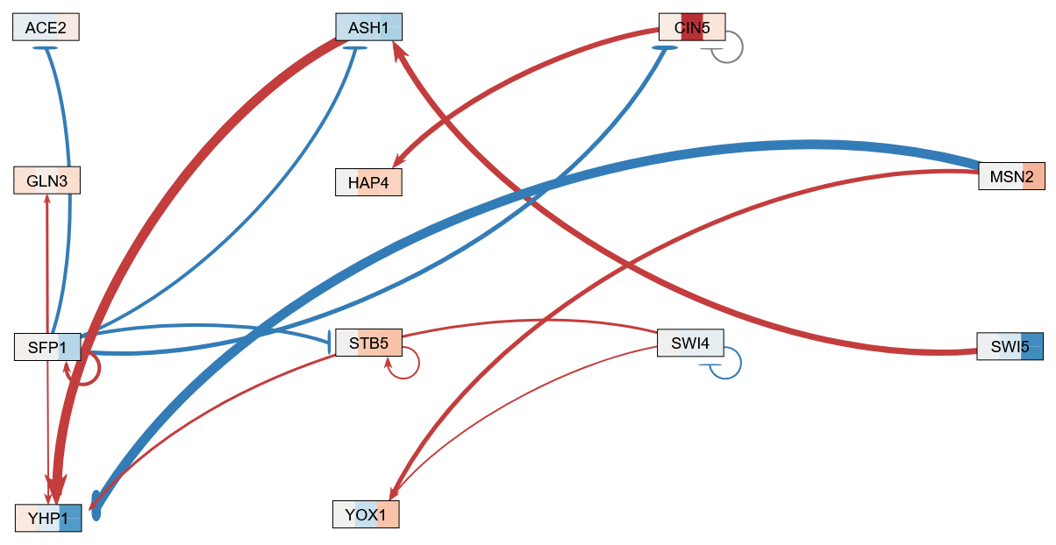
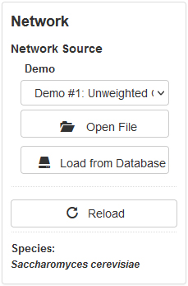
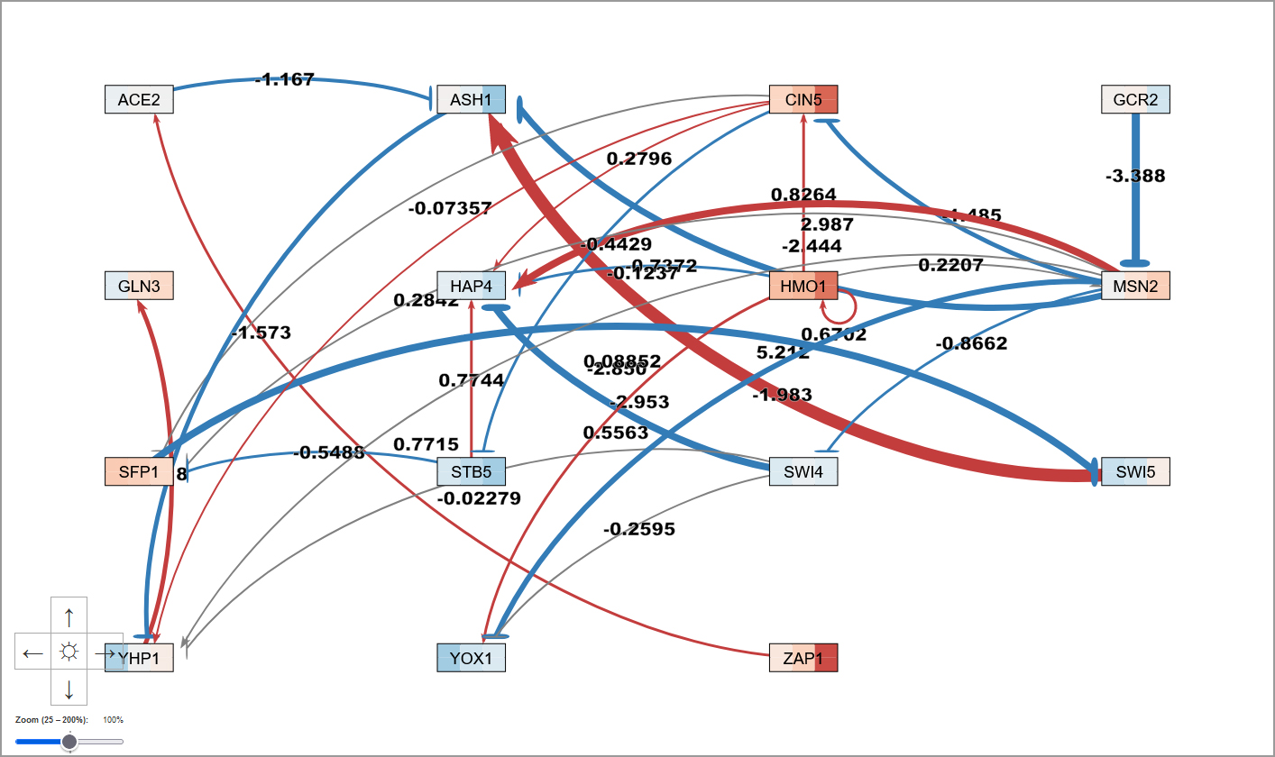
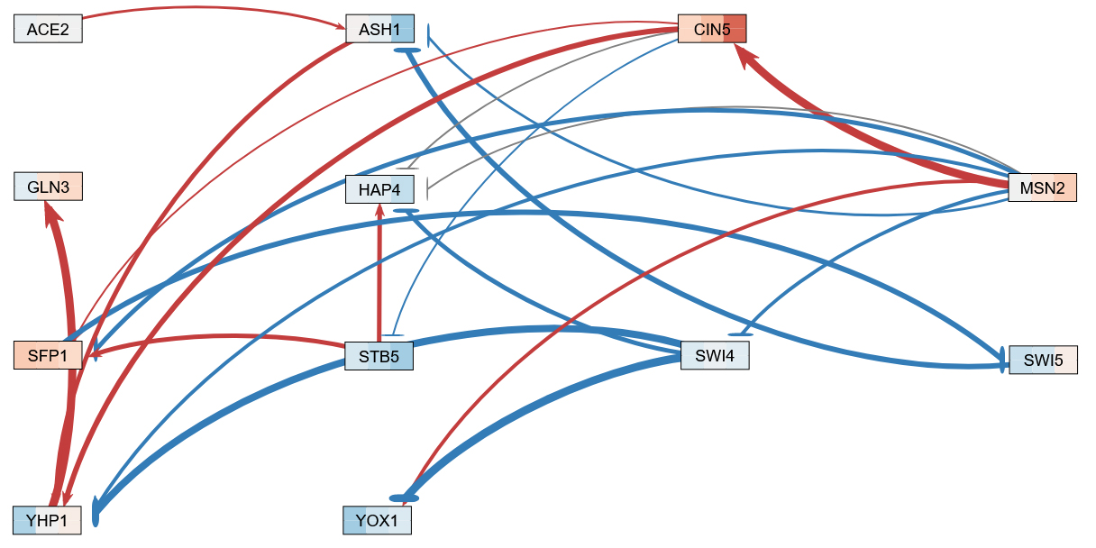
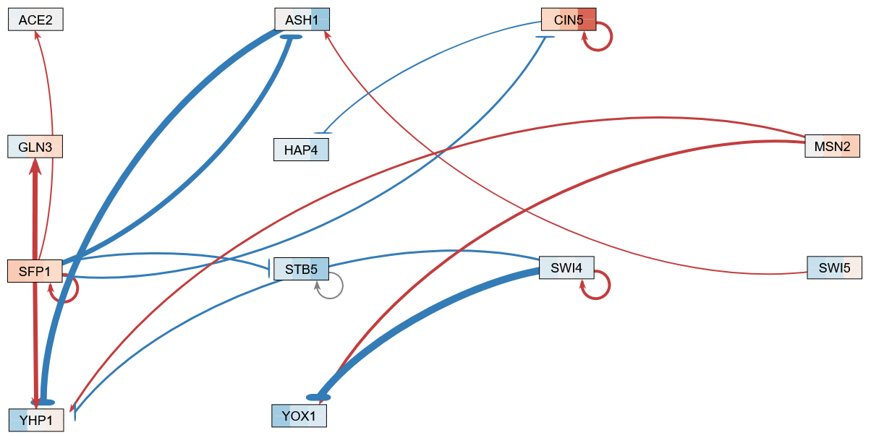
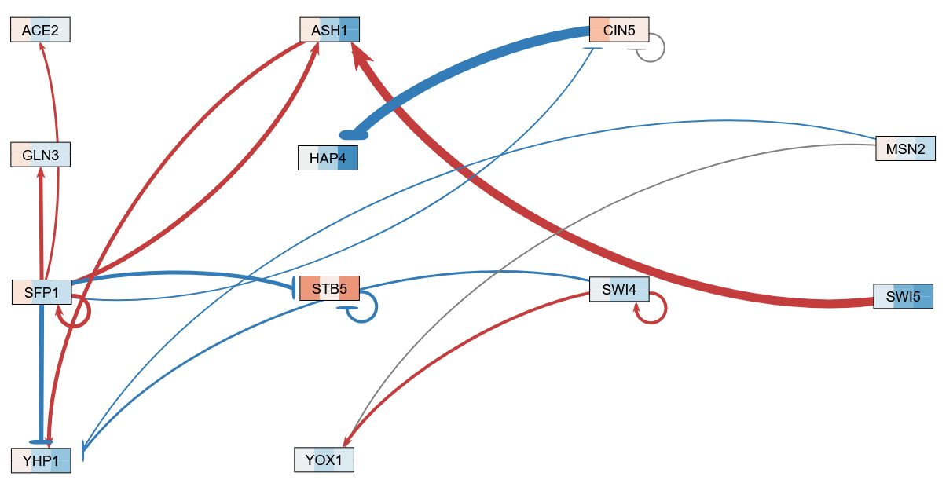
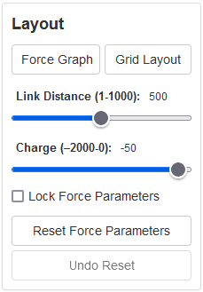
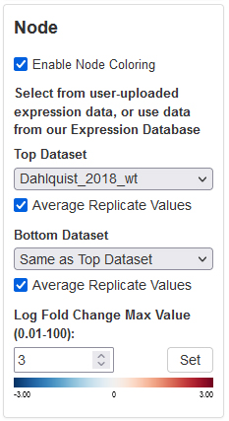
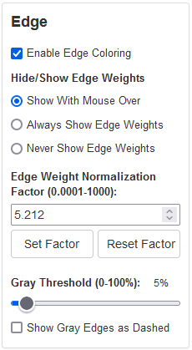
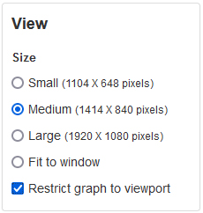
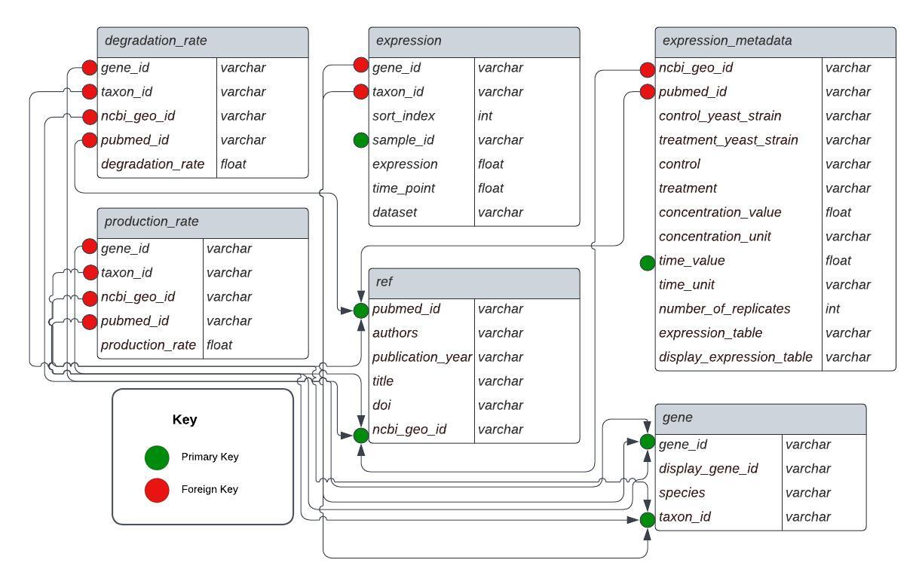
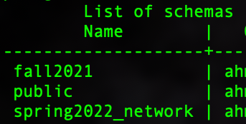
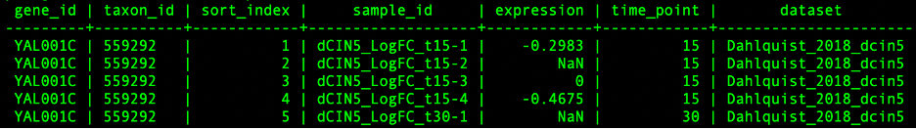
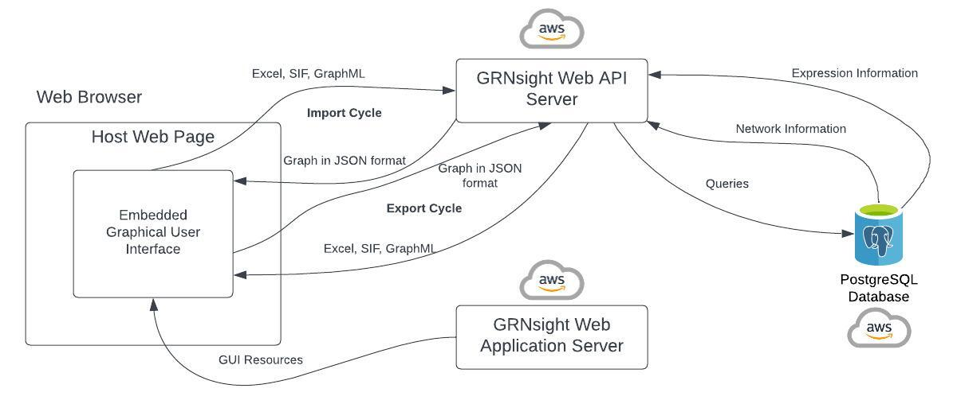
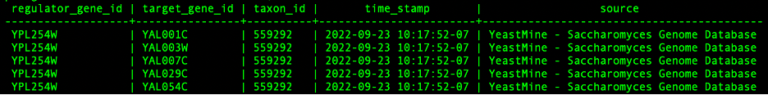


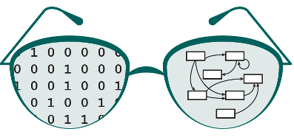

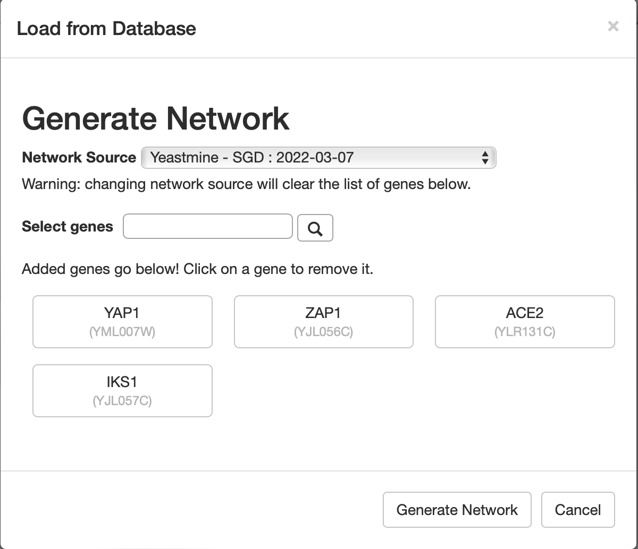
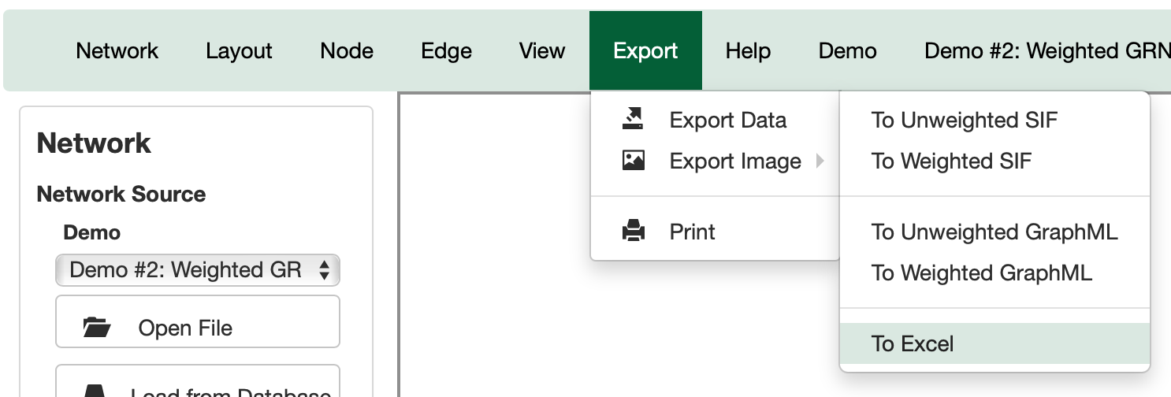
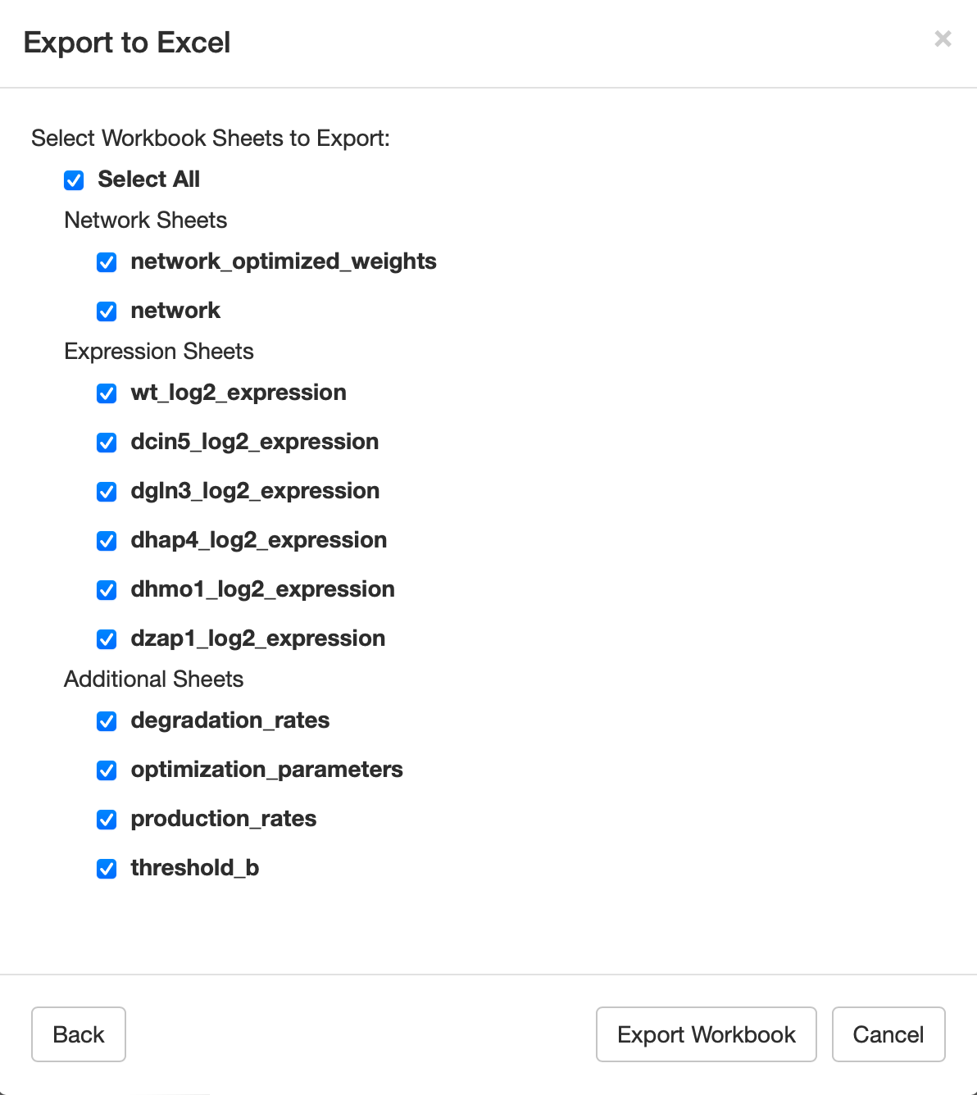
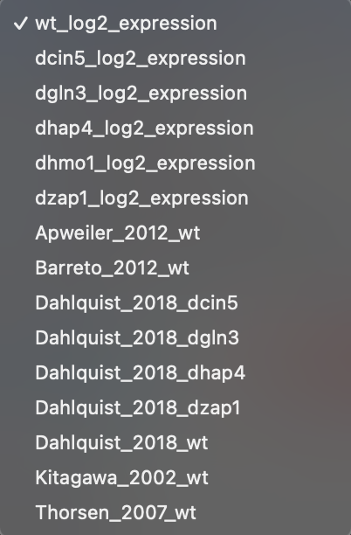
Improved Functionality of GRNsight 6.0: a Web Application for Visualizing Gene Network Models
Ahmad R. Mersaghian*, Sarron A. Tadesse **, Ngan N. Tran**, Kam D. Dahlquist*, John David N. Dionisio**
*Department of Biology, **Department of Computer Science, Loyola Marymount University, 1 LMU Drive, Los Angeles, CA 90045
http://dondi.github.io/GRNsight/
GRNsight Automatically Lays Out Unweighted and Weighted Gene Regulatory Network Graphs
3. Dynamical Systems Modeling
The exported Excel file is GRNmap compatible and can be used for further modeling.
4. Visualization of Modeling Results
The new model can be visualized in GRNsight.
Workflow facilitates modeling multiple networks with multiple expression datasets more quickly.
3
4
.
Network
Demo files are provided.
Can import and export Excel, SIF, or GraphML files.
Can construct a network from SGD regulation data stored in a backend database.
Layout
Users can select a force graph layout or grid layout.
Force graph parameter sliders:
Link distance determines the minimum distance between nodes.
Nodes have a charge which repels or attracts other nodes.
Node
Coloring can be based on user-uploaded expression data or from published expression datasets stored in a backend database.
Datasets available:
Apweiler et al. 2012, GSE33098
Barreto et al. 2012, GSE24712
Dahlquist et al. 2018, GSE83656
Kitagawa et al. 2002, GSE9336
Thorsen et al. 2007, GSE6068
Edge
Edge coloring can be toggled on and off.
Buttons enable the user to always see edge weights, never see edge weights, or see edge weights upon mouseover.
Allows user to set normalization factor so that edge thicknesses for different graphs can be rendered on the same scale.
Changing the gray threshold deemphasizes weaker edges in the visualization.
Presenting gray edges as dashed lines further deemphasizes weak edges.
View
Multiple viewport sizes available.
Graph bounding box can be separated from viewport.
Zooming and scrolling available.
1
LSE/minLSE: 1.8707
12-gene, 17 edge network from SGD
Modeled with Kitagawa et al. (2002) expression data
wt yeast treated with 75 μM thiuram for 15, 30, and 120 minutes
4
4
4
2
LSE/minLSE: 1.0348
LSE/minLSE: 1.0438
LSE/minLSE: 1.0781
12-gene, 21 edge network from YEASTRACT
Modeled with Dahlquist et al. (2018) expression data
wt yeast subjected to 15, 30, and 60 minutes of
cold shock at 13°C
12-gene, 17 edge network from SGD
Modeled with Dahlquist et al. (2018) expression data
wt yeast subjected to 15, 30, and 60 minutes of
cold shock at 13°C
12-gene, 17 edge network from SGD
Modeled with Thorsen et al. (2007) expression data
wt yeast treated with 1 mM As(III) for 15, 30, and
60 minutes
3
4
5
Backend PostgreSQL Databases Store Gene Expression and Gene Regulatory Network Data
Two backend PostgreSQL databases store expression and regulatory data that can be accessed by the user (see top, left code snippet).
The expression database schema consists of 6 tables each containing information about genes and their corresponding expression data from previous experimental studies.
For example, the Ref table lists the current datasets available for GRNsight to use.
The default expression values for nodes in the network are based on expression data from Dahlquist_2018_wt dataset (see top right code snippet), but can be changed to other available options at any time.
The users can also select genes to include in their network from the SGD data stored in GRNsight’s regulation database (bottom code snippet).
The Data Access Layer (DAL) module of the GRNsight database was refactored and expanded to reduce the amount of hard-coded information.
Users can include yeast genes with irregular naming patterns in their network using the load from database function.
When generating a network from the database, GRNsight correctly displays the node and edge count in the menu bar.
The database was updated to store the timestamps in UTC instead of local timezones.
The regulation database will be updated on a regular basis and users can retrieve data from all versions of the databases.
Additional expression datasets will be added to the expression database in the future.
GRNsight Architecture Facilitates Modeling-to-Visualization-to-Modeling Workflow
Workflow
Information stored in expression table from expression database.
2
Export to Excel
Information stored in network table from regulation database. Used to create networks.
Select network and expression data in GRNsight
1
3
Future Directions
Acknowledgments
Dynamical systems modeling using GRNmap
4
To reduce the amount of hard-coded information in GRNsight code, a new GRNsettings table is being implemented in the database.
Identify new bugs associated with current features.
Work on outstanding bugs and feature enhancements to the graph display and user interface.
Extend the backend database to store protein-protein interaction data.
Allow undirected graphs so protein-protein interaction data can be displayed.
We would like to thank the prior developers on this project: Onariaginosa O. Igbinedion, Ian M. Green, Alexia M. Filler, Kevin B. Patterson, Mihir Samdarshi, John L. Lopez, Justin Kyle T. Torres, Eileen J. Choe, Yeon-Soo (Jen) Shin, Edward B. Bachoura, Nicole A. Anguiano, Anindita Varshneya, Katrina Sherbina, Britain J. Southwick.
Visualization of modeling results using GRNsight
1. Selection of Network and Expression Data
Users can select desired Saccharomyces cerevisiae (budding yeast) genes for their network using the data gathered from YeastMine.
The users have the option to select expression data (node coloring) for their network from the current 5 datasets available in the GRNsight expression database.
2. Export to Excel
Users then select which Excel workbook sheets they would like to export.
The expression sheet options change based on the expression dataset selected.
The Excel workbook generated is validated for input into the GRNmap MATLAB modeling software.
1
2
References
2
Availability
Dahlquist, K.D., Dionisio, J.D.N., Fitzpatrick, B.G., Anguiano N.A., Varshneya A., Southwick, B.J., Samdarshi, M. (2016) GRNsight: a web application and service for visualizing models of small- to medium-scale gene regulatory networks. PeerJ Computer Science 2:e85 https://doi.org/10.7717/peerj-cs.85
Dahlquist, K.D., Fitzpatrick, B.G., Camacho, E.T., Entzminger, S.D., and Wanner, N.C. (2015) Parameter Estimation for Gene Regulatory Networks from Microarray Data: Cold Shock Response in Saccharomyces cerevisiae. Bulletin of Mathematical Biology, 77(8), 1457-1492 https://doi.org/0.1007/s11538-015-0092-6
Apweiler, E., Sameith, K., Margaritis, T. et al. Yeast glucose pathways converge on the transcriptional regulation of trehalose biosynthesis. BMC Genomics 13, 239 (2012). https://doi.org/10.1186/1471-2164-13-239
Cherry JM, Hong EL, Amundsen C, Balakrishnan R, Binkley G, Chan ET, Christie KR, Costanzo MC, Dwight SS, Engel SR, Fisk DG, Hirschman JE, Hitz BC, Karra K, Krieger CJ, Miyasato SR, Nash RS, Park J, Skrzypek MS, Simison M, Weng S, Wong ED (2012) Saccharomyces Genome Database: the genomics resource of budding yeast. Nucleic Acids Res. Jan;40(Database issue):D700-5. [PMID: 22110037]
P.T. Monteiro, J. Oliveira, P. Pais, M. Antunes, M. Palma, M. Cavalheiro, M. Galocha, C.P. Godinho, L.C. Martins, N. Bourbon, M.N. Mota, R.A. Ribeiro, R.Viana, I. Sá-Correia, M.C. Teixeira (2020) YEASTRACT+: a portal for cross-species comparative genomics of transcription regulation in yeasts Nucleic Acids Research, 48(D1):D642-D649 doi:10.1093/nar/gkz859
Yeastract: http://www.yeastract.com/index.php
SGD: https://www.yeastgenome.or
GRNmap: http://kdahlquist.github.io/GRNmap/
GRNsight: https://dondi.github.io/GRNsight/
GRNsight’s GitHub: https://github.com/dondi/GRNsight
1
GRNsight is free and open to all users and there is no login requirement.
Web site content is available under the Creative Commons Attribution Non-Commercial Share Alike license.
GRNsight code is available under the open-source BSD license.
Usage is being tracked through Google Analytics.
Current production software is at version 6.0.4.
New Users: 7,536
File Uploads: 7,836
Sessions: 18,470
Pageviews: 39,464
Notes:
References can be 12pt
Acknowledgements can be 16pt
Everything else is 18-24pt
Titles don’t need to be bigger than 36pt

