Slide 1

Major Front-End Migration for GRNsight, a Web Application for Visualizing Gene Regulatory and Protein-Protein Interaction Network Models
Cecilia J. Zaragoza
Department of Computer Science
Loyola Marymount University
Engineering & Computer Science Design Showcase
May 1, 2026

Slide 2
Outline
GRNsight is an open-source tool that allows for easier visualization of
Gene Regulatory Networks (GRN) and Protein-Protein Interactions (PPI).
GRNsight is an integral part of a data analysis workflow for biologists who model GRNs.
GRNsight’s interface was originally built using older web tools, leading to repeated code and making user interface updates difficult.
I have migrated GRNsight’s user interface to React, Vite, and Grommet UI which are modern, scalable, and industry-standard frameworks.
GRNsight React migration has resulted in user interface improvements and bug fixes that enhance the user experience for biologists.
Notes:
Maika

Slide 3
Outline
GRNsight is an open-source tool that allows for easier visualization of
Gene Regulatory Networks (GRN) and Protein-Protein Interactions (PPI).
GRNsight is an integral part of a data analysis workflow for biologists who model GRNs.
GRNsight’s interface was originally built using older web tools, leading to repeated code and making user interface updates difficult.
I have migrated GRNsight’s user interface to React, Vite, and Grommet UI which are modern, scalable, and industry-standard frameworks.
GRNsight React migration has resulted in user interface improvements and bug fixes that enhance the user experience for biologists.
Notes:
Maika

Slide 4
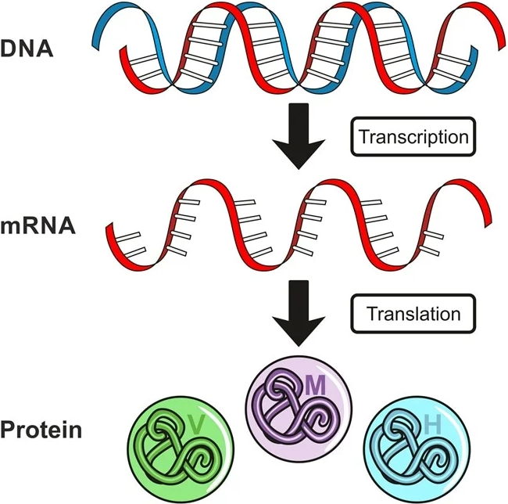
Gene expression is the flow of information in a cell from DNA to RNA to protein
Image from Dr. Surat P, Ph.D. on AZO Life Sciences

Slide 5
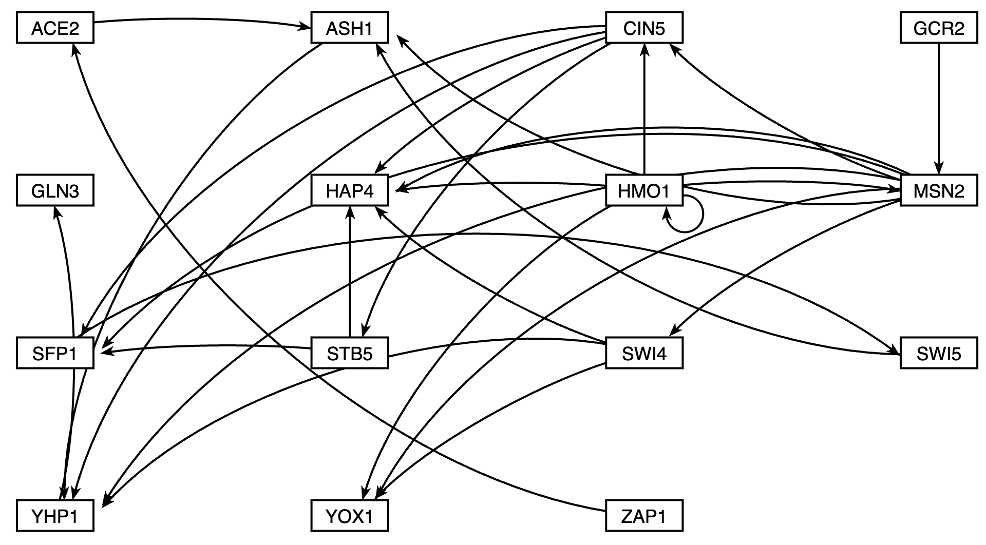
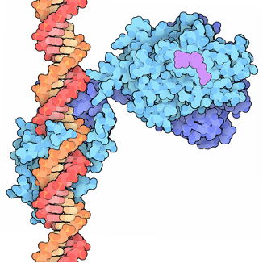
A Gene Regulatory Network (GRN) consists of genes, transcription factors and the regulatory connections between them which govern the level of expression of mRNA and protein from genes
Regulatory Transcription Factors bind to DNA and turn on (activate) or turn off (repress) gene expression
ACE2
ASH1
RCSB: PDB-101. https://pdb101.rcsb.org/motm/155
Yeast GRN that controls the cold shock response
Node = transcription factor / gene
Arrow edge = regulatory relationship
Notes:
Each node represents a regulatory transcription factor and each edge is a regulatory relationship

Slide 6
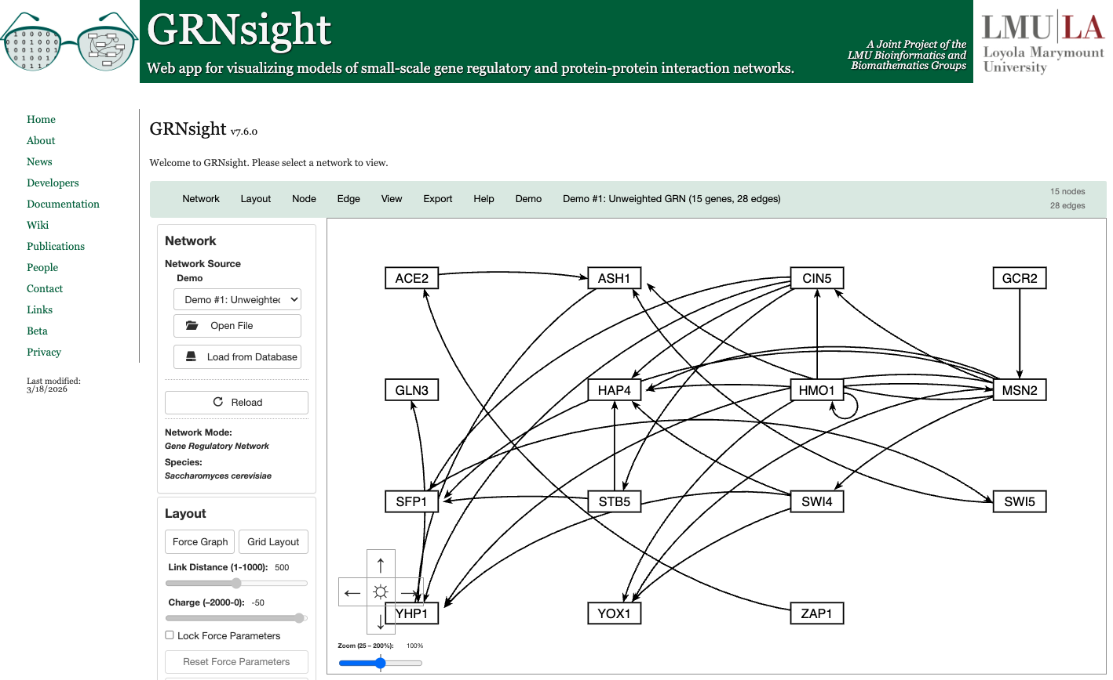
GRNsight is an integral part of a data analysis workflow for biologists who model GRNs
Notes:
Maika

Slide 7
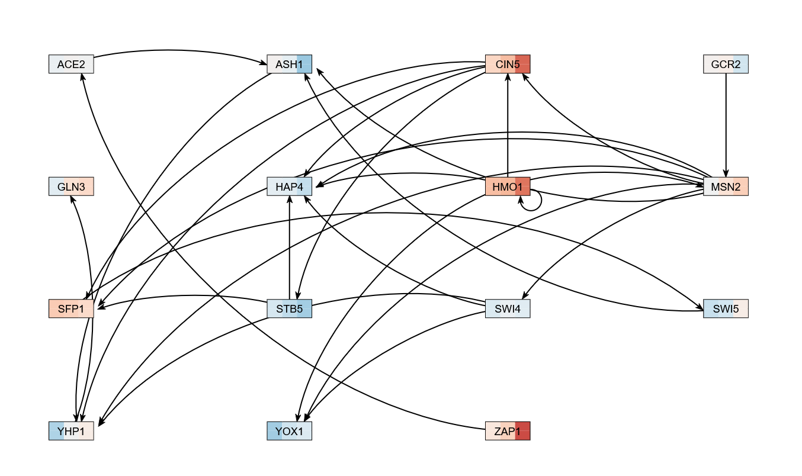



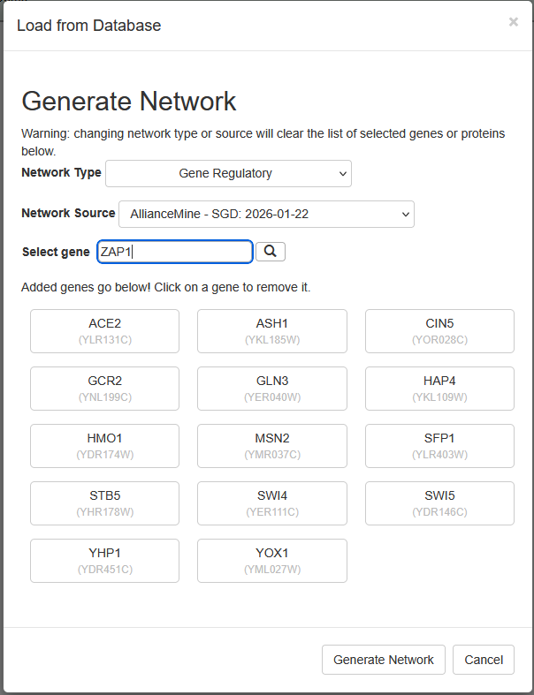
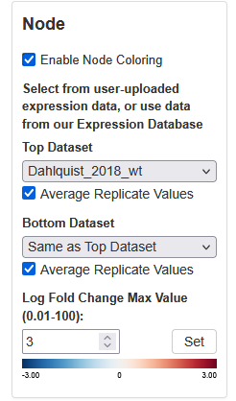
GRNsight is an integral part of a data analysis workflow for biologists who model GRNs
Export to Excel
Select network and expression data from GRNsight database
Notes:
Maika

Slide 8
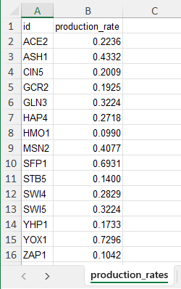
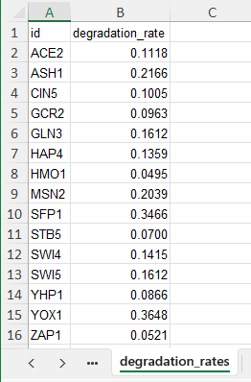
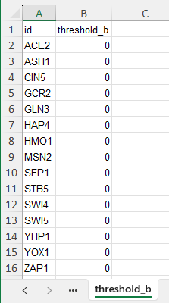
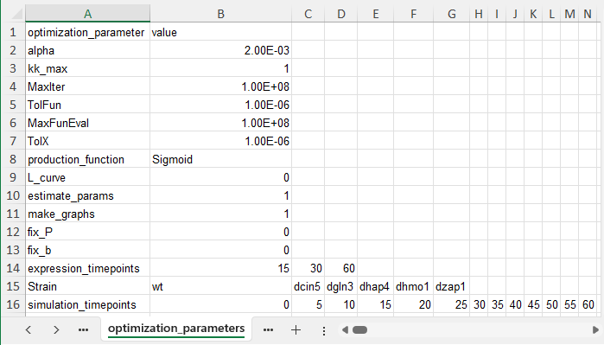
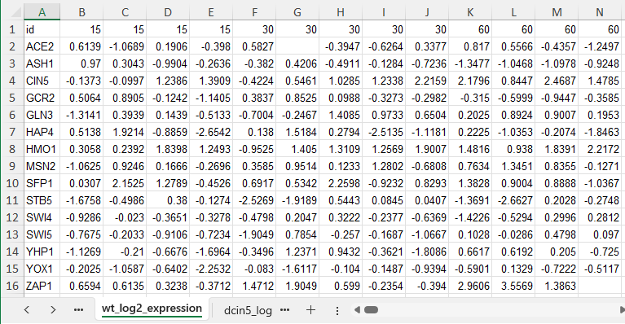

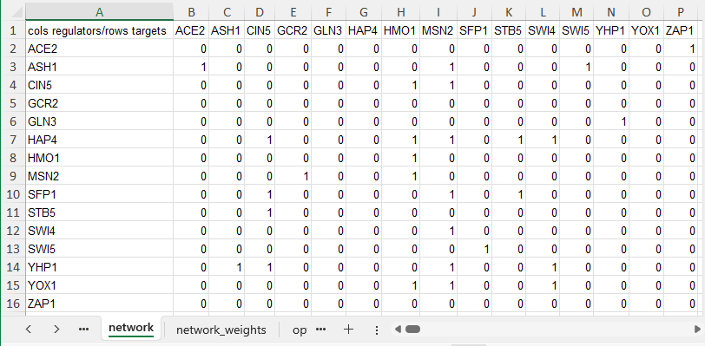
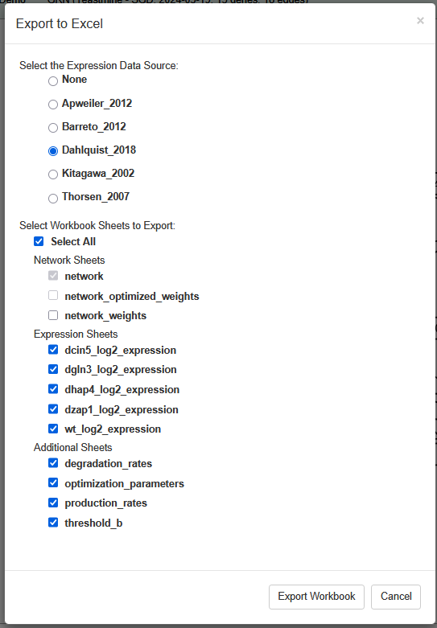
GRNsight is an integral part of a data analysis workflow for biologists who model GRNs
Export to Excel
Select network and expression data from GRNsight database
Notes:
Maika

Slide 9

GRNsight is an integral part of a data analysis workflow for biologists who model GRNs
Export to Excel
Select network and expression data from GRNsight database
Dynamical systems modeling using GRNmap
Visualization of modeling results using GRNsight
Notes:
Maika

Slide 10
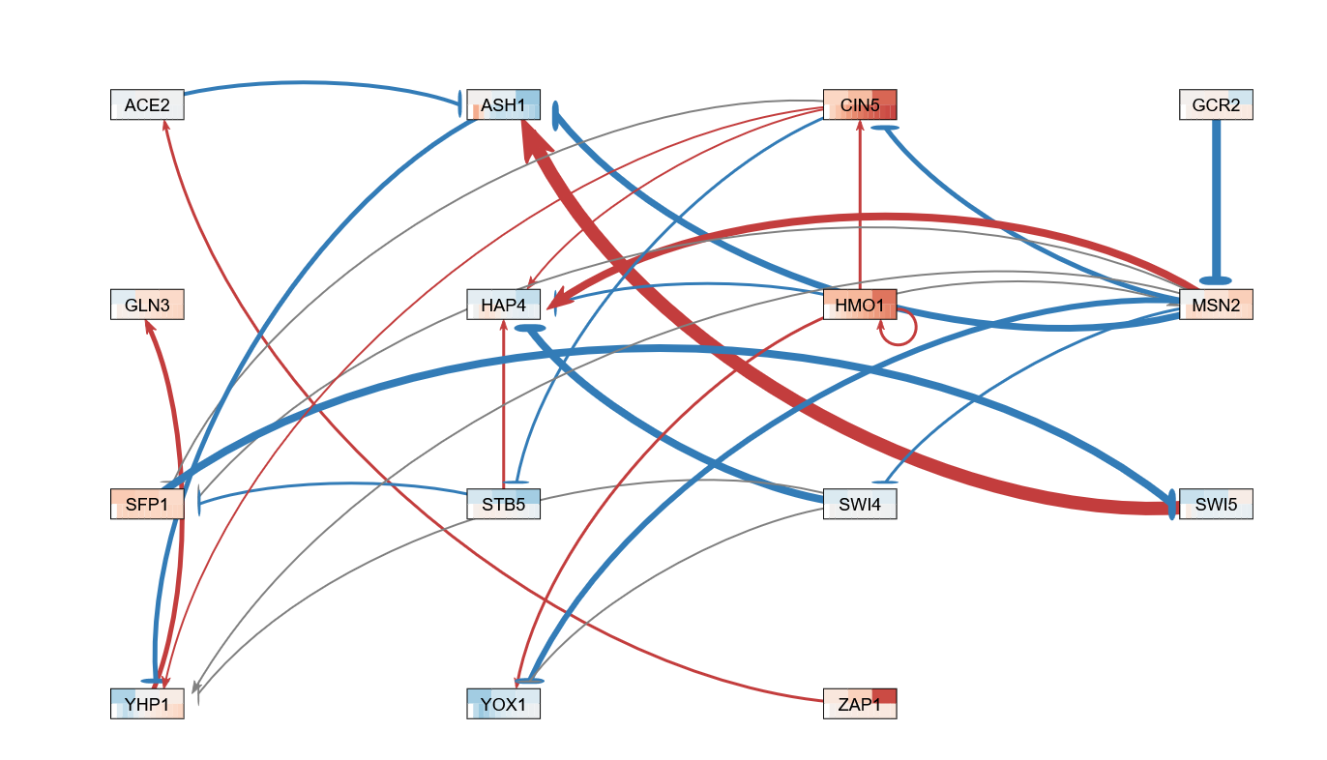
GRNsight is an integral part of a data analysis workflow for biologists who model GRNs
Export to Excel
Select network and expression data from GRNsight database
Dynamical systems modeling using GRNmap
Visualization of modeling results using GRNsight
Notes:
Maika

Slide 11
Outline
GRNsight is an open-source tool that allows for easier visualization of
Gene Regulatory Networks (GRN) and Protein-Protein Interactions (PPI).
GRNsight is an integral part of a data analysis workflow for biologists who model GRNs.
GRNsight’s interface was originally built using older web tools, leading to repeated code and making user interface updates difficult.
I have migrated GRNsight’s user interface to React, Vite, and Grommet UI which are modern, scalable, and industry-standard frameworks.
GRNsight React migration has resulted in user interface improvements and bug fixes that enhance the user experience for biologists.
Notes:
Maika

Slide 12
GRNsight serves the browser UI from the web application server
while the API server handles import/export and all database access.
Web Browser
SQL Query
Excel, SIF, GraphML
GRNsight web
API server
Host web page
Open/import cycle
Query Result
graph in JSON format
PostgreSQL
Database
Embedded graphical
user interface
graph in JSON format
Export cycle
Excel, SIF, GraphML
GUI Resources
GRNsight web
application server
Frontend
Backend
Notes:
Cecilia

Slide 13
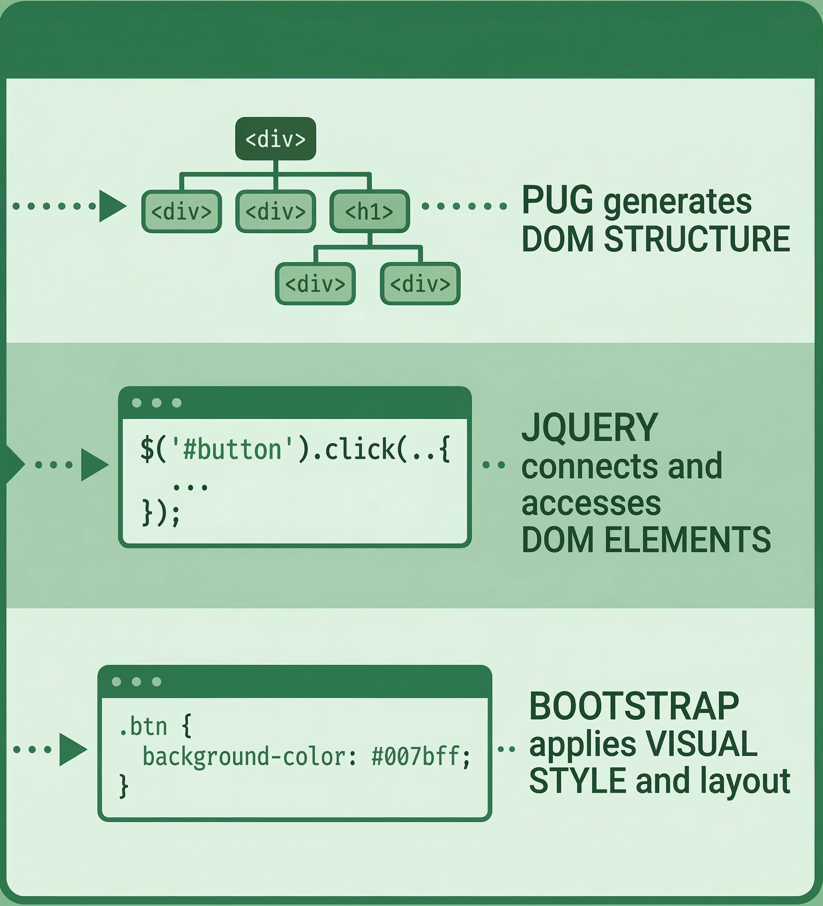
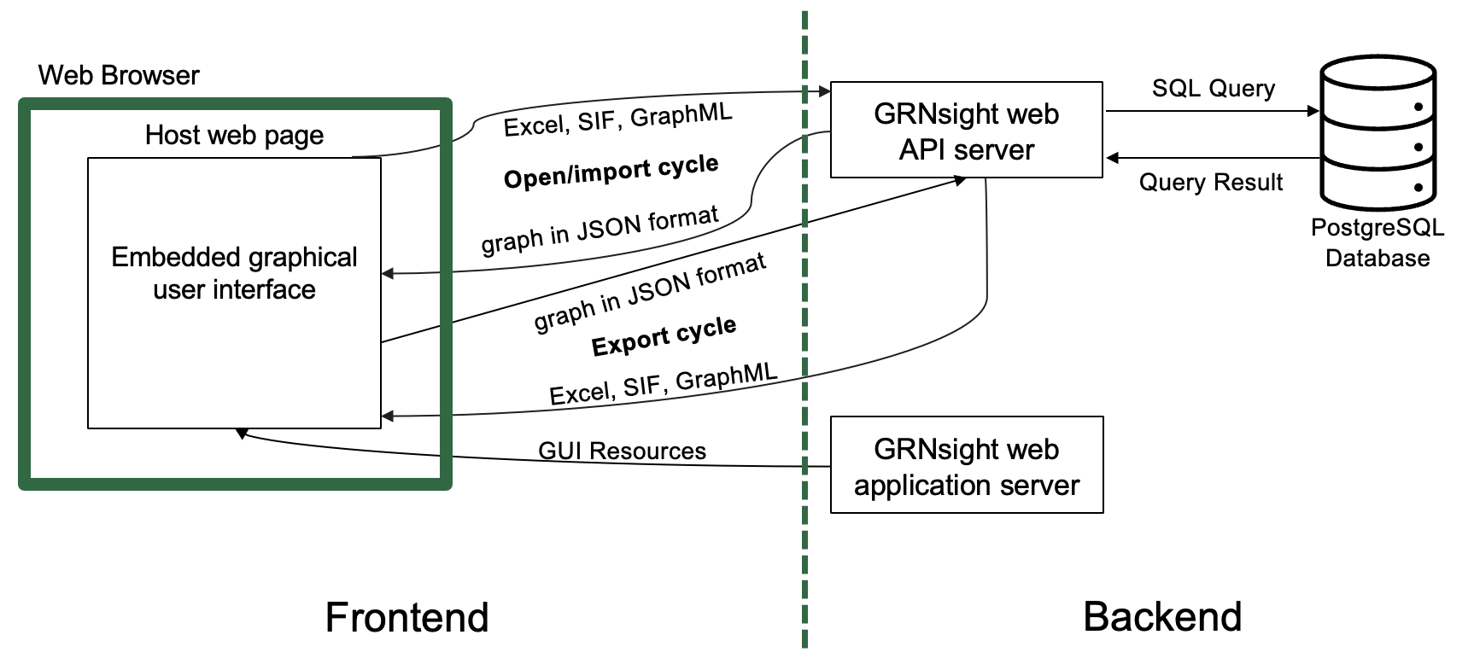



GRNsight Classic built on jQuery/Bootstrap/Pug framework for frontend resulting in code redundancy and complex UI updates
Web Browser
PUG generates DOM structure.
JQuery connects and accesses DOM elements.
Bootstrap applies visual style and layout.
Notes:
Cecilia
we have a classic app that started development in 2014
uses jQuery/Bootstrap/Pug framework
pug: DOM strucutre, contains all elements
pug is static template file
when loaded into browser, generates HTML
after that, any updates are done through JS or jQuery
jQuery: allows you to connect and access those elements
manual
Bootstrap: style the page using CSS classes
Inspiration for migration away from jQuery/Bootstrap/Pug framework
The way old web app is built is no longer industry standard way to develop webapps for a reason
jQuery imperative: a lot of manual updates dedicating to finding elements, removing a class, or or appending text, and it can be hard to keep these updates in sync
have to put out listeners to see when different values are updated, which leads to code redundancy
jQuery manual tracking: no built-in way to store data, have to use data attirbutes, which makes it hard to share data across app
jQuery: when any values change, up to the developer to decide when to rerender the app
pug is static: since pug is just a template, any updates are done through JS or jQuery requiring more work on developer end
(a lot of code because of this, harder to understand code and isolate issues)

Slide 14
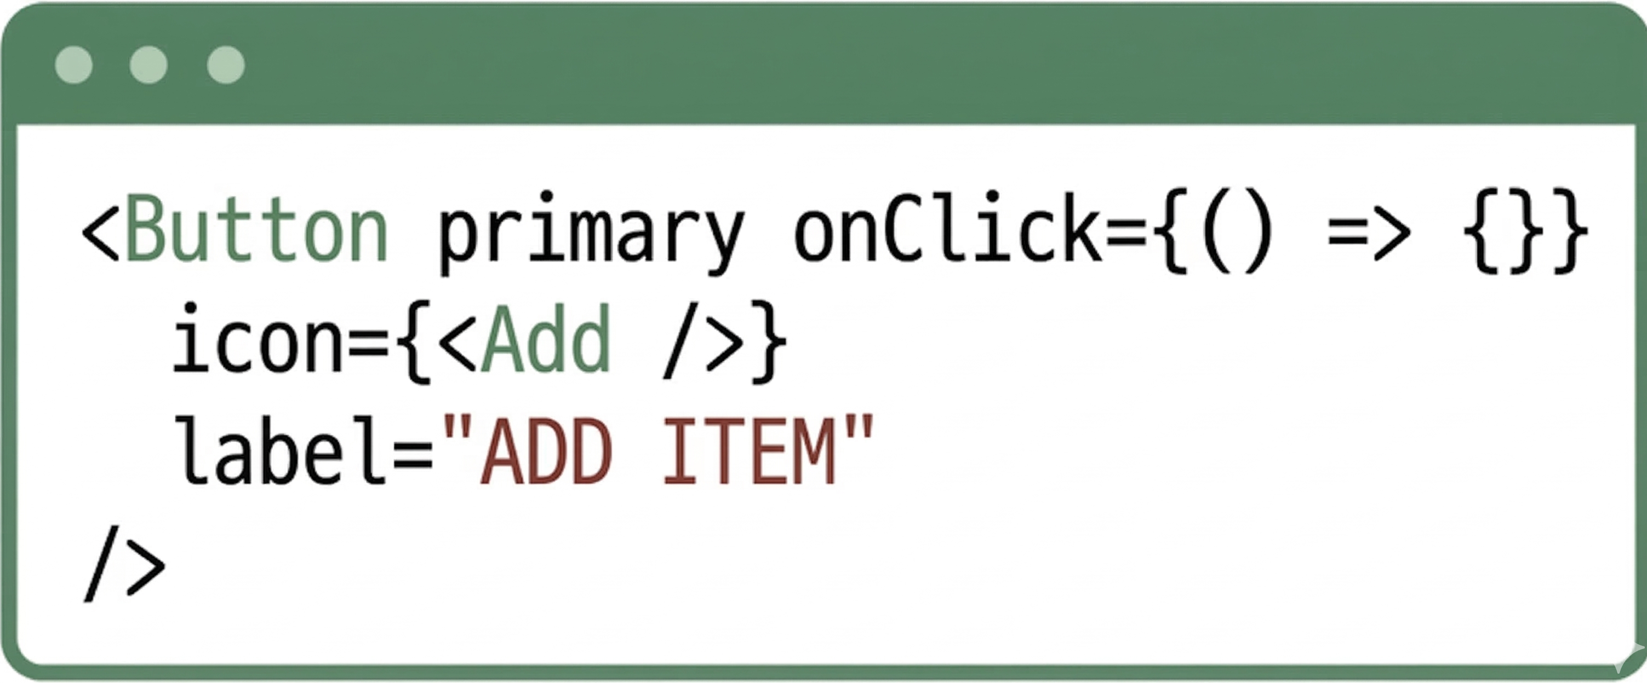

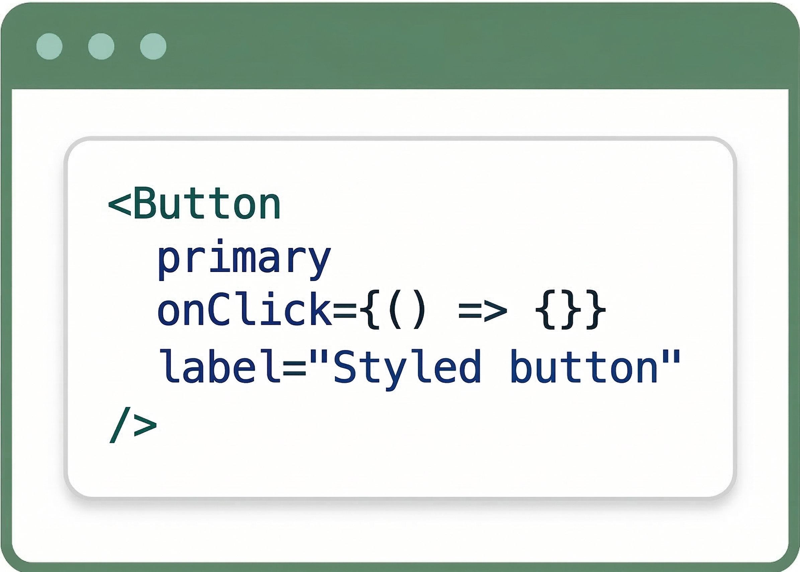

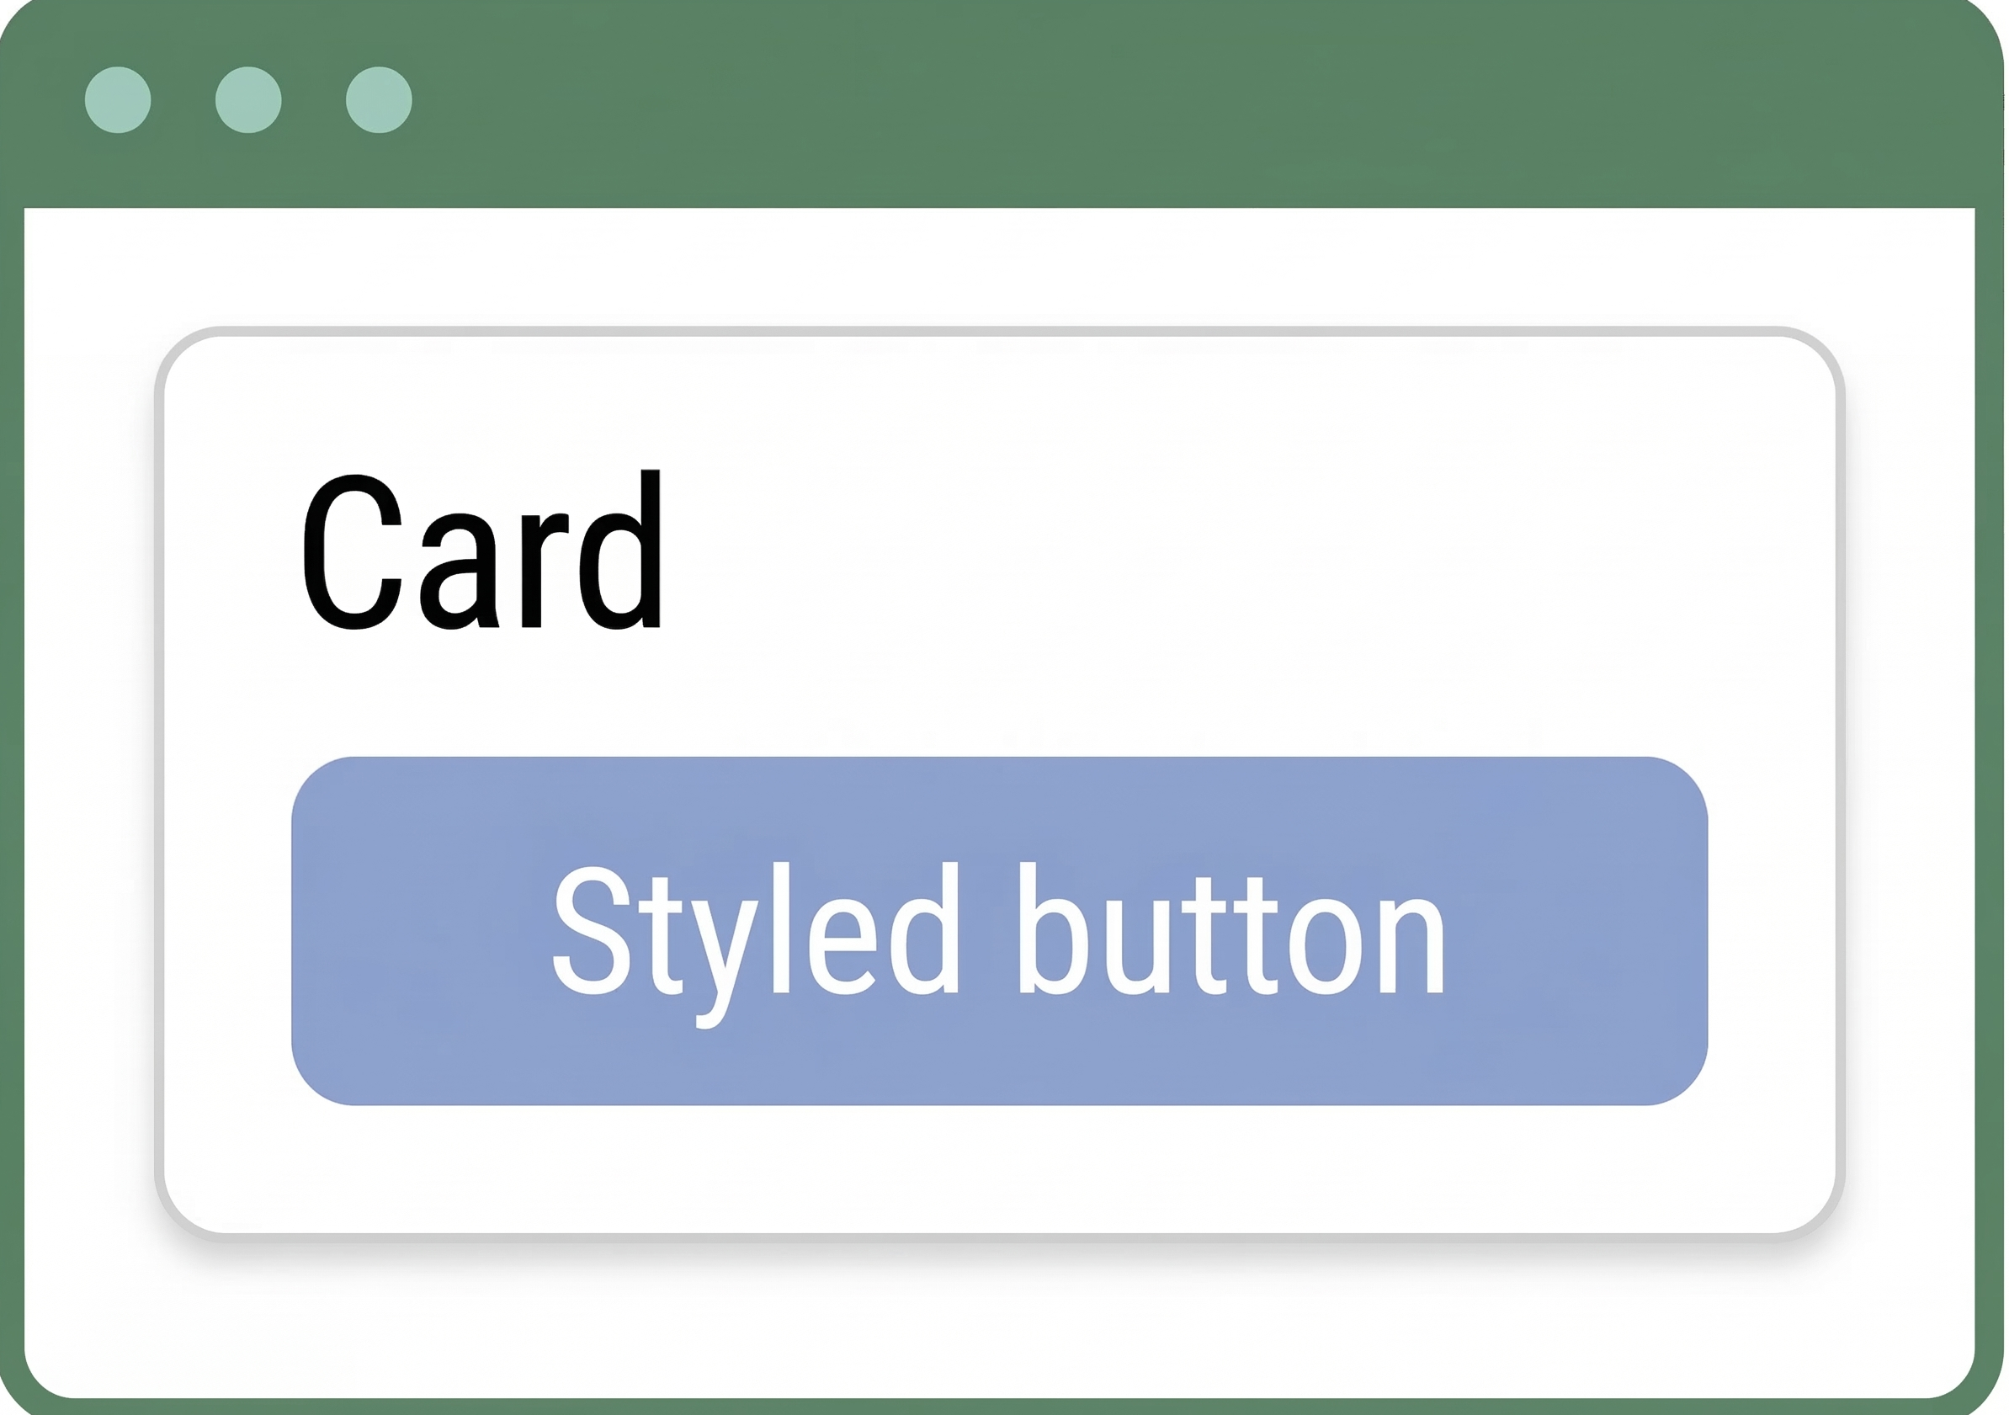
React/Grommet framework for frontend improves state management, code maintainability, and user interaction
Web Browser
React JSX allows creation, access, and manipulation of DOM elements in the same place.
Grommet provides styling and theming via reusable components.
Notes:
Cecilia
React allows UI to be function of current data, or state
react declarative: when data changes, the web app automatically calculates the most efficient way to update the screen without manual manipulation of DOM
single source of truth in React: react components manage internal state and data flows between parent and child elements easily. when a value changes in one place, it changes everywhere
Grommet: pre-built components that are modular and can be easily reused
(can mention this)
React is current industry standard for front-end development
React is the framework that we are choosing because allows code to be divided into components
This increases maintainability of code since makes different parts of code more easily reusable

Slide 15












React migration resulted in tech stack improvements to developer experience and shorter build time
Feature | Classic | React / New Updates
State Management | Manual tracking of user interaction and input, and interface updates are tedious. | Automatic re-rendering of app based on user interaction and input, simplifying code.
Bug Fixes | Repetitive and complicated code makes bugs more likely and harder to find. | Modular code allows for easier discovery of bugs and fewer bugs created.
Frontend
Backend
Build Tool
Testing
Notes:
Cecilia
Improved code readability and state-management
code is more modular because of the nature of component behavior
migrated testing framework over to vitest because it is built-in framework for vite, which allows us to create optimized builds of web app for development and release to production. in Classic just use Node.js
Advanced interactive features
GRNsight positioned to continue expanding functionality as new visualization needs arise

Slide 16
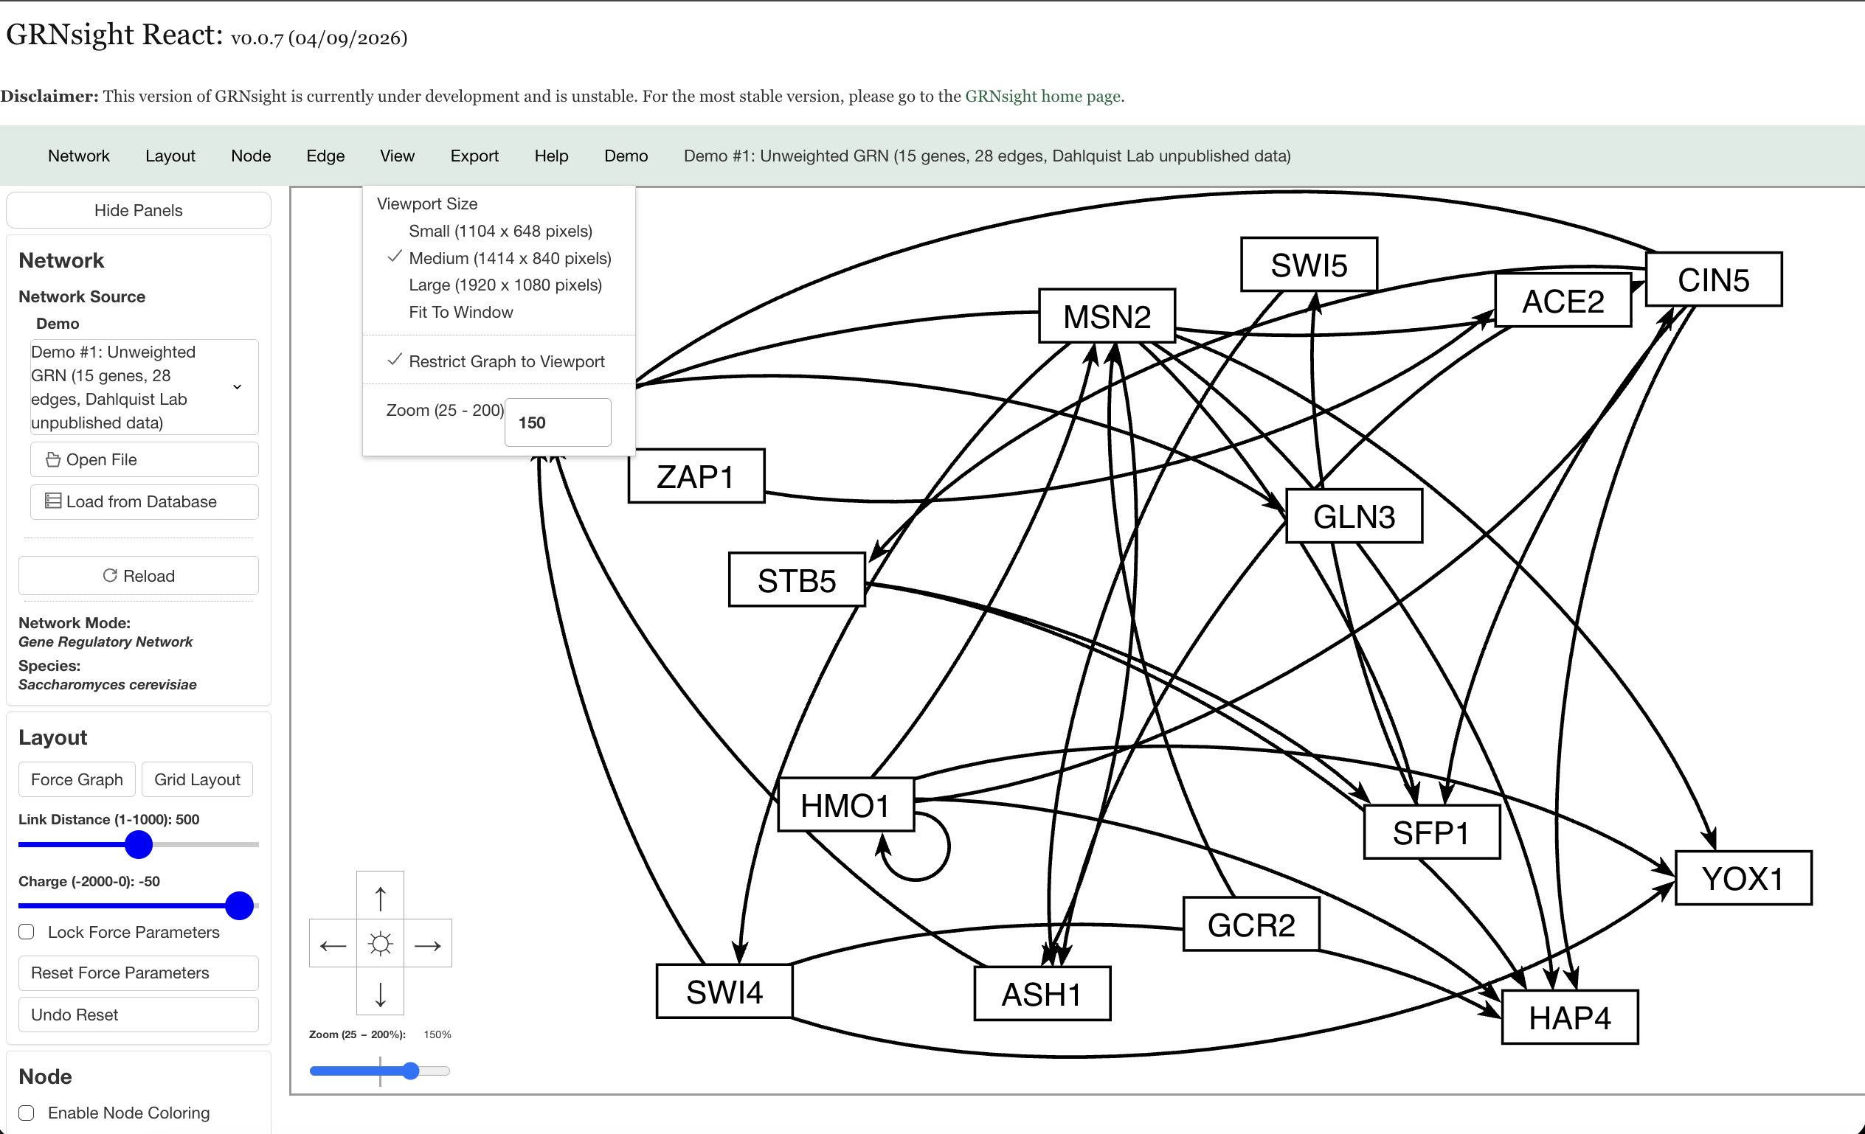
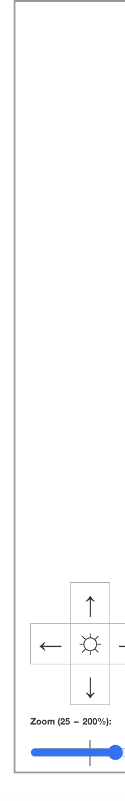
GRNsight React went live on October 15, 2025,
and can now display graphs
https://dondi.github.io/GRNsight/react-thesis-4081/
Viewport size, panning, and zoom are available graph features
Notes:
Cecilia
can display graphs and demos

Slide 17

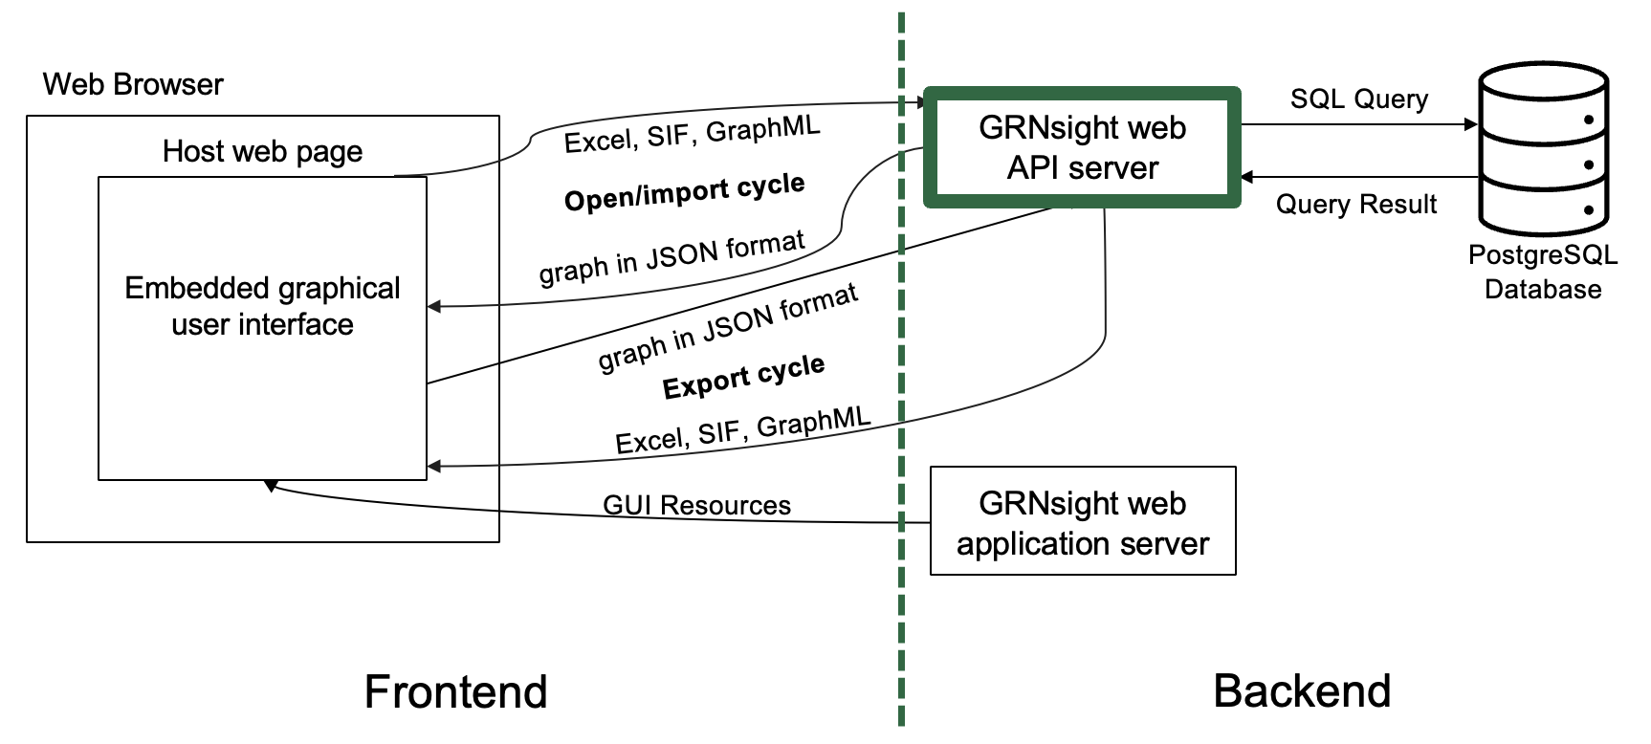
Clients send different requests to the workers in the back
Requests
Load Demo
Classic Client
Import Files
(Excel, SIF, GraphML)
Export Graph
API Server
React Client
Load from Database
Notes:
Cecilia

Slide 18
Workers process the requests and return proper results to clients
Workers Response
Classic Client
JSON of Graph
Downloadable Files
API Server
React Client
Notes:
Cecilia

Slide 19
Outline
GRNsight is an open-source tool that allows for easier visualization of
Gene Regulatory Networks (GRN) and Protein-Protein Interactions (PPI).
GRNsight is an integral part of a data analysis workflow for biologists who model GRNs.
GRNsight’s interface was originally built using older web tools, leading to repeated code and making user interface updates difficult.
I have migrated GRNsight’s user interface to React, Vite, and Grommet UI which are modern, scalable, and industry-standard frameworks.
GRNsight React migration has resulted in user interface improvements and bug fixes that enhance the user experience for biologists.
Notes:
Maika

Slide 20
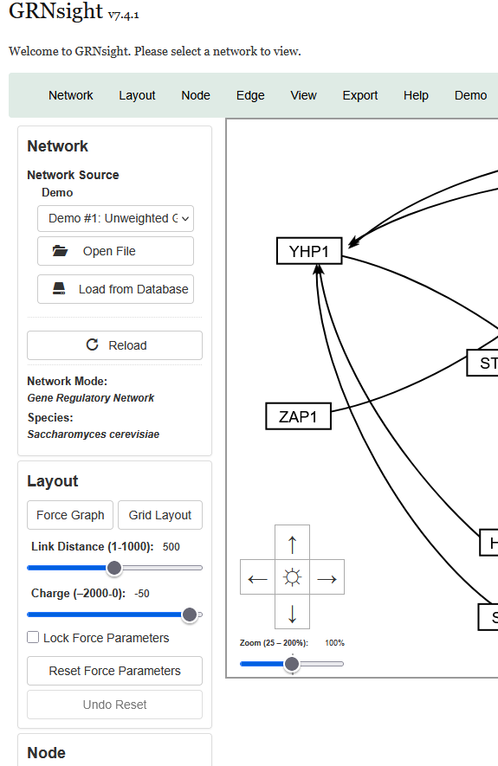
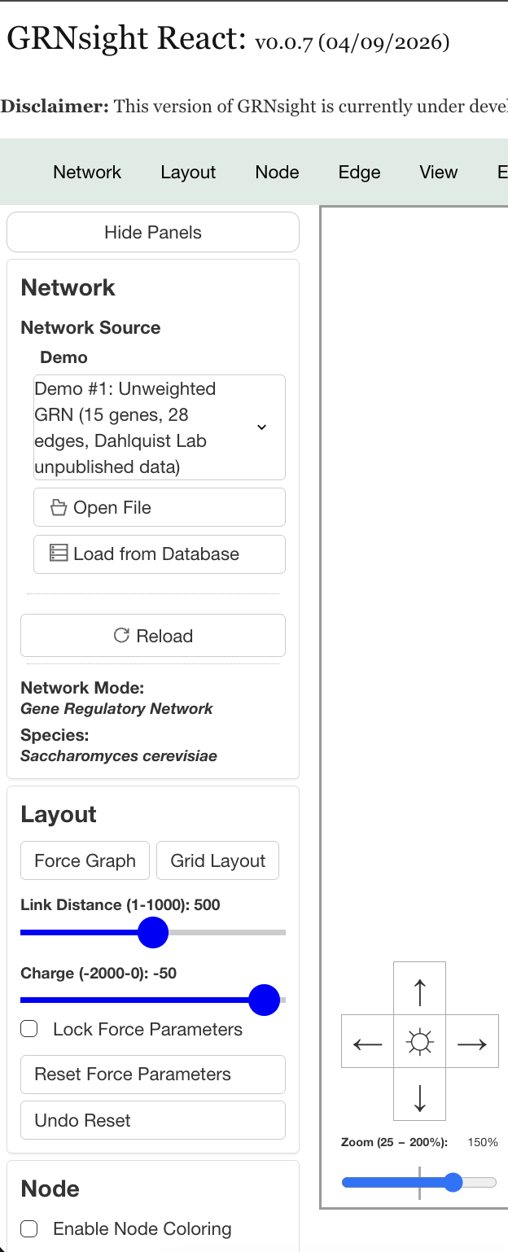
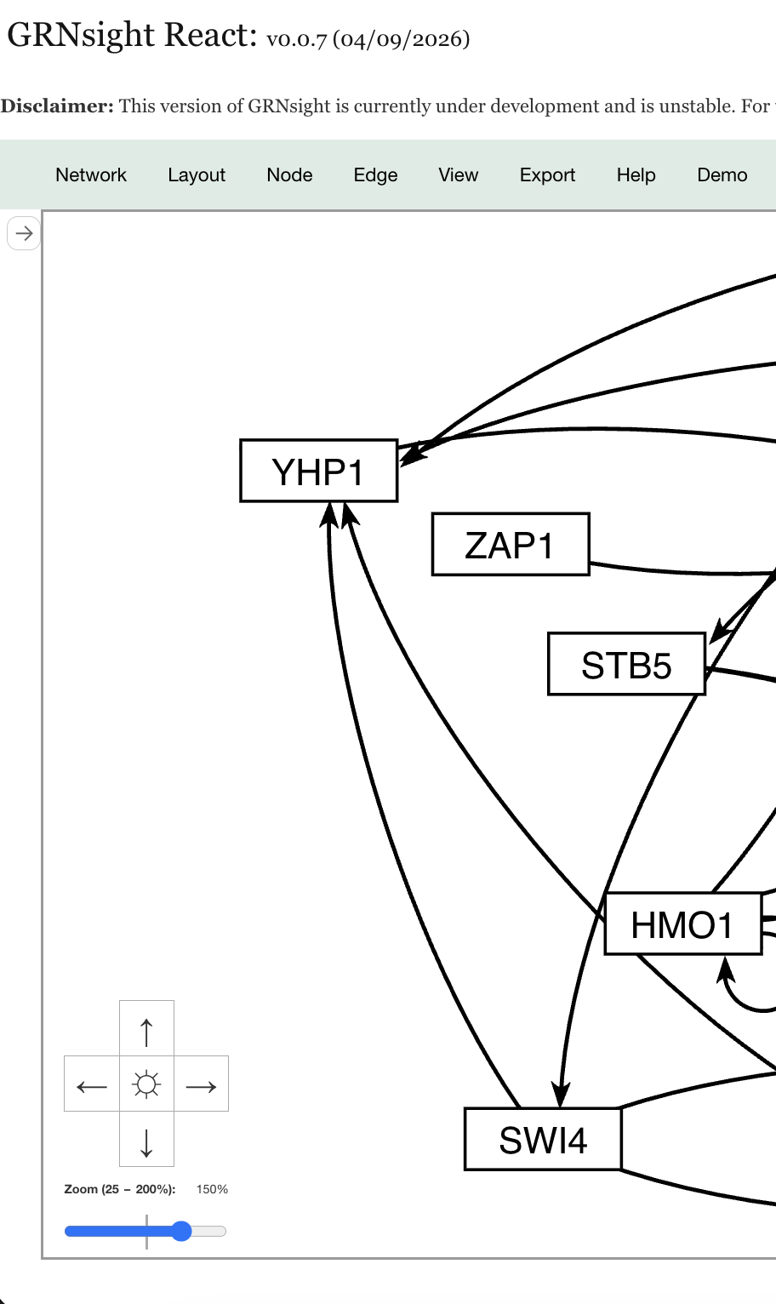
React streamlined the fast implementation of collapsible side panels
Notes:
Cecilia
State management and component structure allows for more complex UI manipulation
easier to pass value across the app, and any changes made to a variable in one place in the app can cause a re-render of the graph, see updates immediately without any extra work
Also easier to enhance user interaction
Can easily hide or show panels without too much extra work (because of state variables)

Slide 21
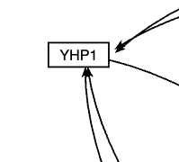
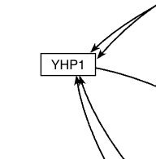
The high-level code review facilitated the fixing of a long-standing arrowhead bug in GRNsight Classic
Classic Arrowheads with space between the perimeter
React Arrowheads touching the perimeter of the node
Notes:
we had a bug in classic where the arrowhead for the edge was too far to one side of the node, and this was fixed in react code over
illustrates that benefit to migrating code over, although it may require time and effort, can allow for improvements of app and resolution of long-standing bug issues

Slide 22
Automated deployment of React app makes release process simpler and less manual
Developer finishes code
Developer finishes code
Push code to GitHub Repo
Push code to GitHub Repo
Manually pull code from main/beta
to server
Automated GitHub Action creates build and deploys
GitHub Pages Live Application
GitHub Pages Live Application
Classic
React
Notes:
currently cycle to deploy is that have to push code to beta and build to gh-pages separately
goal is to automate this

Slide 23
Future Work
Migration | Future Work
Node Coloring
Integrate React app to main GRNsight application
Open File Tests
Notes:
Cecilia

Slide 24
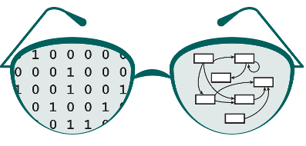
🥂
🎂
🎉
🎈
GRNsight turned 12 years old this year!
Viewport and bounding box separated
Zooming and scrolling
Edge weight normalization factor
Model-View-Controller paradigm introduced
Port to React
Load database from Alliancemine
Backend GRN database from YeastMine
v1 (2014-16)
v2 (2016-18)
v3 (2018)
v4 (2019)
v5 (2019-22)
v6 (2022-23)
v7 (2023-26)
React (2025-26)
GRNsight server live on March 20, 2014
Loads unweighted and weighted GRNs using D3’s force graph layout
Imports Excel, SIF, GraphML formats
Demo files provided
Import an entire GRNmap-compatible Excel workbook
Node coloring
Expression database
Gene pages
Grid layout
Export to GRNmap-compatible Excel workbook
Refactor expression database
Displays PPIs
Backend PPI database from YeastMine
UI and export improvements
GitHub actions
Notes:
Maybe make this one less complex?

Slide 25
Summary
GRNsight is an open-source tool that allows for easier visualization
of Gene Regulatory Network (GRN) and Protein-Protein Interactions (PPI).
GRNsight is an integral part of a data analysis workflow for biologists who model GRNs.
GRNsight’s interface was originally built using older web tools, leading to repeated code and difficult user interface updates.
I have migrated GRNsight’s user interface to React Vite and Grommet UI which are modern, scalable, and industry-standard frameworks.
GRNsight React migration has resulted in user interface improvements and bug fixes that enhance the user experience for biologists.
Notes:
Cecilia

Slide 26
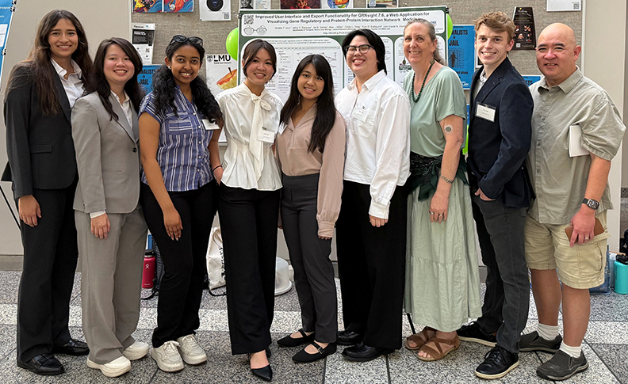



Acknowledgements
Ngoc Kim Ngan Tran
Milka Y. Zekarias
Amelie T. Dinh
Jia S. Garcia
Cindy L. Tong
Kam D. Dahlquist
Alex J. Miller
John David N. Dionisio
LMU Department of Biology
HHMI STEM Research Learning Community
http://dondi.github.io/GRNsight/
https://dondi.github.io/GRNsight/react-thesis-4081/
https://github.com/dondi/GRNsight

Slide 27
References
AZoLifeSciences. “A Guide to Understanding Gene Expression.” AZoLifeSciences, 27 Jan. 2021, www.azolifesciences.com/article/A-Guide-to-Understanding-Gene-Expression.aspx.
“PDB101: Molecule of the Month: Vitamin D Receptor.” RCSB: PDB-101, pdb101.rcsb.org/motm/155.
“PDB101: Molecule of the Month: Cyclin and Cyclin-dependent Kinase.” RCSB: PDB-101, pdb101.rcsb.org/motm/236.

