Slide 1

Dynamical Systems Modeling and Visualization of Yeast Cold Shock Gene Regulatory Networks
Kam D. Dahlquist, Ph.D.
Department of Biology
Loyola Marymount University
SoCalSysBio
UCI
March 16, 2024

Slide 2
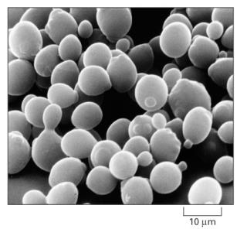
Cold shock is an environmental stress
that is not well-studied
Cold shock temperature range for yeast
is 10-18°C.
The cold shock response can be divided into an early and late response.
General Environmental Stress Response (ESR) genes are induced in the late response.
Late response is regulated by the Msn2/Msn4 transcription factors.
No “canonical” transcription factor responsible for the early response.
Alberts et al. (2004)

Slide 3
Yeast respond to cold shock by changing gene expression
Cold shock temperature range for yeast
is 10-18°C.
The cold shock response can be divided into an early and late response.
General Environmental Stress Response (ESR) genes are induced in the late response.
Late response is regulated by the Msn2/Msn4 transcription factors.
No “canonical” transcription factor responsible for the early response.
Alberts et al. (2004)
Which transcription factors control the early response?
What are their relative levels of influence?
What are the indirect effects of other transcription factors in the gene regulatory network?

Slide 4
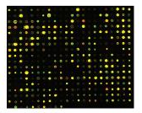
Systems biology approach to understanding the regulation of the cold shock response in yeast
Cold shock microarray data from wt and TF deletion strains

Slide 5
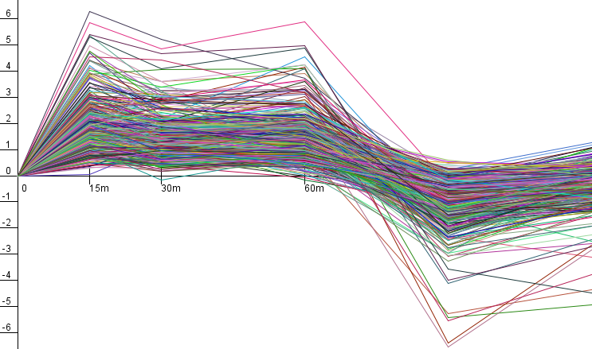
Systems biology approach to understanding the regulation of the cold shock response in yeast
Cold shock microarray data from wt and TF deletion strains
Normalization, statistical analysis, clustering

Slide 6
Systems biology approach to understanding the regulation of the cold shock response in yeast
Cold shock microarray data from wt and TF deletion strains
Normalization, statistical analysis, clustering
Derivation of gene regulatory networks from YEASTRACT

Slide 7
Systems biology approach to understanding the regulation of the cold shock response in yeast
Cold shock microarray data from wt and TF deletion strains
Normalization, statistical analysis, clustering
Derivation of gene regulatory networks from YEASTRACT
Dynamical systems modeling using GRNmap

Slide 8
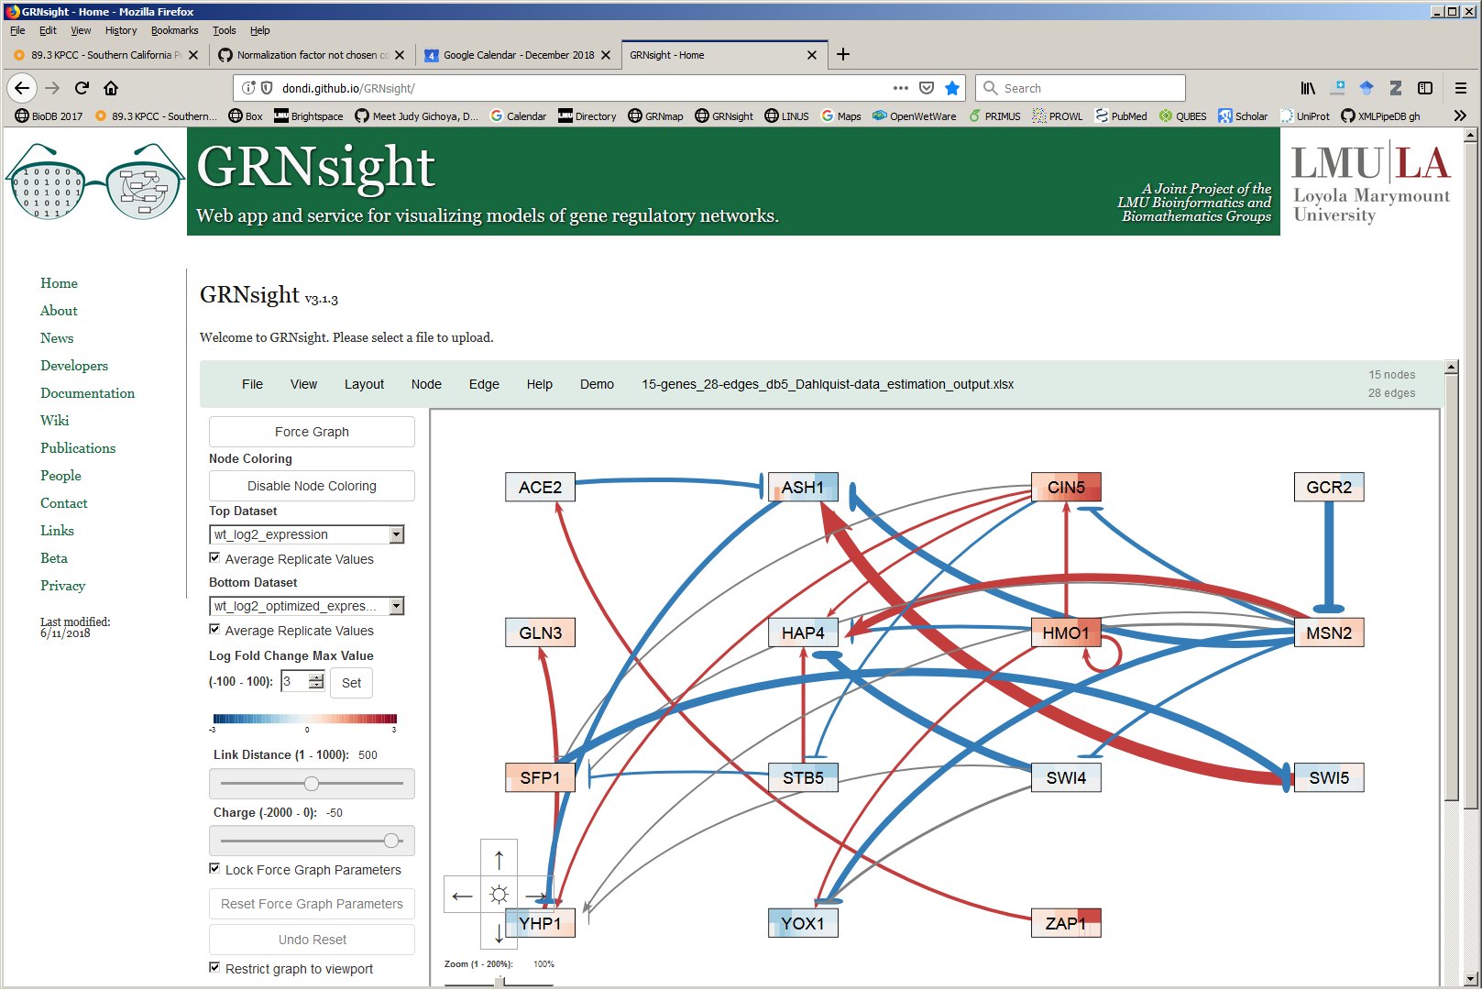
Systems biology approach to understanding the regulation of the cold shock response in yeast
Cold shock microarray data from wt and TF deletion strains
Normalization, statistical analysis, clustering
Visualization of modeling results using GRNsight
Derivation of gene regulatory networks from YEASTRACT
Dynamical systems modeling using GRNmap

Slide 9
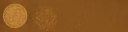
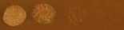
Systems biology approach to understanding the regulation of the cold shock response in yeast
wt
Cold shock microarray data from wt and TF deletion strains
15°C
Δash1
Interpretation,
new questions, new experiments
Normalization, statistical analysis, clustering
Visualization of modeling results using GRNsight
Derivation of gene regulatory networks from YEASTRACT
Dynamical systems modeling using GRNmap

Slide 10
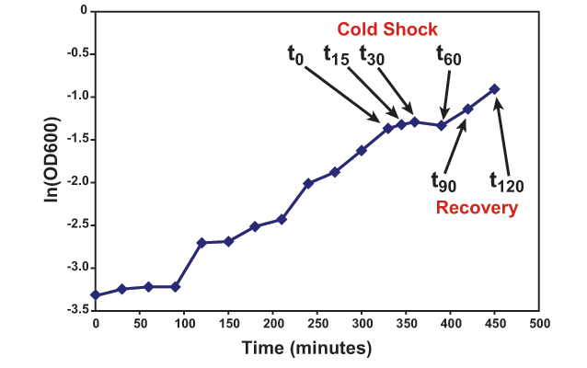
Yeast cells were harvested for microarrays before, during, and after a cold shock and during recovery

Slide 11
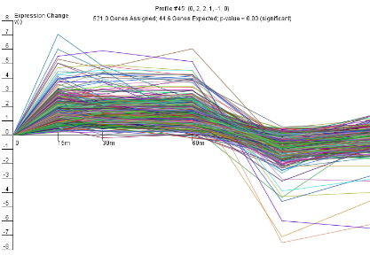
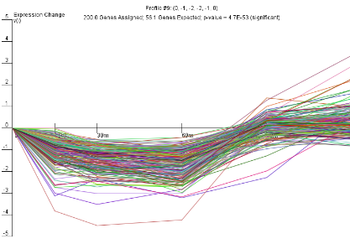
Two dominant expression profiles respond to cold shock and recovery
Expression (log₂ fold change)
Time (minutes)
Gene Ontology categories assigned to clusters:
Ribosome biogenesis
Zinc ion homeostasis
Hexose transport
Endomembrane system
Protein and vesicle transport
Negative regulation of nitrogen
compound process
stem software: Ernst & Bar-Joseph (2006)

Slide 12
Genes with similar expression profiles are regulated by the same transcription factor
Expression (log₂ fold change)
Time (minutes)
Which transcription factors regulate these genes?

Slide 13
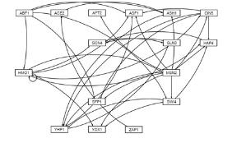
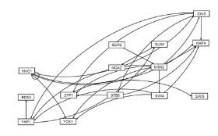
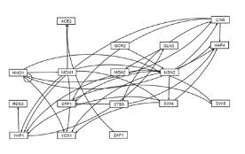
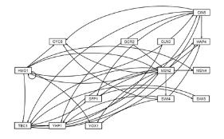
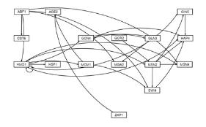
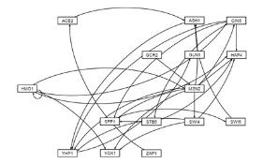
Six candidate GRNs were derived from the YEASTRACT database
Clusters of genes from each strain’s stem analysis were input into YEASTRACT to find potential regulators.
The top 15 potential regulators for each strain’s data were used to generate a regulation matrix.
Transcription factors for which we had deletion strain microarray data were also included.

Slide 14
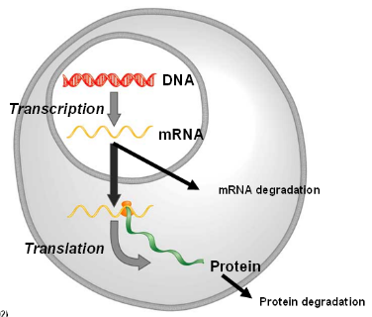
GRNmap: Gene Regulatory Network Modeling And Parameter estimation
The change in expression of one gene is production – degradation.
Weight parameter, w, gives the direction (activation or repression) and magnitude of regulatory relationship.
Freeman (2003)
http://kdahlquist.github.io/GRNmap/

Slide 15
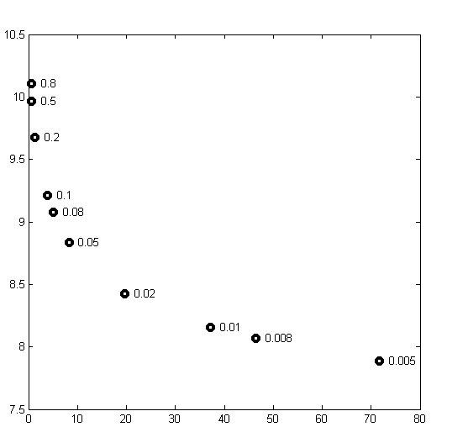
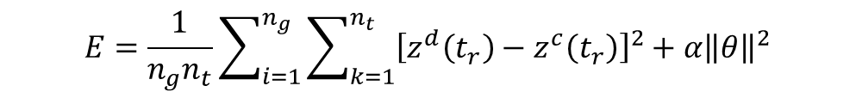
Parameter values are estimated from the time course expression data using a least squares error function
$$E=\frac{1}{n_{g}n_{t}}\sum_{i=1}^{n_{g}}{\sum_{k=1}^{n_{t}}{{\left[z^{d}\left(t_{r}\right)−z^{c}\left(t_{r}\right)\right]}^{2}}}+α{\left\|θ\right\|}^{2}$$
“First Pass” Network
Total number of parameters is
(2 X no. of genes) + no. of edges.
A penalty term forces MATLAB’s optimization algorithm to minimize the function.
θ is the combined production rate, weight, and threshold parameters.
α is determined from the “elbow” of the L-curve.
E represents the difference between the microarray data and simulated data generated by the model.
α = 0.02
Least Squares Residual (E)
Parameter Penalty Magnitude (θ)
Dahlquist et al. (2015) Bulletin of Mathematical Biology 77: 1457.
Notes:
Define alpha and beta and K

Slide 16
Forward simulation of the model fits the expression data well
Notes:
Define alpha and beta and K

Slide 17
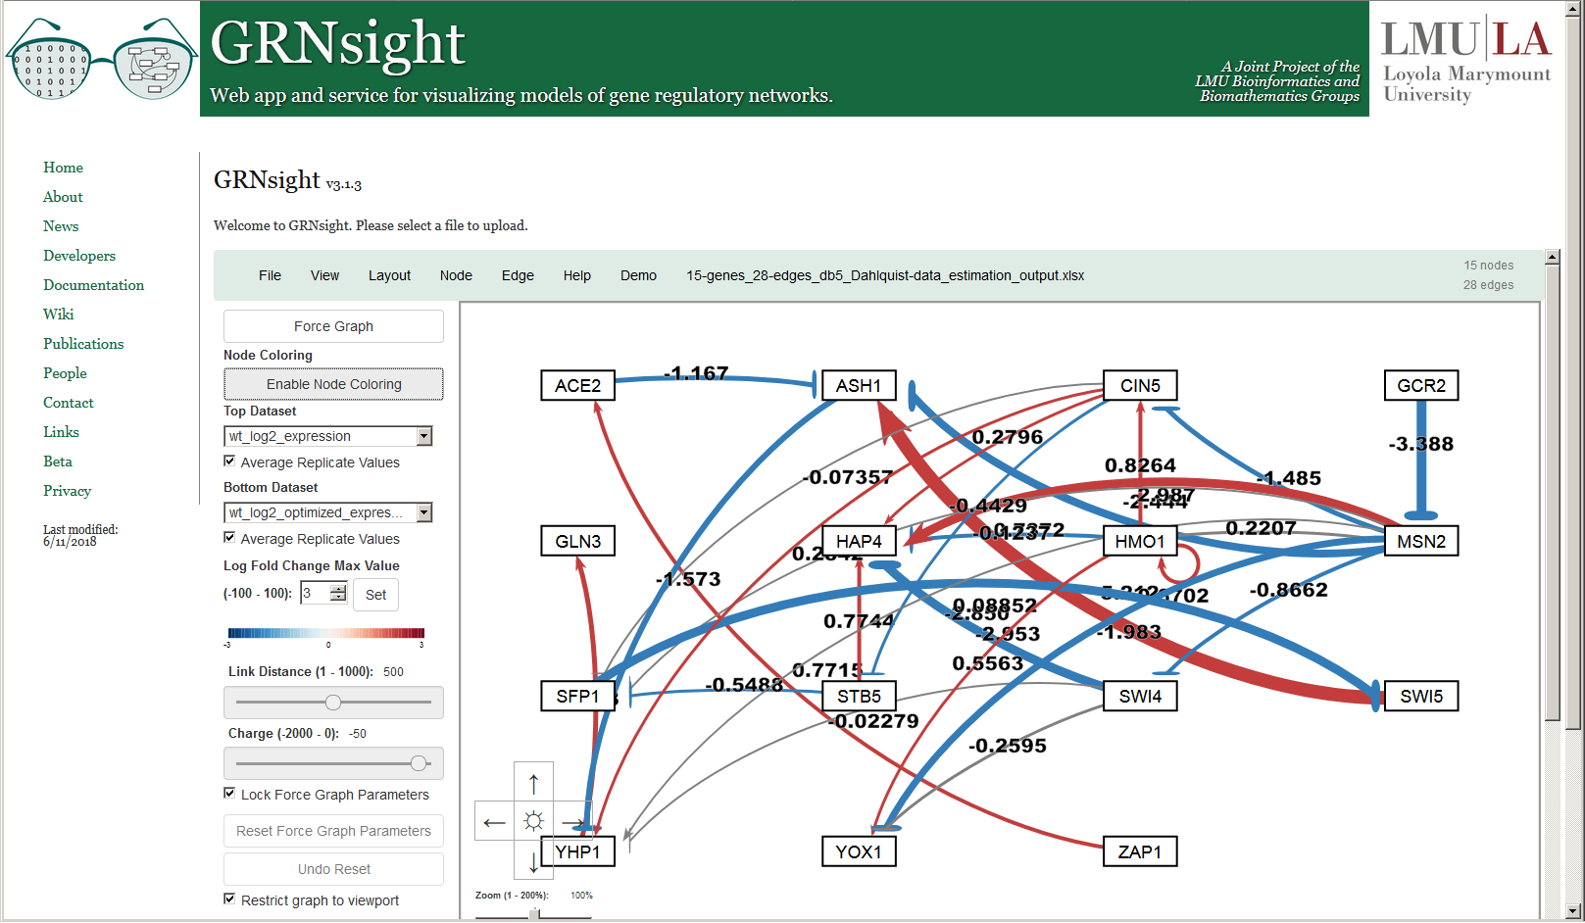
GRNsight automatically lays out GRNmap model results, displaying weight parameters
New in Version 2

Slide 18
Generally, we can see a good concordance between the measured and simulated expression data
Top = wild type microarray data
Bottom = wild type model simulated data

Slide 19
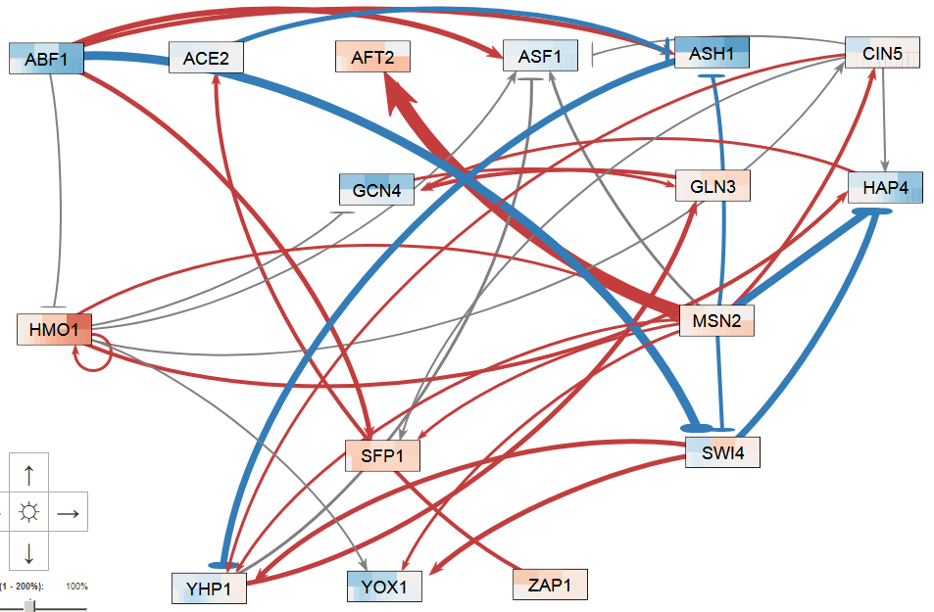
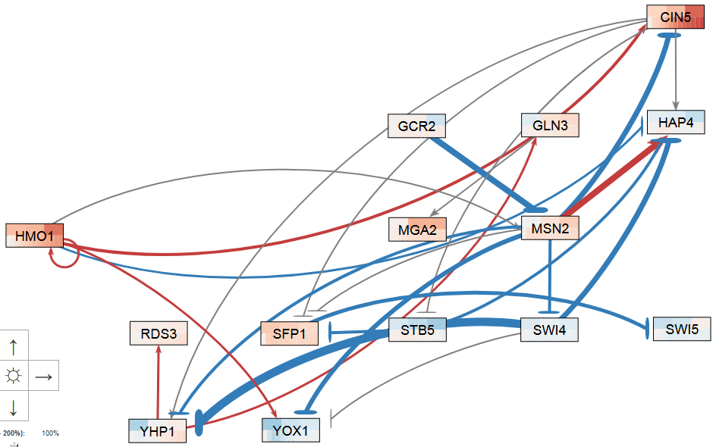
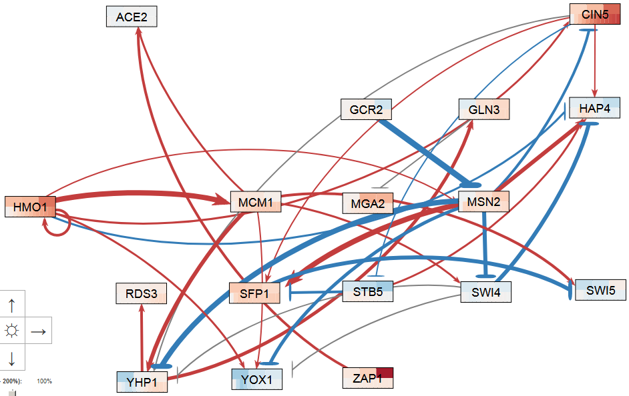
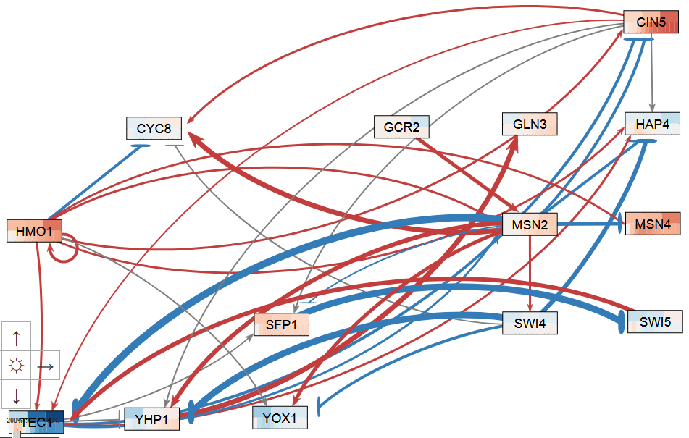
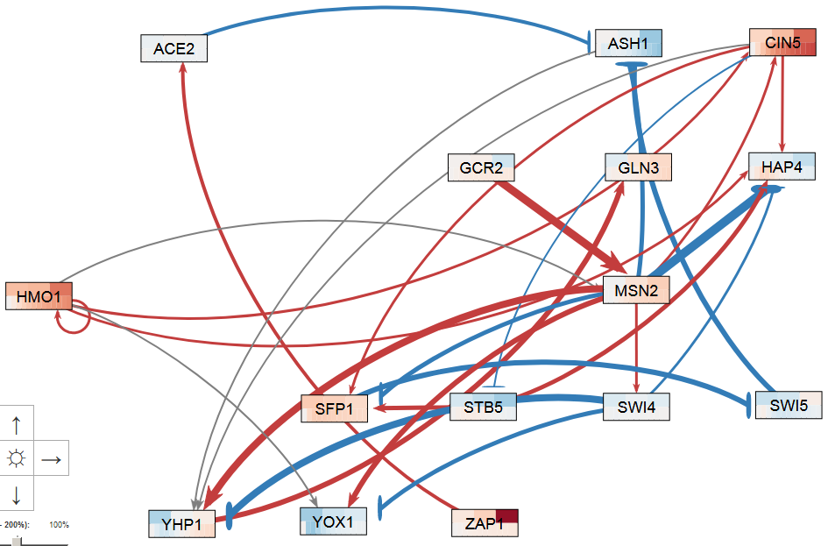
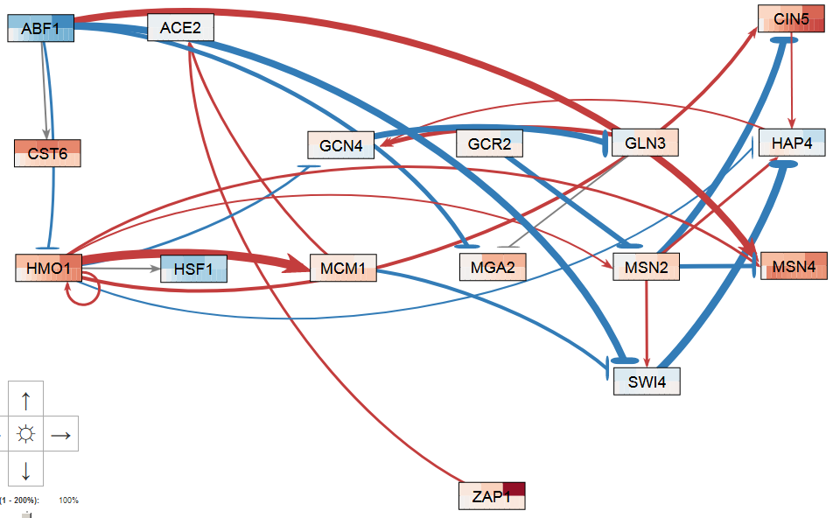
LSE:minLSE ratio used to determine relative model performance
db1: 16 Genes, 26 Edges
LSE:minLSE = 1.42
db2: 14 Genes, 25 Edges
LSE:minLSE = 1.36
db3: 17 Genes, 32 Edges
LSE:minLSE = 1.41
db4: 14 Genes, 35 Edges
LSE:minLSE = 1.30
db5: 15 Genes, 28 Edges
LSE:minLSE = 1.43
db6: 16 Genes, 27 Edges
LSE:minLSE = 1.40
Notes:
Figure 4. GRNsight visualization highlights salient features of db1-db6. Transcription factors are represented by boxes and arranged in a consistent array. Regulatory relationships are represented by arrows directed from regulator to target. Pointed arrowheads and magenta coloration indicate activation, whereas flat arrowheads and cyan coloration indicate repression. Edges colored in grey exhibit small influence, meaning their associated weights are <5% of the maximum edge weight in the network.
Enlarge images of networks, present 2 per row, or rotate CCW 90 degrees.

Slide 20
Modeling revealed consistent regulatory relationships among sets of transcription factors
 | db1 | db2 | db3 | db4 | db5 | db6 |  | db1 | db2 | db3 | db4 | db5 | db6
ABF1->ASF1 |  |  |  |  |  |  | MCM1->SWI4
ABF1->ASH1 |  |  |  |  |  |  | MCM1->SWI5
ABF1->CST6 |  |  |  |  |  |  | MCM1->YHP1
ABF1->HMO1 |  |  |  |  |  |  | MCM1->YOX1
ABF1->MGA2 |  |  |  |  |  |  | MSN2->AFT2
ABF1->MSN4 |  |  |  |  |  |  | MSN2->ASF1
ABF1->SFP1 |  |  |  |  |  |  | MSN2->ASH1
ABF1->SWI4 |  |  |  |  |  |  | MSN2->CIN5
ACE2->ASH1 |  |  |  |  |  |  | MSN2->CYC8
ASH1->YHP1 |  |  |  |  |  |  | MSN2->HAP4
CIN5->ASF1 |  |  |  |  |  |  | MSN2->MSN4
CIN5->CYC8 |  |  |  |  |  |  | MSN2->SFP1
CIN5->HAP4 |  |  |  |  |  |  | MSN2->SWI4
CIN5->SFP1 |  |  |  |  |  |  | MSN2->TEC1
CIN5->STB5 |  |  |  |  |  |  | MSN2->YHP1
CIN5->TEC1 |  |  |  |  |  |  | MSN2->YOX1
CIN5->YHP1 |  |  |  |  |  |  | SFP1->SWI5
GCN4->GLN3 |  |  |  |  |  |  | STB5->HAP4
GLN3->GCN4 |  |  |  |  |  |  | STB5->SFP1
GLN3->MGA2 |  |  |  |  |  |  | SWI4->CYC8
GCR2->MSN2 |  |  |  |  |  |  | SWI4->HAP4
HAP4->GCN4 |  |  |  |  |  |  | SWI4->YHP1
HMO1->ASF1 |  |  |  |  |  |  | SWI4->YOX1
HMO1->CIN5 |  |  |  |  |  |  | SWI5->ASH1
HMO1->CYC8 |  |  |  |  |  |  | SWI5->TEC1
HMO1->GCN4 |  |  |  |  |  |  | TEC1->CIN5
HMO1->HAP4 |  |  |  |  |  |  | TEC1->HAP4
HMO1->HMO1 |  |  |  |  |  |  | TEC1->MSN2
HMO1->HSF1 |  |  |  |  |  |  | TEC1->SFP1
HMO1->MCM1 |  |  |  |  |  |  | TEC1->YHP1
HMO1->MSN2 |  |  |  |  |  |  | YHP1->ASF1
HMO1->MSN4 |  |  |  |  |  |  | YHP1->GLN3
HMO1->TEC1 |  |  |  |  |  |  | YHP1->RDS3
HMO1->YOX1 |  |  |  |  |  |  | ZAP1->ACE2
MCM1->ACE2
Maximum: 1
Minimum : -1
Notes:
Table 5. Heat map visualizing regulatory weights for each of the sixty-nine edges represented in db1-db6. Positive weights are indicated by red and negative weights by blue. Darker shades correspond to higher magnitude weights. All values were normalized to the largest magnitude weight, MSN2→AFT2, in db1.

Slide 21
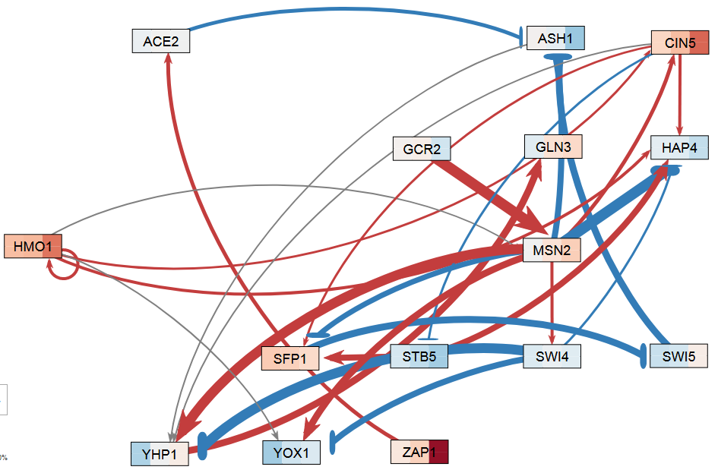
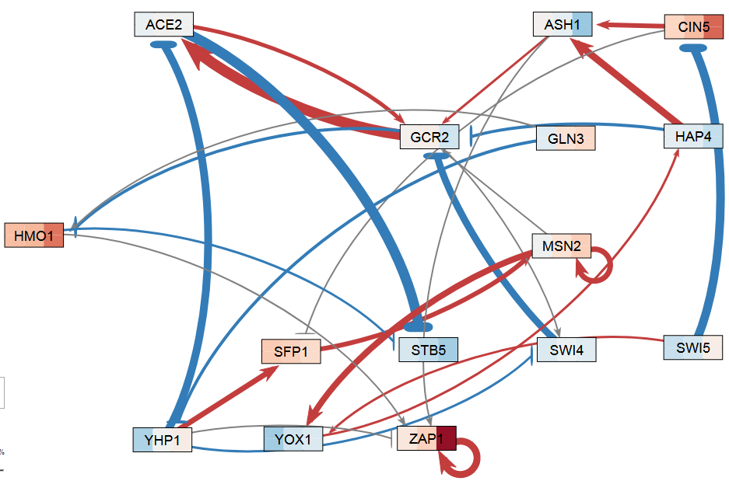
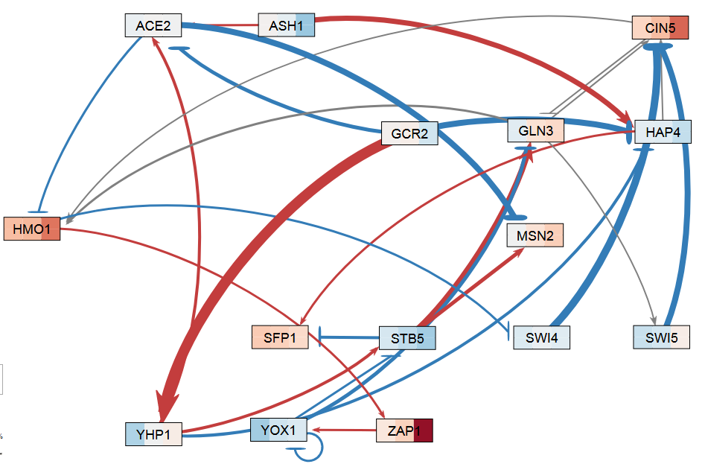
DB5 outperforms 30 random networks containing the same genes and numbers of edges
Ratio of the Observed Least Squares Error to the Minimum Theoretical Least Squares Error
db5
rand24
rand7
Notes:
Figure 8. The network derived from ∆hap4 strain data, db5, generally outperformed 30 random networks composed of the same transcription factors and containing the same number of edges. The LSE:minLSE ratios for db1-db6 are reported on the left and for the thirty random networks on the right. The arrows indicate the bars corresponding to db5 (black), the three best performing random networks (green), and the three worst performing random networks (purple). A horizontal line is drawn demarcating the LSE:minLSE ratio of db5 for comparison.

Slide 22
In general, random networks that share more connections with DB5 perform better
Horizontal Line: LSE:minLSE ratio of db5 (1.4263).
Vertical Line: median number of regulatory relationships shared with db5 (2).
Notes:
Figure 9. LSE:minLSE Ratio of Random Networks vs. # of Regulatory Relationships Shared with db5. The vertical line indicated the median number of regulatory relationships shared with db5 (2). The horizontal line marks the LSE:minLSE ratio of db5 (1.4263).
Q4 is conspicuously empty (except for point where x=7), whereas Q3 contains several points. However, in Q1 & Q2, points appear to slope downwards.
Suggests that for networks that performed worse than db5, having common edges tended to boost performance. However, to exceed db5, rewiring of the network was required.

Slide 23
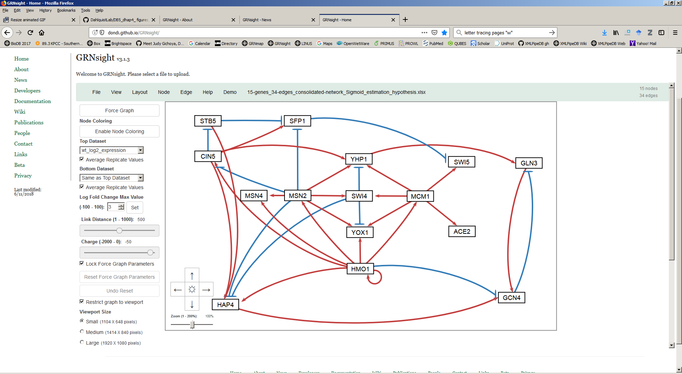
A hypothesis network was constructed and contains key regulators that are also paralog pairs
15 genes and 34 edges
ACE2/SWI5 and YHP1/YOX1 regulate the cell cycle.
MSN2/MSN4 regulate the general environmental stress response, repressing ribosome biogenesis.
HMO1 induces TORC1-dependent upregulation of ribosome biogenesis .
Notes:
15 genes, 34 edges (highly connected; most similar to db4 in this respect, which had lowest LSE:minLSE ratio but also included TEC1).
Colored pairs = paralogs.
Orange borders = known cold-sensitive phenotypes on SGD.
Green borders = tested by Dahlquist lab.
Light grey shading = appears distinct from ESR (not MSN2/4 mediated).
GCN4 has eigen of 1 in both nSFP1 in 5/6 networks + high eigen + consistent repression of SWI5.
etworks where it appears… connects disparate “modules” and created negative feedback loop.
Nodes that did not make it: TEC1 (highly connected, but 1 network), GCR2 (5/6, but negligible experimental expression ∆), CST6 (known cold phenotype, but only connected to ABF1, which is not in this GRN).

Slide 24
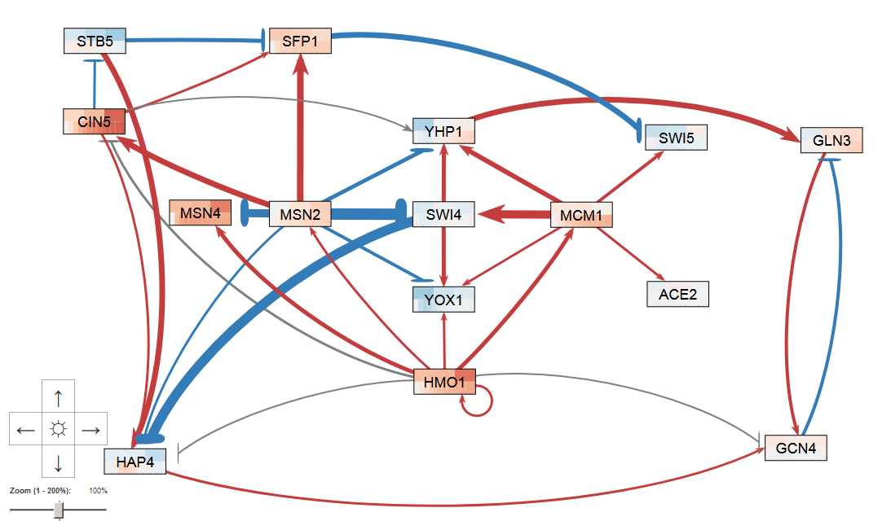
LSE:minLSE from the hypothesis network is smaller than 5 of 6 database-derived networks
Hypothesis
Modeling Results
LSE:minLSE = 1.34
25 out of 34 (74%) activation or repression relationships predicted correctly.
Notes:
15 genes, 34 edges (highly connected; most similar to db4 in this respect, which had lowest LSE:minLSE ratio but also included TEC1).
Colored pairs = paralogs.
Orange borders = known cold-sensitive phenotypes on SGD.
Green borders = tested by Dahlquist lab.
Light grey shading = appears distinct from ESR (not MSN2/4 mediated).
GCN4 has eigen of 1 in both nSFP1 in 5/6 networks + high eigen + consistent repression of SWI5.
etworks where it appears… connects disparate “modules” and created negative feedback loop.
Nodes that did not make it: TEC1 (highly connected, but 1 network), GCR2 (5/6, but negligible experimental expression ∆), CST6 (known cold phenotype, but only connected to ABF1, which is not in this GRN).

Slide 25
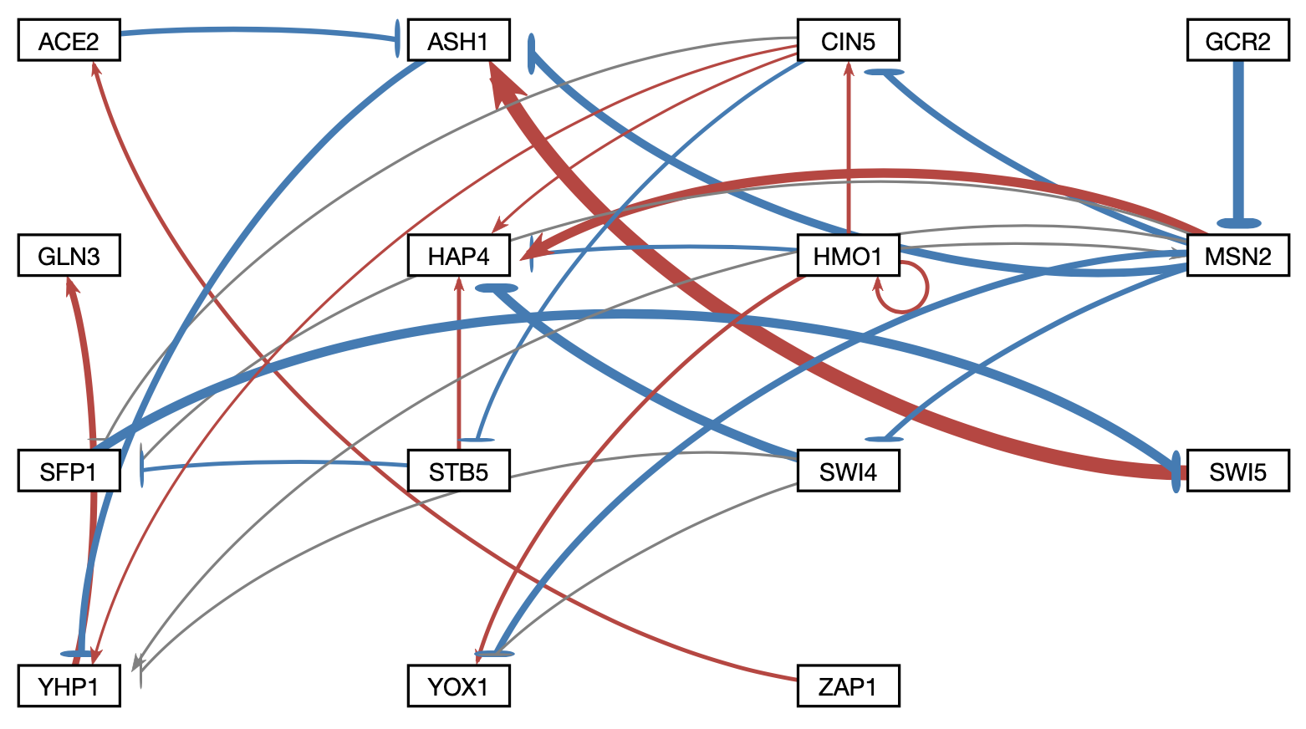
Another approach was to systematically delete each of the 28 edges and re-estimate the parameters

Slide 26
LSE:minLSE ratio compared for 28-edge deletion networks
Notes:
The LSE:minLSE ratio describes how well the GRN was modeled by GRNmap and allows for the comparison of the intact network to each of the edge deletion networks.
A lower LSE:minLSE ratio (a ratio closer to 1) means that the GRN that resulted from the edge deletion is a better fit to the experimental data.
The deletions of HMO1→CIN5 (C) and ZAP1→ACE2 (D) both improved the fit of the model. The deletion of ZAP1→ACE2 resulted in the largest drop in LSE:minLSE ratio, therefore it is likely not a crucial edge in the network.
The deletions of SWI5→ASH1 (E) and GCR2→MSN2 (F) both result in a larger LSE:minLSE than the intact network, which suggest that those edges are important to the network.

Slide 27
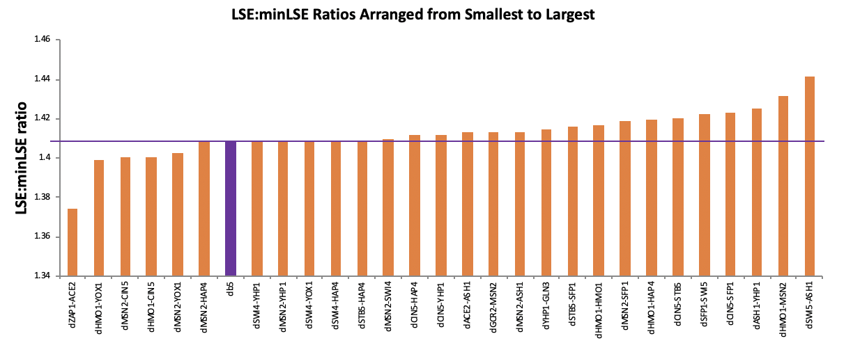
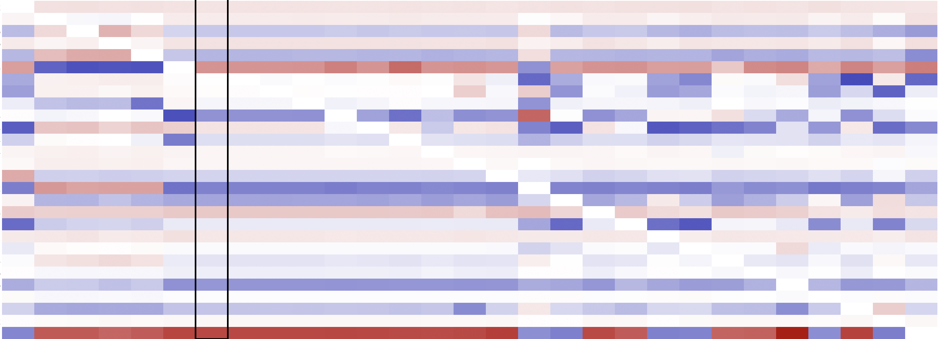
A heatmap of the weight parameters reveals 5 major groupings
1
2
3
4
5

Slide 28
One network from each group was selected for further analysis
1
2
3
4
5
1) Edge ZAP1→ACE2 deleted
2) Edge HMO1→CIN5 deleted
3) Edge MSN2→YHP1 deleted
4) Edge GCR2→MSN2 deleted
5) Edge SWI5→ASH1 deleted

Slide 29
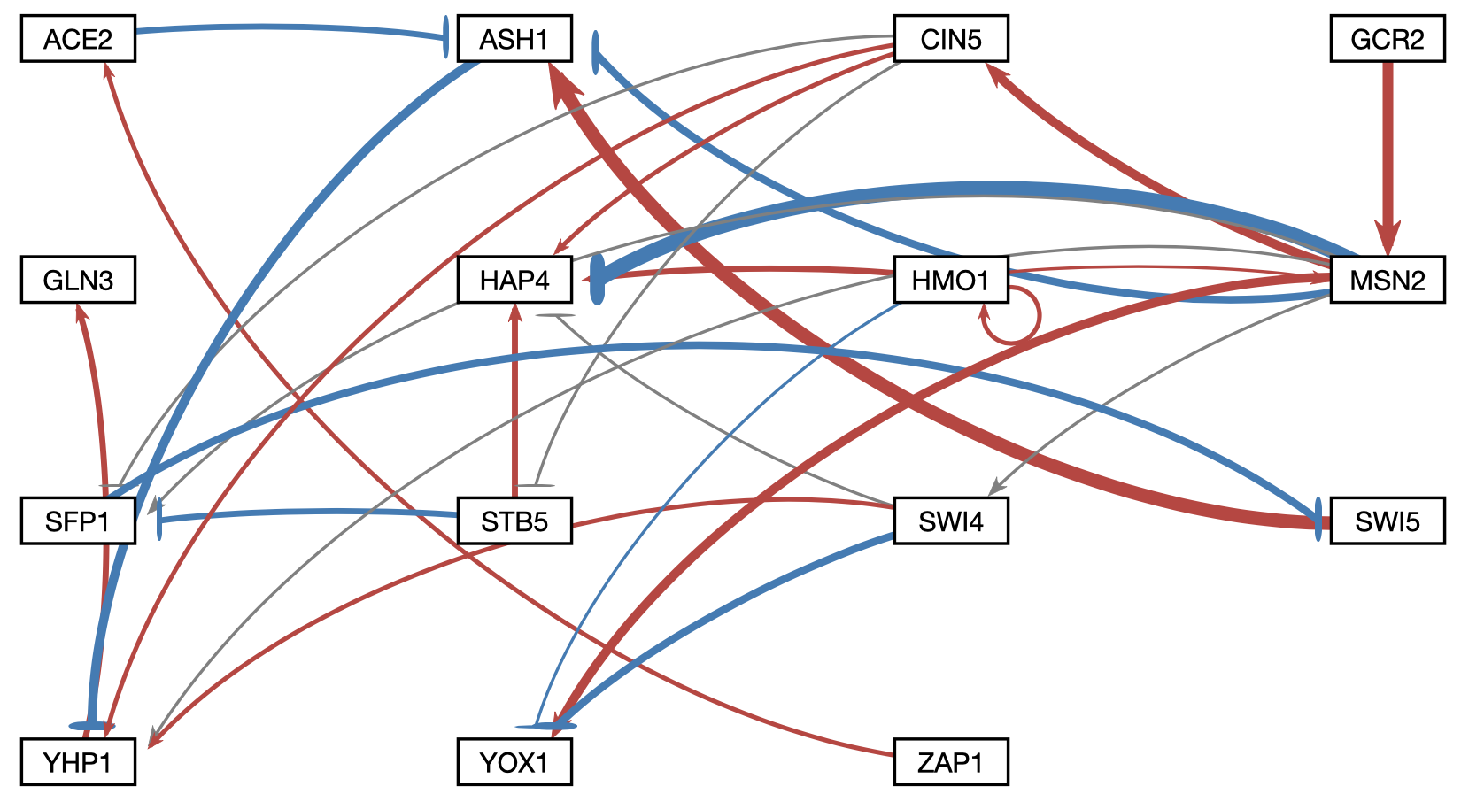
HMO1, CIN5, and MSN2 are central hubs in the network
Intact Network
Group 2: Edge HMO1→CIN5 deleted
*
*
*
*
*
*
*
*
*
*
*
*
*
*
LSE:minLSE = 1.41
LSE:minLSE = 1.40
Notes:
I am summarizing a lot of data, but visually what we arw looking at is that CIN5, MSN2, and HMO1 seem to be critical hubs

Slide 30
Systems biology approach to understanding the regulation of the cold shock response in yeast
wt
Cold shock microarray data from wt and TF deletion strains
15°C
Δash1
Interpretation,
new questions, new experiments
Normalization, statistical analysis, clustering
Visualization of modeling results using GRNsight
Derivation of gene regulatory networks from YEASTRACT
Dynamical systems modeling using GRNmap

Slide 31
Conclusions
Which transcription factors control the early response to cold shock?
Experimental and modeling results suggest Cin5, Gln3, Hap4, Hmo1, Msn2, and Swi4 play important roles.
What are their relative levels of influence?
Expression of target genes is regulated by a balance of activating and repressing transcription factors.
What are the indirect effects of other transcription factors in the gene regulatory network?
Different approaches to analysis have highlighted the importance of certain edges in the network.

Slide 32
GRNsight: http://dondi.github.io/GRNsight/ GRNmap: http://kdahlquist.github.io/GRNmap
Ben G. Fitzpatrick (LMU Mathematics)
John David N. Dionisio (LMU Computer Science)
Current students:
Nikki C. Chun (Biology '26)
A'Kaia Phelps (Computer Science '26)
Ngoc K. Tran (Computer Science '26)
Cecilia J. Zaragoza (Computer Science '26)
Funding
NSF RUI, Kadner-Pitts Research Grant, SURP, Honors Program, Rains Research Assistant Program

Slide 34
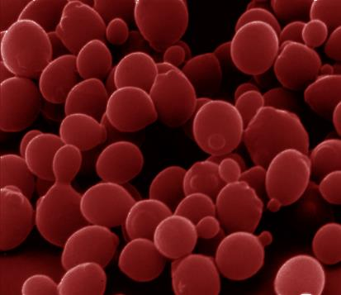
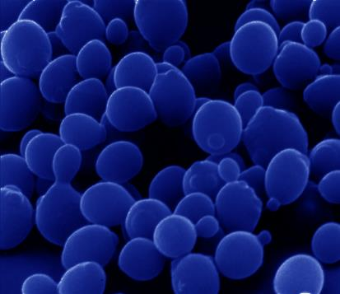
Cold shock is an environmental stress
that is not well-studied
Heat shock
Cold shock
response very well-characterized
proteins denature due to heat
heat shock proteins (chaperonins) induced that assist with protein folding
conserved in all organisms (prokaryotes, eukaryotes)
response less well-characterized
membrane fluidity decreased
DNA and RNA secondary structures stabilized
ribosome function and protein synthesis impaired
enzymatic activities decreased
no equivalent set of cold shock proteins that are conserved in
all organisms

Slide 35
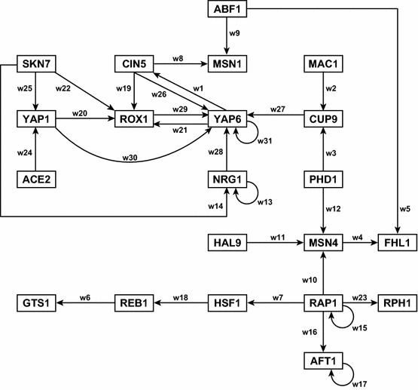
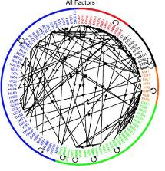
A First Pass at a “Medium-Scale” Gene Regulatory Network that Regulates the Cold Shock Response
Each node represents one gene encoding one transcription factor.
Each edge represents a regulatory relationship, either activation or repression.
Network structure based on Lee et al. (2002) data.
Dahlquist et al. (2015) Bulletin of Mathematical Biology 77: 1457.

Slide 38
An Alpha Value of 0.02 Is Also Reasonable for DB1-DB6
$$E=\frac{1}{n_{g}n_{t}}\sum_{i=1}^{n_{g}}{\sum_{k=1}^{n_{t}}{{\left[z^{d}\left(t_{r}\right)−z^{c}\left(t_{r}\right)\right]}^{2}}}+α{\left\|θ\right\|}^{2}$$
Data for wt and 5 deletion strains are used.
We also experimented with larger networks of up to 35 genes.
This penalized least squares approach is really good at getting the parameters to minimize...
...but, we doubted the results and our ability to interpret them when networks got much larger than ~15 genes.
α = 0.02
Least Squares Residual (E)
Parameter Penalty Magnitude (θ)
Notes:
Define alpha and beta and K

Slide 39
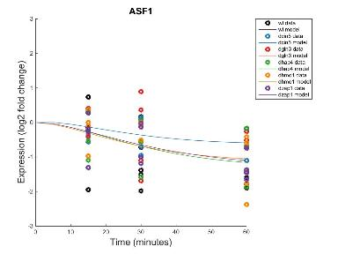
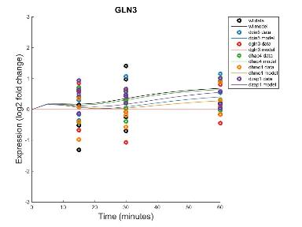
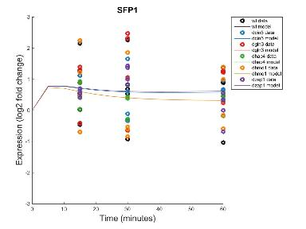
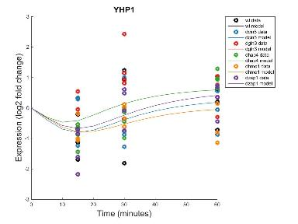
Forward Simulation of the Models Fits the Microarray Data Well (Note that data are noisy!)
Within Strain ANOVA
0.0298
0.4193
0.4165
0.2305
0.8447
0.1669
Within Strain ANOVA
0.4189
0.5468
0.6094
0.5189
0.9281
0.1171
_{MSE:minMSE = 0.3695}
_{MSE:minMSE = 0.2209}
Within Strain ANOVA
0.4097
0.0494
0.0751
0.0533
0.8354
0.0021
Within Strain ANOVA
0.1743
0.8684
0.0433
0.0084
0.8152
0.0653
_{MSE:minMSE = 0.5337}
_{MSE:minMSE = 0.3662}
Notes:
Figure 2. Forward simulation of the wild-type derived network in GRNmap accurately modeled common expression profiles. Within-strain ANOVA p-values are overlain onto the expression plots automatically output by GRNmap, with color coding indicating individual strains from which input data was derived. MSE:minMSE ratio values averaged across all six strains are also reported, indicating the goodness-of-fit of the model data (lines) to the actual expression of each gene (circles).

Slide 40
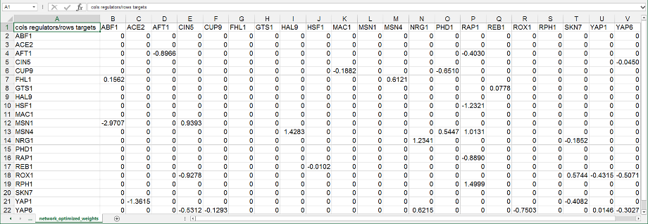
The GRNmap Mathematical Model Answers the Questions:
What are the relative levels of influence of each TF?
What are the indirect effects of other transcription factors in the gene regulatory network?
But how do we make sense of these weight values?

Slide 41
Systems Biology Approach to Understanding the Regulation of the Cold Shock Response in Yeast
Cold shock microarray data from wt and TF deletion strains
Current GRNsight
Coding Team:
Eileen Choe
Mihir Samdarshi
Jen Shin
BIOL 367: Biological Databases
Normalization, statistical analysis, clustering
Visualization of modeling results using GRNsight
Derivation of gene regulatory networks from YEASTRACT
Dynamical systems modeling using GRNmap

Slide 42
Our “First Pass” GRN Diagram Took Several Hours to Create by Hand in Adobe Illustrator
Dahlquist et al. (2015) Bulletin of Mathematical Biology 77: 1457.

Slide 43
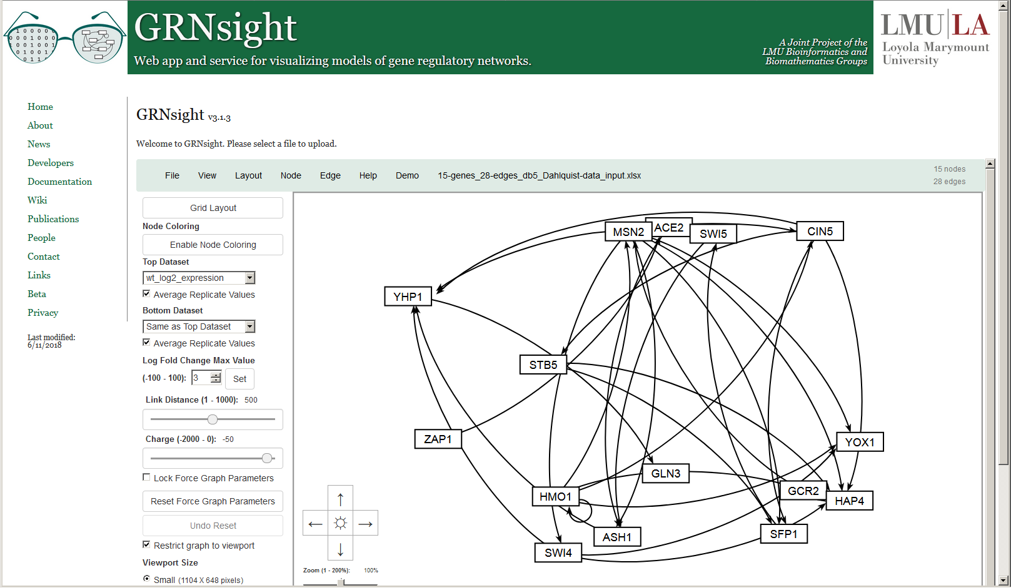
GRNsight Rapidly Generates GRN Graphs Using
Our Customizations to the Open Source D3 Library
Dahlquist et al. (2016) PeerJ Computer Science; Version 1 available March 2014

Slide 44
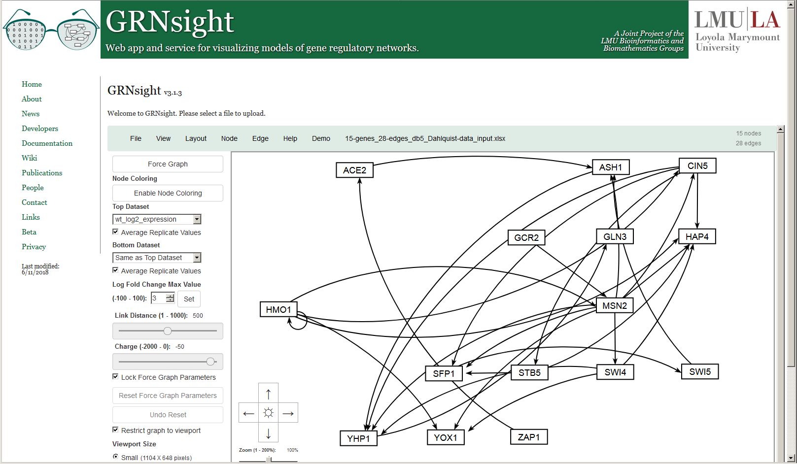
Besides the Force Graph Layout,
Users Can Rearrange the Nodes by Hand
Dahlquist et al. (2016) PeerJ Computer Science

Slide 45
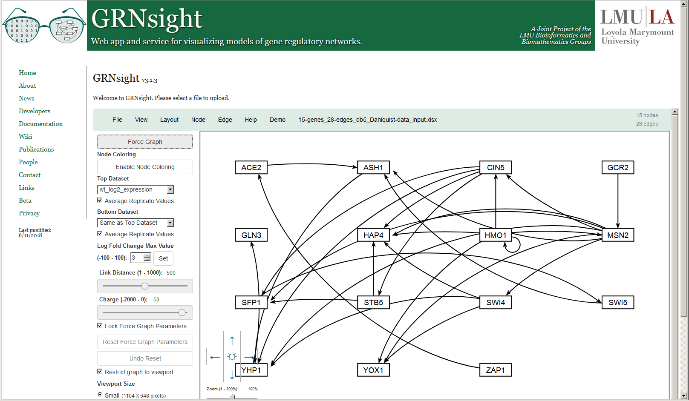
Or Choose the Convenient Block Layout Option
New in Version 3

Slide 46
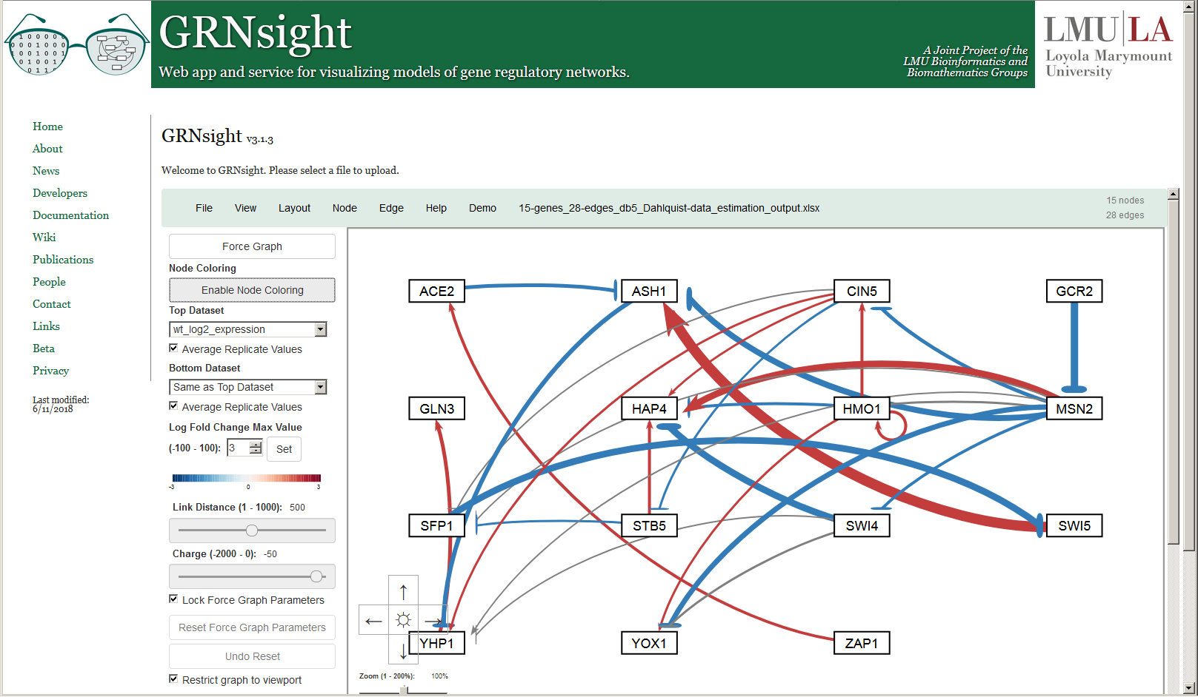
When Model Results are Loaded, Edge Weight Values
Are Indicated by Color, Thickness, and End Marker
New color scheme in Version 3

Slide 47
Edge Thicknesses are Normalized to the Largest Magnitude Weight Value
Normalization Factor = 5.21
Version 1

Slide 48
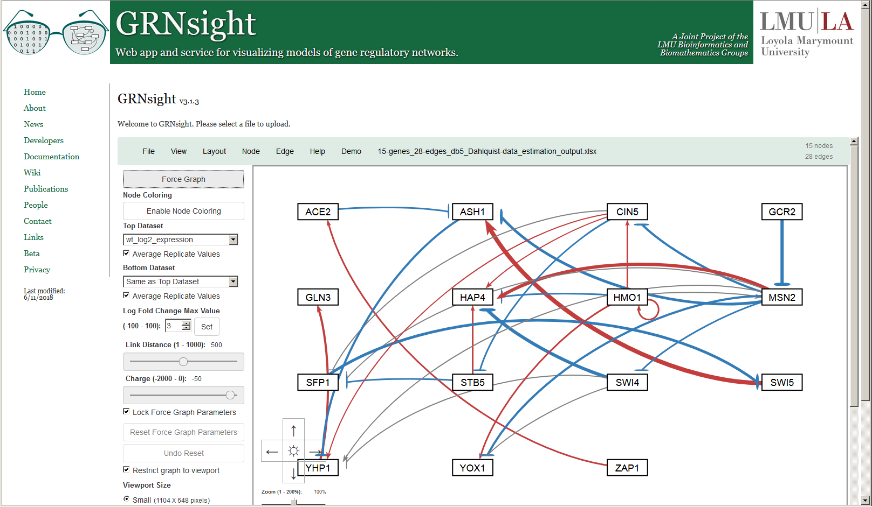
And Can Be Modified to Allow Fair Visual Comparison between Different Graphs
Normalization Factor = 10
New in Version 2

Slide 49
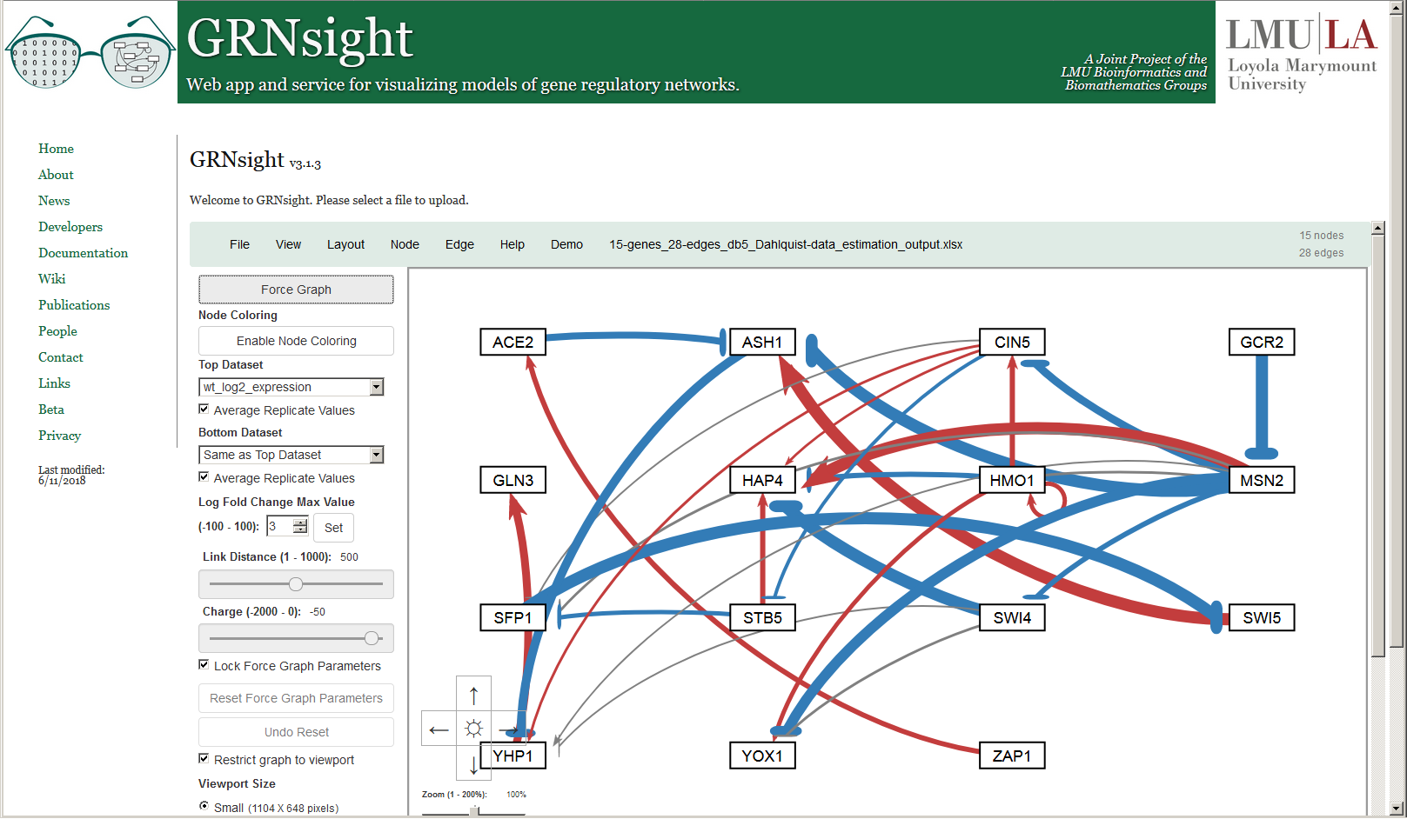
And Can Be Modified to Allow Fair Visual Comparison between Different Graphs
Normalization Factor = 2.5
New in Version 2

Slide 50
Edges with Normalized Weight Values within 5% of 0
Are Displayed as Gray to Minimize Their Visual Strength
Normalization Factor = 5.21
Gray Threshold = 5%
Version 1

Slide 51
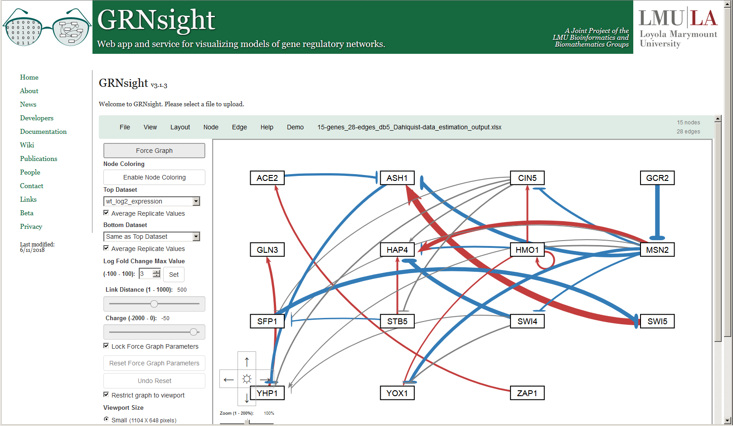
Users Can Change the Gray Threshold with a Slider
Normalization Factor = 5.21
Gray Threshold = 10%
New in Version 2

Slide 52

Users Can Change the Gray Threshold with a Slider
Normalization Factor = 5.21
Gray Threshold = 25%
New in Version 2

Slide 53

Users Can Change the Gray Threshold with a Slider
Normalization Factor = 5.21
Gray Threshold = 50%
New in Version 2

Slide 54

Gray Edges Can Also Be Shown as Dashed Lines to Facilitate Visualization by Color Blind Users
Normalization Factor = 5.21
Gray Threshold = 5%
New in Version 3

Slide 55

Generally, We Can See a Good Concordance Between the Measured and Simulated Data for Each Strain
Top = Δcin5 microarray data
Bottom = Δcin5 model simulated data

Slide 56

Generally, We Can See a Good Concordance Between the Measured and Simulated Data for Each Strain
Top = Δgln3 microarray data
Bottom = Δgln3 model simulated data

Slide 57

Generally, We Can See a Good Concordance Between the Measured and Simulated Data for Each Strain
Top = Δhap4 microarray data
Bottom = Δhap4 model simulated data

Slide 58

Generally, We Can See a Good Concordance Between the Measured and Simulated Data for Each Strain
Top = Δhmo1 microarray data
Bottom = Δhmo1 model simulated data

Slide 59

Generally, We Can See a Good Concordance Between the Measured and Simulated Data for Each Strain
Top = Δzap1 microarray data
Bottom = Δzap1 model simulated data

Slide 60

We Can Also See that There Are Notable Differences in Expression Between Strains
Top = wt microarray data
Bottom = Δgln3 microarray data

Slide 61

Right-clicking on a Gene Opens a New Web Page with Information Dynamically Retrieved from Source Databases
New in Version 3

Slide 62
Back to DB1-DB6: How Well Do Their Models Perform Relative to Each Other?
db1: 16 Genes, 26 Edges
LSE:minLSE = 1.42
db2: 14 Genes, 25 Edges
LSE:minLSE = 1.36
db3: 17 Genes, 32 Edges
LSE:minLSE = 1.41
db4: 14 Genes, 35 Edges
LSE:minLSE = 1.30
db5: 15 Genes, 28 Edges
LSE:minLSE = 1.43
db6: 16 Genes, 27 Edges
LSE:minLSE = 1.40
Notes:
Figure 4. GRNsight visualization highlights salient features of db1-db6. Transcription factors are represented by boxes and arranged in a consistent array. Regulatory relationships are represented by arrows directed from regulator to target. Pointed arrowheads and magenta coloration indicate activation, whereas flat arrowheads and cyan coloration indicate repression. Edges colored in grey exhibit small influence, meaning their associated weights are <5% of the maximum edge weight in the network.
Enlarge images of networks, present 2 per row, or rotate CCW 90 degrees.

Slide 63
Multiple Regression Analyses Identified Determinants of Individual Transcription Factor Model Fits
 | Database-Derived Networks |  |  |  |  |  |  | 3 Best Random Networks |  |  |  | 3 Worst Random Networks
 | db1 | db2 | db3 | db4 | db5 | db6 |  | rand15 | rand16 | rand24 |  | rand7 | rand12 | rand31
ANOVA B&H p-value
Average Expression at 15 min. | -0.507 | -0.624 | -0.479 | -0.552 | -0.528 | -0.626 |  |  |  |  |  | -0.838 |  | -0.656
Average Expression at 30 min.
Average Expression at 60 min. |  |  |  |  |  |  |  |  |  |  |  |  | -0.503
Degradation Rate |  |  |  |  |  |  |  | -0.505 |  | -0.611
Optimized Production Rate | 0.578 |  |  | 0.777 |  | 0.437
Optimized Threshold b |  |  |  | 0.883
Weighted In-degree |  |  |  |  |  | 0.617
Weighted Out-degree |  |  |  |  |  |  |  | -0.627 |  |  |  | 0.433
Eccentricity
Closeness Centrality |  |  |  |  |  |  |  | -0.443
Betweenness Centrality |  |  |  |  |  |  |  |  | -0.609 |  |  | 0.399
Clustering |  | 0.522 | 0.473 |  | 0.501
Eigenvector Centrality | -0.384 |  |  | -0.533 |  | -0.328 |  |  |  | -0.598 |  |  | -0.685 | -0.831
Modularity Class | — | — | — | — | — | — |  |  |  |  |  |  | 0.510
Page Ranks | — | — | — | — | — | — |  |  |  |  |  |  |  | 0.633
Strong Component Number | — | — | — | — | — | — |  |  | 0.633 |  |  |  | -1.033
Adjusted R² | 0.290 | 0.525 | 0.360 | 0.441 | 0.350 | 0.196 |  | 0.436 | 0.552 | 0.257 |  | 0.500 | 0.692 | 0.437
Factors that were not significant predictors of MSE:minMSE ratio: ANOVA B&H p-value, Average Expression at 30 minutes, Eccentricity
Factors that were consistently significant predictors of MSE:minMSE ratio: Average Expression at 15 minutes, Eigenvector Centrality
Notes:
Figure 9. LSE:minLSE Ratio of Random Networks vs. # of Regulatory Relationships Shared with db5. The vertical line indicated the median number of regulatory relationships shared with db5 (2). The horizontal line marks the LSE:minLSE ratio of db5 (1.4263).

Slide 64




Motifs Conserved in the Database-Derived Networks Were Identified
A
B
C
D
Regulator Chains &
5 Feedforward Loops
Notes:
Figure 6. Conserved motifs in the six database-derived GRNs include regulatory chains and feedforward loops (FFLs). A regulatory chain comprised of HMO1, CIN5, YHP1, and GLN3 exhibited consistent activation in five GRNs (A). Addition of MSN2, YOX1, and their associated edges (which were weighted based on frequency) to the regulatory chain yielded a system of 3 FFLs (B). MSN2 also forms symmetrical FFLs mediated by SWI4 that terminate on the paralogs YHP1 and YOX1, which most frequently appear as incoherent type 1 FFLs (C). Addition of the described motifs (A-C) yields a conserved system containing 5 FFLs and a regulatory chain (D). Boxes indicate genes and arrows indicate edges, with pointed arrowheads representing activation (magenta) and flat arrowheads repression (cyan).

