Slide 1
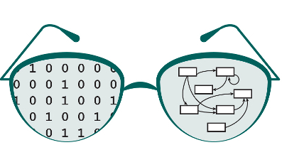

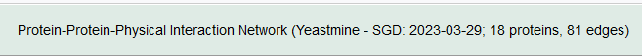
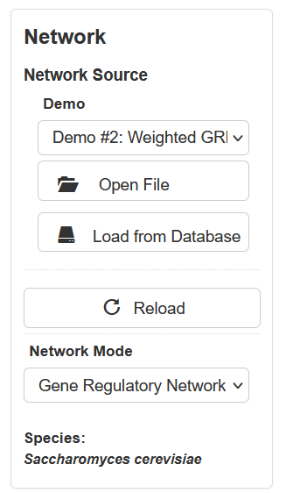
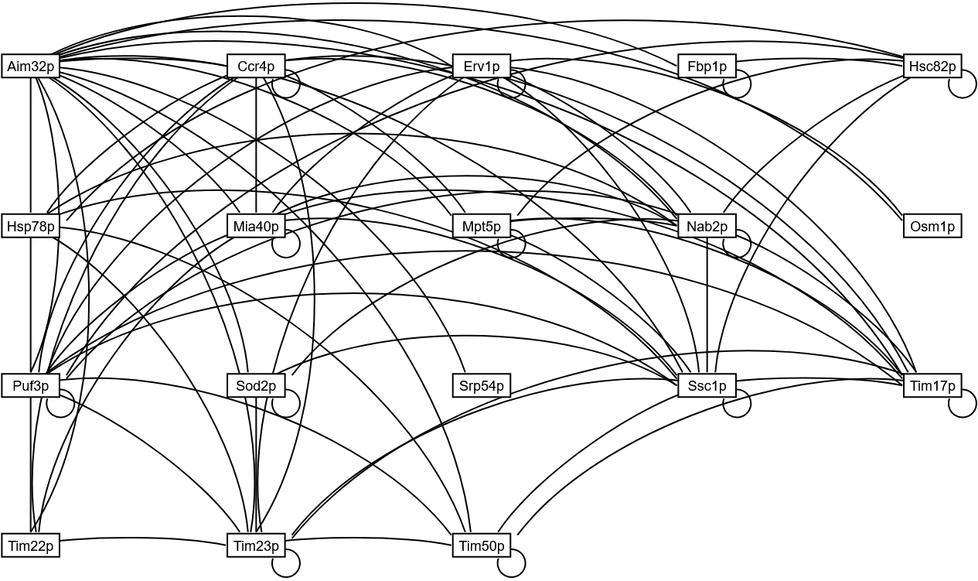
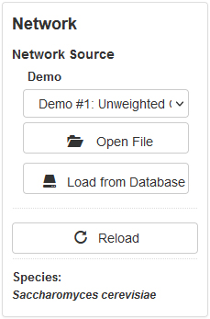
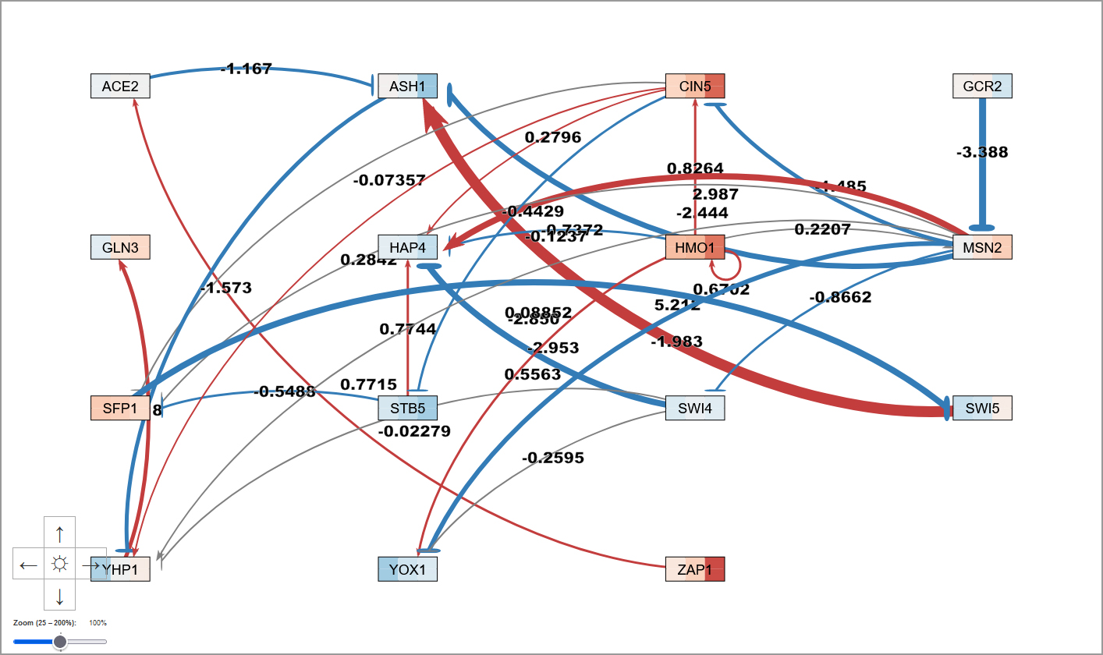
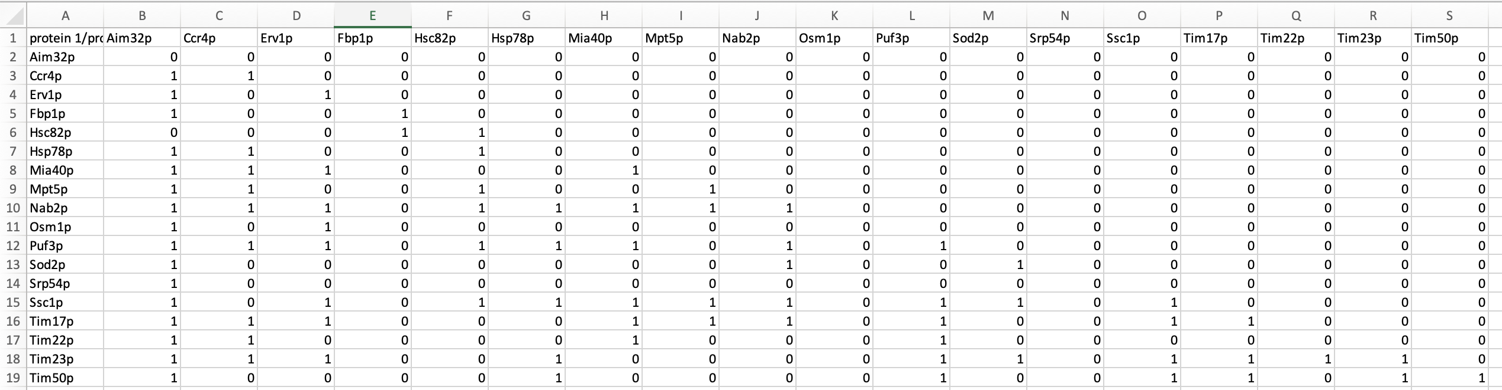
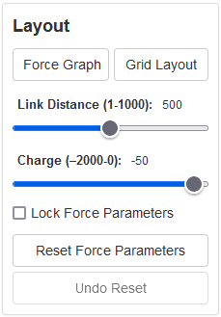

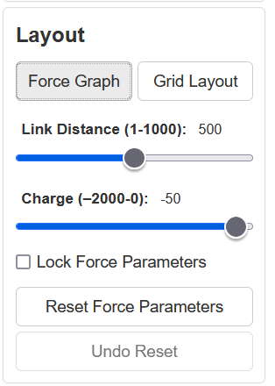
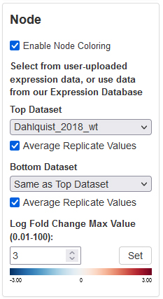
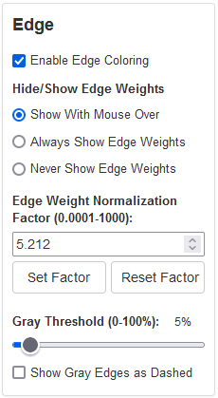
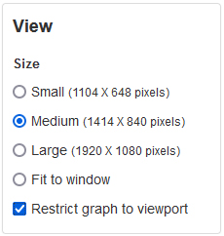
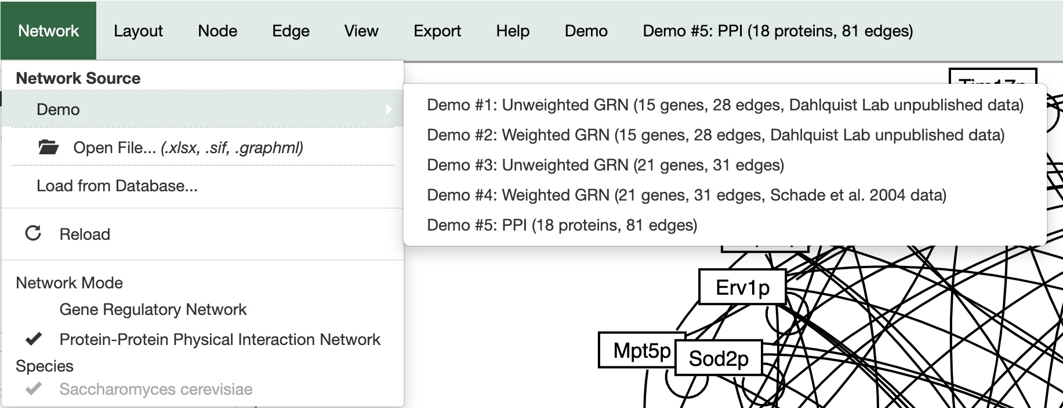
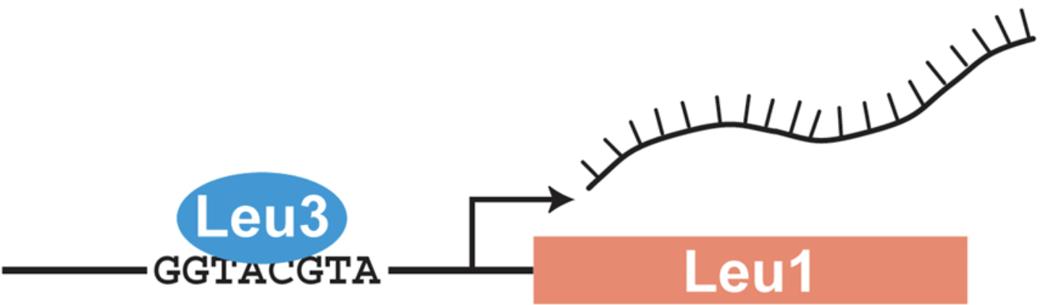
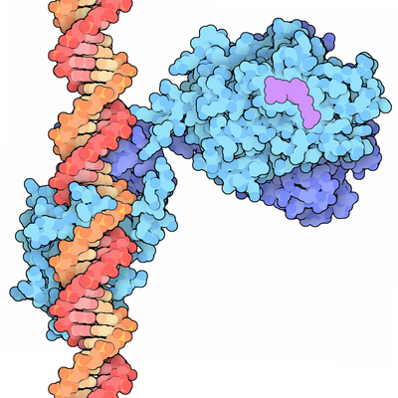

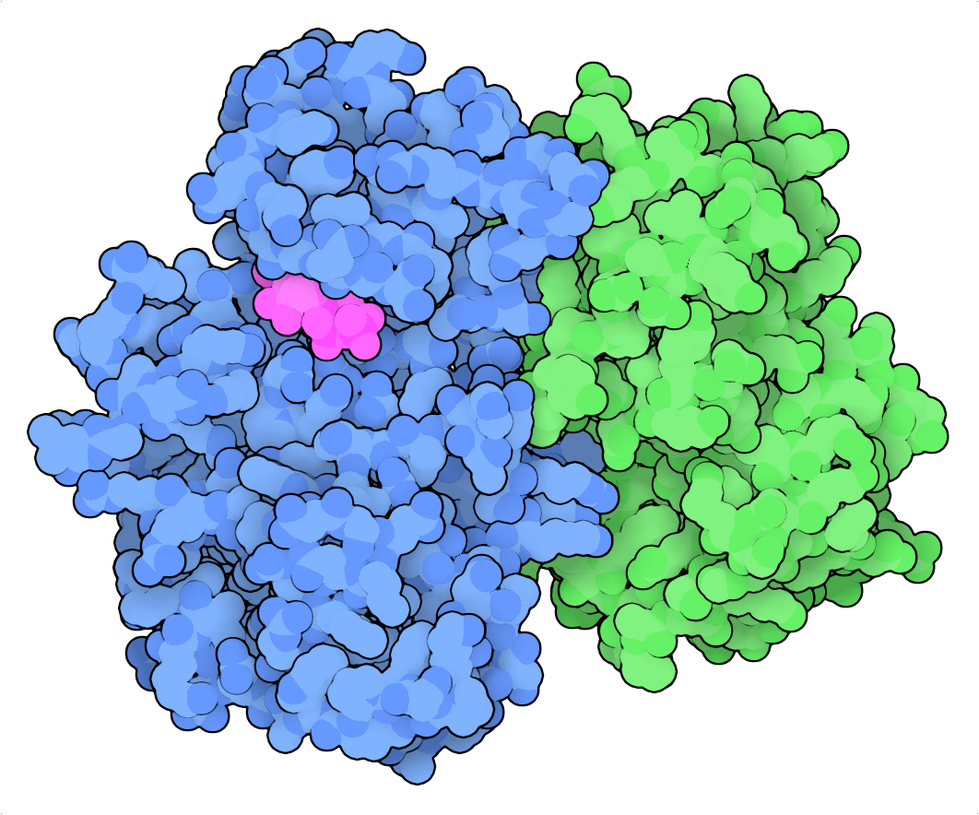
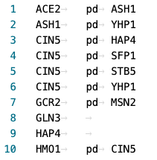
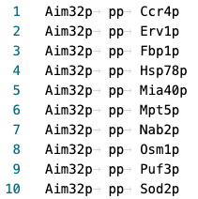
Propagating Protein-Protein Interaction Network Support into GRNsight 7.0,
a Web Application for Visualizing Gene Regulatory Network Models
Ngoc K. Tran¹, Cecilia J. Zaragoza¹, A'Kaia Phelps¹, Kam D. Dahlquist², John David N. Dionisio¹
Departments of ¹Computer Science and ²Biology, Loyola Marymount University, 1 LMU Drive, Los Angeles, CA 90045 USA
http://dondi.github.io/GRNsight/
!.
4. Import and Export ​
GRNsight, automatically lays out a gene regulatory network (GRN) graph, coloring the edges based on regulatory weights, and the nodes based on experimental or simulated expression data
As a result of the incorporation of PPI, GRNsight
required further enhancements
Network Mode Detection
Example of an 18-protein, 81-edge network representing proteins that interact with Aim32p.
Aim32p is a dual-localized 2Fe-2S mitochondrial protein that functions in redox quality control.
Distinguishing between Directed vs. Undirected Edges
Incorporating visualization techniques such as arrowheads for directed edges and absence of arrowheads for undirected edges, facilitates the accurate representation and interpretation of regulatory and physical interactions within these networks.
The Directed Graph represent connections in GRN (gene-regulatory-network)
Demonstrating different types of network types:
In the unweighted GRN SIF file, interactions represent regulatory relationships between genes or transcription factors. Each line indicates a regulatory interaction, with the format ‘Regulator pd Target’.
The Undirected Graph represent interactions of PPI (protein-protein physical interactions)
2. PPI Demo Graph Reference
The dropdown menu serves as an interactive feature in GRNsight, allowing users to select from a range of available demo networks.
3. SIF File (PPI and GRN)
Demonstrating different types of network types:
In the unweighted GRN SIF file, interactions represent regulatory relationships between genes or transcription factors. Each line indicates a regulatory interaction, with the format ‘Regulator pd Target’.
In the PPI SIF file, interactions represent physical associations between proteins. Each line denotes a physical interaction between proteins, with the format ‘Protein pp Protein’
Can be viewed and exported with Excel, VSCode, Word, and more.
Network Mode Imports
SIF files are detected based on either "pp" or "pd" indicator, refer to last image. GraphML files are always associated with GRN. (refer to image in the last section)
Excel files are identified based on the naming convention in cell A1, with "cols regulator/ rows target" for GRN and "cols protein1/ rows protein2" for PPI.
1. Enabling Controls of D-pad, Zoom Slider, and Cursor Grab When Restrict Graph to Viewport
Previously when the graph was restricted to the viewport the D-pad, Zoom Slider, and Cursor Grab controls were disabled. The user is now allowed access to those controls to navigate around the viewport and move the graph.
The goal is to allow users to utilize the D-pad, Zoom Slider, and Cursor Grab controls while ensuring that the nodes remain inside the bounds of the viewport. The nodes will be clamped inside a bounding box, which will be outlined in gray, that will designate the maximum space the nodes can occupy.
Network
Demo files are provided.
Can import and export Excel, SIF, or GraphML files.
Can construct a network from SGD regulation or PPI data stored in a backend database.
Layout
Users can select a force graph layout or grid layout.
Force graph parameter sliders:
Link distance determines the minimum distance between nodes.
Nodes have a charge which repels or attracts other nodes.
Node
Coloring can be based on user-uploaded expression data or from published expression datasets stored in a backend database.
Datasets available:
Apweiler et al. 2012, GSE33098
Barreto et al. 2012, GSE24712
Dahlquist et al. 2018, GSE83656
Kitagawa et al. 2002, GSE9336
Thorsen et al. 2007, GSE6068
Edge
Edge coloring can be toggled on and off.
Buttons enable the user to always see edge weights, never see edge weights, or see edge weights upon mouseover.
Allows user to set normalization factor so that edge thicknesses for different graphs can be rendered on the same scale.
Changing the gray threshold deemphasizes weaker edges in the visualization.
Presenting gray edges as dashed lines further deemphasizes weak edges.
View
Multiple viewport sizes available.
Graph bounding box can be separated from viewport.
Zooming and scrolling available.
1
Key
Ongoing Development
gene
activation
2
repression
3
4
5
weak influence
Future Directions
Automate the process of toggling between a particular PPI network and the GRN that regulates the genes encoding the proteins in the PPI network, as shown above.
Update the backend GRNsight GRN and PPI databases with 2024 data from SGD.
Prioritize bug resolution to enhance stability and reliability of the platform.
Focus on user interface enhancements to improve usability and user experience.
Improve documentation to provide clear and comprehensive guidance for users.
*Some new features are only available in GRNsight v7.0.13 beta.
GRNsight can now be used to visualize protein-protein physical interaction (PPI) networks
A gene regulatory network consists of genes, transcription factors, and the regulatory connections between them which govern the level of expression of mRNA and protein from genes.
Nodes represent both the regulatory transcription factor protein and the gene that encodes it.
An arrow represents a regulatory transcription factor either activating (arrowhead, red color) or repressing (blunt end, blue color) the gene for another regulatory transcription factor.
A PPI is when two proteins bind to each other.
Each node represents a protein, and each edge represents their binding interaction.
Unlike GRNs, PPI graphs have undirected edges of uniform thickness and black color and do not display expression data on the nodes.
Loading a PPI Network: 3 Different Ways
Choose the new PPI Demo file
Navigate to the Network sidebar or the Demo tab of the navigation bar and choose Demo #5, or load from database specific proteins or graph to generate a network.
Upload a PPI (with the column A1 altered)
Can upload an Excel file with PPI data, but the cell A1 must be altered to say “cols protein1/ rows protein2”.
Upload a SIF (simple interaction format)
Upload a SIF with the format ‘Protein1 pd Protein2’.
GraphML not available for PPI
We currently do not support upload with GraphML.
Availability
Transcription Factors Control Gene Expression
by Binding to Regulatory DNA Sequences
Activators increase gene expression
Repressors decrease gene expression
Transcription factors are themselves proteins that are encoded by genes
GRNsight is free and open to all users at http://dondi.github.io/GRNsight/, and there is no login requirement.
GRNsight code is available under the open source BSD license at our GitHub repository at https://github.com/dondi/GRNsight.
Some new GRNsight features are only available in
GRNsight v7.0.13 beta.
Acknowledgments
Regulatory Transcription Factor Bound to DNA
Image from:
https://pdb101.rcsb.org/motm/155
We would like to thank the previous developers on the GRNsight project, and students Nikki C. Chun. A'Kaia Phelps and Cecilia J. Zaragoza would like to thank the HHMI STEM Research Learning Community for funding.
GRN SIF
PPI SIF
References
Dahlquist, K.D., Fitzpatrick, B.G., Camacho, E.T., Entzminger, S.D., & Wanner, N.C. (2015) Parameter Estimation for Gene Regulatory Networks from Microarray Data: Cold Shock Response in Saccharomyces cerevisiae. Bulletin of Mathematical Biology, 77(8), 1457-1492. doi: 10.1007/s11538-015-0092-6
Dahlquist, K.D., Dionisio, J.D.N., Fitzpatrick, B.G., Anguiano, N.A., Varshneya, A., Southwick, B.J., & Samdarshi, M. (2016) GRNsight: a web application and service for visualizing models of small- to medium-scale gene regulatory networks. PeerJ Preprints 4:e2068v1. doi: 10.7287/peerj.preprints.2068v1
Freeman, S. (2002) Biological Science. Upper Saddle River, New Jersey: Prentice Hall.
Wong, E. D., Miyasato, S. R., Aleksander, S., Karra, K., Nash, R. S., Skrzypek, M. S., Weng, S., Engel, S. R., & Cherry, J. M. (2023). Saccharomyces genome database update: server architecture, pan-genome nomenclature, and external resources. Genetics, 224(1), iyac191. doi: 10.1093/genetics/iyac191
Zhang, D., Dailey, O. R., Simon, D. J., Roca-Datzer, K., Jami-Alahmadi, Y., Hennen, M. S., Wohlschlegel, J. A., Koehler, C. M., & Dabir, D. V. (2021). Aim32 is a dual-localized 2Fe-2S mitochondrial protein that functions in redox quality control. Journal of Biological Chemistry, 297(4). doi: 10.1016/j.jbc.2021.101135
Goodsell, D. (2012). Vitamin D receptor bound to DNA, with vitamin D shown in magenta. [Online Image]. PDB-101. https://pdb101.rcsb.org/motm/155
Goodsell, D. (2019). Cyclin A (green) and cyclin-dependent kinase 2 (blue) with ATP (magenta). [Online Image]. PDB-101. https://pdb101.rcsb.org/motm/236
Protein-Protein Interaction
Image from:
https://pdb101.rcsb.org/motm/236
Notes:
Kill abstract
Change to sans serif font
Make title bigger
Make title background white
Use full names
Super script to associate names with correct department
Background color: make it dark green, make writing on white background and writing in black/dark green
4 columns!!!
Smaller pictures
Bold titles
References can be 12pt
Acknowledgements can be 16pt
Everything else is 18-24pt
Titles don’t need to be bigger than 36pt
Remove circles from the arrowhead diagram, group the related labels together
Include menu bar
Testing/error handling – sample error (we don’t crash with errors!)
Mouseovers for edges screenshot

