Slide 1
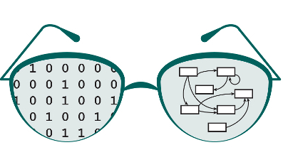

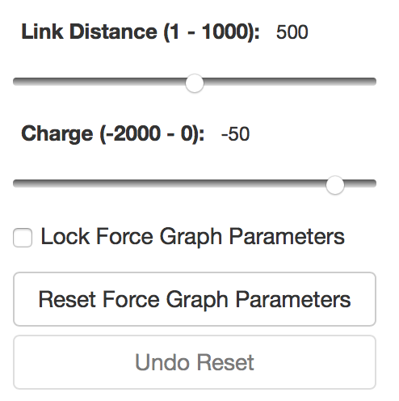
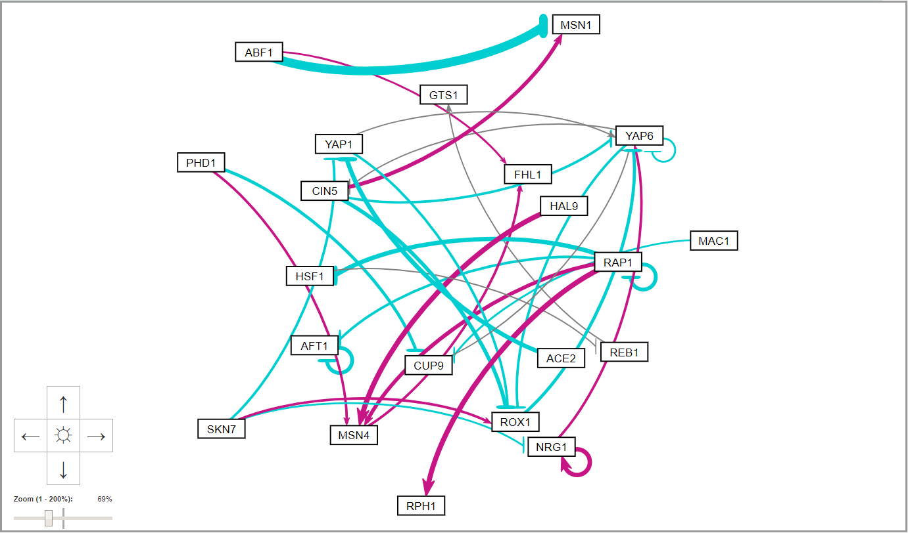
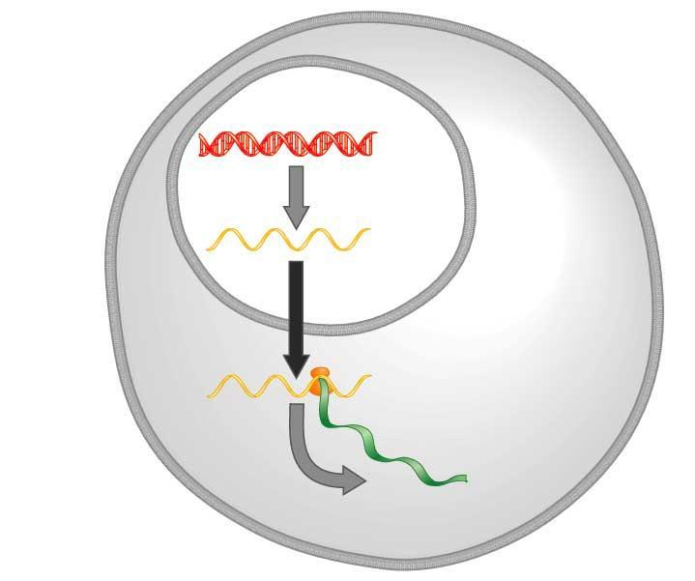
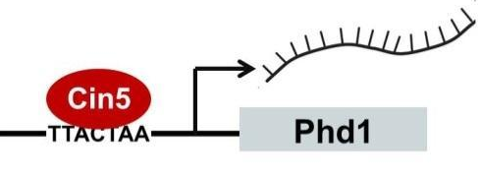
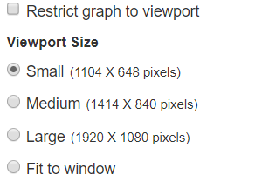
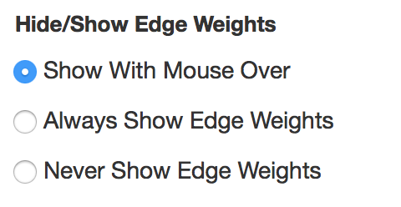
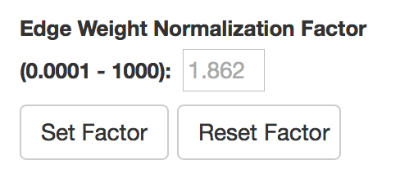


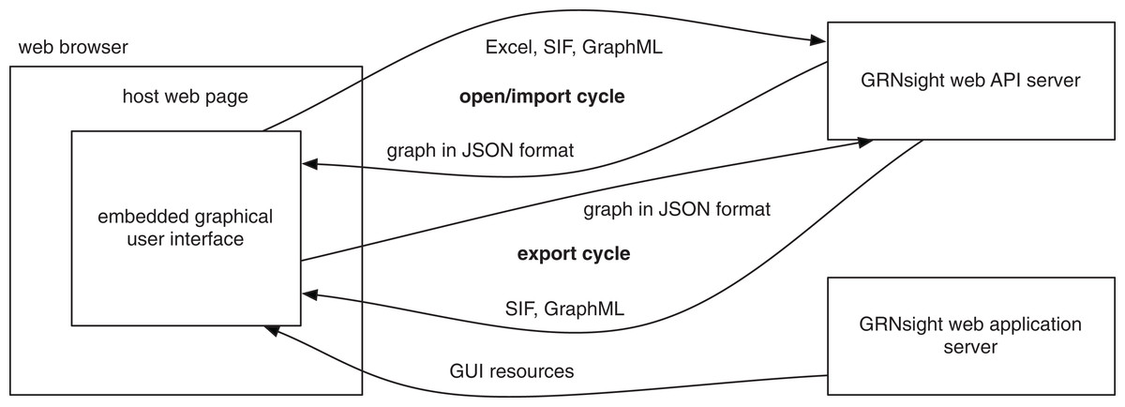
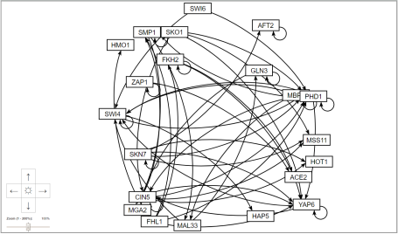
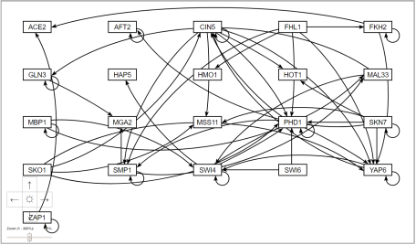
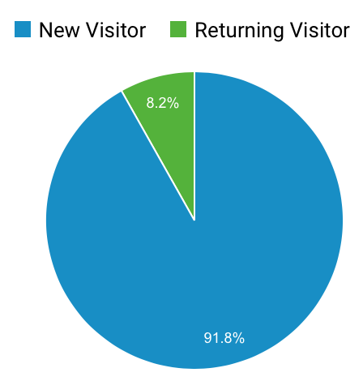

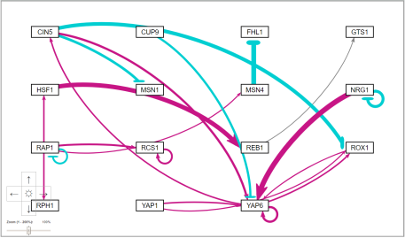
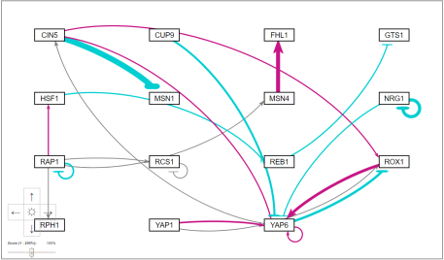
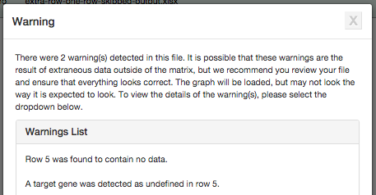
Visualization Improvements to GRNsight: a Web Application for
Visualizing Gene Regulatory Networks
Eileen J. Choe**, Jen Y. Shin**, John David N. Dionisio**, Kam D. Dahlquist*
*Department of Biology, **Department of Electrical Engineering and Computer Science, Loyola Marymount University, 1 LMU Drive, Los Angeles, CA 90045
http://dondi.github.io/GRNsight/
Gene Regulatory Networks (GRNs) Can Be Illustrated by Directed Graphs
GRNsight Automatically Lays Out Unweighted and Weighted Network Graphs
The central dogma of molecular biology describes how the flow of information in a cell during gene expression goes from DNA to RNA to protein.
Transcription factors control gene expression by binding to regulatory DNA sequences.
Activators increase gene expression; repressors decrease gene expression.
Transcription factors are themselves proteins encoded by genes.
Freeman (2002)
A gene regulatory network (GRN) consists of genes, transcription factors, and the regulatory connections between them, which govern the level of expression of mRNA and proteins from those genes.
Each node in a GRN graph represents a regulatory transcription factor, with each edge representing a regulatory relationship, either an activation or repression relationship.
.
s
1. File Formats
Can import and export Excel workbook, SIF, and GraphML files.
1
2. Force Graph Parameter Sliders
Users can manipulate the physics based simulation of the graph using the Link Distance and Charge sliders.
2
3
DNA
mRNA
Protein
3. Viewport
Graph bounding box can be separated from viewport.
Multiple viewport sizes available.
Zoom and scrolling enabled.
4. Show or hide the weight values.
3
5. Zoom and Scroll Menu
5
GRNsight Fulfills a Specific Software
Niche for Visualizing GRNs
4
6. Edge Weight Normalization
Edge thicknesses for different graphs can be rendered on the same scale.
7. Gray Edge Threshold
By default, edges are colored gray if the magnitude of its value is <= 5% of the maximum edge weight value.
Legend
Key:
Existing visualization software such as Cytoscape and Gephi must be installed and is optimized for large-scale graphs.
GRNsight is targeted at both experienced biology investigators and novice undergraduate users.
6
gene
activation
repression
Cytoscape and Gephi | GRNsight
Optimized for large-scale graphs. | Optimized for small- to medium- scale graphs.
Must be installed. | Exists as a web application.
Several complex features in addition to visualization. | Easy to use, and easily interpretable visualizations.
7
weak influence
GRNsight Architecture
Grid Layout
Improved Developer Tools
Future Directions
The server provides a web API that accepts files in multiple file formats and converts them into a unified JSON representation.
The web client provides a graphical user interface for visualizing the JSON graphs returned by the server.
s
s
Calculate and present graph statistics, such as betweenness centrality.
Add new graph layout options.
Further expand and refine the unit testing framework.
Implement node coloring to represent gene expression data.
Change the color palette for easier visualization by color blind users.
Grid layout feature allows the users to:
Toggle between force graph and grid layout using a button on the top of the left menu bar.
Organize the nodes in a grid pattern.
Sort the nodes in alphabetical order.
D3 visualization library was updated to version 4
D3 is the central visualization code library that GRNsight uses to produce our graph.
GRNsight previously used d3 version 3.
Transitioning to version 4 allowed for a more concise and logical code base, allowing developers to read code easier and code to compile faster.
Force Graph
Grid Layout
Availability
The “Gravity” and and “Charge Distance” features previously present in GRNsight were consolidated into “Link Distance” and ”Charge.
GRNsight is free and open to all users and there is no login requirement.
Web site content is available under the Creative Commons Attribution Non-Commercial Share Alike license.
GRNsight code is available under the open source BSD license.
Unit Testing Framework
ESLint added to code base, updated to ES6
The addition of ESLint ensures that all GRNsight code is consistent with style guidelines.
Updated to ES6 to allow import and export.
Usage is being tracked through Google Analytics.
GRNsight has been tested with and confirmed to be working in Chrome version 58 or higher and Firefox version 53 or higher on Windows 7 and Mac OS X.
6236 total visitors and
4521 files uploaded as of
14 March 2018
Mocha and Chai JavaScript testing framework
The unit testing framework consists of 216 tests covering over 500 test files.
Testing is split into two different test groups, with semantic tests being file format independent, and individualized syntactic tests being based on the different file formats.
Initial state when graph is first loaded.
Nodes float and move with applied force.
Nodes do not float like in force graph.
Users can move the nodes around like in force graph.
test-data1
test-data2
Webpack added to package.json
Acknowledgments
Import Excel
Excel Syntax Checker
Webpack was included in order to allow usage of import and export.
This work is partially supported by NSF award 0921038 (K.D.D., B.G.F.), a Kadner-Pitts Research Grant (K.D.D.), the Loyola Marymount University Rains Research Assistant Program (M.S.)
Import SIF
SIF Syntax Checker
Semantic Checker
GRNsight
Additional Developer Tools
An automatic client-side test generator was created that generates a document that can be followed by a user to manually test specific combinations of user interface functions.
The service Travis CI has been incorporated to perform Continuous Integration, which is the automatic testing and linting of the codebase every time new code is added to the Github Repository.
Import GraphML
GraphML Syntax Checker
References
Warnings are returned in cases of non-fatal improper spreadsheets
Cytoscape: http://cytoscape.org
Dahlquist, K.D., Dionisio, J.D.N., Fitzpatrick, B.G., Anguiano, N.A., Varshneya, A., Southwick, B.J., Samdarshi, M. (2016) GRNsight: a web application and service for visualizing models of small- to medium-scale gene regulatory networks. PeerJ Computer Science 2:e85. DOI: 10.7717/peerj-cs.85).
Dahlquist, K.D., Fitzpatrick, B.G., Camacho, E.T., Entzminger, S.D., and Wanner, N.C. (2015) Parameter Estimation for Gene Regulatory Networks from Microarray Data: Cold Shock Response in Saccharomyces cerevisiae. Bulletin of Mathematical Biology, 77(8), 1457-1492, DOI: 10.1007/s11538-015-0092-6
D3.js: http://d3js.org/
Freeman, S., (2002). Biological science, 1st edition. Upper Saddle River, NJ:: Prentice Hall.
Gephi: https://gephi.org
GRNmap: http://kdahlquist.github.io/GRNmap/
Teixeira, M. C., Monteiro, P. T., Guerreiro, J. F., Gonçalves, J. P., Mira, N. P., dos Santos, S. C., ... & Madeira, S. C. (2014). The YEASTRACT database: an upgraded information system for the analysis of gene and genomic transcription regulation in Saccharomyces cerevisiae. Nucleic Acids Research, 42(D1), D161-D166, DOI: 10.1093/nar/gkt1015
In cases where non-fatal errors exist in the format or data of an uploaded spreadsheet, the graph is displayed, and a warning box appears with a detailed message.
The nodes are laid out in a grid pattern with columns and rows.
The nodes are equally spaced out with margins around them.
Allows users to compare and analyze data in a easier and faster way.
Notes:
Kill abstract
Change to sans serif font
Make title bigger
Make title background white
Use full names
Super script to associate names with correct department
Background color: make it dark green, make writing on white background and writing in black/dark green
4 columns!!!
Smaller pictures
Bold titles
References can be 12pt
Acknowledgements can be 16pt
Everything else is 18-24pt
Titles don’t need to be bigger than 36pt
Remove circles from the arrowhead diagram, group the related labels together
Include menu bar
Testing/error handling – sample error (we don’t crash with errors!)
Mouseovers for edges screenshot

