Slide 1
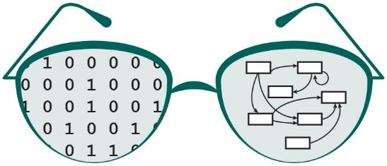
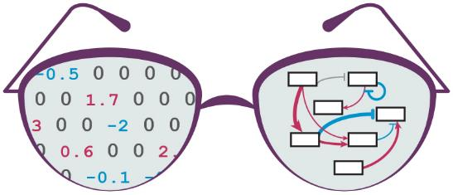
GRNsight
May 5,
2017
CMSI
402
Nicole Anguiano

Slide 2
Outline
GRNsight is a web app and service for visualizing small- to medium-scale gene regulatory networks (GRNs).
The GRNsight project began in 2014 as a web app intended for viewing GRNs generated from the GRNmap mathematical modeling software.
The primary goal for this project was to improve the graph layout by separating the visible area of the graph from the drawable area of the graph.
The goals and resulting subgoals were achieved in version 2 of GRNsight.

Slide 3
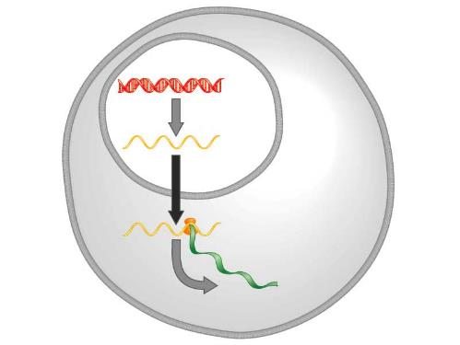
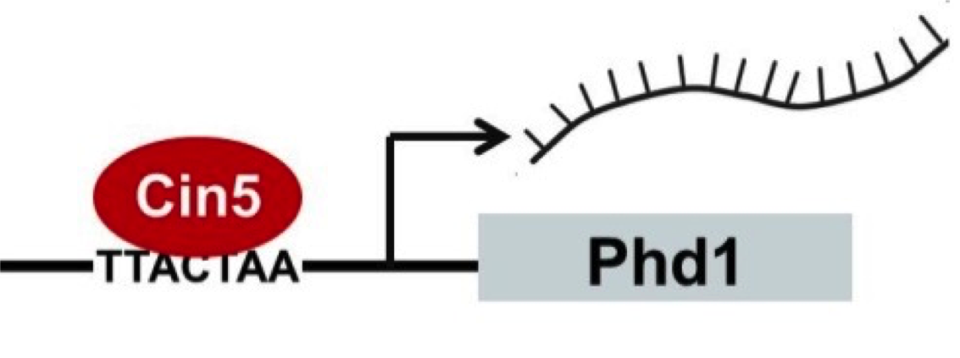
A gene regulatory network controls the level of expression of genes and proteins
Mechanism of control: transcription factors
Transcription factors bind to regulatory DNA sequences
Activators increase gene expression
Repressors decrease gene expression
GRNmap model produces weight values representing the strength of the regulation
DNA
Transcription
mRNA
Translation
Protein
Freeman (2002)

Slide 4
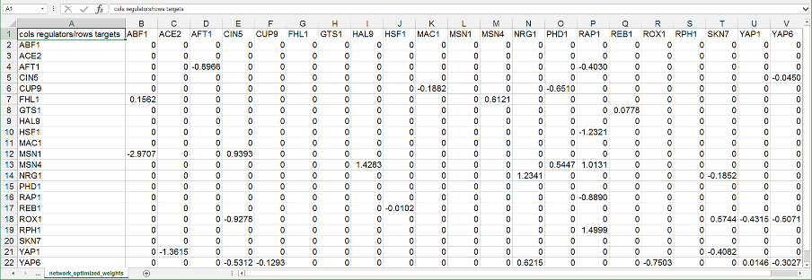
Representations of grns can be difficult to understand without visualization
Weighted adjacency matrix in .xlsx format

Slide 5
Existing GRN visualization software did not fit the Use case needed by the Grnmap TEAM
YEASTRACT GRN visualizations are static, difficult to interpret, and don’t display edge weight values
Cytoscape and Gephi must be installed, are optimized for large GRNs, and have complex features with a steep learning curve
Making a graph by hand in Illustrator is time-consuming
GRNsight exists as a web app, is optimized for small- to medium-scale graphs, is quick to customize, and displays weight values in an intuitive way for the user

Slide 6
GRNsight Turns this…
Weighted adjacency matrix in .xlsx format

Slide 7
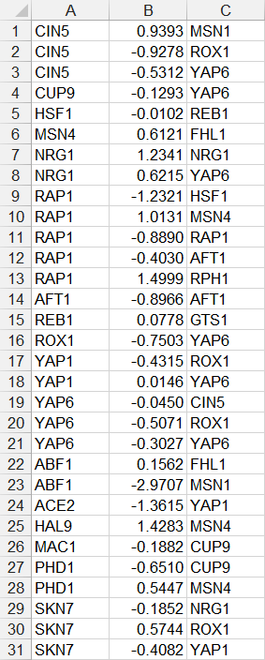
GRNsight Turns this…
Weighted Simple Interaction Format (.sif) file

Slide 8
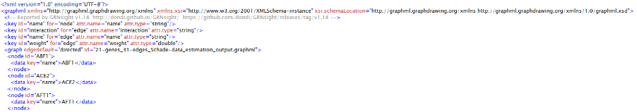
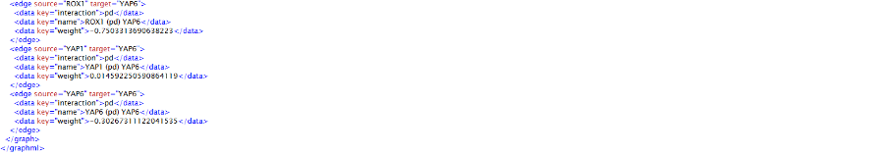
GRNsight Turns this…
Weighted GraphML file

Slide 9
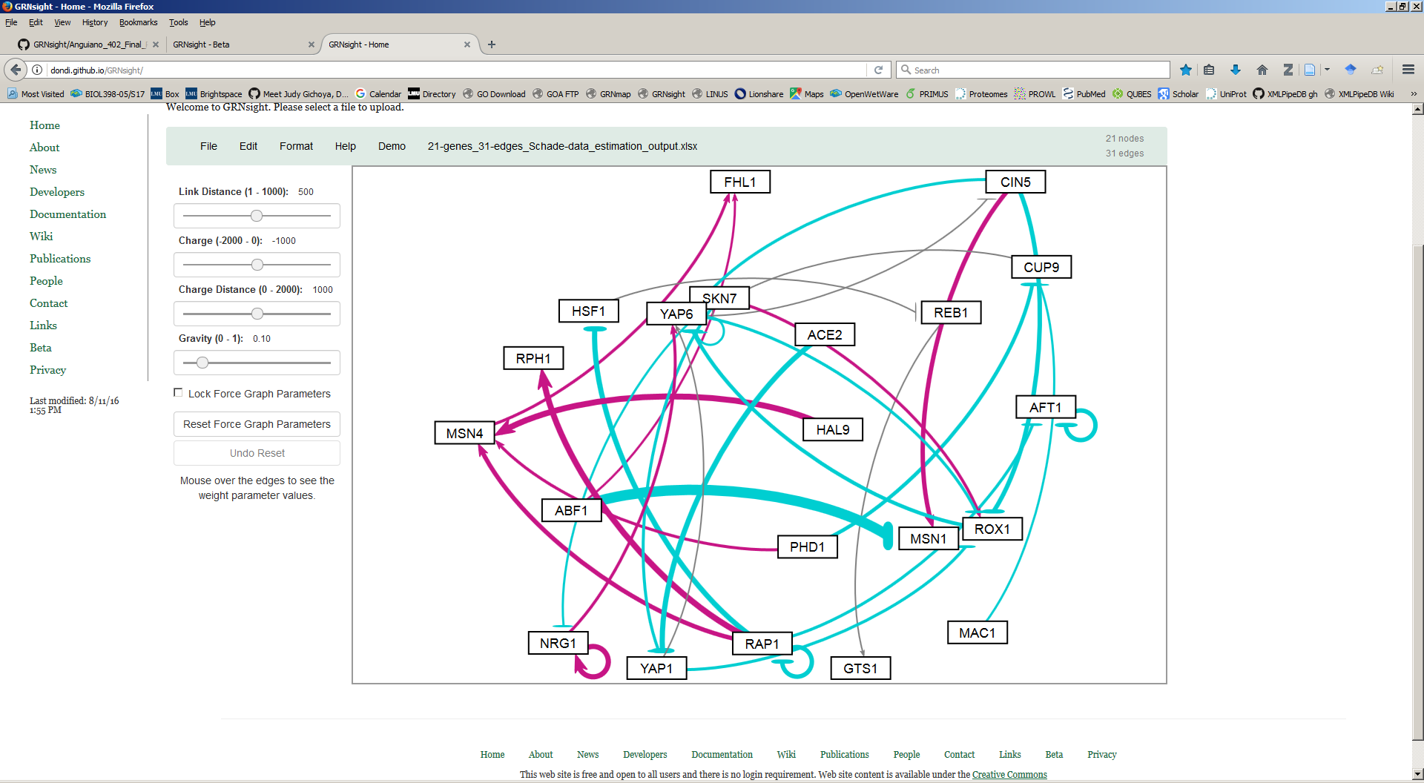
Into this

Slide 10
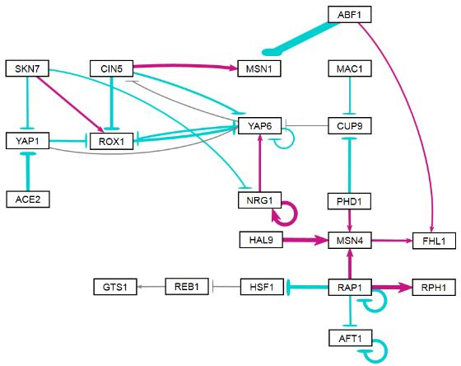
Which can be customized to this!

Slide 11
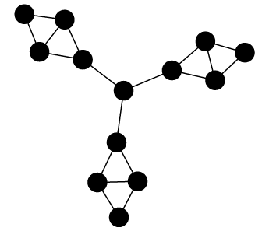
Initial GRNsight Implementation Required Customization of the D3 Library
Developed as part of a 402 project by Britain Southwick
Uses D3.js to generate a graph derived from input network data
D3 dynamically manipulates HTML, CSS and SVG to form the elements of the graph
GRNsight implements D3’s force layout, which applies a physics-based simulation to the graph
Default D3 layout

Slide 12
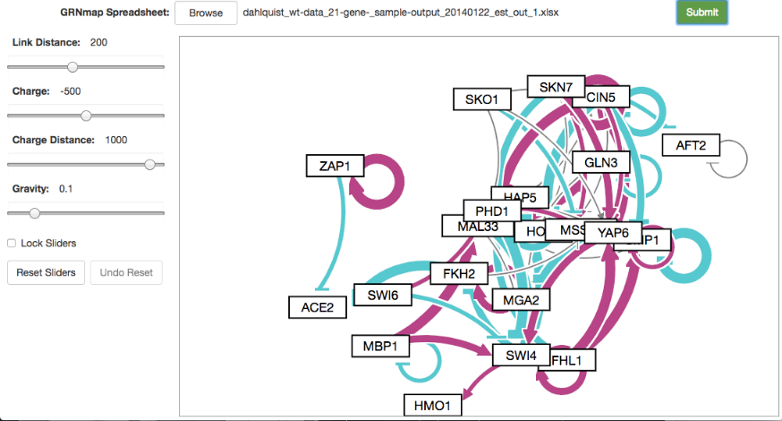
GRNsight v0 (May 2014)
Britain Southwick, CMSI 402

Slide 13
GRNsight v1 (August 2016)

Slide 14
With the initial grnsight application complete, it was time for improvements
Flaw: Force graph could not fully relax when loaded
Viewport and bounding box were the same, and came in only one size
Solution: Allow bounding box to expand as the force was applied
Consequence: Need a way to navigate the newly expanded bounding box
Goal: Separate viewport from bounding box, and allow multiple sizes of both for different screens
Add zooming and scrolling navigation functions
Smaller goals included quality of life improvements for the developers as well as code cleanup

Slide 15
The decision to work on grnsight for 402 was inspired by a number of different factors
Allows me to contribute to an ongoing research project
Dahlquist Lab: Wet Lab, GRNmap, Data Analysis, GRNsight
Combines my interest in biology with my skills as a computer scientist
Create a maintainable project that the remaining members of the GRNsight team could continue without feeling too confused
GRNsight was the first major coding project I ever did at LMU, and it felt fitting for it to also be the last one I did here as well

Slide 16
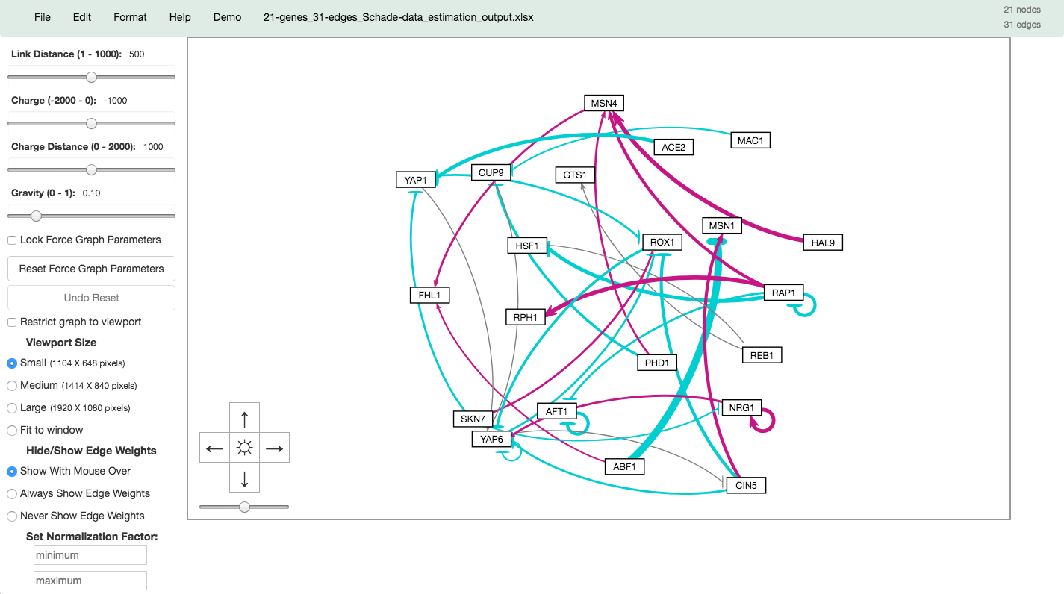
GRNsight v2 (May 2017)

Slide 17
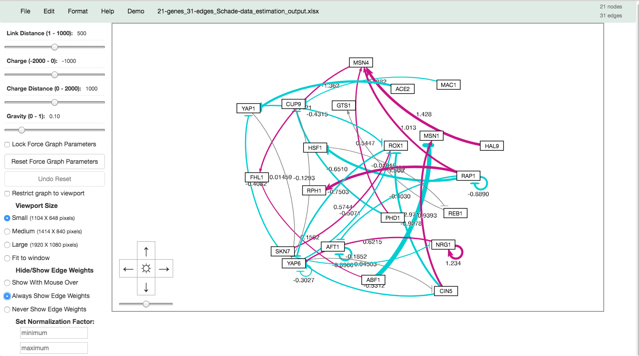
GRNsight v2 (May 2017)
Anu Varshneya, BIOL 598

Slide 18
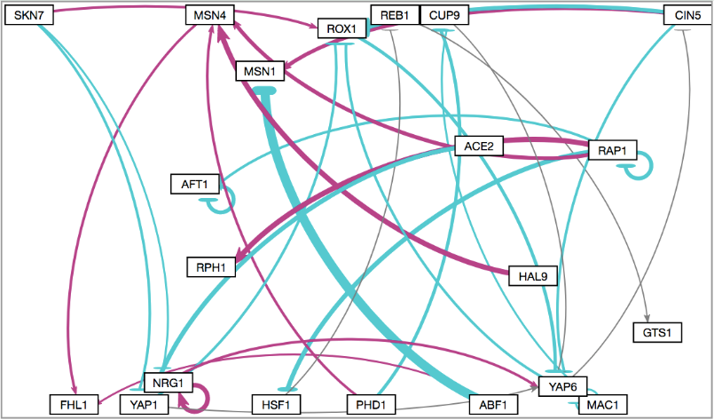
Graph without adaptive bounding box

Slide 19
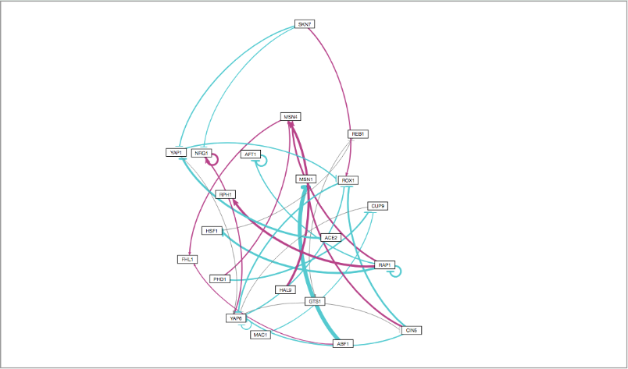
Graph with adaptive bounding box

Slide 20
Every project comes with its challenges, and grnsight was no different
Working in a team (both a challenge and a blessing)
Messy, un-commented chunks of code
Dynamic resizing algorithm
Windows OS
Chrome/Firefox updates
Sudden bug where the entire program broke entirely for two of the developers appeared a week before the end of the semester

Slide 21
SUMMary
GRNsight is a web app and service for visualizing small- to medium-scale gene regulatory networks (GRNs).
New features for v2 include:
Separation of viewport from graph bounding box
Choice of three viewport sizes
Best viewport size automatically detected from browser
Viewport can also be fit to window
Choice of fixing graph inside viewport or adaptively resizing graph bounding box based on graph size
Zooming and scrolling enabled

Slide 22
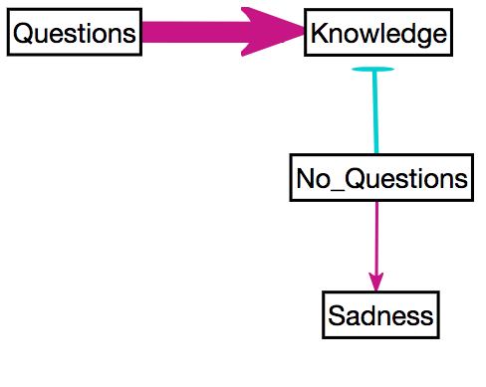
Acknowledgments
Dr. Kam D. Dahlquist
Dr. John David N. Dionisio
Britain Southwick
GRNsight Team:
Anu Varshneya
Mihir Samdarshi
Jen Shin
Eddie Bachoura
Eileen Choe
GRNsight: https://dondi.github.io/GRNsight/
Github: https://github.com/dondi/GRNsight
PeerJ Paper: https://peerj.com/articles/cs-85/
Notes:
List names either alphabetically or in order of seniority

