Slide 1
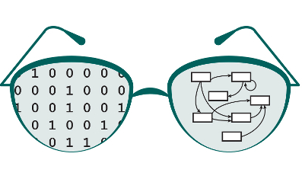


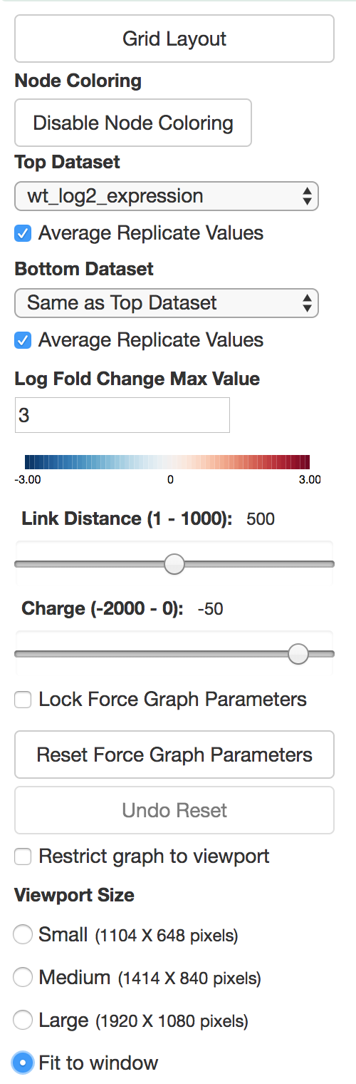
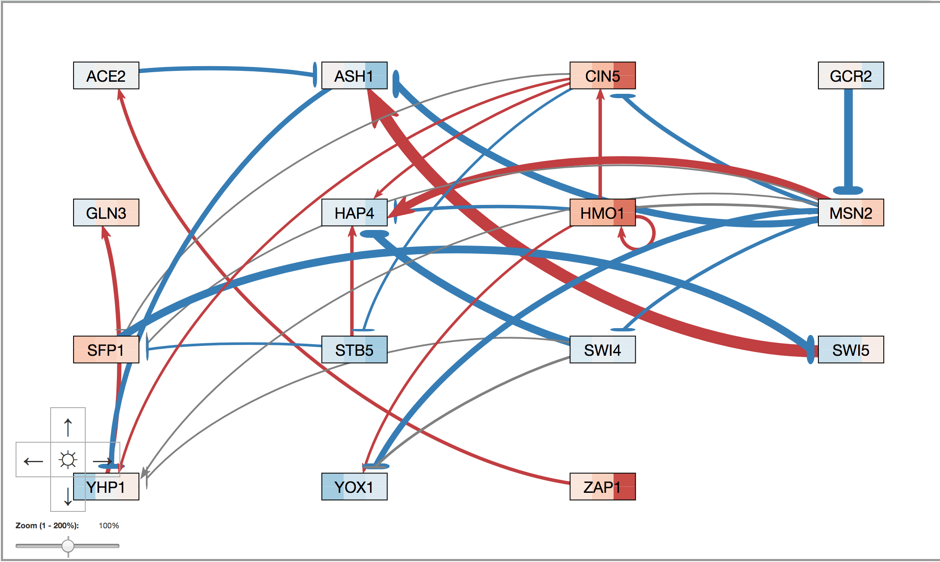
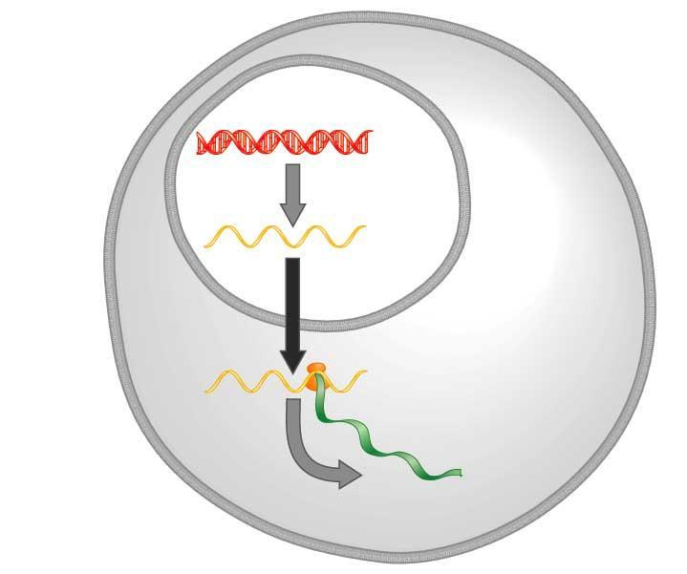
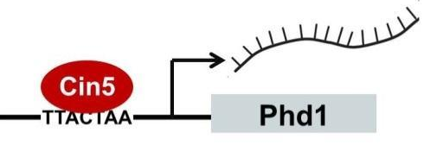

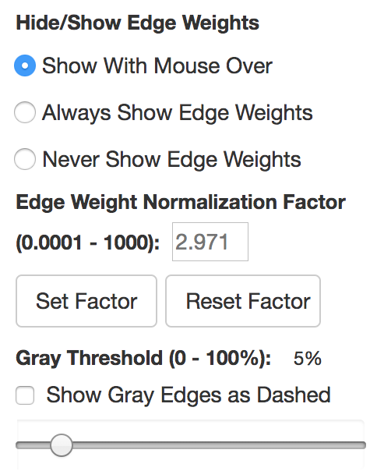
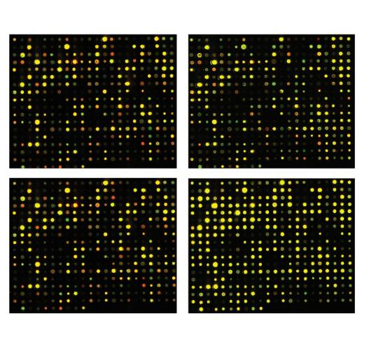
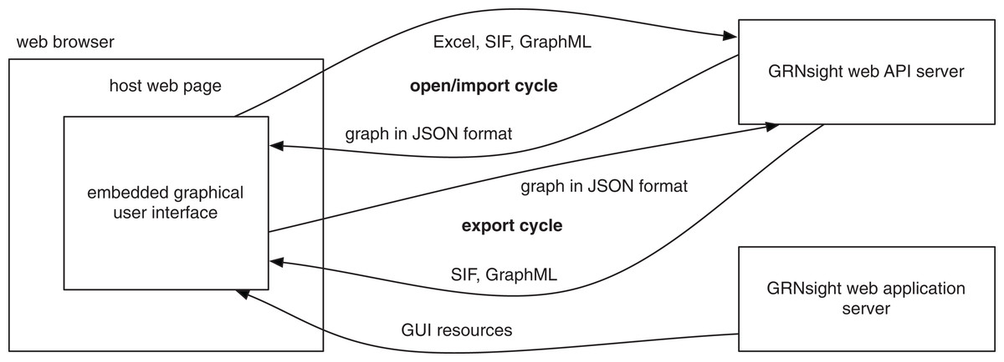
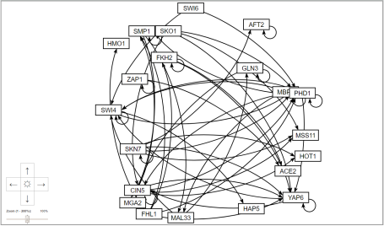
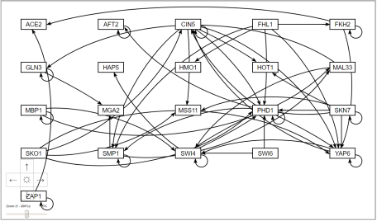
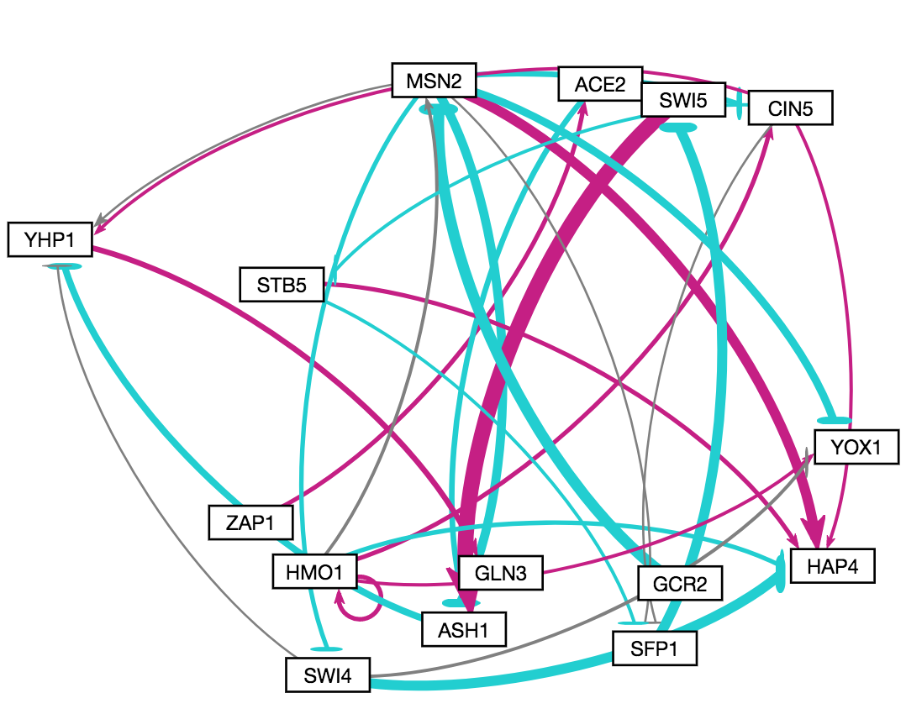
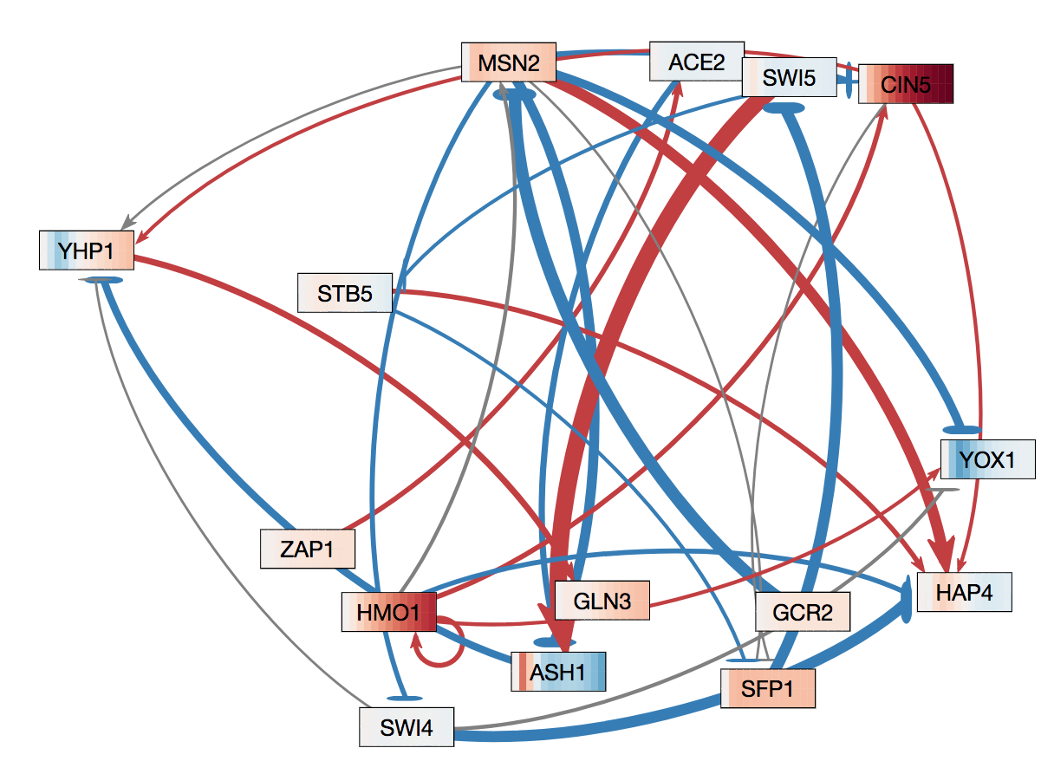
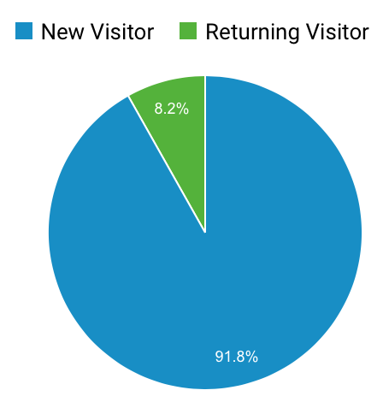
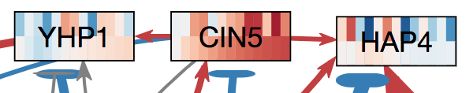
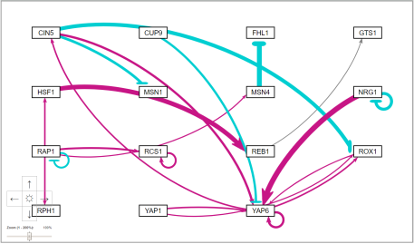
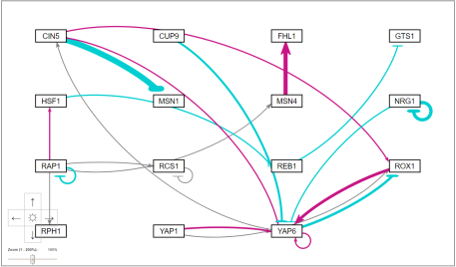
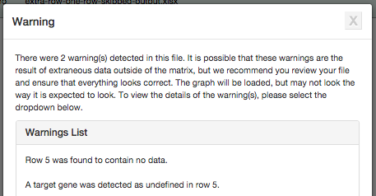
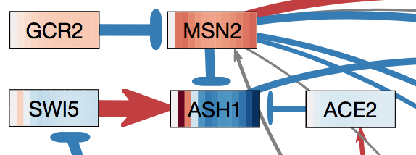
GRNsight v3: New Node Coloring and Grid Layout Features for
a Web Application for Visualizing Gene Regulatory Networks
Eileen J. Choe*, Jen Y. Shin*, John David N. Dionisio*, Kam D. Dahlquist**
**Department of Electrical Engineering and Computer Science, *Department of Biology, Loyola Marymount University, 1 LMU Drive, Los Angeles, CA 90045
http://dondi.github.io/GRNsight/
Gene Regulatory Networks (GRNs) Can Be Illustrated by Directed Graphs
GRNsight Automatically Lays Out Unweighted and Weighted Network Graphs
Improved Developer Tools
.
The central dogma of molecular biology describes how the flow of information in a cell during gene expression goes from DNA to RNA to protein.
Transcription factors control gene expression by binding to regulatory DNA sequences.
Activators increase gene expression; repressors decrease gene expression.
Transcription factors are themselves proteins encoded by genes.
Freeman (2002)
A gene regulatory network (GRN) consists of genes, transcription factors, and the regulatory connections between them, which govern the level of expression of mRNA and proteins from those genes.
Each node in a GRN graph represents a regulatory transcription factor, with each edge representing a regulatory relationship, either an activation or repression relationship.
1. File Formats
GRNsight can import data in the Microsoft Excel, SIF, and GraphML file formats; it can export to SIF and GraphML.
2. Grid Layout
Grid Layout button allows the users to toggle between grid layout and force directed graph layout.
3. Node Coloring
This menu allows users to modify parameters of the node coloring visualization.
Dataset options are automatically generated from expression data sheets detected in an Excel input workbook.
4. Force Graph Parameter Sliders
Users can manipulate the physics based simulation of the graph using the Link Distance and Charge sliders.
5. Viewport
The viewport size is automatically selected to best fit the user’s screen size. Users can manually set it to small, medium, or large, or fit to window.
The graph size can also be restricted to the viewport.
6. Show or hide the weight values
Users may select an edge weight display option for weighted graphs.
7. Edge Weight Normalization
Users may normalize edge weights so that different graphs can be rendered on the same scale.
s
1
D3 visualization library was updated to version 4
D3 is the central visualization code library that GRNsight uses to produce the graph.
GRNsight previously used d3 version 3.
Transitioning to version 4 allowed for a more concise and logical code base, allowing developers to read code easier and code to compile faster.
2
3
DNA
The “Gravity” and and “Charge Distance” features previously present in GRNsight were consolidated into “Link Distance” and ”Charge.
mRNA
Protein
ESLint added to code base
10
The addition of ESLint ensures that all GRNsight code is consistent with style guidelines.
Enabled import and export functionality of ECMAScript2015 (ES6).
4
Webpack added to package.json
GRNsight Fulfills a Specific Software
Niche for Visualizing GRNs
Webpack is a module bundler.
Webpack was included in order to allow usage of “import” and “export” as a function in the code.
6
8. Gray Edge Threshold
By default, edges are colored gray if the magnitude of its value is <= 5% of the maximum edge weight value.
The user may change this value with a slider to allow comparison of two different graphs on the same scale.
9. Show Gray Edges as Dashed
Option added to make GRNsight more accessible for color-blind users.
10. Zoom and Scroll
Users may zoom, scroll, and center the graph in the viewport.
Existing visualization software such as Cytoscape and Gephi must be installed and is optimized for large-scale graphs.
GRNsight is targeted at both experienced biology investigators and novice undergraduate users.
5
Additional Developer Tools
An automatic client-side test generator was created that generates a document that can be followed by a user to manually test specific combinations of user interface functions.
The Travis CI tool has been incorporated to perform Continuous Integration, the automatic testing and linting of the codebase.
Travis CI builds are triggered on every push or pull request against the GRNsight repository on GRNsight.
Cytoscape and Gephi | GRNsight
Optimized for large-scale graphs. | Optimized for small- to medium- scale graphs.
Must be installed. | Exists as a web application.
Several complex features in addition to visualization. | Easy to use, and easily interpretable visualizations.
7
8
9
GRNsight Software Architecture
Grid Layout
Node Coloring Visualization
for Gene Expression Data
Future Directions
The server provides a web API that accepts files in multiple file formats and converts them into a unified JSON representation.
The web client provides a graphical user interface for visualizing the JSON graphs returned by the server.
s
sf
Calculate and present graph statistics, such as betweenness centrality.
Add new graph layout options, including hierarchical layout.
Reorganize the navigation bar above the graph.
Further expand and refine the unit testing framework.
Grid layout feature allows the users to:
Toggle between the force graph and grid layout using a button on the top of the left menu bar.
Organize the nodes in a grid pattern and sort the nodes in alphabetical order.
Data collected from microarray experiments capture gene expression levels at different time points.
Node coloring feature overlays a heat map on nodes corresponding to gene expression levels over time.
The color of each vertical “slice” corresponds to the expression value of that gene at the particular time point.
t₃₀/t₀ cold shock
t₆₀/t₀ cold shock
Force Graph
Grid Layout
Legend
t₉₀/t₀ cold shock
t₁₂₀/t₀ cold shock
Availability
Dahlquist et al. (2015)
GRNsight v3
Visualization Legend
GRNsight is free and open to all users and there is no login requirement.
Web site content is available under the Creative Commons Attribution Non-Commercial Share Alike license.
GRNsight code is available under the open source BSD license.
Unit Testing Framework
 | Red | Blue
Edges | Gene Activation | Gene Repression
Nodes | Increase in mRNA | Decrease in mRNA
6236 total visitors and
4521 files uploaded as of
14 March 2018
Mocha and Chai JavaScript testing framework
The unit testing framework consists of 216 tests covering over 500 test files.
Testing is split into two different test groups, with semantic tests being file format independent, and individualized syntactic tests being based on the different file formats.
Initial state when graph is first loaded.
Nodes float and move with applied force.
Nodes do not float like in force graph.
Users can move the nodes around like in force graph.
Usage is being tracked through Google Analytics.
GRNsight has been tested with and confirmed to be working in Chrome version 58 or higher and Firefox version 53 or higher on Windows 7 and Mac OS X.
GRNsight v2
GRNsight v3
Sample GRN 1
Sample GRN 2
Users can select two datasets to visually compare experimental and simulated expression data
Acknowledgments
Import Excel
Excel Syntax Checker
wt_log2_expression
We want to acknowledge current members of GRNsight: Mihir Samdarshi (Biology ‘19) and John Lopez (Computer Science ‘20). Additionally we want to acknowledge prior members of GRNsight: Edward Bachoura (Computer Science ‘19), Nicole Anguiano (Computer Science ‘17), Anindita Varshneya (Biology ‘17), Katrina Sherbina (Biomathematics ‘14), and Britain Southwick (Computer Science ‘14) for their contributions to GRNsight.
Import SIF
SIF Syntax Checker
Semantic Checker
GRNsight
wt_log2_optimized_expression
Import GraphML
GraphML Syntax Checker
Users may also select an option to average replicate expression values for the same timepoint.
References
Errors and warnings are returned when improper files are detected
Visual inspection of the expression levels of genes is crucial to verifying the correctness of the GRNmap simulation
For non-fatal errors, the graph is still displayed.
For fatal errors, the graph is not displayed
In either case, a box appears with a detailed message.
The expression of ASH1 is explained by incoming edges, but not the expression of MSN2.
There may be another factor missing in the network causing MSN2’s increase in expression.
Cytoscape: http://cytoscape.org
Dahlquist, K.D., Dionisio, J.D.N., Fitzpatrick, B.G., Anguiano, N.A., Varshneya, A., Southwick, B.J., Samdarshi, M. (2016) GRNsight: a web application and service for visualizing models of small- to medium-scale gene regulatory networks. PeerJ Computer Science 2:e85. DOI: 10.7717/peerj-cs.85).
Dahlquist, K.D., Fitzpatrick, B.G., Camacho, E.T., Entzminger, S.D., and Wanner, N.C. (2015) Parameter Estimation for Gene Regulatory Networks from Microarray Data: Cold Shock Response in Saccharomyces cerevisiae. Bulletin of Mathematical Biology, 77(8), 1457-1492, DOI: 10.1007/s11538-015-0092-6
D3.js: http://d3js.org/
Freeman, S., (2002). Biological science, 1st edition. Upper Saddle River, NJ:: Prentice Hall.
Gephi: https://gephi.org
GRNmap: http://kdahlquist.github.io/GRNmap/
The nodes are laid out in a grid pattern with columns and rows.
The nodes are equally spaced out with margins around them.
Allows users to quickly compare two graphs with the same nodes because the layout will be the same.
Snippet of wt_log2_expression visualization
Notes:
Kill abstract
Change to sans serif font
Make title bigger
Make title background white
Use full names
Super script to associate names with correct department
Background color: make it dark green, make writing on white background and writing in black/dark green
4 columns!!!
Smaller pictures
Bold titles
References can be 12pt
Acknowledgements can be 16pt
Everything else is 18-24pt
Titles don’t need to be bigger than 36pt
Remove circles from the arrowhead diagram, group the related labels together
Include menu bar
Testing/error handling – sample error (we don’t crash with errors!)
Mouseovers for edges screenshot

