Slide 1

Chapter 6
Events

Slide 2
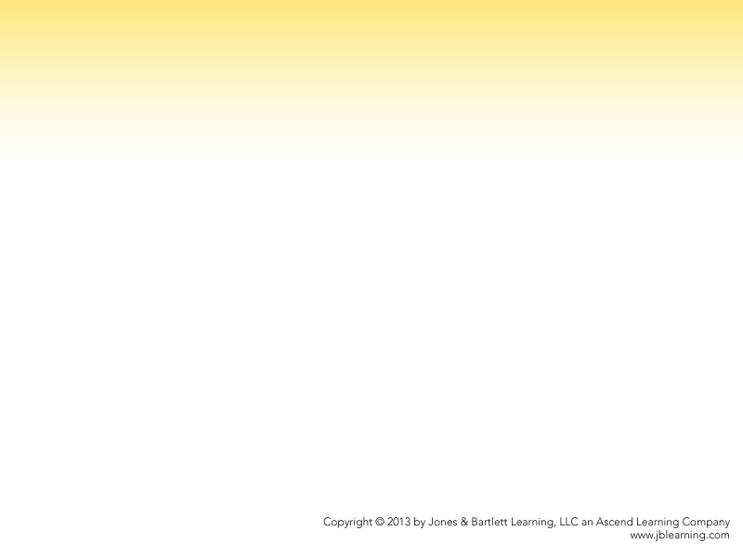
Outline
  User interaction
  Defining user interface elements
  Programmatically accessing user interface elements
  Event handlers
  Event objects
  Event implementation
  Case study

Slide 3
User Interaction
So far, we have been using prompt and alert for user interaction, with programs executing (mostly) from beginning to end, approximating the way we read them.
Event-driven computing represents a paradigm shift from this largely sequential approach to one that is centered around events — anything that can happen while a program is running, such as keystrokes, mouse movements, speech, gestures, or even the passage of time.

Slide 4
An Event-Driven Web Page
<!doctype html>
<html>
<head>
<meta charset="UTF-8"/>
<title>JavaScript Temperature Converter</title>
</head>
<body>
<h1>Temperature Conversion</h1>
<p>
<input type="text" id="temperature" />
<input type="button" id="f_to_c" value="F to C" />
<input type="button" id="c_to_f" value="C to F" />
</p>
<p id="result"></p>
<script src="temperature.js"></script>
</body>
</html>
var report = function (celsius, fahrenheit) {
document.getElementById("result").innerHTML =
celsius + "\xb0C = " + fahrenheit + "\xb0F";
};
document.getElementById("f_to_c").onclick = function () {
var f = document.getElementById("temperature").value;
report((f - 32) / 1.8, f);
};
document.getElementById("c_to_f").onclick = function () {
var c = document.getElementById("temperature").value;
report(c, 1.8 * c + 32);
};
Note how nothing visible happens when the script runs — it only sets up ﻿event handlers that get invoked later, when the buttons are clicked.

Slide 5
Defining User Interface Elements
HTML is used to define a web page’s user interface.
  Web pages are structured documents, very much resembling an outline when diagrammed properly.
  Any particular “node” in this outline is called an element.
  The code that defines an element uses tags to indicate when an element starts and stops.

Slide 6
Elements for User Interface Controls
We focus, here, on HTML elements that are particularly relevant to event-driven programming. Please refer to other resources for HTML web page authoring in general.
Elements that render as user interface controls in a web page are front-and-center when talking about event-driven programming, because many events originate from such controls (they are what the user manipulates, after all).

Slide 7
The input Element
A host of controls can be defined through the input element. Its type attribute determines the control that appears.
  type="button" produces a standard push button (so does the button element, but that’s a different tag entirely)
  type="text" produces a standard text field
  type="number" restricts that text field to numeric values
  type="password" is a text field that hides what the user types (such as when entering, uh, passwords)

Slide 8
input Elements That Need labels
Some input elements require an associated piece of text, or label, that provides information about that user control:
  type="checkbox" produces a checkbox, but just the checkbox. You need a label element to associate that checkbox with explanatory text:
  <input type="checkbox" id="awakeCheck" />
  <label for="awakeCheck">Are you awake?</label>
  type="radio" produces a radio button, and also needs a label. This type of input element also requires a name attribute to enable mutually exclusive choices.

Slide 9
The select Element
The select element produces lists of choices. This element appears as a scrolling list if it has a size attribute, or as a drop-down menu if it does not have size. Choices within the select element are specified using option elements.
<select>
<option>Charles Babbage</option>
<option>Ada Lovelace</option>
<option>Alan Turing</option>
<option>John von Neumann</option>
<option>Kurt G&ouml;del</option>
</select>

Slide 10
Other User Interface Control Elements
  The textarea element allows for longer pieces of text input. Its rows and cols attributes determine its size.
  We’ve already mentioned the button element.
  Please visit http://javascript.cs.lmu.edu/playground to see these and the preceding elements (input, select) in action

Slide 11
Content and Container Elements
Although they don’t render as user interface controls, the other HTML elements do send events as well. Some elements are meant to display typical document content, while others serve more as “containers” for organization or layout purposes.
  p (paragraph), h1 to h6 (heading), a, img, section, article, nav, and others provide the document web content with which we are all familiar.
  div and span, on the other hand, are more generic containers for other elements. Succeeding elements appear below a div or immediately after for spans.

Slide 12
Programmatic Access to UI Elements
With user interface elements now defined in HTML, the question moves to how JavaScript can access and manipulate them.
The key to this access is the document object. document is a web browser host object that exposes the Document Object Model or DOM — the standard data structure that represents a web page to JavaScript.

Slide 13
Exploring document
document is available anytime, anywhere. You need only run this to prove it to yourself:
alert(document);
You can run this in http://javascript.cs.lmu.edu/runner to see that document is chock full of information:
var footer = document.getElementById("footer");￼￼
footer.innerHTML = "<h3>document properties:</h3>";
var properties = [];
for (var property in document) {
properties.push(property + " ");
}
footer.innerHTML += "<p>" + properties.join("<br/>") + "</p>";

Slide 14
Fun with DOM Properties
The DOM is bidirectional: JavaScript can access ﻿and modify it, with immediate, visible results on the web browser.
Run this in http://javascript.cs.lmu.edu/runner:
document.getElementById("introduction").style.background = "red";
The code’s effect should be pretty hard to miss. Virtually all visible, dynamic web page behavior can be tracked down to this: the assignment of a value to some property of some object within the document data structure.

Slide 15
More DOM Manipulation Examples
The following scripts (all for http://javascript.cs.lmu.edu/runner) demonstrate the range of things that you can do with the DOM. Ultimately, mastering this is a matter of mastering what properties to change and to what values, in order to accomplish the desired effect.
Let’s have a little more fun with the introduction element:
var intro = document.getElementById("introduction");
intro.style.color = "blue”;
intro.style.fontWeight = "bold";
intro.style.textDecoration = "underline";
intro.style.paddingTop = "100px";

Slide 16
Reading and Writing
This script copies itself (!) into the footer element of the JavaScript runner page:
var scriptArea = document.getElementById("scriptArea");
var footer = document.getElementById("footer");
footer.innerHTML = "<pre>" + scriptArea.value + "</pre>";
If you examine the HTML, you will note that the script text area does indeed have an id of scriptArea while the region at the bottom has an id of footer.
Note also how innerHTML takes, well, HTML: this script “wraps” the copied text in a pre element to preserve spacing.

Slide 17
Changing and Adding UI Elements
User interface controls are also part of the DOM. This script relabels the JavaScript runner page’s Run button:
var runButton = document.getElementById("runButtonBottom");
runButton.value = "Please Execute This as Soon as Possible";
while this one ﻿adds a button to the page:
var buttonPanel = document.getElementById("buttonPanel");
var newButton = document.createElement("input");
newButton.type = "button";
newButton.value = "I'm New! But I Do Nothing...";
buttonPanel.appendChild(newButton);

Slide 18
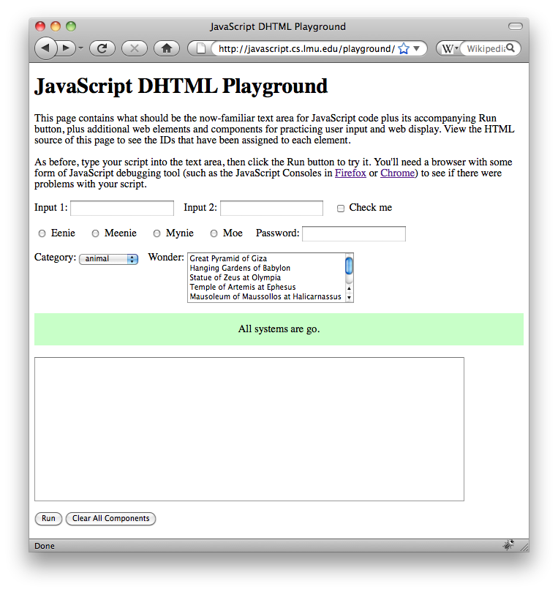
A Change of Scene
The following samples are meant for the aforementioned http://javascript.cs.lmu.edu/playground page, with its built-in “gallery” of user interface elements.

Slide 19
Manipulating User Interface Controls
The following scripts are conceptually no different from the ones that came before. However, they show the use of user interface controls as input and ﻿output elements. This one implements a simple adder:
// Grab the elements that we need.
var input1 = document.getElementById("input1");
var input2 = document.getElementById("input2");
var status = document.getElementById("status");
// Read the required text and convert to numbers.
var number1 = +input1.value;
var number2 = +input2.value;
// Write the result.
status.innerHTML = number1 + " + " + number2 +
" = " + (number1 + number2);

Slide 20
This one is dresses the page up a bit more as an adder.
document.getElementById("header").innerHTML =
"A Simple Dynamic HTML Adder";
document.getElementById("introduction").innerHTML =
"This page adds two numbers.";
document.getElementById("instructions").innerHTML =
"Type a number into each of the fields below, " +
"paste the addition script into the text area, " +
"then click the <i>Add</i> button.";
document.getElementById("input1Label").innerHTML = "Addend 1";
document.getElementById("input2Label").innerHTML = "Addend 2";
document.getElementById("status").innerHTML = "";
document.getElementById("runButton").value = "Add 'Em";
// Make everything else invisible.
var idsToHide = ["check", "checkLabel", "row2", "row3"];
for (var index = 0; index < idsToHide.length; index += 1) {
document.getElementById(idsToHide[index]).style.display = "none";
}
// A final reminder that we need the separate adder script pasted in.
alert("Don't forget to paste/type in the adder script!");

Slide 21
The following one-liners demonstrate a range of other UI manipulation capabilities.
document.getElementById("input1").disabled = true;
document.getElementById("check").disabled = true;
document.getElementById("check").checked = true;
document.getElementById("radio2").checked = true;
// The radio buttons are mutually exclusive.
document.getElementById("radio4").checked = true;
document.getElementById("password").value = "swordfish";
document.getElementById("password").readOnly = true;
document.getElementById("category").selectedIndex = 2;
document.getElementById("category").style.verticalAlign = "bottom";
document.getElementById("wonder").multiple = true;
document.getElementById("wonder").style.float = "right";
document.getElementById("wonder").options[1].selected = true;
document.getElementById("wonder").options[3].selected = true;
document.getElementById("status").style.border = "medium outset #0f0";
document.getElementById("status").style.textAlign = "right";

Slide 22
Walking the DOM*
document object functions such as getElementById, createElement, and appendChild are typically sufficient for writing scripts that add dynamic behavior to web pages.
The following program goes beneath these functions and exposes the actual DOM data structure a little more.
With an understanding of this data structure, the implementations of getElementById, createElement, and appendChild, among others, becomes generally apparent, and largely replicable on one’s own.

Slide 23
/*
* A script that displays the skeleton node structure of the
* enclosing document, without text nodes containing only
* whitespace, in the element with id "footer". The script
* needs work, though: it is not efficient and it may render
* some attributes incorrectly. Fixing it is an exercise for
* the reader!
*/
var TYPES = ["", "element", "attribute", "text", "cdata",
"entity_reference", "entity", "processing_instruction",
"comment", "document", "document_type", "document_fragment",
"notation"];
/*
* Adds the subtree rooted at the given node into the given list
* of nodes, indented four spaces per level.
*/
var showNode = function (list, node, indent) {
var value = indent + TYPES[node.nodeType] + " ";
// Handle elements by showing tag names and attributes, if any
if (node.nodeType === 1) {
value += node.tagName;
for (var i = 0; i < node.attributes.length; i += 1) {
var a = node.attributes[i];
value += " " + a.name + "=" + a.value;
}
}
// If this is a text node containing all whitespace, bail
if (node.nodeType === 3 && /^\s*$/.test(node.data)) {
return;
}
// Add node to list and "descend" tree by processing children
list.push(value);
for (var i = 0; i < node.childNodes.length; i += 1) {
showNode(list, node.childNodes[i], indent + " ");
}
};
// Puts the outline into the footer element, formatted nicely
var list = [];
showNode(list, document, "");
document.getElementById("footer").innerHTML =
"<pre>" + list.join("\n") + "</pre>";
nodeType indicates the kind of object a particular node represents.
childNodes is an array containing a node’s children.
For element nodes, tagName holds that element’s HTML tag name and attributes holds that element’s, well, attributes (i.e., the named properties defined within the element’s start tag).

Slide 24
The script’s output looks something like this (this particular output comes from running the script on http://javascript.cs.lmu.edu/runner):
document
document_type
element HTML
element HEAD
element META charset=UTF-8
element TITLE
text
element SCRIPT
text
comment
element SCRIPT src=http://code.jquery.com/jquery-latest.min.js
element BODY
element H1 id=header
text
element DIV id=scratch
element P id=introduction
text
element INPUT type=button value=Run id=runButtonTop
text
element P
element TEXTAREA id=scriptArea cols=80 rows=16
element DIV id=buttonPanel
element INPUT type=button value=Run id=runButtonBottom
element INPUT type=reset value=Clear id=clearButton
element P id=footer
element SCRIPT
text
element SCRIPT src=http://www.google-analytics.com/ga.js type=text/javascript
element SCRIPT type=text/javascript
text

Slide 25
Event Handlers
Now that we have seen how to (a) define user interface elements and (b) get to them from JavaScript, we can look at how to designate what to do when something happens within that user interface — in other words, how to handle events.

Slide 26
Anatomy of an Event Handler
DOM elements can trigger events such as:
  click — Indicates that the user has clicked on an element
  load — Indicates that the element has finished loading
  keydown — Indicates that the user has held down a key while that event had keyboard focus
  mousemove — Indicates that the user has moved the mouse within that element
There are more, of course. But those should get us started.

Slide 27
Events Have an on- Property
For every event that a DOM element can detect, that DOM element has a property whose name is that event, preceded, without spaces or punctuation, by on: onclick, onload, onkeydown, onmousemove, for example.
Setting up event handlers is a matter of assigning a function to the on- property corresponding to the event that you would like to handle.
// Alert something when the element with id "header" is clicked.
document.getElementById("header").onclick = function () {
alert(this.innerHTML);
};

Slide 28
Other Ways to Assign Event Handlers
You can also assign an event handler using the addEventListener function (useful if you want to differentiate between event capturing and bubbling).
// Does not work on IE prior to version 9.
document.getElementById("header").addEventListener("click", function () {
alert(this.innerHTML);
}, false);
Finally, third-party libraries such as jQuery provide alternative event handler assignment functions that accommodate differences between web browsers automatically.
// Works on all browsers, but requires the jQuery library.
$("#header").click(function () { alert(this.innerHTML); });

Slide 29
Event Handlers are Functions are Objects
It is important to remember that, because event handlers are functions, they are simply objects as well, and can therefore be managed or manipulated like any other object. This affords you a great degree of flexibility.
The following examples are meant to be run in http://javascript.cs.lmu.edu/playground.

Slide 30
You can assign an event handler to a variable.
/*
* Enables or disables the category drop-down menu.
*/
var setCategoryEnabled = function (enabled) {
// Recall that "!" in JavaScript means "not."
document.getElementById("category").disabled = !enabled;
};
/*
* Enables or disables the category drop-down menu based
* on whether or not the "Check me" box is checked.
*/
var handleCheckClick = function () {
setCategoryEnabled(this.checked);
};
// Sync up the drop-down and the checkbox.
setCategoryEnabled(document.getElementById("check").checked);
// Set the event handler.
document.getElementById("check").onclick = handleCheckClick;

Slide 31
You can create a data structure of event handlers and assign them from there.
/*
* We prepare three possible event handlers in an array.
*/
var handlers = [
function () {
document.getElementById("input1").value = Date.now();
setRandomHandler();
},
function () {
alert("Hello events!");
setRandomHandler();
},
function () {
alert(prompt("Type something to capitalize:").toUpperCase());
setRandomHandler();
}
];
/*
* Define a function that sets an event handler for the
* "status" element at random.
*/
var setRandomHandler = function () {
document.getElementById("status").onclick = handlers[Math.floor(Math.random() * 3)];
};
// Set the (initial) event handler.
setRandomHandler();

Slide 32
Event Objects
For some types of events, it is not enough to merely know that they took place.
For key-related events, you would want to know which key was involved, or whether a modifier such as control or alt was being held down at the time.
For mouse events, you typically want mouse coordinates and/or the state of the mouse buttons at the time (possibly keyboard modifiers too).
﻿Event objects serve the purpose of supplying this information.

Slide 33
Delivery to the Event Handler
In the same way that event handlers are “just functions,” so event objects are “just objects.” It is the specific set of properties they hold, such as clientX, clientY, shiftKey, altKey, ctrlKey, and others, that distinguishes them as event objects.
On web browsers other than Internet Explorer, the event object is simply the first argument passed to the event handler.
On Internet Explorer, the event object is assigned to the globally-available variable named event.

Slide 34
The following example allows you to support both mechanisms:
document.getElementById("wonder").onclick = function (e) {
if (!e) {
e = event;
}
var status = document.getElementById("status"),
selection = this.options[this.selectedIndex].text;
status.innerHTML = e.shiftKey ? selection.toUpperCase() :
e.altKey ? selection.toLowerCase() : selection;
};
In Internet Explorer, the e parameter will be undefined. The if statement then assigns the event variable to e. In other web browsers, e will already have the event object, so things can proceed without further action.

Slide 35
Event Implementation Details
As a paradigm, event-driven programming crosses platforms, devices, and technologies. However, for every specific event-driven technology, implementation details and particulars may arise. Web browsers, the DOM, and JavaScript are no exception to this.

Slide 36
Event Capturing and Bubbling
Web browser event detection has a unique two-phase flow: events actually “travel” from the outermost element that may pertain to this event to the innermost applicable element, then back again.
As a result, a single event may actually be handled not once per element that may contain the event, but twice. The initial flow from outermost to innermost element is called the event capturing phase, while the “return trip” from the innermost to outermost element is the event bubbling phase.

Slide 37
By default, events are only reported while in the event bubbling phase.
document.getElementById("widgets").onclick = function () {
alert("Widget area clicked!");
};
document.getElementById("check").onclick = function () {
alert("Checkbox clicked!");
};
document.getElementById("templeOption").onclick = function () {
alert("Temple clicked!");
};
document.getElementById("wonder").onclick = function () {
alert("Wonder clicked!");
};
document.getElementsByTagName("body")[0].onclick = function () {
alert("Body clicked!");
};
(Click on the above elements in the playground page and note the order in which the alerts appear.)

Slide 38
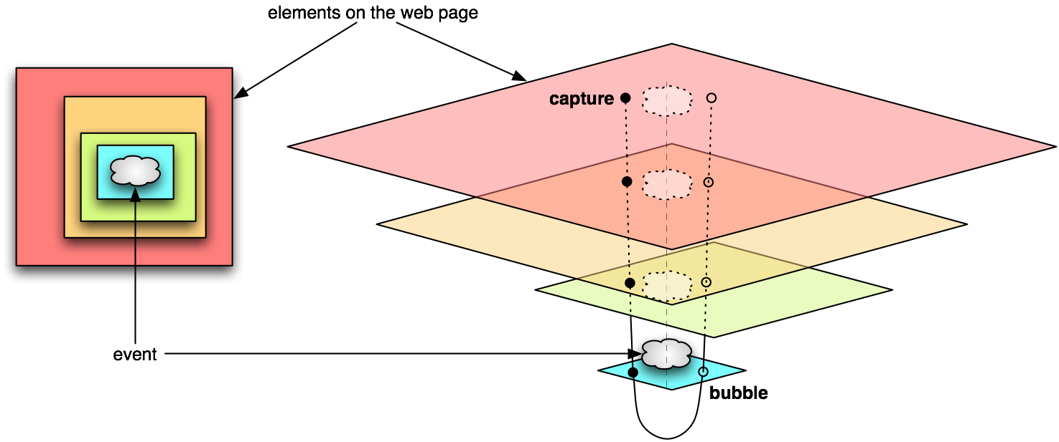
To handle events at the event capturing phase, use the addEventListener function rather than direct on-property assignment: the function’s third [optional] argument is a Boolean that states whether the event should be handled at the capturing phase.

Slide 39
Default Actions
Many elements automatically respond to certain events without your assigning an event handler to them (e.g., pressing a key while a text field has the keyboard focus leads to that key’s character’s insertion into the text field).
These so-called default actions are there to provide standard or expected behaviors where applicable. If you need to override them for some reason, call the preventDefault function within the “overriding” event handler or, in Internet Explorer, set its returnValue property to false.

Slide 40
This example restricts text field keypresses to just digit characters (0–9).
/*
* Eliminates all nondigits from the given string.
*/
var restrictToDigits = function (string) {
return string.replace(/[^\d]/g, "");
};
/*
* Checks if the given value is all digits.
*/
var isAllDigits = function (string) {
return string.match(/^\d*$/);
};
/*
* Rejects nondigit keypresses.
*/
var handleInputKeyPress = function (e) {
if (!e) {
e = event;
}
if (!isAllDigits(String.fromCharCode(e.charCode))) {
// Make sure keypress doesn't cause a character
// to appear.
if (e.preventDefault) {
e.preventDefault();
} else {
e.returnValue = false;
}
}
};
/*
* Rejects nondigits in this.value, and reselects
* the text field.
*/
var handleInputBlur = function () {
if (!isAllDigits(this.value)) {
alert("Sorry, only 0-9 are allowed here.");
this.value = restrictToDigits(this.value);
this.select();
}
};
document.getElementById("input1").onkeypress =
handleInputKeyPress;
document.getElementById("input2").onblur =
handleInputBlur;
This is the most relevant portion. Note also the web browser compatibility logic.

Slide 41
When to Assign Event Handlers
Event handler assignments require that the assigned elements already exist. Because a web browser executes scripts in sequence, this means that a misplaced event handler script element may have no effect, if it runs at a point where the element being connected has not yet been added to the DOM.
You may ensure this by placing all of your JavaScript code at the end of the HTML (i.e., right before the </body> end tag). Alternatively, you can place all of these assignments within a function, then assign that function as the event handler for window.onload. The window’s load event will only fire when the entire page has been processed, no matter where onload is assigned.

Slide 42
This example shows the temperature converter code rewritten to use window.onload.
var report = function (celsius, fahrenheit) {
document.getElementById("result").innerHTML =
celsius + "\xb0C = " + fahrenheit + "\xb0F";
};
window.onload = function () {
document.getElementById("f_to_c").onclick = function () {
var f = document.getElementById("temperature").value;
report((f - 32) / 1.8, f);
};
document.getElementById("c_to_f").onclick = function () {
var c = document.getElementById("temperature").value;
report(c, 1.8 * c + 32);
};
};
The benefit: this script can appear anytime before the web browser ends.

Slide 43
Events Based on the Passage of Time
Users don’t have the monopoly on triggering web browser events — the mere passage of time will do this too. Because this occurrence cannot be attributed to any single web page element, these are assigned differently.
The top-level functions setTimeout and setInterval accept a function that will be called when a certain amount of time passes, once for setTimeout and repeatedly for setInterval.
Use clearTimeout and clearInterval, respectively, to cancel an impending function call due to the passage of time.

Slide 44
setTimeout and setInterval in Action
Try these scripts in http://javascript.cs.lmu.edu/playground:
var timeoutStr = document.getElementById("input1").value;
var timeout = parseFloat(timeoutStr) * 1000;
document.getElementById("status").innerHTML = "Wait for it...";
setTimeout(function () {
document.getElementById("status").innerHTML = "Liftoff!";
}, timeout);
setInterval(function () {
document.getElementById("status").innerHTML = new Date();
}, 1000);
Visit http://javascript.cs.lmu.edu/deferred for additional time-triggered demonstrations and code.

Slide 45
Multitouch Events
Many computing devices, particularly mobile phones and tablets, have touch screens that can detect and track more than one finger at a time.
As you might expect, event-driven programming works perfectly well as a paradigm for multitouch — one simply has to define new events and their associated event objects.

Slide 46
Multitouch-Capable Web Browsers
Web elements on multitouch-capable web browsers can assign event handlers to the following touch events:
  touchstart indicates the addition of a finger, or touch, to the list of known contacts on the device
  touchmove indicates the motion of a previously known contact across on the device
  touchend indicates the removal or lifting of a finger or contact from the device

Slide 47
Multitouch Event Objects
The event object that accompanies a multitouch event is most notable for its one or more arrays of touches. Effective multitouch event handling involves properly following and tracking the members of these touch arrays through multiple event handler invocations. The following event handler for touchmove provides a taste of this:
shiftParagraph = function (event) {
var i, touchCount, element;
for (i = 0, touchCount = event.changedTouches.length; i < touchCount;
i += 1) {
element = getParagraphElement(event.changedTouches[i].target);
element.style["margin-left"] = (event.changedTouches[i].pageX -
element.startX) + "px";
}
}

Slide 48
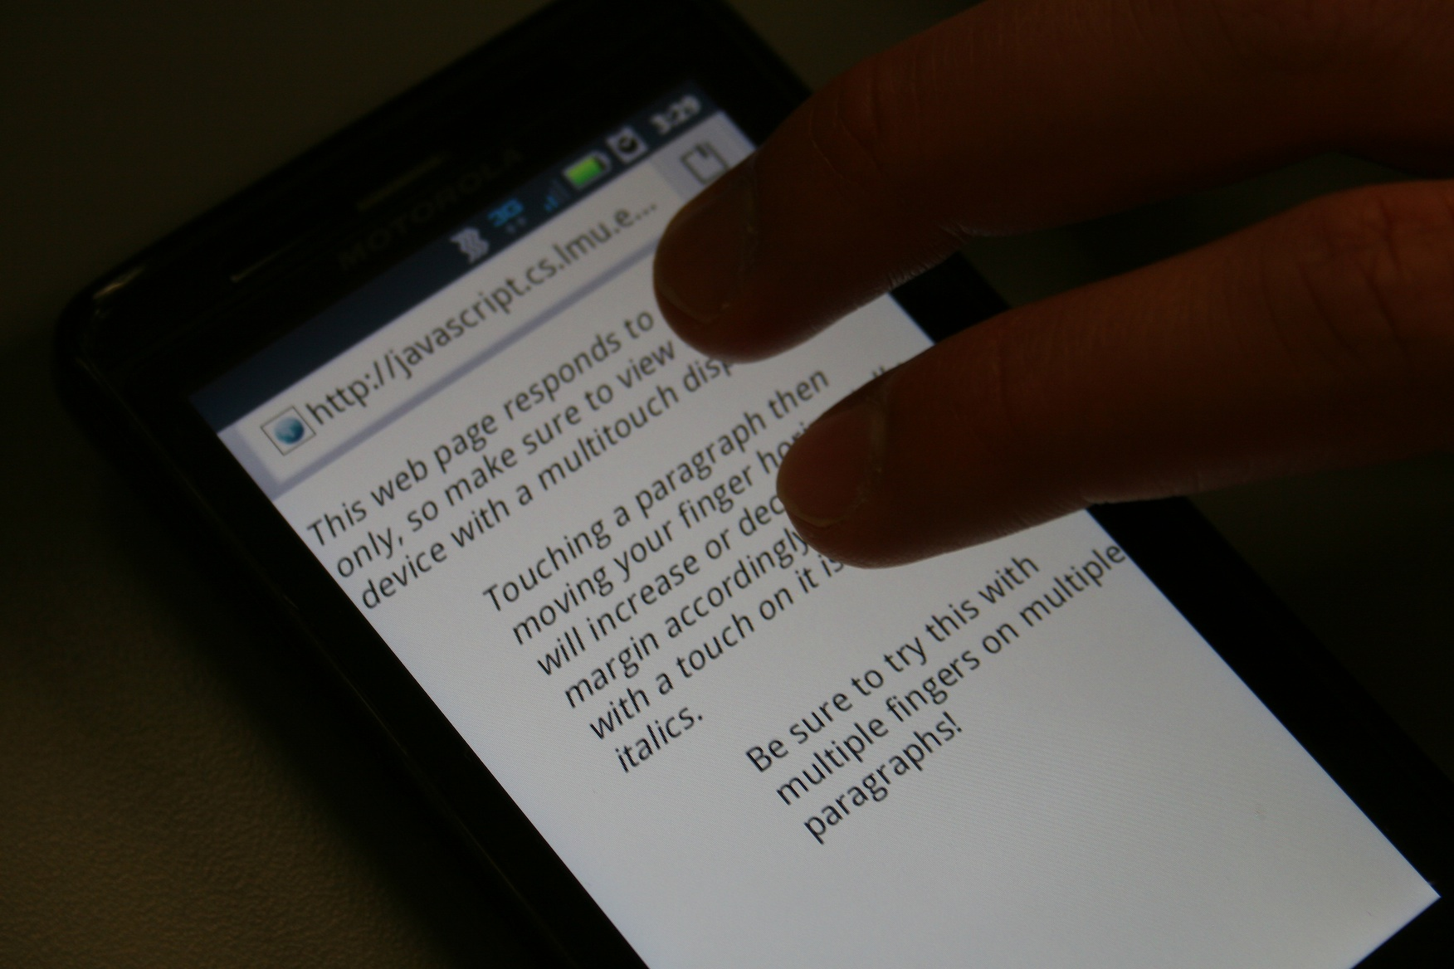
The complete multitouch demonstration can be found at http://javascript.cs.lmu.edu/text-touch:

Slide 49
Gesture Events
Gestures are natural extensions of multitouch events: they are particular multitouch sequences that can be recognized as a single action, just as a mouse click is actually a mouse-down event followed by a mouse-up. Gesture events follow a pattern which should feel somewhat familiar now:
  gesturestart signals the recognition of a new gesture
  gesturechange means that some current gesture is ongoing but has changed in some way
  gestureend indicates that a gesture has concluded

Slide 50
http://javascript.cs.lmu.edu/text-gesture demonstrates gesture event handling.
changeParagraph = function (event) {
var element = getParagraphElement(event.target), newOpacity;
element.style["font-size"] = (element.startSize * event.scale) +
element.sizeUnit;
// Make 180 degrees of rotation correspond to 100% opacity.
newOpacity = +element.startOpacity + (event.rotation / 180.0);
newOpacity = (newOpacity < 0.0) ? 0.0 :
((newOpacity > 1.0) ? 1.0 : newOpacity);
element.style.opacity = newOpacity;
}
Note the “higher-level” nature of gesture events: they deal immediately with scale and rotation, without exposing multiple touches and locations.

Slide 51
Physical Events
Some devices have accelerometers for detecting motion and gyroscopes for detecting orientation, both in three-dimensional space. Web browsers on these devices may thus be able to trigger events based on these physical characteristics:
  devicemotion indicates physical motion in space, reported as an acceleration vector. Gravity may or may not be included in that vector, depending on the device.
  deviceorientation indicates a change in 3D orientation, reported as a directional vector.

Slide 52
Physical Event Handler Demonstrations
Because physical events affect the entire device, they are assigned to the global window object.
Two physical event demonstrations are available:
  http://javascript.cs.lmu.edu/physical-events provides a raw “data dump” of the acceleration and other vectors that come with physical event objects
  http://javascript.cs.lmu.edu/physical-colors converts these vectors into colors, for a more visual and intuitive presentation of these data

Slide 53
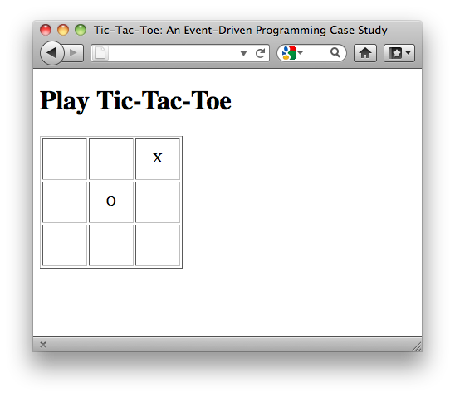
Case Study: Tic-Tac-Toe
A web page implementation of tic-tac-toe is available at http://javascript.cs.lmu.edu/tictactoe/events to demonstrate event-driven programming in the context of a self-contained, fully functional dynamic web page:

Slide 54
The same click handler is assigned to every cell in the tic-tac-toe board.
onload = function () {
// Note how we *really* rely on IDs being assigned properly.
var indicator = 1;
for (var i = 0; i < 3; i += 1) {
for (var j = 0; j < 3; j += 1) {
var cell = document.getElementById("cell" + i + j);
cell.indicator = indicator;
cell.onclick = set;
cell.appendChild(document.createTextNode(''));
squares.push(cell);
indicator += indicator;
}
}
startNewGame();
};
The click handler is the function that is currently stored in the set variable.

Slide 55
The click handler code itself checks for win conditions and updates the game board.
/*
* Sets the clicked-on square to the current player's mark,
* then checks for a win or cat's game. Also changes the
* current player.
*/
var set = function () {
if (this.firstChild.nodeValue !== EMPTY) {
return;
}
this.firstChild.nodeValue = turn;
moves += 1;
score[turn] += this.indicator;
if (win(score[turn])) {
alert(turn + " wins!");
startNewGame();
} else if (moves === 9) {
alert("Cat\u2019s game!");
startNewGame();
} else {
turn = turn === 'X' ? 'O' : 'X';
}
};

Slide 56
Chapter Summary
Event-driven computing and programming represent a paradigm shift from the “do-this-then-this” execution approach.
Event-driven systems consist of mechanisms for: defining and accessing user interface elements, assigning code that handles events within these user interface elements, and for delivering information about the event that took place.
It is advantageous to separate, as cleanly as possible, the data and internal computations within a program (“business logic”) from the way it is presented or formatted (visual properties or layout) and the way it interacts with the user (event handlers).

