Slide 1

Chapter 9
Graphics and Animation

Slide 2

Outline
  Graphics fundamentals
  HTML and CSS
  Animation in HTML and CSS
  The canvas element
  SVG
  3D graphics with WebGL
  Other client-side graphics technologies

Slide 3
Graphics Fundamentals
Certain computer graphics concepts and techniques are common to all systems. These include:
  Coordinate spaces
  Colors
  Pixel vs. objects/vectors
  Animation

Slide 4
Coordinate Spaces
Computer graphics operations are generally performed within a coordinate space — a 2D or 3D region within which colors, lines, shapes, and other entities are placed.
2D coordinates are represented by an ordered pair (﻿x, ﻿y), while 3D coordinates are represented by an ordered triple (x, y﻿, z).
Coordinate spaces have an origin, which is typically (0, 0) in 2D or (0, 0, 0) in 3D.

Slide 5
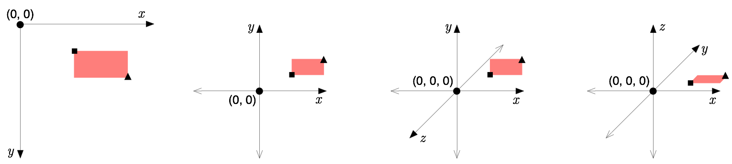
Coordinate spaces in assorted orientations. In all of them, the rectangle is bounded by (2, 1) (the small square) and (4, 2) (the small triangle). Add z = 0 in 3D.
Coordinate spaces are abstract in that they do not have preset units (e.g., inches, meters, miles). Programs attach this meaning depending on the application.

Slide 6
Colors
Coordinate spaces track ﻿where﻿ and how large something is. Colors track (generally) how it looks.
Colors, like 3D points, are also represented by ordered triples, written as (r, g, b) where r indicates the amount of red light in the color, g the amount of green light, and b the amount of blue light. The ranges used vary; one convention is to use 0 for total absence of light and 1 for that light at full intensity.
Some graphics systems accept a fourth value, called the alpha channel, which represents transparency (or opacity, depending on how you see it). In such systems, colors are ordered quadruples (r, g, b, a).

Slide 7
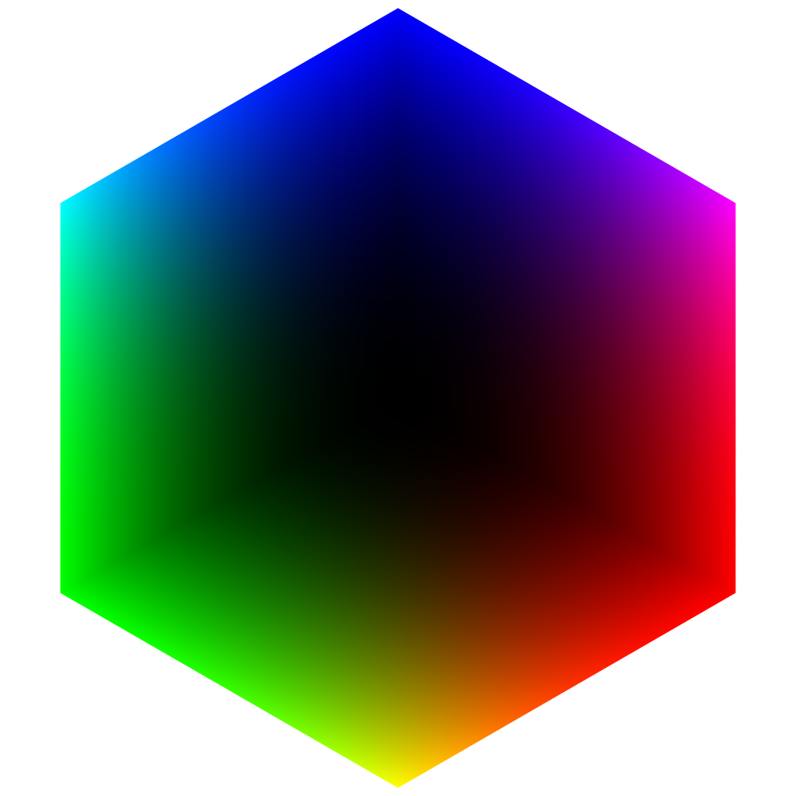
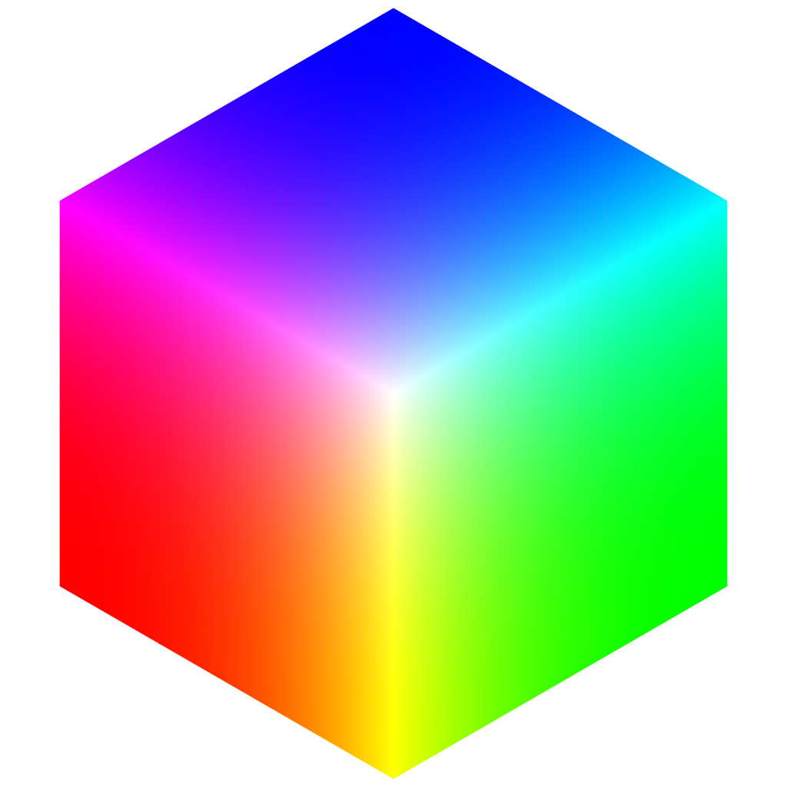
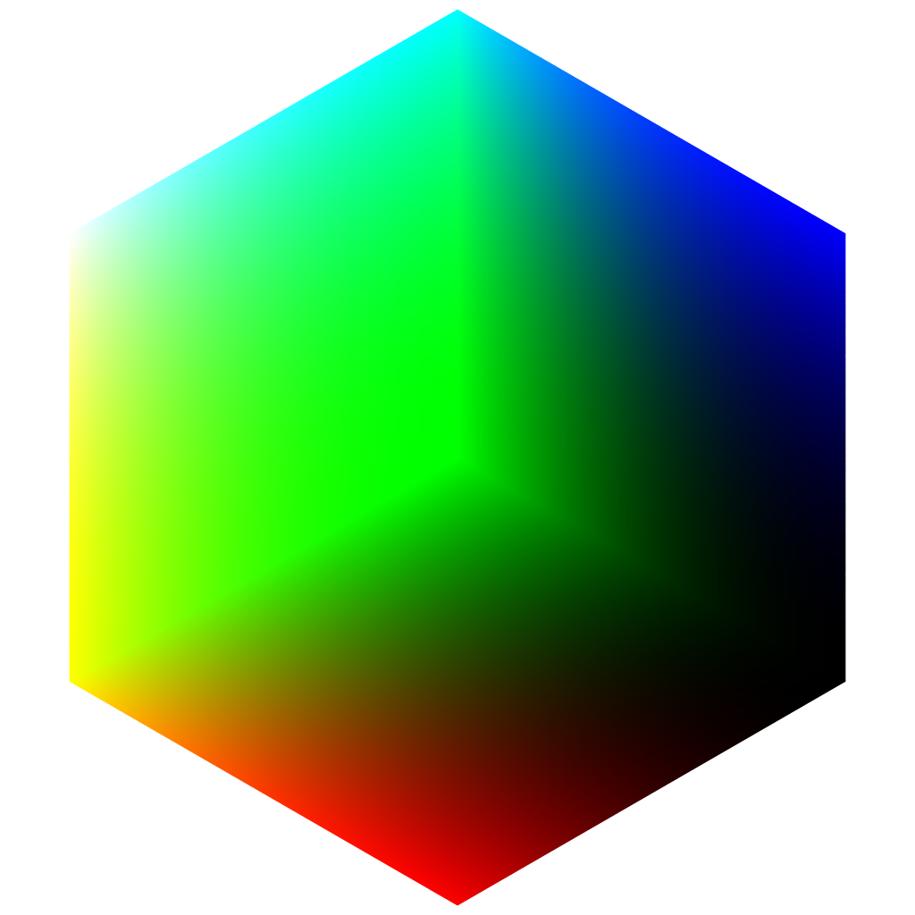
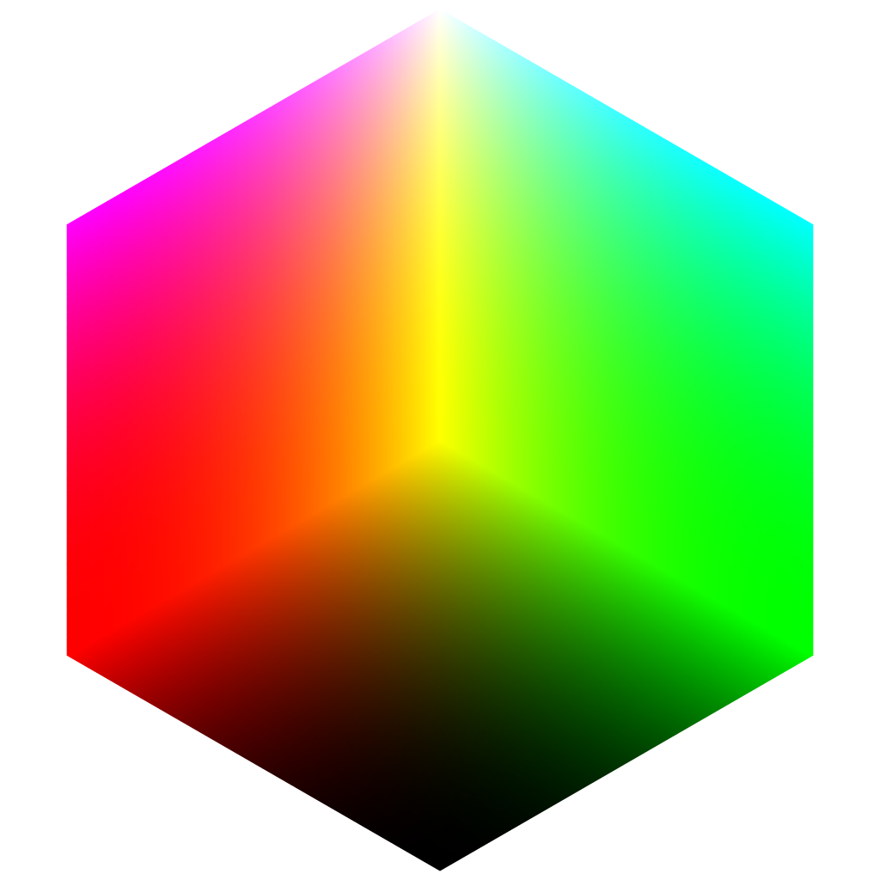
Because colors can be expressed as ordered triples, we can interpret those triples as coordinates themselves, then color those coordinates with the color that they represent. This produces a color cube which provides a visual representation of all possible colors. Here it is from four different viewing angles:
From left to right: black (0, 0, 0), white (1, 1, 1), green (0, 1, 0), yellow (1, 1, 0).

Slide 8
Pixels vs. Objects/Vectors
Computer graphics images or “scenes” can be represented as a discrete grid of colored units or pixels (e.g., pictures from a scanner or camera), or as a set of geometric or other objects (e.g., pictures created by drawing or diagramming programs).
The pixel approach is called an image-space perspective while the object-based approach is an object-space perspective. Vector-based graphics is a synonym for object-space as well.
The main tradeoff between the two is fine-grained control (image-space) vs. resolution independence (object-space), meaning that object-space pictures never get “jaggy.”

Slide 9
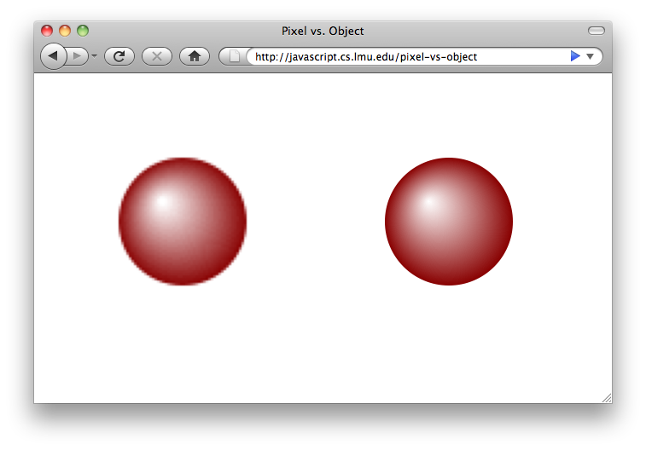
This screenshot (which is produced by an actual program that uses both approaches) illustrates the difference between the two. To produce the “jaggies,” the web page was magnified a few times so that picture pixels became noticeably bigger than screen pixels.

Slide 10
Pixel vs. Object Code Preview
window.onload = function () {
var canvas = document.getElementById("canvas");
var renderingContext = canvas.getContext("2d");
// Image-space circle.
var radialGradient = renderingContext
.createRadialGradient(42, 42, 1, 50, 50,25);
radialGradient.addColorStop(0, "white");
radialGradient.addColorStop(1, "#880000");
renderingContext.fillStyle = radialGradient;
renderingContext.beginPath();
renderingContext.arc(50, 50, 25, 0,
Math.PI * 2, true);
renderingContext.fill();
};
Here is the actual code for both approaches: the canvas element (left) does image-space…
<defs>
<!-- First, define the gradient. -->
<radialGradient id="radialGradient"
cx="50" cy="50" r="25" fx="42" fy="42"
gradientUnits="userSpaceOnUse">
<stop offset="0%" stop-color="white" />
<stop offset="100%" stop-color="#880000" />
</radialGradient>
</defs>
<!-- Then, use it. -->
<circle cx="50" cy="50" r="25"
fill="url(#radialGradient)" />
…while SVG markup (right) does object-space.

Slide 11
Animation
Animation shows a sequence of images quickly enough that the viewer perceives motion, with “quickly enough” being around 30 or more images, or frames, per second.
Image-space animation typically involves redrawing frames in their entirety, since any pixel can change at any time. Sometimes, only the parts of the frame that change can be redrawn, if those parts are known.
For object-space animation, object properties such as position, size, color, and others are changed per frame. The graphics system then takes care of redisplaying the objects.

Slide 12
HTML and CSS
In Chapter 6, we viewed HTML and the DOM from the perspective of user interfaces. Here, we view them from the perspective of a ﻿visual medium.
From this perspective, HTML can be viewed as the basis of an object-based graphics system. HTML defines the objects (elements) to display, while another technology, CSS, determines how these objects look.

Slide 13
HTML Elements for Graphics
Elements such as input, select, textarea, and button provide familiar user interface components. The following elements lean toward graphics and visuals.
It is important to remember, however, that all of these elements can be mixed and matched. While we focus on distinct groups of them in each chapter, overall they can be combined to create web pages that interact with the user ﻿and have visual, aesthetic appeal.

Slide 14
The img Element
img brings ready-made image files into a web page. Its src attribute specifies the URL to the image file:
<img src="http://javascript.cs.lmu.edu/images/bookcover.jpg" />
As you might expect, img elements can also be created and appended to a web page programmatically:
var footer = document.getElementById("footer"),
image = document.createElement("img");
image.src = "http://javascript.cs.lmu.edu/images/bookcover.jpg";
footer.appendChild(image);

Slide 15
The div Element
div is a generic box. It can contain virtually any other collection of elements:
<div><!-- Include anything here, or nothing at all. --></div>
Or, of course:
var footer = document.getElementById("footer"),
div = document.createElement("div");
footer.appendChild(div);
Note, however, that a div with no content is effectively invisible. It is truly a “blank slate” element, needing CSS to supply its visual characteristics.

Slide 16
CSS and Web Graphics
CSS, or Cascading Style Sheets, is the visual or presentation technology of the Web. You have already used CSS: the style attributes you have seen are actually CSS properties.
CSS is relatively simple: it consists of assigning properties, in the form of name-value pairs, to selected web page elements.
Selected is the key word: selectors, or expressions that determine what web page elements to modify, are a central concept in CSS.

Slide 17
CSS for Individual Elements
Individual elements can be “styled” with CSS using one of three mechanisms:
  Setting the style attribute in HTML
<p id="introduction" style="border-style: solid"><!-- etc. --></p>
  Setting the style property in JavaScript
document.getElementById("introduction").style.borderStyle = "solid";
  A CSS selector that specifies the element to modify using its id attribute (wait for it…)

Slide 18
The equivalent CSS code for setting the p element whose id is “introduction” to have a solid border is:
#introduction {
border-style: solid;
}
This code can either be in a style element within the head of the HTML page, or in a separate .css file that is referenced with a link element within the head:
<head>
<!-- etc. -->
<style>
#introduction {
border-style: solid;
}
</style>
</head>
<head>
<!-- etc. -->
<link rel="stylesheet"
href="page.css" />
</head>
- or -
(where page.css contains the CSS code above)

Slide 19
Individual CSS with jQuery
Finally, the #id selector format can also be used to set CSS properties with jQuery:
$("#introduction").css({ "border-style": "solid" });
This code is more or less functionally equivalent to setting the style property with JavaScript.

Slide 20
CSS for Elements of the Same Type
You can also assign CSS properties to all elements of the same type, such as all p or div elements.
In JavaScript, getElementsByTagName returns all elements of a particular type, for which the style property can be set:
var pElements = document.getElementsByTagName("p");
for (var i = 0; i < pElements.length; i += 1) {
pElements[i].style.borderStyle = "solid";
}

Slide 21
The direct CSS code looks like this:
p {
border-style: solid
}
As before, this can be placed in a style element, or in a separate .css file that is referenced by a link element.
Finally, the jQuery equivalent looks like this:
$("p").css({ "border-style": "solid" });

Slide 22
The class Selector
Selectors also exist for other sets of elements. To group elements beyond their type, you can use the class attribute:
<p class="helpbox">A CSS rule that begins with .helpbox will affect this p element.</p>
<div class="helpbox">It will affect this div element too.</div>
A .class selector (i.e., a name preceded by a period) then affects all elements with that class, regardless of type:
.helpbox {
border-style: solid;
}

Slide 23
Compound Selectors
You can lump multiple selectors under the same set of CSS properties with a comma-separated list:
/* p elements, elements with the "helpbox" class, *and* the
element whose id is "mainInstruction" will get these visuals. */
p, .helpbox, #mainInstruction {
background-color: rgb(250, 250, 192);
border-style: outset;
}
Using the greater-than sign (>) signifies direct containment:
/* Only elements with class "helpbox" that are inside a div element
will get these visuals. */
div > .helpbox {
background-color: rgb(250, 250, 192);
border-style: outset;
}

Slide 24
Other Selectors
Other CSS selectors are available. Because our focus here is computer graphics and not web page authoring, we leave the details to other sources:
  You can select elements based on the order of their appearance within their containing element.
  You can select elements based on attribute values.
  You can select elements based on whether they follow another element (also designated by selector).
  You can select elements by pseudoclass (i.e., a predefined state or portion of an element).

Slide 25
jQuery’s $
As with selection by id and selection by element type, all other selectors can be used with jQuery. In all cases, the string to pass into $ is the same selector expression that is used by standard CSS:
  $(".class") for selection by class
  $("selector1, selector2") for multiple selectors
  $("selector1 > selector2") for direct containment
…and so on.

Slide 26
Size and Spacing Properties
Now that we have looked at how CSS properties can be set, we can look at what properties are available to set, particularly from a graphics perspective.
First up are size and spacing. Web page elements, when rendered, all occupy a box that is divided into four regions:
margin
border
(background color or image only goes as far as the border; thus, margin is always transparent)
padding
content

Slide 27
CSS uses the same terms (margin, border, padding) for setting the sizes of these regions. Further, every side of each region (top, left, bottom, right) can be set individually. All size properties must include units (e.g., px for pixels). The border region also has visual properties, such as border-style and border-color.
var footer = document.getElementById("footer");
footer.innerHTML = "Fun with sizes and spaces";
footer.style.width = "100px";
footer.style.height = "100px";
footer.style.borderStyle = "outset";
footer.style.borderWidth = "2px";
footer.style.marginLeft = "300px";
footer.style.marginTop = "100px";
footer.style.paddingRight = "50px";
footer.style.paddingBottom = "200px";
Other variations are available; refer to the full CSS specification for a complete description.

Slide 28
Color, Images, Opacity, and Visibility
Many CSS properties pertain to color, which can be expressed either as a name preset or one of many RGB expression types. This stuff is easier to show than explain:
var footer = document.getElementById("footer");
footer.innerHTML = "Fun with color";
footer.style.color = "yellow";
footer.style.backgroundColor = "rgb(0, 0, 200)";
footer.style.borderStyle = "inset";
footer.style.borderColor = "rgb(150, 150, 150)";
Or, using jQuery:
$("#footer").html("Fun with color").css({
color: "yellow",
backgroundColor: "rgb(0, 0, 200)",
borderStyle: "inset",
borderColor: "rgb(150, 150, 150)"
});

Slide 29
Image files can frequently be used instead of colors. As in HTML, images are specified by URL, written as a url expression. Relative URLs are based on the CSS file’s location. Here is some more JavaScript runner code:
var footer = document.getElementById("footer");
footer.innerHTML = "Fun with color";
footer.style.height = "128px";
footer.style.color = "yellow";
footer.style.backgroundImage =
"url(http://javascript.cs.lmu.edu/images/bookcover.jpg)";
Here is its jQuery equivalent:
$("#footer").html("Fun with color").css({
height: "128px",
color: "yellow",
backgroundImage:
"url(http://javascript.cs.lmu.edu/images/bookcover.jpg)"
});

Slide 30
Opacity and visibility can also be set with CSS. opacity ranges from 0 (totally transparent) to 1 (totally opaque).
var header = document.getElementById("header");
document.body.style.backgroundColor = "rgb(0, 80, 0)";
header.style.color = "cyan";
header.style.opacity = "0.5";
An element with opacity of 0 is still there but transparent, so it still occupies space. To remove it entirely from view (without removing it from the page), set its display property to none:
var header = document.getElementById("header");
header.style.display = "none";
jQuery equivalents for these shouldn’t be too hard to infer at this stage.

Slide 31
Shadows, Borders, and Backgrounds
Box shadows do exactly that: they give elements a graded shadow for a measure of depth. Box shadow settings include a shadow color, its offset from the original element (both horizontally and vertically), a blur radius, and whether the shadow is inset (i.e., falling within the element’s boundaries, or outside of it).
// Gives the footer element a soft, grayish drop shadow
// that falls to the right and below it.
var footer = document.getElementById("footer");
footer.innerHTML = "Getting fancy";
footer.style.boxShadow = "rgb(128, 128, 128) 3px 5px 10px";

Slide 32
The border radius family of properties gives the rectangular bounds of an element rounded corners. You can assign everything uniformly:
var footer = document.getElementById("footer");
footer.innerHTML = "Styling outside the box...";
footer.style.borderStyle = "outset";
footer.style.borderWidth = "2px";
footer.style.borderRadius = "10px";
You can also set separate border radii for each corner, both horizontally and vertically.
border-radius plays well with box-shadow, and with some creativity you can produce ellipses and circles with it.

Slide 33
You have seen how the background-image property can take a url expression to load up an image file. background-image can also accept gradient image expressions, for backgrounds that ramp smoothly from one color to another:
var footer = document.getElementById("footer");
footer.innerHTML = "Look, ma, no images!";
footer.style.backgroundImage =
"linear-gradient(white, rgb(200, 0, 0), rgb(128, 0, 0))";
document.body.style.backgroundImage =
"linear-gradient(left, lightgray, white)";
Gradients may be linear or radial, indicating whether colors change across an element’s bounding box or emanate from a single point. They then consist of one or more color stops, indicating the colors to change into, and how far out to make this change.

Slide 34
Experimental or Preliminary CSS
Web standards are always evolving. Still, new technologies and properties do not appear overnight. While such developments are in progress, they may be considered experimental or preliminary.
Such properties are initially given ﻿vendor-specific names to indicate their nonstandard state. These names begin and end with dashes (-), with a browser-specific identifier in between.
For example, the vendor-specific prefix for the Mozilla or Gecko family or browsers is -moz- while the prefix for the WebKit family is -webkit-. Other browser developers have their own identifiers as well.

Slide 35
The trick with vendor-specific property names is just that: they are ﻿vendor-specific. You have to set these properties repeatedly, if equivalents exist for different browsers:
var footer = document.getElementById("footer");
footer.innerHTML = "Look, ma, no images!";
// Mozilla version: WebKit ignores this.
document.body.style.backgroundImage =
"-moz-linear-gradient(left, lightgray, white)";
footer.style.backgroundImage = "-moz-radial-gradient(25% 50%, circle," +
"white 0%, rgb(200, 0, 0) 50%, rgb(128, 0, 0) 100%)";
// WebKit version: Mozilla ignores this.
document.body.style.backgroundImage =
"-webkit-gradient(linear, 0% 0%, 100% 0%," +
"color-stop(0, lightgray), color-stop(1, white))";
footer.style.backgroundImage =
"-webkit-gradient(radial, 25% 50%, 0, 50% 100%, 750," +
"color-stop(0, white), color-stop(0.5, rgb(200, 0, 0))," +
"color-stop(1, rgb(128, 0, 0)))";
(By the time you read this, gradient images may no longer be browser-specific. But we’re sure you’ll find something else.)

Slide 36
Absolute Position
An important component of using HTML and CSS with a computer graphics focus is absolute position: the ability to place elements anywhere on the page, regardless of order, size, or other factors that typically affect element position.
One can view this as considering web pages as drawings rather than as documents.

Slide 37
Absolute Position “Recipe”
  Absolute positioning requires a designated container element — think of this as your drawing area. This element must have the property position: relative.
  Absolutely positioned elements must then be placed inside this container. Their position property must, in turn, be set to absolute.
  The elements within the drawing area can now have their left, top, right, bottom, width, and height properties set arbitrarily (all with units). This is absolute positioning.

Slide 38
The following example illustrates the absolute position recipe. Here is the relevant HTML:
<div class="container">
<div class="absolute" id="box0"><!-- content --></div>
<div class="absolute" id="box1"><!-- content --></div>
</div>
Here is its corresponding CSS (shown in two columns just so it fits):
.container {
position: relative;
}
.absolute {
position: absolute;
border: solid 1px black;
}
#box0 {
left: 10px;
top: 10px;
width: 100px;
height: 50px;
}
#box1 {
left: 30px;
top: 20px;
width: 40px;
height: 60px;
}

Slide 39
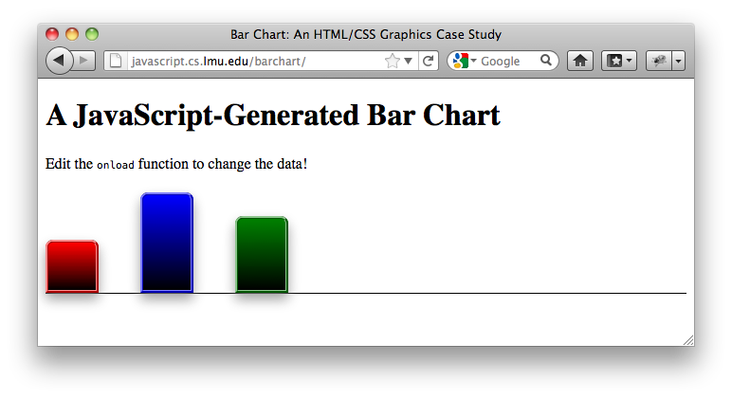
Case Study: Bar Chart
The web page at http://javascript.cs.lmu.edu/barchart provides a case study for how to put all of these techniques together:

Slide 40
The bar chart case study is written so that the chart itself is easy to modify — the colors and values to use are passed into the createBarChart function as an array of objects:
document.body.appendChild(createBarChart([
{ color: "red", value: 50 },
{ color: "blue", value: 100 },
{ color: "green", value: 75 }
]));
Feel free to download the full case study code into your computer, then modify the onload event handler to create your own custom chart.
Alternatively, you can use your web browser’s JavaScript console to create and append new bar charts to the page.

Slide 41
We have chosen to implement everything in JavaScript since programming in that language is our focus. More complicated applications should have a well-separated mix of HTML, CSS, and JavaScript.
The code itself follows the absolute position recipe. A chart element is created to hold the whole thing, with its position set to relative. Its height is then set based on the value of the largest data point:
var chart = document.createElement("div");
chart.style.position = "relative";
var height = 0;
for (var i = 0; i < data.length; i += 1) {
height = Math.max(height, data[i].value);
}
chart.style.height = (height + 10) + "px";

Slide 42
A bar chart div element is then created, styled, and appended for each of data point in the array.
var barPosition = 0;
var barWidth = 50;
for (i = 0; i < data.length; i += 1) {
var dataItem = data[i];
var bar = document.createElement("div");
bar.style.position = "absolute";
bar.style.left = barPosition + "px";
bar.style.width = barWidth + "px";
bar.style.bottom = "0px";
bar.style.height = dataItem.value + "px";
bar.style.backgroundColor = dataItem.color;
bar.style.borderStyle = "ridge";
bar.style.borderColor = dataItem.color;
bar.style.boxShadow = "rgba(128, 128, 128, 0.75) 0px 7px 12px";
bar.style.borderTopLeftRadius = "8px";
bar.style.borderTopRightRadius = "8px";
bar.style.backgroundImage =
"linear-gradient(" + dataItem.color + ", black)";
chart.appendChild(bar);
barPosition += (barWidth * 2);
}

Slide 43
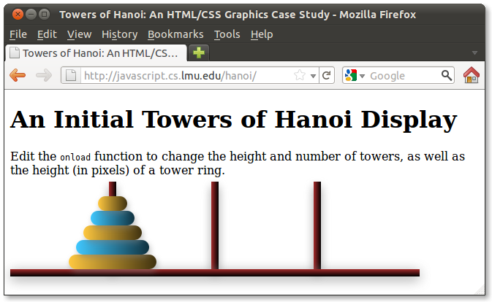
Case Study: Towers of Hanoi Display
The Towers of Hanoi display case study at http://javascript.cs.lmu.edu/hanoi shows how separate CSS rules can be used to separate, more cleanly, any purely visual concerns from procedural computation:

Slide 44
The HTML is minimal, leaving hanoi.css to define the static visuals, then going to hanoi.js to build the towers dynamically with its hanoi function (which itself returns a function, suitable for use as an onload event handler).
<!doctype html>
<html>
<head>
<meta charset="UTF-8"/>
<link rel="stylesheet" type="text/css" href="hanoi.css" />
<title>Towers of Hanoi: An HTML/CSS Graphics Case Study</title>
<!-- Note that this page generates a Towers of Hanoi display only.
The puzzle itself has not been implemented (be our guest!). -->
</head>
<body>
<h1>An Initial Towers of Hanoi Display</h1>
<p>Edit the <code>onload</code> function to change the height and number
of towers, as well as the height (in pixels) of a tower ring.</p>
<script src="hanoi.js"></script>
<script>onload = hanoi(5, 3, 20);</script>
</body>
</html>

Slide 45
The actual look of the rings is handled by CSS on its own. Note (in this excerpt) the absolute position recipe, plus colors, gradients, shadows, and border radius settings:
#hanoi {
position: relative;
}
.base, .tower, .ring, .oddring {
position: absolute;
}
/* .base and .tower redacted; see the full code. */
.ring, .oddring {
border-radius: 10px;
box-shadow: rgba(128, 128, 128, 0.5) 2px 4px 7px;
}
.ring {
background-image: linear-gradient(left, rgb(255, 200, 64), rgb(64, 50, 16));
}
.oddring {
background-image: linear-gradient(left, rgb(64, 200, 255), rgb(16, 50, 64));
}

Slide 46
As with the bar chart case study, towers are created in a loop:
// Represent the towers as arrays, then put those in an overall array.
var towers = [];
for (var i = 0; i < towerCount; i += 1) {
towers.push([]);
}
// Create the rings and place them on the first tower. Their widths
// vary by increments of the given ringHeight (in pixels).
var ringWidth = (height + 1) * ringHeight;
for (i = 0; i < height; i += 1) {
// Each ring is a div element, and we identify it with an ID.
var ring = document.createElement("div");
ring.id = height - i - 1;
ring.style.width = ringWidth + "px";
ring.style.height = ringHeight + "px";
// For variety, we'll display odd and even rings differently.
// The class attribute in HTML tags is accessed via the property
// name className in JavaScript.
ring.className = (i % 2 == 0) ? "ring" : "oddring";
towers[0].push(ring);
// The next ring is smaller.
ringWidth -= ringHeight;
}

Slide 47
The positioning of rings is separated into a function that “walks” through the towers array and sets the HTML elements up accordingly. A working version of Towers of Hanoi will need this separation:
// Define the function for positioning the rings---if actual Towers
// of Hanoi mechanics were implemented, we'll end up doing this a lot.
var positionRings = function () {
towerLeft = positionIncrement;
for (i = 0; i < towerCount; i += 1) {
var bottom = towerWidth;
for (j = 0; j < towers[i].length; j += 1) {
ring = towers[i][j];
ring.style.left = // We use parseInt to chop off the units.
(towerLeft - (parseInt(ring.style.width) / 2)) + "px";
ring.style.bottom = bottom + "px";
bottom += ringHeight;
}
towerLeft += positionIncrement;
}
};

Slide 48
Animation in HTML and CSS
The web page DOM makes up an object-space graphics system, and as mentioned for such a system, animation involves changing object properties such as position, size, color, and others in small increments at frequent intervals. The web browser then takes care of redisplaying the objects.
In web pages specifically, animation makes use of the setInterval function to call a “frame updater” function at these aforementioned frequent intervals. clearInterval can be used to stop the animation if necessary.

Slide 49
Constant Velocity
Demonstrations of DOM animation principles can be found in http://javascript.cs.lmu.edu/basicanimation.
The simplest form of animation changes objects at a constant velocity. This involves modifying an object’s animated properties by a fixed value at each interval.
For motion in the DOM, the object being animated must be set up to use absolute position. Its positional properties (top, left, bottom, right) can then be changed in small amounts over time.

Slide 50
The constant velocity example in http://javascript.cs.lmu.edu/basicanimation moves a gray box from left to right at a speed that the user can set. Its animation logic can be seen in the startConstantVelocityAnimation function:
var intervalID = setInterval(function () {
var newLeft = parseInt(box.style.left) + velocity;
if ((newLeft < 0) || (newLeft > maxLeft)) {
velocity = -velocity;
} else {
box.style.left = newLeft + "px";
}
}, millisecondsPerFrame);
Note how a fixed value is added to the animated box’s left property until it reaches a boundary, at which point its velocity is negated (reversed). This continues indefinitely until the interval is cleared.

Slide 51
Fading In and Out
Fading in and out is structurally the same as motion — the changes are just made to a different property. Animation ends when the square is entirely faded in or out, and goes the other way when it is started again.
var intervalID = setInterval(function () {
// Calculate the new values.
var newOpacity = parseFloat(box.style.opacity) - fadeRate;
if (newOpacity <= 0) {
// Upon reaching maximum transparency, stop the animation
// and toggle the function of the fade button.
newOpacity = 0;
clearInterval(intervalID);
setupButton(document.getElementById("fade-button"),
"Fade In", startFadeInAnimation);
}
box.style.opacity = newOpacity;
}, millisecondsPerFrame);

Slide 52
Animating Other Properties
Any property that can be changed in small increments over time has animation potential. Consider these:
  Color properties (RGB), including gradient images (colors, color stops) and box shadows
  width and height, or any other dimension properties, such as border-width, font-size, border-radius, margin, and padding
For the ultimate in flexibility, look into the CSS transform property — this allows a whole range of geometric changes to elements, in both 2D and 3D.

Slide 53
Ramped or Eased Animation
Conceptually, animation can be viewed as a smooth transition from one state to another: start here, end there, and change smoothly in between. The act of “changing smoothly in between” is known as tweening.
The constant rate of change seen previously is certainly a form of tweening, but is not the most general case, because the rate of change from one state to another does not have to be linear. As long as an object starts in one state, then ends in another at a designated future point in time, one can really do anything in between that can be perceived as smooth. This variation of rate of change is called ramped or eased animation.

Slide 54
The final example in http://javascript.cs.lmu.edu/basicanimation illustrates ramped or eased tweening. To accommodate multiple means of modifying an animation’s rate of change without disrupting a lot of code, we encapsulate tweening activity into a function of this form:
var tweener = function (currentTime, start, distance, duration) {
// Return the distance traveled at the given point in time.
};
This function supplies the beginning and ending value of the animation (start and start + distance), then returns where the animation should be at the given time (currentTime) based on a total animation span (duration). With this approach, we can swap functions that calculate this value differently to change our ramping calculation, without changing any other animation code.

Slide 55
The tweening functions in the sample page change in proportion to the square of the time elapsed. This results in natural-looking acceleration and deceleration.
var quadEaseIn = function (currentTime, start, distance, duration) {
var percentComplete = currentTime / duration;
return distance * percentComplete * percentComplete + start;
};
var quadEaseOut = function (currentTime, start, distance, duration) {
var percentComplete = currentTime / duration;
return -distance * percentComplete * (percentComplete - 2) + start;
};
var quadEaseInAndOut = function (currentTime, start, distance, duration) {
var percentComplete = currentTime / (duration / 2);
return (percentComplete < 1) ?
(distance / 2) * percentComplete * percentComplete + start :
(-distance / 2) * ((percentComplete - 1) *
(percentComplete - 3) - 1) + start;
};

Slide 56
Declarative CSS Animation
As a technology note, we mention the availability of ﻿declarative animation via CSS. This warrants just a “mention” here because this approach to animation does not involve JavaScript at all. However, it does illustrate many of the principles already covered.
One form of declarative CSS animation is delivered through a single property, transition. The transition property, when included in a CSS rule, specifies that when a web page element comes under that rule’s selector, its new property values should be set gradually rather than instantaneously.

Slide 57
The following self-contained example illustrates this. Note the ability to do eased animation, and the need for a duration: this is tweening in action again, although not using JavaScript.
<!doctype html>
<html>
<head>
<meta charset="UTF-8"/>
<title>Declarative CSS Animation Demonstration</title>
<style>
span {
font-size: 48px;
transition: text-shadow 2s ease;
}
span:hover {
text-shadow: 0px 0px 18px red;
}
</style>
</head>
<body>
<span>Follow</span> <span>the</span>
<span>unearthly</span> <span>glow!</span>
</body>
</html>

Slide 58
CSS also has animation properties for arbitrary animated sequences. animation relies on a keyframes definition to specify the CSS states for tweening. Interesting stuff, but again no JavaScript, so we leave that to other sources.
If you’re interested, take a look the transforms, transitions, and animation samples at:
https://github.com/dondi/bazaar/blob/master/hellohtml
(you may want to download the relevant HTML and CSS files there to get the most out of them)

Slide 59
The canvas Element
As mentioned, computer graphics with HTML and CSS is an object-space technology. However, an image-space approach exists in web browsers also, and this one intimately involves JavaScript code: the canvas element.
A canvas element sets aside an image-space drawing area within a web page. Once there, JavaScript code can paint into this drawing area.

Slide 60
Instantiating a canvas
Including a canvas element in a web page is just like including any other element: you may write it directly into HTML…
<canvas width="200" height="200">
A canvas element should appear here, in browsers
that support it.
</canvas>
…or create it programmatically using JavaScript.
var canvas = document.createElement("canvas");
canvas.innerHTML = "A canvas element should appear here," +
" in browsers that support it.";
canvas.width = 200;
canvas.height = 200;
document.body.appendChild(canvas);

Slide 61
canvas Instantiation Notes
  The width and height attributes set the canvas’s drawing size. This determines how many pixels are available, across and down respectively. This pixel count is distinct from the actual size of the canvas. That can be set with CSS, in the same way seen before.
  To accommodate web browsers that do not support canvas (though they should be few and far between at this point), text can be included as the element’s content. Web browsers that do not understand canvas will then just display this text (which typically admonishes the user to get a better web browser!).

Slide 62
The Rendering Context
The bridge between JavaScript code and a canvas element is the ﻿drawing, graphics, or rendering context. In web browsers, the rendering context is a JavaScript object which can be retrieved from a canvas:
// Assume that the canvas variable holds a valid canvas, whether
// created manually, accessed via document.getElementById, or
// obtained by any other method.
var renderingContext = canvas.getContext("2d");
(we’ll learn more about the 3d rendering context later)
All display activity leads to one or more functions in the rendering context object.

Slide 63
The rendering context holds both state and behavior. The former includes values such as current colors, styles, or paths. The latter includes functions that actually put something on the canvas based on the current state:
renderingContext.fillStyle = "rgb(255, 0, 0)"; // State.
renderingContext.fillRect(5, 5, 50, 25); // Behavior.
With regard to canvas state, the save and restore functions are useful: they preserve and reinstate, respectively, a particular set of rendering context values:
var drawingFunction = function (renderingContext) {
renderingContext.save();
/* Do anything you want; change anything you want. */
renderingContext.restore();
/* It's as if nothing has changed! */
};

Slide 64

Drawing Rectangles
Multiple functions exist for drawing rectangles on a canvas. Just call them as needed:
var renderingContext = canvas.getContext("2d");
renderingContext.fillStyle = "rgb(255, 0, 0)";
renderingContext.fillRect(10, 10, 100, 50);
renderingContext.fillStyle = "rgba(0, 255, 0, 0.5)";
renderingContext.fillRect(50, 20, 100, 50);
renderingContext.clearRect(20, 15, 75, 40);
renderingContext.strokeRect(25, 25, 75, 40);

Slide 65
Drawing Lines and Polygons
Paths allow you do draw in a “connect-the-dots” fashion. They follow a particular pattern of first specifying a set of points (the “path”), then drawing a line through or filling those points:
var renderingContext = canvas.getContext("2d");
renderingContext.beginPath();
/* Specify your points. */
/* Optional. */ renderingContext.closePath();
/* One or both: */
renderingContext.stroke();
renderingContext.fill();

Slide 66

While in mid-path, moveTo and lineTo work like a pencil that you lift above or drag across a piece of paper, respectively:
var renderingContext = canvas.getContext("2d");
renderingContext.fillStyle = "rgb(0, 255, 255)";
renderingContext.strokeStyle = "black";
renderingContext.beginPath();
renderingContext.moveTo(10, 10);
renderingContext.lineTo(110, 10);
renderingContext.lineTo(110, 60);
renderingContext.closePath();
renderingContext.fill();
renderingContext.stroke();

Slide 67
Drawing Arcs and Circles
The arc function lets you draw any variation of a circle as part of a path:
arc(x, y, radius, startAngle, endAngle, anticlockwise)
where (x, y) is the center of the arc to draw, radius is the arc’s radius, startAngle and endAngle state what “slice” of the arc is to be drawn (in radians), and anticlockwise determines the direction in which the arc is connected.
To convert degrees to radians, do this:
radians = (Math.PI / 180) * degrees;

Slide 68
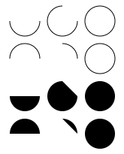
The Mozilla developer site provides a fun arc sampler. Note the use of beginPath to start each arc fresh:
var renderingContext = canvas.getContext("2d");
for (var i = 0; i < 4; i += 1) {
for (var j = 0; j < 3; j += 1) {
renderingContext.beginPath();
var x = 25 + (j * 50),
y = 25 + (i * 50),
radius = 20,
startAngle = 0,
endAngle = Math.PI + ((Math.PI * j) / 2),
anticlockwise = ((i % 2) === 0) ? false : true;
renderingContext.arc(x, y, radius,
startAngle, endAngle, anticlockwise);
if (i > 1) {
renderingContext.fill();
} else {
renderingContext.stroke();
}
}
}

Slide 69
Drawing Bézier and Quadratic Curves
In addition to jumping around (moveTo), drawing lines (lineTo), and drawing parts of a circle (arc), you can also draw Bézier and quadratic curves within paths.
Both types of curves start at one point and end at another, just like line segments. Quadratic curves then require a control point that “pulls” the line segment in order to form the curve.
Bézier curves have two control points, typically seen in drawing programs as “handles” that are attached to each endpoint. The two control points allow Bézier curves to be “pulled” in two directions rather than just one.

Slide 70

The following program draws 4 quadratic curves within a rectangle, using diametrically opposite corners as endpoints and the corners in between them as control points:
var renderingContext = canvas.getContext("2d");
renderingContext.strokeStyle = "rgba(0, 0, 0, 0.25)";
renderingContext.lineWidth = 0.5;
renderingContext.strokeRect(20, 20, 160, 60);
renderingContext.strokeStyle = "rgb(128, 0, 0)";
renderingContext.lineWidth = 1.0;
renderingContext.beginPath();
renderingContext.moveTo(20, 20);
renderingContext.quadraticCurveTo(180, 20, 180, 80);
renderingContext.moveTo(180, 20);
renderingContext.quadraticCurveTo(180, 80, 20, 80);
renderingContext.moveTo(180, 80);
renderingContext.quadraticCurveTo(20, 80, 20, 20);
renderingContext.moveTo(20, 80);
renderingContext.quadraticCurveTo(20, 20, 180, 20);
renderingContext.stroke();

Slide 71

This program draws Bézier curves within the same rectangle, this time using adjacent corners as endpoints with their opposite side providing the two control points:
renderingContext.strokeStyle = "rgb(128, 0, 0)";
renderingContext.beginPath();
renderingContext.moveTo(20, 20);
renderingContext.bezierCurveTo(180, 20, 180, 80, 20, 80);
renderingContext.stroke();
renderingContext.strokeStyle = "rgb(0, 128, 0)";
renderingContext.beginPath();
renderingContext.moveTo(180, 20);
renderingContext.bezierCurveTo(20, 20, 20, 80, 180, 80);
renderingContext.stroke();
renderingContext.strokeStyle = "rgb(0, 0, 128)";
renderingContext.beginPath();
renderingContext.moveTo(180, 80);
renderingContext.bezierCurveTo(180, 20, 20, 20, 20, 80);
renderingContext.stroke();
renderingContext.strokeStyle = "rgb(128, 0, 128)";
renderingContext.beginPath();
renderingContext.moveTo(180, 20);
renderingContext.bezierCurveTo(180, 80, 20, 80, 20, 20);
renderingContext.stroke();

Slide 72
Working with Images
As an image-space drawing region, canvas most certainly works with images, too. You can “paint” images or portions of images onto a canvas. Even better, you can treat another canvas as an image, so you can draw something in one then copy it to another.

Slide 73
Specifying an Image Source
Multiple options are available for bringing an image into a canvas element. You can do this with:
  An img element in the web page (accessed any way you like, whether by DOM, jQuery, etc.)
  A canvas element in the web page (whatever has been drawn in the canvas is treated as an image)
  An Image object created in JavaScript code
If you’re using the first option, and you are using that img element solely for the canvas, you’ll want to set its CSS to have display: none.

Slide 74
Drawing an Image
The drawImage function places the image (referenced through any of the aforementioned approaches) on the canvas. This function has options also:
  drawImage(image, dx, dy) places the image with its upper left corner at (dx, dy)
  drawImage(image, dx, dy, dw, dh) also scales the image to width dw and height dh
  drawImage(image, sx, sy, sw, sh, dx, dy, dw, dh) places a slice or subimage of the referenced image on the canvas, at the given location and size

Slide 75
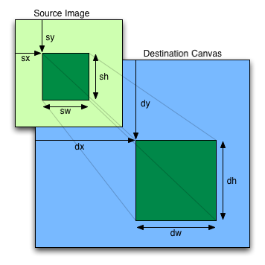
Image Slicing in Detail
That latter version of drawImage is pretty powerful but somewhat complex. This diagram from the official canvas specification spells it out visually:

Slide 76
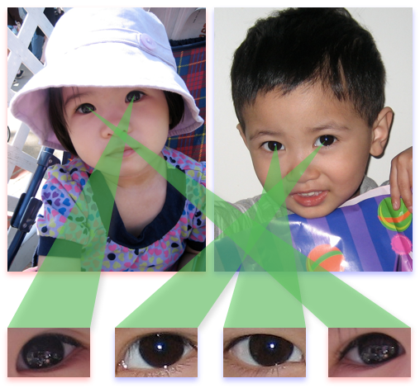
http://javascript.cs.lmu.edu/canvas-image shows drawImage in action, including its slice/subimage variant:
(what you see here is exactly what the JavaScript code puts on the page’s canvas element)

Slide 77
http://javascript.cs.lmu.edu/canvas-image uses only two image files, loaded from img elements that are not visible on the page:
<img id="girl-image" src="girl.jpg" alt="girl" style="display: none" />
<img id="boy-image" src="boy.jpg" alt="boy" style="display: none" />
The page’s associated JavaScript code then brings these images in. Some rendering context settings are also set:
var canvas = document.getElementById("canvas");
var girlImage = document.getElementById("girl-image");
var boyImage = document.getElementById("boy-image");
var renderingContext = canvas.getContext("2d");
renderingContext.shadowOffsetX = 0;
renderingContext.shadowOffsetY = 4;
renderingContext.shadowBlur = 16;

Slide 78
The faces and eyes are then drawn, using just boyImage and girlImage, with the eyes simply taken as subimages from the main ones.
renderingContext.shadowColor = "rgba(120, 120, 255, 0.5)";
renderingContext.drawImage(boyImage, 262, 12, 240, 320);
renderingContext.drawImage(boyImage, 177, 510, 100, 60,
273, 400, 100, 60);
renderingContext.drawImage(boyImage, 380, 488, 100, 60,
142, 400, 100, 60);
renderingContext.shadowColor = "rgba(255, 120, 120, 0.5)";
renderingContext.drawImage(girlImage, 12, 12, 240, 320);
renderingContext.drawImage(girlImage, 250, 365, 100, 60,
400, 400, 100, 60);
renderingContext.drawImage(girlImage, 445, 315, 100, 60,
12, 400, 100, 60);
As an added touch, the boy’s face and eyes have a bluish drop shadow, while a pinkish one is used for the girl.

Slide 79
We mix in some non-image visuals to highlight how we still have those at our disposal within canvas. Here is the code for one of the green “tracer” triangles, done with a path:
renderingContext.shadowColor = "rgba(120, 120, 120, 0.5)";
renderingContext.shadowOffsetX = 4;
renderingContext.fillStyle = "rgba(80, 200, 80, 0.5)";
renderingContext.beginPath();
renderingContext.moveTo(12, 400);
renderingContext.lineTo(112, 400);
renderingContext.lineTo(166, 117);
renderingContext.fill();
Note how the final result, while static, was drawn completely in code and can thus be made interactive if needed.

Slide 80
canvas Image Implementation Notes
One practical consideration when working with images is download time: image data, particularly for large pictures, need to have arrived completely at the web browser before you can work with them.
For img elements, waiting until the load event is triggered (as http://javascript.cs.lmu.edu/canvas-image does) ensures that image data have reached the web browser.

Slide 81
Image objects created in JavaScript have a similar load event. For these, you should wait until the load event has “fired” before working with the Image data. Here is a self-contained example for use with http://javascript.cs.lmu.edu/runner:
var canvas = document.createElement("canvas");
canvas.width = 512;
canvas.height = 512;
document.body.appendChild(canvas);
var image = new Image();
image.onload = function () {
var renderingContext = canvas.getContext("2d");
renderingContext.drawImage(image, 0, 0);
};
image.src = "/images/bookcover.jpg";

Slide 82
Transformations
One of the most powerful capabilities of the canvas element is its capacity for transformations. Transformations allow us to use a single sequence of JavaScript commands to draw the same thing, but with multiple variations.
While a transformation can really be anything that changes the point of reference for what is being drawn on a canvas, it most commonly takes the following forms:
  Translation shifts (moves) where drawing takes place.
  Rotation turns the drawing’s orientation.
  Scaling changes the size of what is drawn.

Slide 83

Consider, for example, this function, which draws a basketball that is centered at the origin (0, 0):
var drawBasketball = function (renderingContext) {
renderingContext.save();
var gradient = renderingContext.createRadialGradient(-15, -15, 5, 15, 15, 75);
gradient.addColorStop(0, "rgb(255, 130, 0)");
gradient.addColorStop(0.75, "rgb(128, 65, 0)");
gradient.addColorStop(1, "rgb(62, 32, 0)");
renderingContext.fillStyle = gradient;
renderingContext.beginPath();
renderingContext.arc(0, 0, 50, 0, 2 * Math.PI, true);
renderingContext.fill();
renderingContext.strokeStyle = "black";
renderingContext.lineWidth = 1;
renderingContext.beginPath();
renderingContext.moveTo(0, -49);
renderingContext.bezierCurveTo(30, -35, 30, 35, 0, 49);
renderingContext.moveTo(-49, 0);
renderingContext.bezierCurveTo(-35, -30, 35, -30, 47, -15);
renderingContext.moveTo(-35, 35);
renderingContext.bezierCurveTo(0, -30, 50, -20, 45, 20);
renderingContext.moveTo(-28, -40);
renderingContext.bezierCurveTo(10, -35, 25, -35, 29, -40);
renderingContext.stroke();
renderingContext.restore();
};

Slide 84
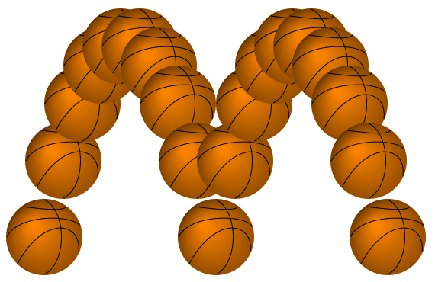
We can now use drawBasketball to paint multiple basketballs on the canvas. Transforms allow us to leave the drawBasketball code unchanged. Note the use of the translate function to move the basketball left to right, up and down, without having to make any changes to the drawBasketball function.
var renderingContext = canvas.getContext("2d");
var xStep = 25, yStep = -100;
// Start the ball at the bottom left of the canvas.
renderingContext.translate(50, 300);
for (var i = 0; i < 19; i += 1) {
drawBasketball(renderingContext);
// Move the ball by the current step values.
renderingContext.translate(xStep, yStep);
yStep += 25;
// Check to see if the ball needs to bounce.
if (yStep > 100) {
yStep = -100;
}
}

Slide 85
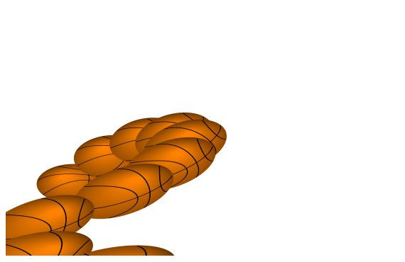
Transforms can be tricky the first time around because they accumulate. Once the mathematics is understood, things fall into place, but an initial attempt to rotate the ball and “squash” it when it hits the ground may look like this:
var renderingContext = canvas.getContext("2d");
var xStep = 25, yStep = -100;
// Start the ball at the bottom left of the canvas,
* // and compressed vertically due to a bounce.
renderingContext.translate(50, 300);
* renderingContext.scale(1, 0.5);
for (var i = 0; i < 19; i += 1) {
drawBasketball(renderingContext);
* // Rotate and scale the ball.
* renderingContext.rotate(10 * Math.PI / 180); // 10 degrees.
* renderingContext.scale(1, 1.1);
// Move the ball by the current step values.
renderingContext.translate(xStep, yStep);
yStep += 25;
// Check to see if the ball needs to bounce.
if (yStep > 100) {
yStep = -100;
}
}
(modifications from previous version marked with *)

Slide 86
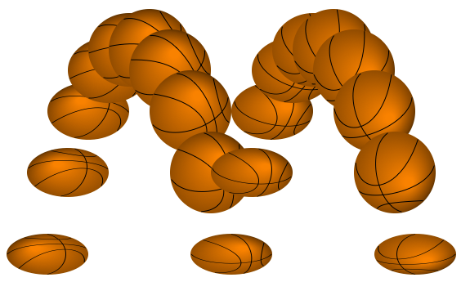
The correct approach, in this situation, is to “reset” the transform before the next “frame.” Fortunately, transforms can also be managed by save and restore.
// We now have variables to represent the absolute position, rotation, and scaling of the ball.
var x = 50, y = 300, angle = 0, compression = 0.5;
for (var i = 0; i < 19; i += 1) {
// Always return to the same state after each iteration.
renderingContext.save();
// Move the ball to the current position.
renderingContext.translate(x, y);
// Scale and rotate the ball.
renderingContext.scale(1, compression);
renderingContext.rotate(angle);
drawBasketball(renderingContext);
// Calculate the new position, rotation, and scale.
x += xStep; y += yStep; yStep += 25;
angle += 10 * Math.PI / 180; // 10 degrees.
compression += (compression <= 0.9) ? 0.1 : 0;
// Check for a bounce.
if (y + yStep > 300) {
compression = 0.5; y = 300; yStep = -100;
}
renderingContext.restore();
}

Slide 87
canvas Animation
As an image-space graphics technology, canvas animation involves redrawing frames in their entirety, since any pixel can change at any time. Sometimes, only the parts of the frame that change can be redrawn, if those parts are known. Thus, canvas animation requires:
  A separate data structure (model) that describes the scene completely, so that it can be redrawn when needed
  A “new frame” function that modifies the model to “advance” to the next frame, then redraws the canvas element
  Having setInterval call the “new frame” function at a sufficient rate

Slide 88
The actual animation computations (e.g., constant velocity, tweening functions) do not change. What changes is how these computations are stored and tracked.
http://javascript.cs.lmu.edu/canvas-animated illustrates canvas animation using the transformed basketball seen previously. Observe how the code is mostly unchanged, except for the following:
  The for loop is now a nextFrame function
  The canvas is cleared for each new frame
  The basketball “loops back” when it crosses the edge
  setInterval is made to call nextFrame repeatedly

Slide 89
The program is too long to display in its entirety, so we just show the precise code that pertains to those changes:
  The for loop is now a nextFrame function
var x = 50, y = 300, angle = 0, compression = 0.5;
var nextFrame = function () {
  The canvas is cleared for each new frame
renderingContext.clearRect(0, 0, canvas.width, canvas.height);
  The basketball “loops back” when it crosses the edge
if (x > canvas.width) {
x = 50;
}
  setInterval is made to call nextFrame repeatedly
// One hundred frames per second!
setInterval(nextFrame, 10);

Slide 90
Case Study: Tic-Tac-Toe on a canvas
For an end-to-end canvas case study, we have implemented yet another variant of tic-tac-toe, this time at http://javascript.cs.lmu.edu/tictactoe/canvas. This version replaces the HTML table/table row (tr)/table cell (td) display with a single canvas element.
The shift from a DOM hierarchy of elements into a single one results in some structural changes, one of which involves event handling. With separate elements, no additional processing is needed to determine which cell gets clicked. With a single canvas element for the entire board, this has to be computed explicitly from mouse coordinates.

Slide 91
Whereas, previously, we would attach a click event handler to each tic-tac-toe cell, and that event handler’s context is the clicked cell, this time, we have a single event handler, attached to the canvas element.
The first order of business for this event handler, then, is to determine which tic-tac-toe cell was “hit” by the click. For this, we posit the existence of a getCursorPosition function that does just that: it determines the coordinates of the mouse click relative to the canvas’s coordinate system.
var set = function (event) {
// Start with our cross-browser coordinate finder.
var location = getCursorPosition(event);
// Continues...

Slide 92
You might be wondering, why an entire getCursorPosition function? Shouldn’t the mouse coordinates be right in the event object? They should, and they are — but in a potentially browser-specific way. Mouse location reporting across browsers actually remains somewhat inconsistent at this writing. Thus, the abstraction into a function.
Mark Pilgrim (2010) provided such a function in his book HTML5: Up and Running. Pilgrim used to also host the web site http://diveintohtml5.org, but for unknown reasons, this site has gone dark.
What follows is our adaptation of Pilgrim’s code (back when it was available online).

Slide 93
The function returns an object with x and y properties: the mouse coordinates of the given event object, normalized across different web browsers.
var getCursorPosition = function (event) {
var x, y;
if (event.pageX || event.pageY) {
x = event.pageX;
y = event.pageY;
} else {
x = event.clientX + document.body.scrollLeft +
document.documentElement.scrollLeft;
y = event.clientY + document.body.scrollTop +
document.documentElement.scrollTop;
}
x -= board.offsetLeft;
y -= board.offsetTop;
return { 'x': x, 'y': y };
};

Slide 94
Again because we have gone from separated table cell elements to a single canvas element, we must include coordinates with our squares array.
var indicator = 1;
var y = 0;
for (var i = 0; i < 3; i += 1) {
var x = 0;
for (var j = 0; j < 3; j += 1) {
squares.push({ x: x, y: y, indicator: indicator });
indicator += indicator;
x += board.width / 3;
}
y += board.height / 3;
}

Slide 95
With getCursorPosition for mouse coordinates, and the squares array holding the coordinates of each square, we can now write getSquare, which returns, given (x, y) coordinates, the square that was clicked:
var getSquare = function (x, y) {
var cellWidth = board.width / 3;
var cellHeight = board.height / 3;
for (var i = 0; i < squares.length; i += 1) {
if ((x > squares[i].x) &&
(x < squares[i].x + cellWidth) &&
(y > squares[i].y) &&
(y < squares[i].y + cellHeight)) {
return squares[i];
}
}
return null;
};

Slide 96
Painted Marks Rather Than Text
Another major shift in the transition to canvas rather than HTML is the display of the X’s and O’s.
In HTML, strings were used for the player marks: "X" for X and "O" for O (not surprisingly).
With the expanded potential afforded by the canvas element, we change from strings to painter functions, which use the rendering context to display the X’s and O’s.

Slide 97
The X painter function is shown below.
function (x, y) {
// X's are dark blue diagonals with drop shadows.
boardContext.save();
boardContext.lineWidth = 5;
boardContext.strokeStyle = "rgb(0, 0, 120)";
boardContext.shadowOffsetX = 0;
boardContext.shadowOffsetY = 1;
boardContext.shadowBlur = 3;
boardContext.shadowColor = "rgba(0, 0, 0, 0.75)";
// We draw within a region whose margin is the grid thickness.
var cellWidth = board.width / 3 - (gridThickness << 1),
cellHeight = board.height / 3 - (gridThickness << 1),
side = Math.min(cellWidth, cellHeight),
xCorner = side >> 2,
xSize = side * 3 >> 2;
// The translate call helps to simplify the path coordinates.
boardContext.translate(x, y);
boardContext.beginPath();
boardContext.moveTo(xCorner, xCorner);
boardContext.lineTo(xCorner + xSize, xCorner + xSize);
boardContext.moveTo(xCorner, xCorner + xSize);
boardContext.lineTo(xCorner + xSize, xCorner);
boardContext.stroke();
boardContext.restore();
}

Slide 98
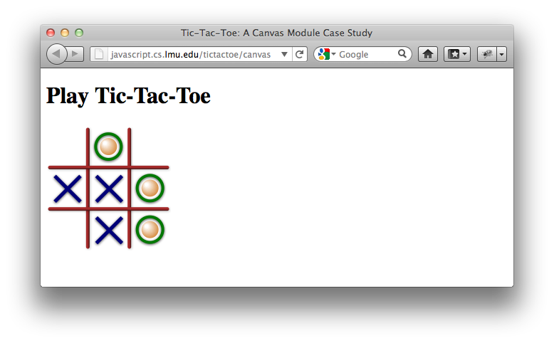
With canvas, we are not even restricted to something that looks like X’s and O’s, but we do so anyway to keep things recognizable. The final result is a tic-tac-toe board that looks like this:

Slide 99
Animated Tic-Tac-Toe Marks
As an additional touch, we animate the tic-tac-toe marks as they appear on the board. This follows the aforementioned pattern; after determining the clicked square, an animate function kicks things off:
var set = function (event) {
// Start with our cross-browser coordinate finder.
var location = getCursorPosition(event);
var square = getSquare(location.x, location.y);
if (square) {
if (square.paint !== squarePainters['\xA0']) {
return;
}
// Animate the incoming mark.
animate(square);
}
};

Slide 100
animate calls setInterval on a function that uses tweening as described previously. That function then clears its own interval once it has reached the target number of rendered frames.
var nextFrame = setInterval(function () {
// The "empty square" painter serves as our eraser.
squarePainters['\xA0'](square.x, square.y);
// The current mark is drawn using some intermediate rendering
// context state.
boardContext.save();
tweeners[turn](frameCount / frameTotal, square.x, square.y);
squarePainters[turn](square.x, square.y);
boardContext.restore();
// Are we done?
frameCount += 1;
if (frameCount > frameTotal) {
clearInterval(nextFrame);
finishTurn(square);
}
}, 1000 / 30);

Slide 101
The tweeners array holds one tweener function each for X’s and for O’s:
var tweeners = {
'X': function (animationFraction, x, y) {
/* Tweening code for X goes here. */
},
'O': function (animationFraction, x, y) {
/* Tweening code for O goes here. */
},
};
This makes it easy to call the correct function depending on the mark that is appearing: tweeners["X"] for X’s and tweeners["Y"] for Y’s.

Slide 102
Worth the Trouble?
Implementing tic-tac-toe with animation on a canvas element involves quite a bit more code than the HTML/DOM version. Whether that additional code is worth it may be a judgment call to be made per web application, per user population.
In the end, we can only ask you to visit http://javascript.cs.lmu.edu/tictactoe/canvas, and form an opinion for yourself.

Slide 103
SVG
SVG is short for Scalable Vector Graphics. Like HTML, it is an object-space technology, and its code look similar: elements expressed as tags and attributes.
But like canvas, its range of objects and visuals is expressly designed for computer graphics.
As before, we will show “just enough” SVG to display some interesting visuals, then go right to working with those visuals with JavaScript.

Slide 104
SVG in a Web Browser
Current web browsers can display SVG in many ways:
  Direct file display — Modern web browsers can display files that contain only SVG code (typically ending in .svg)
  iframe element — With an iframe element, you can reference an SVG file in its src attribute, just like with images and the img element
  Inline tags — You can include an svg tag (element) directly in HTML
  JavaScript — You can create an entire SVG diagram with JavaScript code

Slide 105
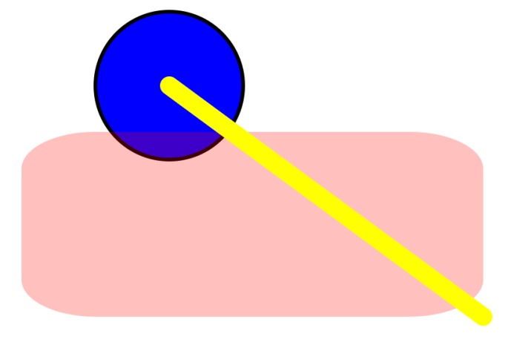
SVG in Its Own File
If you place the following code in a file, say diagram.svg, you can open it right in a web browser:
<svg version="1.1" xmlns="http://www.w3.org/2000/svg">
<circle cx="100" cy="50" r="40"
stroke="black" stroke-width="2" fill="blue"/>
<rect x="20" y="75" width="250" height="100"
rx="40" ry="20" fill="red" opacity="0.25"/>
<line x1="100" y1="50" x2="270" y2="175"
stroke="rgb(255, 255, 80)" stroke-width="10px"
stroke-linecap="round"/>
</svg>

Slide 106
SVG in an iframe Element
To mix the SVG drawing in with other HTML elements, the standalone file approach won’t work. You can keep the SVG separated while still mixing it within HTML by specifying it as the src of an iframe element:
<iframe src="diagram.svg" width="500" height="500"></iframe>
The result will look the same, but in the context of the web page within which the iframe resides.

Slide 107

Inline SVG
If file separation is somehow not feasible, you can drop the SVG right inside the HTML. An HTML body that has such an inline svg element looks like this:
<!-- HTML doctype, html, and head above this line. -->
<body>
<!-- Some HTML can go here. -->
<svg xmlns="http://www.w3.org/2000/svg" version="1.1"
viewBox="0 0 100 100" width="400" height="400">
<linearGradient id="backgroundGradient"
x1="0%" y1="5" x2="0%" y2="20" gradientUnits="userSpaceOnUse">
<stop offset="0%" stop-color="rgb(255, 200, 200)" />
<stop offset="40%" stop-color="red" />
<stop offset="100%" stop-color="rgb(60, 0, 0)" />
</linearGradient>
<rect x="5" y="5" width="20" height="20"
fill="url(#backgroundGradient)" />
</svg>
<!-- More HTML can go here. -->
</body>

Slide 108
SVG from JavaScript
The code below builds SVG from scratch with JavaScript. Note the use of createElementNS instead of createElement.
var svgns = "http://www.w3.org/2000/svg";
var svg = document.createElementNS(svgns, "svg");
svg.setAttribute("width", 256);
svg.setAttribute("height", 256);
svg.setAttribute("viewBox", "0 0 50 50");
var shape = document.createElementNS(svgns, "circle");
shape.setAttribute("cx", 25);
shape.setAttribute("cy", 25);
shape.setAttribute("r", 10);
shape.setAttribute("fill", "green");
svg.appendChild(shape);
document.body.appendChild(svg);

Slide 109
Case Study: SVG Bézier Curve Editor
Rather than walk through a laundry list of SVG elements and attributes, all of which are conceptually similar to what you have seen in HTML or the canvas element, we go straight to a case study that covers many of these bases in a functional context.
The case study is a standalone SVG file that can be found at http://javascript.cs.lmu.edu/curve-editor.svg: it is an interactive Bézier curve editor similar to what can be found in drawing programs like Adobe Illustrator.

Slide 110
The svg Element
Like html, SVG drawings have a top-level container: svg. Our case study conforms to this of course:
<svg version="1.1" xmlns="http://www.w3.org/2000/svg"
xmlns:xlink="http://www.w3.org/1999/xlink" onload="editorSetup();">
<!-- Generalized functionality for editing curves. -->
<script xlink:href="../js/curve-editor.js" />
Note also how the comment syntax is the same, while the script element prepends xlink: to its href attribute. The linked script is, as you might expect, in JavaScript.

Slide 111
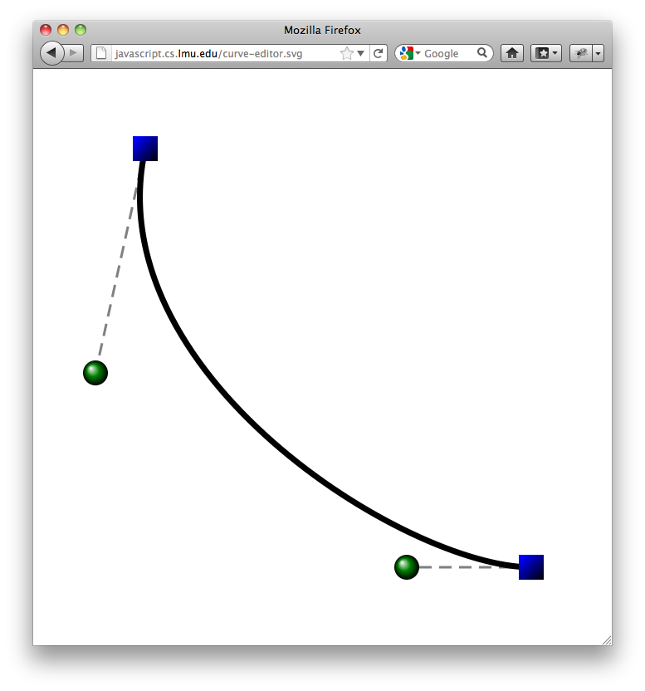
Before we go on, we should probably look at the drawing so we know what to expect…
The curve endpoints (vertices) are gradient blue squares, and their control points are gradient green circles. The curve itself “glows” subtly between black and red.

Slide 112
SVG Gradients
As a graphics technology, SVG is closer conceptually to CSS than HTML. Gradients, for example, are first-class elements in SVG; the case study defines two:
<linearGradient id="vertexGradient" gradientUnits="objectBoundingBox"
x1="0" y1="0" x2="1" y2="1">
<stop offset="0%" stop-color="rgb(0, 0, 200)" />
<stop offset="10%" stop-color="blue" />
<stop offset="100%" stop-color="black" />
</linearGradient>
<radialGradient id="controlGradient" gradientUnits="objectBoundingBox"
cx="0.5" cy="0.5" r="0.5" fx="0.3" fy="0.3">
<stop offset="0%" stop-color="white" />
<stop offset="50%" stop-color="green" />
<stop offset="100%" stop-color="black" />
</radialGradient>
<!-- Note how they provide similar information as CSS gradients, which makes sense
because gradients are ultimately the same regardless of the technology. -->

Slide 113
SVG Circles
Unless otherwise manipulated, SVG shape elements are “drawn” in the order that they appear (a so-called “painter’s model”). We start with the last ones specified, which thus appear “on top of” the other elements — the circles representing the control points:
<circle id="startControl" cx="25" cy="122" r="5"
fill="url(#controlGradient)" />
<circle id="endControl" cx="150" cy="200" r="5"
fill="url(#controlGradient)" />
Specific properties (e.g., center, radius, fill style) are set as attributes within the element. Note the reference to #controlGradient — yes, that is a URL.

Slide 114
SVG Rectangles
The curve’s vertices are rendered as gradient blue squares, which are really rectangles with the same width and height. The attributes shown should be fairly self-explanatory:
<rect id="startVertex" x="40" y="27" width="10" height="10"
fill="url(#vertexGradient)" />
<rect id="endVertex" x="195" y="195" width="10" height="10"
fill="url(#vertexGradient)" />
We looked at the control points and endpoints first because the remaining graphic elements — the dotted lines between the control and end points as well as the curve itself — depend on the locations of these points. Their markup is thus incomplete, as will be seeb next.

Slide 115
SVG Paths
Paths in SVG are just like canvas paths. In the markup, the path is incomplete because its main information — the actual Bézier curve — is set in JavaScript based on the control and end points. We will complete this when we look at the script.
<path id="path" fill="none" stroke="black" stroke-width="2">
<animateColor attributeName="stroke" dur="5s" repeatCount="indefinite"
values="black;rgb(220, 0, 0);black" />
<animate attributeName="stroke-width" dur="5s" repeatCount="indefinite"
values="2;4;2" />
</path>
Worth noting here, though, are the declarative animation elements. Conceptually similar but syntactically quite different from declarative CSS animation.

Slide 116
SVG Lines
At the “bottom” of the drawing — and thus the first elements to be specified — are two line elements that connect the end points to their control points. Due to this dependency, the markup is incomplete (it lacks coordinates!):
<line id="startConnector" stroke="gray" stroke-dasharray="5,3" />
<line id="endConnector" stroke="gray" stroke-dasharray="5,3" />
These coordinates are always the coordinates of the control and end points. The JavaScript code ensures that, whenever any of these points moves, the corresponding vertices of the lines are updated accordingly.

Slide 117
SVG Attributes in JavaScript
Speaking of JavaScript, it’s time that we look at the code. We start with the code in curve-editor.js, which is written so that it can work with any Bézier curve editor object “suite” consisting of the end points (vertices), control points, connectors, and the curve element itself (a path):
var updateCurve = function (startVertexElement, endVertexElement,
startControlElement, endControlElement,
startConnectorElement, endConnectorElement, path) {
This is the function that supplies the information not supplied in the markup (i.e., the path’s geometric data and the lines’ start and end points).

Slide 118
This updateCurve function retrieves the centers of the end points and control points passed in the arguments then sets the path’s data to a curve based on these points. The line connectors are also set to these same coordinates.
// Grab the data needed for the path.
var startVertex = getCenter(startVertexElement),
endVertex = getCenter(endVertexElement),
startControl = getControlCenter(startControlElement),
endControl = getControlCenter(endControlElement);
// Build the path data string.
var pathData = "M" + startVertex.x + "," + startVertex.y + " ";
pathData += "C" + startControl.x + "," + startControl.y + " ";
pathData += endControl.x + "," + endControl.y + " ";
pathData += endVertex.x + "," + endVertex.y;
// Assign the new data string to the path.
path.setAttribute("d", pathData);
// Update the indicator lines.
updateConnector(startConnectorElement, startVertex, startControl);
updateConnector(endConnectorElement, endVertex, endControl);

Slide 119
To avoid code repetition, helper functions retrieve the point coordinates and update the connector lines:
var getCenter = function (vertex) { // Assumes that vertex is a rect.
return {
x: +vertex.getAttribute("x") + (vertex.getAttribute("width") / 2),
y: +vertex.getAttribute("y") + (vertex.getAttribute("height") / 2)
};
};
var getControlCenter = function (control) { // Assumes that control is a circle.
return {
x: control.getAttribute("cx"),
y: control.getAttribute("cy")
};
};
var updateConnector = function (connectorElement, vertex, controlPoint) {
connectorElement.setAttribute("x1", vertex.x);
connectorElement.setAttribute("y1", vertex.y);
connectorElement.setAttribute("x2", controlPoint.x);
connectorElement.setAttribute("y2", controlPoint.y);
};
Note that the “getter” functions consist of getAttribute calls with some calculation, while the one “setter” (updater) relies on setAttribute.

Slide 120
The path code merits further attention. Here it is again:
// Build the path data string.
var pathData = "M" + startVertex.x + "," + startVertex.y + " ";
pathData += "C" + startControl.x + "," + startControl.y + " ";
pathData += endControl.x + "," + endControl.y + " ";
pathData += endVertex.x + "," + endVertex.y;
// Assign the new data string to the path.
path.setAttribute("d", pathData);
Whereas canvas paths are built through functions like moveTo, lineTo, arc, quadrativeCurveTo, and bezierCurveTo, SVG paths use a “command string.” Each command starts with a letter, followed by the data needed by that command.
Once the command string has been built, it is assigned to the d attribute of the path, which finally changes its content.

Slide 121
The SVG path commands are:
Letter
Command
For the curve editor, the command string is simple: it moves to one of the end points (Mx,y), then draws a curve to the other end point using the control points (Cscx,scy ecx,ecy x,y).
// Build the path data string.
var pathData = "M" +
startVertex.x + "," +
startVertex.y + " ";
pathData += "C" +
startControl.x + "," +
startControl.y + " ";
pathData += endControl.x + "," +
endControl.y + " ";
pathData += endVertex.x + "," +
endVertex.y;
M
move to
L
line to
H
horizontal line to
V
vertical line to
C
curve to
S
smooth curve to
Q
quadratic Bézier curve to
T
smooth quadratic Bézier curve to
A
elliptical arc
Z
close path

Slide 122
SVG Interactivity
Interactivity within SVG drawings is little different from web page interactivity in general: determine the user actions that need to be handled, implement those event handlers as functions, and assign them to the appropriate elements.
For the curve editor case study, we need to respond to mouse events in the control points (circles) and vertices (squares). Holding down the mouse button on those elements initiates a drag on them. We change those elements’ locations as the mouse moves, updating the curve as we go, then stop following the mouse when the user releases the button.

Slide 123
The inline script at the end of the SVG code performs the event handler setup. The svg element’s onload attribute calls this code when the browser is ready. Here is the event handler assignment code:
var editorSetup = function () {
/* Function and variable definitions. */
...
return function () {
document.getElementById("startVertex").onmousedown =
getStartDragHandler(updateVertex);
document.getElementById("endVertex").onmousedown =
getStartDragHandler(updateVertex);
document.getElementById("startVertex").onmouseup = endDragHandler;
document.getElementById("endVertex").onmouseup = endDragHandler;
document.getElementById("startControl").onmousedown =
getStartDragHandler(updateControl);
document.getElementById("endControl").onmousedown =
getStartDragHandler(updateControl);
document.getElementById("startControl").onmouseup = endDragHandler;
document.getElementById("endControl").onmouseup = endDragHandler;
updateSampleCurve();
};
}();

Slide 124
The event handlers themselves rely on helper functions, and some are actually created dynamically. A function that is almost universally needed is updateSampleCurve, which calls updateCurve with the specific elements in the diagram:
var updateSampleCurve = function () {
updateCurve(document.getElementById("startVertex"),
document.getElementById("endVertex"),
document.getElementById("startControl"),
document.getElementById("endControl"),
document.getElementById("startConnector"),
document.getElementById("endConnector"),
document.getElementById("path"));
};

Slide 125
To understand the event handling, note that we have one piece of transient state while the user is dragging a control point or a vertex, and that is the element being dragged:
var dragElement = null;
During a drag sequence, a number of functions have to see dragElement, and so it is declared in the scope above the helper functions.

Slide 126
The primary operation during a mouse drag is the updating of the element being dragged so that it “follows” the mouse. That is, its position is constantly updated to match the mouse’s current location (stored in the event object).
var updateVertex = function (event) {
dragElement.setAttribute("x", event.clientX -
dragElement.getAttribute("width") / 2);
dragElement.setAttribute("y", event.clientY -
dragElement.getAttribute("height") / 2);
};
var updateControl = function (event) {
dragElement.setAttribute("cx", event.clientX);
dragElement.setAttribute("cy", event.clientY);
};
Note how two distinct functions are needed because the attributes to modify are different for the rect (end point/vertex) and circle (control point) elements.

Slide 127
Finally, we look at the actual event handler code. A mouse drag starts when the user holds the mouse button down over one of the movable elements. While a drag is in progress, mouse motion must be tracked. Once the dragged object has been moved, then the rest of the curve is updated.
var getStartDragHandler = function (moveFunction) {
return function (event) {
dragElement = event.target;
document.onmousemove = function (event) {
moveFunction(event);
updateSampleCurve();
};
};
};
Note how startDragHandler is not the event handler itself, but a function that returns the event handler. This is done to accommodate a different mousemove function, depending on what dragElement currently is.

Slide 128
Concluding an object drag is now a matter of “releasing” the mousemove event handler and the current dragElement. Once this is done, the cycle repeats, as we wait for another mousedown event at one of the vertices or control points.
var endDragHandler = function (event) {
document.onmousemove = null;
dragElement = null;
};
We hope you’ll agree that, in the end, SVG interactivity is really little different from general web page interactivity. That’s because it is: we have user interface objects, event handlers, and event objects, just like in Chapter 6.

Slide 129
Other SVG Features
SVG has many capabilities beyond those shown in the curve editor case study:
  SVG supports element grouping, so you can treat multiple elements as one entity (as in many drawing programs).
  SVG support transforms, like canvas does.
  SVG has image processing filter functionality, allowing objects to be manipulated at the pixel level if desired.
  SVG does work with CSS as well, so you can use CSS to define common appearance characteristics for the different SVG elements.

Slide 130
3D Graphics with WebGL
3D graphics in web browsers involves WebGL, which itself is derived from the widely used OpenGL 3D standard.
3D graphics is complex and challenging, and is best studied in the context of a computer graphics course. As such, we focus solely on a WebGL case study and highlight how WebGL interacts with JavaScript, rather than the core concepts of 3D graphics programming.

Slide 131
WebGL is the 3D Canvas
Not surprisingly, 3D graphics also uses the canvas element. It can be accessed by requesting a "webgl" rendering context instead of "2d":
var gl = canvas.getContext("webgl");
What may be surprising is that the resulting object has completely different set of functions. These functions will be more familiar to OpenGL programmers than web/JavaScript folks. The variable name gl is a nod to these OpenGL roots.
What does remain the same here is event handling, which we will see in the case study.

Slide 132
Case Study: The Sierpinski Gasket
The WebGL case study renders the 3D version of a fractal called the Sierpinski gasket. It can be rotated in 3D and features a simple lighting/shading model. It can be found at http://javascript.cs.lmu.edu/webgl-sierpinski.

Slide 133
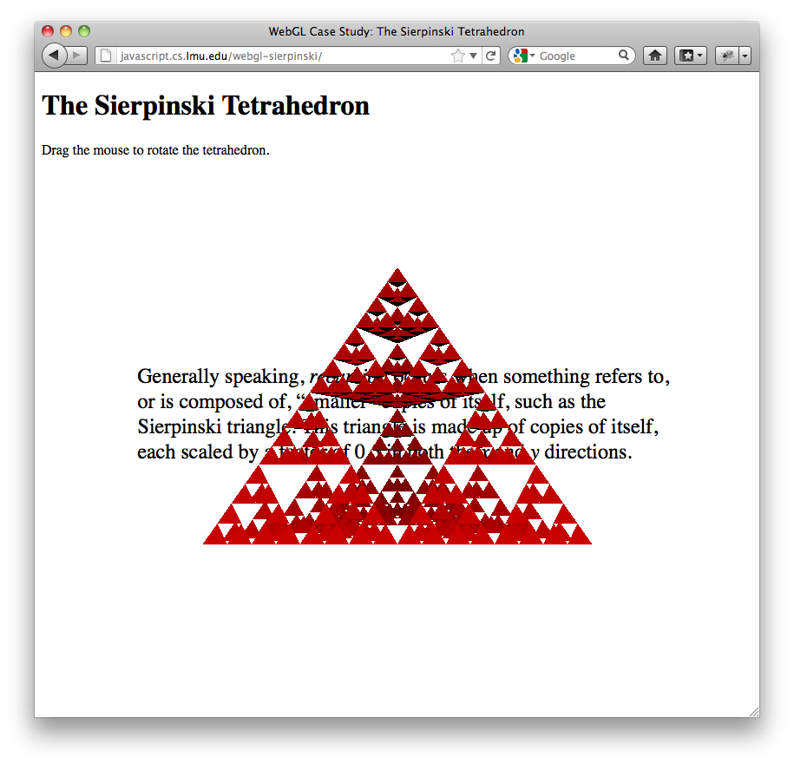
First, let’s look at the case study itself:

Slide 134
Let’s start with some HTML points of interest:
<head>
<meta charset="UTF-8"/>
<title>WebGL Case Study: The Sierpinski Tetrahedron</title>
<script src="matrix4x4.js"></script>
<script src="sierpinski.js"></script>
<script>
window.onload = function () {
// All of the action is in the startSierpinski function.
startSierpinski(document.getElementById("sierpinski"));
};
</script>
</head>
The interesting parts of this case study dwell completely within the JavaScript code referenced in sierpinski.js, entered via the startSierpinski function. The additional script matrix4x4.js is a helper library for common 3D mathematical operations written by the Mozilla Foundation.

Slide 135
The body uses CSS to make the 3D display appear to float above some text. The canvas element’s content only appears in web browsers that don’t support it.
<body>
<h1>The Sierpinski Tetrahedron</h1>
<p>Drag the mouse to rotate the tetrahedron.</p>
<!-- Some HTML/CSS trickery to put the tetrahedron on top of
some text about the Sierpinski triangle. -->
<div style="position: relative; width: 100%">
<div style="position: absolute; width: 75%; margin-top: 20ex; margin-left: 10ex; font-size: 150%;">
Generally speaking, <em>recursion</em> occurs when something
refers to, or is composed of, smaller copies of itself, such
as the Sierpinski triangle. This triangle is made up of
copies of itself, each scaled by a factor of 0.5 in both the
<em>x</em> and <em>y</em> directions.
</div>
<div style="position: absolute; width: 100%; top: 5em; text-align: center;">
<canvas id="sierpinski" width="512" height="512">
Your web browser does not support the
<code>canvas</code> element! Sorry.
</canvas>
</div>
</div>
</body>

Slide 136
The startSierpinski function is written for beginning-to-end reading. Real-world 3D graphics code typically is written with more structure and modularity.
Everything happens through a WebGL rendering context, so we grab that first. If it is null, we really can’t continue, so an error message appears in that case (and the script ends).
var startSierpinski = function (canvas) {
// Grab the WebGL rendering context.
var gl = canvas.getContext("webgl");
if (!gl) {
alert("No WebGL context found...sorry.");
// No WebGL, no use going on...
return;
}
...

Slide 137
With the WebGL context in hand, the code immediately starts resembling OpenGL more than it does 2D canvas code:
// Set up everything that is needed for the scene.
gl.enable(gl.DEPTH_TEST);
gl.clearColor(0.0, 0.0, 0.0, 0.0);
gl.viewport(0, 0, canvas.width, canvas.height);
These function calls set up the scene. The clearColor of (0.0, 0.0, 0.0, 0.0) facilitates the “floating object” effect by making the canvas background transparent.
DEPTH_TEST involves hidden surface removal, while the viewport is the user’s “opening” into the 3D space. They bear further explanation in a computer graphics context, so will leave their descriptions as such.

Slide 138
Defining the 3D Data
The locus of most 3D applications is the scene, or set of 3D objects, that the application presents to the user. The 3D objects in the scene, in turn, consist of vertices, polygons, and other related data.
The next major section of sierpinski.js focuses on this part of the case study. The polygons that make up the Sierpinski gasket are calculated, and these data are then relayed to the underlying 3D driver and hardware.

Slide 139
The divideTetrahedron function implements the classic Sierpinski algorithm for computing the vertices and polygons of the gasket. Arguments include the output arrays, the tetrahedron’s vertices, and the subdivision count:
var vertices = [], normals = [];
divideTetrahedron(vertices, normals,
[ 0.0, 3.0 * Math.sqrt(6), 0.0 ],
[ -2.0 * Math.sqrt(3), -Math.sqrt(6), -6.0],
[ -2.0 * Math.sqrt(3), -Math.sqrt(6), 6.0 ],
[ 4.0 * Math.sqrt(3), -Math.sqrt(6), 0.0 ], 5);
Once this is done, the code returns to WebGL functions:
// Pass the calculated vertices and normals to WebGL.
var vertexBuffer = gl.createBuffer();
gl.bindBuffer(gl.ARRAY_BUFFER, vertexBuffer);
gl.bufferData(gl.ARRAY_BUFFER, new Float32Array(vertices),
gl.STATIC_DRAW);
var normalBuffer = gl.createBuffer();
gl.bindBuffer(gl.ARRAY_BUFFER, normalBuffer);
gl.bufferData(gl.ARRAY_BUFFER, new Float32Array(normals),
gl.STATIC_DRAW);

Slide 140
Shader Code
In OpenGL, most 3D graphics operations are performed in shaders written in the specialized GL Shading Language (GLSL). This departs completely from JavaScript and lies completely in the realm of computer graphics programming.
Notably, GLSL shader code is identical whether you are using full-blown OpenGL or browser-based WebGL. This facilitates effective knowledge migration for 3D programmers.
For our purposes, we look at how GLSL code is set up from within JavaScript for use by WebGL.

Slide 141
The shaders themselves are simply strings, just like most other source code. Two shaders are involved in 3D rendering; the vertex shader code is shown below:
var vertexShaderSource =
"#ifdef GL_ES\n" +
"precision highp float;\n" +
"#endif\n" +
"attribute vec3 vertexPosition;" +
"attribute vec3 normalVector;" +
"uniform mat4 modelViewMatrix;" +
"uniform mat4 projectionMatrix;" +
"uniform mat4 normalMatrix;" +
"uniform vec3 lightDirection;" +
"varying float dotProduct;" +
"void main(void) {" +
" gl_Position = projectionMatrix * modelViewMatrix * " +
" vec4(vertexPosition, 1.0);" +
" vec4 transformedNormal = normalMatrix * vec4(normalVector, 1.0);" +
" dotProduct = max(dot(transformedNormal.xyz, lightDirection), 0.0);" +
"}";

Slide 142
The script compiles and links the shader code into a ready-to-run shader program. Values needed by the shaders, such as light direction, vertices, and other 3D state, can be made accessible to and modifiable by JavaScript with code that looks like this:
// One-time initialization: light direction.
gl.uniform3f(gl.getUniformLocation(shaderProgram, "lightDirection"), 0, 1, 1);
// Hold on to the important variables within the shaders.
var vertexPosition = gl.getAttribLocation(shaderProgram, "vertexPosition");
gl.enableVertexAttribArray(vertexPosition);
var normalVector = gl.getAttribLocation(shaderProgram, "normalVector");
gl.enableVertexAttribArray(normalVector);
var modelViewMatrixLocation = gl.getUniformLocation(shaderProgram, "modelViewMatrix");
var projectionMatrixLocation = gl.getUniformLocation(shaderProgram, "projectionMatrix");
var normalMatrixLocation = gl.getUniformLocation(shaderProgram, "normalMatrix");

Slide 143
Drawing the Scene
After all this setup, the scene can finally be drawn. State variables, many corresponding to the “hooks” shown previously that go into the shaders, are defined first:
// Set up the requisite matrices and the values that determine them.
var modelViewMatrix = new Matrix4x4();
var projectionMatrix = new Matrix4x4();
var viewerLocation = { x: 0.0, y: 0, z: 20.0 };
var rotationAroundX = 0.0, rotationAroundY = -90.0;
The drawScene function is then defined. This function is called whenever the 3D canvas needs to be redrawn:
var drawScene = function () {
...

Slide 144
drawScene is almost all OpenGL, called with JavaScript:
// Clear the display.
gl.clear(gl.COLOR_BUFFER_BIT | gl.DEPTH_BUFFER_BIT);
// Set up the viewing volume.
projectionMatrix.loadIdentity();
projectionMatrix.perspective(45, canvas.width / canvas.height, 11.0, 100.0);
// Set up the model-view matrix.
modelViewMatrix.loadIdentity();
modelViewMatrix.translate(-viewerLocation.x, -viewerLocation.y, -viewerLocation.z);
modelViewMatrix.rotate(rotationAroundX, 1.0, 0.0, 0.0);
modelViewMatrix.rotate(rotationAroundY, 0.0, 1.0, 0.0);
// Set up the normal matrix.
var normalMatrix = modelViewMatrix.copy();
normalMatrix.invert();
normalMatrix.transpose();
gl.uniformMatrix4fv(normalMatrixLocation, gl.FALSE, new Float32Array(normalMatrix.elements));
// Display the gasket.
gl.bindBuffer(gl.ARRAY_BUFFER, vertexBuffer);
gl.vertexAttribPointer(vertexPosition, 3, gl.FLOAT, false, 0, 0);
gl.bindBuffer(gl.ARRAY_BUFFER, normalBuffer);
gl.vertexAttribPointer(normalVector, 3, gl.FLOAT, false, 0, 0);
gl.uniformMatrix4fv(modelViewMatrixLocation, gl.FALSE,
new Float32Array(modelViewMatrix.elements));
gl.uniformMatrix4fv(projectionMatrixLocation, gl.FALSE,
new Float32Array(projectionMatrix.elements));
gl.drawArrays(gl.TRIANGLES, 0, vertices.length / 3);
// All done.
gl.flush();

Slide 145
Interactivity and Events
Finally, we come to code that is familiar: event handling, which, in WebGL, is unchanged from web browser-based event handling in general.
For the case study, the only interactivity available is the ability to rotate the gasket in 3D. When the user holds down the mouse, its position is tracked as it moves, then converted into rotations along the x and y axes.
These rotations, stored in the rotationAroundX and rotationAroundY variables, are then taken into account when the scene is redrawn.

Slide 146
As with event handling in prior case studies, we need to store some transient state:
// Set up event handlers: we want a drag-to-rotate.
var xDragStart, yDragStart;
var xRotationStart, yRotationStart;
The event handlers themselves initialize the transient state from the event object, then follow and update that state, finally redrawing the scene when necessary:
var cameraRotate = function (event) {
rotationAroundX = xRotationStart + yDragStart - event.clientY;
rotationAroundY = yRotationStart + xDragStart - event.clientX;
drawScene();
};
canvas.onmousedown = function (event) {
xDragStart = event.clientX;
yDragStart = event.clientY;
xRotationStart = rotationAroundX;
yRotationStart = rotationAroundY;
canvas.onmousemove = cameraRotate;
};
canvas.onmouseup = function (event) {
canvas.onmousemove = null;
};

Slide 147
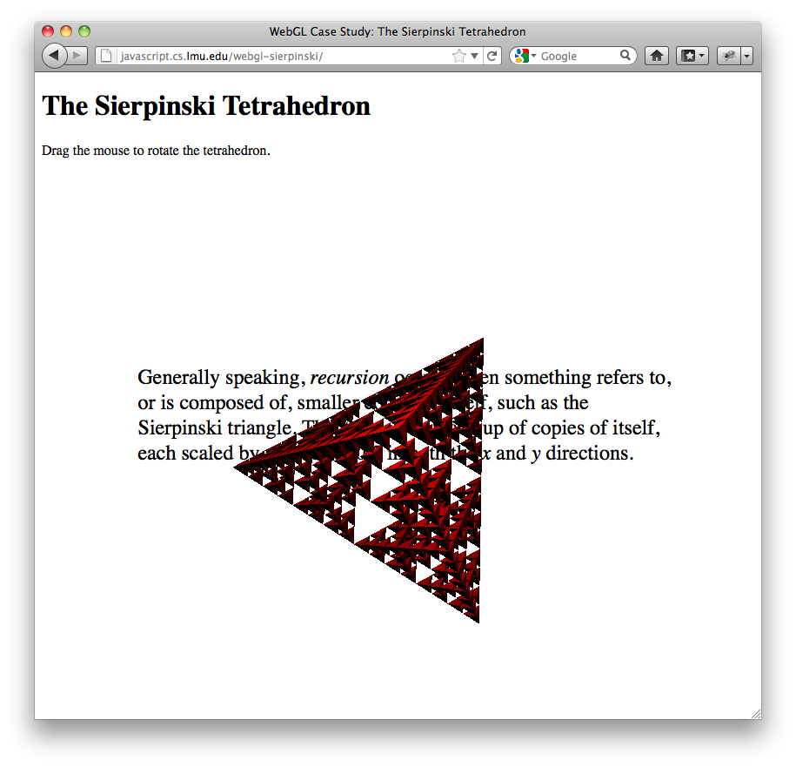
This screenshot shows the Sierpinski tetrahedron when rotated.

Slide 148
Other Graphics Technologies
Primarily for historical purposes or additional context, we catalog prior or other graphics technologies used on the Web:
  Flash is perhaps the most prevalent pre-standard graphics technology available. It runs as a plug-in with a JavaScript-like language called ActionScript.
  Java is not as much a graphics technology as an early candidate for dynamic web pages, which are now covered by JavaScript.
  VML, or Vector Markup Language, is a direct alternative to SVG. It is currently supported by Internet Explorer only.

Slide 149
Chapter Summary
HTML and CSS provide visual options that allow them to be used directly for graphics and animation.
Time-based events, particularly those triggered by setInterval, drive procedural web browser animation.
Image space graphics is done with the canvas element.
Object space graphics can be done in HTML and SVG.
WebGL adds 3D graphics to the canvas element.
The covered technologies are built in to modern web browsers, unlike prior ones which ran in plugins or add-ons.

