Slide 1
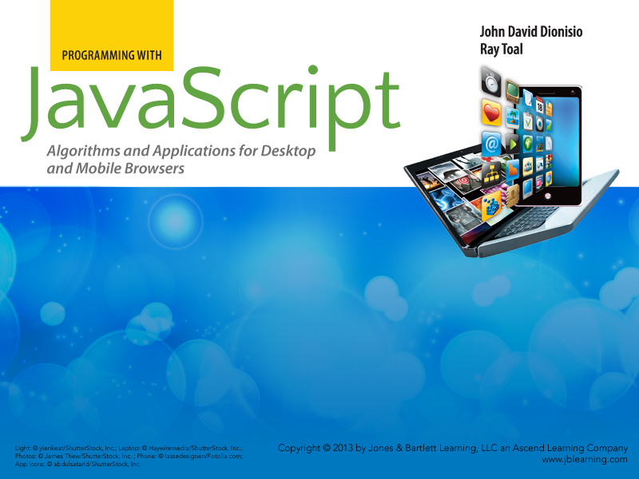
Chapter 5
Functions

Slide 2

Outline
  What is a function?
  Defining and calling functions
  Learning by example
    Simple functions
    Validation and Preconditions
    Parameters are distinct from arguments
    Separation of concerns
  Scope
  Functions as objects
  Context
  Higher order functions

Slide 3
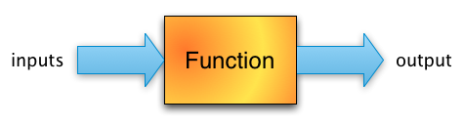
What is a Function?
A function is an object that you call with inputs to produce an output.
In JavaScript, functions are values just like numbers, booleans, strings, and arrays. Here are some function values:
  function (x) {return x + x + x;}
  function (x, y) {return Math.sqrt(x * x + y * y);}
  function (p, n, r, t) {return p * Math.pow(1 + (r / n), n * t)}

Slide 4
Defining and Calling Functions
Usually, but not always, you will store a function in a variable so as to make it easier to reuse:
var triple = function (x) {
return x + x + x;
};
alert(triple("ho")); // alerts hohoho
alert(triple(100)); // alerts 300
We can use triple over and over again, with different arguments.
Notice that alert is also a function

Slide 5
Evaluating Functions in a Shell
> var half = function (x) {return x / 2;};
> half(50)
25
> half(1.2)
0.6
> var discountedPrice = function (originalPrice, discountPercent) {
return originalPrice - (originalPrice * discountPercent / 100);
};
> discountedPrice(2000, 25)
1500

Slide 6
Function Values vs Function Calls
> var diceRoll = function () {
return Math.floor(Math.random() * 6) + 1
};
> diceRoll()
6
> diceRoll()
4
> diceRoll()
5
> diceRoll
function () {
return Math.floor(Math.random() * 6) + 1
}

Slide 7
Simple Example Functions
Normally when writing functions, we prefix the function with a comment saying what the function does, not how it does it.
/*
* Returns the area of a circle with radius r.
*/
var circleArea = function (r) {
return Math.PI * r * r;
};

Slide 8
More Simple Examples
/* * Returns whether x evenly divides y. For example * divides(5, 20) returns true, but divides(2, 17) * returns false. */ var divides = function (x, y) { return y % x === 0; };
/* * Returns whether a given year is a leap year, according to * the usual rules of the Gregorian calendar. A year is a leap * year if it is (1) divisible by 4 but not 100, or else (2) * is divisible by 400. */ var isLeapYear = function (y) { return divides(4, y) && !divides(100, y) || divides(400, y); };

Slide 9
Validating Arguments
  /*
  * Returns the balance after t years of an account
  * where the initial balance of p has been compounded n
  * times per year with an annual interest rate of r.
  */
  var balanceAfter = function (p, n, r, t) {
  return p * Math.pow(1 + (r / n), n * t);
  }
What could go wrong? This is the right formula, after all.
Let's see….

Slide 10
Validating Arguments (2 of 3)
Start with $1000, compound monthly, 5% APR, go 10 years: balanceAfter(1000, 12, 0.05, 10) ⇒ 1647.00949769028
Start with $1, compound once per year, 100% APY, go 20 years: balanceAfter(1, 1, 1, 20) ⇒ 1048576
I had $500 but they took money from me quarterly at a 20% APY for two years: balanceAfter(500, 4, -0.2, 2) ⇒ 331.7102156445312
I want to make a million dollars in my 8% APY account, compounded daily in 5 years. What should I start with? balanceAfter(1000000, 365, 0.08, -5) ⇒ 670349.426279003
Those were all fine, but what about these:
    balanceAfter(1000, -2, 0.05, 10) ⇒ 1659.234181850974
    balanceAfter(1000, -0.06, 0.05, 10) ⇒ 2930.1560515835217
  balanceAfter(1000, -0.05, 0.05, 10) ⇒ Infinity
  balanceAfter(1000, -0.02, 0.05, 10) ⇒ NaN

Slide 11
Validating Arguments (3 of 3)
  Compounding a negative number of times per year, doesn't make sense. In this case the function shouldn't return anything. It should throw something instead.
  /*
  * Returns the balance after t years of an account
  * where the initial balance of p has been compounded n
  * times per year with an annual interest rate of r. If n
  * is negative, the function throws a string saying so.
  */
  var balanceAfter = function (p, n, r, t) {
  if (n < 0) {
  throw "Cannot compound a negative number of times";
  }
  return p * Math.pow(1 + (r / n), n * t);
  };

Slide 12
Objects as Arguments
  There's nothing special about passing objects as arguments to functions
  /*
  * Returns the sum of all the elements in an array.
  */
  var sum = function (a) {
  var result = 0;
  for (var i = 0; i < a.length; i += 1) {
  result += a[i];
  }
  return result;
  };

Slide 13
Modify an Object or Return a New One?
  Understand the difference between these two functions!
/* * Uppercases all the strings in an array. */ var uppercaseAll = function (a) { for (var i = 0; i < a.length; i += 1) { a[i] = a[i].toUpperCase(); } };
/* * Returns a new array that is equivalent to its input array * but with its elements uppercased. */ var uppercased = function (a) { var result = []; for (var i = 0; i < a.length; i += 1) { result.push(a[i].toUpperCase()); } return result; };

Slide 14
Parameters are Distinct Variables
  When you call a function, any parameters are new variables distinct from any other variable
  Completely new, completely distinct
  Distinct from the arguments passed in
  Distinct from "global" variables of the same name
  Distinct from the same parameter in different invocations
  Totally new, totally distinct from all other variables
  Let's see some details….

Slide 15
Parameters: Distinct from Arguments
  Changing a parameter does not change the corresponding argument
  var x = 5;
  var f = function (y) {y = 10; alert(y);}
  f(x);
  alert(x);
  Alerts 10 then 5, because changing y did not change x (they are two different variables)

Slide 16
Parameters: Distinct from Globals
  Changing a parameter does not change global variables of the same name
  var x = 5;
  var f = function (x) {x = 10; alert(x);}
  f(100);
  alert(x);
  Alerts 10 then 5, because changing parameter did not change global x (they are two different variables)

Slide 17
Parameters: Distinct per Call
  Changes to a parameter are not remembered in subsequent calls
  var f = function (x) {x = 10; alert(x);}
  f(100);
  f();
  Alerts 100 then undefined, because every call to f() creates a brand new variable x

Slide 18
Preconditions (1 of 3)
  Here's a function that looks correct
  /*
  * Returns the largest element in an array.
  */
  var max = function (a) {
  var largest = a[0];
  for (var i = 1; i < a.length; i += 1) {
  if (a[i] > largest) {
  largest = a[i];
  }
  }
  return largest;
  };

Slide 19
Preconditions (2 of 3)
  Let's run some tests
  max([7, 19, -22, 0]) ⇒ 19 // Yup
  max(["dog", "rat", "cat"]) ⇒ "rat" // Cool, works on nums and strings
  max([7, "19", -22, "0"]) ⇒ "19" // Not bad, JS is smart!
  max([3, "dog"]) ⇒ 3 // Weird, but okay, I guess ?!
  max(["dog", 3]) ⇒ "dog" // WAIT, WHAT?
  The result only makes sense if
  The argument is an array
  The argument has at least one element (we referred to a[0] in the body after all)
  Every element is mutually comparable

Slide 20
Preconditions (3 of 3)
  Do we really need to check all three conditions and throw an exception if any are not met?
  We could, but testing the last one can be rather involved
  An alternate approach is to simply tell the callers, via a comment, that unless they meet these three "preconditions" your function could return anything
  /*
  * Returns the largest element in a. PRECONDITION:
  * a must be a non-empty array, and all elements of
  * a must be mutually comparable.
  */
  Preconditions put responsibility for disaster on the caller
  They're not always a good idea….

Slide 21
Separation of Concerns (1 of 3)
  A function should do one thing and do it well
  Systems should be built out of a collection of functions each doing their own tasks
  For example, we can refactor the prime number tester from Chapter 2 so that one function just determines primality, while the rest of the script does the user interaction

Slide 22
Separation of Concerns (2 of 3)
  The refactored function. Now it's reusable!
  /*
  * Returns whether n is prime. Precondition: n is an integer
  * greater than or equal to 2, and within JavaScript's main
  * contiguous range of representable integers.
  */
  var isPrime = function (n) {
  for (var k = 2, last = Math.sqrt(n); k <= last; k += 1) {
  if (n % k === 0) {
  return false;
  }
  }
  return true;
  };
THE FUNCTION ONLY RETURNS A BOOLEAN INDICATING WHETHER A NUMBER IS PRIME; IT DOES NOT ALERT OR DISPLAY A MESSAGE SAYING SO. All communication with a user is separated out into its own portion of the script.

Slide 23
Separation of Concerns (3 of 3)
  The refactored main script
  var SMALLEST = 2, BIGGEST = 9E15;
  var n = prompt("Enter a number and I'll check if it's prime");
  if (isNaN(n)) {
  alert("That wasn't a number");
  } else if (n < SMALLEST) {
  alert("I can't test numbers that small");
  } else if (n > BIGGEST) {
  alert("That number is too large for me to test");
  } else if (n % 1 !== 0) {
  alert("I can only test integers");
  } else {
  alert(n + " is " + (isPrime(n) ? "" : "not ") + "prime");
  }

Slide 24
Scope
  A variable's scope is the region of the source code where it is visible. In JavaScript a variable has either global scope or local scope.
  Variables defined at the "top-level" (outside of any function) have global scope and are visible everywhere from the point of declaration onward (including within functions).
  Variables that are parameters or defined within a function body have local scope and are visible only within the function (and any nested functions within that function).

Slide 25
Scope Example 1
  Globals are visible within inner scopes
  var message = "Hello"
  var greet = function () {
  alert(message);
  }
  greet(); // Alerts "Hello"

Slide 26
Scope Example 2
  Locals are not visible in outer scopes
  var meaning = function () {
  var answer = 42; // NEW local variable,
  // only lives during call
  }
  meaning();
  alert(answer); // throws ReferenceError,
  // can't see answer out here

Slide 27
Scope Example 3
  Locals hide globals of the same name
  var message = "Hello"
  var greet = function () {
  var message = "Hola"; // a NEW local variable,
  // DIFFERENT than the outer one
  alert(message); // Alerts "Hola" - inner var
  // hides the outer one
  }
  greet(); // Alerts "Hola"
  alert(message); // Alerts "Hello" - global was
  // just hidden, not changed.

Slide 28
Scope Example 4
  Forgetting var trashes a global
  var message = "Hello"
  var greet = function () {
  message = "Hola"; // O NOES! FORGOT THE VAR
  alert(message); // Alerts "Hola"
  }
  greet(); // Alerts "Hola"
  alert(message); // Alerts "Hola" - global changed!
Be careful about this! Read this article.

Slide 29
Scope Example 5
  Because local scope is the whole function, variables are effectively hoisted
  var message = "Hello"
  var greet = function () {
  alert(message); // undefined, refers to local
  // var not yet initialized
  var message = "Hola"; // NEW local variable
  alert(message); // Alerts "Hola" now (as
  // expected)
  }
  greet(); // Alerts "Hola"
  alert(message); // Alerts "Hello" - global was
  // just hidden, not changed.

Slide 30
Hoisting
  Hoisting means that variable declarations within a function body are virtually pulled up to the top (the declaration part, not the initialization part)
var f = function () {
var x;
alert(x);
x = 1;
alert(x);
}
var f = function () {
alert(x);
var x = 1;
alert(x);
}

Slide 31
Functions are Objects
  Recall JavaScript has 6 types: Undefined, Null, Boolean, Number, String, and Object
  So functions must be objects
  Functions can therefore have properties
  They get two properties upon creation
    length, initialized to the number of parameters the function has
    prototype, initialized to a new object containing one property named constructor, which references the function itself
  All function objects have inherited properties too (from Function.prototype)
    apply
    call
    bind

Slide 32
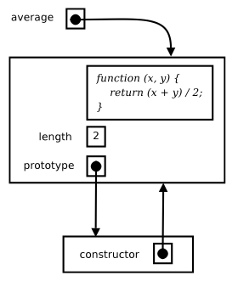
Properties of Functions
var average = function (x, y) {
return (x + y) / 2;
}

Slide 33
Adding your own Function Properties
  You can attach any property you like to a function because a function is, after all, just an object
  Examples you may see in practice: number of calls, data shared among objects created by the function (Chapter 7), cached results (Chapter 10)
  var average = function (x, y) {
  average.calls += 1;
  return (x + y) / 2;
  }
  average.calls = 0; // Let's invent a new property
  alert(average(4, 8)); // Alerts 6.
  alert(average(10.5, 11)); // Alerts 10.75.
  alert(average(0, 1)); // Alerts 0.5.
  alert(average.calls); // Alerts 3.

Slide 34
Functions as Properties: Namespaces
  var Geometry = {
  circleArea: function (radius) {
  return Math.PI * radius * radius;
  },
  circleCircumference: function (radius) {
  return 2 * Math.PI * radius;
  },
  sphereSurfaceArea: function (radius) {
  return 4 * Math.PI * radius * radius;
  },
  boxVolume: function (length, width, depth) {
  return length * width * depth;
  }
  };

Slide 35
Functions as Properties: Methods
  A function-valued property of an object is called a method. Methods are used to express the "behavior" of an object.
  var circle = {
  radius: 5,
  area: function () {
  return Math.PI * this.radius * this.radius;
  },
  circumference: function () {return 2 * Math.PI * this.radius;}
  };
  alert(circle.area()); // Alerts 78.53981633974483
  circle.radius = 1.5; // Change the circle's radius
  alert(circle.circumference()); // Alerts 9.42477796076938

Slide 36
Functions that Create Objects
  Suppose we wanted multiple circles. We could try this….
  // BAD CODE - DO NOT DO THIS - BAD CODE - DO NOT DO THIS
  var Circle = function (r) {
  return {
  radius: r,
  area: function () {
  return Math.PI * this.radius * this.radius;
  },
  circumference: function () {
  return 2 * Math.PI * this.radius;
  }
  };
  };
  // BAD CODE - DO NOT DO THIS - BAD CODE - DO NOT DO THIS

Slide 37
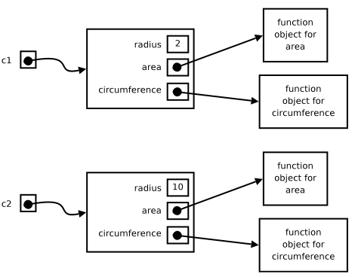
Unnecessary Copies of Methods
  Why did the code on the last slide fail?
  Consider:
  var c1 = Circle(2);
  var c2 = Circle(10);
We don't want multiple copies of the methods!

Slide 38
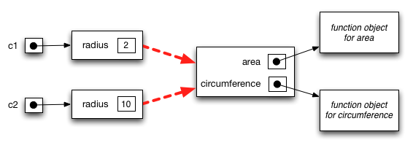
Avoiding Copies of Methods
  All we need to do is to put the methods in the circles' prototype
  Now we have only one copy of each method, even if we create millions of circles.
  But how and where do we create the prototype? There are several approaches, but using the ready-made prototype property of the constructor function is convenient!

Slide 39
Prototypes as Constructor Properties
  /*
  * A circle datatype. Synopsis:
  *
  * var c = Circle(5);
  * c.radius => 5
  * c.area() => 25π
  * c.circumference() => 10π
  */
  var Circle = function (r) {
  var circle = Object.create(Circle.prototype);
  circle.radius = r;
  return circle;
  };
  Circle.prototype.area = function () {
  return Math.PI * this.radius * this.radius;
  };
  Circle.prototype.circumference = function () {
  return 2 * Math.PI * this.radius;
  };

Slide 40
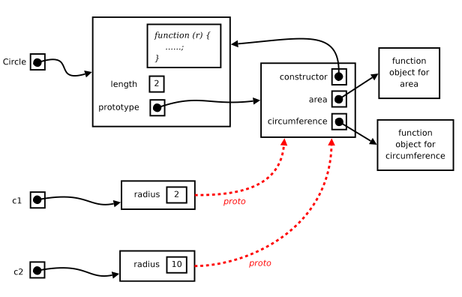
Constructor and Prototype Details

Slide 41
The new Operator
  You can get the exact same scenario on the previous slide with slightly less code, using operator new
  With new, you won't need Object.create
  Invoking a function with new
    Creates a new object
    Makes the new object's prototype the value of the function's prototype property
    Calls the function with this set to the new object
    Automatically returns the new object, unless the function returns its own object

Slide 42
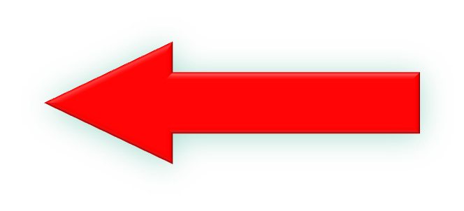
Using operator new
  /*
  * A circle datatype. Synopsis:
  *
  * var c = new Circle(5);
  * c.radius => 5
  * c.area() => 25π
  * c.circumference() => 10π
  */
  var Circle = function (r) {
  this.radius = r;
  };
  Circle.prototype.area = function () {
  return Math.PI * this.radius * this.radius;
  };
  Circle.prototype.circumference = function () {
  return 2 * Math.PI * this.radius;
  };
Note the use of new in the call

Slide 43
Understanding this
  T

Slide 44
Higher-Order Functions
  T

Slide 45
Passing Functions as Arguments
  T

Slide 46
Higher-Order Array Methods
a.every(f) produces true if f(x) is truthy for all elements x of a, or false otherwise. The elements of a are tested in order, and the testing will stop as soon as a test is falsy.
a.some(f) produces true if f(x) is truthy for at least one element x of a, or false otherwise. The elements of a are tested in order, and the testing will stop as soon as a test is truthy.
a.forEach(f) calls f(x) for each element x of a, in order.
a.map(f) produces [f(a0),f(a1),f(a2),f(a3),...].
a.filter(f) produces a new array containing all elements x of a for which f(x) is truthy.
a.reduce(f, x) produces f(x, f(a0, f(a1, f(a2, f(a3, ...))))). If the second parameter is not supplied, the call produces f(a0, f(a1, f(a2, f(a3, ...)))), but will throw a TypeError if a is empty.

Slide 47
Array Examples
  T

Slide 48
Timeouts and Intervals
  T

Slide 49
Returning Functions
  T

Slide 50
Hiding Data
  T

Slide 51
Function Declarations
  T

Slide 52
Chapter Summary
  T

