Slide 1
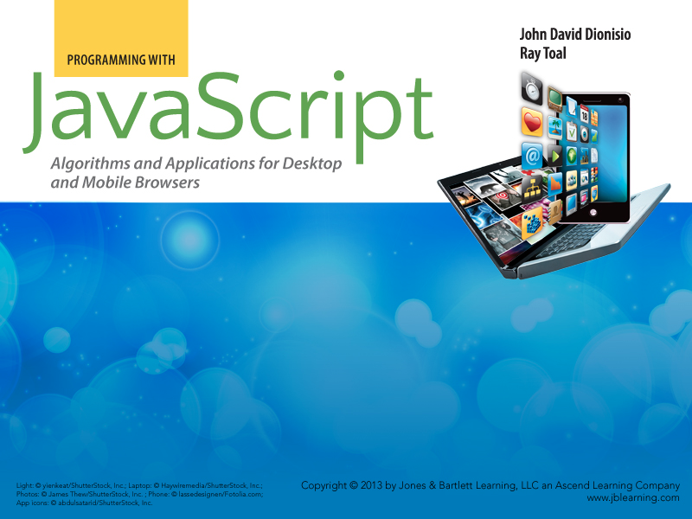
Chapter 2
Programming

Slide 2

Outline
  Programming and programming languages
  Learning to program
  About JavaScript
  Four ways to write JavaScript
  Elements of programming
    Expressions
    Variables
    Statements
  Code quality

Slide 3
Programming is...
Broadly, the creation of instructions for an agent to carry out
This definition covers the creation of all of the following:
  Recipes
  Architectural blueprints
  Code for computers, media players, phones, factory machinery, robots, and other equipment
  Musical scores
  Choreography
Some people prefer to limit the term “agent” to inanimate agents

Slide 4
Learning to Program
  Programming is a skill, like
    Martial arts
    Music
    Dance
    Sports
    Trades
  You need practice, practice, and practice
  Apprenticeship model useful
    Start by looking at existing code, and build on it
    Theory is learned during practice

Slide 5
Programming Languages
  Program/script — the encoding of a process in a language
  Example Programming Languages:
    Fortran, Algol 58, COBOL, LISP, APL, Simula, SNOBOL, BASIC, PL/1, B, SETL, Pascal, Smalltalk, C, Schema, Modula, MATLAB, Ada, PostScript, C++, occam, Standard ML, Eiffel, LabVIEW, Self, Perl, Oberon, Erlang, Tcl, J, Haskell, Python, AppleScript, K, Lua, Java, JavaScript, PHP, Ruby, D, C#, Io, Scala, Boo, Groovy, F#, Clojure, Go, CoffeeScript
    And thousands more...

Slide 6
JavaScript
  Designed by Brendan Eich in 1996
  Has evolved over the years — new versions have several features that old versions do not have
  Expressive and powerful
  One of the most popular languages in the world
  Has been misunderstood in the past, but now generally accepted as very sophisticated, though definitely with its share of quirks, rough edges, and flaws
  Very similar to its cousin ActionScript
  Not a “standalone” language — JavaScript programs run inside a host environment such as a web browser

Slide 7
More on JavaScript
  Not only for web pages — used in image editors, word processors, and many other systems
    http://en.wikipedia.org/wiki/JavaScript#Uses_outside_web_pages
    "Server-side" JavaScript is gaining popularity
  Used for serious applications including mail, maps, document editing, massive multiplayer online games, graphics, 3-D graphics, networking....
  Core language is standardized as ECMA-262 and officially known as ECMAScript
  Next version in the works (currently goes by names such as ES6, ES.next, and Harmony)

Slide 8
Four Ways to Run JavaScript Code
  Bookmarklets
    Enter directly in the browser’s address box after the prefix javascript:
  Runners
    http://javascript.cs.lmu.edu/runner
    http://jsfiddle.net
  Interactive Shells (consoles, REPLs)
    http://www.squarefree.com/shell/shell.html
    The developer tools in your browser (Firebug for Firefox)
    The built-in shell of node.js
  Files

Slide 9
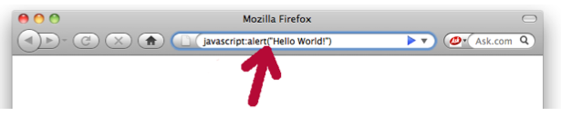
Bookmarklets
  Allow you to type code directly into browser address box
  Only provide a limited space for your scripts

Slide 10
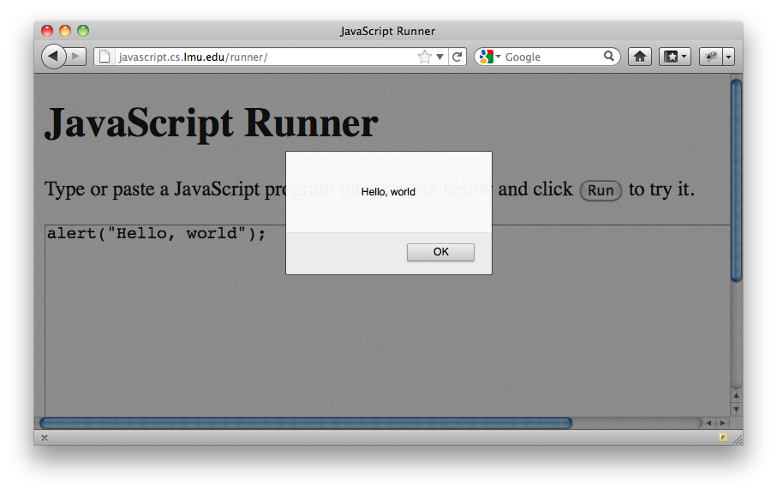
Runners
  Provide space for long scripts
  A simple runner is at http://javascript.cs.lmu.edu/runner
  Let's start with “Hello, world!”
  Enter the previous script, without the javascript: prefix, and press “Run”

Slide 11
Some Scripts to Run
Get started by doing! Enter and run these scripts at http://javascript.cs.lmu.edu/runner:
alert("I like " + prompt("Please enter a city:") + " in " + prompt("Please enter a month:") + ", how about you?")
var message = prompt("Enter a sentence:"); alert("Shouted: " + message.toUpperCase()); alert("Toned down: " + message.toLowerCase());
var now = new Date(); var newYear = new Date(now.getFullYear() + 1, 0, 1); var days = (newYear - now) / 86400000; alert("From " + now + ", " + days + " days until the New Year!");
document.body.style.backgroundColor="green";

Slide 12
More Scripts to Run
We've enhanced javascript.cs.lmu.edu/runner with the popular jQuery library; try these:
$("h1").css("color", "red").css("font-size", "4em"); $("textarea").css("border-width", "5px");
$("h1").animate({"margin-left": "+=1000"}, 3000);
$("body").fadeOut(5000);
To restore the page after running the last script, reload the page in the browser

Slide 13
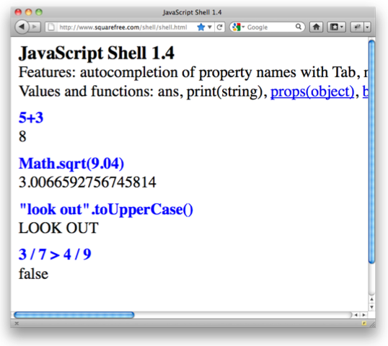
Interactive Shells
  Allow you to write a bit of code and watch it run immediately
  Most modern web browsers have their own built-in shell
  http://www.squarefree.com/
shell/shell.html
  A shell is also known as a console
  Many browsers come with their own console

Slide 14
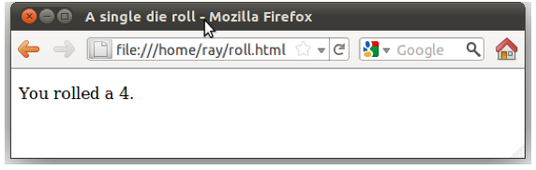
Files
  Permit distribution of JavaScript programs
  Can be typed in a text editor and saved for later use
  Embedded into and linked from an HTML document and opened in a web browser

Slide 15
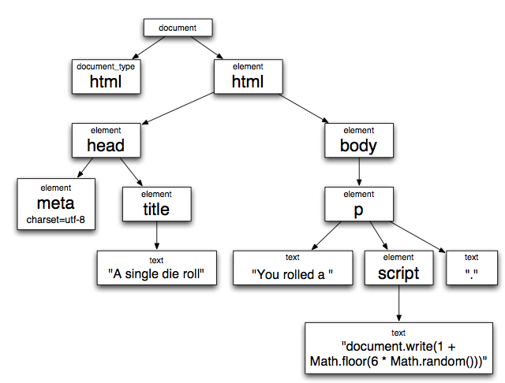
Your First HTML Document
Code is represented by a tree of nodes:
<!doctype html>
<html>
<head>
<meta charset="UTF-8"/>
<title>A single die roll</title>
</head>
<body>
<p>You rolled a
<script>document.write(1 + Math.floor(
6*Math.random()))</script>.</p>
</body>
</html>

Slide 16
A Minimal Introduction to HTML
  HTML — Hypertext Markup Language
  Elements — visible features of HTML, such as html, head, meta, title, p, body, and script
    delimited with start tags and end tags
      e.g. <html> and </html>
      Sometimes the end or even a start tag is optional
    or with an empty tag
      e.g. <meta />
  Elements can have attributes
    e.g. charset = "UTF-8"

Slide 17
Separation of HTML and JavaScript
<!doctype html>
<html>
<head>
<meta charset="UTF-8"/>
<title>A single die roll</title>
</head>
<body>
<p id="message"></p>
<script src="singleroll.js"></script>
</body>
</html>
singleroll.html
HTML (presentation) in one file; JavaScript (behavior) in another.
singleroll.js
document.getElementById("message").innerHTML =
"You rolled a " + (1 + Math.floor(6 * Math.random())) + ".";

Slide 18
Elements of Programs
Now that we have seen some example programs, it's time to study how they are built. Programming is learned by doing, but knowing the fundamentals is indispensible to becoming a professional programmer.
We start with the big three:
  Expressions compute values
  Variables store data
  Statements perform the actions of the script

Slide 19
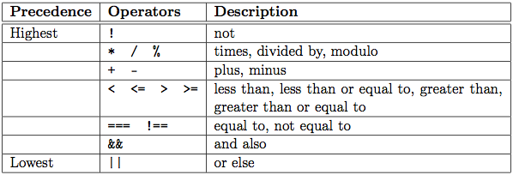
Expressions
  Expression — a fragment of code containing values and operations, evaluated to produce a new value
  Values include numbers, text, and truth values (true/false)
  Operators include + (addition), * (multiplication), === (equal to), < (less than), and many more
  Interpretation of expression depends on precedence

Slide 20
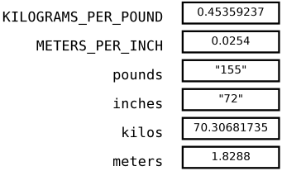
Variables
A variable holds a value to be used later
var KILOGRAMS_PER_POUND = 0.45359237;
var METERS_PER_INCH = 0.0254;
var pounds = prompt("Enter your weight in pounds");
var inches = prompt("Enter your height in inches");
var kilos = pounds * KILOGRAMS_PER_POUND;
var meters = inches * METERS_PER_INCH

Slide 21
Statements
  Expressions and variables are wired together in statements
  A script is a sequence of statements
  Each statement is executed when the script is run
  JavaScript provides statements to:
    Declare variables
    Invoke predefined operations
    Replace the value in a variable with a new variable
    Perform an operation only if some condition is true
    Perform an operation repeatedly as long as some condition is true

Slide 22
Good Programming Practices
  Provide comments indicating the intent of your script
    Comments should be more general than the code
    Comments should never “repeat the code”
    Take care to keep the comments in sync with the code
  Follow coding conventions, such as consistent capitalization, punctuation, and formatting
    http://javascript.crockford.com/code.html
  Use code quality checkers to find problems in your code
    JSLint
    (JSLint is also accessible from a button in jsfiddle.net)

Slide 23
A Slightly Larger Sample Program
/*
* This script prompts the user to enter four words: a noun, then
* a verb, then an adjective, and finally an adverb. It then alerts
* a sentence using these four words. The template for the sentence
* is one that would make sense if the user entered "dog" for each
* prompt.
*/
// Prompt for the four words
var noun = prompt("Enter a noun");
var verb = prompt("Enter a verb");
var adjective = prompt("Enter an adjective");
var adverb = prompt("Enter an adverb");
// Alert the composed sentence
alert("If you " + verb + " a " + noun + " during the " +
adjective + " days of summer, you'll be " + adverb +
"tired.");

Slide 24
Chapter Summary
  Programming (scripting) can be defined as the act of writing instructions for some agent to carry out
  JavaScript programs (scripts) can be run as one-liners, in runners, in shells, or in files loaded into a web browser.
  Scripts are most commonly packaged in separate .js files
  Programs are made of:
    Expressions (that compute values)
    Variables (that store values for later use)
    Statements (that produce actions)
  Programs should:
    Be written in a consistent style
    Have useful comments
    Be checked using code quality tools

