Slide 1
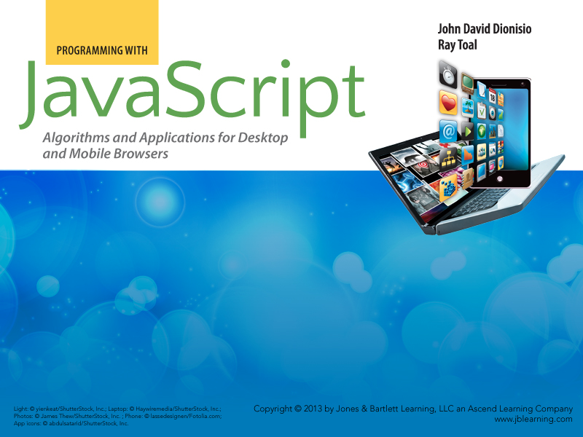
Chapter 1
The Field of Computing

Slide 2

Outline
  Computing is a natural science
  The five disciplines of computing
  Related fields
  Careers in computing
  Myths about computing
  Resources

Slide 3
Computing is a Natural Science
Computing is a science of information processes.
  “Biology is today an information science. The output of the system, the mechanics of life, are encoded in a digital medium and read out by a series of reading heads.”
— David Baltimore
  Business management workflow and commitments
  Evolution of social networks, economies, political groups
  DNA Transcription
  Quantum waves (are information carriers)
  Chemistry: 2H₂ + O₂ → 2H₂O + E
  Neurons, brain function, thought processes

Slide 4
The Five Disciplines of Computing
  Computer Science (CS)
  Software Engineering (SE)
  Computer Engineering (CE)
  Information Technology (IT)
  Information Systems (IS)

Slide 5
Computer Science
The theory and practice of computation, algorithms, software systems, data organization, knowledge representation, language, intelligence and learning.
  What can and cannot be computed?
  How fast can certain computations be carried out?
  How much information needs to be stored to carry out a certain computation?
  How can information be efficiently and securely encoded, stored, and retrieved?
  How do we design information processes (programs)?
  How do we know our programs are correct?
  How can computational theories help to explain intelligence and consciousness?

Slide 6
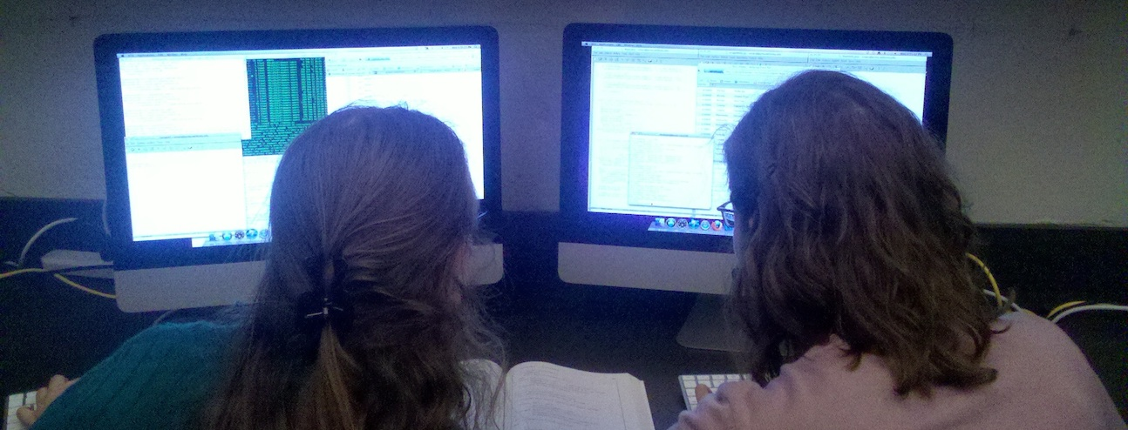
Software Engineering
The design and construction of large-scale, mission-critical systems, with a focus on product efficiency, reliability, robustness, testing, maintenance, and cost-effectiveness.

Slide 7
Computer Engineering
The design of digital systems such as communications systems, computers, cell phones, digital audio players, digital video recorders, alarm systems, x-ray machines, and laser surgical tools.

Slide 8
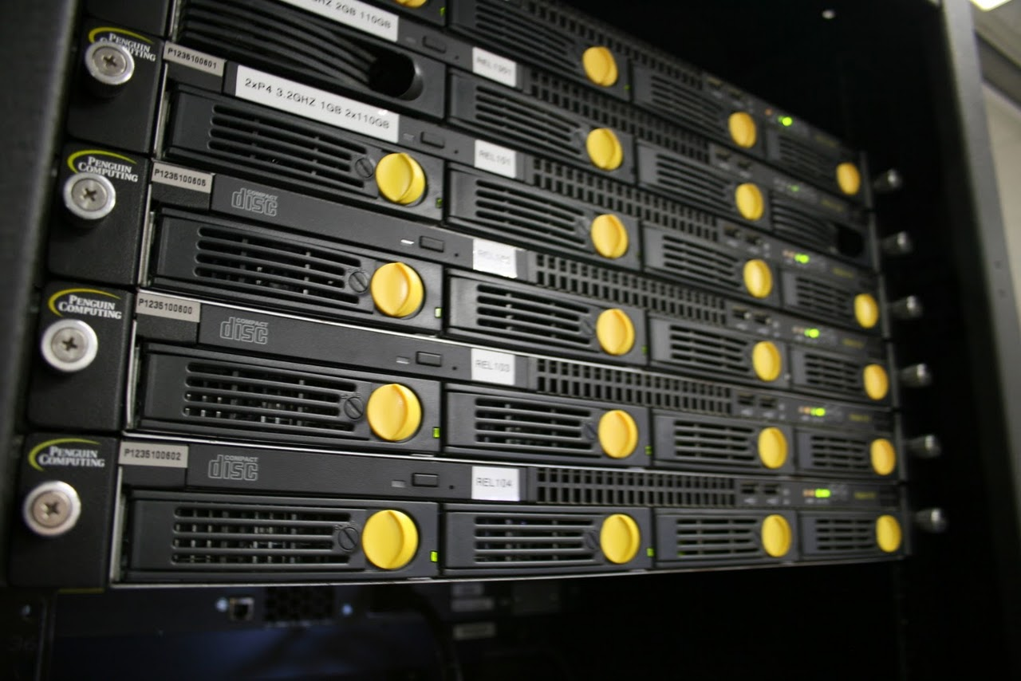
Information Technology
The construction, maintenance, and troubleshooting of an organization’s computing infrastructure (both hardware and software), including networks, email systems, web sites, databases, and telephony.
IT work generally involves a good deal of configuration, customization, and upgrading
IT practitioners must understand security, reliability, networking, economic tradeoffs, and usability

Slide 9
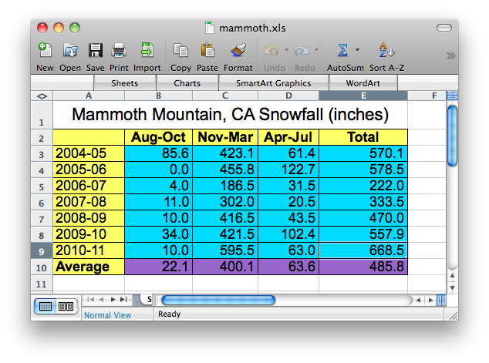
Information Systems
The design of “computing solutions” for companies, non-profit organizations, educational institutions, and governments to support their mission and improve their effectiveness.
Generally taught in business schools
Programming often involves spreadsheets

Slide 10
Related Fields
Fields related to computing (and esp. computer science)
Linguistics | Language theory, syntax, semantics
Biology | Computational biology
Psychology | Computers “thinking like us” can be useful
Electrical Engineering | Electronic components make great computing devices
Math | Formalization of algorithms and data
Education | Knowledge representation and learning
Philosophy | Logic and epistemology
Economics | Markets
Sociology | Social networking, virtual environments

Slide 11
Careers in Computing
  Biology, Genetics, Computational Biology
  Medicine, Medical Imaging
  Search, Data Mining, Information Retrieval
  Online Music and Movie Distribution
  Entertainment: Film, Television, Animation
  Gaming
  Mobile Devices and Applications
  Security, Defense, Cyberwarfare
  Aerospace
  Business, Law, or Medicine (Professional schools love students with a technical background, as these students generally have strong logical and analytical skills.)

Slide 12
Myths about Computing
Lies and Damn Lies:
  The only people that study computing are game-playing, socially inept, nerdy, male geeks.
  All jobs in computing are being offshored.
  Computing is only about programming computers.
  Computing ended with the dot-com bust.
  There’s no real field of computing, anyway, it’s just a minor part of other fields — my art class or business class will teach me all I need to know to be a great programmer.
These myths have harmed the image of computing and kept much-needed talent away.

Slide 13
“Computer science is no more about computers than astronomy is about telescopes.”
— Edsger Dijkstra

Slide 14
Resources
  ACM Careers in Computing
  ACM TechNews
  U.S. Bureau of Labor Statistics Occupational Outlook
    Programmers and Software Engineers
    Computer Scientists
    Network, Systems, and Database Administrators
  Biographies of Alan Turing and Grace Hopper
  Articles by Peter Denning and Jeanette Wing
  ENIAC Programmers Project
  Computer History Museum timeline
  Computer Science Unplugged (for kids but still interesting)
  Great Principles of Computing

